Slide 1

BillingCenter Data Model

Slide 2
Lesson Objective
By the end of this lesson, you should be able to:
Describe the major entities of the BillingCenter data model and their relationships
6

Slide 3
Lesson Outline
BillingCenter Data Model
6

Slide 4
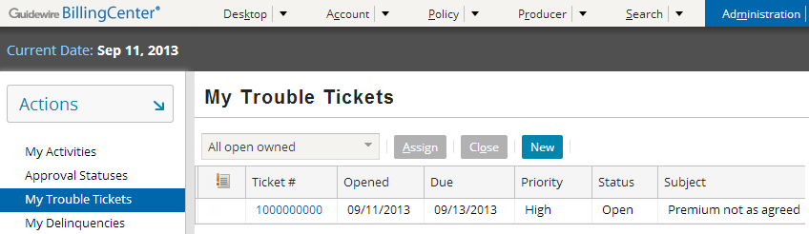
Trouble tickets
Provide central management for tracking issues that relate to accounts, policies, and producers
Often created in response to a customer inquiry
Can be created and assigned automatically in response to processing exceptions
Notes:
BillingCenter configuration developers can write business rules that automatically create trouble tickets.

Slide 5
BillingCenter data model
The Guidewire platform provides the functionality on which BillingCenter is built
BillingCenter base application contains robust data model for bill processing
BillingCenter
Data Model
User Inter.
Bus. Logic
Int. APIs
Guidewire Platform, with a common technology for configuring...
Data Model
User Interface
Business Logic
Integration APIs
Notes:
The Guidewire platform includes four main areas of technology. There is one area for configuring:
Data model, which defines the structure of the data
User interface, which defines the forms and fields the end user interacts with
Business logic, which automates processing such input validation, work flow, and decision making
Integration APIs, which connect a given application to external applications, such as a reporting system or check printing system
Every application uses this common technology to define its own data model, user interface, business logic, and integration APIs. Each application is distinct, but every application shares common abilities and configuration techniques with the other applications.

Slide 6
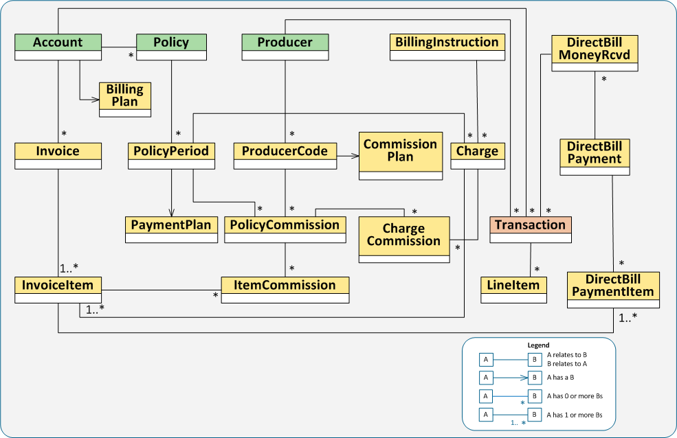
BillingCenter data model
Notes:
There are three top-level entities within BillingCenter – the producer, the account, and the policy, all represented by tabs in the BillingCenter user interface. The graphic in the slide shows a simplified version of the BillingCenter data model for direct bill. Agency bill entities are not represented.

Slide 7
Entities relevant to accounts
Account
Contact
T-account
Trouble ticket
Delinquency
Document
Note
Policy
Charge
Invoice
Invoice Stream
Payment
Transaction
Disburse- ment
Collateral
. . .
Notes:
There may be several instances of each of these entities associated with an individual account.

Slide 8
Entities relevant to producers
Codes
Contact
T-account
Net Payment
Cycle
Statement Invoice
001
002
Policy
Commission
Disbursement
Document
Transaction
Statement
Trouble Ticket
Note
Notes:
There may be several instances of each of these entities associated with an individual producer.

Slide 9
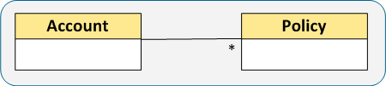
Types of relationships
<array arrayentity= "Policies">
<foreignkey fkentity= "Account">
Most relationships are bidirectional, but some occur in only one direction
Most relationships are one-to-many, but some are one-to-one or many-to-many
Most one-to-many relationships are built using <array> and <foreignkey>, but some are built using queries or lists
Notes:
Most relationships are bidirectional. For example, each account has an array of policies, and each policy has a foreign key to its account. However, some are uni-directional.
Most relationships are one-to-many. For example, an account can have many policies, and each policy is related to only one account. However, some small number of relationships may be one-to-one.
Most one-to-many relationships are built using an array key in the entity on the "one" side and a foreign key in the entity on the "many" side. For example, the Account entity has an <array> tag named Policies referencing Policy. The Policy entity has a foreign key referencing Account.
Lists and queries provide other ways to implement one-to-many relationships. For example, the "Credits" field on the Account entity is a query, and "ApplicableDelinquencyPlans" is a list. If there is a large amount of data, a query provides better performance than an array or list because a query is can be restricted to return a limited set of relevant data.
Many-to-many relationships are usually implemented by defining a "join" entity between the two related entities. For example, a PolicyCommission resolves the many-to-many relationship between PolicyPeriod and ProducerCode. A policy period can have many related producer codes that earn or have earned commission, and a producer code can earn commission on many policies. Each PolicyCommission describes the commission earned by a specific producer code on a specific policy period.

Slide 10
Data model entity relationships: accounts
Account
Account.AccountDelinquencyProcesses (array)
BillingPlan (foreign key)
Account.Contacts (array)
Account.Credits (query) Account.ApplicableDelinquencyPlans (list)
Account.DelinquencyPlan (foreign key)
Account.History (array)
Account.Invoices (array)
Account.InvoiceStreams (array)
Account.Policies (array)
Account.ParentAccount (foreign key)
Account.SecurityZone (foreign key)
Notes:
Some, but not all, of these entities are shown on the data model on a previous slide.

Slide 11
Data model entity relationships: producers
Producer
Producer.AgencyBillPlan (foreign key)
Producer.Contacts (array)
Producer.History (array)
Producer.PolicyPeriods (query)
Producer.PrimaryContact (foreign key)
Producer.ProducerCodes (array)
Producer.Statements (array)
ProducerCode
ProducerCode.CommissionPlan (foreign key)
ProducerCode.Producer (foreign key)
Lesson 1 Configuration Basics
Lesson 1 Configuration Basics
Notes:
Some, but not all, of these entities are shown on the data model on a previous slide.

Slide 12
Lesson objectives review
You should now be able to:
Describe the major entities of the BillingCenter data model and their relationships

