Slide 1

Location Groups and Pages
Editable List View

Slide 2
Lesson objectives
By the end of this lesson, you should be able to:
Describe the architecture of a location group
Configure existing location groups
Create and modify pages
This lesson uses the notes section for additional explanation and information. To view the notes in PowerPoint, choose View→Normal or View→Notes Page. If you choose to print the notes for the lesson, be sure to select “Print hidden slides.”

Slide 3
Lesson outline
Location group basics
Location group configuration
Page configuration

Slide 4
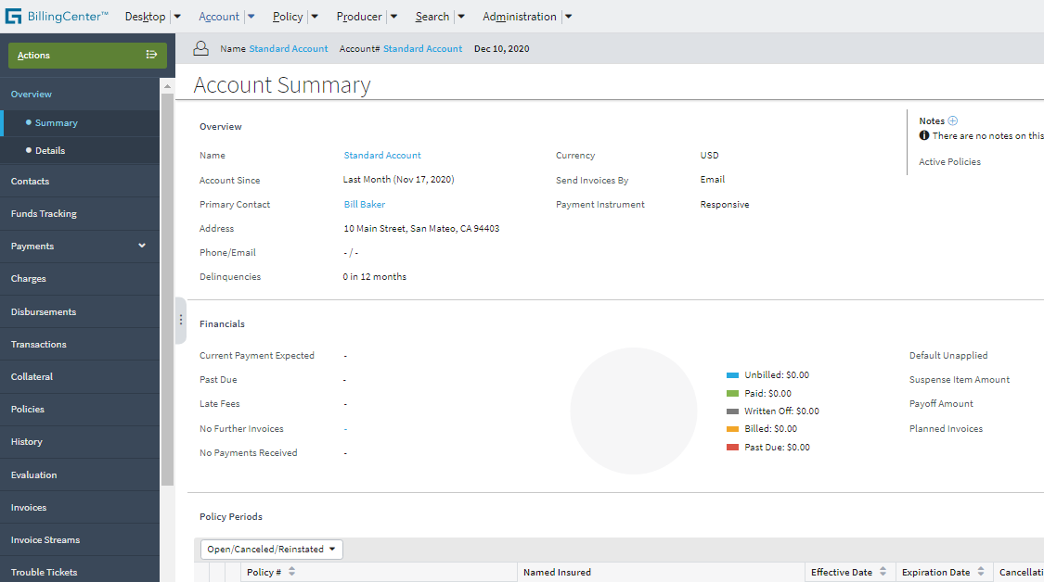
Location groups
A location group is a group of page locations associated with a common set of menu links and (typically) a set of menu actions and an info bar
Location Group
Menu actions
Info bar
Menu links
Notes:
As the user navigates between locations in a location group, the menu links, menu actions, and info bar remain the same.
The menu links are the set of clickable labels in the side bar (such as Summary or Distribution).
The info bar is the set of widgets that appear below the tabs but above the screen area. (In other words, they're the widgets in the horizontal gray strip just above the Summary label.) Some location groups do not have info bars, in which case the gray strip is not visible.
The menu actions are collapsed inside the Actions menu.
The info bar and menu actions are not applicable for third-level navigation, which will be discussed in later slides.

Slide 5
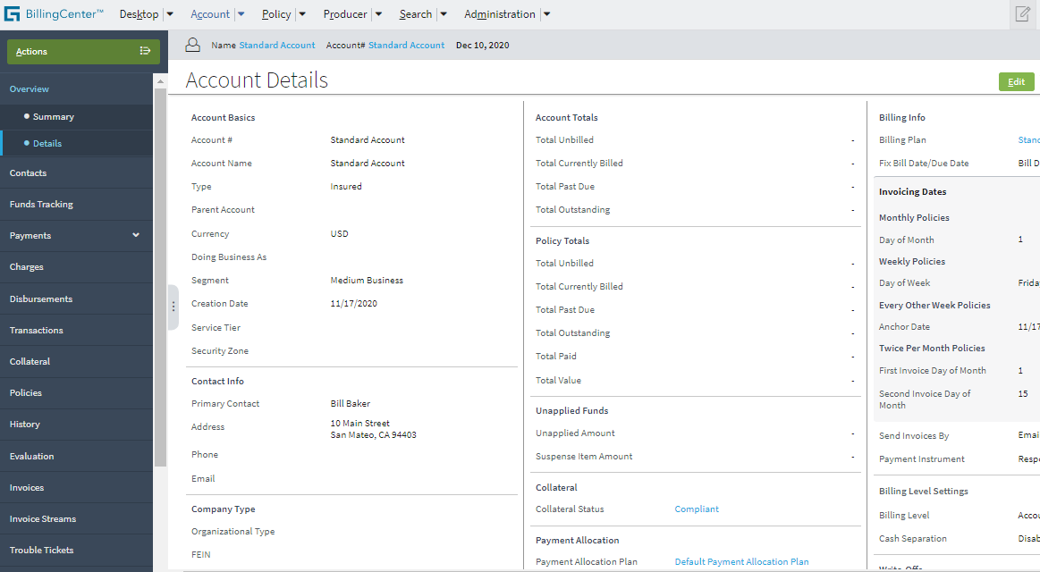
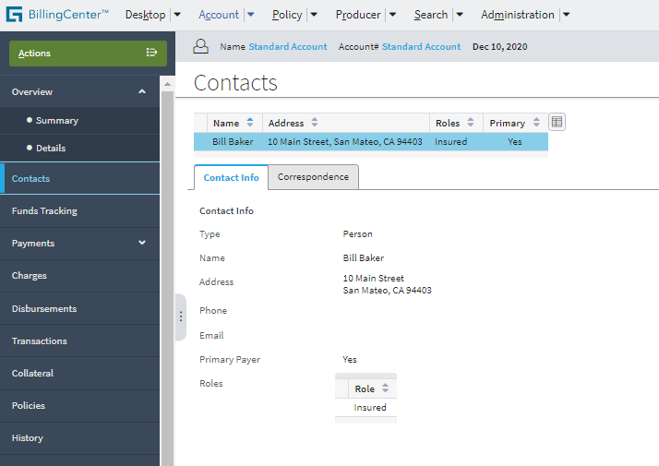
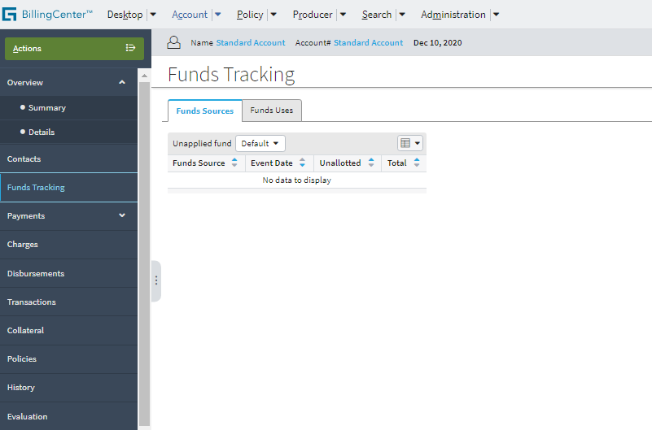
Navigating within a location group
Unchanged
Only the screen area changes
Unchanged
Notes:
When you navigate from one location within the location group to another location within that same group, the contents of the screen area changes. However, the menu links, menu actions, and info bar remain the same.

Slide 6
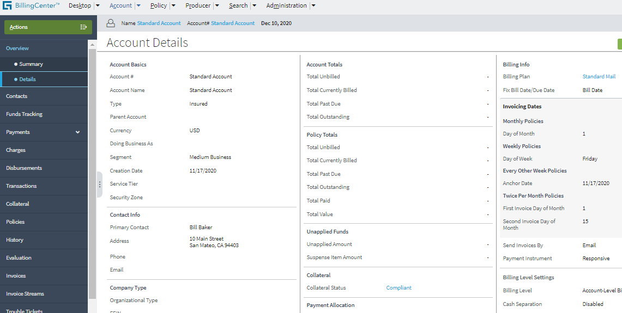
Pages
A page is a location that contains a single screen in the main frame
Pages are used exclusively within location groups
Notes:
Pages are the most common location. The contents of a location group consist of pages, child location groups, or both. A child location group is simply a sub-group of pages.

Slide 7
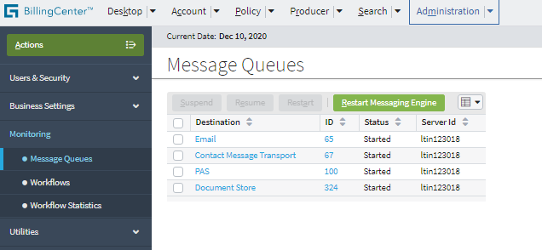
Location refs
A location ref points to a location, which can be either a location group or a page
Monitoring location ref points to Monitoring location group
Message Queues location ref points to Message Queues page
Location refs
Notes:
Location groups are used to define the menu links that appear on the sidebar of the BillingCenter UI, as you see in the slide. The Admin location group contains four location refs: UsersAndSecurity, BusinessSettings, Monitoring, and Utilities. Each of these location refs points to a location group of the same name. For example, the Monitoring location ref points to the Monitoring location group.
Inside the Monitoring location group, there are three location ref elements defined, each of which specifies a page location. For example, the Message Queues location ref points to MessagingDestinationControlList page.
When you click the Message Queues, Workflows, or Workflow Statistics menu link, the associated page is displayed. When you click the Monitoring menu link, the Message Queues page is displayed because Message Queues is the first location ref in the Monitoring location group.

Slide 8
Navigation hierarchy example
1st level - tab bar
2nd level – (parent) menu links, can include info bar, menu actions
3rd level – child menu links

Slide 9
Location group and page configuration
Configuration for location groups and pages includes:
Entry point and navigation
Logic to control visibility and access
Location group configuration also involves location refs
Page configuration also includes:
Screen that a page renders
Page labels
Location Group
Location Ref
Location Group
Location Ref
Page
Location Ref
screen
Notes:
The next section of this lesson discusses configuring location groups. The section after that discusses configuring pages.

Slide 10
Review: Location groups in BillingCenter
Some tabs have two location groups
DesktopGroup.pcf
PolicyGroup.pcf PoliciesGroup.pcf
SearchGroup.pcf
AccountGroup.pcf AccountsGroup.pcf
ProducerDetailGroup.pcf ProducersGroup.pcf
Admin.pcf (Visible only if user can view any administration screen)
Note: Blue indicates a search location group
Notes:
BillingCenter has extra behavior for the Account, Policy, and Producer tabs so that you can be taken to one of two different location groups:
If you click the tab name, you are taken to a search location group for accounts, policies, or producers.
If you click a link to a specific account, policy, or producer, you navigate to a typical location group.
This behavior is implemented by means of a forward, which immediately forwards the user to the appropriate location.

Slide 11
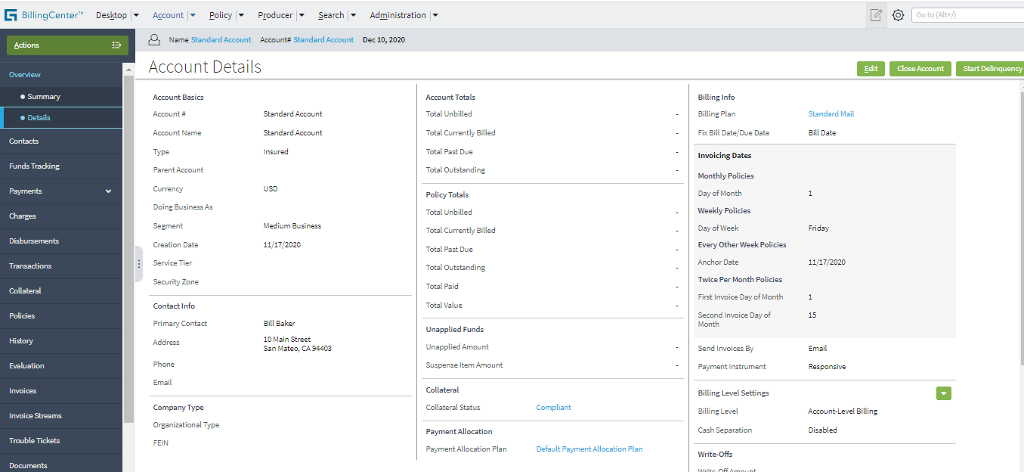
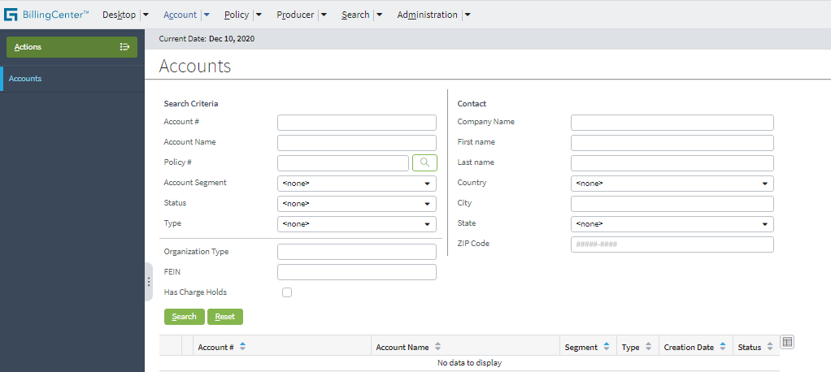
Review: Account location groups
AccountGroup.pcf
AccountsGroup.pcf
Notes:
AccountsGroup is the search location group for accounts.
AccountGroup is the location group for a specific account.
Similarly, producers and policies have two location groups.

Slide 12
Lesson outline
Location group basics
Location group configuration
Page configuration

Slide 13
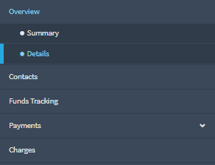
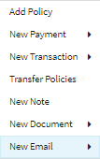
Information in location group PCF file
Info bar
AccountGroup.pcf
Entry Point
Menu actions
…
Entry point and required objects
Location refs that point to pages or child location groups
Attributes that point to separate files for info bar and menu actions

Slide 14
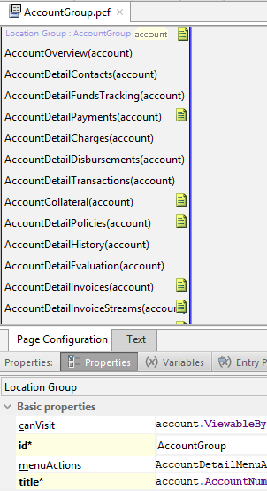
Example PCF file: AccountGroup
Location refs declared in top pane
Tabs, including: Properties (menu actions, info bar) Entry Points (entry points)
Notes:
The PCF file for a location group consists of location refs. The location group attributes are specified on the tabs at the bottom.

Slide 15
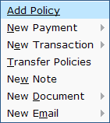
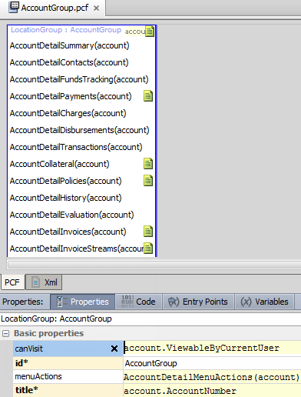
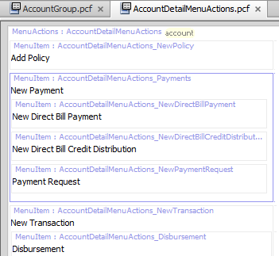
Location group menu actions
In UI:
Notes:
The location group's menuActions property specifies the file to use for contents of the Actions menu.

Slide 16
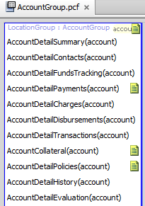


Location group info bar
In UI:
Notes:
The location group's infoBar property specifies the file to use for contents of the info bar.

Slide 17
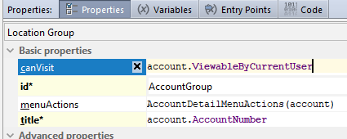
canVisit property on location group
canVisit property determines whether a user can visit the location group
If true or blank, user sees location group
If false, location group is not rendered
Notes:
The visibility of a location group can also be controlled by the Visible attribute of the tab whose action navigates to the location group. When set to false, the Visible attribute prevents users from accessing the location (unless another navigation link is available). Consider setting the target’s visibility rather than the caller so it doesn’t matter how navigation is attempted.
In addition to the canVisit property, single-screen locations and wizards also have a canEdit attribute. Location groups do not. Editablility for location groups is controlled at the level of each page.

Slide 18

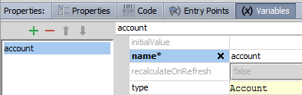
Defining entry point(s) for a location group
Define the entry point, which is used by navigation widgets
Define each object in entry point as a variable on Variables tab
Entry point name
Object name
Object type
Note: Entry point name must match PCF ID and file name
Notes:
In the example above, the AccountGroup location group has an entry point named AccountGroup. It expects a single object of type Account, which is referred to within the PCF page as "account". For the purposes of instructional clarification, the location group could also have been declared as AccountLG (aAccount: Account). In this case, the entry point name is AccountLG (which is how any widget navigating to this location would need to reference it). It would expect an object of type Account, which is referred to within the PCF file as aAccount.
Locations can have multiple entry points. This functionality is useful when a single location is referenced from different places with different known pieces of information. (For example, in ClaimCenter, a document can be associated with a contact, but it is not required. A location displaying a document might have two entry points, such as Document (aDocument: Document) and ClaimDocument (aDocument: Document, aContact: Contact). This lets two widgets reference the same location, even if one widget wants to pass both a document and a contact to the location, and the other has only a document to pass.

Slide 19
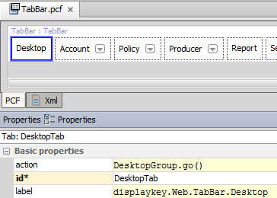
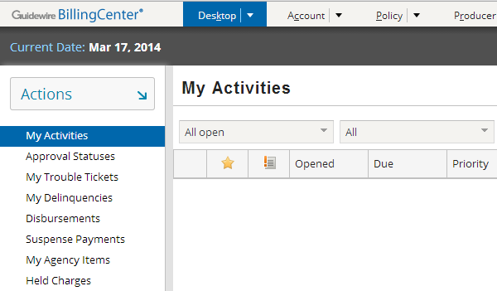
Navigating to a location group
Navigation uses go()
Syntax:
EntryPointOfLocation.go(objectsToPass)
Notes:
Most navigation widgets have an action attribute, which defines where to navigate when the widget is clicked. The syntax for an action attribute that navigates to a location is: pcf.LocationEntryPoint.method(objectList), where
LocationEntryPoint is (one of) the location entry point(s) defined on the destination location's Entry Points tab.
method is the method used to navigate to the location (which, for location groups, is almost always "go").
objectList is a comma-delimited list of zero to many objects. This list must match the number of objects and the type that are expected by the location entry point.

Slide 20
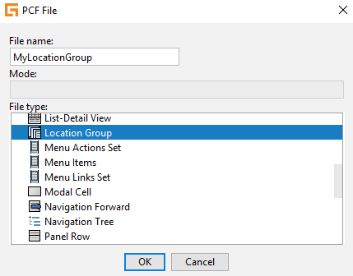
Steps for creating a location group
Create new PCF of type Location Group
Set essential properties:
title
Entry point with matching variable (Entry Points tab)
A variable for each object in entry point (Variables tab)
Add location references for all included pages and location groups
Add location reference in the action property of a navigation widget to call the location group
Deploy changes
Notes:
When creating the location group, there is no requirement to add an extension to the filename, but it is good practice to add the suffix Group as in AgencyBill Group.

Slide 21
Lesson outline
Location group basics
Location group configuration
Page configuration

Slide 22
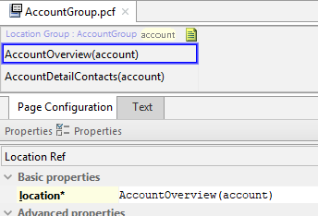
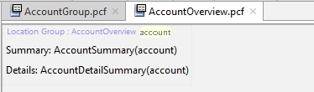
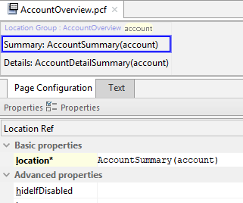
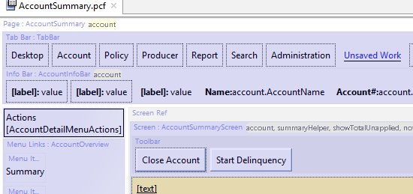
Pages are referenced by location refs
Location Group's Location Ref
When I am clicked where do I go?
location attribute specifies page or child location group
Notes:
Each location ref has a location attribute. This specifies the location that the location ref points to. The location is typically a child location group or a page. If the destination location group or page requires one or more objects, then the location attribute must specify which objects to pass.
Note that the location ref does not use the "go" method.

Slide 23
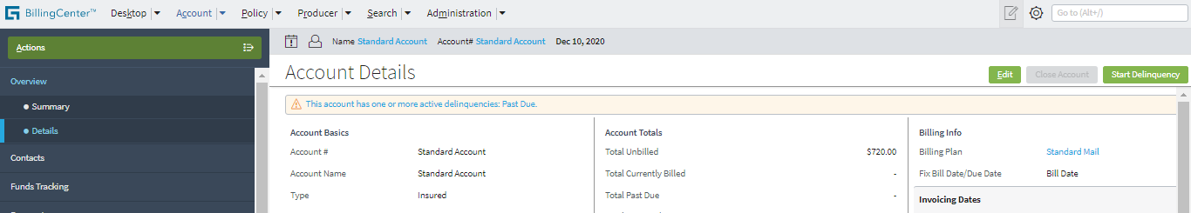
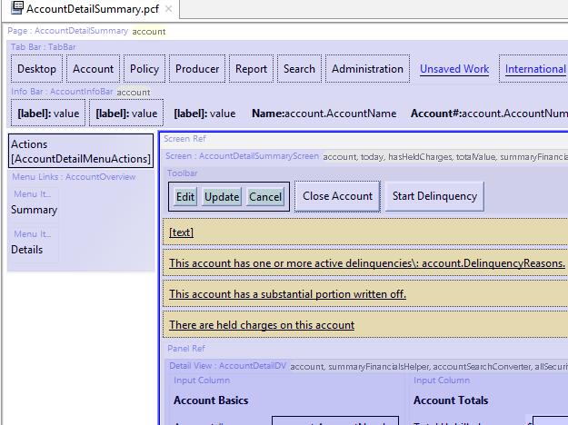
Page PCFs
Page PCF file contains references to all embedded content
Notes:
A page is actually very simple, as it typically contains just a screen with panel references to the views to embed within it. However, the rendering of the page in Studio can look somewhat complex, as all the embedded elements are visible in the page.

Slide 24
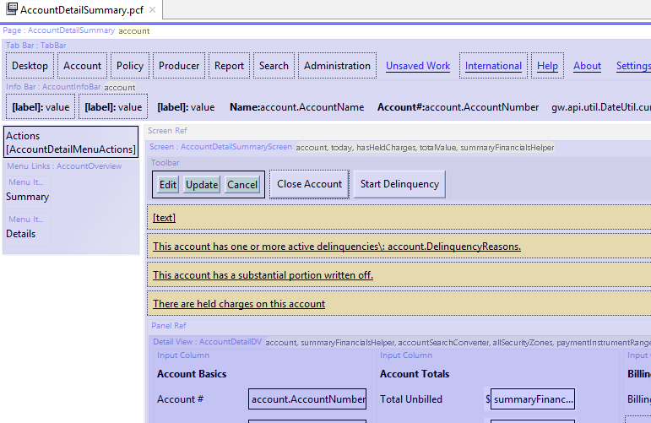
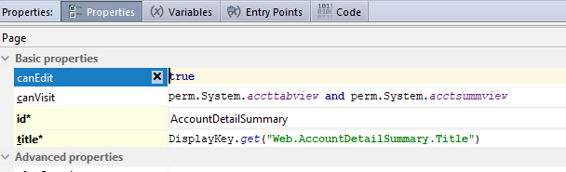
canVisit property on page
Notes:
The behavior of the canVisit property for a page is similar to the canVisit property for a location group: a user can see links to (and therefore can navigate to) a page only if canVisit evaluates to true.

Slide 25
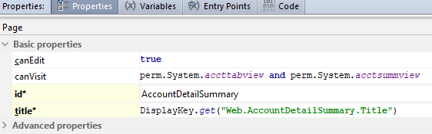
Edit mode
A page is either in read-only or edit mode
If canEdit evaluates to true, the page has Edit/Update buttons
If startinEditMode is true, then page renders in Edit mode
Notes:
If canEdit mode for a page evaluates to false, then the page appears only in readonly mode, even if startInEditMode is set to true.
Note: In the base application, canEdit is set to true.

Slide 26
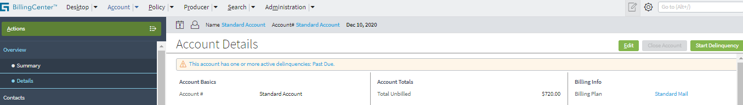
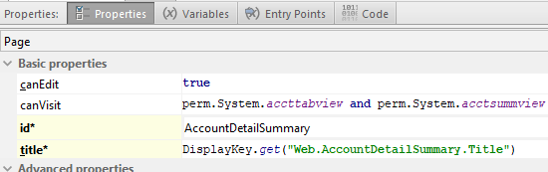
Page-related labels
Title bar label comes from page's title property

Slide 27
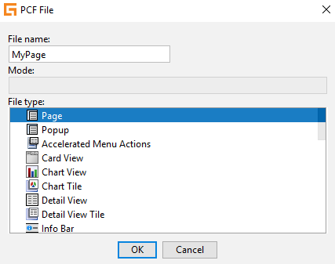
Steps for creating a page
Create new PCF of type Page
Set essential properties:
title
Entry point with matching variable (Entry Points tab)
A variable for each object in entry point (Variables tab)
Add a screen
In the location group that will contain the page, add a locationref widget for navigation to the page
For editable pages:
Set canEdit property
Add EditButtons to the page's screen
Include panels for viewable and/or editable content
Notes:
When creating the page, there is no need to add an extension to the filename. No file extension is generated or required for a page.
Step 6: You must include at least one LV or DV. You can include the panels inline or by reference.

Slide 28
Lesson objectives review
You should now be able to:
Describe the architecture of a location group
Configure existing location groups
Create and modify pages

Slide 29
Notices
Copyright © 2001-2014 Guidewire Software, Inc. All rights reserved.
Guidewire, Guidewire Software, Guidewire ClaimCenter, Guidewire PolicyCenter, Guidewire BillingCenter, Guidewire Reinsurance Management, Guidewire ContactManager, Guidewire Vendor Data Management, Guidewire Client Data Management, Guidewire Rating Management, Guidewire InsuranceSuite, Guidewire ContactCenter, Guidewire Studio, Guidewire Product Designer, Guidewire Live, Guidewire DataHub, Guidewire InfoCenter, Guidewire Standard Reporting, Guidewire ExampleCenter, Guidewire Account Manager Portal, Guidewire Claim Portal, Guidewire Policyholder Portal, ClaimCenter, BillingCenter, PolicyCenter, InsuranceSuite, Gosu, Deliver Insurance Your Way, and the Guidewire logo are trademarks, service marks, or registered trademarks of Guidewire Software, Inc. in the United States and/or other countries.
All other trademarks are the property of their respective owners.
This material is confidential and proprietary to Guidewire and subject to the confidentiality terms in the applicable license agreement and/or separate nondisclosure agreement.
This file and the contents herein are the property of Guidewire Software, Inc. Use of this course material is restricted to students officially registered in this specific Guidewire-instructed course, or for other use expressly authorized by Guidewire. Replication or distribution of this course material in electronic, paper, or other format is prohibited without express permission from Guidewire.
Guidewire products are protected by one or more United States patents.

Slide 30
Demo
6

Slide 31
Provide demo details and link to the demo video
7

Slide 32
Lab
6

Slide 33
Complete the exercises listed in “Lesson 10: Configuring Location Groups and Pages” chapter in the “BillingCenter 10 Configuration: Essentials - Student Workbook“
7

Slide 34
Review
6

Slide 35
This is for Review questions and answers
7

