Slide 1

Configuring Activities
Editable List View

Slide 2
Lesson Objective
By the end of this lesson, you should be able to:
Create an activity pattern
Create activities in Gosu
Create a shared activity
6

Slide 3
Lesson Outline
Activity basics
Creating activities in Gosu
Shared activities
6

Slide 4
Activities
Activities are reminders set by BillingCenter, users, or rules to perform some action
Commonly related to one or more other entities, such as
TroubleTicket, Delinquency, PolicyPeriod
Transaction types requiring approval
Accounts gone inactive
Two basic types:
General (created by users or configuration)
Approval (created by BC when approval is required)
May be owned by a group and user, or shared (all users can see them)
6

Slide 5
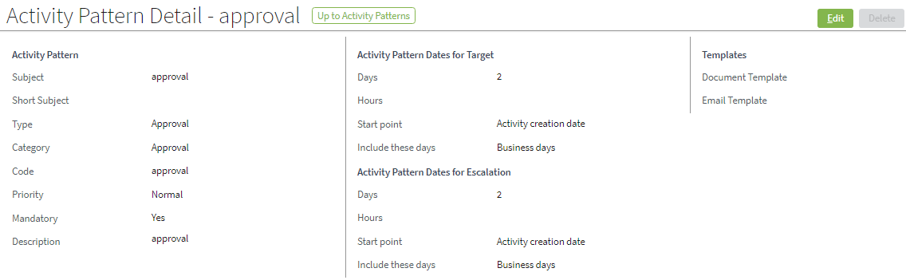
Activity Patterns
An activity pattern is a template that standardizes the way BillingCenter creates activities
6

Slide 6
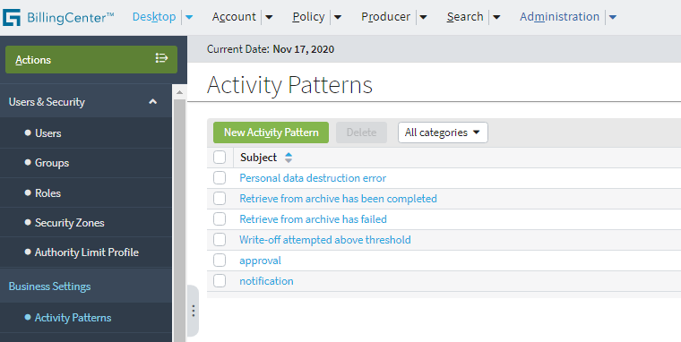
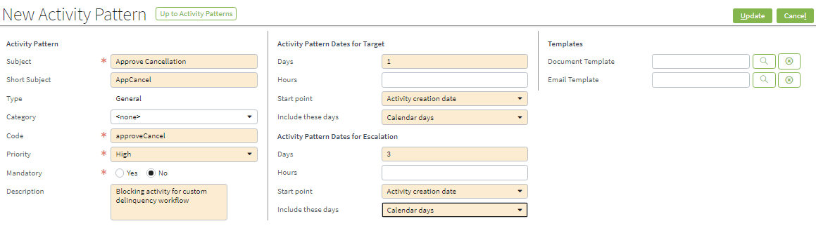
Creating an Activity Pattern
6

Slide 7
Who creates activities?
Users from Desktop
Example: A reminder to self or others to contact customer
Gosu rule or workflow
Example: Preupdate rule on Policy or Account
Example: From a delinquency workflow when an account is sent to a collection agency
BillingCenter
From transactions requiring approval such as commission payments, charge reversals, and disbursements
AccountInactivity batch process executes when accounts become inactive (see DaysBeforeAccountIsConsideredInactive in config.xml)
6

Slide 8
Lesson Outline
Activity basics
Creating activities in Gosu
Shared activities
6

Slide 9

Creating activities in Gosu (1)
Create the activity Syntax: var activityVar = new Activity()
Set an activity pattern for the new activity Syntax: activityVar.ActivityPattern = gw.api.web.admin.ActivityPatternsUtil.getActivityPattern(code)
Populate other activity fields such as Subject and Priority
6

Slide 10
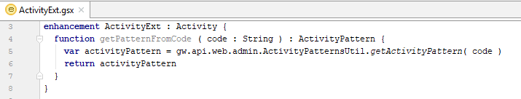

Creating activities in Gosu (2)
Recommended:
Define an enhancement to retrieve the ID from the activity pattern code
Call the method, passing the code of the relevant pattern
6

Slide 11
Lesson outline
Activity basics
Creating activities in Gosu
Shared activities
6

Slide 12
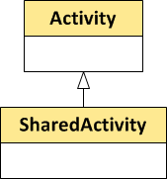

Shared activities
A shared activity is an activity with no specific owner
Ownership is collective
Everyone can see the shared activity
Anyone can complete the activity
SharedActivity is a subtype of the Activity entity
To create a shared activity programmatically:
6

Slide 13
Lesson Objectives review
You should now be able to:
Create an activity pattern
Create activities in Gosu
Create a shared activity
6

Slide 14
Notice:
Copyright © 2001-2014 Guidewire Software, Inc. All rights reserved.
Guidewire, Guidewire Software, Guidewire ClaimCenter, Guidewire PolicyCenter, Guidewire BillingCenter, Guidewire Reinsurance Management, Guidewire ContactManager, Guidewire Vendor Data Management, Guidewire Client Data Management, Guidewire Rating Management, Guidewire InsuranceSuite, Guidewire ContactCenter, Guidewire Studio, Guidewire Product Designer, Guidewire Live, Guidewire DataHub, Guidewire InfoCenter, Guidewire Standard Reporting, Guidewire ExampleCenter, Guidewire Account Manager Portal, Guidewire Claim Portal, Guidewire Policyholder Portal, ClaimCenter, BillingCenter, PolicyCenter, InsuranceSuite, Gosu, Deliver Insurance Your Way, and the Guidewire logo are trademarks, service marks, or registered trademarks of Guidewire Software, Inc. in the United States and/or other countries.
All other trademarks are the property of their respective owners.
This material is confidential and proprietary to Guidewire and subject to the confidentiality terms in the applicable license agreement and/or separate nondisclosure agreement.
This file and the contents herein are the property of Guidewire Software, Inc. Use of this course material is restricted to students officially registered in this specific Guidewire-instructed course, or for other use expressly authorized by Guidewire. Replication or distribution of this course material in electronic, paper, or other format is prohibited without express permission from Guidewire.
Guidewire products are protected by one or more United States patents.
6

Slide 15
Demo
6

Slide 16
Provide demo details and link to the demo video
7

Slide 17
Lab
6

Slide 18
Complete the exercises listed in “Lesson 4 : Configuring Activities” chapter in the “BillingCenter 10 Configuration: Kickstart - Student Workbook“
7

Slide 19
Review
6

Slide 20
This is for Review questions and answers
7

