Slide 1

Configuring Trouble Tickets
Editable List View

Slide 2
Lesson Objectives
By the end of this lesson, you should be able to:
Create trouble tickets in Gosu
Assign trouble tickets to users using common assignment methods
Determine whether a trouble ticket has been escalated
7

Slide 3
Lesson outline
Creating trouble tickets
Assigning trouble tickets
7

Slide 4
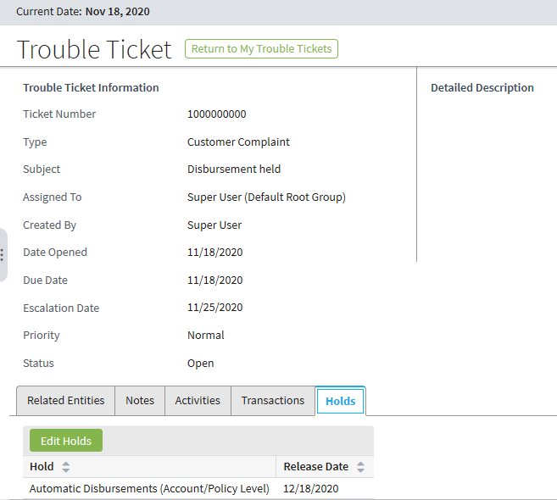
Trouble tickets
Trouble tickets provide central management for tracking and handling issues that relate to customer and producer accounts and their policies
Trouble tickets are
Attached to accounts, policies, and/or producers
Always assigned to a group and user, but viewed and worked on by many users
May have associated activities, notes, transactions, holds
7

Slide 5
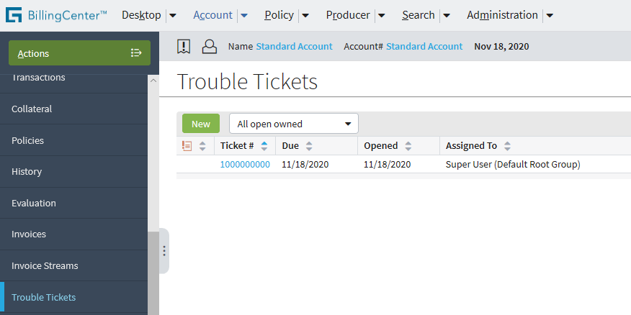
How users create a trouble ticket
Use New Trouble Ticket wizard
Launch wizard from My Trouble Tickets page, or Account, Policy, or Producer tabs
7

Slide 6
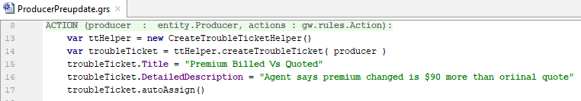
Creating trouble tickets in Gosu
Use the CreateTroubleTicketHelper class
You can use similar code to create a trouble ticket for an account or policy period
Owner of trouble ticket, which can be an account, producer, or policy period
7

Slide 7
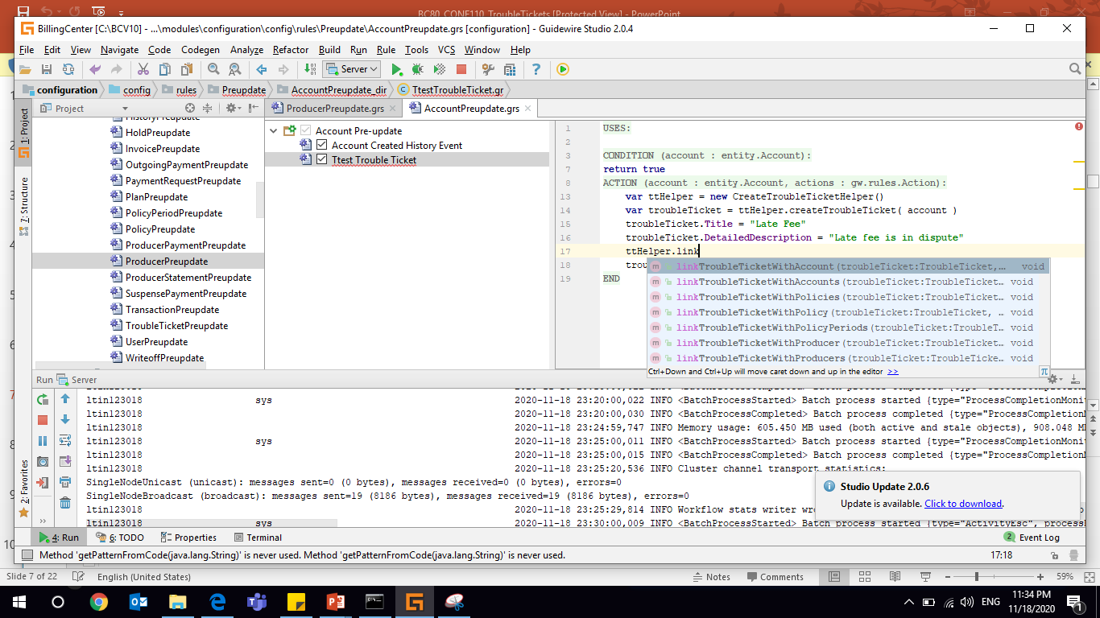
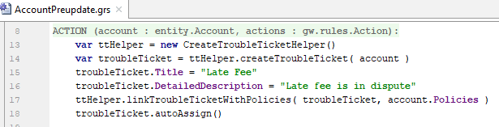
Attaching entities to a trouble ticket
You can associate a trouble ticket with one or more accounts, producers, and/or policies
Use ttHelper.linkTroubleTicket <entity>( ) method
Example :
Account Preupdate rule
7

Slide 8
Lesson outline
Creating trouble tickets
Assigning trouble tickets

Slide 9
Review: Assignment in BillingCenter
In the base application, only activities and trouble tickets are assignable in the UI and through business rules
Assignment is either explicit or rule based
Activity
Trouble Ticket
Assign entity to a group
Assign entity to a user in the group
Notes:
The concept of assignment in Guidewire applications is basically equivalent to ownership. The user to whom an activity or trouble ticket is assigned is the user who "owns" that activity or trouble ticket and so has primary responsibility for it. An entity that can be owned in this way is said to be "assignable".
A user belonging to more than one group could receive assignments through any of the groups.
Activities and trouble tickets are the only entities in the BillingCenter base application that are assignable through the UI. They are also the only entities that have associated Assignment business rules. However, various other BillingCenter entities are marked as Assignable in the data dictionary. In addition, you can make extension entities assignable.
Note: Examples of assigning trouble tickets are provided in a later lesson.

Slide 10
Initiating assignment from Gosu autoAssign()
Invokes Assignment engine to assign entity on which it is invoked
Can cause assignment rules to be run
Do not call autoAssign() from an assignment rule
Signature | Assignment rules that will be run
TroubleTicket.autoAssign() | Global and Default Group
TroubleTicket.autoAssign( group, null ) | Default Group
TroubleTicket.autoAssign( group, user ) | -
Notes:
The autoAssign() method is often called as part of trouble ticket creation to perform the initial assignment.

Slide 11
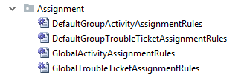
Review: Assignment rule sets
2. Assigns a user
1. Assigns a group and may assign a user
Each assignable entity has two rule sets:
Global - assigns an object to a group, but can also assign to a user
Default Group - assigns an object to a user in assigned group
Notes:
Each assignable entity has two rule sets: Default Group and Global. Assignment is the process of running these rules. Assignment is complete either when the object has an assigned group and user or when there are no more rules left to run.
Once invoked—for example, using autoAssign() —assignment rules are run whenever an assignable entity:
Is not assigned to either a group or user, or
Is assigned to a group but not to a user
Assignment rules are not run when a user and group are specified by the user who is creating or reassigning the entity.

Slide 12
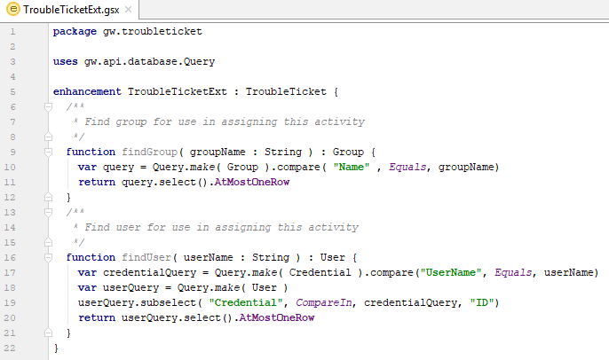
Suggested TroubleTicket Enhancement
findGroup()
findUser()

Slide 13
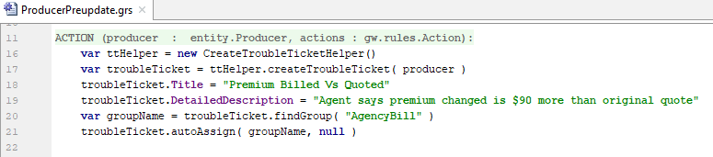
AutoAssign() example
Initiating assignment of a new trouble ticket
Producer Preupdate rule
Default Group rule set will be run because group is assigned, but user is not

Slide 14

Review: Exit rule when assignment succeeds
Avoid reassigning an entity that has just been assigned
Assignment methods return boolean values
True → assignment was successful
False →unsuccessful, appropriate group (or user) could not be found
Place methods in if/exit wrapper to exit rule set as needed
if (assignMethod) { actions.exit() }
If assignment is successful, ensures that no other assignment is done
Notes:
After you have assigned an object to its final group, there is no reason to continue in the rule set. Furthermore, there is some risk that a rule further down in the list will reassign your entity to another group in a way that you do not want. Therefore, it is important to execute the actions.exit() method as soon as the object has an appropriate group assignment. By wrapping the assignment method inside an IF command, you will exit the rule set if and only if the assignment is successful. It is best practice to use this approach for every single assignment method in your assignment rule sets.
In the example above, BillingCenter executes the assignGroup method for a given trouble ticket. If the method is able to assign the trouble ticket to a group (in this case, the Agency Bill group), then the method returns true and the rule set is exited. If the method is unable to assign the trouble ticket to the group, then the method returns false, and execution proceeds with the next assignment rule.
The assignGroup() method is discussed later in this lesson.

Slide 15
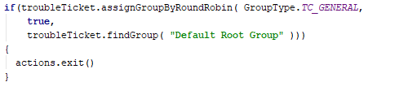
Review: Assigning to a group by round robin
assignGroupByRoundRobin first assigns object to specified parent group, then uses round-robin algorithm to assign object to a child group
Syntax: object. assignGroupByRoundRobin (groupType, includeSubGroups, group)
Note: All BillingCenter configured groups are children of Default Root Group
Notes:
Because BillingCenter has a group structure where all configured groups are children of the default root group (meaning, there is no configured group hierarchy), you can use assignGroupByRoundRobin() to evenly distribute assignments among all of the groups. The groupType of "general" is given to all BillingCenter groups other than the default root group. Default Root Group is the "parent" group from which the round-robin will be done.

Slide 16
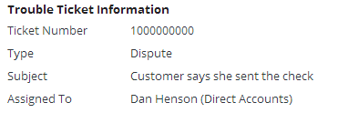
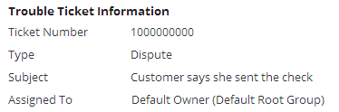
Review: Global assignment outcomes
If global assignment is successful, object is assigned to group
Subsequently, default assignment rules assign object to a user
If global assignment is unsuccessful, object is assigned to root group and "Default Owner"

Slide 17

Review: Assigning to a user and any group
assignUserAndDefaultGroup()assigns object to a user and any group that the user belongs to
Syntax: object. assignUserAndDefaultGroup (User)
Always assigns to both a group and user
Called from either global or default group rules
Notes:
This method can be called from either global or default group rules. If it is called from global rules, then the object will have an assigned user at the end of execution of that rule set, and therefore the Default Group rule set will not execute.

Slide 18

Review: Assigning to entity creator
assignToCreator()assigns trouble ticket to user who created the source entity and any group that the user belongs to
Syntax: troubleticket.assignToCreator (sourceEntity)
Assigns trouble ticket to the user who created the first activity associated with the trouble ticket
Notes:
This method can be called from either global or default group rules. If it is called from global rules, then the object will have an assigned user at the end of execution of that rule set, and therefore the Default Group rule set will not execute.
Note: The TroubleTicket entity has fields that track who created and last updated the trouble ticket (CreateUser, UpdateUser). These fields are managed by the system only and should never be used in user-written configuration code.

Slide 20

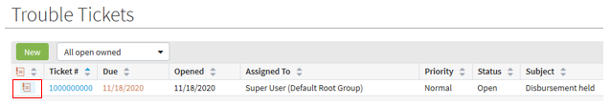
Escalating trouble tickets
trouble ticket escalation
Like activities, trouble tickets have an escalation date
But trouble tickets do not have escalation rule sets
Trouble ticket escalation batch process runs on a scheduled basis
Sets TroubleTicket.Escalated to true
You can test for escalation in a preupdate rule:
Escalated trouble tickets are flagged in the UI
Notes:
In the base application, the only behavior assigned to overdue or escalated trouble tickets is the way in which they appear in trouble ticket lists. BillingCenter can be configured to add special functionality for overdue or escalated trouble tickets. The simplest approach to handling escalated trouble tickets is to create an activity for the group supervisor to check on the reason the trouble ticket has not been closed.

Slide 21
Lesson objectives review
You should now be able to:
Create trouble tickets in Gosu
Assign trouble tickets to users using common assignment methods
Determine whether a trouble ticket has been escalated

Slide 22
Demo
6

Slide 23
Provide demo details and link to the demo video
7

Slide 24
Lab
6

Slide 25
Complete the exercises listed in “Lesson 5: Configuring Trouble Tickets” chapter in the “BillingCenter 10 Configuration: Kickstart - Student Workbook“
7

Slide 26
Review
6

Slide 27
This is for Review questions and answers
7

