Slide 1

Configuring Charge Invoicing
Editable List View

Slide 2
Lesson objectives
You should be able to:
Explain how invoice items are allocated to invoices
Describe how various parameters on billing plans and payment plans influence invoicing
Explain the difference between bill date invoicing and due date invoicing
Configure payment plans and billing plans for charge invoicing
This lesson uses the notes section for additional explanation and information. To view the notes in PowerPoint, choose View→Normal or View→Notes Page. If you choose to print the notes for the lesson, be sure to select "Print hidden slides."

Slide 3
Lesson outline
Charge invoicing basics
Influences on invoicing: example
Configuring the payment plan
Configuring the billing plan

Slide 4
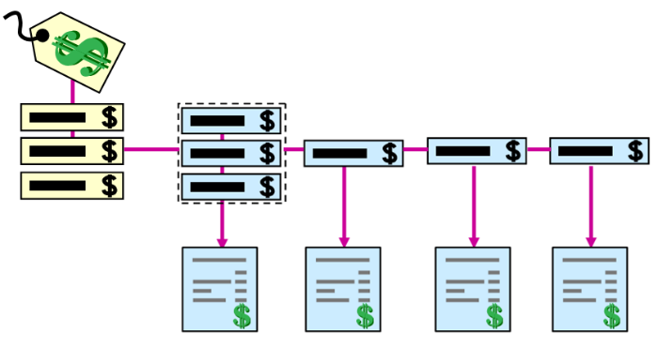
Charge invoicing
Charge invoicing is the process of dividing charges into invoice items and assigning the items to invoices
Type of charge determines whether to split a charge into more than one item
Pro-rata charges are typically divided into a down payment item and installment items
All other charges are billed as single invoice items
Each invoice item is placed on an invoice in a predefined invoice stream
An invoice stream is a set of invoices
Typically invoice stream dates are spaced at regular intervals such as monthly and twice monthly
Notes:
Configuring Charge Invoicing - 4
"Type of charge" refers to the charge pattern type. The Premium charge pattern has a type of "ProRataCharge" and an Invoicing Approach of "Down Payment and Installments". For this reason, premiums are split into a down payment, which is a percentage of the premium, and a set of installments. Other charge patterns in the base application have "One-time Charge" as their invoicing approach. These are billed as single invoice items.
Charge invoicing is the process of taking a charge, breaking it into invoice items, and placing the items on either direct bill invoices or agency bill statements. Charge invoicing happens under two circumstances:
A billing instruction is received
A payment plan is changed
Charge invoicing functionality also plays a part in other areas such as:
Charge holds
Assignment of items
Policy transfers
All invoice streams in the base application are created to support invoices with dates that are based on a regular interval. BillingCenter can add invoices with "off sequence" dates to an invoice stream. These are called "ad hoc" invoices.
The topic of charge invoicing is complex with several "moving parts". For this reason, the examples in this lesson are based on default invoice streams. "The Invoice Lifecycle" lesson discusses how to create and edit custom invoice streams.

Slide 5
Charge invoicing dates
Policy effective date: date the policy period takes effect
Charge effective date: date the coverage or coverage reduction specified by the charge takes effect
Charge date: date BillingCenter receives the billing instruction that contains the charge
Invoice date: date an invoice is billed
Also called billing date or statement date
Due date: last date an invoice can be paid before it becomes past due
Due date = invoice date + lead time
Invoice item event date: date the item becomes billable
Notes:
The slide defines various dates that you need to know about in order to understand how charge invoicing works. "Policy effective date", "charge effective date", "charge date" and "invoice item event date" influence how invoice items are placed on invoices. "Invoice date" and "due date" refer to when an invoice is billed and due, respectively.
The invoice item event date is based on the settings in the payment plan, which is discussed later in this lesson.
Notice that the date a charge is received on a billing instruction (charge date) isn't necessarily the charge effective date. The charge effective date depends on the type of billing instruction:
For a new policy, the charge effective date is the same as the policy period's effective date.
For an existing policy, the charge effective date is the same as the billing instruction's modification date. Note that the modification date is the effective date of a billing instruction for an existing policy (such as a policy change or a cancellation).
When a charge is divided into invoice items, each invoice item has an event date, which is the earliest date that the invoice item can be billed. The invoice item is placed on the first available planned invoice that occurs on or after this date.
You will see the dates defined on the slide when you look at payment plans and invoices in BillingCenter.

Slide 6

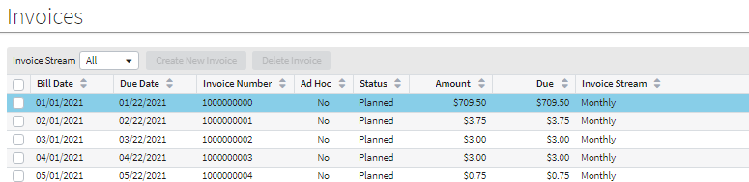
A set of invoices
Payment Plan
Account tab -> Invoices
Invoice stream
Invoice date: date the invoice is billed
Due date: date the invoice is made due
Notes:
The "Payment Interval" in the payment plan determines the invoice stream for the invoices. The Monthly invoice stream is used for several payment intervals including Monthly, Quarterly, and Every Six Months.
An invoice becomes "Past Due" if it remains unpaid one day after the due date.

Slide 7
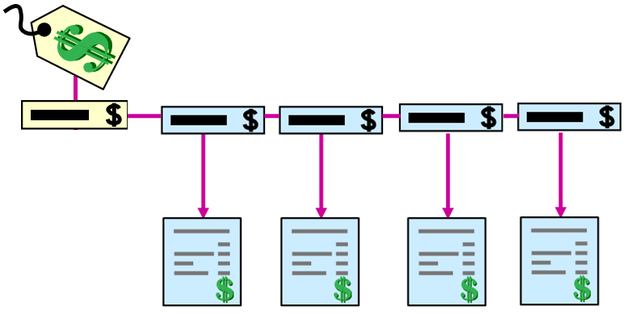
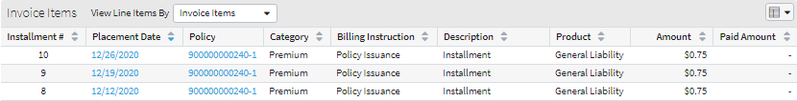
Invoice items
An invoice item is that portion of a charge
that is separately invoiceable.
Example: a charge that consists of a down payment and 3 installments will be split into 4 invoice items
Each invoice item has an placement date, the earliest date on which the item can be billed
Account tab -> Invoices
Placement date
Notes:
The topics of how item event dates are assigned and the role that they play in charge invoicing are covered later in this lesson.

Slide 8
Typical charge invoicing requirements
Policy submission:
Invoice date must never be before charge date
Invoice must be scheduled on first available invoice date based on policy effective date
Invoice date must follow lead times as defined in billing plan
Last installment must be scheduled and due prior to policy expiration date
Renewal:
Down payment is not applicable
Due date of first installment must not be prior to renewal effective date
Due date must be scheduled before renewal expiry date
Notes:
Configuring Charge Invoicing - 8
The slide shows selected requirements from one carrier. Invoicing requirements vary from carrier to carrier. In fact, no two carriers do invoicing in the exactly same way. For this reason, BillingCenter provides several configuration points for customizing the charge invoicing process.

Slide 9
Lesson outline
Charge invoicing basics
Influences on invoicing: an example
Configuring the payment plan
Configuring the billing plan

Slide 10

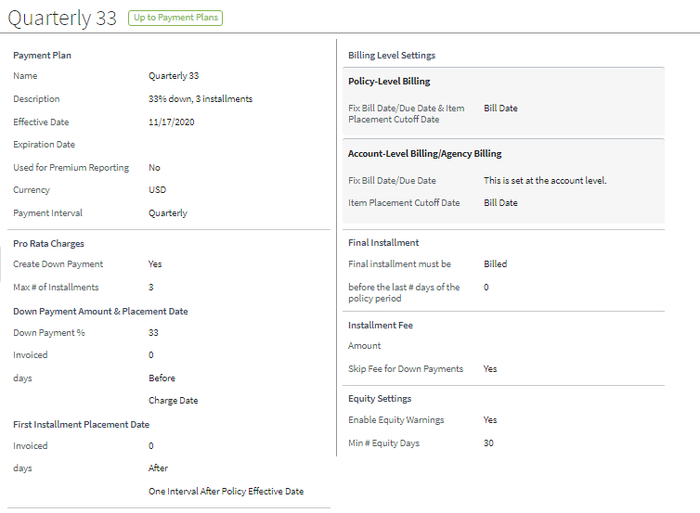

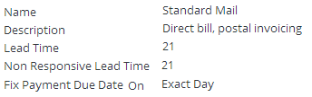

Influences on invoicing (1)
Payment plan
Billing
instruction
Charge date: 20 Apr 2014
20 Apr 14
20 Apr 15
Policy period
20 Apr 14
20 Apr 15
Policy period
Charge pattern
Account
Billing plan
Notes:
Charges are sent to BillingCenter by means of a billing instruction. The charge date is the date of the billing instruction. A charge pattern is a template for a charge. Every charge is associated with a single charge pattern.
Every policy period has an effective date and an expiration date. These dates define an interval of time during which invoices can be billed (that is, sent to the payer) and made due.
The Billing Info fields on each account specify details that are used for determining the timing of invoices. The Invoices Fixed On fields provide values for all the payment intervals supported by the base application. Only one or two of these fields will be used for invoicing a particular policy. For example, if a policy is to be invoiced twice a month, then the two "Twice a Month" entries are used to establish the invoice dates. If instead a policy is invoiced once a month, then only the "Monthly – Day of Month" entry is used to establish the invoice dates. The Invoice By field determines whether different policies can be billed on the same invoice or separate invoices.
The policy payment plan identifies how the charges are to be distributed across invoices. It includes information such as the percent expected for down payment, the payment interval (monthly, every other week, and so on), the installment fee, and the time period in which first installment is invoiced.
The account billing plan identifies account-level information on how the account is to be billed. It contains any billing information which should not vary from policy to policy, but rather should be the same for all policies for a given account. For example, it can specify the fee for any payment reversals, as well as the lead time (amount of time between the sending of the invoice and the expectation of receipt of the payment).

Slide 11
Influences on invoicing (2)
This information … | Comes from ….
Invoicing approach: one-time charge or split charge into installments? | Charge patterns
Number and frequency: how many invoices? which invoice stream? | Payment plan
Timing: which invoice dates (billing date) and due dates? | Billing Info fields on account Billing plan
Placement on invoices: which items on which invoices? | Billing instruction Policy period effective date Payment plan Invoice By field on account
Notes:
The next few slides present an example of how invoice items are placed on invoices.

Slide 12
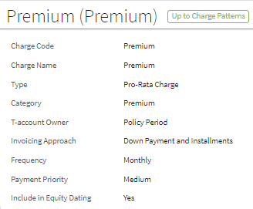
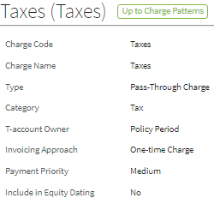
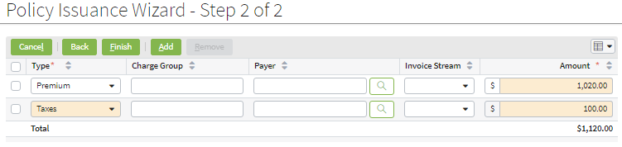
Determining the invoicing approach Which charges to split into more than 1 invoice item?
Charge pattern: Taxes
Charge pattern: Premium
Premium charge will generate multiple invoice items (down payment and installments)
Tax charge will generate a single invoice item
Billing instruction
Notes:
Every charge on a billing instruction is of a type that corresponds to a charge pattern. Each charge pattern defines an invoicing approach. The Premium charge pattern is the only charge pattern in the base application that has an invoicing approach of "Down Payment and Installments". All other charge patterns have "One-time Charge" as their invoicing approach.

Slide 13

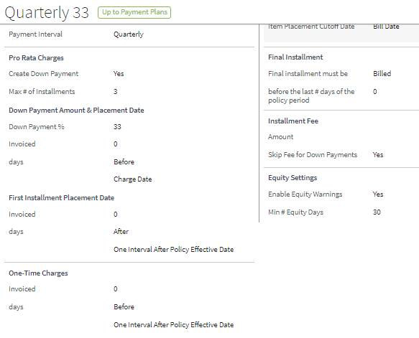
Determining number and frequency of invoices
Payment plan
Determines the invoice stream to use
Maximum of 4 invoices
Notes:
The payment plan associated with the policy defines the payment interval (that is, the frequency of the invoices). For premium charges, it also specifies details for the down payment and installments.
The reference dates on the payment plan (that is, the Down Payment, First Installment, and One-Time Charges fields on the bottom right of the plan) are used to determine the event dates for the resulting invoice items. The "Interval" referred to in the reference dates is determined by the "Payment Interval" value. So, in the screenshot, the first installment and all one-time charges will be invoiced one quarter (three months) after the policy effective date.

Slide 14
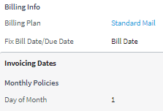
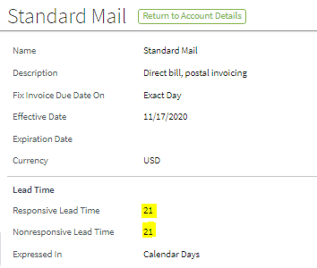
Establishing timing: billing and due dates
Account
Send invoices on the first day of the month
Billing plan
Billing Plan
Invoice will be due 21 days after "Invoice Day of Month" [Invoice date + Lead time]
. . .
Billed:
1 Jan
1 Feb
1 Mar
1 Apr
1 May
1 Jun
1 Jul
1 Aug
1 Sep
1 Oct
Billed: Due:
1 Jan 22 Jan
1 Feb 22 Feb
1 Mar 22 Mar
1 Apr 22 Apr
1 May 22 May
1 Jun 22 Jun
1 Jul 22 Jul
1 Aug 22 Aug
1 Sep 22 Sep
1 Oct 22 Oct
Notes:
If "Fix Bill Date/Due Date" is set to "Bill Date" for the account, then the "Monthly - Day of Month" field specifies the invoice date (also called the billing date) for the invoices. In this case, the due date of each invoice is calculated by adding the "Lead Time" from the billing plan to the invoice day of the month.
A set of possible invoices is shown at the bottom of the slide with the billing date and due dates. The next step is to determine which invoices in this endless set of invoices will be used.
Two lead times
Lead time is the number of days that must be allowed between the invoice billing date and the due date. The value in the "Lead Time" field is used in cases where the payment method is "Responsive" (that is, the carrier bills the customer directly and the customer must respond). "Non responsive lead time" applies where the payment method for the account is credit card, EFT, ACH, or wire. In other words, in cases where the payment is automatic with no response required of the customer.

Slide 15
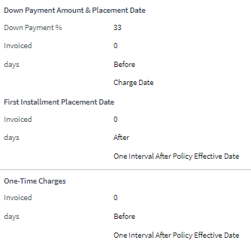



Placing invoice items on invoices item event dates
Billing instruction
Payment plan
Charge date: 28 Dec 2009
28 Dec '09
28 Dec '10
Policy
period
Down payment item event date = 28 Dec
Item event dates = 28 Mar
Down payment item
Tax and installment #1 items
. . .
Billed: Due:
1 Jan 22 Jan
1 Feb 22 Feb
1 Mar 22 Mar
1 Apr 22 Apr
1 May 22 May
1 Jun 22 Jun
1 Jul 22 Jul
1 Aug 22 Aug
1 Sep 22 Sep
1 Oct 22 Oct
Notes:
Configuring Charge Invoicing - 15
The example uses the account information and billing plan from the previous slide, so the Invoice Day of Month is 1 and the lead time is 21.
Either the charge date from the billing instruction or the policy period effective date is used to establish the first candidate invoice (depending on the payment plan settings). In the example on the slide, an invoice cannot be billed ("invoiced") before the charge date. So, the first possible invoice in our example is 1 Jan 2010.
Information on the payment plan establishes rules for setting the item event dates for the down payment, first installment, and one-time charges. Recall that an item event date is the earliest date that an item can be billed. In our example, the down payment can be "invoiced [no earlier than] 0 days after Charge Date" (that is, can be billed any time after the charge date). So the down payment item event date is 28 Dec, which means that the item goes on the 1 Jan 2010 invoice.
The first installment can be billed any time after "one interval after policy effective date". As you saw earlier, the interval on this payment plan is quarterly, so the first installment can be billed 0 days after one quarter following the policy effective date. This translates into an item event date of 28 Mar, with the result that the first installment is placed on the 1 Apr 2010 invoice. Taxes are a one-time charge and, in this case, the rule for one-time charges is the same as for the first installment, so both taxes and installment 1 are placed on the 1 Apr invoice.
Note: BillingCenter places items on planned invoices only.

Slide 16
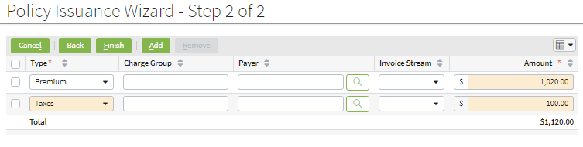
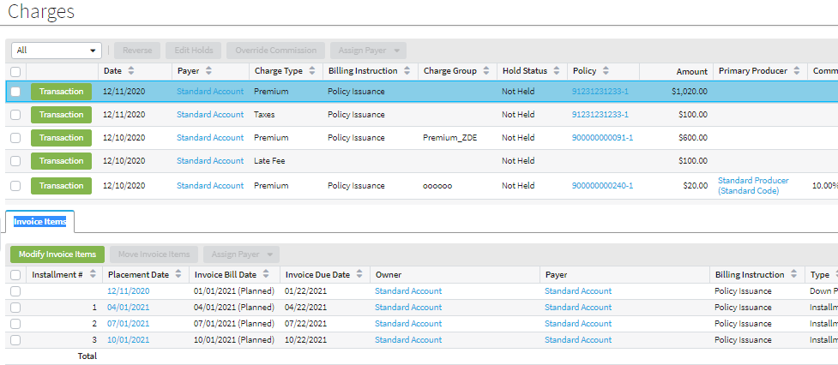
Generated invoice items for Premium charge
Billing instruction
Charges and generated invoice items
Item event dates
Notes:
The screenshots on this slide and the next slide confirm our predictions of how the invoices will be generated and how items will be placed on invoices.

Slide 17
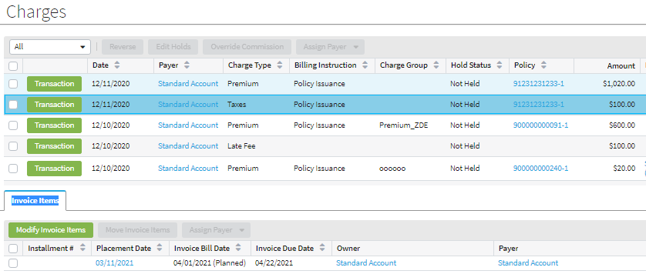
Generated invoice item for Taxes charge
Billing instruction
Charges and generated invoice items

Slide 18




Allowing for a "blackout window"
Payment Plan
Payment plan can specify a period at end of a policy term when no invoices can be billed
If necessary, BillingCenter reduces number of invoices to accommodate blackout window
Example: Given this policy period the last possible invoice is 18 Jan
Counts backwards from day before policy expiration date
Item #1
Last item
. . .
Billed: Due:
18 Mar 28 Mar
18 Apr 28 Apr
18 May 28 May
18 Jun 28 Jun
18 Nov 28 Nov
18 Dec 28 Dec
18 Dec 28 Dec
18 Jan 28 Jan
18 Feb 28 Feb
Notes:
There are two settings on the payment plan that, along with the policy expiration date, determine the blackout window:
"Make last invoice", which can be set to Billed or Due
"by # days before policy expiration date", which specifies the size of the blackout window.
The default behavior of the base application is to reduce the number of invoices if necessary to accommodate the blackout window. In the example on the slide, the 18 Feb invoice is discarded because it will be billed after the latest date allowed by the blackout window (20 Mar – 40 days, which is 8 Feb). Note that 20 Mar is used rather than 21 Mar because there is no coverage on the expiration day. Therefore, the blackout window calculation counts backwards from the day before the policy expiration date. Note also that the bill date (or due date, if due date is used) can fall on the first day of the blackout period.

Slide 19
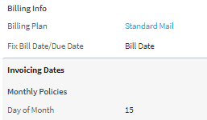
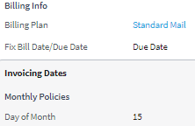
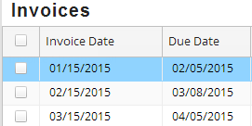
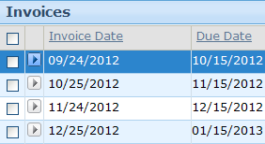
Two ways to establish invoice and due dates
Invoice Date Invoicing
Due Date Invoicing
Invoice Day of Month used to fix the date an invoice is billed
Example: Given a lead time of 21 days:
Invoice Day of Month used to fix the date an invoice is due
Example: Given a lead time of 21 days:
Account
Account
- 21
+ 21 =
Due date = invoice date + 21
Invoice date = due date - 21
Notes:
The "Fix Bill Date/Due Date" field for an account determines how the numbers in the "Invoices Fixed On" set of fields will be used.
If "Fix Bill Date/Due Date" is set to Billed, the values in the "Invoices Fixed On" fields are used to establish the invoice (billing) dates for account invoices. The due date is then calculated by adding the lead time (specified in the associated billing plan) to the invoice date.
If "Fix Bill Date/Due Date" is set to Due, the values in the "Invoices Fixed On" fields are used to establish the due dates for account invoices. The invoice date is then calculated by subtracting the lead time (specified in the associated billing plan) from the due date.
Note: "Invoice date invoicing" is sometimes referred to as "bill date invoicing".

Slide 20
Lesson outline
Charge invoicing basics
Influences on invoicing: an example
Configuring the payment plan
Configuring the billing plan

Slide 21
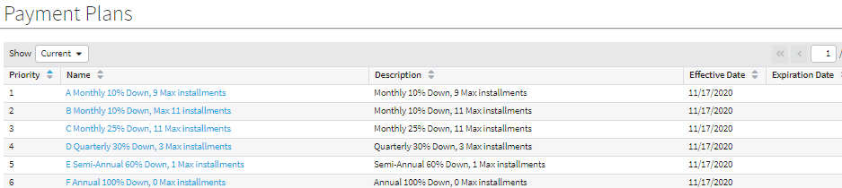
Payment plans
Payment plans:
Are associated with policy periods
Specify how to distribute pro-rata charges across invoices
Specify when to bill one-time charges
Administration→Business Settings→Payment Plans

Slide 22
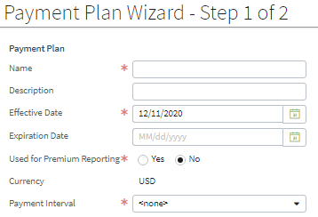

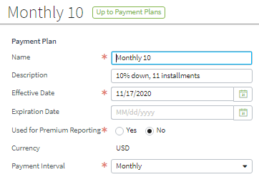
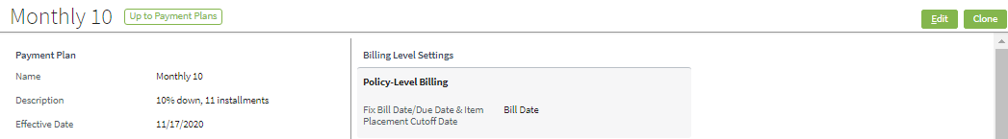
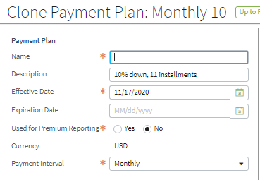
Creating a new payment plan
Create new plan
Clone existing plan
Notes:
Unlike billing plans, payment plans can be edited when in use. However, like billing plans, you can also clone and then modify cloned payment plans. When you modify a payment plan that is in use, the changes apply only to subsequently executed billing instructions.

Slide 23
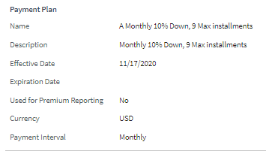
Payment plan: general fields
Name displayed on screens
Description displayed on some screens
Period when this plan is allowed to be used
A "Yes" would indicate that payroll reporting is used
Currency, displayed only when configured for multicurrency
Notes:
Is Reporting?
A yes indicates that payroll reporting is used, and so invoices are not generated. Workers’ compensation is an example of premium reporting, where the total premium is not known at the beginning of the policy period. Every month the account sends a payroll report to the carrier and makes a payment based on the report. The topic of premium reporting policies is beyond the scope of this course.

Slide 24
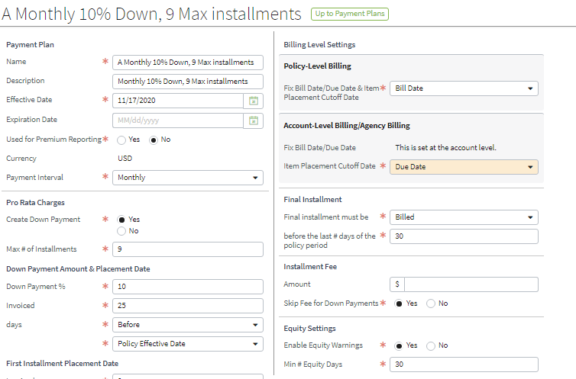
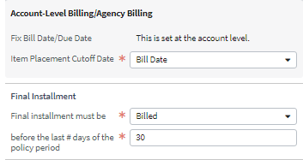
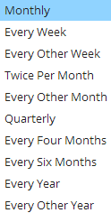
Payment plan – invoicing window
Payment Interval determines how often billing can occur
Defines "blackout window" during which billing cannot occur
21 Mar '10
21 Mar '11
Example policy period
"Blackout window"

Slide 25
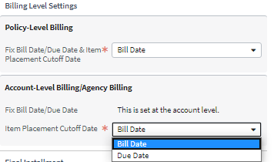

Payment plan – invoicing window Item Placement Cutoff Date
Item Placement Cutoff Date defines how the item event date is used when invoice items are placed on invoices
Given: Item event date of 20 Oct
$
20 Oct is on or before due date of 22 Oct, so item goes on this invoice
20 Oct is greater than bill date of 15 Oct but less than bill date of 15 Nov, so item goes on this invoice
Billed: Due:
15 Oct 22 Oct
Billed: Due:
15 Nov 22 Nov
Notes:
Configuring Charge Invoicing - 25
When BillingCenter is assigning invoice items to invoices, the Item Placement Cutoff Date determines whether to compare the item's event date to the invoice's bill date or the invoice's due date. In the example on the slide:
If the Item Placement Cutoff Date is the Invoice Due Date (refer to lefthand arrow in the diagram), then BillingCenter looks at the due date of the invoice. This means the invoice item will be placed on the earliest planned invoice with a due date that is on or after the invoice item's event date. For example, if the account's due day of month is the 15th and it has a 7 day lead time, then the invoices are due on the 22nd. An invoice item with event date 10/20/2010 will be placed on the next invoice that is due on or after the item's event date. So, it is placed on the invoice that is billed on 10/15/2010 and due on 10/22/2010.
If the Item Placement Cutoff Date is the Invoice Bill Date (refer to righthand arrow in the diagram), then BillingCenter looks at the bill date of the invoice. This means the invoice item will be placed on the earliest planned invoice with a bill date that is on or after the invoice item's event date. For example: If the account's invoice day of month is the 15th, then the invoices are billed on the 15th. An invoice item with event date of 10/20/2010 will be placed on the next invoice that is billed on or after the item's event date. So, it is placed on the 11/15/2010 invoice.
Setting Item Placement Cutoff Date to "Invoice Due Date" ensures that each invoice item is placed on the earliest possible planned invoice. This setting is most appropriate for non-responsive billing because it does not take into account time for mailing the invoice and sending the payment.

Slide 26
Payment interval details
Payment Interval on payment plan determines invoice stream
Invoices Fixed On fields on account determine timing and frequency of invoices
Payment Interval on payment plan | Every week | Every other week | Twice per month | Monthly Every other month Quarterly Every 4 months Every 6 months Every year Every other year
Invoices Fixed On on account | Invoice day of week | Every other week invoice anchor date | First & Second day of month for twice per month invoicing | Invoice day of month or Due day of month
Example | Every Friday | Every other Friday from 4 Dec 2010 | 15 and 31 | 31
Notes:
On the account, the "Every other week invoice anchor date" is used as a basis to calculate dates to synchronize with a company's payroll schedule. The anchor date is not the starting date.
An "invoice day of month" of 31 actually means the last day of the month. BillingCenter makes the correct adjustments for months that are shorter than 31 days and for leap years.

Slide 27
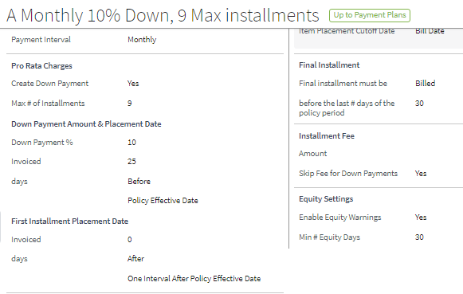
Payment plan: pro-rata charges
How pro-rata charges are divided up into invoice items
Timing of the down payment
Timing of first installment
Percentage of charge to be paid up front
Maximum number of equal installments to be billed using remaining charge amount after down payment has been taken
Notes:
In the example, the payment plan specifies a "Max # Installments" of 9. It is possible that fewer installments will be created, depending on the number of invoices that can fit in the invoicing window. The payment plan also specifies that the down payment can be "invoiced [no earlier than] -25 days after Policy Effective Date" (that is, can be billed as early as 25 days before the policy effective date). The first installment can be billed as early as "one interval" (in this case, the payment interval is a month) after the policy effective date. The invoicing dates for the remaining installments are based on the first installment's invoice date.
Note that where an installment fee is included in the payment plan, BillingCenter will add a charge for this fee to each installment.

Slide 28
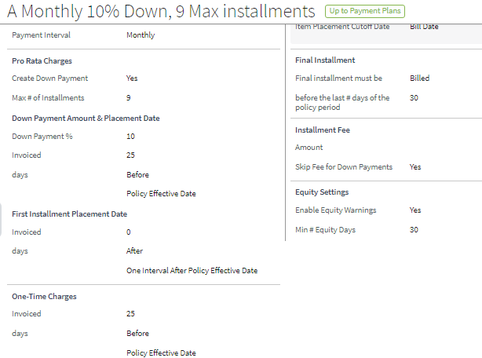
Payment plan: one-time charges
Timing of one-time charges
Invoice for full-pay items can be sent as early as 25 days before policy effective date
Notes:
One-time charges include invoice fees, installment fees, reinstatement fees, late fees, and taxes. The event date is determined for all one-time charges. The settings are used in the same way as the first installment's settings.
In the example, one-time charges will be invoiced -25 days after the policy effective date. Using a negative number is useful if you want the first payment to be billed as soon as the policy becomes effective.

Slide 29
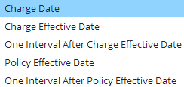




Controlling when an item can be invoiced some timing examples
"…days after/before " can be:
Examples:
Item can be invoiced as early as 10 days after the charge date
Item can be invoiced as early as 25 days before the policy effective date
Given: Item can be invoiced as early as 1 week + 0 days after policy effective date
Notes:
The Charge Date is the day the charge is received. "One interval after policy effective date" refers to the Payment Interval on the payment plan (monthly, every week, every other week, and so on).

Slide 30
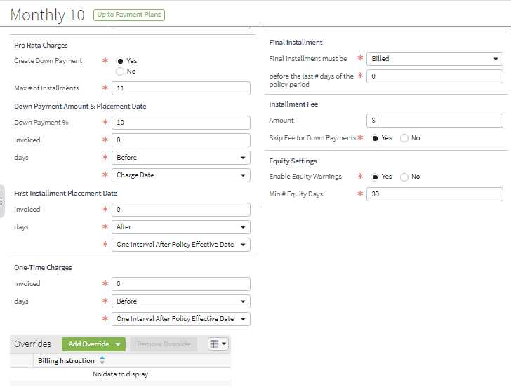
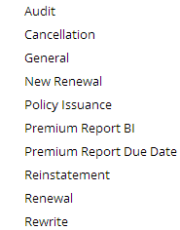
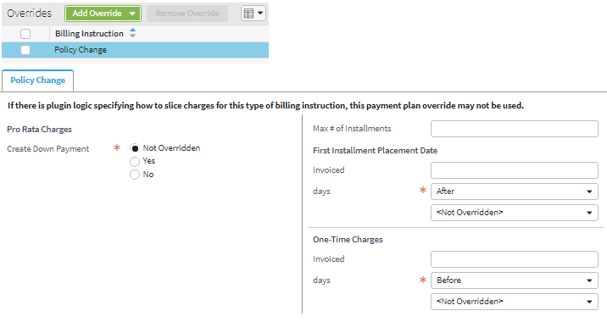
Defining context-specific overrides
Overrides section of payment plan lets you define override values for selected context
Context (billing instruction type)
Notes:
BillingCenter uses the same payment plan for a policy, regardless of the billing instruction type. However, different types of billing instructions can have different billing requirements. The Overrides section of a payment plan allows you to define overrides that are specific to the billing instruction type. The example shows an override that omits the down payment for a policy change billing instruction and restricts the maximum number of installments to 10.
When BillingCenter receives a billing instruction and the billing instruction type matches the context of an override in the policy’s payment plan, the context field settings are used.

Slide 31
Lesson outline
Charge invoicing basics
Influences on invoicing: an example
Configuring the payment plan
Configuring the billing plan

Slide 32
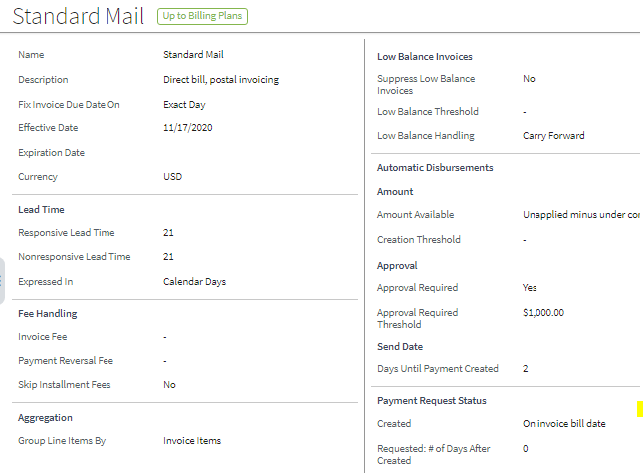
Invoicing settings on billing plan
The number of days between the invoice date and the due date
How to adjust due dates that fall on non-working days
Suppressing trivial invoices
Suppressing trivial invoices
Automated account fees
Level of itemization on invoices
Level of itemization on invoices
Notes:
Configuring Charge Invoicing - 32
Notes about the invoicing fields of the billing plan:
Lead time is the number of days that are must be allowed between the invoice billing date and the due date. "Non responsive lead time" applies to payments made by credit card, EFT, ACH, and wire (that is, automated payments that require no response from the customer). These payment types require some processing time but less than for a customer response. "Dunning Lead Time" is no longer used by BillingCenter.
Payment date may be left as the exact date or moved to the previous or following working day
An invoice fee, if specified, is added to each invoice billed
A payment reversal fee is raised only for those reversals that are due to the client’s defaulting, such as a dishonored check
When charging an invoice fee, there is the option to not charge any individual policy installment fee
Invoices may be itemized to show:
Charges – Each individual invoice charge item (the most detailed)
Charge Groups – Charges grouped by charge group (for example, all charges on a policy relating to a particular vehicle)
Context – One line for each billing instruction
Categories – Charges grouped by charge category (that is, premium, taxes, and so on).
Policies – One line per policy (the least detailed)
Small invoice balances can be carried forward or written off

Slide 33
Lesson objectives review
You should now be able to:
Explain how invoice items are allocated to invoices
Describe how various parameters on billing plans and payment plans influence invoicing
Explain the difference between bill date invoicing and due date invoicing
Configure payment plans and billing plans for charge invoicing

Slide 34
Notices
Copyright © 2001-2014 Guidewire Software, Inc. All rights reserved.
Guidewire, Guidewire Software, Guidewire ClaimCenter, Guidewire PolicyCenter, Guidewire BillingCenter, Guidewire Reinsurance Management, Guidewire ContactManager, Guidewire Vendor Data Management, Guidewire Client Data Management, Guidewire Rating Management, Guidewire InsuranceSuite, Guidewire ContactCenter, Guidewire Studio, Guidewire Product Designer, Guidewire Live, Guidewire DataHub, Guidewire InfoCenter, Guidewire Standard Reporting, Guidewire ExampleCenter, Guidewire Account Manager Portal, Guidewire Claim Portal, Guidewire Policyholder Portal, ClaimCenter, BillingCenter, PolicyCenter, InsuranceSuite, Gosu, Deliver Insurance Your Way, and the Guidewire logo are trademarks, service marks, or registered trademarks of Guidewire Software, Inc. in the United States and/or other countries.
All other trademarks are the property of their respective owners.
This material is confidential and proprietary to Guidewire and subject to the confidentiality terms in the applicable license agreement and/or separate nondisclosure agreement.
This file and the contents herein are the property of Guidewire Software, Inc. Use of this course material is restricted to students officially registered in this specific Guidewire-instructed course, or for other use expressly authorized by Guidewire. Replication or distribution of this course material in electronic, paper, or other format is prohibited without express permission from Guidewire.
Guidewire products are protected by one or more United States patents.

Slide 35
Demo
6

Slide 36
Provide demo details and link to the demo video
7

Slide 37
Lab
6

Slide 38
Complete the exercises listed in “Lesson 2: Configuring Charge Invoicing Behaviors” chapter in the “BillingCenter 10 Configuration: Kickstart - Student Workbook“
7

Slide 39
Review
6

Slide 40
This is for Review questions and answers
7

