Slide 1

InsuranceSuite 10 Integration
PLUGINS PREDEFINED

Slide 2
  Describe the basic functionality of Guidewire plugins
  Determine the methods needed for a given predefined plugin
  Write predefined plugins in Gosu
  Register and deploy plugins

Slide 3
Overview of Guidewire plugins
Gosu plugins
Plugin parameters plugins

Slide 4
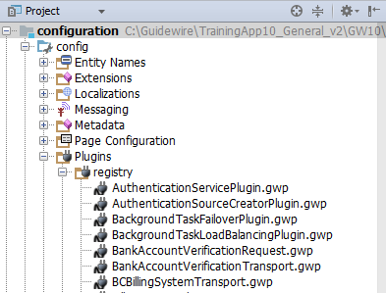
Plugin
Often defines integration point
with external system(s)
.gwp file
  …\config\plugin\registry\
  Specifies Gosu or Java class
  Defined additional parameters
Gosu, OSGi, or Java
  Contains a set of methods
  called by internal code to
  execute application functionality
Code executes in…
  the Guidewire application Java Virtual Machine (JVM) process
  a user context or outside of user context
  the current transaction bundle
Notes:
In Guidewire, a plugin is a Gosu, OSGi Java, or Java class that contains a set of methods called by internal code to execute application functionality. Guidewire plugins run in the same Java Virtual Machine (JVM) process as the Guidewire application itself.
A plugin might do the required work by itself or it might interact with other external systems. If a plugin must retrieve data from an external system, the integration point must be synchronous. Guidewire strongly recommends that you carefully consider response time, including network response time, as you write your plugin implementations.
In some cases, calls to a plugin block the user from doing further work until the call is complete. End users should not wait for long responses from the application. Developers must ensure that predefined plugins perform quickly and, when possible, synchronously.

Slide 5
Implemented plugins behaviors
All applications
  User authentication
  Geocoding
  Number generation for significant entities
  Document production and storage
ClaimCenter
  Policy search
  New Claim Wizard
PolicyCenter
  Vehicle identification
  number (VIN)
  search
BillingCenter
  Commission
  calculation
Notes:
Geocoding is the process of finding geographic coordinates from geographic data, such as street addresses or postal codes, and using that information for various purposes, for example:
Verifying the accuracy of an address
Executing proximity searches (such as finding all auto repair ships within a 10-mile radius of a damaged auto's location)
Providing driving directions
Number generation is done for:
ClaimCenter's Claim entity
PolicyCenter's PolicyPeriod and Job entities
Seven entities in BillingCenter: Account, CollateralRequirement, Disbursement, Invoice, Statement, Transaction, TroubleTicket

Slide 6
Types of plugins
Predefined plugins
  Used to implement customizable
  behavior for predefined points in the application
Messaging plugins
  Used to send messages to external systems and process the resulting replies
Startable plugins
  Used to listen for incoming messages and processes them asynchronously
Notes:
Calls to predefined plugins block the user from doing further work. Calls to messaging plugins and startable plugins occur outside of a user context and do not block any user from doing further work.

Slide 7

Plugin application scope
Internal to Guidewire
Number generator plugin example
  Generates a unique, sequential number for claims, policies, or accounts
  Application logic internal to Guidewire
External system integration
Authentication plugin example
  Interacts with an external system such as Active Directory, Single Sign On (SSO) or LDAP Server
Number Generator
Authentication
LDAP Server
Notes:
Many plugins execute behaviors that are typically internal to Guidewire. For example, the number generator plugin generates a unique, sequential number for claims, policies, or accounts and typically uses logic entirely within Guidewire. Other plugins execute behaviors that involve communication with external systems. For example, the authentication plugin typically interacts with an external LDAP server.
The term "plugin" should not be considered synonymous with integration. Although many plugins are used for external system integration, some are used exclusively for internal processing. The number of non-integration plugins varies from application to application.
When a predefined plugin does integration work, the data exchange is typically outbound (initiated by Guidewire) and synchronous. All plugins are documented in the Integration Guide (whether they typically involve integration with external systems or logic that's entirely internal to Guidewire).

Slide 8
Plugin interfaces
Every plugin class must implement at least one interface
  Interface varies based on the plugin to be implemented
  Interface contains methods that internal code will call
Authentication Service plugin example:
  Must implement the
  AuthenticationServicePlugin interface
  Calls authenticate() and setCallback()
class AcmeAuthenticationPlugin implements
AuthenticationServicePlugin {
…
function authenticate() {…}
…
function setCallback() {…}
…
}
Notes:
An interface is a set of properties and methods whose purpose is to define how software elements interact without identifying any specific implementation. An interface defines property and method names and return values. An interface does not define property or method implementations.

Slide 9
Recommend plugin source code options
Gosu Plugin*
  Use Guidewire Studio
  Native access to application API
  Native debugging within Guidewire Studio
OSGi Plugin
  IntelliJ IDEA with OSGi Editor
  Access to Guidewire application API
  Easily add third party libraries
  Easy deployment
Java plugin
  Third party IDE
  Needs ALL Guidewire JARs
  No inspection support for Guidewire Internal API
  Require special deployment
*Lesson covers only Gosu Plugins
Notes:
You can write your plugin implementations in Gosu or Java. An OSGi plugin is a Java plugin that employs OSGi for modularization.
By using Gosu, you can take full advantage of Gosu language features. For example, Gosu blocks, Gosu collection enhancement methods, native access to data model types, intelligent code completion after you type the period (.) character, and type inference. These features help you quickly write concise and easy-to-maintain code.
Guidewire recommends all new plugins be written in Gosu. The main reasons for this recommendation are speed of development and code conciseness.
Guidewire recommends OSGi for all new Java plugin development. For OSGi plugin development, Guidewire recommends using the IntelliJ IDEA with OSGi Editor. You can learn more about OSGi plugin development in documentation. For Java plugin development, there are very specific rules and requirements for class placement in plugins directories. When using a third party IDE for Java plugins, you will need to copy all JAR files from the \java-api\lib\ directory to your Java IDE.

Slide 10
Developer environments for plugins
 | Guidewire Studio | IntelliJ IDEA with OSGi Editor | Third party IDE (Eclipse, other)
Gosu plugin | Yes
OSGi plugin |  | Yes | Yes*
Java plugin |  | Yes | Yes
*Requires manual configuration of OSGi files and bundle manifest

Slide 11
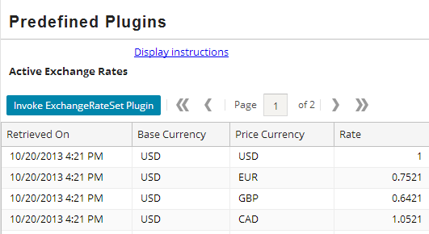
Use case: Exchange rate requirements
Create an exchange rate set that includes one exchange rate for every typekey currency
TrainingApp
  Predefined Plugins
  Click Invoke
  ExchangeRateSet
  Plugin
Interface to
implement:
  IExchangeRateSetPlugin
Methods to implement:
  createExchangeRateSet()
Notes:
In the ContactManager base application, exchange rates are not retrieved. By calling the gw.api.util.CurrencyUtil.invokeMarketExchangeRateSetPlugin() method in Gosu code, you can trigger the plugin.
In ClaimCenter, you can trigger exchange rate retrieval both manually and through the exchange rate batch process. PolicyCenter and BillingCenter do not currently make use of exchange rates.

Slide 12
Use case: Exchange rate calculation
$
1.301
€
€
0.769
$
ExchangeRate
Plugin
TrainingApp supports multiple currencies and needs to be able to convert values from one currency to another
Exchange rates are retrieved through a plugin
Notes:
Every predefined plugin meets a specific business need and therefore has unique business-specific issues tied to it. The focus of this lesson is the implementation work common to all plugins. Therefore, the remainder of this lesson focuses on TrainingApp's exchange rate plugin, a plugin used to support currency conversion. This plugin has been chosen because the business issues are straight-forward and the discussion can focus on the plugin technology itself.
The more commonly implemented plugins involve additional concerns. Some of these plugins and their issues are discussed in later lessons. (For example, the "Authentication Integration" lesson discusses the authentication plugin and the mechanics of authentication.)

Slide 13
Overview of Guidewire plugins
Gosu plugins
Plugin parameters plugins

Slide 14
Steps to implement Gosu plugins
Determine plugin requirements
Write plugin class in Guidewire Studio
Create or modify and then configure the
plugin registry file
Deploy the changes
Notes:
Guidewire recommends all new plugins be written in Gosu whenever possible.

Slide 15
Step 1: Gosu plugin requirements
What interface(s) must the plugin implement?
What methods are included in the interface(s)?
When are the methods called?
What issues should you consider
when implementing the plugin?
Does the plugin reference third party JARs?
Resources to consult:
  Integration Guide
  Gosu API and docs
Notes:
The Integration Guide for each product describes all the plugins in the plugin overview chapter. In some cases, there are numerous issues around a given plugin, and therefore an entire chapter in the documentation is devoted to it.

Slide 16
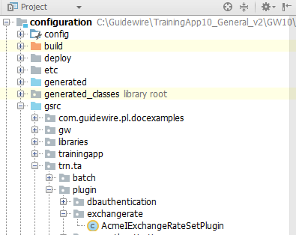
Step 2a: Create the plugin class
Create Gosu plugin class in a package
located in \gsrc
Use a package naming convention recommendation
  <company>.<app_code>.plugin.<functional_area>
Use plugin naming convention recommendation
  <meaningfulName><interfaceImplemented>
Notes:
Packages
To create a new package, right-click the parent and select New → Package. Then, provide a name for the package. You can development multiple packages at once by using dot notation.
Do not create your own plugins within the built-in gw.* package hierarchy or the plugins.* package hierarchy in Studio. These packages have special functionality reserved for the Guidewire application.
Classes
When you are using Studio to create your new class, create it within a root package that you created.
To create a new class, right-click the parent package and select New → Gosu Class. Then, provide a name for the class. Studio automatically creates a shell class for you, including a construct method. Many plugins do not require a construct method. For these plugins, it can be omitted.

Slide 17

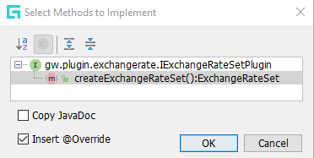
Step 2b: Implement required interface(s)
1 package acme.ta.plugin.exchangerate
2
3 uses gw.plugin.exchangerate.IExchangeRateSetPlugin
4
5 class AcmeIExchangeRateSetPlugin implements
IExchangeRateSetPlugin {
6 override function createExchangeRateSet(): ExchangeRateSet {
7 return null
8 }
9 }
Implement the interface
ALT+ENTER (1) to
import the class
ALT+ENTER (2) to
implement methods
Notes:
Recall that the first step of plugin implementation is to determine the plugin requirements. This includes the name of the interface to implement, which can be determined from either the Integration Guide or the Java API Reference.
A plugin class can implement one or more interfaces. You must manually type in the implements keyword and the name of the appropriate interface. To implement multiple interfaces, list each interface after the implements keyword and separate interfaces with a comma.
Next, click the interface name and press ALT+ENTER. The first ALT+ENTER adds a uses statement to the class that references the interface as in Line 3. The second ALT+ENTER adds stubs for all methods that need to be declared in the plugin (lines 6-8).

Slide 18
Step 2c: Replace method stubs with code
6 override function createExchangeRateSet(): ExchangeRateSet {
7 // Create and initialize new exchange rate set
…9 var erSet = new ExchangeRateSet()
10 erSet.Name = "Acme ExchangeRateSet " + DateUtil.currentDate()
12 erSet.MarketRates = true
13 erSet.EffectiveDate = currentDate()
…36 return erSet
37 }
Every public method from the interface must exist
Some methods can be left as stubs that do nothing
If needed, create private methods within the plugin
From public methods, call private methods
Notes:
For some plugins, you do not need to override the interface methods. If the method does not return a value, set a property, or call an internal method, you can leave it as it is.
For any plugin, you can create and call additional (non-public) methods. For example, an exchange rate plugin might have a private extractRate method which communicates to a web service to both submit and receive values.

Slide 19
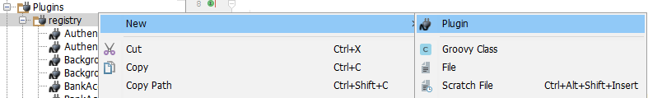
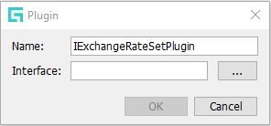
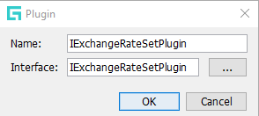
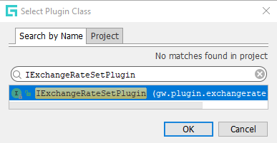
Step 3a: Create the plugin registry file
Registry → New → Plugin
Specify name and select interface
In many cases, the plugin definition ALREADY exists in the project and it is NOT necessary to create a new plugin file!
Notes:
In the Project view, select the registry folder. The path is …\config\plugin\registry. Right click to open the context menu and select New → Plugin. In the Plugin dialog, specify the name of the new plugin registry file. Next, click the ellipse button to select the interface. In the Select Plugin Class dialog, select the required class.
In many cases, the plugin definition already exists in the project and it is not necessary to create a new plugin file!
Each plugin registry is a .gwp file that is in XML document. All plugin files are created in <install>\modules\configuration\config\plugin\registry.
Regular plugins must be named after the plugin interface. The plugin name and the plugin interface name must be identical for all plugins other than startable or multi-instance plugins.

Slide 20
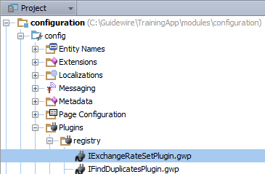
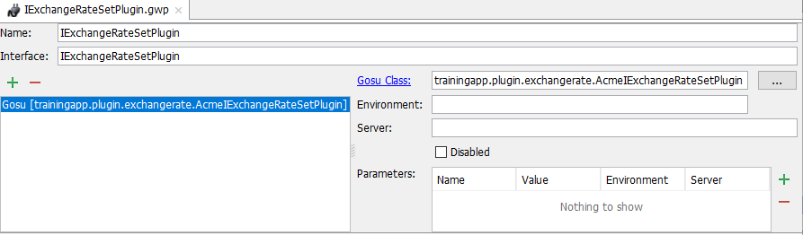

Step 3b: Configure the registry file
In Project View, open .gwp
Plugin Editor
  Add Plugin type
  Specify class
  Mark enabled
  Define parameters
1
2
3
4
Notes:
In the slide example, the IExchangeRateSetPlugin is a Gosu plugin. To change the plugin type, first remove the existing plugin reference (click -) and then add a new plugin type (click +) .
Guidewire only reads the files in the plugin registry at server startup. To deploy changes to registry entries, you must restart the server.
For predefined plugins, a given registry file can point to only one class at a time. There can be multiple entries for startable and messaging plugins.

Slide 21
Step 4: Deploy plugin and code
Restart Server
Make Project or
Reload Changed Classes
New Gosu plugin class
New or modified
  Plugin registry file
Modified Gosu plugin class
GWP
Gosu Plugin Class
Plugin
File
Modified
Gosu Class
Notes:
Guidewire only reads the contents plugin registry directory at server startup. You must restart the server when you create or modify plugin registry files.
You must restart the server when you create a new Gosu plugin class. For modified Gosu plugin classes, you can Make Project or Reload Changed classes.
You can restart the server from Studio by stopping a running server (debug mode is ok) and after the server stops, then running the server again in either Run or Debug mode.

Slide 22
Overview of Guidewire plugins
Gosu plugins
Plugin parameters plugins

Slide 23
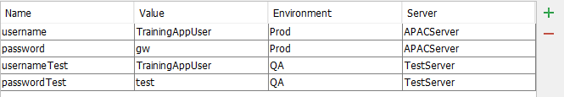
Plugin Parameters
Specify values that can be passed into a plugin at the registry level
Useful for varying plugin behavior without changing the plugin code itself
Example:
  Testing environment compared to a production environment
Plugin class must implement InitializablePlugin interface and setParameters() method
Notes:
Plugin parameters can be useful in the following situations:
You want a single plugin implementation to have different behavior over time (such as changing the user name or password needed to access a remote system).
You want a single plugin implementation to have different behavior in a development environment compared to a production environment.
You want a single plugin implementation to have different behavior on different servers in a clustered environment.

Slide 24
Reading plugin parameters
1 package acme.ta.plugin.exchangerate
2
3 uses gw.api.system.database.SequenceUtil
4 uses gw.plugin.InitializablePlugin
5 uses gw.plugin.exchangerate.IExchangeRateSetPlugin
…7 uses java.util.Map
8
…13 class AcmeIExchangeRateSetPluginWithParameters implements
IExchangeRateSetPlugin, InitializablePlugin {
14 override function createExchangeRateSet():ExchangeRateSet {
…40 }
43 override function setParameters(parameters:Map<Object,Object>) {
44 var userName = parameters.get("username")
45 var password = parameters.get("password")
46 print("Retrieving currency rates as "
+ userName + " with password " + password)
47 }
Notes:
In the slide example, the AcmeIExchangeRatePluginWithParameters class is available in TrainingApp, but its implementation is not.
To make use of plugin parameters, the plugin must implement the InitializablePlugin interface and implement the setParameters method.
The input for this method is a Map object that contains name/value pairs representing the names and values passed in from the plugin registry's Parameters table. The setParameters method is called only once, before the first use of the plugin.

Slide 25
  Describe the basic functionality of Guidewire plugins
  Determine the methods needed for a given predefined plugin
  Write predefined plugins in Gosu
  Register and deploy plugins

Slide 26
DEMO

Slide 27
The video demonstrates creating a plugin that retrieves exchange rate values from an external system that requires authentication.
Pre-Requisites
  Training App and Studio
  External App
  Supported Browser

Slide 28
LAB

Slide 29
Complete the exercises listed in “Plugins Predefined” chapter in the “InsuranceSuite 10 Integration: Kickstart “ work book

Slide 30
Identify if each statement is true or false.
  Plugins implement methods that are called by internal code.
  Plugins must be written in Gosu.
  A plugin class must contain a predetermined set of methods based on the business need it serves.
  Plugins are used exclusively for external application integration.
What is the purpose of a plugin registry entry?
Do you need to restart the server when you:
  Modify code in an existing Gosu plugin?
  Modify a plugin registry entry?
Notes:
Answers
1a) True
1b) False (Guidewire recommends that they be written in Gosu, but they can be written in Java.)
1c) True
1d) False (They are also used to execute tasks exclusively within the Guidewire application.)
2) The plugin registry entry identifies the plugin class to use for a given set of internally called methods and initialization parameters that may be used to affect the plugin's behavior
3a) No, you do not to restart the server when you make changes to a top level Gosu plugin class. However, you need recompile the class or make the project.
3b) Yes, you need to restart the server when change a plugin registry entry because plugin registry entries are initialized only during the server application start-up.

