Slide 1

InsuranceSuite 10 Integration
InsuranceSuite 10 Fundamentals
MESSAGING INTRODUCTION

Slide 2
  Recall the basic components of Guidewire messaging
  Describe the basic stages of Guidewire messaging

Slide 3
Overview of messaging
Walkthrough of a sample message

Slide 4
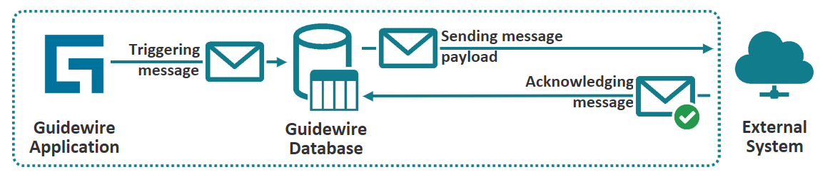
What is Guidewire Messaging
Guidewire Messaging is an asynchronous integration mechanism
  Event Based Model
    Predefined and custom events raised by new or changed business data
      Part of the user interaction
    Events are evaluated and processed in the Event Fired ruleset
      Message is created and persisted in the Guidewire database
Message are sent from Guidewire Application to an external System
An External System acknowledges receipt and processing of the message (either positively or negatively)
Notes:
The overall architecture of Guidewire messaging is asynchronous. It is possible for an outbound message to be sent to an external system synchronously or asynchronously, depending on the delivery mechanism supported by external system. However, typically the messages are not processed immediately upon being placed in the message table. Therefore, since the acknowledging message processing aspect is asynchronous, the overall architecture is considered asynchronous.

Slide 5
Physical message table
xx_message
Stores messages
  Unsent messages
  Sent and awaiting acknowledgement
  Retryable Error
XX_MESSAGE
  Hub of messaging infrastructure
  Database table where XX is application code, e.g., AB_MESSAGE
Notes:
The message table has a prefix (represented above by "xx_") that varies with each application. For TrainingApp, which is based on ContactCenter, the message physical table is named ab_message in the database.
An exception in the initial sending of the message throws an error. An error can also occur in the external system that the message is being sent to. In either case, Guidewire reports an error with the message. Guidewire will always retries to resend the message with an error. The message status is Retryable Error. Later lessons discuss how to configure the resending of a message.

Slide 6
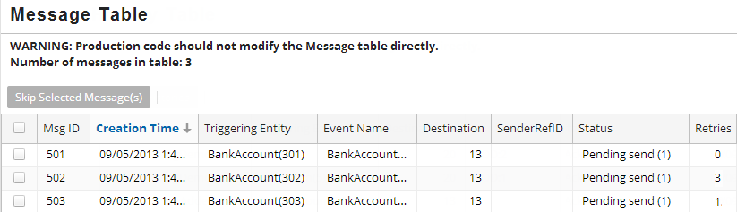
Message table example
Shows the sent and awaiting acknowledgement messages
  Message Table list view details messages in the message table
  TrainingApp's Administration tab
Notes:
Almost all of the screens in the "Training: Messaging" location group (including the Message Table screen shown above) are unique to TrainingApp and have been created for instructional purposes only. The genuine Guidewire applications provide an "Event Messages" administration screen. This screen is discussed in the "Sending Messages" and "Acknowledging Messages" lessons.

Slide 7
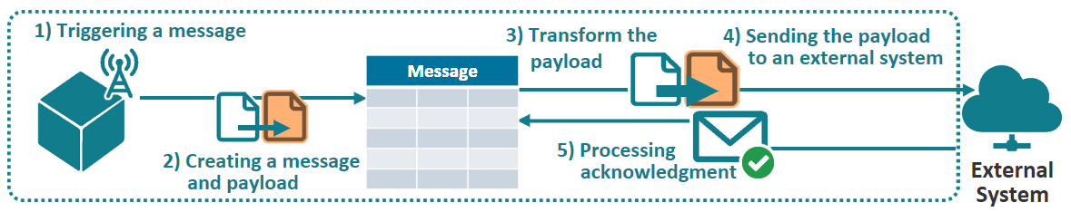
Stages of messaging
  Triggering a message
    Newly created or modified entity triggers message creation
  Creating a message and payload
    Application creates message and the payload and stores in message table
  Transform the payload
    Optional
  Sending the payload to an external system
    Application checks message table for messages to process and sends payload
  Processing acknowledgement
    External system acknowledges success or reports an error
    Application processes the received response
Notes:
Technically speaking, message creation is triggered by adding an event to an event-aware entity. This almost always involves a data change, though it isn't a requirement.
A positive acknowledgement means that the message was successfully received and processed by the external system.
A negative acknowledgement means that the message was received, but some type of error occurred and the message was not processed. (In some cases, the integration code will attempt to resend the message. In other cases, the message must be addressed manually.)

Slide 8
Primary components of messaging (1)
Event
  An notification of a change
  May be of interest to an external system
  Triggers Event Fired rule set
Event Fired rule set
  Called for each messaging event
  Generates message payload
  Creates message
Message Payload
  Formatted string such as CSV, XML,
  or JSON
Message
  Information, including payload, to send to an external system in response to an event
EventAware EntityAdded
Notes:
Messaging is accomplished using a variety of Guidewire components. The primary components have been listed above, but the list is not exhaustive.

Slide 9
Primary components of messaging (2)
Message table
  Unsent messages
  Sent messages awaiting acknowledgement
  Sent and acknowledged with an error messages
Destination
  Represents external system that receives sent messages
Messaging plugins
  Transform payload
  Sends the message
  Process synchronous and asynchronous responses from the external system
xx_message
Destination
ID = 20
Request
Plugin
Transport
Plugin
Reply
Plugin
Notes:
Other messaging components are discussed through the messaging section of the course, such as:
The MessageContext entity, which is used to simplify creation of the message.
Gosu templates, which are used to generated message payloads.
Guidewire XML models, which are used to generated message payloads.
Web services, which can be used to send messages to external systems or receive responses from them.

Slide 10
Overview of messaging
Walkthrough of a sample message

Slide 11
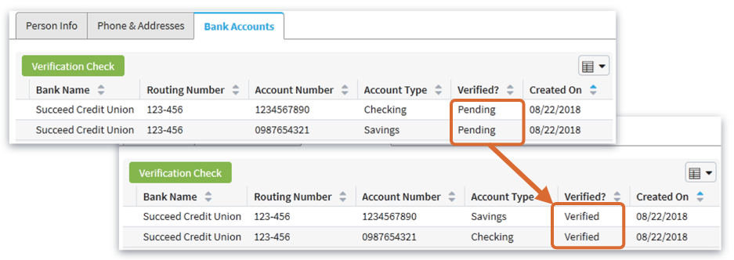
Use case: Bank account verification
Messaging process verifies bank account details
  Bank name, routing number, and account number
  New and modified accounts
Verified? shows messaging acknowledgment status
  Pending, Verified or Invalid
Notes:
When a new bank account is created, Acme wants to verify that the bank name, routing number, and account number reference a real bank account.

Slide 12
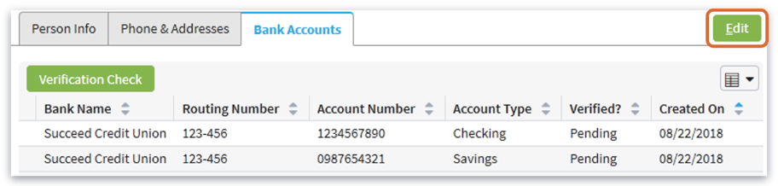
Stage 1: Triggering the message (1)
Pending
is
unverified
account
Event
  A notification of a change (add, update, remove)
  May trigger Event Fired rule set, if listened by destinations(s)
BankAccount is an EventAware entity
  Once a bank account is modified (created, changed, removed) an event is triggered
Notes:
BankAccount is an EventAware entity. The entity specifies an <events /> element in its definition which means that the BankAccount entity delegates to the EventAware delegate. A delegate is an entity associated with an implemented interface that multiple parent entities can reuse. The EventAware entity is an internal entity that implements the messaging interface.
For all entities that implement the EventAware delegate, the Guidewire application automatically creates specific events: entityNameChanged, entityNameRemoved, and entityNameAdded. The BankAccount entity implements the BankAccountChanged, BankAccountRemoved, and BankAccountAdded messaging events.
When a user clicks Update, each BankAccount in the ListView row triggers an event specific to each bank account entity instance. Newly added bank accounts trigger the BankAccountAdded event. Modified bank accounts trigger the BankAccountChanged event. Removed bank accounts trigger the BankAccountRemoved event.
A messaging destination represents external system used to reply with a response to sent messages. Bank Account Verification is messaging destination that subscribes to the BankAccountAdded and BankAccountChanged events. In other words, the Bank Account Verification messaging destination listens for when user creates a bank account and when a user edits a bank account.

Slide 13
Stage 1: Triggering the message (2)
Messaging destination listens to specific events
  Subscribes to BankAccountAdded and BankAccountChanged events
  Represents an external system used to reply to sent messages

Slide 14
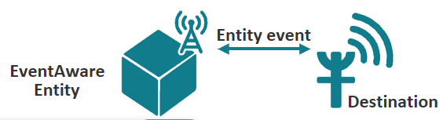
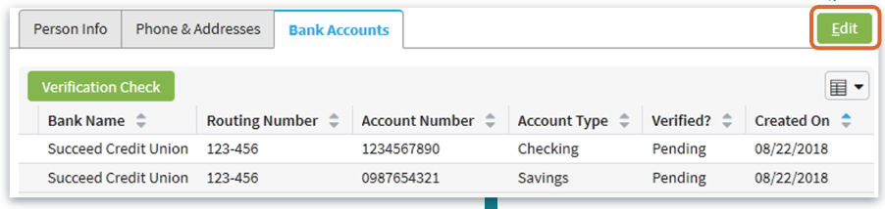
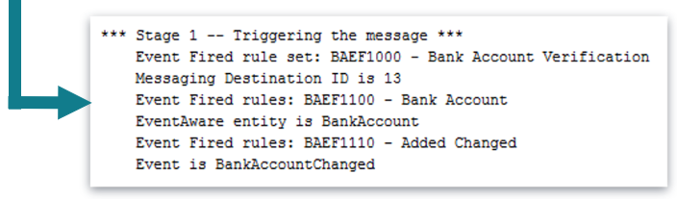
Stage 1: Triggering the message (3)
Console output details
  Messaging Destination ID is 13
  EventAware entity is BankAccount
  Event is BankAccountChanged
Notes:
When a user clicks Update, each modified BankAccount row in ListView triggers an event specific to each bank account entity instance. Newly added bank accounts trigger the BankAccountAddedEvent. Modified bank accounts trigger the BankAccountChaned event. Removed bank accounts trigger the BankAccountRemoved event.

Slide 15
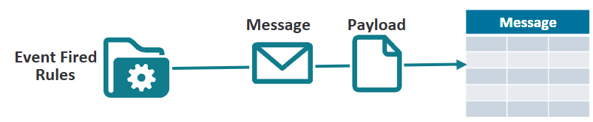
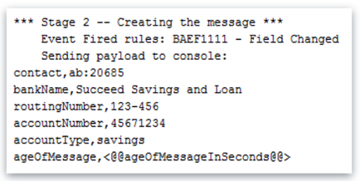
Stage 2: Creating a message and payload
Event Fired rule set
  Called for each destination-subscribed messaging event
  Generate a new message and payload
Message payload
  Formatted string, such as text, xml or JSON
Message database table
  Hub of messaging infrastructure that provides persistent storage for messages with following status:
    Unsent (new)
    Sent and awaiting acknowledgement (pending)
    Retryable Error (errored)
Notes:
When the application triggers a subscribed-to messaging event (listened for by a destination), the application calls the Event Fired rule set.
An event fired rule set defines a specific root entity as the entity that implements the event messaging interface.
The root entity differs from the Message entity. The distinction is important to understand. The root entity represents the instance of the entity that fired the event, in this case, an instance of a BankAccount. The message represents an instance of the Message entity.
All instances of a message entity are stored in the message table. The Message entity has many fields. The field that stores the content of the message is the Payload field. The payload field is what the application sends to the messaging destination.
Payload generation is not reflected in the user interface.
The Event Fired rule creates message payload and message that is associated with the root entity and the default root object is the entity instance that triggers the event. The message payload is text-base content regarding root object (typically). The message context assigns a root object for the message.

Slide 16
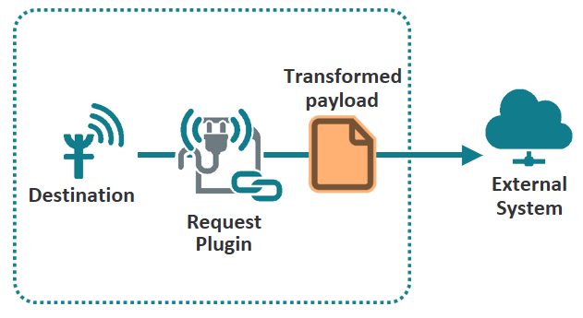
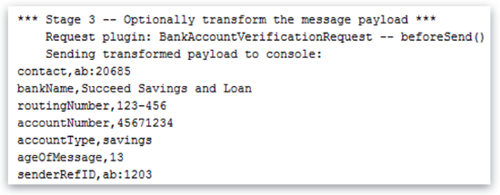
Stage 3: Transform the payload
Destination-specific messaging plugins send the message plugins process the outbound request messages
  Request plugin
    Optional payload transformation

Slide 17
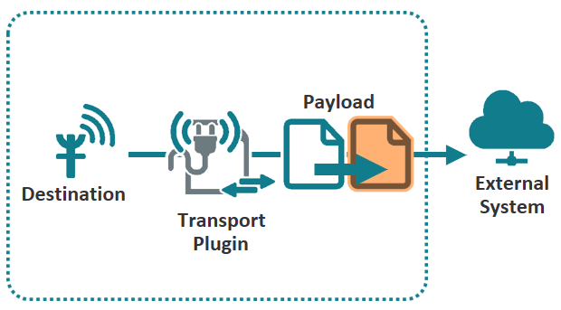
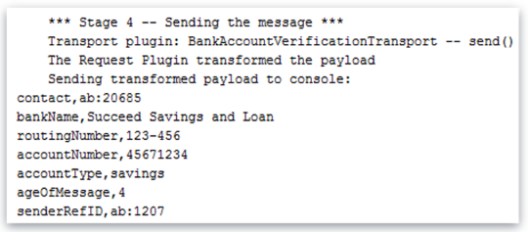
Stage 4: Sending the message to an external system
Destination-specific messaging plugins send the message plugins process the outbound request messages
  Transport plugin
    Sends the payload to the external system
    Either original payload or transformed payload
Notes:
If you create or change a bank account in TrainingApp and watch the console, you will see a short lag between the click of the Update button and the printing of the payload. This lag occurs because the message table is scanned for new messages only once every few seconds (polling frequency). In other words, the lag occurs because all message integration points are at least partially asynchronous.
A late binding value is a message payload value that can not be determined until right before the message is sent (send-time-only available data v. event-time data). Payload transformation is when the original payload is altered prior to sending the payload to the external system. Late binding is a form of payload transformation.

Slide 18
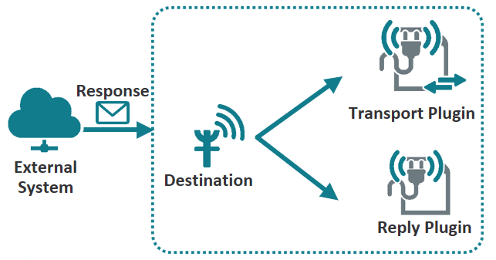
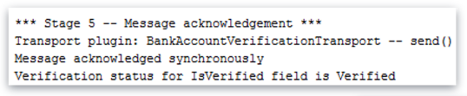
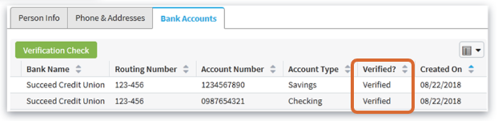
Stage 5: Processing acknowledgement
External system
  Receives sent message
  Sends back a response
Guidewire application receives a reply message
  Processed by transport plugin (synchronous)
  Processed by Reply plugin or API (asynchronous)
Response determines the Verified? Field value
  Verified or Invalid
Notes:
In TrainingApp, for contacts with newly added or changed bank accounts, you can see the results of message acknowledgement in the user interface when the “Verified?” value changes from Pending to Verified or Invalid.
A response is a reply from an external system that usually contains some additional data for the Guidewire application to process. Such a reply message may be received and handled by either the transport plugin or the reply plugin, or even a published web service API, depending on the reply message exchange protocol utilized.

Slide 19
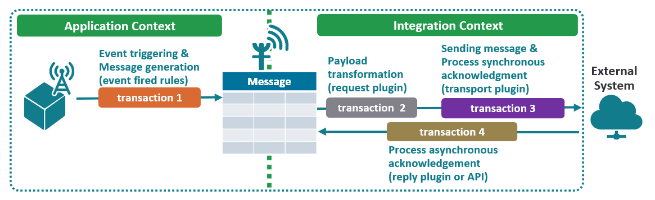
Guidewire servers and messaging transactions
Messaging is managed in multiple contexts
  The application context processes message creation (on server(s) with the “ui” role)
  All other work is done in the integration context (on server(s) with the “messaging” role)
Messaging occurs across multiple transactions
  If an exception is thrown, work in the current transaction is rolled back
Notes:
The servers involved at each point of the process are important because they determine where payload work should occur. The majority of payload generation should be done in Event Fired rules on the ui role server that manages the given user's session. However, if some portion of payload generation must be done immediately before the message is sent, that portion of the payload can be generated on the messaging role server.
A message is always processed in at least two and as many as four transactions:
* Transaction 1 —- Creates the message and generates the payload. This transaction always occurs.
* Transaction 2 — Prior to sending the message, an optional transaction may transform the message payload. This is usually done when the message must include information that can only be known immediately before sending the message.
* Transaction 3 – The sending of the message to the external system occurs in its own transaction. This transaction always occurs. If the external system acknowledges the message synchronously, then the acknowledgement is included in this transaction.
* Transaction 4 — If the external system acknowledges the message asynchronously, then a separate transaction processes the
acknowledgement. This transaction does not occur for messages that are acknowledged synchronously.
The transaction structure is important because this determines the work that is rolled back if an error occurs.
Message plugins
Request plugin
Handles payload transformation of an message about to be sent
Transport plugin
Sends the message
Process synchronous acknowledgment replies
Reply plugin
Processes asynchronous acknowledgment replies

Slide 20
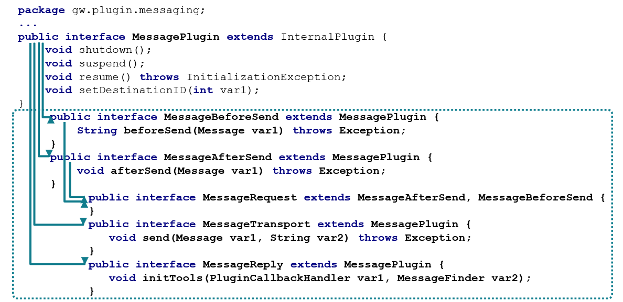
Message plugin interfaces
Notes:
gw.plugin.messaging.MessagePlugin - the base message plugin interface extended by all specialized message plugin interfaces
shutdown, suspend, resume, setDestinationID methods
These four methods are declared in the common MessagePlugin interface, which all specialized messaging plugin interfaces extend further more. In other words, every messaging plugin class must implement these either directly (or indirectly, e.g. inherited from a common messaging plugin implementation base class). The first three methods (shutdown/suspend/resume) provide the essential
control over a messaging plugin instance status (and ultimately a messaging destination), and are consumed either implicitly by the GW messaging framework when/as needed (app shutdown, failed send, unhandled exception, app startup) or explicitly by user actions via the messaging admin UI (suspend/resume).
The setDestinationID method is called by the GW application framework at the time a messaging plugin class is loaded/instantiated for a particular destination. This allows the initialized plugin class instance to preserve and later utilize/reference the actual destination ID for which this messaging plugin instance has been loaded (such as SenderReflD generating in the request plugin, or the reply plugin message finder API, logging in all of them etc.).

Slide 21
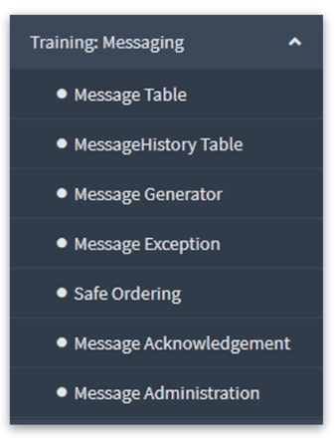
Training: Messaging
Available only in the TrainingApp application
  Administration tab → Training: Messaging
Message Table
  Shows pending send (unsent), pending acknowledgement (sent), and Retryable error (errored messages)
MessageHistory Table
  Shows acknowledged, duplicate, or errored messages
Message Administration
  A copy of the Message Queues screen found in all InsuranceSuite applications
Notes:
The screens in the Training: Messaging location group (including the Message Table screen shown above} are unique to the TrainingApp only and have been created for learning purposes only. The genuine Guidewire applications provide a Message Queues
administration screen (under the Monitoring location group).

Slide 22
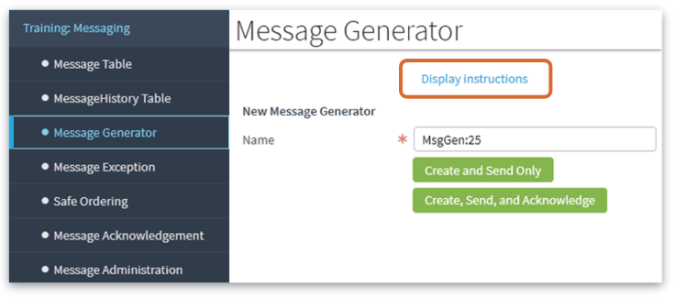
Training: Messaging – Demo Screens
Each demo screen has a Display instructions link
Message Generator
  Creates a new message for a given message reference ID
Message Exception
  Throws an exception for a given message reference ID
Message Acknowledgement
  Simulates message acknowledgement from an external system for a given message reference ID
Safe Ordering
  Lets you send multiple messages for the same entity for safe-order and non-safe-order entity
Notes:
The screens in the Training: Messaging location group (including the Message Table screen shown above} are unique to the TrainingApp only and have been created for learning purposes only. The genuine Guidewire applications provide a Message Queues
administration screen (under the Monitoring location group).

Slide 23
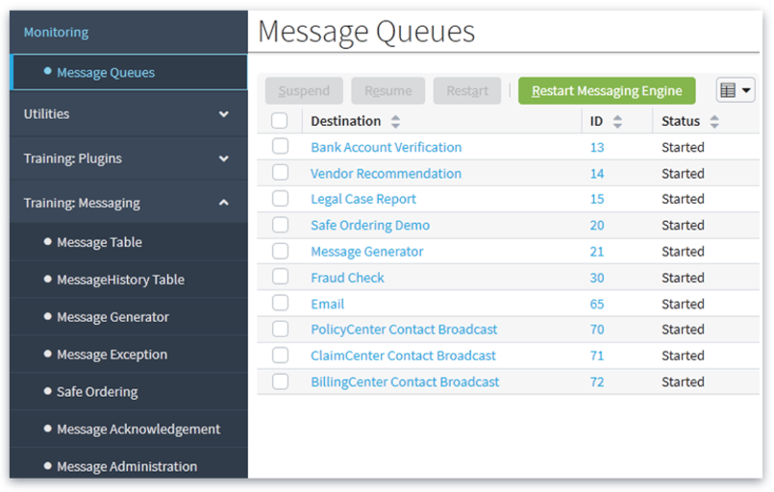
Message Queues
A series of drilldown screens for message administration
Administration tab
  Monitoring →Message Queues, or
  Training: Messaging → Message Administration
Suspend, resume, and view messages for each destination
Notes:
The Message Queues screen is available in all InsuranceSuite applications. The screens in the Training: Messaging location group (including the Message Table screen shown above) are unique to the TrainingApp only and have been created for learning purposes only.
From Message Queues, you can suspend, resume, and view messages for each destination
The Message Queues screens group all unacknowledged messages by:
Destination, then...
Primary entity (safe-ordering, plus one set for all unordered), then...
Status: failed, retryable error, in flight, and unsent

Slide 24
DEMO

Slide 25
The video demonstrates creating messages using messaging administration screens in Training App.
Pre-Requisites
  Training App and Studio
  Supported Browser

Slide 26
LAB

Slide 27
Complete the exercises listed in “Bundles and Database Transactions” chapter in the “InsuranceSuite 10 Integration: Kickstart “ work book

Slide 28
Review Question
What are the five stages of Guidewire messaging?
What are the three possible statuses for messages that are in the message table?
For a Guidewire implementation using clustering, what two server roles execute the work for messaging? What work is done by each server role?
Notes:
1. a) Triggering a message
1. b) Creating a message and payload
1. c) Optionally transform the payload
1. d) Sending the message to an external system
1. e) Processing message acknowledgement
2. a) Pending send.
2. b) Pending acknowledged (sent but no acknowledgement received).
2. c) Retryable error (sent and and error reported by external system, a negative acknowledgement or NACK).
3. The two clustering server roles are: the ui role and messaging role.

Slide 29
Lesson objectives review
You are now able to:
Understand the concept of Guidewire messaging
Identify the basic components of Guidewire messaging
Describe the basic stages of Guidewire messaging
Understand how to message administration screens

