Slide 1

InsuranceSuite 10 Integration
InsuranceSuite 10 Fundamentals
TRIGGERING MESSAGES

Slide 2
  Describe how event messages are triggered
  Create destinations and configure required fields
  Create messages in Event Fired rules
  Describe the role that message payloads play in messaging

Slide 3
Entities used to trigger messaging
Destinations
Event Fired rules

Slide 4
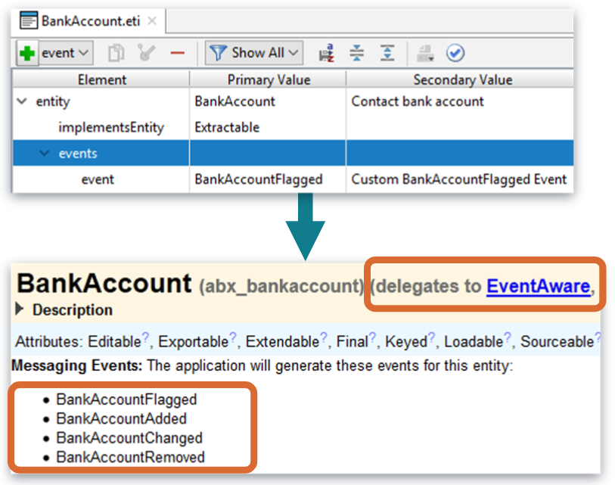
EventAware entity
An messaging event often occurs when adding, changing or removing an instance of an EventAware entity
An EventAware entity delegates to EventAware delegate
  Configured by adding the events Element to the entity
    Implements the default set of messaging events: Added, Changed and Removed
    Naming convention
      <EventAwareEntityName><ChangeType>
  Custom message events can be added
    Ex: Custom BankAccountFlagged message event added
Notes:
You can identify that an entity is EventAware by reviewing the entity in the Entity Editor in Guidewire Studio. You can also review the Data Dictionary to see the entity implements the EventAware delegate.

Slide 5
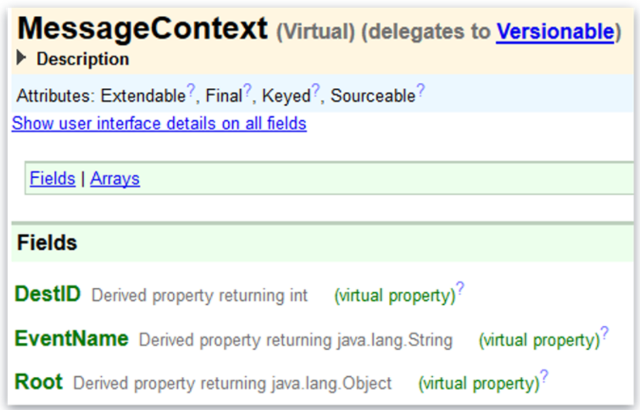
MessageContext entity
An internal, non-persistent, virtual entity
  Only used in Event Fired rules
Important fields
  DestID
    Identifies the subscribing destination
  EventName
    Identifies the name of the triggering event
  Root
    Can be used to reference data from the triggering entity
    Ex: messageContext.Root typeis BankAccount
Notes:
Event Fired rules depend on the message context object. You can access this object using the messageContext variable. The messageContext object contains information such as the event name, messaging destination ID, and the Root object. Event Fired rules often generate one or more messages, although the logic can omit creating messages as appropriate.

Slide 6
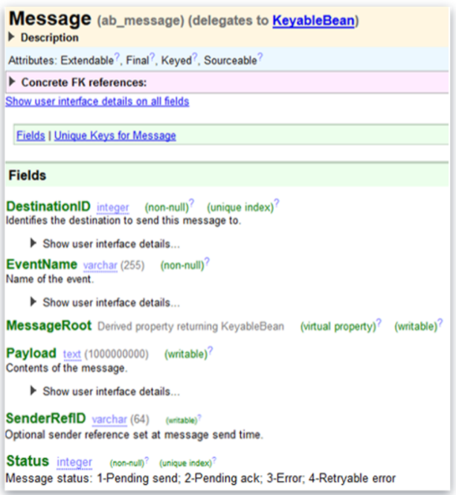
Message entity
An entity containing message details and payload to be sent to an external system
  DestinationID
    Identifies the subscribing destination
  EventName
    Identifies the name of the triggering event
  MessageRoot
    Is a pointer to the triggering event-aware entity instance
  Payload
    Holds the information to communicate
  SenderRefID
    Is a sender reference number typically set at message send time
  Status
    Message status pending and errored messages
Notes:
Avoid unnecessarily large or complex messages if possible. A message is information to send to an external system in response to an event.

Slide 7
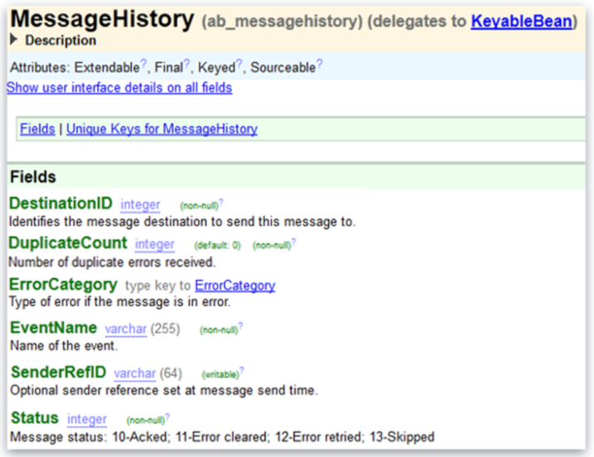
Message History entity
An entity containing message history details
  DestinationID
    Identifies the subscribing destination
  DuplicateCount
    Number of duplicate message acknowledgments
  ErrorCategory
    Type of message processing error
  EventName
    Identifies the name of the triggering event
  SenderRefID
    Is a sender reference number typically set at message send time
  Status
    Message status for acknowledged, skipped, or errored messages
Notes:
Avoid unnecessarily large or complex messages if possible. A message is information to send to an external system in response to an event.

Slide 8
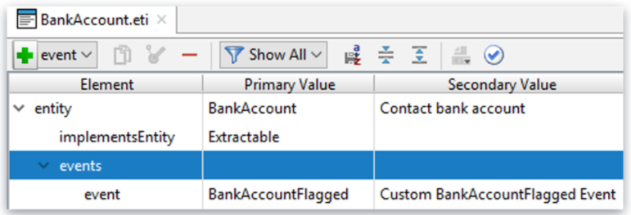
Triggering custom message events
Useful when messaging must be initiated by something that cannot be captured in a standard(built-in) message event
Syntax
  eventAwareEntityInstance.addEvent(“CustomEventName”)
    Only for EventAware entity
    Triggered manually in code
  Ex: aBankAccount.addEvent(“BankAccountFlagged”)
Notes:
Custom events provide additional flexibility in the messaging architecture. Sometimes, you may want to trigger a message event in a context where an EventAware object hasn't necessarily been created or changed. For example, you may want to provide the user with the ability to trigger messaging by clicking a button on the user interface. In some cases, you want to group messaging logic at a more granular level than EntityChanged.
There may be significantly different messaging requirements for a Request entity that is approved as opposed to one that is denied. In other cases, you may want to send another message event during the processing of a message acknowledgement. Message events cannot be triggered for non-EventAware entities.

Slide 9
Entities used to trigger messaging
Destinations
Event Fired rules

Slide 10
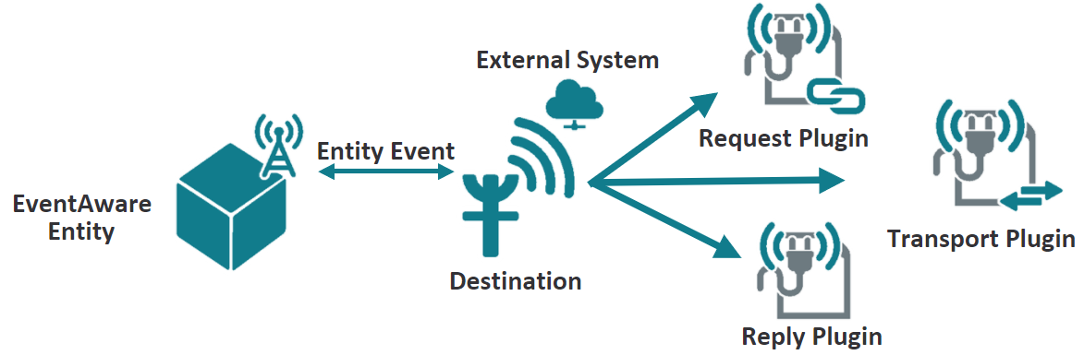
Destination
A message destination is an abstraction of an external system
  Subscribes to message events of interest
  Defines list of message plugins used in processing outbound request messages and received inbound replies
  Defines connectivity, retryable error parameters, predictable message ordering, multithreading and distributed actions
Notes:
Each Guidewire message is sent to a single destination only. If there is a situation where multiple external systems need to receive the same information in response to a single event, then the Event Fired rules should create multiple messages, one for each destination of interest. (The term "multicasting" means that the same message is sent simultaneously to multiple receivers. Guidewire message does not make use of multicasting.)
Every message should receive a response. The response indicates to Guidewire that the message has been successfully processed. In some cases, the response comes immediately upon sending the message and simply indicates the message was successfully consumed. In other cases, the response comes sometime after the message is sent. The response can also contain data from the external system (such as a verification code or a report).
The mechanism for the external system response depends on if the message is synchronous or asynchronous. For synchronous replies, often the message transport plugin is the reply mechanism. For asynchronous replies, often a Guidewire Application published web service or a message reply plugin is the reply mechanism.

Slide 11
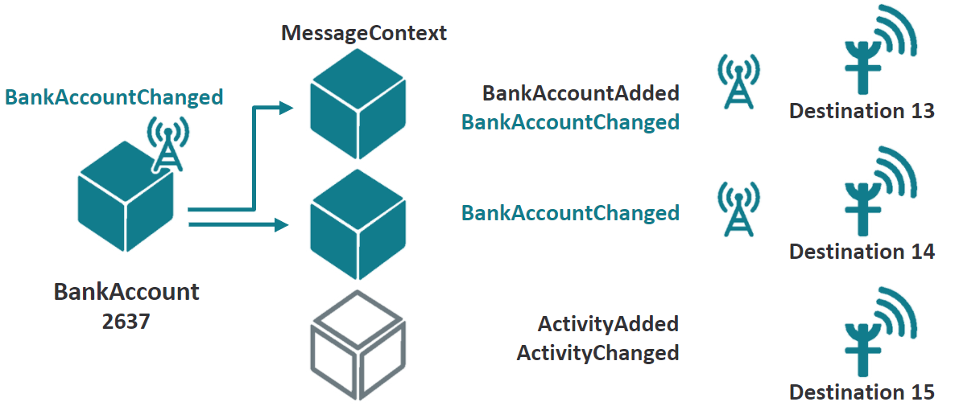
Destination message events
Messaging destination subscribes to one or more specific message events
When a message event occurs:
  One MessageContext instance is created for each destination that listens to that event
  Each MessageContext is then processed by the event fired business rules
Notes:
In the example above, BankAccount 2637 is an instance of BankAccount, an event-aware entity. There are also three destinations. Destinations 13 and 14 listen for the BankAccountChanged event. Destination 15 does not. When BankAccount 2637 changes, a MessageContext object is created for destination 13 and destination 14. But because destination 15 does not listen for BankAccountChanged events, no MessageContext is created for BankAccount 2637.

Slide 12
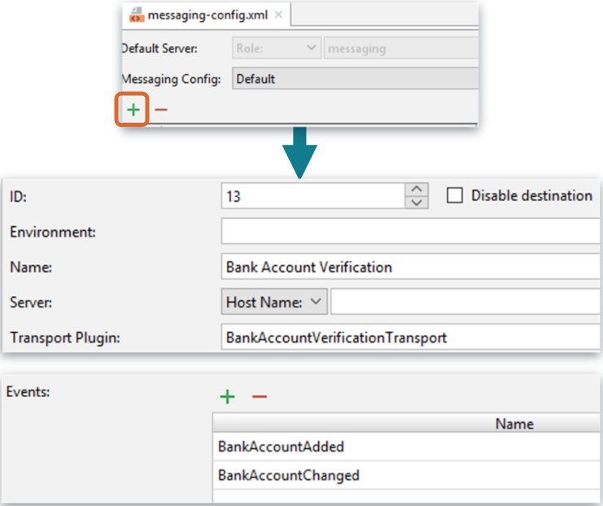
Defining a messaging destination
Destinations are defined in the messaging-config.xml file
  Under configuration.config.Messaging
To create a new destination, click the plus symbol and define the required fields
  ID: unique ID value from 0 to 63
  Name: unique name displayed in the UI messaging administration screen
  Transport Plugin: sends message to external systems
    Discussed in sending messages lesson
  Events: subscribed messaging events
Notes:
The message ID must be an integer from 0 to 63, inclusive. Values greater than 63 are reserved by Guidewire. The message destination can specify up to three messaging plugins: message transport plugin, message request plugin, and message reply plugin.
The message transport plugin is responsible for sending your message to the external system. The nature of this plugin will vary depending on the external system and/or the technology used to communicate to the external system (such as a JMS queue, a web service request to an external system, or an FTP call). Every destination must provide a message transport plugin implementation, but multiple destinations can use the same implementation.
The message request plugin transforms a message's payload immediately before sending it. For example, two messages might be sent from a single event, but data received in a reply to the first message (such as an external identification code) might need to be included in the second. Because this identifier is not known at the time the message payloads are initially created, the request plugin is needed to transform the payload of the second message. If a given destination requires no payload transformation, then this plugin is not implemented.
The message reply plugin initializes a listener queue and associates it with the destination. This plugin is used for destinations that receive asynchronous replies via a listener queue. If a given destination does not reply asynchronously (or it does reply asynchronously, but the replies are received through some other mechanism, such as a web service), then this plugin is not implemented.

Slide 13
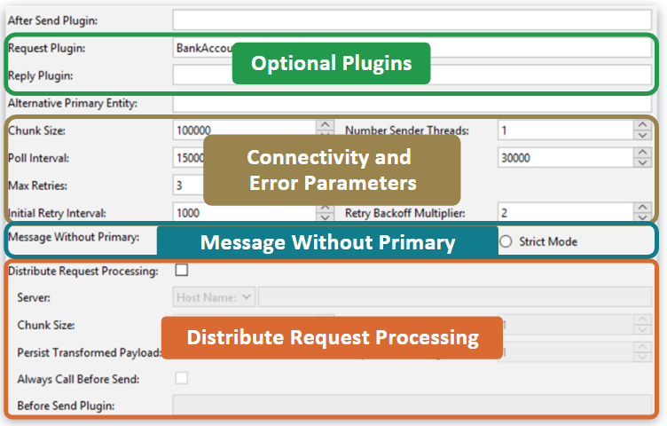
Other messaging destination parameters
Optional Plugins
  Request plugin is discussed in the Message Payload Transformation lesson
  Reply plugin is discussed in the Asynchronous Message Acknowledgements lesson
Connectivity and error parameters
  Discussed in the Sending Messages lesson
Message without primary
  Discussed in the Sending Messages lesson
Distribute Request Processing
  Discussed in documentation
Notes:
For messaging plugins, you can implement any number of MessageRequest, MessageTransport, and MessageReply plugins, though each destination can use at most one of each type. Every destination can use only one message reply plugin. However, a given message reply plugin class can be used by multiple destinations.
The strings in the Events list are regex patterns. For example, if the Events list included the string "BankAccount", then the destination would listen for "BankAccountAdded", "BankAccountChanged", and "BankAccountRemoved". In practice, though, it is best to explicitly list all the events a destination listens to.
Developers must be careful to spell the regex patterns in the Events list correctly, as the destination will not work as expected if they are spelled incorrectly. For example, a destination that listens for "BankAccountChanged" will not respond to a BankAccountChanged message event.
You can have multiple sender threads for a single destination, which allows multithreaded access to the plugins and potentially better performance when sending messages. Multiple sender threads are meant primarily to accommodate destinations that use synchronous web service calls and other synchronous remote calls, which are stateless. If you choose to assign multiple sender threads, be careful that your plugins are actually thread safe (for example, sharing a JMS Session across threads would NOT be thread safe) and that the resulting higher load on the reply plugin (if used) is acceptable. Do NOT set the sender threads value above 1 for destinations using transport or request plugins that are not thread safe. Such thread safety is often dependent on the external system itself being able to handle multithreaded communications properly.
The Enabled checkbox controls whether the Event Fired rules are run for a destination.

Slide 14
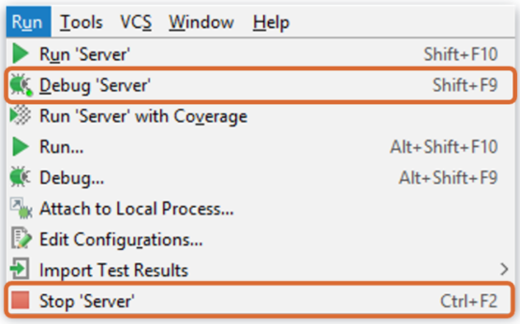
Deploy code changes
Restart Server
Any new or modified destinations
  Read only at server startup

Slide 15
Entities used to trigger messaging
Destinations
Event Fired rules

Slide 16
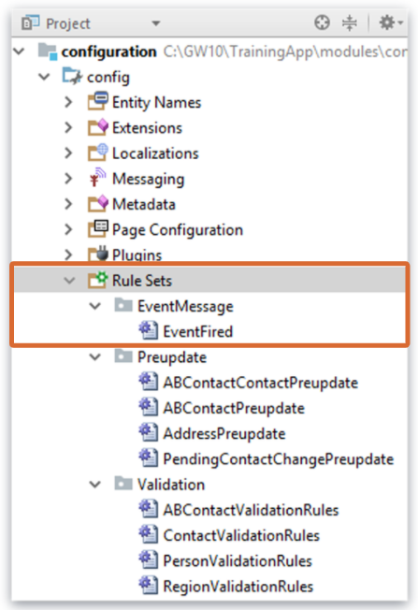
Guidewire business rules
A business rule written in Gosu accomplishes some task for a given entity
Three base types of rule set categories in TrainingApp
  EventMessage
    One rule set called EventFired
      Root entity is MessageContext
    Rules execute when an integration event is triggered
  Preupdate
    Four rule sets
    Rules execute when an update has occurred on a root entity
  Validation
    Four rule sets
    Rules check for missing information or invalid data on a root entity
Notes:
Business rules are covered in the Business Rules lesson in Configuration Fundamentals. Your instructor may discuss this and the next slide in detail or skip over them depending on whether that lesson was covered in your delivery of the Configuration Fundamentals course.
Setting a rule condition to true means that the action will always be performed whenever the rule is evaluated.
Notice that there is no condition test. It is implied. The only valid condition is a Boolean expression.

Slide 17
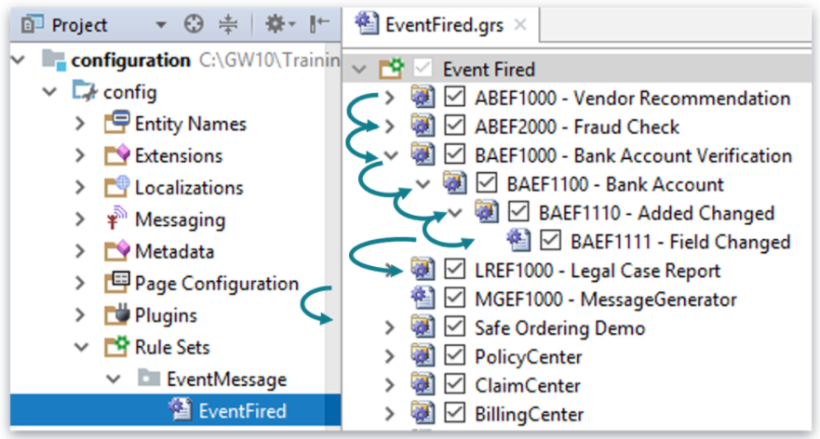
Rule set execution
Rule execution follows the order listed in Studio
Per node, rules execute in a hierarchy
Rule condition code resolves to true or false
  When condition is true, rule action code executes, and
  Child rules execute (if any)
Notes:
If a rule has child rules and the parent rule condition is false, neither the parent action nor the child rules are executed.
All top-level rules in a rule set are executed unless an explicit "exit" is encountered.

Slide 18
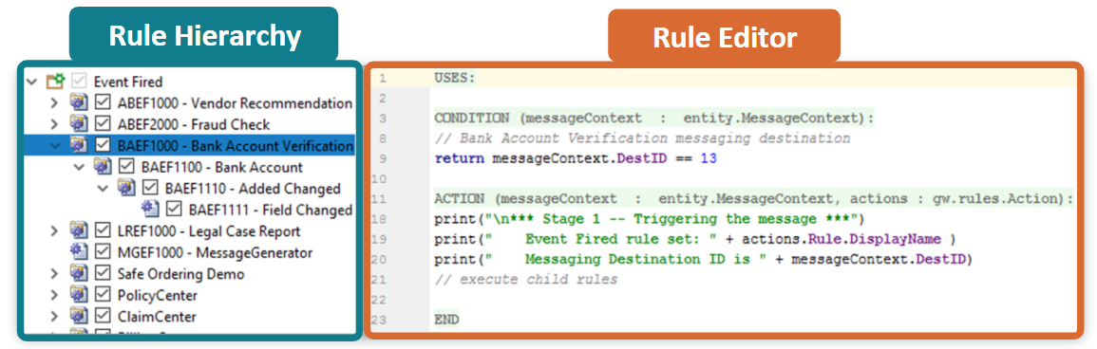
Rule set editor
Rule Hierarchy
  Context menu
  Activate/Deactivate checkbox
  Drag-and-drop ordering
Rule Editor
  Overlays segment Uses, Condition, and Action
IMPORTANT
  Do NOT delete keyword return in condition
Notes:
You can think of a rule set as a logical grouping of rules that are specific to a business function. You typically organize these rules sets into a hierarchy that fits your business model. Guidewire strongly recommends that you implement a rule-naming scheme that is hierarchal in nature. A hierarchal naming convention will reflect the hierarchal structure when you create rules and organize rules into a hierarchy. However, the naming scheme for rules corresponds to the file structure on disk. So, if it has too many levels customers can run into problems with file names being too long on Windows.
A rule set combines many individual rules into a useful set to consider as a group. A rule set is a collection of rules that share the same root entity and share common triggers. In the example above, the rule set is Event Fired.grs. Selecting the rule set in the editor displays the rule set description and details the root entity. In this example, the root entity is entity.MessageContext.
In a rule set, a Guidewire application evaluates the individual rules recursively in the hierarchy, unless an exit action is encountered. The process starts with the first direct child of the root and then evaluates all children and siblings. All rules in a rule set are processed unless an explicit "exit" is encountered.
Individual rule files have the file extension .gr. For each rule, there is a condition and action. The Rule Editor provides overlays to segment the condition and action. When a rule condition evaluates to true, the Guidewire application executes the rule action.
An inactive rule is not executed. You can activate and deactivate rules to get the rules engine to selective process and ignore rules. To deactivate a rule, disable the check box that appears to the left of the rule name. Inactive rules appear in gray. To reactivate the rule, enable the check box. To delete or rename a rule, right-click the rule and select the appropriate command from the context menu.

Slide 19
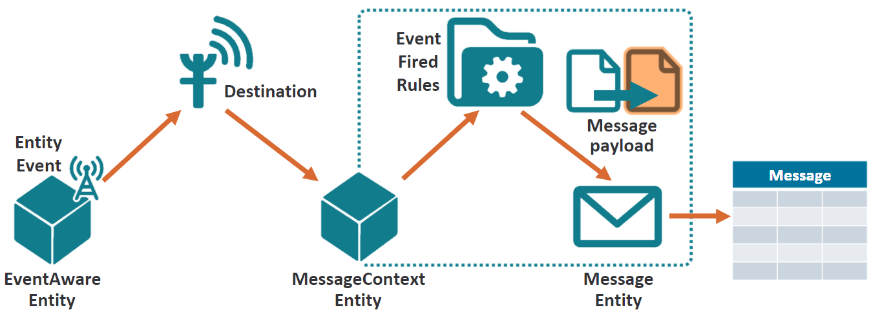
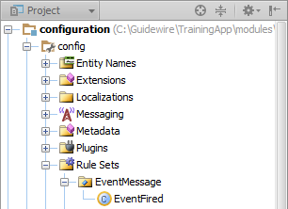
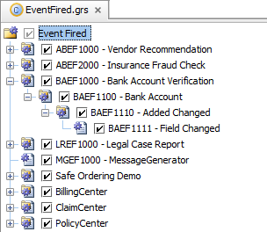
Event Fired rule set
Creates message and payload
  The payload typically
    Contains static and/or dynamically generated data
    Is formatted based on the needs of external system
Notes:
The top-level Event Fired rule conditions are checked for every entity-event/destination combination. For example, if seven destinations listen to a given event, and you have 20 Event Fired rules, then every time the event is fired, 140 checks need to be made. Thus, it is critical to keep your Event Fired rules organized to avoid duplicate checks.

Slide 20
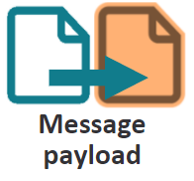
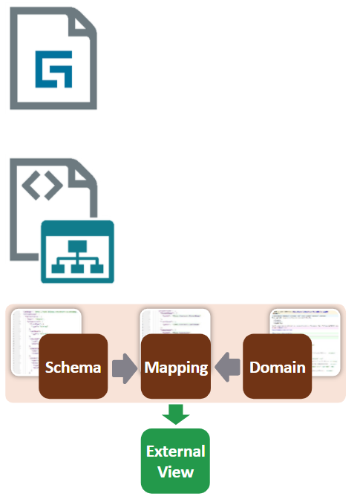
Common options for generating message payloads
Gosu template
  Formatted strings with entity data
XML modeler
  Strongly typed XML with XSD validation
  Supports object graph
Integration View
  JSON
  Strongly typed XML with XSD validation

Slide 21
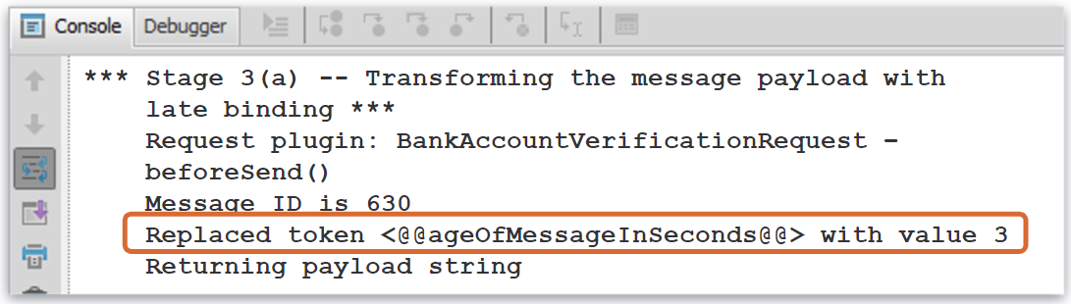
Late binding in the payload
A late binding value is a message payload value that cannot be determined until right before the message is sent
  Use placeholders (tokens) during payload generation in the Event Fired business rules action logic (event-time)
Message Request plugin (send-time) may search for and replace such late binding tokens with the data values immediately before the message is sent out

Slide 22
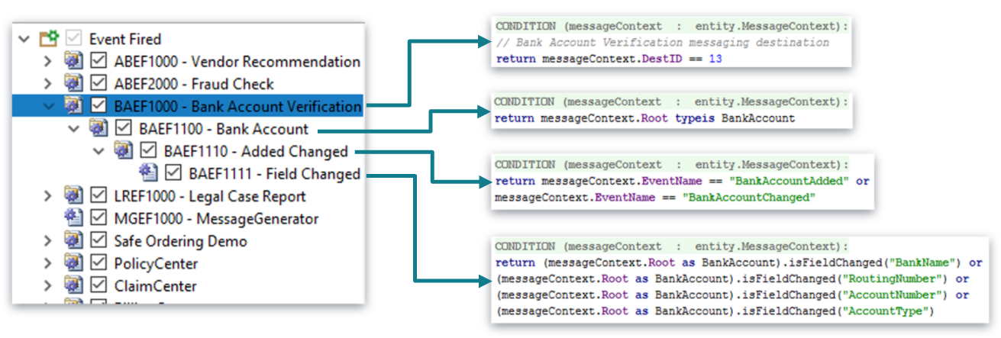
Event Fired rule set hierarchy structure
Create a rule hierarchy to filter MessageContext objects
  First, by destination ID...
  Then, by root entity type...
  Then, by event name...
  Finally, by any other relevant logic, such as fields of interest changed
Notes:
Every MessageContext is processed by the entire Event Fired rule set. However, each is typically of interest to a small subset of rules. Therefore, you should create a hierarchy to filter MessageContexts whenever possible.

Slide 23
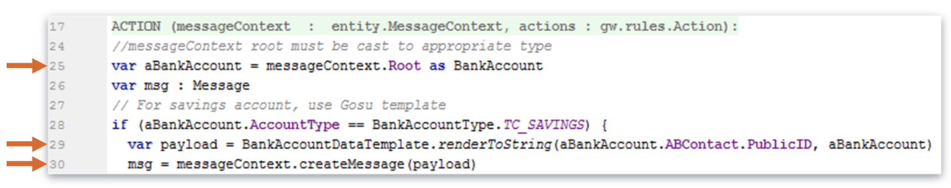
Creating a message from MessageContexts
Be extremely careful about modifying entity data in Event Fired rules and messaging plugin implementations
  Entity changes in these code locations do not cause the application to run or re-run validation or preupdate rules.
  Use rules to perform only the minimal data changes necessary for integration code
    Only changes fields that are not modifiable from the user interface.
    For example, you might set custom data model extension flags only used by messaging code.
Notes:
In the example above, the message payload is simply "Payload for account xxx" where "xxx" is the account number. This does not match the payload that was shown in the messaging example earlier in this lesson. The following lesson discusses how to generate payloads. Prior to that discussion, the simpler "Payload for account xxx" payload will be used in the examples.

Slide 24
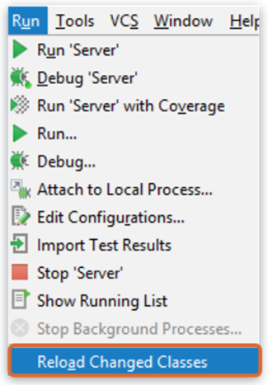
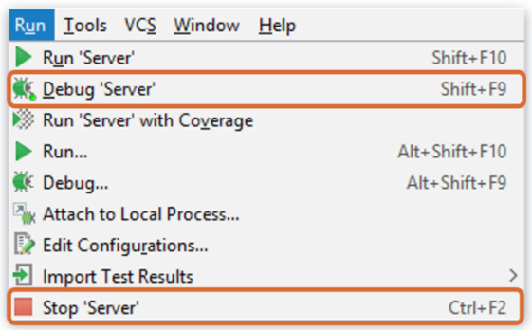
Deploy code changes
Restart Server
Reload Changed Classes
Create a rule hierarchy (parent rule and then children rules)
Newly created and modified event fired rules
Notes:
You must restart the server when you create or modify destinations.
For transport plugins and/or custom web service classes, you must reload changed classes. If your classes reference newly created display keys, you must reload PCFs (ALT+SHIFT+L).
For newly created and modified event fired rules, you must reload changed classes. If you create a rule hierarchy (parent rule and then children rules), you must restart the server.

Slide 25
  Describe how event messages are triggered
  Create destinations and configure required fields
  Create messages in Event Fired rules
  Describe the role that message payloads play in messaging

Slide 26
DEMO

Slide 27
Demo : 1
The video demonstrates testing the following messaging components for bank account verification:
  Configuration of BankAccountEntity to make it EventAware.
  Configuration of the destination focusing on the required fields.
  Triggering a message in the UI.
Pre-Requisites
  Training App and Studio
  External App
  Supported Browser
7

Slide 28
Demo : 2
The video demonstrates testing the following messaging components for bank account verification:
  Creating a message from MessageContexts
Pre-Requisites
  Training App and Studio
  External App
  Supported Browser

Slide 29
LAB

Slide 30
Complete the exercises listed in “Triggering messages” and “Creating messages” chapter in the “InsuranceSuite 10 Integration: Kickstart “ work book

Slide 31
When does a message event get triggered?
What is the primary purpose of the MessageContext entity?
A Guidewire application has seven destinations and an event-aware entity called Escalation. When an Escalation is created, what is the maximum number of MessageContexts that might get created? What is the minimum?
What plugin is required for every destination? What does this plugin do?
Why does every Event Fired rule cast the MessageContext.Root object it receives?
Notes:
Answers
1) Typically, a message event gets triggered when an event-aware entity is created, changed, or removed. (There are also other application-specific message events.)
2) The primary purpose of the MessageContext entity is to create messages using information from the message event and the triggering entity.
3) Seven, which would occur if all seven destinations listen to EscalationAdded. Zero, which would occur if none of the destinations listen to EscalationAdded.
4) MessageTransport, which sends the message to the external system.
5) MessageContext.Root is of type Object, but message payloads typically need to work with the MessageContext.Root as the type of entity that triggered the message event. Therefore, the MessageContext.Root entity must be cast to be of that type.

