Slide 1

InsuranceSuite 10 Integration
InsuranceSuite 10 Fundamentals
MESSAGE PAYLOAD TRANSFORMATION

Slide 2
  Describe the plugins used in sending messages
  Set sender reference IDs and late bind messages
  Write message request plugins
  Write message transport plugins
  Describe the functionality of safe ordering
  Describe how errors are handled when sending messages

Slide 3
Sending message plugins
SenderRefIDs and late binding
The message request plugin
The message transport plugin
Retry scenarios
Safe ordering

Slide 4
Messaging plugins
A messaging destination calls
messaging plugin to…
  Handle the late binding of a generated
  message
  Send a message
  Acknowledge a received message
Request Plugin
  Handles the late binding of an
  message about to be sent
Transport Plugin
  Sends the message
  Acknowledges synchronous replies
Reply Plugin
  Acknowledges a received message
Destination
ID = 20
Request
Plugin
Transport
Plugin
Reply
Plugin
Notes:
A plugin is a defined program that perfoms an action, for example, authenticates a user, generates a number for checks, or sends a message to an external system. A plugin can implement either a Gosu or Java class.
A predefined plugin executes generic functionality unrelated to messaging. You can have only one implementation of a given predefined plugin (such as authentication) per application.
Only one plugin of each type can be defined per destination. Multiple destination can specify the same plugin type

Slide 5
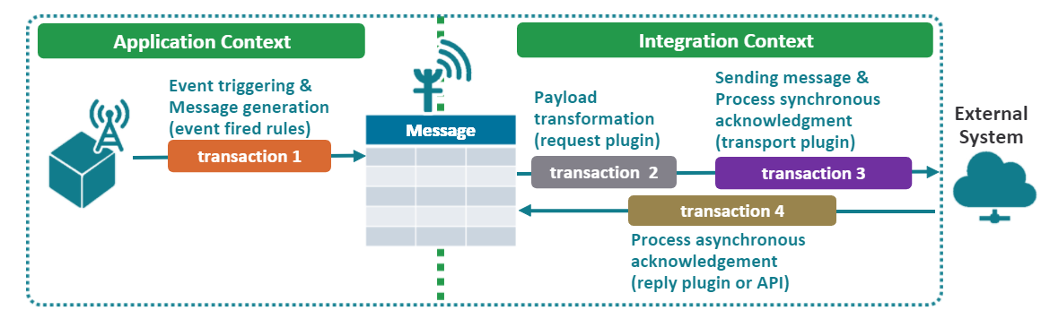
Plugins for sending a message
All activity from payload transformation tales place in transaction 2
Messaging Occurs across multiple transactions
  If an exception is thrown, work in the current transaction is rolled back.
Notes:
Guidewire servers and messaging transactions
The servers involved at each point of the process are important because they determine where payload work should occur. The majority of payload generation should be done in event fired rules on the ui role server that manages the given user’s session.
However, if some portion of payload generation must be done immediately before the message is sent, that portion of the payload can be generated of the messaging role server.
A message is always processed in at least two and as many as four transactions:
Transaction 1 – Creates the message and generates the payload. This transaction always occurs.
Transaction 2 – Prior to sending the message, an optional transaction may transform the message payload. This is usually done when the message must include information that can only be known immediately before sending the message.
Transaction 3 – The sending of the message to the external system occurs in its own transaction. This transaction always occurs. If the external system acknowledges the message synchronously, then the acknowledgement is included in the transaction.
Transaction 4 – If the external system acknowledges the message asynchronously, then a separate transaction processes the acknowledgement. This transaction does not occur for messages that are acknowledged synchronously.
The transaction structure is important because this determines the work that is rolled back if an error occurs.

Slide 6
Sending message plugins
SenderRefIDs and late binding
The message request plugin
The message transport plugin
Retry scenarios
Safe ordering

Slide 7

SenderRefIDs
message ab:61
Guidewire application
message ab:61
processed
External
system
When message acknowledgement is asynchronous, the external system needs a way to identify which message it is acknowledging
  To do this, a SenderRefID is assigned to the message when it is sent
  When the external system sends an acknowledgement, it uses the SenderRefID to identify the message
Notes:
In some cases, a message does not need a reply from the external system. These are "fire and finish" messages where Guidewire must simply inform some other system of some event, but Guidewire does not get any response from the other system.
In other cases, a message is replied to synchronously at the time that it is sent.
In both cases, there is no need to set the SenderRefID field. Guidewire synchronously marks the message as acknowledged within the transport plugin's send() method.

Slide 8
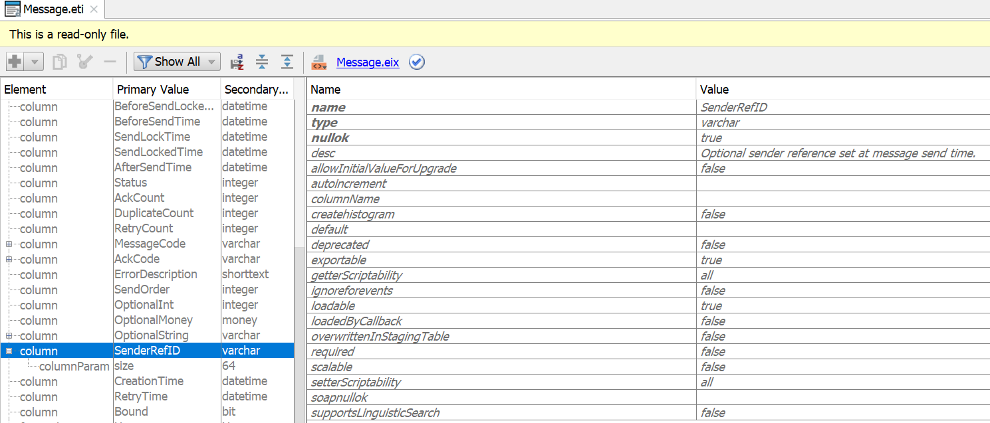
SenderRefID field
Optional identifier
Guidewire application adds during late binding
External systems sets in acknowledgement
Notes:
All entities, including Message, have a PublicID field. The purpose of this field is to identify instances of the entity as they are known by the external system. Thus, the purpose of the SenderRefID field is identical to that of the PublicID field. The Message entity has two public identification fields because earlier versions of the Guidewire applications did not have the PublicID field across all entities. However, the Message entity absolutely required a settable field that could be shared with external systems, and so Message was created with the SenderRefID field. As the Guidewire applications matured, the PublicID field was added to entities in the data model. This allowed other entities beyond Message to be shared with external systems.
Even though you theoretically could use Message's PublicID field, Guidewire recommends you use SenderRefID instead. There are numerous base application methods that make use of SenderRefID, such as IMessagingToolsAPI's getMessageID() method that takes the SenderRefID as an input and the MessageFinder's findHistoryBySenderRefID() method). Using PublicID to identify a message could make an implementation more complex.

Slide 9
Guidewire determines SenderRefID…
SenderRefID handled in
late binding
Request
Plugin
external
system
xx_message
sending
message
sending
message
Transport
Plugin
When the request plugin handles late binding
  Sets the SenderRefID
  Adds the SenderRefID to the message payload
The transport plugin sends the payload (with the ID) to the external system
Notes:
When a message is replied to asynchronously, a Guidewire application can generate a message identifier that is acceptable to the external system. The SenderRefID is an option identifier that the external system can use to manage Guidewire application messages.
A request plugin can set the SenderRefID field during late binding of the message. This is helpful for setting the SenderRefID to the PublicID of the message being sent. The PublicID is only discoverable after the Guidewire application generates the initial message and commits the message to the database. Generating the message and the message payload occurs during the Event Fired rules. Of course, it is possible to set the SenderRefID for the message to another value, but a common approach in these situations is to simply set the SenderRefID to the PublicID during late binding.

Slide 10
External system determines SenderRefID…
Request
Plugin
external
system
xx_message
sending
message
sending
message
Transport
Plugin
synchronous
reply
SenderRefID saved
SenderRefID sent immediately
The request plugin does not handle the SenderRefID
The transport plugin:
  Sends the message
  Receives the SenderRefID value from the external system
  Sets the SenderRefID field for the message

Slide 11
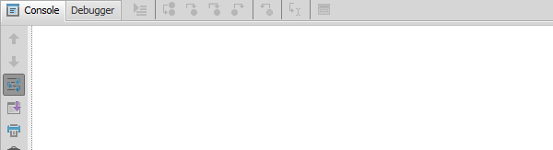
Late binding values
*** Stage 3(a) -- Transforming the message payload with
late binding ***
Request plugin: BankAccountVerificationRequest –
beforeSend()
Message ID is 630
Replaced token <@@ageOfMessageInSeconds@@> with value 3
Returning payload string
Replace token
with age
in seconds
Request
Plugin
A late binding value is a
message payload value
that cannot be determined
until right before the message is sent
The message request plugin is responsible for replacing all late binding values with actual values
Notes:
Good candidates for late binding include:
A send timestamp
The message ID and/or its public ID
An identifier from the external system that was sent in reply to a previous message
For example, imagine an integration point in which the first message communicates that a new entity was added. The reply to the first message contains the ID to be used for the new entity on the external system. The second message identifies a change on this new entity. However, the second message is created before the first message has been sent (or before the reply to the first message has been received). The second message must use the ID in the reply to the first message. The only way this ID can be added to the second message is through late binding.
Typically, values that are to be late bound are added to the message payload using a placeholder marked by special character delimiters, such as <@@ and @@>. In the message request plugin, these placeholders are replaced with the required data.
Be careful about what data you set via late binding. Typically, the message payload should reflect a consistent snapshot of the system at the time the Event Fired rule executed. Late binding should not be used to capture entity data after message creation.

Slide 12
Sending message plugins
SenderRefIDs and late binding
The message request plugin
The message transport plugin
Retry scenarios
Safe ordering

Slide 13
Message request plugin
Request
Plugin
Payload
Transformation
xx_message
External
System
  Transport Plugin
The message request plugin is responsible for:
  Setting the SenderRefID and adding the value to the message payload (when replies are asynchronous and Guidewire can determine the ID)
  Setting any other non-SenderRefID late binding values
  Called before the payload is sent by transport plugin

Slide 14
beforeSend() – override
39 override function beforeSend(aMessage : Message) : String {
…44 var payload = aMessage.Payload
…53 return payload
55 }
gw.plugin.messaging.MessageRequest
  Message request plugin class must implement interface
  Override beforeSend()
beforeSend()
  Called before message is sent
  Must always return a String, even if payload is not transformed
Notes:
Payload transformation is done in the request plugin's beforeSend() method. It is called immediately before the message is sent. The method must always return a payload.
If the payload is not transformed, then the original payload should be returned.

Slide 15
beforeSend() – transform payload
39 override function beforeSend(aMessage : Message) : String {
…44 var payload = aMessage.Payload
45 var ageInSeconds = DateUtil.secondsSince(aMessage.CreationTime)
as java.lang.CharSequence
46 var token = "<@@ageOfMessageInSeconds@@>"
47 if (payload.containsIgnoreCase(token)) {
48 payload = payload.replace(token, ageInSeconds )
…50 }
…53 return payload
54 }
Do NOT modify the message payload field directly
Modify the content of payload for sending final values
Replace tokens with late binding values
Return the transformed payload
Notes:
You can modify the message payload using a placeholder or token. Often, tokens and placeholders are designated with special character delimiters, such as <@@ and @@>. In the beforeSend() method, these placeholders are replaced with the required data for late binding.
In some situations, the initial sending of the message is unsuccessful. This could be because of a problem with the Guidewire application or with the external system. In these situations, the message needs to be resent. Because a message may be sent multiple times, the beforeSend() method may be called multiple times. Therefore, the beforeSend() method should not modify the message payload directly. Instead, it should return a transformed payload. This lets later attempts to send the message update the payload as appropriate.

Slide 16
Setting the SenderRefID in beforeSend()
35 override function beforeSend(aMessage : Message) : String {
…44 if (aMessage.SenderRefID == null) {
45 aMessage.SenderRefID = aMessage.PublicID
…47 }
48 var transformedPayload = aMessage.Payload.replace(
49 "<@@senderRefID@@>", aMessage.SenderRefID)
…51 return transformedPayload
52 }
Set SenderRefID only if it hasn't already been set
  Line 44 – 47: Guidewire may need to attempt the send multiple times, but a single SenderRefID should be used for all attempts to send the same message
Once set, SenderRefID should be added to the payload
  Line 48-49: Replace token with value
Notes:
When an asynchronous reply is received, the SenderRefID is used to locate the message to acknowledge, even if the message was sent multiple times. As long as all automatically retried messages have the same SenderRefID as the original, Guidewire can find the correct message to acknowledge, regardless of which specific instance the external system is replying to.
In the example above, the SenderRefID is set to the message's public ID. Theoretically, the public ID shouldn't change with multiple calls to the beforeSend() method. So in this particular case, it is unlikely that the SenderRefID would change, even if it was reset multiple times. Nevertheless, it is best practice to set the SenderRefID only once, and to check that the value is not null prior to setting it.
In the example above, the code that inserts the SenderREFID value into the payload is located outside of the "if SenderRefID is null" branch. This is because SenderRefID should be set only if it hasn't already been set, but the SenderRefID should always be added to every transformed payload, regardless of when the SenderRefID value was set.

Slide 17
Message request plugin implementation
Create the request plugin class
  Implement the MessageRequest interface
  Implement beforeSend() as needed
Create the plugin registry
Configure the plugin
Specify the destination plugin
Deploy your changes

Slide 18
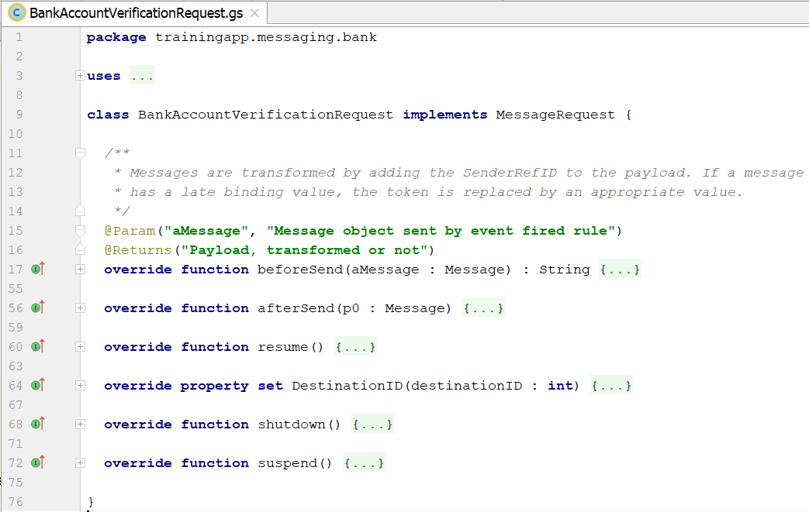
Step 1: Create request plugin class
  Use a package naming convention recommendation
  <company>.<app_code>.messaging.<functional_area>
Notes:
Create a message request Plugin class
Line 9
Implement the MessageRequest interface.
Message entity instance is in transaction scope.
Line 15-16
Add method annotations.
Line 17
Must Override beforeSend method.
Passed the Message Object.
Payload transformation is done in the request plugin’s beforeSend method.
It is called immediately before the message is sent.
The method must always return a transformed payload. If the payload is not transformed, then the original payload should be returned.
afterSend method
It performs post-processing on the message object immediately after sending the message with the send method of the MessageTransport plugin. Typically not implemented.

Slide 19
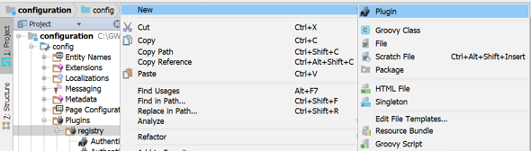
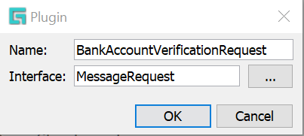
Step 2: Create the plugin registry
\configuration\config
\plugins\registry\
  New → Plugin
  In the dialog, specify Plugin name and MessageRequest interface
Example:
  BankAccountVerificationRequest

Slide 20
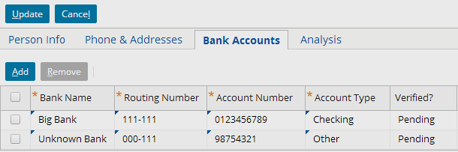

Example: Late binding
Payload
transformed
late binding
Request
Plugin
*** Stage 3(b) -- Transforming the message payload with late
binding ***
Request plugin: BankAccountVerificationRequest –
beforeSend()
Message ID is 303
Replaced token <@@ageOfMessageInSeconds@@> with value 10
Returning payload string
Notes:
The example above shows the triggering entity in the user interface (a savings account for William Andy, whose public ID is ab:5), the request plugin's beforeSend() method, and the payload generated for that message. Note that the age in seconds has been added to the payload.

Slide 21
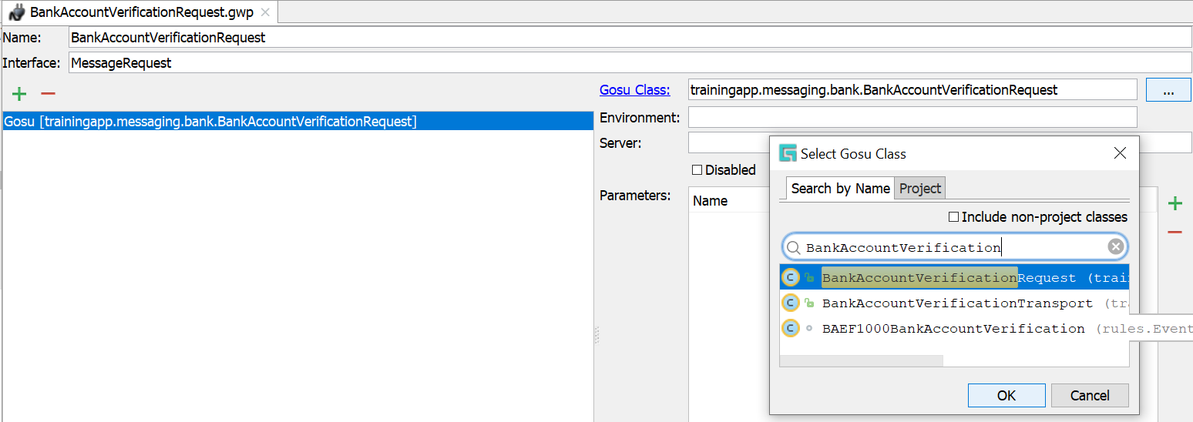

Step 3: Configure the plugin
Add Gosu or Java Plugin
Click the ellipse (...)
  Select the Class in the dialog
Example:
  BankAccountVerificationRequest

Slide 22
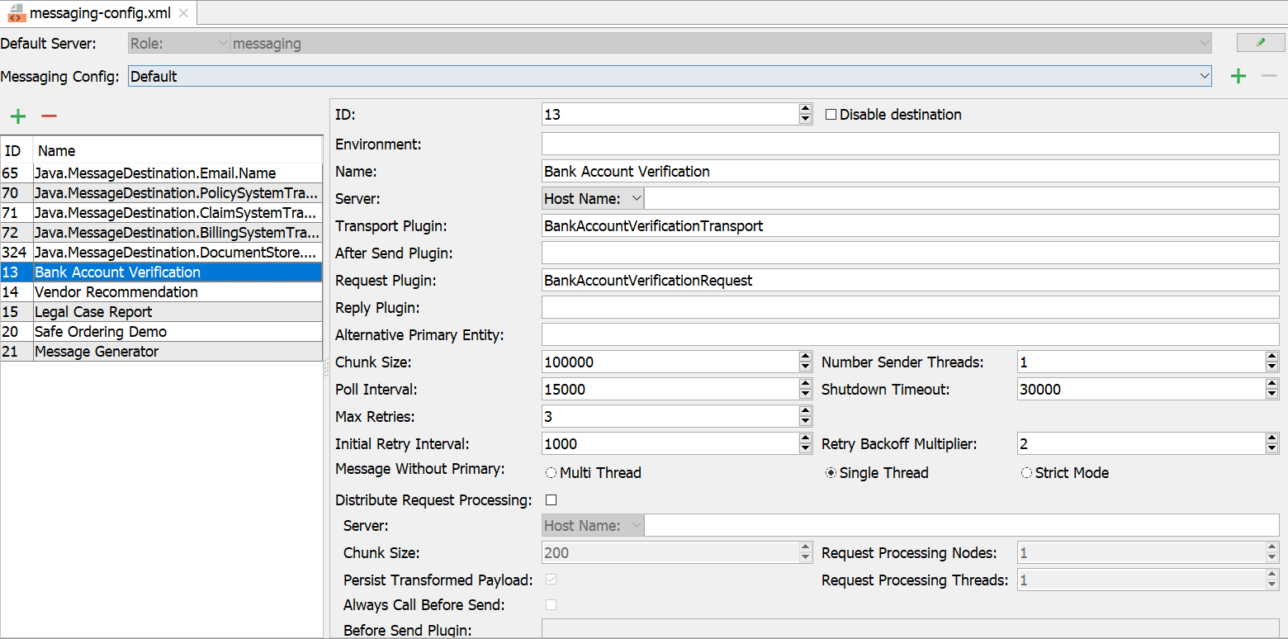
Step 4: Specify the destination plugin
\configuration\config\messaging\messaging-config.xml
Click Add
The destination must point to a plugin registry element that references the appropriate Message Request plugin
Notes:
For non-messaging plugins (such as authentication), you can implement only one version of each plugin at a time. For messaging plugins, you can implement any number of MessageRequest, MessageTransport, and MessageReply plugins.
Every destination can use only one message transport plugin. Theoretically, a given message transport plugin class can be used by multiple destinations. However, this would be uncommon for most types of destinations, except for standardized cases, such as simple transport of the payload as a text message sent to a JMS destination.

Slide 23
Step 5: Deploy message request plugin
Restart Server
Reload Changed Classes
Destinations
Plugin registry elements
Request Plugin Gosu class
Destination
Plugin
Registry
Request Plugin
Gosu Class
Notes:
If you implement your message request plugin in Java, then you will need to compile the Java class and recopy it into the Guidewire directory structure.

Slide 24
  Describe the plugins used in sending messages
  Set sender reference IDs and late bind messages
  Write message request plugins
  Write message transport plugins
  Describe the functionality of safe ordering
  Describe how errors are handled when sending messages

Slide 25
DEMO

Slide 26
This demonstration will examine the following messaging components for bank account verification.
Creating the request plugin.
Configure the plugin
Specify the destination plugin
Requires:
-Training App, External App
-GW studio & Supported Web Browser

Slide 27
LAB

Slide 28
Complete the exercises listed in “Message Payload Transformation” chapter in the “InsuranceSuite 10 Integration: Kickstart “ work book

Slide 29
With regards to payload generation and payload transformation:
  On which server does each take place?
  At what point in time does each take place?
Under what circumstance would you need to "late bind" a message payload?
Notes:
Answers
1a) Payload generation occurs on the application server. Payload transformation occurs on the batch server.
1b) Payload generation occurs during Event Fired rules (right after the triggering event occurs). Payload transformation occurs right before the message is sent (in the request plugin's beforeSend() method, which is called immediately before the transport plugin's send() method).
2) You would need to "late bind" a message if information that needs to go in the message payload is not known at the time the message payload is generated in Event Fired rules.

