Slide 1

InsuranceSuite 10 Integration
InsuranceSuite 10 Fundamentals
SENDING MESSAGES

Slide 2
  Describe the plugins used in sending messages
  Set sender reference IDs and late bind messages
  Write message request plugins
  Write message transport plugins
  Describe the functionality of safe ordering
  Describe how errors are handled when sending messages

Slide 3
The message transport plugin
Retry scenarios
Safe ordering

Slide 4
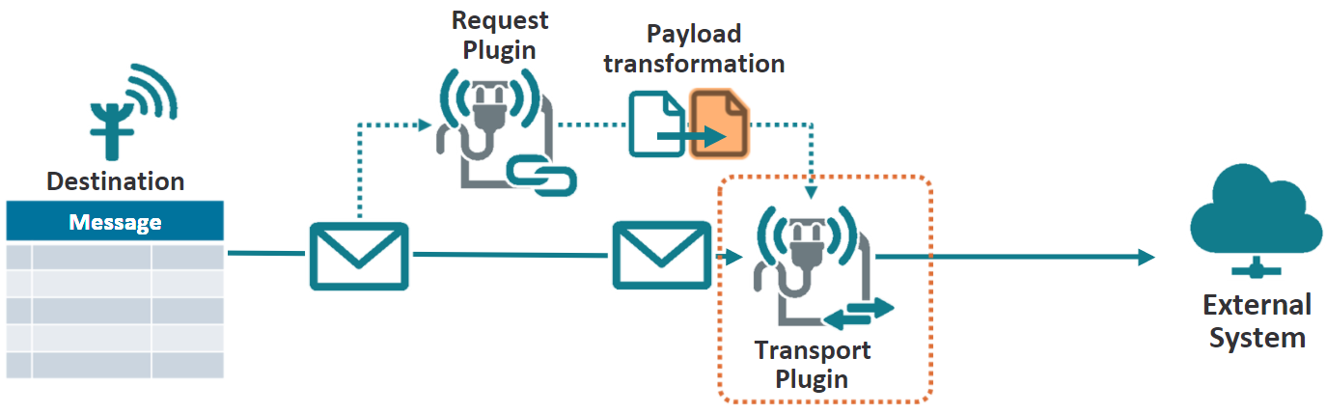
Message transport plugin
The message transport plugin is responsible for sending the message
The message transport plugin may also become responsible for:
  Persisting the SenderRefID in a message if the SenderRefID is provided by an external system
  Acknowledging in case of synchronous message with an external system
Notes:
Communication with the external system may use any type of connectivity or transport, including some not normally considered "messaging", such as:
File-based, shared database
Raw socket (TCP/IP)
FTP
Email
Synchronous invocations, such as RMI/JRMP, RMI/IIOP, and SOAP.
Asynchronous, message-based transports, such as JMS, native WebSphere MQ, or SOAP/JMS.
A message request plugin can optionally implement the InitializablePlugin interface, which adds the setParameters method to the plugin. However, there is rarely a need for this with a Request plugin, as the plugin typically does the same thing in any environment.

Slide 5
Steps to implement message transport
Create a message transport plugin class
  Implement the MessageTransport interface
  Implement send() as needed
Create plugin registry
Configure the plugin
Configure the destination
Deploy code changes

Slide 6
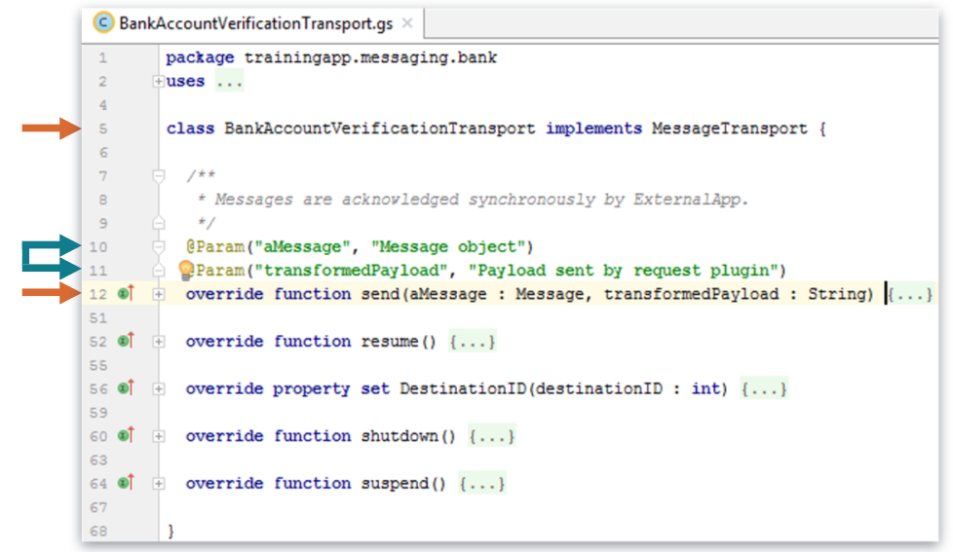
Step 1: Create a message transport plugin class
Create Gosu plugin class in \configuration\gsrc\
  Use a package naming convention recommendation
  <company>.<app_code>.messaging.<functional_area>
Implement the MessageTransport interface
Must override send()

Slide 7
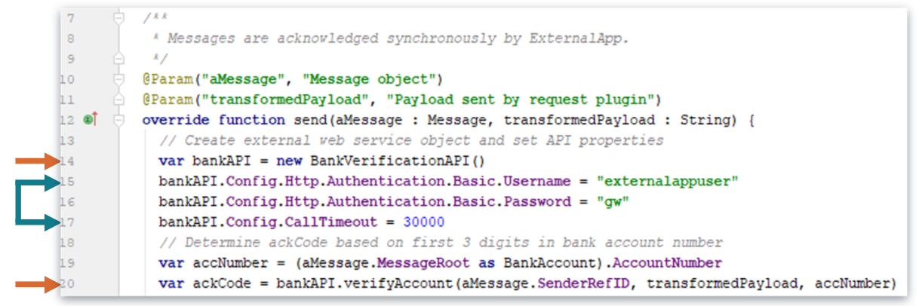
Send payload to web service example
BankAccountVerificationTransportPlugin
  Messages are acknowledged synchronously by ExternalApp
Notes:
The send method uses Gosu's Java file I/O capabilities to write the payload to a simple flat file. The payload contains information about the evaluations for that vendor.
See the VendorRecommendationTransport.gs file for more details.

Slide 8
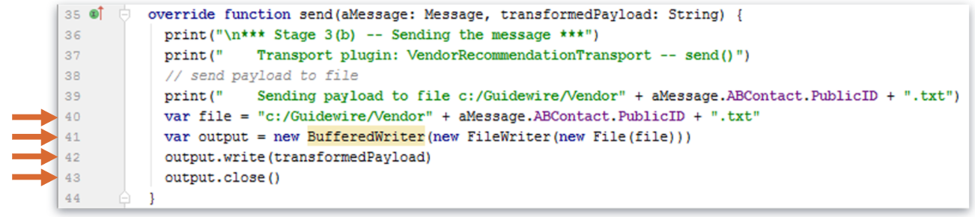
Send payload to file example
VendorRecommendationTransportPlugin
  The send method uses Gosu’s Java file I/O capabilities to write the payload to a simple flat file
  The payload contains information about the evaluations for that vendor
Notes:
The send method uses a web service collection to send a request for a legal case report to an external system using a web service API. See the LegalReportTransport.gs file for more details.

Slide 9
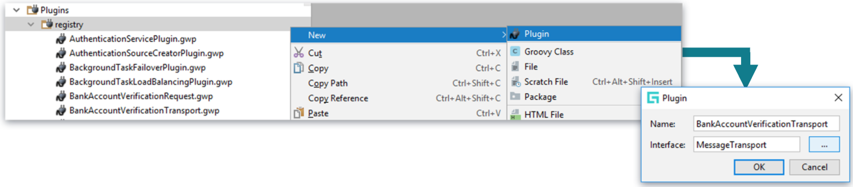
Step 2: Create plugin registry
\configuration\config\plugins\registry\
  Specify a new request plugin registry entry name
  Specify the interface to be implemented
Add the type of plugin to be implemented in the plugin name

Slide 10
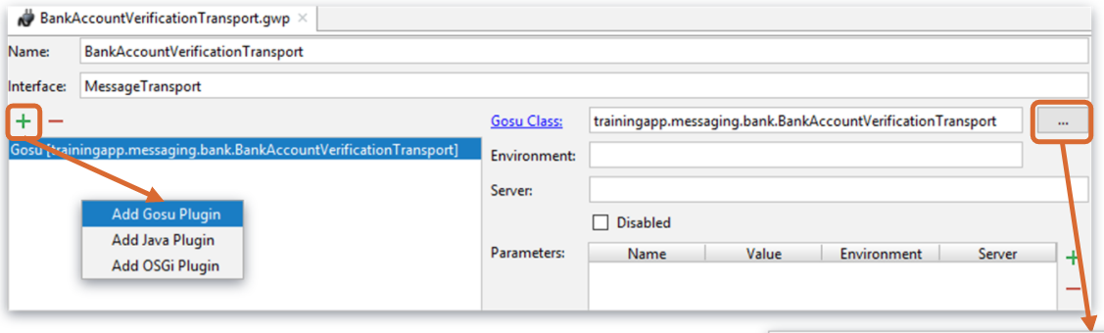
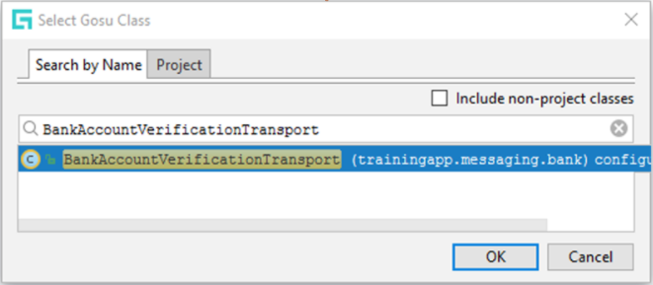
Step 3: Configure the plugin
Add Gosu Plugin
  Optionally, select Java or OSGi plugin
Click the ellipse (...) and select the plugin implementation class in the dialog

Slide 11
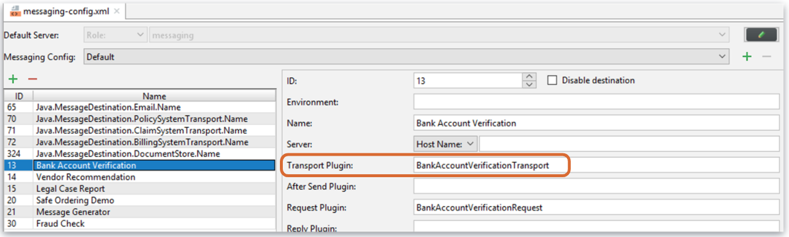
Step 4: Configure the destination
Navigate to \configuration\config\messaging\messaging-config.xml
The destination must point to a plugin registry element that references the appropriate Message Transport plugin

Slide 12
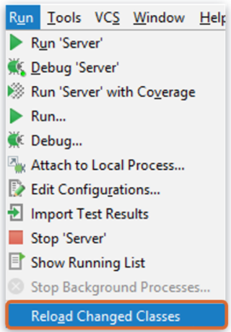
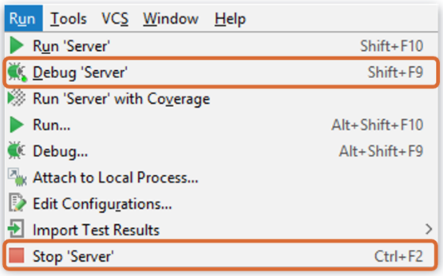
Step 5: Deploy code changes
Restart Server
Reload Changed Classes
New transport plugin class
New or modified plugin registry
New or modified destination
Modified transport plugin class
Notes:
If you implement your message request plugin in Java, then you will need to compile the Java class and recopy it into the Guidewire directory structure.

Slide 13
The message transport plugin
Retry scenarios
Safe ordering

Slide 14

Transport or Request plugin error
When Transport or Request plugins throws an exception, the Guidewire application automatically
  Compares message send attempts to Max Retries
  Waits the Initial Retry Interval
  Retries to send message
  Increases the time between resends (Retry Backoff Multiplier)
  Continues until reaching Max Retries
Parameters defined in message destination
Notes:
An exception handled differently than a reported error for a message. There are various types of exceptions such as a java.net.ConnectionException or gw.xml.ws.WsiAuthenticationException.
Sometimes a message transport plugin has a send error and expects it to be temporary. To support this common use case, if the message transport plugin throws an exception from its send method, the Guidewire application will retry to send the message after a specified amount of delay time, and will continue to retry sending the message multiple times.
When there is an exception is thrown in a transport plugin class in a send method, the Guidewire application response is to retry sending the message until reaching the maximum number of retries. The message's destination configuration defines the value for the maximum number of retries. When reaching the maximum number of retries, Guidewire suspends the destination.
Destinations have specific parameters that impact how messages are retried.
Initial Retry Interval - The amount of time (in milliseconds) to wait before attempting to resend a message after an exception is thrown.
Max Retries - The number of retries to attempt
Retry Backoff Multiplier - The amount to increase the time between resends, specified as a multiplier of the time previously attempted.
Shutdown Timeout - The length of time to wait before attempting to shut down the messaging subsystem.
(continued)

Slide 15
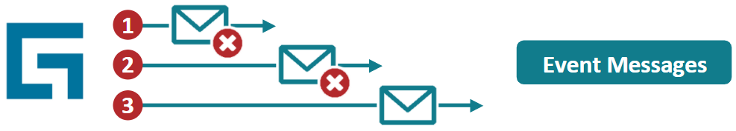
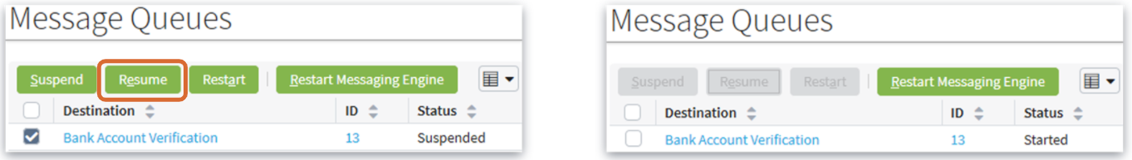
Error Administration
Guidewire automatically suspends a destination when exceeding Max Retries
  No further messages are sent for destination
An administrator must manually resume the destination
  The message that caused the suspend will be resent, up to the maximum retries if necessary
Notes:
A message causes the destination to be suspended when:
The beforeSend() or send() method throws an exception, AND
The message has reached the retry limit.
In order for an additional messages to be processed for the messaging destination, you need to skip any messages reporting an error and to resume the suspended destination. An administrator can manually skip a message. It is also possible for custom code to skip messages, for example, from within a batch process. If a message is safe ordered, the next message for the destination/entity pair will not be sent until the message is either resent and successfully acknowledged or skipped.
Messaging plugins have methods to suspend, resume, and shutdown the system. During the suspend(), shutdown(), and resume() methods of the plugin, the plugin must not call any APIs that suspend or resume messaging destinations. This includes—but is not limited to—MessageToolsAPI web service APIs. Doing so creates circular application logic.

Slide 16

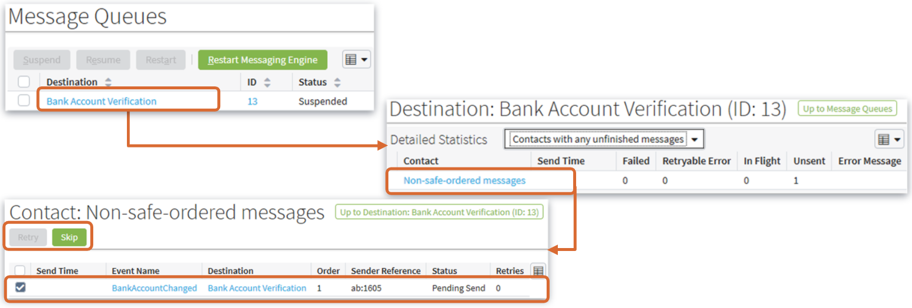
Retry and skip messages
Notes:
Every Guidewire application has an Event Messages screen on the Administration tab. The Event Messages screen shown above is present in every Guidewire application. It is used to administer messages.
To manually retry or skip a specific message:
From the "Event Messages" screen, click the Destination name.
From the "Destination: <Destination Name>" screen, click the appropriate link.
If the destination has messages associated to non-safe-ordered entities, the screen will have a "Non-safe-ordered messages" link.
If the destination has messages associated to safe-ordered entities, the screen will have a "Safe-ordered messages" link for each safe-ordered entity.
From the next screen, click the appropriate message or messages. Then, click "Retry" or "Skip".
When you manually retry a message, Guidewire attempts to resend the message by calling the same methods as the first attempt: the beforeSend() method (if a reply plugin has been implemented) and the send() method. If the issue that caused the original problem has not been rectified, the message will cause another exception, and after the Max Retries has been exceeded, the destination will be suspended again.
When you skip a message, the message is moved from the Message table to the MessageHistory table. The status of the message is set to "13" (skipped). Then the next message in its order (if there is one) can be sent. Note that skipping a message implies that the information that it was expected to carry to the external system is lost. When programming for messaging, care should be taken to avoid programming in such a way that large numbers of messages may be inadvertently skipped.

Slide 17
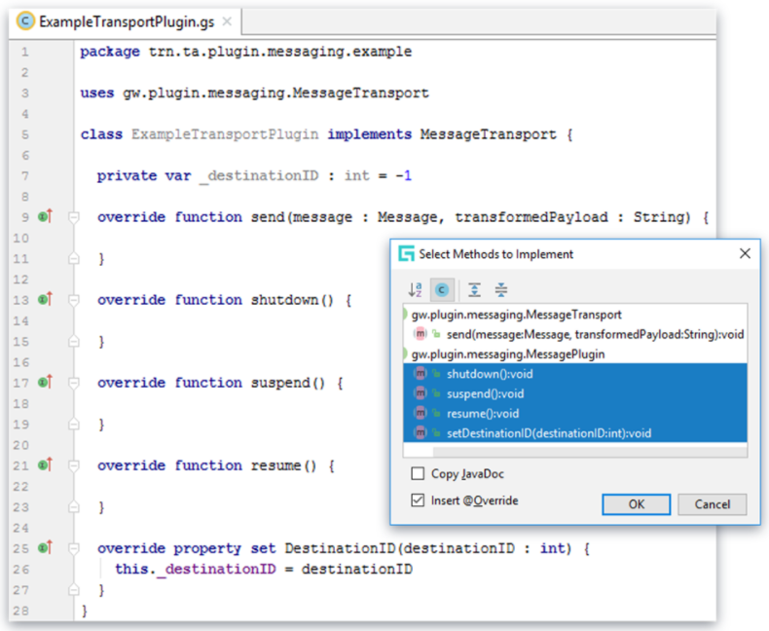
Controlling messaging destinations
Implement control methods and property for messaging plugins:
suspend
  When messaging destination is suspended
resume
  When messaging
  destination resumes
shutdown
  When application
  server shuts down
set DestinationID
  When messaging plugin instance is initialized
Notes:
The resume(), shutdown(), and suspend() methods are called by the application when the destination is resumed, or suspended, or the server shuts down. Plugins should acquire or release external resources at these times. For example, a plugin may need to create or close JMS or JDBC connections, JMS Sessions, sockets, and so on.
Typically, these methods are empty in a request plugin. In a production environment, they should be implemented for transport and reply plugins.
The plugin should throw a Guidewire InitializationException (gw.plugin.messaging.InitializationException) from resume() if the resources have not initialized successfully. (A manual resume could be attempted later and may be successful.)
The setDestinationID method is not related to how a message is suspended or resumed. It allows your destination to get its own destination ID to store it in a private variable. Your code can use the stored destination ID value for logging messages or send it to integration systems so that they can programmatically suspend/resume the destination if necessary. Keep in mind that the valid range for your destination IDs is 0 through 63, inclusive. Guidewire reserves all other destination IDs for built-in destinations, such as the email transport destination.

Slide 18
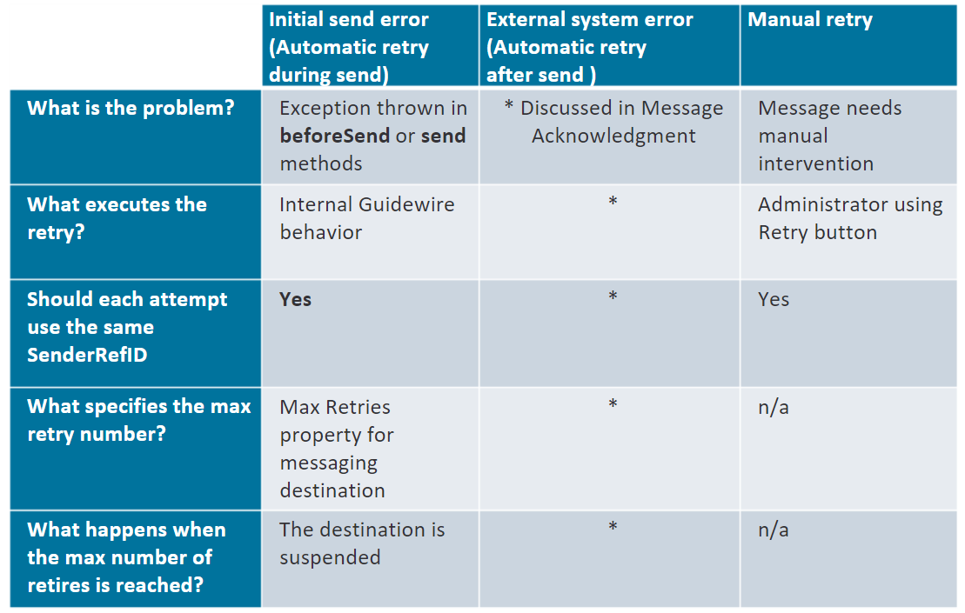
Contrasting retry scenarios
Notes:
A message could be retried automatically during the sending of the message.
During the sending of a message, a message has a status of "(1) Pending send". Guidewire automatically retires sending of a message when an exception is thrown in the beforeSend() or Send() method. The message destination's Max Retries property determines the maximum number of retries. Because the message has not yet been sent, each attempt should use the same SenderRefID. The message request, code should set the SenderRefID only if it is null.) If a given message exceeds the maximum number of retries, the Guidewire application suspends the destination. The Guidewire application will not send any more messages for a suspended destination. You must resume the destination to remove the suspension.
A message could be retried manually.
This occurs when a message requires manual intervention. (This could be necessary for several reasons, such as a message that caused an exception during send() where the situation has now been rectified, or a message whose payload needed to be modified manually, or a message for which the external system never provided a response.) An admin retries the message manually by selecting the message from one of the Message Administration screens and clicking the Retry button. There is no notion of maximum retries for a message retried manually. A message could be retried automatically after the sending of the message. This is discussed in detail in the "Acknowledging Messages" lesson.

Slide 19
The message transport plugin
Retry scenarios
Safe ordering

Slide 20
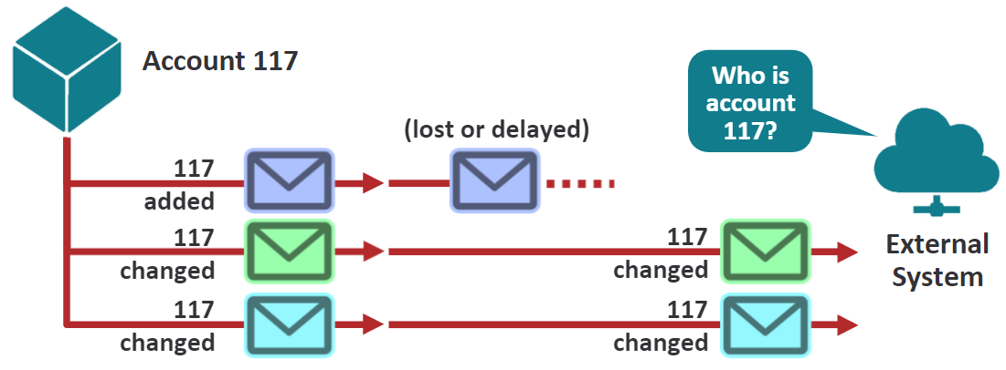
Sending simultaneous related messages
Some destinations create multiple messages for a single entity or a single set of related entities
  Typically, they should not be sent at the same time
  "Later" messages reference work done in "earlier" messages
If an earlier message gets lost or arrives late, a later message will not make sense
Notes:
Some of the slides in this section pertain exclusively to one product (PolicyCenter, BillingCenter, ClaimCenter, or ContactManager). The instructor may skip over slides that pertain to products that are not relevant to the course.

Slide 21
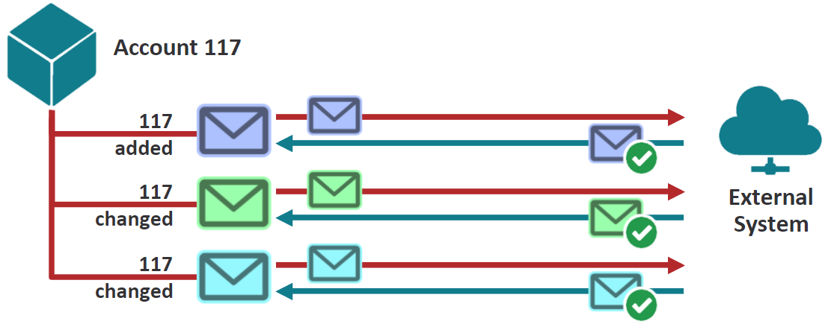
Safe ordering
Guidewire has a built-in mechanism called safe ordering
  Its primary purpose is to ensure that the external system gets related messages one at a time
When safe ordering is enforced:
  For a given destination/entity pair, only one message is sent
  The external system must acknowledge the first message before the next message is sent
Notes:
Safe ordering allows Guidewire to send messages as soon as possible, and yet prevents errors that might occur if related messages were processed out of order.
Safe ordering is not a simple first-in first-out order (FIFO). Messages are sent based on the order in which they must be received by the external system, which may or may not be identical to the order in which they were created in Event Fired rules.
This feature has large implications for messaging performance. Only one message can be in flight for each entity/destination pair. If the send queue contains 10 messages associated with different claims/accounts/contacts/producers, Guidewire can send all these safe-ordered messages immediately. However, if the send queue contains 10 safe-ordered messages for the same claim/account/contact/producer, Guidewire can send only one. Guidewire must wait for the message acknowledgement, and then at that point can send the next message, but once again can send only one.

Slide 22
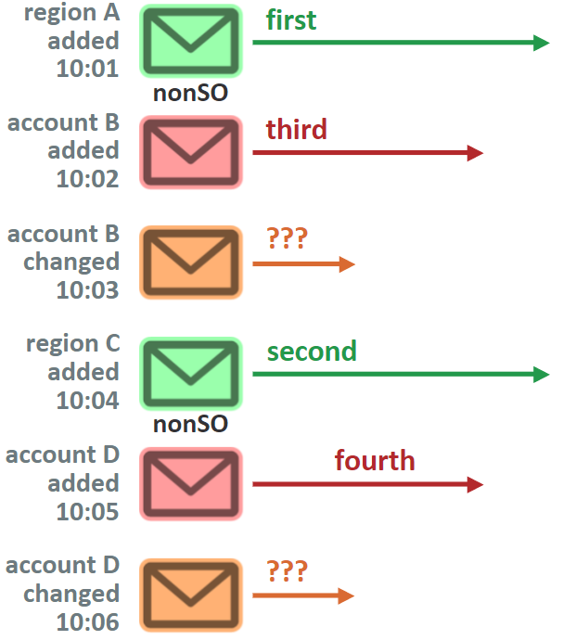
Default ordering and sending behavior
Non-safe ordering messages sent…
  Before safe-ordering message
  In message creation order
  Immediately
Safe-ordering messages sent…
  After non-safe messages
  In message creation order
  Per entity instance, only one message at a time
Notes:
The example above represents a single destination with six messages. Two messages apply to regions. Two messages apply to account B. Two messages apply to account D. The time each message was created is also listed, and the messages appear in the order in which they were created.
First, Guidewire sends all the non-safe ordered messages. This is because non-safe ordered messages usually relate to "administrative" data that may be referenced by many other messages. Non-safe ordered messages are sent in the order they are created. (Therefore, the region A message is sent first, as it was created at 10:01. The region C message is sent second.) All non-safe ordered messages are sent immediately. Guidewire does not wait for any acknowledgement from the external system.
Next, Guidewire sends all the safe-ordered messages. As much as possible, safe-ordered messages are sent in the order that they are created. But, Guidewire sends only one message for a given entity/destination pair at a time. So, the send time of later messages for a given entity/destination pair depends upon when acknowledgement is received for earlier messages in that entity/destination pair. (Therefore, the "account B added" message is sent third. The "account B changed" message cannot be sent until the "account B added" message is acknowledged. Assuming there is no immediate acknowledgement of the message, the "account D added" message is sent fourth. The order and timing of the "account B changed" and "account D changed " messages is unknown because the sending of these messages depends upon the acknowledgement of the corresponding "account added" messages.)
(continued)

Slide 23
Notes:
Strict mode
Destinations have an option known as "strict mode". By default, it is turned off. Checking the destination's "Strict mode" turns it on.
When a destination is in strict mode:
Non-safe-ordered messages are sent one at a time. The next non-safe ordered message is not sent until the previous non-safe ordered message is acknowledged.
Safe-ordered messages are not sent until all non-safe-ordered messages have been sent and acknowledged.
This option is intended solely for destinations that send messages for multiple types of entities, and the order in which those messages are sent affects the external system's ability to understand them. Strict mode should be used cautiously, as it potentially affects the through-put of the destination because a single non-safe-ordered message that does not receive a positive acknowledgement will prevent the destination from sending further messages.

Slide 24
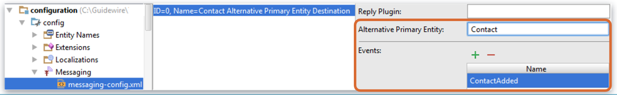
Safe ordering in ClaimCenter
Safe ordering applies only to messages related directly or indirectly to instances of Claim
Alternative Primary Entity can be configured in a destination to safe order for the Contact entity
Notes:
For most destinations, the default behavior of Claim-based safe ordering is appropriate. However, some destinations represent integration points to a contact management system such as Guidewire ContactManager. For these integration points, each message may pertain to only one contact, and there are no issues around sending multiple messages for the same claim at the same time provided that each message pertains to a different contact. For these destinations, you can define that safe ordering should be enforced at the Contact level. This means a given claim may have multiple messages in flight, but it will never have more than one message in flight for any given contact.
To configure a destination to do safe ordering at the Contact level, select "Contact" in the Alternative Primary Entity field. Contact is the only alternative primary entity in ClaimCenter.

Slide 25
Safe ordering in PolicyCenter
Safe ordering applies only to messages related directly or indirectly to instances of Account
Alternative Primary Entity can be configured in a destination to safe order for the Contact entity
Notes:
For most destinations, the default behavior of Account-based safe ordering is appropriate. However, some destinations represent integration points to a contact management system such as Guidewire ContactManager. For these integration points, each message may pertain to only one contact, and there are no issues around sending multiple messages for the same account at the same time provided that each message pertains to a different contact. For these destinations, you can define that safe ordering should be enforced at the Contact level. This means a given account may have multiple messages in flight, but it will never have more than one message in flight for any given contact.
To configure a destination to do safe ordering at the Contact level, select "Contact" in the Alternative Primary Entity field. Contact is the only alternative primary entity in PolicyCenter.

Slide 26
Safe ordering in BillingCenter
Safe ordering is not used for any primary entity messages
For any destination, you can enable safe ordering for one of the supported primary entity types:
  Account
  Contact
  PolicyPeriod
  Producer
Notes:
Unlike ClaimCenter (where most business information is owned uniquely by a claim) or PolicyCenter (where most business information is owned uniquely by an account), BillingCenter does not have a single entity whose instances uniquely own most of the business information. Therefore, BillingCenter does not have a single entity that is the default safe-ordered entity. The default is not to use safe ordering, and safe ordering must be enabled for each destination with the appropriate entity.
Because safe ordering reduces the likelihood of errors on the external system and can increase performance, the best practice is to enable safe ordering for every destination that can make use of it.
To configure a destination to do safe ordering, select the appropriate entity type (Account, Contact, PolicyPeriod, or Producer) in the Alternative Primary Entity field.

Slide 27
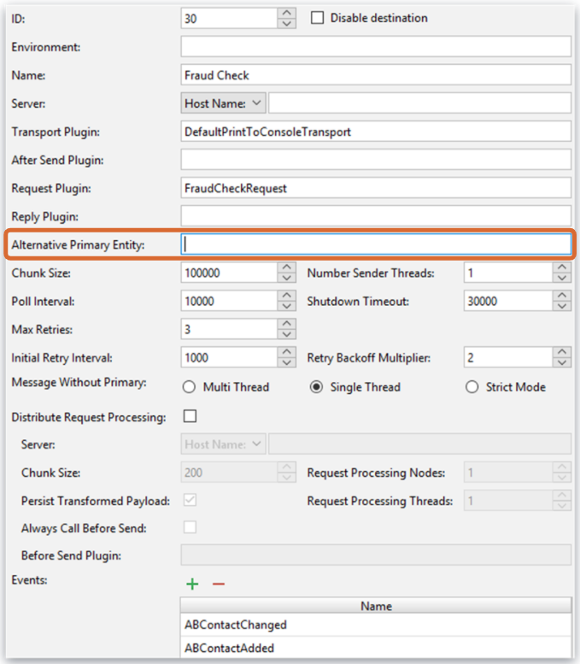
Safe ordering in ContactManager
In ContactManager (and TrainingApp), messages are safe ordered based on ABContact
  This is true for every destination
  There are no alternative primary entity types

Slide 28
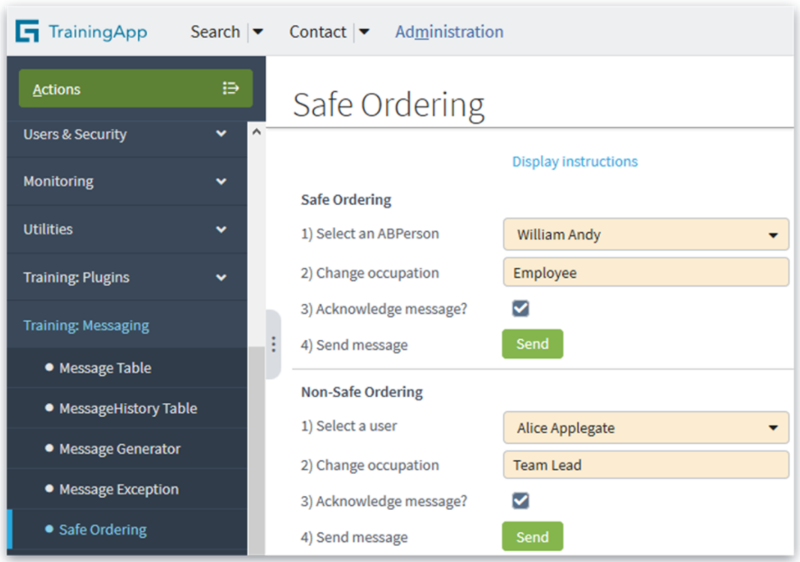
Safe ordering demo in TrainingApp
Administration → Training: Messaging → Safe Ordering
Notes:
TrainingApp includes a safe ordering demo. Using this demo, you can select and change either an ABContact or a User. You can send a message with acknowledgement or without acknowledgement. Message activity is printed to the console. Using this demo, you can see that:
If two messages are sent for the same ABContact (a safe-ordering entity), the second message is sent only if the first message is acknowledged.
If two messages are sent for the same User (a non-safe-ordering entity), the second message is always sent, regardless of the acknowledgement of the first message.
The demo is located on the Administration tab's "Training: Messaging→Safe Ordering" screen. Detailed instructions for how to use the demo are also included. To view the instructions, click the "Display demo instructions" link at the top of the detail view.

Slide 29
  Describe the plugins used in sending messages
  Write message transport plugins
  Describe the functionality of safe ordering
  Describe how errors are handled when sending messages

Slide 30
DEMO

Slide 31
This demonstration will examine the following messaging components for bank account verification.
configuration of bank account verification transport plugin.
Triggering a message in the UI
Perform send, error , Recovery
Requires:
-Training App, External App
-GW studio & Supported Web Browser

Slide 32
LAB

Slide 33
Complete the exercises listed in “Sending Messages” chapter in the “InsuranceSuite 10 Integration: Kickstart “ work book

Slide 34
Every destination can optionally have a request plugin, but it must have a transport plugin. Why is the transport plugin required?
Can one destination have two transport plugins? Can one transport plugin be used by two destinations?
Why should the send() method never send a message to multiple external systems?
Notes:
Answers
1) The transport plugin is required because it is used to send the message when it is processed from the Message table. Without a transport plugin, messages for a given destination would have no way of being sent to the corresponding external system.
2) A destination cannot have two transport plugins, but a transport plugin class can be used by two (or more) similar destinations.
3) The message acknowledgement architecture assumes that each message is sent to only one destination. If a given send() method sent a message to multiple destinations, then there could be multiple acknowledgements, errors, or unprocessed messages, and the messaging architecture would not be able to identify the state of the message.

