Slide 1

InsuranceSuite 10 Integration
InsuranceSuite 10 Fundamentals
ACKNOWLEDGING MESSAGES

Slide 2
  Describe messaging acknowledgement
  Identify various messaging acknowledgement mechanisms
  Characterize the difference between an exception in sending a message and a messaging error
  Use the administration screens to view a message's status and manipulate it manually as needed

Slide 3
Overview of message acknowledgements
Working with acknowledgements
Synchronous acknowledgement
Asynchronous remote call acknowledgement
Reply plugin acknowledgement
Message administration

Slide 4

Message acknowledgement
Send
message
Guidewire application
External
system
Response
interpret
response
Message acknowledgement is the process in which Guidewire interprets a messaging response from an external system
Expected behavior is that every sent message will receive a response
Notes:
Guidewire expects that every sent message will immediately or eventually be followed by a response from the external system. An immediate response is a synchronous response. An eventual response is an asynchronous response. There, is of course, the possibility that the external system never replies with a response.
In some cases, a response is simply a reply that is a positive acknowledgement. In other cases, a response includes both an acknowledgement and some type of data such as a report.
An acknowledgement comes in the form of a positive acknowledgement or negative acknowledgement. With regards to the messaging Guidewire API, integration code calls an acknowledgement or reports an error. Code that calls an acknowledgement is a positive acknowledgement. Code that invokes an error is generally a negative acknowledgement.
The reply mechanism for the external system to make a response often depends if the response synchronous or asynchronous. For a synchronous response, often the message transport plugin is the reply mechanism. For asynchronous responses, often a Guidewire Application published web service or a message reply plugin is the reply mechanism.

Slide 5
Interpreting the external system response
ACK
positive acknowledgement
error
negative acknowledgment
External
system
Guidewire application
duplicate message
(no response)
Guidewire interprets three response types
  Positive acknowledgement, error, and duplicate response
No response may also requires handling
Notes:
Guidewire can interpret a response to be one of three types: positive acknowledgement, error, and duplicate response. Guidewire applications must also decide how to react when the external system never sends a response to a message.

Slide 6
Message and MessageHistory
Message table contains
MessageHistory table contains
Unsent Messages that…
  Have yet to be sent
  Failed send
Sent messages that are…
  Pending acknowledgement
  Waiting to be retried
Errored messages that…
  Require manual intervention
Positively acknowledged messages
Skipped messages
Retried messages
xx_message
xx_message history
ACK'd
skipped
Notes:
A message can move from the message table to the message history table if the message is positively acknowledged or skipped. The Message table contains messages that need further processing. The MessageHistory table contains messages that do not need further processing. A message can move from the message table to the message history table if the message is positively acknowledged or skipped. Otherwise, the message remains in the message table.
Over time, the message history table accumulates a large number of message histories and therefore needs to be pruned on a regular basis. The MessageToolsAPI has a purgeCompletedMessages() method that can be used to do this. For more information on pruning the MessageHistory table, refer to the System Administration Guide.

Slide 7
Message Statuses
Status | Description | Meaning | Message table | Message History table
1 | Pending send | Waiting to send message | X
2 | Pending ACK | Message sent. Waiting for acknowledgment. | X
3 | Error | Legacy, no longer used | X
4 | Retryable error | Error reported. Can be send() exception or negative acknowledgement from external system | X
10 | Acked | Positive acknowledgement of message; message moved into message history |  | X
11 | Error cleared | Message was in retryable error (4). Moved to message history table. |  | X
12 | Error retried | Message with error retried. Original message with the error in message history. Clone of the original message created in message table and will be resent. |  | X
13 | Skipped | Message was not in error (4). Message was in pending send(1) or pending ack (2). Moved to message history table. |  | X

Slide 8
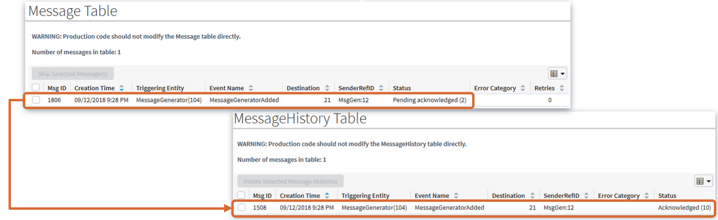
Positive acknowledgements
A positive acknowledgment is when the external system reports the acknowledgement
  Message was successfully received and processed
Guidewire application response to ACK
  Moves the message from Message to MessageHistory
  Changes the status to reflect acknowledgement
Notes:
When the external system reports a message was successfully received and processed, Guidewire interprets this as a positive acknowledgement, also known as an ACK. When a message is positively acknowledged, Guidewire a) moves the message from Message to MessageHistory, and b) changes the status to reflect acknowledgement.
Status is an integer field on both Message and MessageHistory. In most cases, developers do not need to know what each integer represents. However, the statuses are defined in the Data Dictionary. The "Status" column in the TrainingApp Message Table and MessageHistory Table screens includes both the integer code and its meaning. (For example, a Status of "2" means "pending acknowledged".)

Slide 9
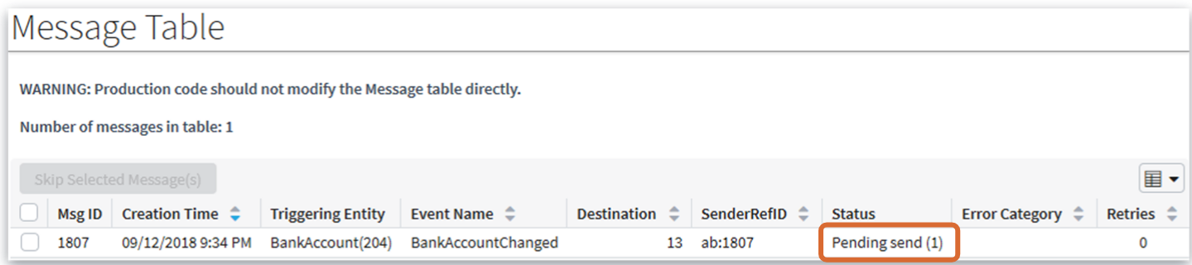
Messaging exception during send
Initial send from Guidewire transport throws an exception
Guidewire application response
  Message stays in Message table
  Message status stays as Pending send (1)
  Guidewire retries to send the message until reaching the maximum number of retries as defined in the destination
  At maximum retries, the Guidewire suspends the destination
Notes:
An exception is different than a reported error for a message. There are various types of exceptions such as a java.net.ConnectionException or gw.xml.ws.WsiAuthenticationException.
When there is an exception is thrown in a transport plugin class in a send method, the Guidewire application response is to retry sending the message until reaching the maximum number of retries. The message's destination configuration defines the value for the maximum number of retries.
In order for an additional messages to be processed for the messaging destination, you need to skip any messages reporting an error and to resume the suspended destination. An administrator can manually skip a message. It is also possible for custom code to skip messages, for example, from within a batch process. If a message is safe ordered, the next message for the destination/entity pair will not be sent until the message is either resent and successfully acknowledged or skipped.

Slide 10
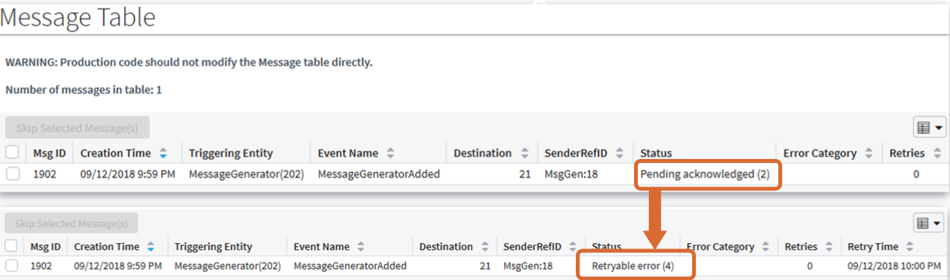
Messaging errors
Error from external system is a NACK
  Temporarily cannot process the successfully received message
  Reports error, a negative acknowledgement (NACK)
Guidewire application response
  Message stays in Message table
  Guidewire assigns message status of retryable error
Retry scenario
  Manual retry from administrator or integration code to resend message
Notes:
Guidewire applications consider all messages with an error as retryable messages. A status of a retryable error indicates a condition that is expected to be temporary for the messaging destination. Some examples of temporary errors are: the external system is unreachable due to network problems, authentication protocols require new credentials, database locks, and the file system is full. In all cases, Guidewire application considers the messaging error as a retryable error.
The term "negative acknowledgement" (or "nack") indicates that the external system is reporting an error. The mechanism for a negative acknowledgement is similar to an acknowledgement with respect to if the messaging architecture is synchronous or asynchronous. If the messaging is synchronous, the negative acknowledgement occurs in the transport plugin. If the messaging is asynchronous, a reply plugin, or a remote API reports the error.

Slide 11
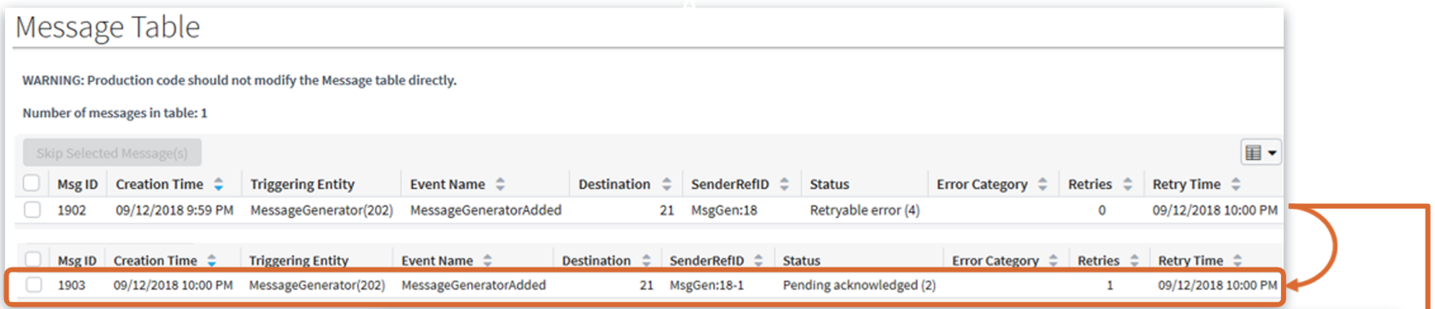
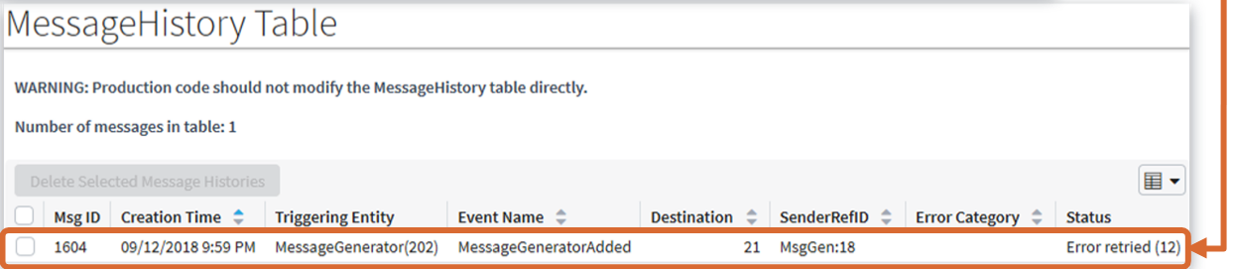
Retrying an error
Message is moved to MessageHistory
A copy of the message is created and sent
  References the same event and triggering entity
  Uses a different SenderRefID
  Incremented retry field by 1
Notes:
Note that in the screenshot of the Message table, there are two messages, one with an ID of 330 and one with an ID of 331. The first message had a status of "Pending acknowledged" and then had a status of "Retryable error". When the error was retried, Message 330 was moved to the MessageHistory table, and Message 331 was created and sent. Even though Message 331 has a different SenderRefID, it is linked to the same triggering entity (MessageGenerator(20)). So Message 330 and Message 331 are two separate message instances that relate to the same logical business event.

Slide 12
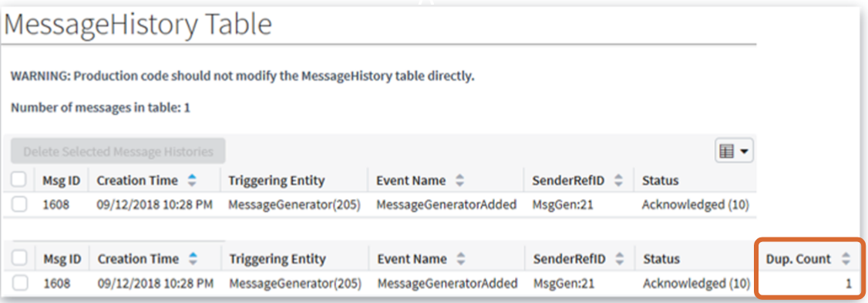
Duplicate messages
Duplicate messages
  One message sent successfully
  Received by the external system
  External system processes the same message more than once
  External systems responds with a positive acknowledgement (ACK) per each processed duplicate
Guidewire application response
  Increments the Duplicate Count (Dup. Count) in the Message History table
Notes:
Guidewire does not treat a message with a non-zero duplicate count any differently from a message with a zero-duplicate count. However, the recommendation is to process duplicates reported by the external system so as to retain as much information as possible about what was sent from the external system.

Slide 13
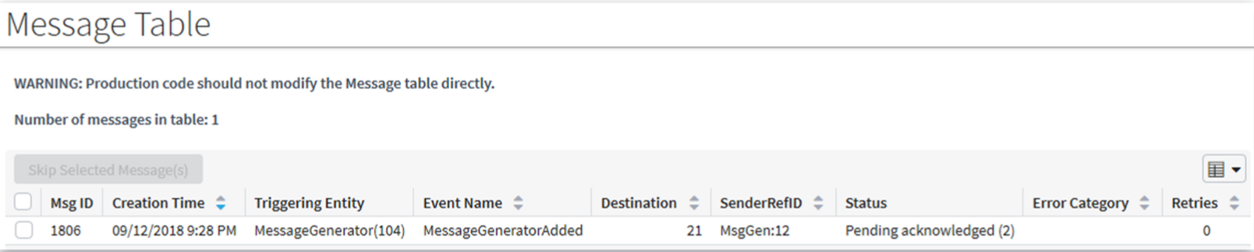
No response
Guidewire application sends message to external system
  No ACK or NACK from external system
Guidewire application response
  Keeps the message in the Message table
Consider batch process to purge message table and avoid manual intervention
  Apply logic for overdue messages
Notes:
If no reply is received for a message, the message remains in the Message table. There is no time frame at which the message is automatically resent or abandoned. Typically, a custom batch process or third-party database tool checks the Message table for messages whose responses are overdue and then takes appropriate steps to fix the situation.
The Message table should be checked for messages that have not received a reply within a timely fashion. This could be a Guidewire custom batch process or a database tool that monitors the Message table. Each non-response message typically requires manual evaluation to determine the cause of the non-response and the appropriate steps to fix the situation.

Slide 14

Acknowledgement mechanisms
Messaging destinations require acknowledgement mechanisms
Synchronous with the sending of message
Asynchronous via an API
Asynchronous via a listener or polling mechanism
Synchronous
Asynchronous
API
Asynchronous
listener / polling
Notes:
Often, each destination expects to receive acknowledgements in one of three ways: synchronous with the sending of message, asynchronous from an API, or asynchronous with a listener or polling mechanism.

Slide 15
Plugins that acknowledge messages
Request
Plugin
external
system
xx_message
sending
message
Transport
Plugin
synchronous
reply
Web service
or socket
asynchronous
reply via
API
asynchronous
reply via
listener
or polling
Reply
Plugin
Notes:
Every destination has up to three plugins that are used for messaging. Two of these plugins could play a role in acknowledging a message, though it is possible that no plugin is used for acknowledgement.
The request plugin is an optional plugin that is responsible for payload transformation. It is not involved in the acknowledgement of messages.
The transport plugin is a required plugin that is responsible for sending the message to the external system. If the acknowledgement is received synchronously, then this plugin also processes the reply.
An external system can acknowledge a message using a remote call (either the IMessageToolsAPI or a custom-built web service). If a remote call is used, then the message reply is handled independent of the destination's plugins.
The reply plugin is an optional plugin that initializes a listener queue and associates it to the destination. It processes acknowledgements sent asynchronously using the listener queue.
Like predefined plugins, messaging plugins can be implemented in Gosu or Java.

Slide 16
Message acknowledgement transactions
Application server(s)
Batch server
triggering and
payload generation
sending to external system
xx_message
payload
tran 1
tran 2
tran 3
tran 4
processing
acknowledgement
external
system
Synchronously acknowledged message
  Acknowledgement processed in the sending transaction, trans 3
  Messaging transport plugin acknowledges
Asynchronously acknowledged message:
  Acknowledgement processed in separate transaction, trans 4
  Remote call API or Messaging reply plugin acknowledges
Notes:
If a message is acknowledged synchronously, the acknowledgement is processed in the same transaction that sends the message.
If a message is acknowledged asynchronously, the acknowledgement is processed in its own transaction.
Transaction scope has particular meaning in how a Guidewire application manages the lifecycle of a message. It also has implications for messaging code that creates, updates, or deletes a non-messaging entity instance within a messaging transaction. In these instances, the code should use the current transaction. If there is an error in the messaging transaction, the work done to the non-messaging entity instance gets rolled back. In other words, messaging transaction code that creates, updates, or deletes a non-messaging entity instance should not occur in a new bundle transaction, but within the current messaging transaction.

Slide 17
Overview of message acknowledgements
Working with messaging acknowledgements
Synchronous acknowledgement
Asynchronous remote call acknowledgement
Reply plugin acknowledgement
Message administration

Slide 18
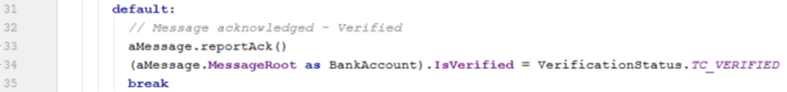
Reporting positive acknowledgement
message.reportAck()
Include processes that respond to the acknowledgement:
  Changing a verified status to true
  Recording an acknowledgement code
  Saving a received report to the database
Notes:
In some cases, Guidewire applications use messaging to request data such as reports from external systems, such as:
A police report detailing an accident or burglary of insured items.
A medical report detailing customary prices for given medical procedures.
A fraud report detailing that a claim for a given loss has already been filed.
In these cases, the external system responds with the report data and acknowledges the message. Often, the mechanism for the external system response is a Guidewire application published web service or messaging reply plugin.

Slide 19
Reporting errors (below max)
Message destination should define retry behavior
  Max retries after initial send
  Initial retry interval
  Retry backoff multiplier
Define parameters for maximum retries
  Plugin parameter (for reply code in transport/reply plugin)
  Script parameter (for reply code in web services)
message.reportError(retryTime)
  Call before the max retries has reached
  Guidewire send again at the retry time
  Use a new SenderRefID
  Increase the resend time per each resend
Notes:
Every destination should have a specific number of times a message can be retried after the initial send. The number of retries should be specified using either a plugin parameter for the reply code in the transport or reply plugin or a script parameter for the reply code in the web services handler.
Before the max has been reached, report the error using message.reportError(whenToResendMessage). Then, when sending the retry message, use a new SenderRefID even though it pertains to the same message event, it must be treated as a new message. The amount of time between resends should increase with each resend.
If a message is resent two or more times because the external system reported a retryable error, each message should use a different SenderRefID. This is because the external system may treat two messages with the same ID as the same message. In other words, the external system may be "duplicate aware". If the second message uses the same SenderRefID as the first, then the external system may ignore it or report it as a duplicate, which would prevent the message from ever getting processed.
You can also manually retry any message using the Event Messages administration screens. This is discussed later in this lesson.

Slide 20
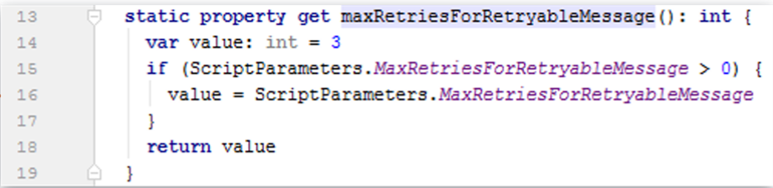
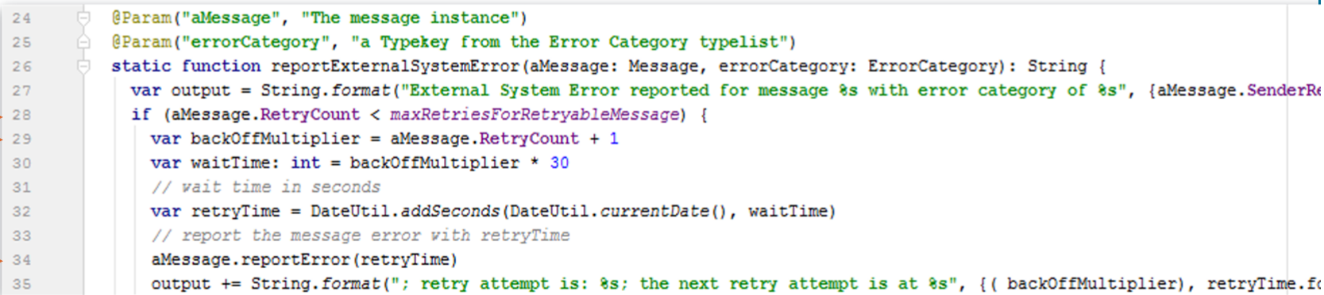
Retry time example
Code Example 1
Code Example 2
Notes:
Code example 1
Line 16
Custom parameters needed for re-send retry behavior.
Defined for maximum retries, retry delay etc.
Plugin parameters(for reply code in plugins)
Script parameters (for reply code in webservices)
Code example 2
Line 28
Check if below max retries
Line 29
RetryCount property starts at 0 and increments with each resend.
Line 34
Call reportError(retryTime) before maximum retries limit reached
Application sends a cloned message at the future retry time
In the slide example, the code references a function that you can find in the trainingapp.demo.messageack.MessageAckUtil class in TrainingApp.
The reportExternalSystemError() function illustrates how an external system can report an error using a remote API call or message reply plugin.
A backoff multiplier is a value that is used to increase a retry interval arithmetically. In the example above, the backoff multiplier simply increases the wait time by 60 seconds per iteration. For the first resend, aMessage.RetryCount is 0, so backOffMultiplier is set to 1 and waitTime is set to 30 seconds. For the second resend, aMessage.RetryCount is 1, so backOffMultiplier is set to 2 and waitTime is set to 60 seconds. For the third resend, waitTime is set to 120 seconds, and so on.

Slide 21
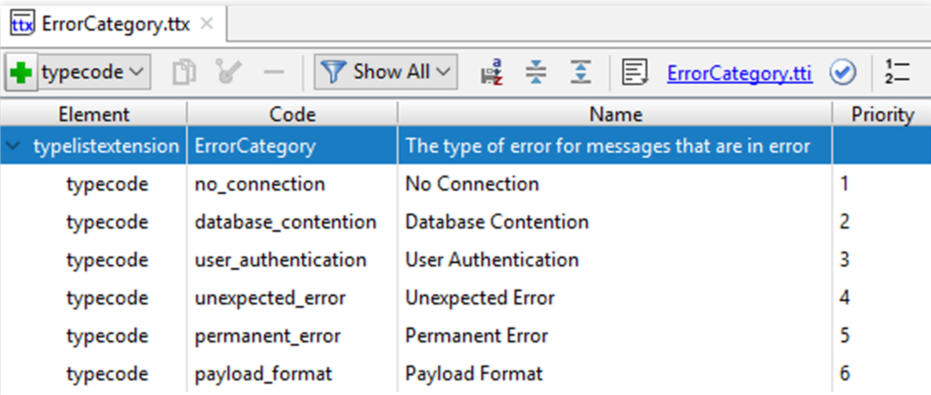
Reporting errors (at max retries)
Define typekeys in ErrorCategory typelist extension
  …\config\extensions\typelist\ErrorCategory.ttx
message.reportError(errorCategory)
  Call when retry max has been reached
  Specify the error category
  Alert an administrator to the message error
  Guidewire no longer tries to resend the message
Notes:
ErrorCategory is a typelist that identifies the error reason for a message. In each base application, the typelist is empty.
When a given message's retry max has been reached, report the error using message.reportError(errorCategory) and alert an administrator to the issue as it pertains to the message error. Guidewire will no longer try to resend the message. When you simply report the error, but no exception is thrown, Guidewire will not suspend the message destination.

Slide 22
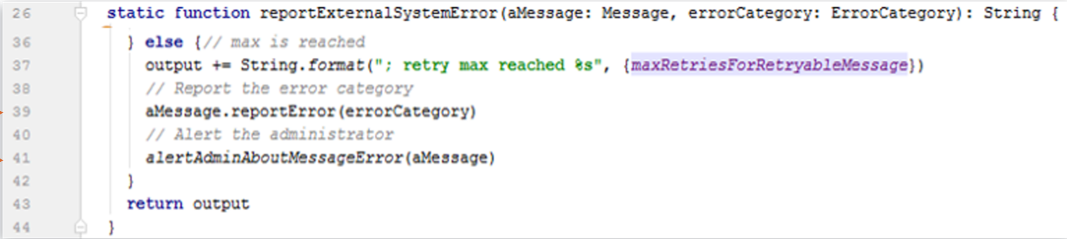
At errors (at max retries) example
message.reportError(errorCategory)
  Call before the max retries has reached
An administrator alert usually takes the form of:
  An email sent to the administrator,
  An activity assigned to the administrator
Notes:
Code example
Line 39
Call message.reportError(errorCategory) when the maximum retries limit reached
Application no longer tries to resend the message
Line 41
An administrator alert usually take the form of
An email send to the administrator
An activity assigned to the administrator
In the slide example, the code references a function that you can find in the trainingapp.demo.messageack.MessageAckUtil class in TrainingApp.
A backoff multiplier is a value that is used to increase a retry interval arithmetically. In the example above, the backoff multiplier simply increases the wait time by 60 seconds per iteration. For the first resend, aMessage.RetryCount is 0, so backOffMultiplier is set to 1 and waitTime is set to 60 seconds. For the second resend, aMessage.RetryCount is 1, so backOffMultiplier is set to 2 and waitTime is set to 120 seconds. For the third resend, waitTime is set to 180 seconds, and so on.

Slide 23
Contrasting retry scenarios
 | Initial send error (Automatic retry during send) | External system error (Automatic retry after send ) | Manual retry
What is the problem? | Exception thrown in beforeSend() or send() | External System reports error | Message needs manual intervention
What executes the retry? | Internal Guidewire behavior | Integration code | Admin (using Retry button)
Should each attempt use the same SenderRefID | Yes | No | Yes
What specifies the max retry number? | Max Retries property for messaging destination | Integration code using parameter from plugin or script | n/a
What happens when the max number of retires is reached? | The destination is suspended | Integration code reports error with error category | n/a
Notes:
A message could be retried automatically during the sending of the message. A message could be retried manually. Both are discussed in detail in the Sending Messages lesson.
A message can be retried automatically after the sending of the message.
Occurs when the external system reports a retryable error. For example, the message was received but not successfully consumed. The error is expected to be temporary, such as unavailable network resource.
The message should be retried automatically by the integration code. When the code reports a an error, it should specify a retry time.
Even though it pertains to the same message event, the retry is a different message and the same SenderRefID should not be used. If the same SenderRefID is used, then the external system may consider the second attempt to be a duplicate message and disregard it.
The maximum number of retries is specified by the integration code as defined by plugin parameter (for the transport or reply plugin) or a script parameter.
If a given message exceeds the maximum number of retries, then the message should be reported with an appropriate error category, an administrator should be alerted somehow, and no further automatic attempts should be made. Any other messages for the same destination should not be affected.

Slide 24
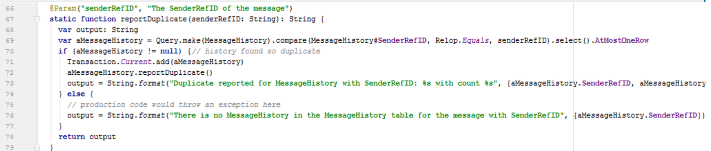
Reporting duplicates
messageHistory.reportDuplicate()
From MessageHistory instances, report duplicates
  One message sent successfully and received by the external system
  External system processes the same message more than once
  External systems responds with a positive acknowledgement (ACK) per each processed duplicate
Notes:
In the slide example, the code references a function that you can find in the trainingapp.demo.messageack.MessageAckUtil class in TrainingApp.
Duplicates can be reported only from MessageHistory instances. When an external system reports a duplicate, the integration code should simply find the related entry in the MessageHistory table (based on the message identifier, such as the SenderRefID) and report the duplicate. The only effect this has is incrementing the MessageHistory entry's DuplicateCount integer. Guidewire does not treat a message with a non-zero duplicate count any differently than a message with a zero-duplicate count. However, the recommendation is to process duplicates reported by the external system so as to retain as much information as possible about what was sent from the external system.

Slide 25
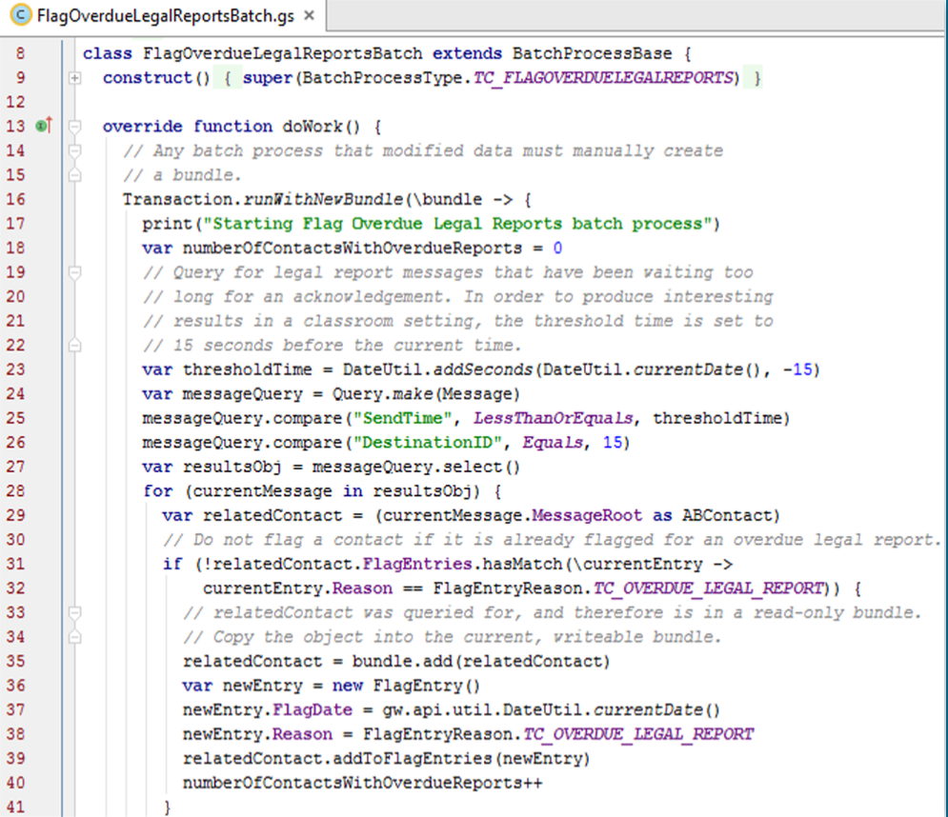

Messages without responses
Check for messages
that have not received a reply within a timely fashion
Check the xx_message table
  Batch process
  Database monitoring tool
Evaluate the cause and handle the resolution
FlagOverdueLegalReportsBatch
Notes:
Periodically, the Message table should be checked for messages that have not received a reply within a timely fashion. This could be a Guidewire custom batch process or a database tool that monitors the Message table. Each message typically requires manual evaluation to determine the cause of the non-response and the appropriate steps to fix the situation.

Slide 26
Overview of message acknowledgements
Working with acknowledgements
Synchronous acknowledgement
Asynchronous remote call acknowledgement
Reply plugin acknowledgement
Message administration

Slide 27
Synchronous acknowledgement
Request
Plugin
external
system
xx_message
sending
message
Transport
Plugin
synchronous
reply
Synchronous acknowledgement implemented immediately after sending the message
Acknowledgement code is included in the transport plugin's send() method
Notes:
Messages can be acknowledged in the send() method if successful delivery constitutes successful consumption, or if there is a return value from the external system that indicates success. For example, in a synchronous call, a certain return value could indicate acknowledgement.

Slide 28
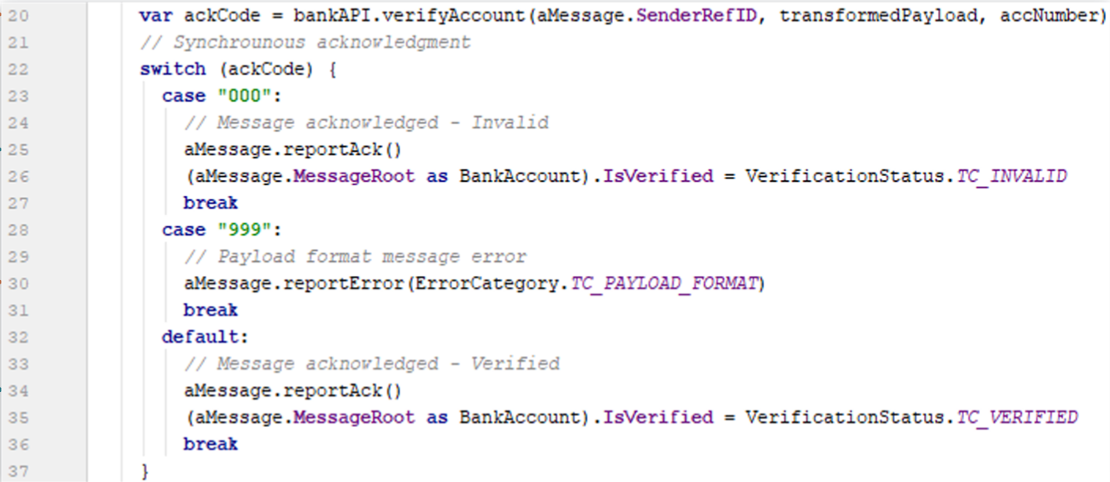
Example: Synchronous acknowledgement
message.reportAck()
  Occurs within transaction scope of message transport plugin's send() method
  IsVerified field is set based on the value returned from the external system (lines 22 - 36)
Notes:
In the slide example, the code references a function that you can find in the BankAccountVerificationTransport class in TrainingApp.
When there is a bank account verification from an external system, then the message is acknowledged synchronously within the message transport plugin's send method. If there no verification (null value), you would want to capture and throw an exception and then report the error

Slide 29
Overview of message acknowledgements
Working with acknowledgements
Synchronous acknowledgement
Asynchronous remote call acknowledgement
Reply plugin acknowledgement
Message administration

Slide 30
No plugin for asynchronous remote calls
Request
Plugin
external
system
xx_message
sending
message
Transport
Plugin
Web service
or socket
asynchronous
reply via
API
Ack code is not executed from a plugin
Message acknowledged asynchronously through an API
Notes:
Messages can be acknowledged asynchronously through an API. In this case, the ACK code is not executed from a plugin. An external system can acknowledge a message using a remote call (either the MessageToolsAPI or a custom-built web service). If such a remote call is used, then the message reply is handled in code that is independent of the destination's plugins.

Slide 31
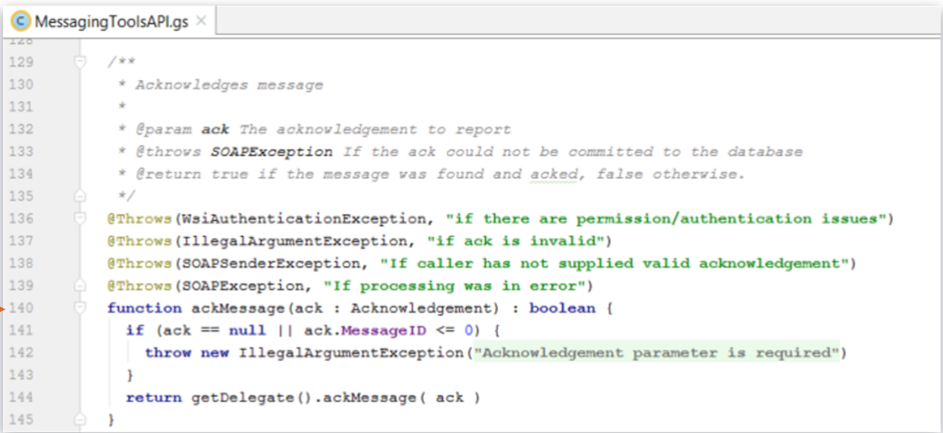
Using a WebService API
External system uses a published web service API
  MessagingToolsAPI, or
  Custom API
Provides a message acknowledgement
  Positive ACK
  Report external error (NACK)
  Duplicate
  No response
Notes:
There is a base application API, MessageToolsAPI, that can also be used to acknowledge a given message. However, for a given message, the only thing you can do is acknowledge it. You cannot execute any associated data changes. Because custom web services provide the flexibility to execute any required logic, Guidewire recommends that acknowledgements should be received through a custom web service.
Publishing custom web services is covered in detail in the Publishing Guidewire Web Services lesson.

Slide 32
Overview of message acknowledgements
Working with acknowledgements
Synchronous acknowledgement
Asynchronous remote call acknowledgement
Reply plugin acknowledgement
Message administration

Slide 33
Reply plugin acknowledgement
Request
Plugin
external
system
xx_message
sending
message
Transport
Plugin
asynchronous
reply via
listener
or polling
Reply
Plugin
Acknowledges message asynchronously through a listener queue
Notes:
The reply plugin is an optional plugin that initializes a listener queue and associates it with the destination. The reply plugin is implemented to receive replies as dictated by the external system, such as: a listener to a JMS message queue, a socket listener, or a RMI server.

Slide 34
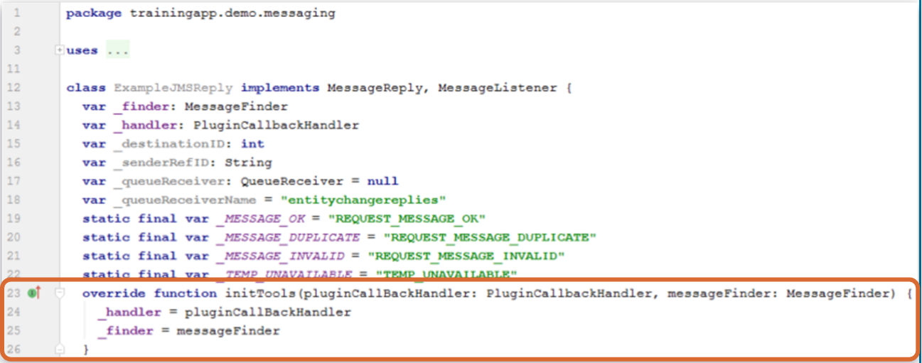
initTools() executed at application startup
initTools method
Executed during reply plugin instance startup, helpful in processing asynchronous replies
Notes:
initTools() is method specified in the reply plugin that is executed during server startup. It provides resources that may be useful in processing replies. Like both the request and transport plugins, a reply plugin also includes the same set of lifecycle methods including resume(), shutdown(), and suspend(). Reply plugins also have a setDestinationID() method.

Slide 35
Message reply plugin tools
MessageFinder finds the message to be acknowledged based on:
  The message identifier (often SenderRefID and destination ID)
  The message integer ID if SenderRefID is not used
PluginCallbackHandler provides transaction context for:
  Acknowledging the message
  Any additional entity data changes
If multiple replies are received for the same message, the reply plugin implementation should not change system state or cause harm

Slide 36
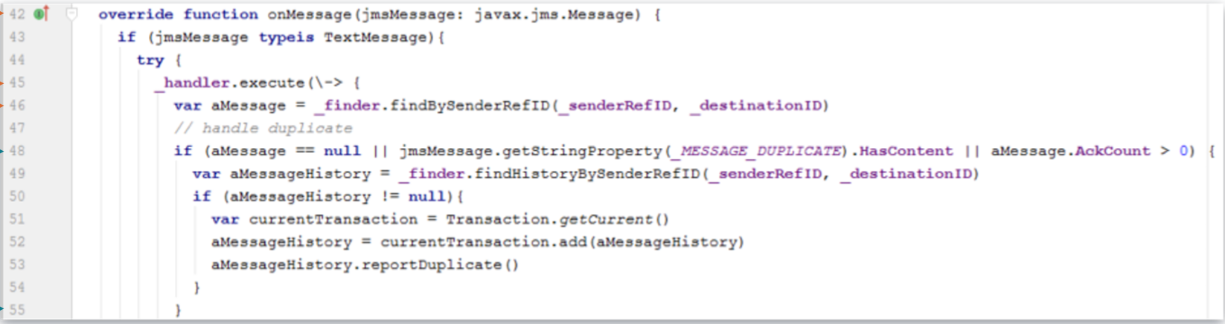
Message reply plugin: Example (1)
Notes:
Code example
Line 42
onMessage method executes message acknowledgement
Line 45
_handler provides transactional context
Line 46
Find pending acknowledgement message using SenderRefID and destination
Line 48-55
Handle duplicate acknowledgement

Slide 37
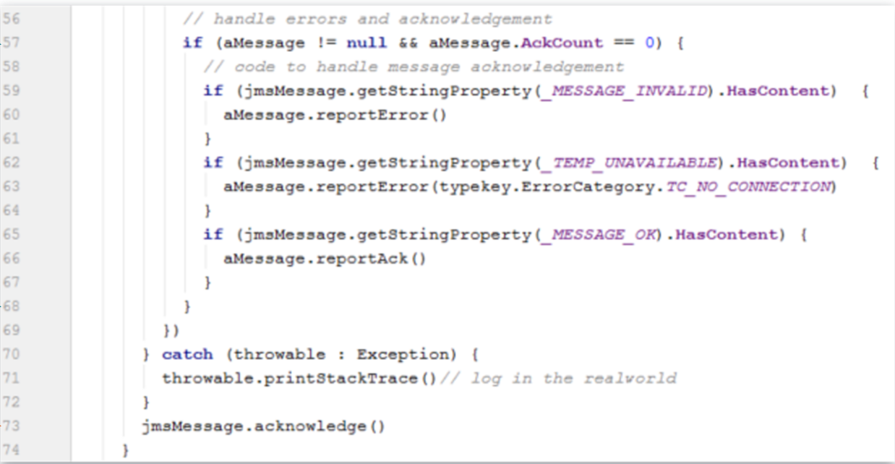
Message reply plugin: Example (2)
Notes:
Line 57-68
Handle errors and acknowledgement based on error type
Line 73
Acknowledge the message. The message will be moved from the MessageTable to the history table

Slide 38
Step 5: Deploy message acknowledgement
Restart Server
Reload Changed Classes
Destinations
Plugin registry elements
Reply Plugin Gosu class
Destination
Plugin
Registry
Reply Plugin
Gosu Class
Notes:
You must restart the server when you create or modify destinations, plugin registry elements, and/or reply plugins.
If you implement your message reply plugin in Java, then you will need to compile the Java class and recopy it into the Guidewire directory structure.

Slide 39
Overview of message acknowledgements
Working with acknowledgements
Synchronous acknowledgement
Asynchronous remote call acknowledgement
Reply plugin acknowledgement
Message administration

Slide 40
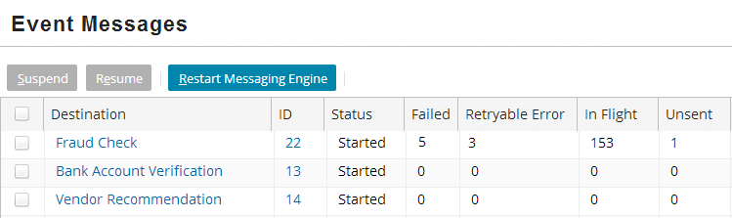
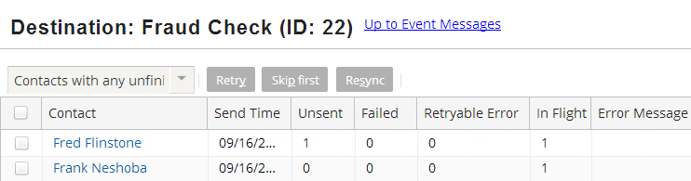
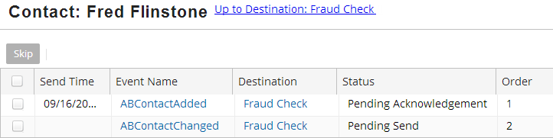
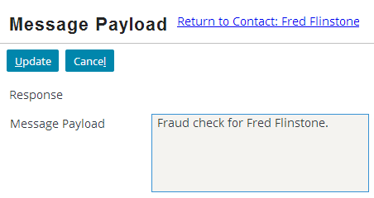
Message administration
A series of
drilldown
screens for
message administration
Administration tab →
Event Messages
Notes:
The Event Messages screens group all unacknowledged messages by:
Destination, then...
Primary entity (safe-ordering, plus one set for all unordered), then...
Status: failed, retryable error, in flight, and unsent

Slide 41
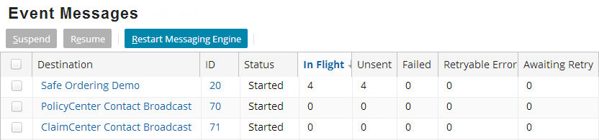
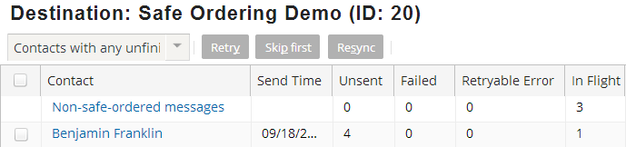
Event Message
Suspend, resume, and view messages for each destination
Safe-ordered and non-safe-ordered messages
  When applicable, screen segments messages
Notes:
From Event Messages, you can suspend, resume, and view messages for each destination
When safe ordering applies to a destination, the screen separates messages into safe-ordered and non-safe ordered
The following lists the primary safe ordering entity and resync event name for each application:
ClaimCenter: Claim; ClaimResync
PolicyCenter: Account; ResyncAccount
ContactCenter: ABContact; ABContactResync
BillingCenter does not use safe ordering.

Slide 42
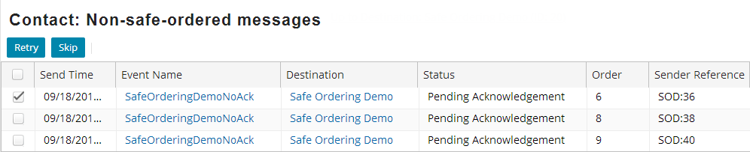
Drilldown screens
Retire or skip messages
Drilldown into message event
Edit the payload manually
Notes:
Each message can be retried or skipped as needed. You can also click the message's event name to view and manually edit the payload. Using the Destination screen, you can initiate a resync, which:
Skips ALL ordered messages (failed, retryable, in-flight, and unsent) on primary entity / destination pair
Raises an entity resync event, which is handled by Event Fired rules. The rules typically send similar message(s) to bring the external system back in sync with the Guidewire application.

Slide 43
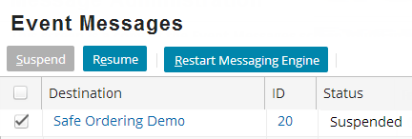
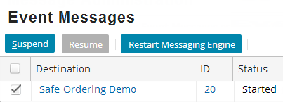
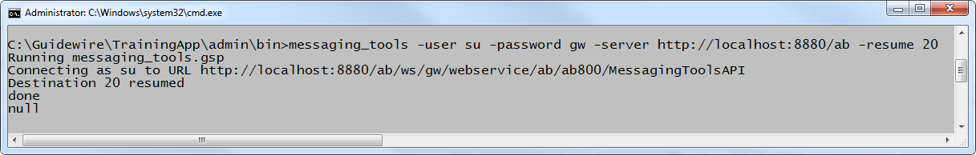
Message admin using MessagingToolsAPI
messaging_tools
  -user user -password password -command -param
  Syntax to execute from admin/bin
Commands include
  [ -suspend | -resume ] destinationID
  [ -retry | -skip ] messageID
Notes:
The specified user must have SOAP administration permissions. The list below specifies parameters relevant to messaging administration. The API also has additional non-messaging capabilities. For further information on messaging_tools, refer to the System Administration Guide.
Option Description
-user user Specifies the user to run the process.
-password password Specifies the administrative password.
-server url Specifies the host server url.
-resume destinationID Resumes the operation of the specified message
destination.
-retry messageID Attempts to resend a message that failed.
The message must be a candidate for retrying.
A message is a candidate if the error at the
destination system was
temporary and the message destination has no
automatic retry mechanism.
-retrydest destinationID Retries all retryable messages for a message
destination.
(continued...)

Slide 44
Notes:
Option Description
-skip messageid Skips a message with the specified ID. If you mark a
message as skipped, then Guidewire stops trying to
resend the message. After you skip a message, you
can not retry it.
-statistics destinationID Prints the statistics for the specified destination.
-suspend destinationID Suspends a message destination.
Use this command if the destination system is going to be shut down or to halt sending while Guidewire
processes a daily batch file.
-purge date Deletes completed messages that are older than a
specified date. (See "Purge Tool" below.)
Purge Tool
The purge tool deletes messages in Acked, ErrorCleared, Skipped or ErrorRetried state with send time before the specified date. If the purge tool succeeds in removing these messages without error, it reports “Message table purged”. Since the number and size of messages can be very large, periodically use this command to purge old messages to avoid the database from growing unnecessarily.

Slide 45
  Describe messaging acknowledgement
  Identify various messaging acknowledgement mechanisms
  Characterize the difference between an exception in sending a message and a messaging error
  Use the administration screens to view a message's status and manipulate it manually as needed

Slide 46
DEMO

Slide 47
This demonstration will examine the following Asynchronous acknowledgement scenarios.
-Positive acknowledgement
-Negative acknowledgement
-Duplicate acknowledgement
Requires:
-Training App &Supported Web Browse

Slide 48
LAB

Slide 49
Complete the exercises listed in “Acknowledging Messages” chapter in the “InsuranceSuite 10 Integration: Kickstart “ work book

Slide 50
What is a messaging acknowledgement from an external system?
What are the possible ways Guidewire can interpret an external system's response to a message?
Under what three circumstances is an entry added to the MessageHistory table?
Under what circumstances are acknowledgements processed:
  By the transport plugin?
  By the reply plugin?
  Without involvement from any plugin?
  (continued)
Notes:
Answers
1) A messaging acknowledgement is Guidewire's process for interpreting a messaging response from an external system.
2) Guidewire can interpret an external system's response, if one exists, as a positive acknowledgement, error, or duplicate.
3) A message is added to the message history table when a message is positively acknowledged, skipped, or retried. For the first two, the message is removed entirely from the Message table. For the third, a copy of the original message remains in the Message table
4a) When the reply is received synchronously.
4b) When the reply is received asynchronously through a listener or polling mechanism.
4c) When the reply is received asynchronously by an external system call to an API
(continued)

Slide 51
When should you use each of the following methods?
  aMessage.reportError(retryTime)?
  aMessage.reportError(errorCategory)?
Notes:
Answers (continued)
5a) When the message needs to be retried and the message has not reached its maximum number of retries.
5b) When the message needs to be retried, but the message has reached its maximum number of retries.

Slide 52
THANK YOU

