Slide 1

InsuranceSuite 10 Integration
InsuranceSuite 10 Fundamentals
AUTHENTICATION INTEGRATION

Slide 2
  Describe the process for Guidewire user authentication
  Create plugins that build authentication sources
  Create plugins that user authentication sources to authenticate users
  Create plugins that authenticate Guidewire application when connecting to a Guidewire database

Slide 3
User authentication overview
User authentication source creator plugin
User authentication service plugin
Soap Webservice API Authentication
Database authentication overview and plugins

Slide 4
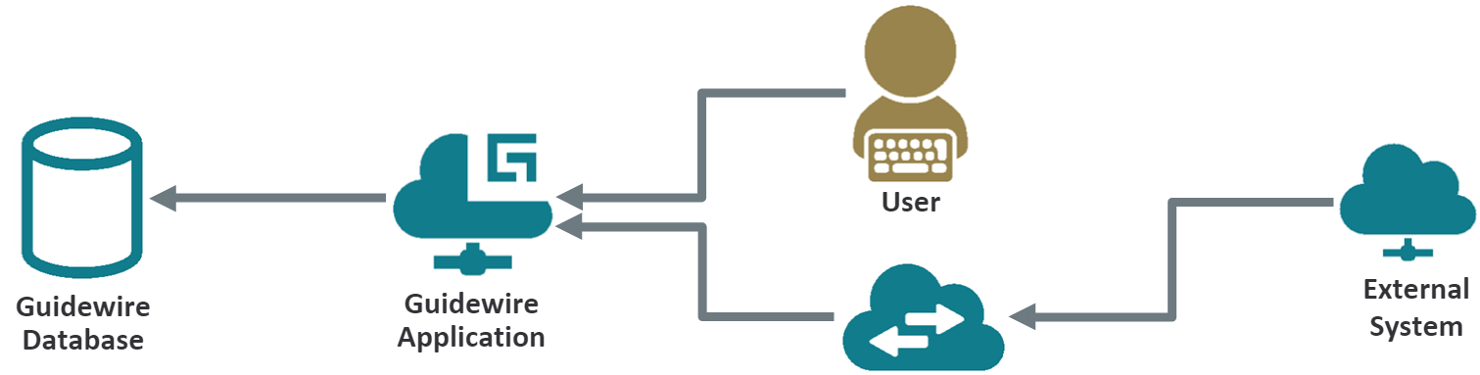

Authentication scenarios
Web Service
User Authentication
User logs into a Guidewire application via login page
SOAP Web Service API Authentication
External system user via webservice API
Database Authentication
Database connection requires username and password
Notes:
There are various authentication scenarios and uses cases for authentication. In most cases, an authentication scenario includes having a user log into a Guidewire application via a web form login page. Another common scenario is for an external system to log into a Guidewire application via a web service API. Similarly, Guidewire applications often integrate and share data with third party databases. In order to do so, the Guidewire application must itself be authenticated.

Slide 5
User authentication information
Can consist of:
  Username/password from web form or external system
  Single sign-on credential (SSO)
  Client certificate
Authentication Source Creator plugin
  Creates authentication source
Authentication Service plugin
  Determines if credential is valid
  Allows user to log into
  Guidewire application
Authentication
source creator
plugin
Authentication
service
plugin
Notes:
One important detail with clients certs (certs in general) is that is can be exported and most implementations do not lock down portability of the cert. Stronger implementations (application dependent) may store the certs and keys in a keystore (i.e. java key store). The key store can add additional protection like ensuring the private key is not exportable. Hardware key stores (i.e. smart cards, usb hsm, ironkey, etc) offer a much stronger assurance that private key is not exportable than software key stores.

Slide 6
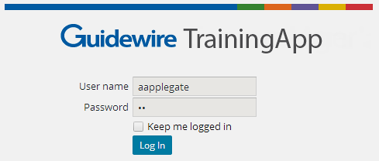
Authentication source creator plugin
Key value
pair
Web Form Login
Authentication source
creator plugin
Authentication Source
Receives user authentication information
  Username and Password key value pair
  Example: Web Form Login
Creator Plugin converts to an Authentication Source
  A structured credential used by the Authentication Service
All Guidewire applications use the Authentication source creator plugin by default
Notes:
If you implement the AuthenticationSourceCreator plugin such that it uses a source type other than UserNamePasswordAuthenticationSource, you should either:
(a) Extend your AuthenticationSource type from UserNamePasswordAuthenticationSource, so that it is compatible with the authentication process. The application code will check if the authentication source returned from the source creator plugin is a UserNamePasswordAuthenticationSource, or subtype thereof, and if so will examine the username property. An empty username property indicates that this is a first access attempt, and the user will be taken to the Login Form.
...OR...
(b) Include logic in the AuthenticationService plugin's authenticate(..) method to differentiate between the types of AuthenticationSource objects that may be received.
If you use an authentication source that does not inherit from UserNamePasswordAuthenticationSource, you will probably have to fix up some other parts of the application configuration, so that a first access attempt does not appear to be a failed login. You may need to differentiate a login from the UI from a login from an API / the Studio.
Note that for web service API and Studio logins, the AuthenticationSourceCreator plugin is not invoked. The Guidewire Studio application and the web service APIs for login can only send a username and password. Rather, the Guidewire application creates a UserNamePasswordAuthenticationSource object that holds the username and password values provided. Then, the object invokes the authentication service's authenticate() method.

Slide 7

Authentication service plugin
User
Authentication
service plugin
Guidewire
Application
Determines whether to permit a user to log in
Typically validates a user credentials using
  An external system such as MS Active Directory or LDAP
  Internal user table such as gwXX_Credential
  Other data store, internal or external, for user credentials
Notes:
The Authentication service plugin determines whether or not to permit a user to log into a Guidewire application. The Authentication Service Plugin typically validates a user credential using an external system, and internal user credential, or other data store, internal or external, for user credentials.
When creating a custom AuthenticationServicePlugin implementation, you need to override the authenticate() method.
Both user and web service requests call the authenticate() method. Often, a custom implementation only checks the presence of the user login in the system bypassing the password verification. The reason for this is that user requests often have already supplied the required password verification with a Single Sign On (SSO) service.
If this is not the case, your AuthenticationServicePlugin code should enable a password check when you supply a username. The AuthenticationServicePluginCallbackHandler interface contains the verfyInternalCredentials() method that takes both the username and password as input parameters. Use this method to verify the username and password. The method returns a CredentialVerificationResult that can contain on of the following: BAD_USER_ID, WAIT_TO_RETRY, CREDENTIAL_LOCKED, PASSWORD_MISMATCH, or SUCCESS.

Slide 8
Web services authentication plugin
Web Service
WS-I Web Service
Authentication plugin
Guidewire
Application
For WS-I web services that require permissions
  Handle the name/password authentication for a user connecting to WS-I web services
  Calls the registered implementation of the AuthenticationServicePlugin
A registered and enabled version of the plugin required otherwise web services are unable to authenticate
Notes:
The default configuration of the WebservicesAuthenticationPlugin is registers gw.plugin.security.DefaultWebservicesAuthenticationPlugin. This internal class uses the WebservicesAuthenticationContext for authentication information that is in found in either the Http Request headers or the request SoapHeaders.
The DefaultWebservicesAuthenticationPlugin plugin implementation supports WS-I web service connections only. This plugin does not support authentication for the older style of RPCE web services nor for authenticating login from the application user interface. The class looks at HTTP request headers for WS-I authentication information.
To change the default web services authentication behavior, write your own class that implements the WebservicesAuthenticationPlugin plugin interface and performs authentication against the local Guidewire applications users in the database. This class calls the registered implementation of the AuthenticationServicePlugin plugin interface, so if you implement your own version of the interface, be aware of this interaction.
There must always be a registered version of the WebservicesAuthenticationPlugin plugin otherwise web services that require permissions cannot authenticate successfully.

Slide 9
User authentication flow
Application Server
API client /
Web browser
(2) Auth. source plugin extracts credentials
External Directory
Auth.
source
creator
plugin
Guidewire
application
(3) Server request auth.
(1) Login request
contains key value pair of username /password
(6) Auth. service sends response
(4) Auth. service
verifies credentials
Auth.
service
plugin
(5) Auth. service gets
User.PublicID
Guidewire database
Notes:
The user authentication flow consists of six steps:
An initial login request is received. User authentication requests can come from web browsers and web service API calls (including command line tools). If the specified user is not currently logged in, Guidewire attempts to log in the user.
An authentication source creator plugin extracts the request’s credentials. Guidewire externalizes the logic for extracting the login information from the initial request and placing it in a structured credential called an authentication source. This plugin creates the authentication source from information in an HTTPRequest from the browser and returns it to Guidewire. If an Authentication Source Creator plugin is not configured, a default built-in plugin will take the role, which will extract username/password from HTTPRequest attributes having the same names.
The server requests authentication using an authentication service plugin. Guidewire passes the authentication source to the authentication service plugin, which is responsible for determining whether or not to permit the user to log in.
The authentication service plugin checks the credentials. If authentication service plugin is not defined, the built-in plugin checks the provided username and password against information stored in Guidewire’s database. However, a custom implementation of the plugin can check against an external authentication service such as a corporate LDAP directory or a single sign-on system (SSO).
The authentication service looks up the user’s public ID. If the user’s credential is verified successfully above, authentication service plugin will use the callback handler to look up the user’s public ID from Guidewire’s database.
Authentication service plugin responds to the request. The authentication service plugin responds, indicating whether to permit the login attempt. If allowed, Guidewire will set up the user session and give the user access to the system. If rejected, Guidewire will redirect the user to a login page to try again, or return authentication errors to the Web Service API client.

Slide 10
Review: Steps to implement plugins
Determine plugin requirements
  What interface must it implement?
Write (or modify) plugin class
  Gosu
  Java
Move plugin code to proper directory (if necessary)
  Special requirements for Java classes and libraries
Modify plugin registry file (if necessary)
Deploy changes
Notes:
For Gosu plugins, the class files should be located in modules/configuration/gsrc. Some exceptions apply for Gosu classes
For Java plugins, see the Guidewire application documentation for details about where to put Java classes and JARS in the project structure.

Slide 11
Review: Deploy plugin and code
Restart Server
Make Project or
Reload Changed Classes
New Gosu plugin class
New or modified
  Java plugin class
  Plugin registry file
Modified Gosu plugin class
GWP
Java or Gosu Plugin Class
Plugin
File
Modified
Gosu Class
Notes:
If you implement your message reply plugin in Java, then you will need to compile the Java class and recopy it into the proper Guidewire directory structure. Then, you must restart the server.
Guidewire only reads the contents plugin registry directory at server startup. You must restart the server when you create or modify plugin registry files.
You must restart the server when you create a new Gosu plugin class. For modified Gosu plugin classes, you can Make Project or Reload Changed classes.
You can restart the server from Studio by stopping a running server (debug mode is ok) and after the server stops, then running the server again in either Run or Debug mode.

Slide 12
User authentication overview
User authentication source creator plugin
User authentication service plugin
Soap Webservice API Authentication
Database authentication overview and plugins

Slide 13
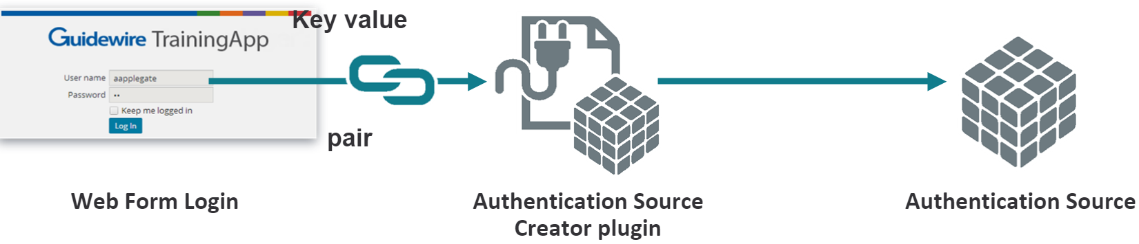
Authentication Source Creator Plugin
Receives user authentication information
Single sign-on credential (SSO)
Client certificate
Username and Password key value pair
  Example:Web Form Login
Converts user credential information to an authentication Source object
  A structured credential used by Authentication Service plugin
All Guidewire applications use the Authentication source creator plugin by default
Notes:
Implementation Options
If you implement the Authentication source Creator Plugin such that it uses a source type other than UserNamePasswordAuthenticationSource you should either:
Extend your AuthenticationSource type from UserNamePasswordAuthenticationSource, so that it is compatible with the authentication process. The application code will check if the authentication source returned from the source creator plugin is a UserNamePasswordAuthenticationSource, or subtype thereof, and if so will examine the username property. An empty username property indicates that this is a first access attempt, and the user will be taken to the login form
OR
Include logic in the AuthenticationService plugin's authenticate(..) method to differentiate between the types of AuthenticationSource objects that may be received. If you use an authentication source that does not inherit from UserNamePasswordAuthenticationSource, you will probably have to fix up some other parts of the application configuration, so that a first access attempt does not appear to be a failed login. You may need to differentiate a login from the UI versus a login from a API/Studio

Slide 14
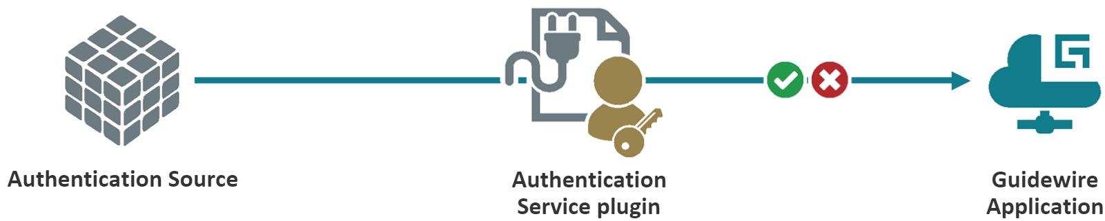
Authentication Service Plugin
Determines whether to permit a user to login
Typically validates a user credentials using
    An external system such as MS Active Directory or LDAP
    Guidewire database
    Other data store, internal or external, for user credentials
Notes:
When creating a custom Authentication Service plugin implementation, you need to override the authenticate() method.
Both user and webservice API requests call the authenticate() method.
Often, a custom implementation only checks the presence of the user login in the system bypassing the password verification. The reason for this is that user requests often have already supplied the required password verification with a Single Sign On(SSO) service.
If this is not the case, your Authentication Service plugin code should enable a password check when you supply a username. The AuthenticationServicePluginCallbackHandler interface contains verifyInternalCredentials() method that takes both the username and password as input parameters. Use this method to verify the username and password. This method returns a CredentialVerificationResult that can contain one of the following
BAD_USER_ID, WAIT_TO_RETRY,CREDENTIAL_LOCKED,PASSWORD_MISMATCH, or SUCCESS.

Slide 15
Use Case
Design approach
Create custom Authentication Source Creator Plugin
Create custom Authentication Service Plugin
Register the plugins
Deploy the changes
Requirements
User logs into a Guidewire application via login page
Authenticate users based on username and password provided
Create custom plugins for user authentication

Slide 16
Authentication source creator
Interface for Gosu and Java plugins
  gw.plugin.security.
  AuthenticationSourceCreatorPlugin
Required method
  createSourceFromHTTPRequest(request :
  HttpServletRequest) : AuthenticationSource
  If authentication source cannot be created, throws InvalidAuthenticationSourceData exception

Slide 17
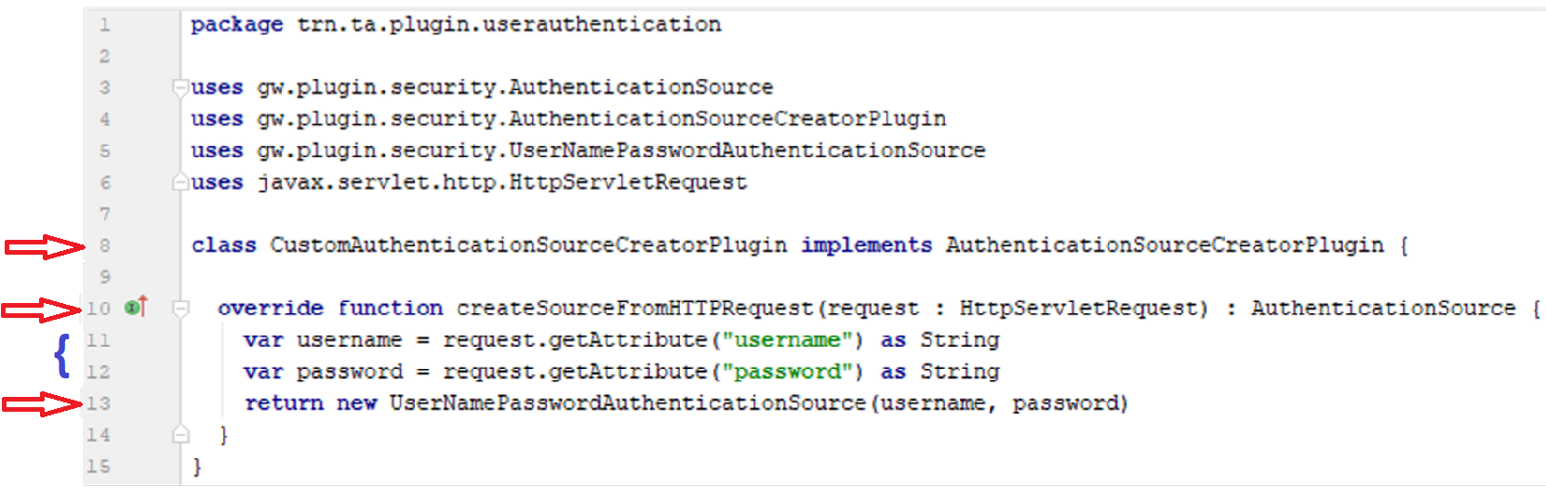
Custom Source creator plugin
Notes:
Code example
Line 8
Implement the plugin interface AuthenticationSourceCreatorPlugin and its method
Line 10
Implement the createSourceFromHTTPRequest method
The Parameter for the method contain credentials information.
Returns an AuthenticationSource object that will be used by the AuthenticationServicePlugin
Line 11-12
Extract credentials from HttpServletRequest object
Line 13
Call the constructor on an object called UserNamePasswordAothenticationSource and thus matches the requirement of the method
The AuthenticationServicePlugin prefers a UserNamePasswordAuthenticationSource object.
This is a very simple implementation of the AuthenticationSourceCreatorPlugin, however its based on the ootb default implementation. The insurers requirements most likely will be more complex

Slide 18
Ways to retrieve credentials
From HTTP request attributes
  Default mechanism
  Login form posts "username" and "password" attributes
From headers for HTTP basic authentication
  Assumes alternate UI configuration
By other means if UI configuration is modified
  Could include extracting certificate from the HttpRequest

Slide 19
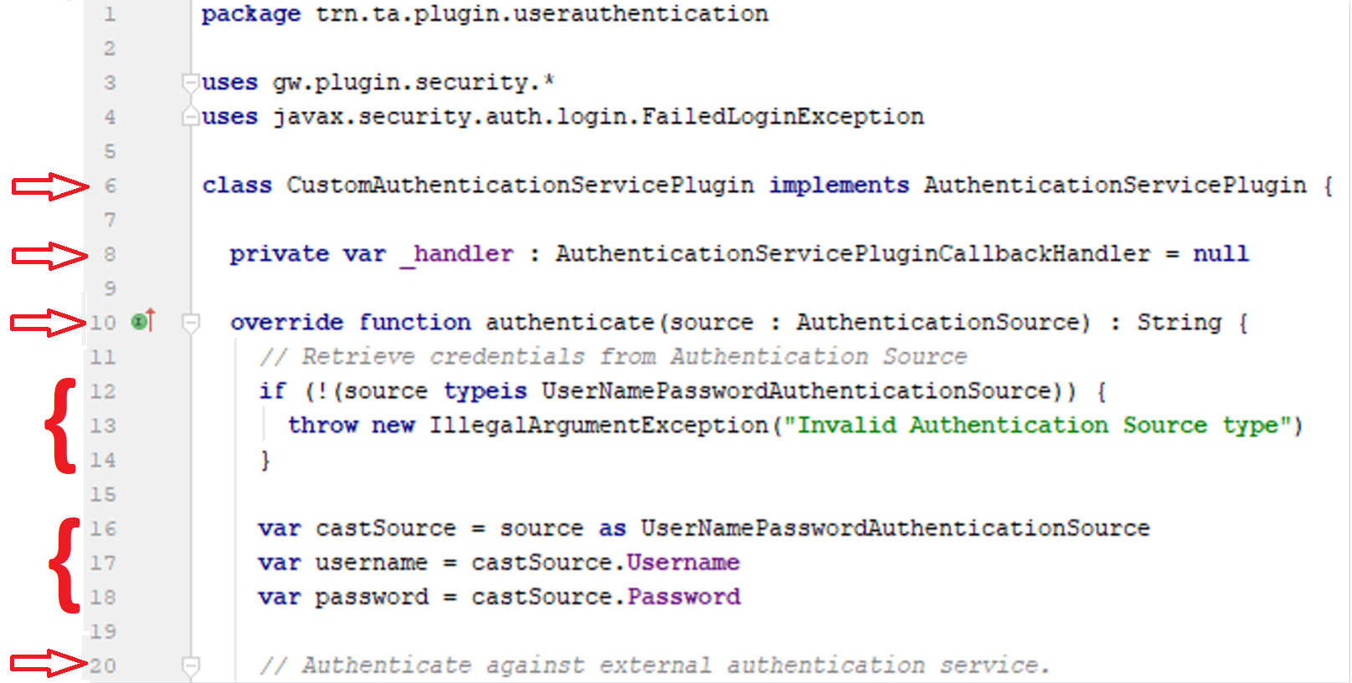
Custom Authentication Service
Notes:
Code example
Line 6
Implement the plugin interface AuthenticationServicePlugin and its method and property.
Line 8
Create aclass variable of type AuthenticationServicePluginCallbackHandler, that will be used to contacin the call back handler object taht is used by the authenticate method to lookup the user in the Guidewire DB User and Credential tables
Line 10
Implement the authenticate method.
Returns a PublicID of a user entity that represents an authenticated Guidewire user who is logging in or throws an exception.
Line 12-14
In the OOTB implementation of the AuthenticationSourceCreator Plugin, the AuthenticationSource object passed to the AuthenticationServicePlugin is of type UserNamePasswordAuthenticationSource and a check is performed to make sure the object being passed is of that type.
An objcet of any other type, even if it is a subtype of AUthenticationSource potentially represents an attempt to compromise the system and an IllegalArgumentException is thrown.The custom implementations of the authentication plugins could include definitions of new types of AuthenticationSource objcets and teh code should check for them accordingly.
Lines 16-18
Once the input parameter type is validated, the authenticate method casts the input para and extracts teh credentials from UserNamePasswordAuthenticationSurce object.
Line 20
Implement the code to authenticate against an external authetication service like an Active Dirctory,some other DB soem otehr method like a file based,webservice call,socket connection etc.

Slide 20
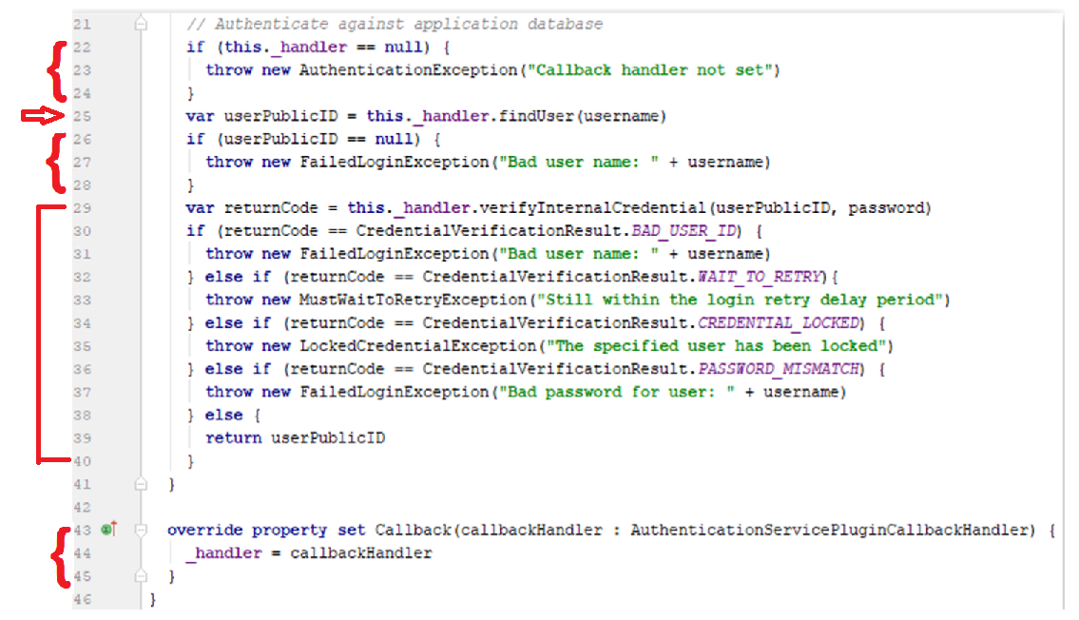
Custom Authentication Service(2)
Notes:
The job of the authenticate method is to authenticate the user, and if authenticated, return the PublicID of that user or throw an appropriate exception.
In order to achieve this, the code needs to access the GW User and Credential tables. But since there is no user in the context of the AuthenticationService plugin, i.e., it is not executing as a particular user, the code can legitimately access this data using the AuthenticationServiceCallbackHandler object.
The callbackhandler provides serveral methods among which the findUser method returns the PublicID of the user entity associate to the userName if its exists and the verifyInternalCredential method which validates the password provided matches the password from the database.
Stash a callback handler object in a private class variable.
The set Callback property is called by the application platform code when the AuthenticationServicePlugin is instantiated and the callback handler is passed at that time.
Lines 22-24
Verify the _handler variable has been set, otherwise throw an AuthenticationException.
Line 25
Retrieve the users PublicID using the findUser method
Line 26-28
Verify that a PublicId was returned by the findUser method, otherwise throw a FailedLoginException.
Lines 29-40
The verifyInternalCredentials method is used to verify that the user Publicid and password are valid.
The returnCode variable is checked for any unsucecssful response and appropriate exception is thrown, otherwise return the PublicId which indicates a successful authentication.

Slide 21
Authentication service implementation
Interface for Gosu and Java plugins
  gw.plugin.security.
  AuthenticationServicePlugin
Required method(s):
  setCallback(callbackHandler: AuthenticationServicePluginCallbackHandler)
    callbackHandler used to find the user's publicID from the Guidewire database
    Does not return anything; just used to set the handler
  authenticate(source: AuthenticationSource): String
    Verifies user credentials against authentication system
    Returns user's publicID as string
    Place where callbackHandler calls the findUser() method
Notes:
An authentication service plugin may need to initialize itself. If the plugin implements InitializablePlugin, initialization can occur during the invocation of either the setCallback() or setParameters() methods.
An authentication service plugin finds the user information as part of the authentication process, and in certain cases, may update user information (for example, locking out a user). The default implementation of Guidewire base application is to lookup the User.PublicId from the XX_credential table in the Guidewire application database. Successful authentication occurs when the authenticate methods returns the user's public ID. The authenticate method uses the callback handler to find the user's public ID for the Guidewire application database. The authentication service plugin should save the handler in a field. The authentication process can later use the field value. To indicate an unsuccessful login, throw a javax.security.auth.login.LoginException (or subtypes such as FailedLoginException). Guidewire applications treat a returned null value from the authenticate method as a failed login.
Do not invoke a local Guidewire web service API from an authentication plugin because calling a web service may itself require authentication resulting in an authentication loop. For a web service authentication, exception messages are visible to the caller as part of the returned SOAP Fault. Avoid verbose login failure exception messages. Capture verbose exceptions in system logs. The ILoginAPI allows a user to log in before accessing a given web service. The session identifier returned by the ILoginAPI is used to track user requests to other APIs after authentication. However, ILoginAPI itself still makes use of the AuthenticationServicePlugin.

Slide 22
Example: LDAP authentication service (1)
12 class LDAPAuthenticationServicePlugin implements
AuthenticationServicePlugin, InitializablePlugin {
…15 private static final var SERVER_NAME_PROPERTY = "serverName"
16 private static final var SERVER_PORT_PROPERTY = "serverPort"
17 private static final var DOMAIN_NAME_PROPERTY = "domainName"
…19 private var _handler : AuthenticationServicePluginCallbackHandler
20 private var _serverName : String
21 private var _serverPort : String
22 private var _domainName : String
23
24 override function setCallback(callbackHandler :
AuthenticationServicePluginCallbackHandler) {
25 _handler = callbackHandler
26 }
…28 override function setParameters(map: Map <Object, Object>) {
29 _serverName = map.get(SERVER_NAME_PROPERTY) as String
30 _serverPort = map.get(SERVER_PORT_PROPERTY) as String
31 _domainName = map.get(DOMAIN_NAME_PROPERTY) as String
32 }
Notes:
The setParameters method is present because the class also implements the InitializablePlugin interface.

Slide 23
Example: LDAP authentication service (2)
…34 override function authenticate(src:AuthenticationSource):String{
35 if (!(src typeis MyLDAPAuthenticationSource)) {
36 throw new IllegalArgumentException(msgExArg + src.toString())
37 }
38 var mySrc = src as MyLDAPAuthenticationSource
39 if (!authenticateAgainstLDAP(mySrc)) {
40 throw new FailedLoginException(msgFailed + mySrc.Username)
41 }
…42 var userPublicId = _handler.findUser(mySrc.Username)
…46 return userPublicId
47 }
…49 private function authenticateAgainstLDAP(
pSrc:MyLDAPAuthenticationSource):boolean {
50 var username = pSrc.Username
51 var password = pSrc.Password
52 var domain = pSrc.Domain
53 // LDAP authentication here
54 return true
55 }
Notes:
Line 34 – We check the authentication source to insure that we are using the correct authentication source, such as a UserNamePasswordAuthenticationSource
Line 39 - Calling external system to authenticate the user
Line 42 - Using setCallback method via the _handler private variable to find the User in the Guidewire database.
Line 46 - Return publicID which indicates user is authenticated
When creating a custom AuthenticationServicePlugin implementation, you need to override the authenticate() method.
Both user and web service requests call the authenticate() method. Often, a custom implementation only checks the presence of the user login in the system bypassing the password verification. The reason for this is that user requests often have already supplied the required password verification with a Single Sign On (SSO) service.
If this is not the case, your AuthenticationServicePlugin code should enable a password check when you supply a username. The AuthenticationServicePluginCallbackHandler interface contains the verfyInternalCredentials() method that takes both the username and password as input parameters. Use this method to verify the username and password. The method returns a CredentialVerificationResult that can contain on of the following: BAD_USER_ID, WAIT_TO_RETRY, CREDENTIAL_LOCKED, PASSWORD_MISMATCH, or SUCCESS.

Slide 24
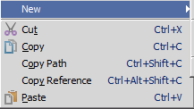


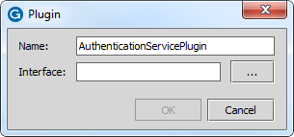
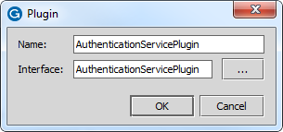
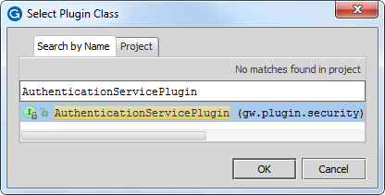
Create the plugin registry file
Registry → New → Plugin
Plugin name must be same as select interface name!
Notes:
In the Project view, select the registry folder. The path is …\config\plugin\registry. Right click to open the context menu and select New → Plugin. In the Plugin dialog, specify the name of the new plugin registry file. Next, click the ellipse button to select the interface. In the Select Plugin Class dialog, select the required class.
Regular plugins must be named after the plugin interface. The plugin name and the plugin interface name must be identical for all plugins other than startable or multi-instance plugins.

Slide 25
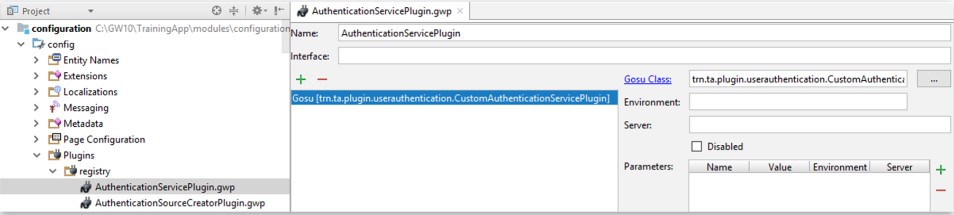
Configure plugin with the Plugin editor
In Project View, open .gwp
Plugin Editor
  Add Plugin type
  Specify class
  Mark enabled
  Optional: define parameters
Notes:
The plugin name and the plugin interface name must be identical for all plugins other than startable or multi-instance plugins. Regular plugins must be named after its interface.

Slide 26
User authentication overview
User authentication source creator plugin
User authentication service plugin
Soap Webservice API Authentication
Database authentication overview and plugins

Slide 27
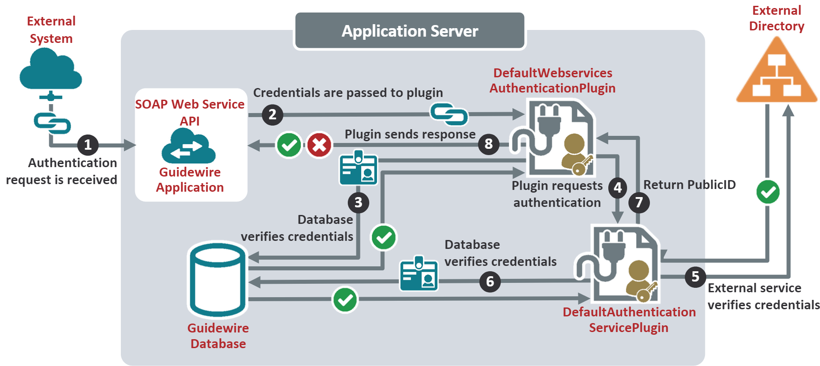
Default Soap WebService Authentication Flow

Slide 28
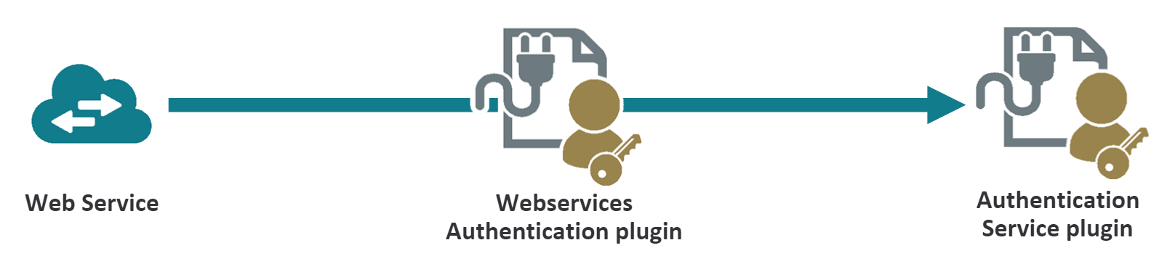
Soap WebService Authentication Plugin
For web services that require permissions
  Handle the name/password authentication for a user connecting to a SOAP webservices
  Calls the registered implementation of the Authentication ServicePlugin
    Never call a Guidewire web service from within the Authentication Service plugin - it will create an endless loop
A registered and enabled version of the plugin is required otherwise web services are unable to authenticate
Notes:
Default Implementation
The base configuration of the application includes a registered implementation of the webservice authentication plugin called DefaultWebservicesAuthenticationPlugin.
The class performs two main operations.
Scans HTTP request headers for authentication information
Performs authentication against the local application users in the database.
The class calls the registered implementation of the AuthenticationServicePlugin plugin interface.
If you write your own implementation of the AuthenticationServicePlugin plugin interface, beware of this interaction with webservice authentication. For eg. You might want LDAP authentication for most users but for webservice authentication to authenticate against current Application administrative data. The DefaultWebservicesAuthenticationPlugin plugin implementation supports WSI webservice connections only. This does not support older style of RPCE webservices not authenticating users from app UI. The class looks at HTTP request header for WSI authentication info.
Custom WebservicesAuthentication Plugin
Write your own class that implements WebservicesAutheticationPlugin interface
The interface has a single method that the implementation must implement called authenticate which accepts a parameter of type WebservicesAuthenticationContext.This object contains authentication information such as name and password.
The relevant properties in the WebservicesAuthenticationContext arg are
Httpheaders- HTTP headers of type gw.xml.ws.httpHeaders.This argument includes a list of header names
RequestSOAPHeaders-The requesr headers as an XmlElement object
If successful, the authenticate method returns relevant User object from DB. If the authentication couldn't be attempted due to a network problem or such, method returns a null. Other cases of authentication failures throw a WsiAuthenticationException.

Slide 29
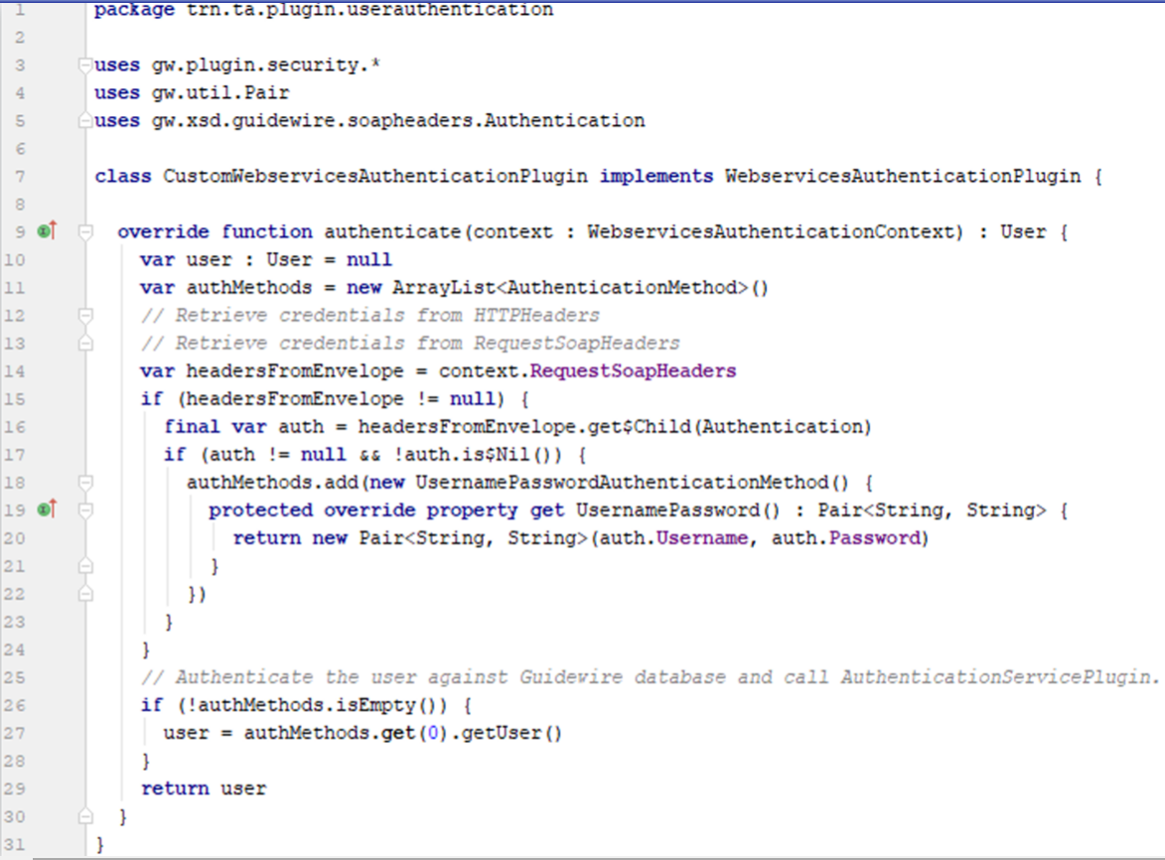
Custom WebServiceAuthenticationServicePlugin
Notes:
Code example
Line 7
Implement the plugin interface WebServicesAuthenticationPlugin and its method
Line 9
Implement the authenticate method.
Returns a User object or null to the GW application . If it returns a User object, that means the user is authenticated. If it returns null, that means the user failed authentication.
Lines 14-24
Retrieve credentials from Soap Headers
Lines 26-28
Call getUser method to perform three tasks
1)Tries to authenticate the user against the GW DB. If authentication fails , the system throws a WsiAuthenticationException("Bad Username or password")
2)If DB authentication passes, then calls the AuthenticationServicePlugin for further authentication.
3)If authentication passes, then returns the User object to the WebservicesAuthenticationServicePlugin
Line 29
The user object or null is returned

Slide 30
User authentication overview
User authentication source creator plugin
User authentication service plugin
Soap Webservice API Authentication
Database authentication overview and plugins

Slide 31
Database plugin
Guidewire application
Database
authentication
plugin
Database
Database connection requires a database username and password as part of jdbcURL
  database-config.xml in <dbcp-connection-pool /> element
  Password file
  Database authentication plugin can suppliy
Database plugin can supplies database authentication credentials for Guidewire database
  Guidewire application requires connection to Guidewire Database
Notes:
Database authentication plugins help the a Guidewire application server connect to its database server. User authentication plugins authenticate users (from the user interface or using API) for a given Guidewire application.
A database authentication plugin can retrieve name and password information from an external system, encrypt passwords, read password files from the local file system, or perform similar actions. The resulting username and password substitutes into the database configuration file anywhere that ${username} or ${password} are found in the database parameter elements.
In Guidewire 7 (Diamond) applications, the database element is found in the config.xml file in the database element. Guidewire 8 (Emerald) application now have a separate database-config.xml file and the <dbcp-connection-pool> element defines the jdbcURL attribute.

Slide 32
Database authentication implementation
Interfaces to implement in Gosu and Java
  gw.plugin.DBAuthenticationPlugin
Required methods:
  retrieveUsernameAndPassword(StringOrMap):
  UsernamePasswordPair
Returns user name and password to use
Database authentication
plugin
Notes:
To implement a database authentication plugin, implement a plugin that implements the class DBAuthenticationPlugin. This class has only one method you need to implement:retrieveUsernameAndPassword, which must return a username and password. Store the username and password combined together as properties within a single instance of the classUsernamePasswordPair.
The one method parameter for retrieveUsernameAndPassword is the name of the database (as a String) for which the application requests authentication information. This will match the value of the name attribute on the database or archive elements in your config.xml file.
If you need to pass additional optional properties such as properties that vary by server ID, pass parameters to the plugin in the Studio configuration of your plugin. Get these parameters in your plugin implementation using the standard setParameters method ofInitializablePlugin.
Typically, a database plugin encodes, encrypts, hashes, or otherwise converts the data into a secure format. The only requirement is that your database (or an intermediate proxy server that pretends to be your database) knows how to authenticate against this username and password.

Slide 33
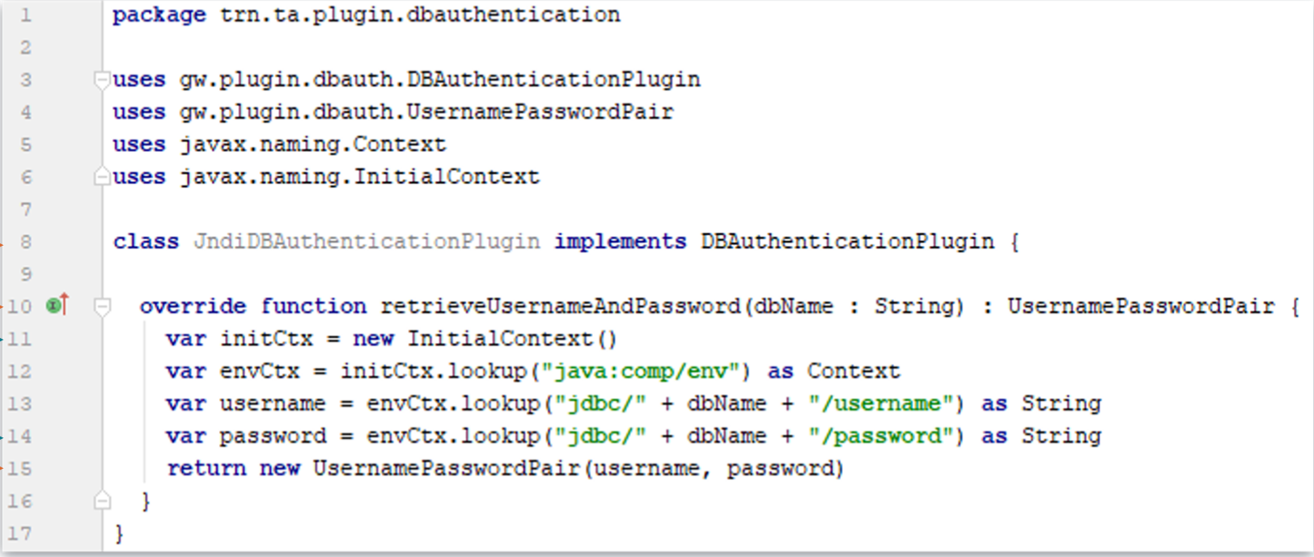
Example: Database authentication plugin

Slide 34
  Describe how Guidewire authentication works
  Create plugins that build authentication sources
  Create plugins that use authentication sources to authenticate users
  Create plugins that authenticate Guidewire application when connecting to databases

Slide 35
DEMO

Slide 36
This demo will illustrate user authentication flow by implementing the TrainingApp authentication plugins and setting breakpoints.
Requires
Training App
GW Studio
Supported web browser

Slide 37
LAB

Slide 38
Complete the exercises listed in “Bundles and Database Transactions” chapter in the “InsuranceSuite 10 Integration: Kickstart “ work book

Slide 39
What is the purpose of the user authentication plugins?
What is the purpose of the database authentication plugin?
What interface and methods are required for a user authentication source creator plugin?
What interface and methods are required for a user authentication service plugin?
What interface and methods are required for a database authentication plugin?
Why can't you use local Guidewire web service (SOAP) APIs from within authentication plugins?
How do you deploy a user authentication service plugin?
The user , api and database authentication mechanisms reference which plugins?
  1) AuthenticationSourceCreatorPlugin
  2) AuthenticationServicePlugin
  3) WebserviceAuthenticationPlugin
  4) DBAuthenticationPlugin
Notes:
Answers
1) User authentication plugins authenticate users when logging on to Guidewire (either from the user interface or via a web service API).
2) The database authentication plugin returns the username and login that Guidewire should use to log in to the Guidewire database. The database authentication plugin does not do the work of authentication. It only returns authentication credentials.
3) A user authentication source creator plugin needs to implement the interface AuthenticationSourceCreatorPlugin and provide an implementation for the method createSourceFromHTTPRequest().
4) A user authentication service plugin needs to implement the interface AuthenticationServicePlugin and provide an implementation for two methods: setCallback() and authenticate().
5) A database authentication plugin needs to implement the interface DBAuthenticationPlugin and provide an implementation for the method: retrieveUsernameAndPassword().
6) You cannot attempt to use Guidewire web service (SOAP) APIs from within authentication plugins because doing so would require authentication and thus cause an authentication loop.
7) You can deploy a user authentication service plugin in two steps: (a) Move your code to the proper directory, and (b) Register your plugins in the plugin registry using Studio.
8) 1. user
2. user and api
3. api
4. database

Slide 40
THANK YOU

