Slide 1

InsuranceSuite 10 Integration
Document Management

Slide 2
Lesson Objective
  Explain how to integrate a Guidewire application with an external Document Management System (DMS)
  Identify the plugins that enable DMS integration
  Implement the plugins to support DMS integration
  Deploy and configure DMS integration plugins
  Describe the features and limitations of Guidewire’s demo or default implementations of document storage functionality

Slide 3
Lesson Outline
Document basics
Document management system (DMS) integration
IDocumentContentSource plugin
IDocumentMetadataSource plugin
DMS integration configurations
Document related SOAP APIs
Asynchronous Document Storage

Slide 4






What is a Document?
A document is a digital file that is related to one or more objects.
  Content is stored by a DMS
  Metadata stored in DMS, or Guidewire, or both
Documents are related to business objects
  Business objects vary by Insurance Suite application
Policy, Account, Producer
Claim
Policy, Account

Slide 5

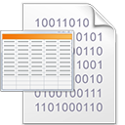

Document contents
Anything that represents incoming or outgoing documents
Often a digital file
  Fax
  MS Word
  JPEG
  PDF
  CSV
Notes:
Document content can be anything that represents incoming or outgoing documents such as a fax image, a Microsoft Word file, a photograph, or a PDF file. A document content source is code that stores and retrieves the document content.

Slide 6
Content and Metadata
Content
  The content of a digital file
    Word, Excel, JPG, MP4, PDF, etc.
Metadata
  Attributes that describes and classify a document
    Name, Description, Section
    Document Type (MIME type)
    Related objects, Author, Recipient
    Inbound, Status, Security Type, Type, Hidden
Represented by a Document entity in Guidewire
  If the application is configured such that Metadata is maintained in Guidewire
Notes:
Document content can be anything that represents incoming or outgoing documents such as a fax image, a Microsoft Word file, a photograph, or a PDF file.
Multipurpose Internet Mail Extensions(MIME) is an internet standard that extendds the format of email to support :
Text in character sets other than ASCII
Non-text attachments:
audio,video,images,application programs etc.
Message bodies with multiple parts
Header information in non-ASCII character sets
Although MIME was designed mainly for SMTP, the content types defined by MIME standards are also of importance in communication protocols outside of email, such as HTTP for the World Wide Wed. Servers insert the MIME header at the beginning of any Web transmission. Clients use this content type or media type header to select as appropriate "player" application for the type of data the header indicates. Some of these players are built into the Web client or browser (for example, almost all browsers come with GIF and JPEG image players as well as the ability to handle HTML files)

Slide 7
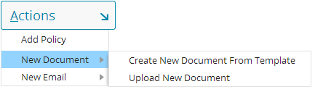

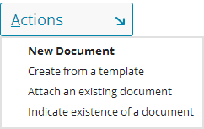

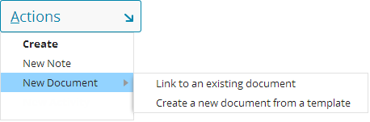

Creating new documents
BillingCenter
ClaimCenter
PolicyCenter
Notes:
In BillingCenter, ClaimCenter, and PolicyCenter, there are menu actions that allow users to create, link, attach, indicate, or upload a document.

Slide 8

Digital document production
Dear <Insured.FullName>,
On <effectiveDate>,
your policy…
Document template
Digital document
Dear Ray Newton,
On June 4, 2014,
your policy…
Account: C000143542
Policy: 7561197102
Insured: Ray Newton
Effective: 06/04/14
Business object data
Document production creates digital documents using a digital template and set of business object data values
Notes:
A document template is a Guidewire template used to generate commonly needed documents. Document templates often include information drawn from the primary business object (claim, policy, account, or producer) and its related records.
A document template can retrieve any information available to the primary business object. In this regard, a document template differs in the various Guidewire applications.
In ClaimCenter, a document template contains information about the claim such as the claim file number.
In PolicyCenter, a document template contains information about the policy such as the deductible for a given coverage.
In BillingCenter, a document template contains information about the account such as the amount due for a policy.
A digital document that results from the document production is often a draft document. The user producing the document often need the opportunity to review, edit, amend, and then finalize the document before it is sent to the relevant party.
Document metadata is stored apart from the document itself.

Slide 9

Five systems for document storage
User System
Guidewire App
Various types of documents can exist in five systems in a Guidewire document management architecture
Doc Production
Doc Storage
Physical Storage
Notes:
There are five systems where information about documents can exist:
The user system
The Guidewire application
A document production system, which stores templates used to generate documents
A document storage system, which stores digital documents
A physical location, which stores physical documents (used in ClaimCenter only)

Slide 10
Physical Documents (ClaimCenter only)
User System
ClaimCenter
Physical Storage
Physical location contains the document itself
For physical documents, ClaimCenter tracks only the information about the document
User can view the information that ClaimCenter has stored about the document, but not the document itself

Slide 11
Digital document storage
User System
Guidewire App
Document Storage
local
master
Guidewire application and document storage system both store (and synchronize) document metadata
Document storage system stores master copy of document
User system views and edits a local copy of the master document
Notes:
Document metadata consists of the type of document, the security permissions for the document, and many other properties and attributes that describe the document. Other properties include, but are not limited to the date created, data modified, the authors, the editors, content tags, document categories, document title, and comments. For some types of photograph and digital image documents, other properties may include the device taking the picture as well as global position system (GPS) coordinates for where the picture was taken.

Slide 12
Digital document production (1)
User System
Guidewire App
Doc Production
Guidewire application sends object data and a template identifier to the document production system
Document production system stores the document template
Document production system creates document and makes the document visible to user system
Notes:
Various digital document production configurations are possible.
Client-side document production consists of the creation of documents on the user system using local application such as Microsoft Word or Adobe Acrobat. Server-side document production consists of an application server creating new documents from a server document template. A server document template can be a physical file or can be an application library that logically represent a document template.
In some cases, document templates are stored on a separate document in the production system. When a document needs to be produced, the business object data values and a document template identifier (name, ID, or GUID) are passed to the document production system. The document production system process the object data using the document template and create a document. The document is available to the user system.

Slide 13
Digital document production (2)
User System
Guidewire App
Guidewire application stores a document template
Guidewire application creates a document with object data
Document visible to the user system
Notes:
In some cases, document templates are stored on the application server that hosts the Guidewire application. The Guidewire application merges the document itself and makes the resulting draft available to the user system. This approach may be less typical for documents authored in a Microsoft product like Word and may be more typical for open-source formats such as PDF.

Slide 14
Digital document production (3)
User System
Guidewire App
Guidewire application stores the document template
Guidewire application sends a document template and object data to the user system
User system creates document
Notes:
In some cases, document production takes places on the user system. In this case, the template and the field values are passed to the user system. The user system's local copy of the application merges the information and creates the document draft.
The three approaches are not mutually exclusive. It is possible for some documents to be produced on a document production system, some to be produced by the Guidewire application server, and some to be produced on the user system. In these circumstances, it is often the type of document that determines where the document is created. For example, in ClaimCenter, a reservation of rights letter may exist in a legacy content management system and be produced on a separate machine whereas a basic, contact the claimant letter is drafted on the user system.

Slide 15
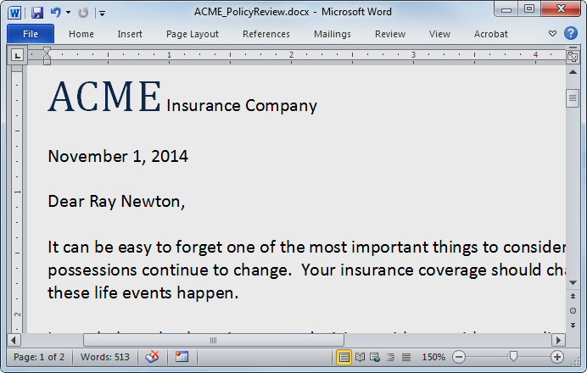
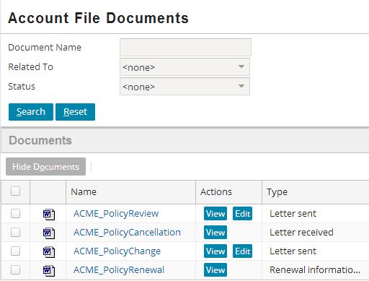
View and editing documents: PolicyCenter
Actions → Documents
Search
View and edit documents

Slide 16
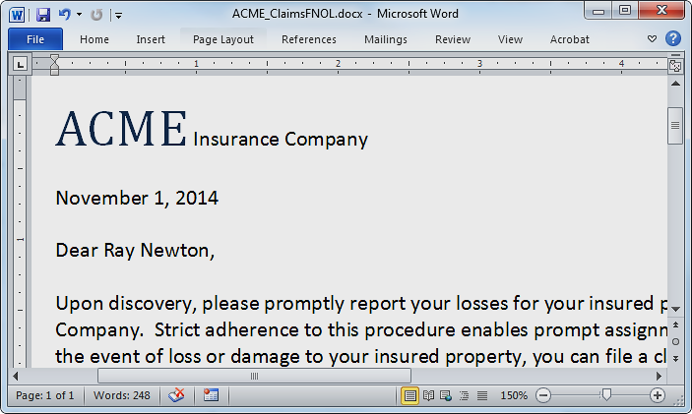
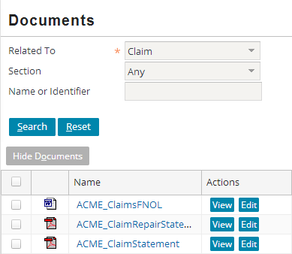
View and editing documents: ClaimCenter
Actions → Documents
Search
View and edit documents

Slide 17
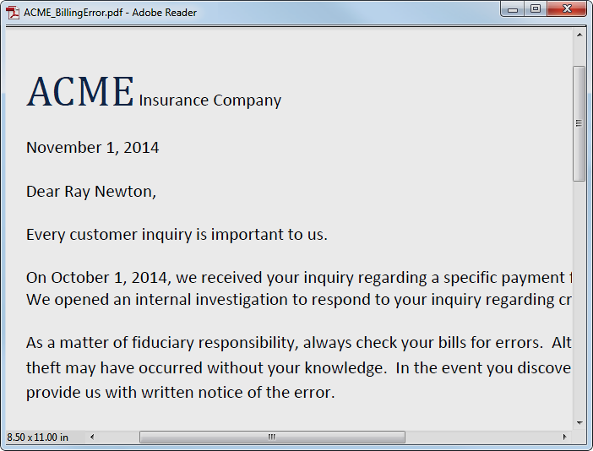
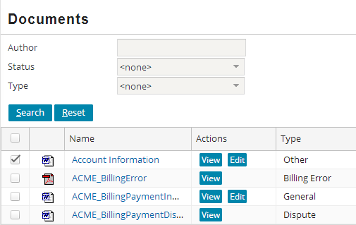
View and editing documents: BillingCenter
Actions → Documents
Search
View and edit documents

Slide 18
Lesson Outline
Document basics
Document management system (DMS) integration
IDocumentContentSource plugin
IDocumentMetadataSource plugin
DMS integration configurations
Document related SOAP APIs

Slide 19

Document management system (DMS) provides :
Document storage
  Document content
    The digital content of a document file
  Document metadata
    Date created, Date modified, Author(s)
    Tags, Categories, Title, Subject
Document Services
  Search and retrieval
  Add and Update
  Indexing
  Versioning
  Workflow management
  Security

Slide 20
Guidewire default DMS implementations
Default DMS implementation
  Provided and enabled
  xx_document table in Guidewire database stores document metadata
  Guidewire application server file system stores document contents
Alternate DMS implementation
  Proof of Concept (demo)
  Provided, but NOT enabled
  User system stores metadata as a serialized Document entity in local file system
  Guidewire application server file system stores document contents
Neither implementation intended for production use
Notes:
In the default configuration, asynchronous document storage is enabled. For maximum user interface responsiveness with an external document storage system, choose asynchronous document storage

Slide 21
DMS integration plugins
IDocumentContentSource plugin handles storage and retrieval of document content
  Optionally stores metadata
  More efficient if same system holds content and metadata
IDocumentMetadataSource plugin manages document metadata and document searches
Implementing IDocumentMetadataSource plugin is optional, if not implemented
  Application stores document metadata in its database
  Eliminates runtime dependency on DMS for document metadata and search
Notes:
Guidewire defines two plugins to support DMS integration: IDocumentContentSource and IDocumentMetadataSource plugins.

Slide 22
DMS integration and Document IDs
Document.PublicID
Document.DocUID
Document.Id
Unique identifier for a single document in the DMS
If versioning supported, then PublicID does not change
Unique identifier for a single version of a single document in the DMS
If versioning supported, DocUID most likely changes
Internal Guidewire application property
Not used for DMS
Not used for versioning
Notes:
Depending on how a DMS functions, if the DMS supports versioning, the PublicID property does not change for each new version, but the DocUID property might change.
You can extend the base Document entity to contain version related properties or other properties if it makes sense for your DMS.
Never use the Id property to identify a document. Never get or set this property for document management.

Slide 23
DMS storage choices
No DMS storage
External DMS storage
Use the default implementaion of the IDocumentContent
Source plugin
Do NOT enable IDocumentMetadata
Source plugin
To store and retrieve content, implement custom plugin for IDocumentContent
Source plugin
If added to DMS outside of a Guidewire application process, implement a custom IDocumentMetadata
Source plugin
Notes:
Whichever approach to handling document metadata you choose (internal or external), be aware that you must continue that approach permanently. Note objects and other similar text blocks reference a document within text as a specially-formatted hyperlink within the text itself. The format of this hyperlink within text blocks is slightly different based on whether the Guidewire application or a remote system handles the document metadata. If this quality changes from internal to external, or from external to internal, those document hyperlinks fail.

Slide 24

Internal document storage and metadata
User System
Guidewire App
External systems
1
2
4
3
Notes:
In the slide example, the configuration for document management uses the built-in document content source plugin implementation. The document metadata source plugin remains disabled.
1) Document metadata is stored in Guidewire internal database.
2) Document contents are stored in Guidewire server file system.
3) Integration glue code manages how the Guidewire application and external systems communicate for document management.
4) Optionally, the external system can use web services to link documents to business objects (entities).

Slide 25
External doc storage and internal metadata
User System
Guidewire App
DMS
1
2
5
4
3
Notes:
In the slide example, the configuration for document management uses a custom document content source plugin implementation. The document metadata source plugin remains disabled.
1) The document content source plugin is enabled. The document content source plugin manages how document contents get added, retrieved, and updated.
2) Document content is sent and retrieved from the DMS. The DMS stores document contents.
3) Integration code manages how the Guidewire application and the DMS work together (integration glue code).
4) Optionally, the external DMS can use web services to link documents to business objects (entities).
5) The DMS can retrieve a user system document content from a http URL request.

Slide 26
External DMS with external metadata
User System
Guidewire App
DMS
2
1
3
4
5
6
7
10
9
8
Notes:
In the slide example, the configuration for document management uses a custom document content source plugin implementation and a custom document metadata source plugin.
1) The document metadata source plugin is enabled and manages the document metadata.
2) The document metadata is sent to external system. The DMS stores metadata.
3) The DMS returns metadata including the document unique identifiers (docUIDs).
4) The document content source plugin is enabled and manages the document contents.
5) The document content is sent and retrieved from the DMS. The DMS stores document contents.
6) The document content source plugin optionally manages document metadata.
7) The document content source plugin optionally sets metadata for add and update operations to the DMS.
8) The integration code that manages how the DMS works with the Guidewire application (integration glue code).
9) Optionally, the external DMS can use web services to link documents to business objects (entities).
10) The DMS can retrieve a user system document content from a http URL request.

Slide 27
Lesson Outline
Document basics
Document management system (DMS) integration
IDocumentContentSource plugin
IDocumentMetadataSource plugin
DMS integration configurations
Document related SOAP APIs

Slide 28
Basic document storage Flow
IDocumentContentSource
Doc Production
Document
contents storage
Guidewire App
Modified
metadata
(with doc ID)
Newly created
or updated
document contents
Doc Storage (file sys)
Document metadata storage
(if IDocumentContentSource
not handling metadata)
IDocumentMetadataSource

Slide 29
IDocumentContentSource plugin
Manages document content
May also manage document metadata based on :
  Configuration of IDocumentMetadataSource plugin interface and
  Configuration of IDocumentContentSource plugin interface addDocument method
No search capability in plugin
Notes:
A significant concern for the content source plugin is the upload size of document content – this content will usually need to be read from the input stream into memory in some fashion, which can potentially cause the JVM to run out of memory.
In config.xml, you can set a parameter to control file upload size:
<!– The maximum allowable file size (in megabytes) which may be uploaded. Any attempt to upload a file larger than this will fail. Since the uploaded document must be handled on the server, this parameter protects the server from possible memory consumption problems. -->
<param name="MaximumFileUploadSize" value="25"/>

Slide 30
IDocumentContentSource plugin interface addDocument(InputStream, Document) : boolean
Parameters
  An InputStream object, which is a new document as a stream of bytes
  A Document object, which contains document metadata
Purpose
  Add new document content in the DMS
  Set metadata properties on the Document object
    Such as DocUID and PublicID
    Properties that uniquely identify the content corresponding to the Document entity
    If called with a null InputStream properties should still be set
Returns boolean
  Controls how metadata is managed
  If IDocumentMetadataSource plugin is not implemented and enabled
    Must return false
    System saves the metadata in the Document entity
  If IDocumentMetadataSource plugin is implemented and enabled
    Return false if IDocumentMetadataSource plugin saves metadata
    Return true if IDocumentContentSource plugin saves metadata
Notes:
Common document object metadata properties that are set :
DateModified
DMS, true if there is content stored
DocUID
PublicID if content os identified differently than metadata
persistenceRequired is true
The IDocumentContentSource implementation may use any fields it wishes to determine where to store the content. It should set the DocUID field, PublicID field, or whatever field(s) are being used to uniquely identify the content corresponding to the Document entity.

Slide 31
Notes only Slide
Notes:
(continued)
The application may call the addDocument method with a null InputStream. This can occur as a result of the following scenarios :
1) The user creates a Document entity with some content and clicks Update in the application interface.
2) The document fails validation for some reason. Guidewire has already read the InputStream and uploaded the document.
3) The user fixes the problem and clicks Update again. Any changes made to the document metadata during the previous call to addDocument method call have been lost. Guidewire calls the addDocument method again so that the IDoucmentContentSource plugin has a chance to set any fields such as the DocUID before the metadata is persisted.

Slide 32
IDocumentContentSource plugin interface updateDocument(Document,InputStream) : boolean
Parameters
  An InputStream object, which is a replacement document as a stream of bytes
  A Document object, which contains document metadata
Purpose
  Update the contents of an existing document in the DMS
  Update metadata properties on the Document object that represent the change
    Set DateModified, UpdateTime and UpdateUser properties at a minimum
Returns boolean
  Controls how metadata is managed
  If IDocumentMetadataSource plugin is not implemented and enabled
    Must return false
    System saves the metadata in the Document entity
  If IDocumentMetadataSource plugin is implemented and enabled
    Return false if IDocumentMetadataSource plugin saves metadata
    Return true if IDocumentContentSource plugin saves metadata
Notes:
To update the contents of an existing document in the DMS system, call the updateDocument method. This is separate from the addDocument method because the semantics are different, especially regarding name and other unique fields. Whether or not the metadata is stored, the DMS system should update any appropriate data, includig versio information (if any) and date modified. The InputStream will contain the new contents to be stored in the DMS. The same identifying fields which are set by the addDocument method should be used to determine which content to update.Any version is completely upto the implementation. No version information will be set on the Document entity by Guidewire, but the IDocumentContentSource implementation may set version-related fields on the Document entity with the expectation that changes to the Document entity will then be persisted by the application.

Slide 33
IDocumentContentSource plugin interface removeDocument(Document) : boolean
Parameters
  A Document object, which contains document metadata
Purpose
  Logically or physically delete the content
  Optionally delete the metadata properties on the Document object based on the return value
Returns boolean
  Controls how metadata is managed
  If IDocumentMetadataSource plugin is not implemented and enabled
    Must return false
    System saves the metadata in the Document entity
  If IDocumentMetadataSource plugin is implemented and enabled
    Return false if IDocumentMetadataSource plugin removes metadata
    Return true if IDocumentContentSource plugin removes metadata

Slide 34
IDocumentContentSource plugin interface getDocumentContentsInfo (Document,boolean) : DocumentContentsInfo
Parameters
  A Document object, which contains document metadata
  boolean value
  If true, call to include content
  If false, call to retrieve just metadata
Purpose
  Retrieve the contents of the document
  Use DocUID property to retrieve content from DMS
    Use publicID if content is identified differently than metadata
  Any changes to Document entity are not persisted.
Returns DocumentContentsInfo Object
  Encapsulates document contents as an InputStream
  Describes Content Response Type
    DOCUMENT_CONTENTS or URL
  Specifies MIME Type
Notes:
To retrieve the contents of a document, call the getDocumentContentsInfo method. The Document entity itself should not be modified as any changes made are not guaranteed to be persisted. The boolean arguement to include contents should be true if the caller wants the DocumentContentsInfo object to include an InputStream with the contents of the document. If it is false, then the InputStream in the returned DocumentContentsInfo object will be null. The boolean should be false in situations where only the metadata is required. The getDocumentContentsInfo method returns a DocumentContentsInfo object. The application calls some methods in a IDocumentContentSource plugin twice for each document :isDocument and getDocumentContentsInfo. Your plugin implementation must support this design.

Slide 35
Notes Only Slide
Notes:
(continued)
Content Response Types
Use DOCUMENT_CONTENTS when the DMS system returns the pure contents of the document. DOCUMENT_CONTENTS is supported in all situations and is the only valid type of response when Gosu creates a document. DOCUMENT_CONTENTS is compatible with the Edit/Upload buttons in the base Documents page.
inputStream - Must contain the contents of the document.
responseMimeType - Should contain the mime type of the document
targetHiddenFrame - Not relevant for this content type, may be ignored. Opens content in a hidden frame if true for other content types.
Use the URL type when the DMS intergration code will return a URL which, when accessed, will somehow display the document contents. It may be a URL to the contents directly, or to a web page which uses a script or a web control to display the document contents. Use the URL type for when the client, based on physical location, need to be redirected to a local cache of document contents.
inputStream - Must contain the URL
responseMimeType - Not applicable, may be ignored
iargetHiddenFrame - Must be true or false depending on wheather the URL returned should be opened in a new window or in a hidden frame.

Slide 36
IDocumentContentSource plugin interface isDocument(Document) : boolean
Parameters
  A Document object, which contains document metadata
Purpose
  Check for the existence of a document in the DMS
  Often used DocUID or PublicID property
Returns boolean
  Return true is DMS system already contains content corresponding to the appropriate fields on the Document entity
  Return false otherwise
Notes:
isDocument method
Used to determine whether the DMS system contains content corresponding to the DocUID or customer-specific fields(s) identifying the content. The isDocument method implementation returns true when the backing DMS system already contains content corresponding to the appropriate fields on the Document entity, otherwise the method returns false. The application calls some methods in a IDocumentContentSource plugin twice for each document : isDocument and getDocumentContentsInfo. Your plugin implementation must support this design.

Slide 37
Demo implementation
gw.plugin.document.impl.
LocalDocumentContentSource
Stores document content in the local file system
  …\plugins\document\files\documents
  Sub-directory for each root object such as claim
Notes:
In ClaimCenter, see the getSubDirForDocument() method for how the files are created and stored in sub-directories.

Slide 38
Lesson Outline
Document basics
Document management system (DMS) integration
IDocumentContentSource plugin
IDocumentMetadataSource plugin
DMS integration configurations
Document related SOAP APIs

Slide 39
Basic document search and retrieval
Flow
IDocumentMetadataSource
Doc Production
Search criteria
Matching
document list
Guidewire App
Metadata (ID)
for single
document content
Doc Storage (file sys)
Display document
contents
IDocumentContentSource

Slide 40
IDocumentMetadataSource plugin
When enabled, handles the document metadata
  IDocumentContentSource plugin does not handle metadata in this case
Add / change / remove metadata for documents with or without content.(Only CC may have docs without content)
Supports search

Slide 41
Plugin Methods searchDocuments(DocumentSearchCriteria,RemotableSearchResultSpec) : DocumentSearchResult
Parameters
  DocumentSearchCriteria object which defines search criteria to DMS
  RemotableSearchResultsSpec object containing sorting and paging info for PCF
Purpose
  Return the set of Documents in DMS that match the search criteria
Returns DocumentSearchResult object
  Contains Document[] collection
  For each item in DocumentSearchResult, set properties as needed
    docUID to the linked identifier in the external system
    DocumentIdentifier
    DMS (true/false
Notes:
Usually called to populate a list of documents, such as the documents list view panel, the searchDocuments() method retrieves the set of documents which match the given search criteria. The DocumentSearchCriteria values indicate the set of documents that should be returned. The RemotableSearchResultSpec is an object which contains sorting and paging information for the search so that the results can be manipulated by the list view. The DocumentSearchResult object encapsulates a set of Document objects containing information about the documents matching the search criteria. Since the results will be displayed in a list, the Document objects returned need not be fully populated. The objects must have all properties set which will be used in the lists and any properties which would be required to retrieve the contents or a detail view of the document.
getnumResultsOnly – Boolean that specifies whether to return only number of results
SortColumns – An array of RemotableSortColumn objects that define sort order
StartRow – Start row as int value
MaxResults – Max results to return as int value
IncludeTotal – Boolean that specifies whether to return number of search results in TotalResults property

Slide 42
Plugin Methods – Other methods
retrieveDocument(String) : Document
  Retrieve the metadata for a document from a DMS
  Returns a Document object containing the retrieved metadata
    Set the DocUID of the returned document to the ID that was retrieved
    Must initialize the internal properties of the returned Document object by calling
    DocumentsUtilBase.initOriginalValues method
    Must call setRetrievedFromIDMS method on the Document entity instance
saveDocument(Document)
  Create or update the metadata for a Document to a DMS
  If IDocumentContentSource plugin methods addDocuement or updateDocument return false
    Indicates they did not handle metadata
    Application calls the saveDocument method
removeDocument(Document)
  Logically or physically delete document metadata
Notes:
To display the complete metadata for a document, call the retrieveDocument() method. The retrieveDocument() method retrieves the complete metadata for a single document. The returned document should be completely populated. The docUID value of the Document entity being retrieved is a unique and is set as the value of the Document entity’s docUID property. It uniquely identifies the document on the external DMS to return the appropriate metadata.
The internal properties of the document object must be initialized by calling the following methods
DocumentdUtilBase.InitOriginalValues – Doc object is argument
The Document object’s setRetrievedfromIDMS method – no arguments and does the following
Mark doc as initialized
Sets doc.PersistenceRequired to false and as coming from IDocumentMetadataSourcePlugin
Initializes doc entity’s internal flag indicating it need not be persisted
To persist either a new Document’s metadata or changes made to the metadata for an existing Document, call the saveDocument() method after the IDocumentContentSource interface has persisted the document contents. This is not necessary, however, if the IDocumentContentSource interface handles metadata persistence itself and returns true. The saveDocument() method is also called in the case of saving metadata changes to an inferred document (null document reference). The Document parameter represents the new set of metadata to be saved to the backing DMS system.
When the user indicates that a Document should be permanently removed from the Guidewire application, call the removeDocument() method. If the document metadata stored in the DMS is referenced from multiple objects (like Claims) in the Guidewire application, it is up to the DMS system to do whatever reference counting or other mechanism is required to remove the Document from one context but not another. The Document parameter represents the document to be removed.

Slide 43
Other methods in both plugin interfaces
isInboundAvailable
isOutboundAvailable
Outbound content methods
  isDocument()
  getDocumentContentsInfo()
Outbound metadata methods
  searchDocuments()
  retrieveDocument()
If the external DMS is available for the desired actions
Inbound content methods
  addDocument()
  updateDocument()
  removeDocument()
Inbound metadata methods
  saveDocument()
  removeDocument()

Slide 44
Lesson Outline
Document basics
Document management system (DMS) integration
IDocumentContentSource plugin
IDocumentMetadataSource plugin
DMS integration configurations
Document related SOAP APIs

Slide 45



DMS integration considerations
DMS Uptime and availability
If metadata stored locally, users can continue limited doc related work
Is DMS able to handle modifying both content and metadata in a single call?
If yes, IDocumentMetaDataSource plugin not needed
Is external and Guidewire data synchronization required?
Requires IDocumentMetaDataSource plugin usually

Slide 46
Default DMS Implementation
Used for demo purposes only and not for Production
IDocumentMetadataSource
  Plugin not implemented and enabled
  Document table in App DB stores document metadata
IDocumentContentSource
  Plugin is enabled
  Implemented by AsyncDocumentContentSource class
    Stores doc content in GW app server file system
    Example, in windows environment C:\Users\<user>\AppData\Local\Temp\GuideWire_Server\...
Notes:
In ClaimCenter, see the getSubDirForDocument() method in AsyncDocumentContentSource class for how the files are created and stored in sub-directories.

Slide 47
Default DMS Implementation
Alternate implementation
Used for POC demonstrations and not for Production
IDocumentMetadataSource
  Implement and enable plugin using LocalDocumentMetaDataSource class
  IDocumentContentSource plugin addDocument() returns false
    IDocumentMetadataSource saves XML metadata in server file system
    C:\Users\<user>\AppData\Local\Temp\jetty-0.0.0.0-8080-webapp-cc…
IDocumentContentSource
  Implement and enable plugin using LocalDocumentMetaDataSource class
  Implemented by AsyncDocumentContentSource class
    Stores doc content in GW app server file system
    Example, in windows environment C:\Users\<user>\AppData\Local\Temp\GuideWire_Server\...
Notes:
In ClaimCenter, see the getSubDirForDocument() method in AsyncDocumentContentSource class for how the files are created and stored in sub-directories.

Slide 48
First DMS integration option
IDocumentMetaDataSource Enabled
IDocumentMetaDataSource – reads only metadata
IDocumentContentSource
  Writes /updates metadata with
    addDocument
    updateDocument
    removeDocument
  Manages No Content docs
  Document table not used
Runtime Characteristics
Create,update,delete is more efficient
Appropriate for DMS that maintains content and metadata. Single call can modify content and metadata
List Documents depends on DMS availability

Slide 49
First DMS integration option
Method call sequences (1)
Create document
  1. IDocumentContentSource.addDocument()*
    Returns true
List documents
  1. IDocumentMetadataSource.searchDocuments()
Retrieve document (contents)
  1. IDocumentMetadataSource.retrieveDocument()
    Retrieve call may be omitted if search has loaded metadata
  2. IDocumentContentSource.getDocumentContentsInfo()
Notes:
The complete set of lifecycle calls is:
New document with content. Can be a template or locate file reference. Calls addDocument() with a non-null input stream.
New document with content fails validation after content is uploaded. User resubmits. Calls addDocument() with null input stream*.
New document with no content. The document is inferred or is indicated. Calls saveDocument().
Edit document with content from a user interface. User can change content only. Calls updateDocument with InputStream.
Edit document with content from a user interface. Edits metadata only. Calls saveDocument().
Edit document with content from a user interface. Change (swap) content only. Calls addDocument() with input stream.
Edit document with content from a user interface. Change content and metadata. Calls addDocument() with input stream. Unless a retry of failed update, then no stream*.
Edit document with no content from a user interface. Edits only metadata. Calls saveDocument().
The rather unexpected addDocument () calls made from the document detail view panel when "swapping" content illustrates the use case for when the new content does not yet exist on the DMS. An upload of edited content from the user interface might require the DMS to save the document, notate a version change of the edited content, and replace the bytes.
* There can be a null input stream due to the content having already been uploaded. When this occurs, the addDocument() and updateDocument() methods need to make any required metadata changes and not attempt to modify or remove any existing content.

Slide 50
First DMS integration option
Method call sequences (2)
Update document content only
  1. IDocumentContentSource.updateDocument()
    Returns true
Update document metadata only
  1. IDocumentMetadataSource.saveDocument()
Delete document
  1. IDocumentContentSource.removeDocument()
    Returns true

Slide 51
Second DMS integration option
IDocumentMetaDataSource Enabled
IDocumentMetaDataSource – read & write metadata
IDocumentContentSource
  Methods return false
    addDocument
    updateDocument
    removeDocument
  Document table not used
Runtime Characteristics
Create,update,delete is less efficient
Calls IDocumentMetaDataSource & IDocumentContentSource
Suitable for DMS whose API does not allow content and metadata modification in single call
List Documents depends on DMS availability

Slide 52
Second DMS integration option
Method call sequences (1)
Create document
  1. IDocumentContentSource.addDocument()
    Returns false
  2. IDocumentMetadataSource.saveDocument()
List documents
  1. IDocumentMetadataSource.searchDocuments()
Retrieve document
  1. IDocumentMetadataSource.retrieveDocument()
    Retrieve call may be omitted if search has loaded metadata
  2. IDocumentContentSource.getDocumentContentsInfo()

Slide 53
Second DMS integration option
Method call sequences (2)
Update document
  1. IDocumentContentSource.updateDocument()
    Returns false
  2. IDocumentMetadataSource.saveDocument()
Delete document
  1. IDocumentContentSource.removeDocument()
    Returns false
  2. IDocumentMetadataSource.removeDocument()

Slide 54

Third DMS integration option
IDocumentMetaDataSource Disabled
Base configuration of IDocumentMetaDataSource
IDocumentContentSource
  Methods return false
    addDocument
    updateDocument
    removeDocument
  Document table is used for read write of metadata
Runtime Characteristics
Create,update,delete more efficient
  No remote calls through IDocumentMetaDataSource
GW app queries it DB for document list independent of DMS
DMS metadata changes are not detected
  Sync issues between GW doc table and DMS possible

Slide 55
Third DMS integration option
Method call sequences (1)
Create document
  1. IDocumentContentSource.addDocument()
    Returns false
  2. Row added to xx_document table
List documents
  1. Query of xx_document table

Slide 56
Third DMS integration option
Method call sequences (2)
Retrieve document
  1. Reads row from xx_document table
    Read may be omitted if search has loaded metadata
  2. IDocumentContentSource.getDocumentContentsInfo()
Update document
  1. IDocumentContentSource.updateDocument()
    Returns false
  2. xx_document table row updated
Delete document
  1. IDocumentContentSource.removeDocument()
    Returns false
  2. Row marked as retired in xx_document table

Slide 57
Third DMS integration option Variant
IDocumentContentSource modifies DMS metadata
  DMS stores metadata in parallel to xx_document table
Metadata versions must be synchronized
  Concern if metadata on DMS is changed outside of Guidewire
Listing documents is still independent of the DMS
  Read metadata from xx_document table

Slide 58
Lesson Outline
Document basics
Document management system (DMS) integration
IDocumentContentSource plugin
IDocumentMetadataSource plugin
DMS integration configurations
Document related SOAP APIs
Asynchronous Document Storage

Slide 59
Document related SOAP APIs
Add document metadata to Guidewire programmatically
APIs that have methods for adding documents:
  ClaimAPI (CC)
  BCAPI (BC)
  AccountAPI (PC)
May be used by external system to notify Guidewire
  Sends document ID and other metadata for document added / changed directly on the DMS*
Notes:
*The document related APIs do not differentiate adding Documents from updates. For example, there are only addDocument() or similar methods.
When the document related APIs are used by an external client, the assumption is that the incoming document's content has been handled separately and already exists on the DMS.
In order to match the entity metadata with its content, the corresponding identifier (often the DocUID property) that is used to locate the content on the DMS should be set on the SOAP Document entity.
During an API call to add a document, the document metadata source plugin calls saveDocument() to handle the metadata for the incoming Document entity. The document content source plugin is not called.
If you implement saveDocument() such that an update on an existing document can be differentiated from the addition of an entirely new document, use the incoming document's PublicID or DocUID properties to determine if the document was already saved into Guidewire.

Slide 60
Lesson Outline
Document basics
Document management system (DMS) integration
IDocumentContentSource plugin
IDocumentMetadataSource plugin
DMS integration configurations
Document related SOAP APIs
Asynchronous Document Storage

Slide 61
Asynchronous Document Storage
Transfer of large documents between external DMS needs significant memory and resources
  External DMS or network maybe slow
  Multiple simultaneous requests translate to multiple threads competing for CPU cycles
One alternative is to create/add/update documents asynchronously so that users are not blocked while operation completes
  GW includes following reference implementation for this feature
    The built-in asynchronous document content source gw.plugin.document.impl.AsyncDocumentContentSource
    The built-in document storage messaging transport
Notes:
*The document related APIs do not differentiate adding Documents from updates. For example, there are only addDocument() or similar methods.
When the document related APIs are used by an external client, the assumption is that the incoming document's content has been handled separately and already exists on the DMS.
In order to match the entity metadata with its content, the corresponding identifier (often the DocUID property) that is used to locate the content on the DMS should be set on the SOAP Document entity.
During an API call to add a document, the document metadata source plugin calls saveDocument() to handle the metadata for the incoming Document entity. The document content source plugin is not called.
If you implement saveDocument() such that an update on an existing document can be differentiated from the addition of an entirely new document, use the incoming document's PublicID or DocUID properties to determine if the document was already saved into Guidewire.

Slide 62
Lesson Objectives Review
  Explain how to integrate a Insurance Suite application with an external Document Management System (DMS)
  Identify the plugins that enable DMS integration
  Implement the plugins to support DMS integration
  Deploy and configure DMS integration plugins
  Describe the features and limitations of Guidewire’s default implementations of document storage functionality

Slide 63
DEMO

Slide 64
Provide demo details<The video creator to fill this slide>

Slide 65
LAB

Slide 66
Complete the exercises listed in “Document Management” chapter 3 in the "InsuranceSuite 10 Integration: Essentials" work book

Slide 67
Review Questions
A Guidewire application uses which plugin interfaces for document storage?
What are the characteristics of the default implementation for document metadata storage?
What are the characteristics of the default implementation for document content storage?
Name the 2 types of document contents that a Guidewire application supports.
Notes:
Answers
1) IDocumentMetadataSource and IDocumentContentSource
2) Document metadata is stored in the Guidewire database
3) Document content is stored in the file-system of the Guidewire application server.
4) DOCUMENT_CONTENTs, URL

Slide 68
Thank you

