Slide 1

InsuranceSuite 10 Integration
InsuranceSuite 10 Fundamentals
Consuming External Web Services

Slide 2
  Describe how Guidewire applications and external systems can integrate with each other using web services
  Determine a given web service's binding style
  Consume external WS-I web services from Guidewire

Slide 3
Web services overview
Resources for consuming external web services
Consuming external WS-I web services

Slide 4

Web Service
Web
Service
Guidewire application
External
system
A web service is a collection of application program interfaces (APIs) that lets one application send and receive information from another, usually synchronously
Notes:
A user interface lets humans send and receive information from an application synchronously. A web service is interface for one application to communicate to another application.
Web services are not inherently synchronous. The Web Services Interoperability Organization standard does support asynchronous web services. By convention, web service names typically end in "API".
Guidewire implementations support asynchronous calls to web services published by external systems. A web service typically is a synchronous web service. All web services hosted by Guidewire are synchronous.
For asynchronous calls into Guidewire, you should consider using startable plugins. For more information about startable plugins, refer to documentation.
Web service consumers must know what communication protocol to use for sending messages to the service, along with the specific mechanics involved in using the given protocol including command use, error codes, and headers.

Slide 5

WSDL
Consumer
WSDL
Publisher
exchange
rate
system
CurrencyAPI
Service: CurrencyAPI
- Method: getRate
- Input: toCurrency (String)
- Input: fromCurrency (String)
- Output: rate (float)
A WSDL (Web Services Description Language) is an XML file that defines the operations available for a web service and the required input and output values
  Generated by the "publisher"
  Used by the "consumer" to create requests
Notes:
A WSDL describes a way to group messages into operations and operations into interfaces. It also provides a way to define bindings for each interface and protocol combination as well as the endpoint address for each one. A WSDL provides the XML grammar for describing how a consumer of a web service can interact with a web service. A complete WSDL definition contains all of the information necessary to invoke a Web service.
The structure of a WSDL includes several elements:
A Type defines schemas (XSDs) or imports other WSDL or XSD files that describe each method argument type and each method return type.
A portType is an abstract set of operations defined by an exchange of messages supported by one or more endpoints. Each operation element contains an input and output element. Output elements have one or more related fault elements. The order of the input and output defines the message exchange pattern. The WSDL 1.2 term for portType is interface.
A binding is a concrete protocol and data formation for a particular portType. It influences the way abstract messages are encoded on the wire by specifying the style of service document and the encoding mechanism (literal vs. encoded).
A service supports one or more bindings for a given portType, but each binding should be accessible at a unique address identified by a URI, also referred to as a Web service endpoint.
A message consists of one or more part elements, where each part is associated with an element (when using document style). Although the message parts typically refer to XML types or elements, they can also refer to non-XML types. It defines an abstract message that can serve as the input or output of an operation.

Slide 6

SOAP
Vehicle Request
(XML)
Vehicle Report
(XML)
SOAP (originally Simple Object Access Protocol) is a protocol specification for exchanging structured information through a web service
Examples of structure information
  Simple data such as integers and Booleans
  JSON
  Complex XML data structures
Notes:
A protocol is a set of rules used by computers to communicate with each other across a network. A protocol is a convention or standard that controls or enables the connection, communication, and data transfer between computing endpoints. In its simplest form, a protocol can be defined as the rules governing the syntax, semantics, and synchronization of communication. Protocols may be implemented by hardware, software, or a combination of the two.
Simple Object Access Protocol (SOAP) is a "request and response” protocol transported, in the majority of cases, over HTTP. SOAP describes objects and data as XML. SOAP supports remote APIs as both platform-neutral and language-neutral.
External systems must use WSDL and SOAP to call a web service using the SOAP protocol. This includes systems written in Java and Gosu.
When a web service is imported into Guidewire, the Gosu language handles all aspects of object serialization, object deserialization, basic authentication, and SOAP fault handling.
.

Slide 7
WSDL binding styles
<soap12:binding transport="http://schemas.xmlsoap.org/soap/http"
style="document"/>
…
<soap12:body use="literal"/>
WSDL bindings defines for a web service
  Protocol details: http
  Message format: body as literal
Two possible binding styles
  Document encoded
  Document literal (WS-I)
Notes:
A Web Services Description Language (WSDL) binding style can be a Document. WSDL is an XML-based language for describing web services and how to access the web services.
The focus of the Gosu documentation for WS-I web services is the support for Document Literal encoding. This lesson uses the phrase "WS-I" to refer exclusively to Document Literal encoding.

Slide 8

Web services for Guidewire integration
exchange rate
system
get exchange rates
CurrencyAPI
make payment
financial
system
FinancialsAPI
Guidewire can consume and publish web services
This lesson focuses on how to consume external web services
The next lesson discusses how to publish Guidewire web services for other systems to consume
Notes:
In the example above:
The exchange rate system is the publisher of the CurrencyAPI web service. Guidewire is a consumer of that service and uses it to get exchange rates.
Guidewire is the publisher of the FinancialsAPI web service. The financial system is a consumer of that service and uses it to make payments.
This lesson discusses how to consume external web services. The "Publishing Guidewire Web Services" lesson discusses how to publish Guidewire web services.

Slide 9
Web services overview
Resources for consuming external web services
Consuming external WS-I web services

Slide 10
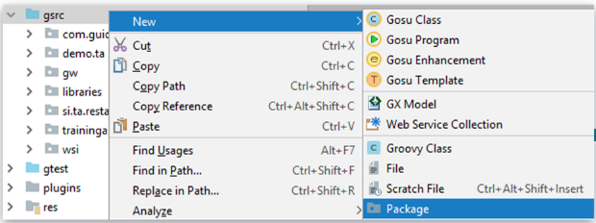

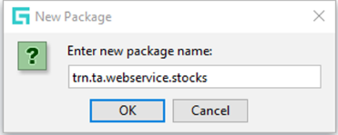
Webservice collection (WSC)
Webservice collection (WSC)
  Connect to WS-I web services
/configuration/gsrc
Create Package

Slide 11
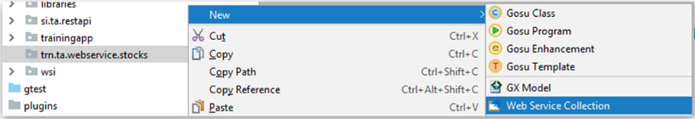
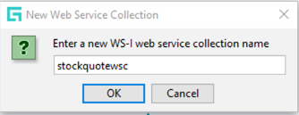
Create in the package a Webservice collection
To Create a new Web service collection:
Right-click on the package
Select New → Web Service Collection
Enter a new WS-I web service collection name

Slide 12
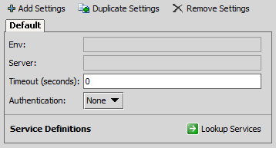
Additional configuration options
1 var api = new soap.ChemicalSymbol.api.ChemicalElementApi()
2 // set authentication
3 var handler = new gw.api.soap.GWAuthenticationHandler("su","gw")
4 api.addHandler(handler)
5 var symbolInfo = api.getDataAsXml("Au")
6 print (symbolInfo)
GWAutheticationHandler()
  Specify a handler for authentication
Configure default
or add additional
settings in editor
  Environment
  Server
  Timeout
  Service definitions
Notes:
With web service endpoints, some of the additional options are configured in the endpoint entry in Studio, and others are accessed in the Gosu code that makes the API instance. For example:
In the endpoint entry in Studio, you can:
Specify a timeout
Specify an override URL
From the API object, you can:
Specify a handler for authentication (as shown above)
For more information on how to set each option, refer to the Integration Guide.

Slide 13
Web services overview
Resources for consuming external web services
Consuming external WS-I web services

Slide 14
Web service collections
stockquotesWSC
WS-I
stockquote
WSDL
stockquote
XSD
related
WSDLs (if any)
related
XSDs (if any)
A web service collection is a collection of references to an external WS-I web service
It consists of one or more resources including:
  Primary WSDLs and XSDs for the external web service
  Any WSDLs and XSDs referenced by the primary files
Notes:
A given web service collection contains only one copy of each file, even if multiple files reference that file. (For example, if two WSDLs in the web service collection reference the same XSD, there is only one copy of the XSD in the web service collection.)

Slide 15
Consuming an external WS-I web service
Create a package for the web service collection
Create a new web service collection
Fetch the resources
Deploy your changes
Reference the web service in Gosu as needed

Slide 16
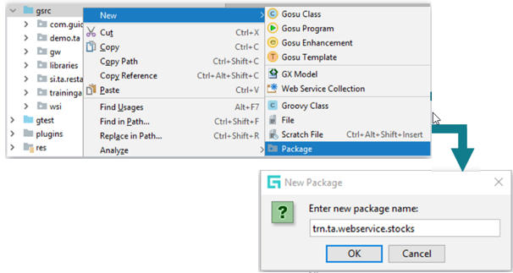
Step 1: Create a package
/configuration/gsrc/
  Create package
  New → Package
Guidewire naming convention recommendation
  <company>.<app_code>.webservice.<functional_area>
  Example: trn.ta.webservice.stocks
Notes:
To create a package:
1. Right-click the package that is to be parent of new package.
2. Name the package. The name must be unique for the given parent.
The package roots "com.guidewire" and "gw" are reserved. You should not create any child packages in either of these packages.
For more information on recommended naming conventions for packages, refer to the "Gosu for Integration" lesson.

Slide 17
Step 2: Create a web service collection
To Create a new Web service collection:
Right-click on the package
Select New → Web Service Collection
Enter a new WS-I web service collection name

Slide 18

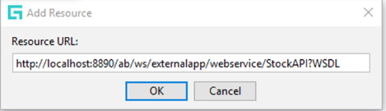
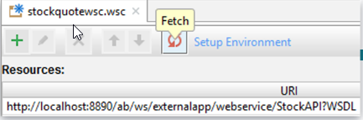
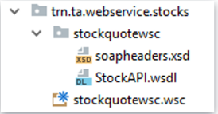
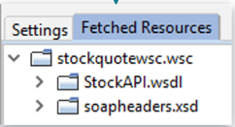
Step 3: Fetch the resources
To fetch the external resource:
  Click Add New Resource
  Specify the resource URL
Click Fetch
  The External system must be running
Project view shows fetched resource
  wsc folder
  XSD and WSDL files
Notes:
To add resources to a collection:
1. In the editor, click Add Resource.
2. In the Add Resource dialog, enter the URL for the WSDL of the web service. Click OK to add the resource to the Fetched Resources pane. At this point, the resource has not been fetched.
3. In the dialog, click Yes to fetch the resources.
4. In the editor, click Fetch Updates to update an existing resource.
In order to replicate these steps in TrainingApp, ExternalApp must be running.

Slide 19
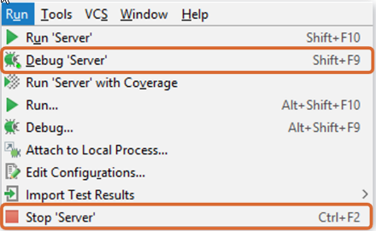
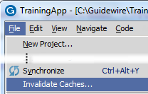
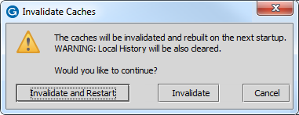
Step 4: Deploy your changes
Invalidate Caches
and Restart Studio
Restart Server
To call the new web service collection, restart the server from Guidewire Studio
  Stop (if running)
  Run 'Server or
  Debug 'Server'
To reference the web service API in Studio, invalidate the caches and restart Studio
Notes:
To reference the newly added web service in Gosu code in Guidewire Studio, you need to first invalidate the caches and restart Guidewire Studio.
To clear the Guidewire Studio caches, from the menu bar, select File and then select Invalidate Caches. In the dialog, click Invalidate and Restart.
After Guidewire Studio restarts, you will be able to reference the web service collection in Gosu code.
In order to instantiate the web service collection in Gosu code, you must restart the Guidewire application.

Slide 20
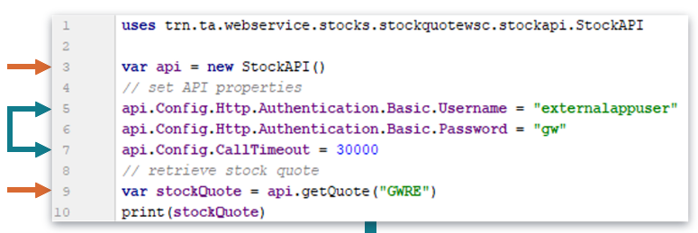
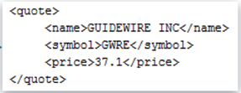
Step 5: Reference the web service in Gosu
new packagepath.webservicecollection.
Wsdlname.ServiceName()
  Syntax to reference a web service collection API instance:
ServiceName()
is case
sensitive;
use value of
name attribute
No reference?
  File →
  Invalidate caches… → Invalidate and Restart
Notes:
The web service collection name is converted to lower-case letters. For example, the web service collection in the example is named StockQuoteWSC., but it is referenced in Gosu as "stockquoteswsc". The Service name is case sensitive.
From Gosu, there are three types of WS-I web service client connections:
Standard round trip methods (synchronous request and response)
One-way methods (synchronous request without response)
Asynchronous round trip methods (send the request and immediately return to the caller, and check later to see if the request finished).
A typical WS-I method invocation has two parts: the SOAP request and the SOAP response. WS-I supports a concept called one-way methods. The WSDL defines a one-way method to not provide a SOAP response. The transport layer (HTTP) may send a response back to the client, however, but it contains no SOAP response. Gosu fully supports calling one-way methods. Your web service client code does not have to do anything special to handle one-way methods. Gosu automatically handles the one-way method if the WSDL defines a one-way method. For more information on one-way methods, refer to the Integration Guide.
Gosu supports optional asynchronous calls to web services. For more information, refer to the Integration Guide.
Further processing of the return value may be needed. For example, if the return value is XML data, you may need to parse the data to get the value you need. For further information on parsing XML, refer to the "Gosu and XML" lesson.

Slide 21
Additional configuration options
1 var stockAPI =
2 new acme.ta.webservice.stocks.stockquotewsc.stockapi.StockAPI()
3 // set authentication properties
4 stockAPI.Config.Http.Authentication.Basic.Username = "su"
5 stockAPI.Config.Http.Authentication.Basic.Password = "gw"
6 // set timeout to 30 seconds (30000 milliseconds)
7 stockAPI.Config.CallTimeout = 30000
8 var stockQuote = stockAPI.getQuote("GWRE")
9 print (stockQuote)
Specify additional configurations for the API:
  Authentication information
  Timeout period
  Custom SOAP headers
  HTTP headers
  Server override URL
Notes:
If a web service does require authentication, then you can set the user name and password using the following syntax:
apiInstance.Config.Http.Authentication.Basic.Username = "userName"
apiInstance.Config.Http.Authentication.Basic.Password = "password"
If you need to add encryption, authentication, or digital signatures, you can do so by modifying options on the API object's Config namespace.
For more information on how to set each option, refer to the Integration Guide.

Slide 22
  Describe how Guidewire applications and external systems can integrate with each other using web services
  Determine a given web service's binding style
  Consume external WS-I web services from Guidewire

Slide 23
DEMO

Slide 24
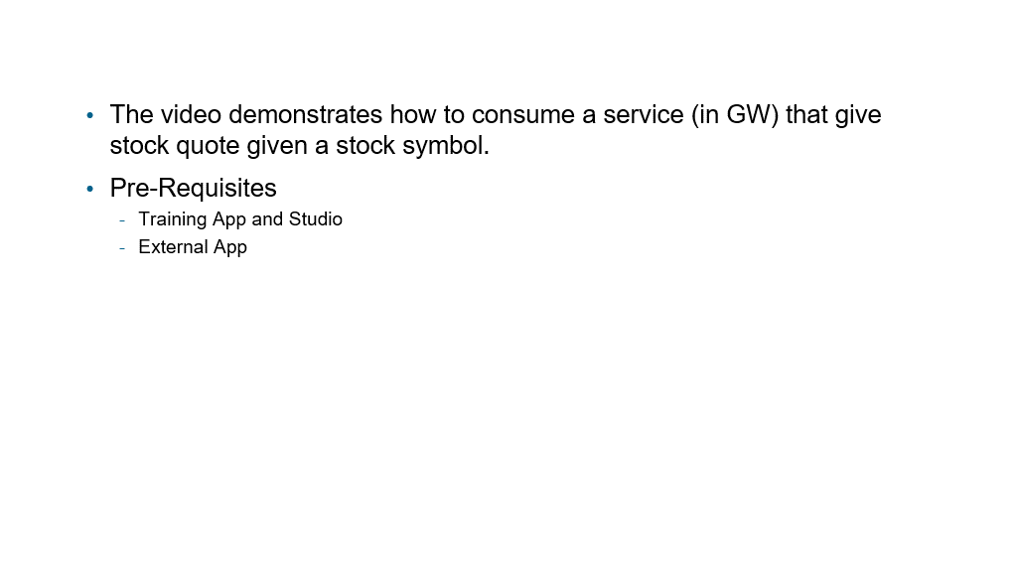
Provide demo details<The video creator to fill this slide>

Slide 25
LAB

Slide 26
Complete the exercises listed in “SOAP Web Services” chapter in the “InsuranceSuite 10 Integration: Kickstart “ work book

Slide 27
What is a WSDL? What does it describe?
With regards to WSDL binding styles:
  How can you tell the style used by a given WSDL?
  What Guidewire resource is used to consume WS-I WSDL style?
What two types of files can be included as resources in a web service collection?
You have an API instance named "conversionAPI". Under what circumstances would you set properties on conversionAPI.Config?
Notes:
Answers
1. A WSDL is an XML document that describes how an external system can interact with a web service.
2a. The style attribute in the WSDL's binding tag
2b. Web service collections are used to consume WS-I WSDLs
3. WSDLs and XSDs
4. You would set values there if you needed to provide authentication information, timeouts, or custom SOAP headers.

