Slide 1

InsuranceSuite 10 Integration
Introduction to Guidewire Integration

Slide 2
  Identify technologies and strategies commonly used for application integration
  Describe the Guidewire integration mechanisms
  List the resources available to Guidewire integrators

Slide 3
Guidewire integration
Integration technologies
Integration resources

Slide 4

Guidewire integration
API client /
Web browser
Application Server
Authentication
DocumentStorage
J2EE
Application Server
Legacy PAS
Guidewire database
Integration is the communication between Guidewire applications and external systems
  Every implementation involves multiple integration points that make use of a variety of integration technologies and Guidewire integration mechanisms
Notes:
"Integration" is typically used to refer to external systems other than: (1) the web browser used to connect end users to the application, or (2) the application database.
The connections to the web browser and to the application database typically require little configuration. You can modify certain properties relevant to each (such as the port number on which the Guidewire application listens or the application database that Guidewire points to), but these changes are straight-forward and require no coding.

Slide 5
Integration points
Authenticate users during sign-on
Create documents (such as printed policy quotes, Dunning letters, or "coverage in question" letters)
Store documents received or created by the application
Store information for contacts used by multiple systems
Authentication
System
Document
Production
System
Document
Storage
System
Address
Book
Application
Notes:
Almost every instance of a Guidewire application is integrated with an authentication system, such as Microsoft Active Directory. This system takes a user name and either a token or a password and verifies if they are authentic.
Almost every instance of a Guidewire application has an integration point to a document production application somewhere in the application architecture. This application merges templates and data, and it may also store the document templates. Implementations may also have some documents created on a user's machine.
Almost every instance of a Guidewire application has an integration point to a document storage application, such as FileNet or Box.Net. The document storage system manages documents that end users download, create, edit, and upload.
Many instances of a Guidewire application have an integration point to an address book application. Many implementations use Guidewire ContactManager (formerly known as ContactCenter) as the address book application.

Slide 6
PolicyCenter integration points: Examples
Rates a policy transaction (calculates the cost of the transaction)
Bills the insured for policy transactions bound by PolicyCenter
Manages policies for which PolicyCenter is not the system of record
Processes claims made against policies
Policy
Rating
System
Billing
System
Legacy
Policy Admin.
System
Claims
System
Notes:
(During deliveries to customers who are not learning PolicyCenter integration, the instructor may skip this slide.)
A policy transaction is an action that creates, modified, or cancels a policy. Most policy transactions have a cost associated to them. A rating engine is a system that takes information on an unbound policy transaction and calculates the rating (the amount of money that will be charged or refunded to the policy holder if the policy transaction is bound).
Whenever a policy transaction with billing implications in bound (such as when a new policy is issued, a policy is changed, or a policy is cancelled), PolicyCenter sends information to a billing system so that the appropriate parties can be charged or refunded. The billing system may also need to inform PolicyCenter that a policy is delinquent and that the cancellation process should be initiated.
PolicyCenter can be integrated with one or more legacy policy administration systems (PAS). This is typical during the first year of the PolicyCenter implementation. Existing policies are shifted from the legacy system to PolicyCenter as each legacy policy comes up for renewal. The legacy system triggers the renewal process in PolicyCenter. This can also occur if PolicyCenter manages policies for some, but not all, lines of business, especially if a given insured can have policies in each system.
Every instance of PolicyCenter is integrated with one or more claims systems. The claims system searches PolicyCenter for policies whenever a new claim is created. PolicyCenter retrieves claim information during the renewal process to determine if a given policy should be renewed and what impact the claims may have on the policy's rating.

Slide 7
BillingCenter integration points: Examples
Contains the policies which need to be billed (and need to be cancelled if a policy becomes delinquent)
Tracks finances for the carrier
Prints checks for disbursements (refunds) and producer commissions
Used to receive money from and/or send money to policy payers and producers
Policy
Admin.
System
General
Ledger
System
Check
Processing
System
Financial
Institution
Notes:
(During deliveries to customers who are not learning BillingCenter integration, the instructor may skip this slide.)
The billing process is initiated by a policy administration system (PAS). It contacts BillingCenter whenever there is a policy transaction with billing implications (such as when a new policy is issued, a policy is changed, or a policy is cancelled). BillingCenter may also need to inform the PAS that a policy is delinquent and that the cancellation process should be initiated.
Some instances of BillingCenter have an integration point to a general ledger system, such as Oracle Financials. This system tracks finances for the carrier, and the integration point exists so that the ledger system can stay abreast of the activity occurring in BillingCenter.
Most instances of BillingCenter have integration points to a check processing system. This system prints paper checks for outgoing money, such as disbursements (refunds) to policy holders, and commission payments to producers.
BillingCenter can also be integrated to one or more financial institutions. This integration point manages payments coming into BillingCenter as well as outgoing electronic fund transfers.

Slide 8
ClaimCenter integration points: Examples
Captures "first notice of loss" information, which is imported and transformed into claims
Retrieves policy to determine what items are listed on the policy and what types of losses are covered
Tracks finances for the carrier (and must know about reserves and payments related to a claim)
Issues payments to claimants
First
Notice
Application
Policy
Admin.
System
General
Ledger
System
Check
Processing
System
Notes:
(During deliveries to customers who are not learning ClaimCenter integration, the instructor may skip this slide.)
Nearly every instance of ClaimCenter has an integration point to a first notice application. This application stores First Notice of Loss reports in a standard XML-based file format called ACORD XML. It could be hosted by the carrier or by an FNOL service provider.
Every instance of ClaimCenter has an integration point to a policy administration system, such as PolicyCenter. This application stores information about:
Policies issued by the carrier
Coverages on each policy
People or assets covered by those coverages
Some instances of ClaimCenter have an integration point to a general ledger system, such as Oracle Financials. This system tracks finances for the carrier (reserves and payments), and the integration point exists so that the ledger system can stay abreast of the payments ClaimCenter is making.
Every instance of ClaimCenter has an integration point to a check processing system. This system prints paper checks and/or manages electronic funds transfers.

Slide 9
Guidewire integration
Integration technologies
Integration resources

Slide 10
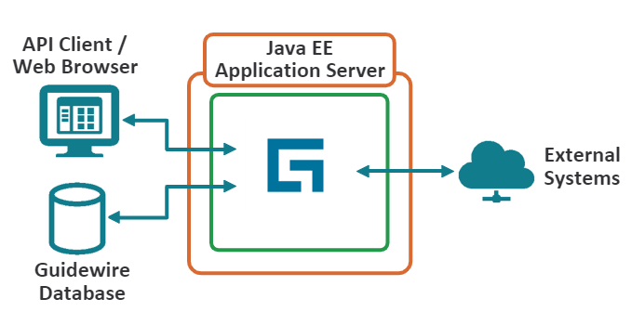
Integration technologies
InsuranceSuite implementations use a wide variety of industry-standard technologies to share information with external systems, including:
  Batch Processes*
  Database tables
  Web Services*
  Messaging*
  Plugin*
* Details provided in a separate lesson
Notes:
Java Platform, Enterprise edition (Java EE)
The application server implements Java EE technology which defines the standard for developing multitier enterprise applications. The Java EE platform simplifies enterprise application by basing them standardized, modular components, by providing a complete set of services to those components, and by handling many details of application behavior automatically, without complex programming.

Slide 11

Database tables
Guidewire application
database tables
External
system
One system writes data to a database table and other system accesses the data
  Query for near real-time
  Batch process for delayed and/or scheduled
Common examples in Guidewire implementations:
  JDBC, Spring, Hibernate
Notes:
Another technique includes using a database table to share data across multiple systems. Theoretically, this could involve Guidewire writing data directly into a database table "owned" by the external system. In practice, it is much more common for the two systems to interact with an intermediate table that isn't owned by either system.
Spring - The Spring Framework is an open source application framework for the Java platform. Although the Spring Framework does not impose any specific programming model, it has become popular in the Java community as an alternative to, replacement for, or even addition to the JavaBean model.
JDBC - JDBC is an API for the Java programming language that defines how a client may access a database. It provides methods for querying and updating data in a database. JDBC is oriented towards relational databases. A JDBC-to-ODBC bridge enables connections to any ODBC-accessible data source in the JVM host environment.
Hibernate - Hibernate is an object-relational mapping (ORM) library for the Java language, providing a framework for mapping an object-oriented domain model to a traditional relational database. Hibernate's primary feature is mapping from Java classes to database tables (and from Java data types to SQL data types).

Slide 12
Best practices: Integration tables
Guidewire application
integration table
file
External
system
An integration table is a table that both systems can access
For file based data exchange, write data to the integration table first
Then, generate the file from the integration table, for example, with a batch process, later
Notes:
Often, an integration point needs to write information that is static, queryable, processable and reprocessable. Integration points based on writing information initially to a file can be unstable. The file could easily be deleted and there may not be an easy way to retrieve or recreate it. Integration points that initially write information to a stand-alone database table are more stable. The rows in the database cannot easily be deleted. They provide a static snapshot of the data at a given point in time. The information can be queried, flagged as processed, and potentially reprocessed if something goes wrong.
Therefore, when data must be written out to a static repository, the most common technique is to use an integration table. The table sits in a separate database. Either Guidewire or an external system writes information to the table. Periodically, some sort of tool, such as a batch process, processes the rows in the table. For example, a batch process could write all unprocessed rows in the table into a file, change the status of the unprocessed rows to "processed", and then make the file available to the consuming system.
Integration tables are not used just to generate files. They can also be used for reporting, data warehouses, or any other requirement in which one must have a snapshot of the state of the application at a specific point in time. For example, an integration point could contain information about invoices overdue or claims filed. This information could then be copied into a data warehouse.

Slide 13
Message queues
message
message queue
response
Guidewire application
External
system
One system sends a message to another system, which is placed in a queue, and at a later point in time, the other system processes it
  Typically, the receiving system provides some type of response indicating that the message has been processed
Common examples in Guidewire implementations include JMS and MQSeries
Notes:
A message queue involves the exchange of data between two systems that consists of messages.
Each message describes events, requests, and/or replies. Unlike remote procedure calls, which involve a synchronous exchange of information, the exchange in messaging is typically asynchronous.
The system that creates the message does not necessarily send the message immediately after it has been created.
The system that receives the message does not necessarily process the message immediately after it is received. Sun Microsystem's Java Message Service (JMS) and IBM's MQSeries are examples of technologies that provide messaging interfaces and services.

Slide 14
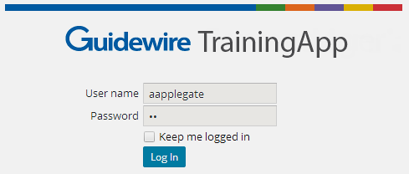
Predefined Plugins
AcmeAuthentication
ServicePlugin
Authenticate
"aapplegate"
authenticate()
setCallback()
A predefined plugin is a Gosu or Java class which implements a set of methods called by internal code and related to fundamental application behavior
  For example, the authentication plugin implements methods that define how authentication is executed
Predefined plugins may or may not interact with other systems
  When predefined plugins interact with other systems, they are typically outbound and synchronous
Notes:
Some predefined plugins must interact with external systems, such as an authentication plugin or a geocoding plugin. Other plugins are not required to interact with external systems. For example, number generator plugins generate unique numbers following specific patterns for primary entities. These plugins are not required to interact with external systems, and often they execute logic that is stored entirely within Guidewire.
In Guidewire, there are three functionally different types of plugins: messaging plugins, startable plugins, and non-messaging, non-startable plugins. The term "predefined plugins" refers to non-messaging, non-startable plugins.

Slide 15
Web services
Does account 1733 exist?
false
IAccountAPI
(web service)
External
system
A Guidewire web service is a web service that external applications use to make synchronous calls to Guidewire
  The code is triggered by a request from the external system
Example:
  IUserAPI, with doesexist() and addUser() methods
Notes:
Guidewire applications can both publish and consume web services. External systems can consume a Guidewire web service that is published.

Slide 16
Messaging
check data
Reply with check number
check printing system
Messaging is a Guidewire integration mechanism in which messages are asynchronously sent to external systems and potentially replied to
  Messages are typically sent in response to the creation or change of business data
Examples:
  PC: Sending billing instruction for new policy to billing system
  BC: Sending notice of unpaid premium to a collection agency
  CC: Sending request to issue check for given claim
Notes:
Messaging makes use of a variety of Guidewire features, including:
Event Fired rules
Destinations
Messaging plugins (These plugins have behaviors that are somewhat different than predefined plugins.)
Messages may be sent, and the replies may be received, using flat files, database tables, remote procedure calls, and/or message queues.

Slide 17
Startable plugins
Startable plugin
payment
external payment system
A startable plugin is a mechanism that listens for requests from an external system that communicates with Guidewire via a mechanism such as:
  JMS Messaging
  Sockets
Triggered by an incoming external request and typically processes the message asynchronously
  Example: BillingCenter accepting payment information from external systems

Slide 18
Batch processes
Exchange rate
system
Exchange
Rate
A batch process is background process that performs a periodic task independent of a user
  Example: Exchange Rate batch process queries an external system for exchange rates on a schedule
May execute logic entirely within Guidewire or interact with other systems
An external system calling a Guidewire web service may trigger a batch process to run
Notes:
A batch process completes background work that must be done on a periodic basis without user input. In this regard, a batch process in not triggered typically by a specific business event.
For example, the Exchange Rate batch process periodically queries an external system for exchange rates
May execute logic entirely within Guidewire or interact with other systems
Can also be triggered by an external system calling a Guidewire web service

Slide 19
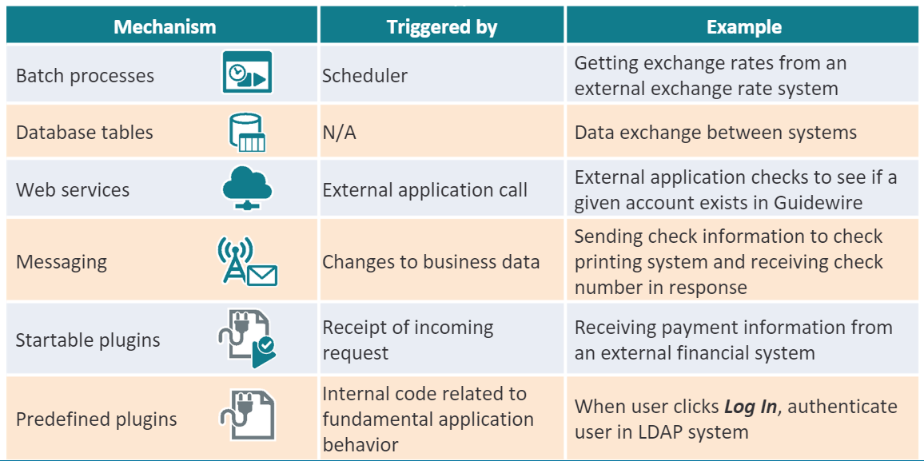
Summary of integration mechanisms
Notes:
In the table above, the "Triggered by" row lists the event or mechanism that typically triggers the integration mechanism. It is not an exhaustive list of all events or mechanisms that could trigger the integration mechanism.
LDAP – Lightweight Directory Access Protocol

Slide 20
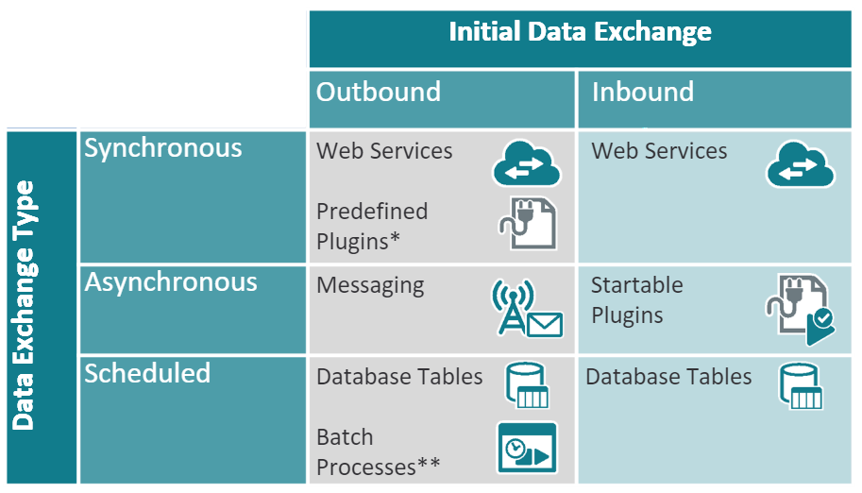
Contrasting mechanisms
Notes:
The table above provides a general comparison of the different integration mechanisms. The table does not describe absolute rules, and any implementation may use the mechanisms in ways that do not exactly adhere to the table.
The columns of the table separate the mechanisms into two general categories. "Outbound", which means the data exchange is initiated by Guidewire, and "Inbound", which means the data exchange is initiated by the external system. Keep in mind that most integration points involve a two-way exchange of data, regardless of who initiates the exchange.
Keep in mind that most integration point involve a two-way exchange of data regardless of who initiates the exchange.
For example, when authenticating a user, Guidewire initially sends information to the external system. Then, the external system replies with information on whether the user has been authenticated. So data typically flows in both directions. The critical point is which system initiated the exchange.
*Some predefined plugins do not typically interact with other systems. For example, ClaimCenter's claim number generator plugin and BillingCenter's commission calculation plugin typically execute logic entirely internal to Guidewire. When a plugin does interact with other systems, the data exchange is outbound.
**Batch processes can be initiated by the scheduler or by a web service call from an external system. So technically, they could be either outbound or inbound. In practice, most batch processes are initiated by the scheduler and are therefore outbound. In other cases, Guidewire application initiate a batch process from the internal API.

Slide 21
General best practices
Always send the smallest amount of data possible
Whenever possible, write integration points to be asynchronous
When an integration point must be synchronous, create it so that it has a timeout
When data is duplicated across systems, be clear about which system is the "system of record"
Be cautious about vendor information regarding the uptime and/or response times of their systems
External systems should never write data directly into a Guidewire database table
  They should always write data via an integration mechanism
Notes:
You should always send the smallest amount of data possible. For example, if an external system needs information about a contact, exactly what information does it need? Typically, it does not need the entire contact object as understood by Guidewire, but rather a subset of fields. An integration point will be faster to develop and test and will perform better if it sends the smallest amount of data possible.
Whenever possible, integration points should be written asynchronously. Synchronous integration points can be more resource-intensive and can block the user from doing work.
Asynchronous integration points provide the flexibility of processing a request outside of specific user activity, and they can potentially accomplish work during times when there is minimal user activity (such as in the evenings and on the weekends).
Synchronous integration points are typically blocking. When an integration point must be synchronous, you should create it so that it times out if the external system does not respond within a reasonable amount of time. This prevents the user from waiting unnecessarily for a response that is less likely to come.
It is not unusual for similar or identical data to be stored both in Guidewire and in a non-Guidewire system (or in two non-Guidewire systems that both interact with Guidewire). When designing integration points, be clear about which system is the system of record. This helps to resolve issues when the data in one system is not identical to the data in the other.
(continued...)

Slide 22
Notes:
Be wary of what a vendor has to say about the uptime or response time of their systems. Vendors can have a vested interest in making the performance of their system sound better than it actually is.
External systems should never write data directly into a Guidewire database table. Data should always be written via an integration point (such as a web service, message reply plugin, or startable plugin). There are several reasons for this, including the following:
Additional and critical data is often written into the database when the data is written via an integration mechanism. Data written directly into a Guidewire table will miss this information.
Upgrades of the product may involve changes to the structure of the database. Integration mechanisms will automatically account for this, whereas data written directly into a Guidewire table will not.

Slide 23
Guidewire integration
Integration technologies
Integration resources

Slide 24
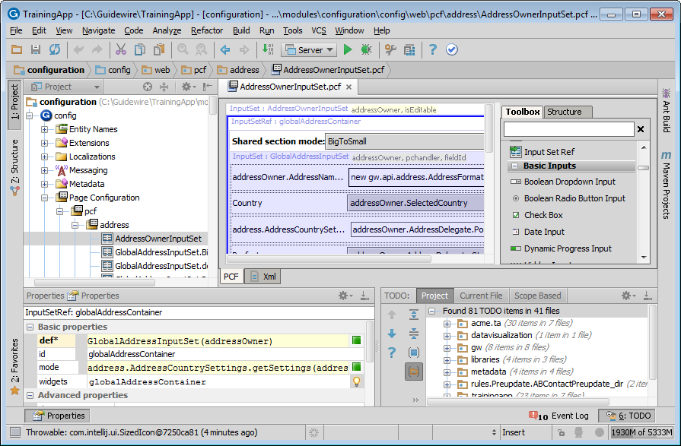
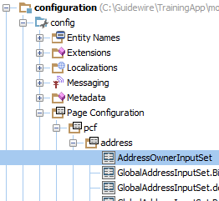
Guidewire Studio
Create and register predefined plugins
Create web service collections to consume external web services
Create Guidewire web services for external systems to consume
Create messaging integrations
Create startable plugins
Create batch processes
Studio is the primary IDEs used for integration development

Slide 25

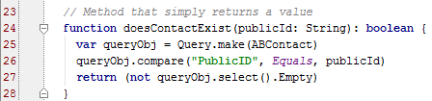
Public IDs
doesContactExist("ab:5")
External System
PublicID is a field on almost every Guidewire data model entity that is used to identify business objects as they are known to external systems
  Unlike the "ID" field, PublicID is a writeable string
In most cases, when integration code needs to identify a given business object, it does so using the object's PublicID
Notes:
The Gosu code shown above is from an example of a web service hosted by Guidewire. The web service method, doesContactExist(), takes a string that is a public ID. It then queries the database for any contact who has that public ID. Finally, it returns a boolean that is true (the query's result set was not empty, meaning at least one contact with that public ID was found) or false (the query's result set was empty, meaning no contact with that public ID was found). Queries are discussed in the "Gosu Queries" lesson. Guidewire-published web services are discussed in the "Publishing Guidewire Web Services" lesson. Every Guidewire data model entity has two fields that are used to uniquely identify instances of that entity: ID and PublicID.
The ID field is of type Key and is "owned" by the relational database. The database sets it and the Guidewire application cannot influence how it is set. Furthermore, if an object is transferred from one database to another (such as when admin data, such as users and groups, are moved from a development environment to a production environment), there is no guarantee that the object will have the same ID in the second system as it did in the first.
The Public ID field is of type String and is "owned" by Guidewire. When a new object is created, customer logic can set the public ID. If customer logic does not set it, then Guidewire base application logic sets the public ID before the object is committed to the database. (For example, in TrainingApp, ABContacts are stored with a public ID of "ab:X", where X is a unique integer value.) Because Guidewire "owns" the field, you can guarantee that objects transferred from one system to another will have the same public ID in both systems.
(continued)

Slide 26
Notes:
Once set, the public ID value can be reset. This is useful in situations where an object is created in Guidewire, but an external system later assigns its own ID value and Guidewire must use the external system's value. For example, imagine that Guidewire ClaimCenter creates a check to be sent to a claimant to pay for medical bills. Guidewire initially assigns it a public ID of "ccCheck:113". The check is then transferred to the check processing system. That system assigns a value of "234-2219" to the external copy of the check, and Guidewire changes the public ID of the Guidewire copy to match the external system's value. Sometime later, the check processing system informs Guidewire that the check is sent to the claimant. The system identifies the check using the "234-2219" value. Because Guidewire reset the public ID to match the external system's ID, Guidewire is able to locate and update the appropriate check.
There is one data model entity whose instances are not identified by PublicID: Message. The Message entity is used to create messages that are asynchronously created, sent to external systems, and then acknowledged. Message instances are typically identified by their SenderRefID field. The motivation for and functionality associated to SenderRefIDs are discussed in detail in the "Sending Messages" and "Acknowledging Messages" lessons.
Every data model entity which delegates to the KeyableBean data model delegate, either directly or indirectly, has a PublicID. This includes entities that delegate to Retireable, Editable, or Versionable, and includes virtually every business object entity (such as Claim, Policy, Account, and Contact) in every Guidewire application.

Slide 27
Guidewire integration documentation
Guidewire Integration Guide
  For questions specific to integration mechanisms
Guidewire Gosu Reference
  For questions specific to Gosu
Guidewire Rules Guide
  Useful for integration points that require rules, especially messaging
Guidewire Configuration Guide
  Occasionally needed for some integration steps
  Also documents functionality of every Studio editor (including some that are exclusive to integration)
Generated documentation
Notes:
The Studio editors exclusive to integration include:
The plugin registry
The destinations editor
There are several sets of documentation that are specific to a given instance of a Guidewire application. Each set must be generated. This includes the following:
The Data Dictionary, which documents the entities and typelists in the Guidewire data model. It is generated using the gwxx regen-dictionary command (which also generates the Security Dictionary). Once generated, it is located in <application>\build\dictionary\data. (The Data Dictionary is discussed in detail in the Configuration Fundamentals course's "Introduction to the Data Model" lesson.)
The Security Dictionary, which documents the system permissions and roles for the application. It is generated using the gwb genDataDictionary command (which also generates the Data Dictionary). Once generated, it is located in <application>\build\dictionary\security.
The Gosu Reference, which documents the Gosu type system. It is generated using the gwb gosudoc command. Once generated, it is located in <application>\build\gosudoc.
The Guidewire Java API Javadocs, which documents the Java classes that represent Guidewire entities, typelists, and plugin interfaces. It is generated using the gwb genJavaApi command. You must add a reference to the Guidewire Studio project for Javadocs.

Slide 28
The training environment
This course make the following assumptions:
  You are working in development mode
  EnableInternalDebugTools parameter in config.xml has been set to true
  You are using the Dynamic Code Evolution Virtual Machine (DCEVM)
  All Guidewire applications are located in the c:\Guidewire directory
The training environment also provides the following resources:
  TrainingApp
  ExternalApp
Notes:
Guidewire recommends that all development work be done using the Dynamic Code Evolution (DCE) virtual machine.
With the DCEVM, there are numerous situations where you can deploy your new code simply by saving the code in Studio and reloading the changed class or compiling the class. Without the DCEVM, you must often stop and restart the server to deploy your new code.
If your classroom environment was set up as recommended by Guidewire, then the DCEVM has been installed. For more information on the DCEVM, refer to the Installation Guide.
The Guidewire applications used in this course (including TrainingApp and ExternalApp) come with shortcuts that can be used to start and stop the application and start Studio. These shortcuts assume that the Guidewire applications are in the c:\Guidewire directory.
If these applications are stored in a different directory in your environment, then you will need to modify the shortcuts to point to the correct directories, or start and stop applications manually through the command line interface.
That said, you will often work in Guidewire Studio and deploy you changes in a Debug 'Server' process. You can stop and start the debug 'server' process from Guidewire Studio.

Slide 29
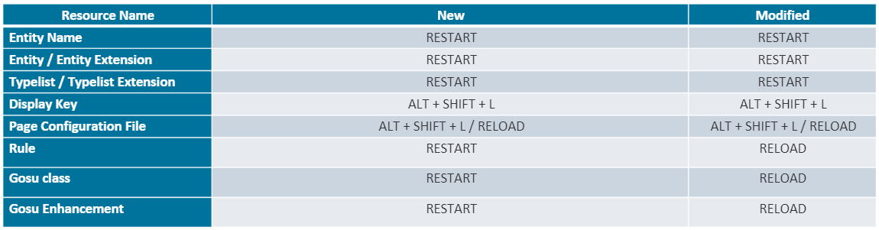
Deploying integration resources
In a development environment, resources require different actions to be deployed:
  ALT + SHIFT + L: reloads PCF and displaykey changes without restarting the server
  RELOAD: In Studio, Run -> Reload Changed Classes
  Deploying Gosu changes in local development environment only works if DCEVM is installed on your development machine
  Restarting the server always deploys all changed resources
Notes:
In some situations, provided that Studio is connected to the application, the only thing you need to do to deploy a resource is to click Save in Studio.
This requires that the EnableInternalDebugTools parameter in config.xml has been set to true.
In some situations, you must restart the server. This typically pertains to resources that can only be read during server startup.
In some situations, you must also copy files into the Guidewire application. This typically pertains to resources developed in Java.

Slide 30
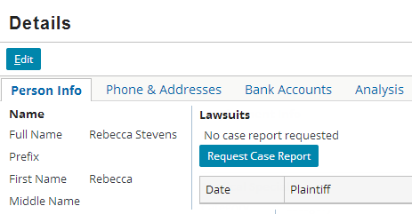
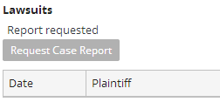
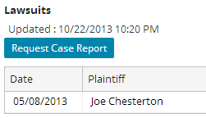
TrainingApp for integration students
immediately
TrainingApp has resources
for integration students, including:
  Example integration points
  Admin screens that display data relevant to integration
  Admin screens that demo internal integration functionality
eventually
Notes:
TrainingApp is a simple application used to store contact information. It is not sold as a genuine Guidewire product. It is used exclusively by Guidewire Education for teaching students about platform-level functionality.
TrainingApp contains examples and partially-built functionality for both configuration students and integration students. The legal case report integration point shown above is a fully functional integration point that uses Guidewire messaging and web services to request a legal case report from an external system, process the reply when it is received, and display any reports received. The integration point interacts with ExternalApp (which is discussed on the next slide), so you must have ExternalApp running to see the end-to-end functionality.
To view the legal case report integration point:
Start ExternalApp. (Navigate to c:\Guidewire\ExternalApp and double-click the ExternalApp shortcut.)
In TrainingApp, navigate to an ABDoctor (such as Samantha Andrews).
On the Details screen's Person Info card, click the "Request Case Report" button. (This disables the "Request Case Report" button and displays the "Report requested" text.)
Wait for approximately two minutes. (You can view the consoles of both TrainingApp and ExternalApp to view the exchange on information between the two systems.)
Refresh the Person Info card by clicking on a different card and then clicking back on the Person Info card. You should now see the "Updated" text under the Lawsuits label, and the "Request Case Report" button should be re-enabled. Most of the time, there will also be a case report in the list view, but not always.

Slide 31
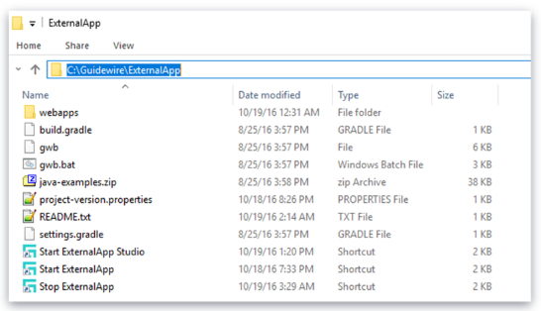
ExternalApp
ExternalApp is a simple application that simulates a variety of external systems
  Not sold as a genuine Guidewire product
  Used exclusively by Guidewire Education
You will not log onto or configure ExternalApp
  You'll simply start it, stop it, and build integration points to it
Notes:
Like TrainingApp, ExternalApp is a modified version of ContactManager. However, the modifications in ExternalApp are significantly less than that of TrainingApp. Beyond the base application, it has just a small number of web services, batch processes, and logic to react to incoming requests.
You do not need to have ExternalApp running at all times. If a TrainingApp example or course lab requires the application to be running, then explicit notes or instructions identify this.

Slide 32
DEMO

Slide 33
Provide demo details<The video creator to fill this slide>

Slide 34
LAB

Slide 35
Complete the exercises listed in “Introduction to InsuranceSuite Integration” chapter in the “InsuranceSuite 10 Integration: Kickstart” work book

Slide 36
  Identify technologies and strategies commonly used for application integration
  Describe the Guidewire integration mechanisms
  List the resources available to Guidewire integrators

Slide 37
What are the four industry-standard technologies commonly used in Guidewire integration?
For each of the InsuranceSuite integration mechanisms, identify its typical "timing" (synchronous, asynchronous, or scheduled) and initial direction (outbound or inbound):
  Predefined plugins
  Web services
  Messaging
  Startable plugins
  Batch processes
Name three general best practices.
Notes:
Answers
1)Database tables, Plugins, webservice, message queues
2a) Synchronous and outbound
2b) Synchronous and inbound
2c) Asynchronous and outbound
2d) Asynchronous and inbound
2e) Scheduled and outbound
3) Possible answers:
When possible, write information out to database tables as opposed to files.
Send the smallest amount of information possible.
Whenever possible, write integration points asynchronously.
When an integration point must be synchronous, include a timeout with the integration point.
Do not write information directly into a Guidewire database table.

Slide 38
THANK YOU

