Slide 1

InsuranceSuite 10 Integration
InsuranceSuite 10 Fundamentals
GOSU QUERIES

Slide 2
  Describe a query object
  Identify various types of query restrictions
  Write Gosu queries to retrieve objects from a Guidewire application
  Iterate through the results of query

Slide 3
Gosu query basics
Working with queries
Working with result sets

Slide 4
Gosu queries
A Gosu query specifies the
entity and criteria associated with the entity
to retrieve from the Guidewire application
Use Gosu queries to retrieve
one or more objects
  Referenced by foreign key relationships
  NOT in an array relationship
Example:
  All ABPersons with an assigned user who also created a confidential note for the ABPerson
Notes:
Gosu queries are useful when code must work with a set of objects that does not exist as an array, such as "all contact notes created by this user". Guidewire recommends that all new queries be written as Gosu queries because Gosu queries have the following advantages:
They more readily support the construction of complex queries.
They use builder patterns, which simplify the creation of search screens.
They use a syntax more intuitive to people accustomed to writing queries in Structured Query Language (SQL).
Here is an example query for the referenced example. If Bruce Baker is assigned to an ABPerson and creates a contact note for that person that is marked confidential, Gosu Scratchpad will show the results:
uses gw.api.database.Query
uses gw.api.database.Relop
var qryUser = Query.make(User)
qryUser.compare(User#PublicID, Relop.Equals, "ab:11")
var qryContactNotes = Query.make(ContactNote)
qryContactNotes.compare(ContactNote#IsConfidential, Relop.Equals, true)
var qryPerson = Query.make(ABPerson)
qryPerson.subselect(ABPerson#AssignedUser, CompareIn, qryUser, User#ID)
qryPerson.subselect(ABPerson#AssignedUser, CompareIn, qryContactNotes, ContactNote#CreateUser)
var result = qryPerson.withLogSQL(true).select()
for (obj in result ) {
print(obj.DisplayName)
}

Slide 5
Objects for querying database
Query object
Results object
ab_abcontact
?
Query object specifies the query criteria
  Which entity to query
  What restrictions to apply
Results object is set of entity instances fetched from the Guidewire application
  How many?
  How to order?
Notes:
Results are fetched from the Guidewire application when they are counted, made iterable, or when one object is retrieved. Depending on the query, the results may be fetched from the Guidewire application cache and/or the Guidewire application database. To learn more, refer to documentation in the Gosu Reference Guide.

Slide 6
Steps to execute a basic query
Create the query object using the make() method
Create the results object using the select() method
Process the results of the query as needed

Slide 7
Step 1: Create the query object
1 uses gw.api.database.Query
2
3 var output = ""
4 var queryObj = Query.make(entity.ABContact)
Query is a class in the gw.api.database package
make(EntityName) is a method that requires a named entity type
Line 4: creates the query object for the ABContact entity type
Notes:
The make method is a method of the Query class. This class is declared in the gw.api.database package. A package is a collection of classes grouped together for convenience or because fields or methods in those classes should have access to one another while instances of classes outside of the package should not, or both.

Slide 8
Step 2: Create the results object
1 uses gw.api.database.Query
2
3 var output = ""
4 var queryObj = Query.make(entity.ABContact)
5 var resultsObj = queryObj.select()
Create the result object with select()
  However, results are not fetched
Lines 5 : creates the results object
Notes:
In the slide example, the results object is a convention the helps distinguish the query object and the results object. The results object is not required. It is not always necessary to create an explicit results object. For example, it is possible to write the above as:
var queryObj = Query.make(ABContact).select()
Results are fetched from the Guidewire application when they are counted, iterated over, or when one object is retrieved. In many cases, the results are fetched from the Guidewire application cache. In other cases, the results are retrieved from the Guidewire application database.

Slide 9
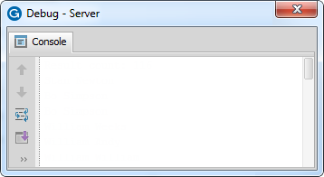
Step 3: Process results
1 uses gw.api.database.Query
2
3 var output = ""
4 var queryObj = Query.make(entity.ABContact)
5 var resultsObj = queryObj.select()
6
7 for (anABContact in resultsObj) {
8 output += anABContact.DisplayName + "\n"
9 }
10 print(output)
Use a for loop to iterate
through the result set
Lines 7-9: fetches the
result objects
Line 10: prints to console
Stan Newton
Bo Simpson
Bo Simpson
William Weeks
William William
Notes:
In the slide example, the DisplayName property improves the readability of the console output.
Recall the for-loop syntax in Gosu has an optional index variable. Use the index variable to number results:
for (anABContact in resultsObj index i) {
print (i + ": " + anABContact.DisplayName
}
…produces the following output...
1: Alex Newton
2: Bert Simpson
3: Charles Simpson

Slide 10
Viewing approximation of SQL query
1 uses gw.api.database.Query
2
3 var output = ""
4 var queryObj = Query.make(entity.ABContact).withLogSQL(true)
5 output += queryObj.toString())
6 var resultsObj = queryObj.select()
7
8 for (anABContact in resultsObj) {
9 output += anABContact.DisplayName + "\n"
10 }
11 print(output)
For real SQL, use withLogSQL(true)
For SQL approximation, use queryObj.toString()
INFO Executing sql = SELECT /* KeyTable:ab_abcontact; */ gRoot.ID col0, gRoot.Subtype col1 FROM ab_abcontact gRoot WHERE gRoot.Retired = 0 []
SELECT FROM ab_abcontact gRoot WHERE gRoot.Retired = 0
Notes:
The query object's toString() method provides an approximation of the SQL sent to the database to execute the query. These results are an approximation because the actual SQL may have vendor-dependent variations or vendor-dependent optimizations or both. A given query may have slight syntactic variations depending on whether it is used for an Oracle database or a SQL Server database.
You can record a more specific version of the SQL query in the logs. Call the withLogSQL(true) method on the query object. The method takes a single boolean argument that, when set to true, logs the query in the system logs using PLLoggerCategory of SERVER_DATABASE.

Slide 11
Gosu query basics
Working with queries
Working with result sets

Slide 12
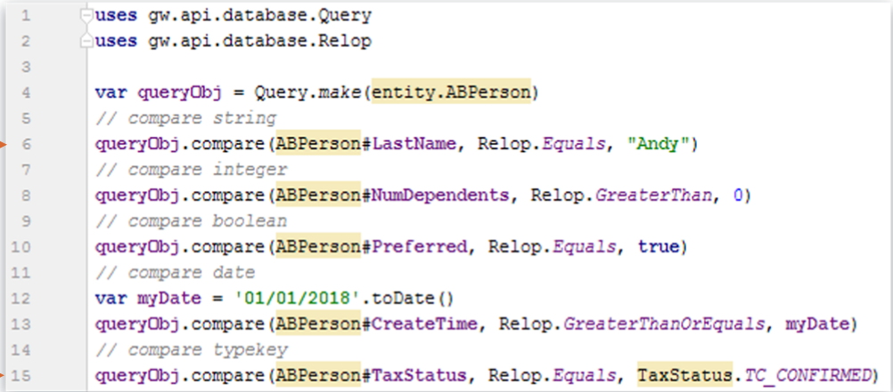
Restricting queries: compare() method
Compare() applies restrictions to query object
Compare method is overloaded-has one or more signature
Line 6: restricts to ABPersons with last name as "Andy"
William Andy
Eric Andy
Notes:
The syntax for restricting a query using the compare() method comparison predicate is:
queryObj.compare("field", operator, value)
Valid operators include:
Relop.Equals
Relop.NotEquals
Relop.LessThan
Relop.LessThanOrEquals
Relop.GreaterThan
Relop.GreaterThanOrEquals

Slide 13
Compare() method syntax
4 var queryObj = Query.make(entity.ABPerson)
5
6 // String
7 queryObj.compare("LastName", Relop.Equals, "William")
8
9 // Feature Literal
10 queryObj.compare(ABPerson#LastName, Relop.Equals, "Andy")
Comparison predicates are columns in SQL Where clause
When applied to character fields, the values in the field must match exactly the comparison value
compare() method is overloaded, meaning it has one or more method signatures
Line 7: String reference for column Name
Line 10: Property Name using feature literal syntax

Slide 14
Feature literals for property reference
Statically refer to the features of a given type in the Gosu type system with feature literals
Various kinds of feature references
  Property
  Method
  Directly invoke/get/set
Syntax : type#Feature
  ABContact#LastName
  ABContact#addContactNote()
Uses
  Bind feature literal to instance
  Bind argument values in method reference
  Supports chaining
  Covert method references to blocks
When it needs to be type safe, use feature literals!
Notes:
Any place you need to refer to a property or method on a type and want it to be type safe, use feature literals.
You can refer to the "features" of a type using the # operator in the Gosu Language.
Here are a few examples for why feature literals for the Gosu language are useful:
Mapping between properties of two types (mapping layer)
Creating data-binding (data layer)
Specify type-safe bean paths (query layer)
One reason that the feature literal syntax is preferred in the compare() method is because you can reference the property/field of the entity without referring to the data dictionary.
For business rules where often the getOriginalValue() method is called, the feature literal supports the property reference method signature. This means that the method can return a properly typed reference and not just a reference to the Object type.

Slide 15
compare() method examples (1)
4 var queryObj = Query.make(entity.ABPerson)
5
6 // compare string
7 queryObj.compare(ABPerson#LastName, Relop.Equals, "Andy")
8
9 // compare integer
10 queryObj.compare(ABPerson#NumDependents, Relop.GreaterThan, 0)
11
12 // compare boolean
13 queryObj.compare(ABPerson#PrefersContactByEmail, Relop.Equals,
true)
Line 7: String literals require quotes
Notes:
Often you want to select data based on the values of typekey fields. A typekey field takes its values from a specific typelist, which contains a set of codes and related display values used in the drop-down lists of the ClaimCenter application.

Slide 16
compare() method examples (2)
4 var queryObj = Query.make(entity.ABPerson)
5
6 // compare date
7 queryObj.compare(ABPerson#CreateTime, Relop.GreaterThanOrEquals,
"09/01/2010" as java.util.Date)
8
9 // compare typekey
10 queryObj.compare(ABPerson#TaxStatus, Relop.Equals,
typekey.TaxStatus.TC_UNCONFIRMED)
11
12 // compare null
13 queryObj.compare(ABPerson#Score, Relop.Equals, null)
Line 7: Cast date values that are strings to java.util.Date
Line 10: Use typekey reference syntax for typecode comparisons
A null value signifies the absence of or void of a value
Notes:
When using the compare method with a date value, you must cast the value as a date value. Otherwise, Guidewire treats the value as a string and it throws a type mismatch exception. To cast a value as a date value, use the syntax: "<datevalue>" as java.util.Date.
Avoid strings for typecode values as this also requires casting to a typekey, To cast a value as a typecode from the appropriate typelist, use the syntax: "<typecode>" as typekey.<typelist>. Gosu provides typekey literals that let you specify typelist codes in your programming code. Gosu creates typekey literals at compile time by prefixing typelist codes with TC_ and converting code values to upper case.
A null value signifies the absence of or void of a value.

Slide 17
Null values for query restrictions
…3 var queryNull= Query.make(entity.ABPerson)
4 var queryNotNull= Query.make(entity.ABPerson)
5
6 // ABPerson where Score IS NULL
7 queryNull.compare(ABPerson#Score, Relop.Equals, null)
8
9 // ABPerson where Score IS NOT NULL
10 queryNotNull.compare(ABPerson#Score, Relop.NotEquals, null)
Entities can have elements that allow for null values
If there is no value, the database leaves the field as null unless the element specifies a default value
Restriction queries can compare for null or not null values
gw.api.database.Query | ANSI SQL
compare(entity.Property, Equals, null) | where table.columnName IS NULL
compare(entity.Property, NotEquals, null) | where table.columnName IS NOT NULL
Notes:
In Guidewire applications, there are some data model entity elements that specify a nullok attribute. Column, foreignkey, onetoone, and typekey are elements that have the nullok attribute. When specified as an attribute of an element, you must define the nullok attribute (8.0.0).
Guidewire applications transform an entity element with a nullok=true attribute to a column definition in a physical database table. Relational databases create database tables using a form of Structure Query Language (SQL) known as Data Definition Language (DDL). With a nullok=false attribute, a Guidewire application executes a SQL / DDL statement to create a column constraint that specifies that the named column cannot contain a null value.

Slide 18
Multiple restrictions ANDed together
1 uses gw.api.database.Query
2 uses gw.api.database.Relop
3
4 var output = ""
5 var queryObj = Query.make(ABPerson)
6 // Last name
7 queryObj.compare(ABPerson#LastName, Relop.Equals, "Andy")
8 // First name
9 queryObj.compare(ABPerson#FirstName, Relop.NotEquals, "William")
10
11 var resultsObj = queryObj.select()
12 for (anABContact in resultsObj) {
13 output += anABContact.DisplayName + "\n"
14 }
15 print(output)
Restrictions are inherently ANDed together
Line 7 + 9: Restricts ABPersons to last name equal to "Andy" and the first name not equal to "William"
Notes:
A query can have as many restrictions as needed.

Slide 19
Multiple restrictions ORed together
1 uses gw.api.database.Query
2 uses gw.api.database.Relop
3
4 var output = ""
5 var queryObj = Query.make(ABPerson)
6 // Last name or First name
7 queryObj.or(\ criteria -> {
8 criteria.compare(ABPerson#LastName, Relop.Equals, "Andy" )
9 criteria.compare(ABPerson#FirstName, Relop.NotEquals, "William")
10 } )
11 var resultsObj = queryObj.select()
12 for (anABContact in resultsObj) {
13 output += anABContact.DisplayName + "\n"
14 }
15 print(output)
or() requires block that specifies criteria to OR together
Line 7-10: or() block consists of a criteria element that represents the query object
Notes:
The block syntaxfor the or() method is:
queryObj.or( \ criteria -> {
criteria.compare()
criteria.compare() // add as many criteria as needed
})
You can create a query that consists of multiple conditions that are ORed together. To do this, you must use the or() method. It takes a block as an input parameter. The block consists of a placeholder that represents the original query object. You can then list multiple criteria, all of which are ORed together.
You can also combine conditions with AND and OR logic in complex ways. The following example finds all policy people whose first name is "John" or whose name is "Erica Hinds" (first name is Erica and last name is Hinds):
policyPersonQuery.or( \ orCriteria -> {
orCriteria.compare("FirstName", Equals, "John")
orCriteria.and( \ andCriteria -> {
andCriteria.compare("FirstName", Equals, "Erica")
andCriteria.compare("LastName", Equals, "Hinds")
})
})

Slide 20

Additional restriction options
See the
Predicate Methods Reference
in the
Gosu Reference Guide
between()
compareIgnore()
contains()
subselect()
startsWith()
Notes:
The Gosu Reference Guide contains complete list of all options for restricting queries. In addition, documentation covers how to write aggregate queries, row queries, column value comparison queries, and join queries.

Slide 21
Gosu query basics
Working with queries
Working with result sets

Slide 22
Counting results –taking a peek without retrieving data
1 uses gw.api.database.Query
2
3 var output = ""
4 var queryObj = Query.make(ABPerson)
5 var resultsObj = queryObj.select()
6 var count = resultsObj.Count
7 output += "Result count: " + count + "\n"
8 print(output)
Result count: 116
Count property returns the number of result objects
Line 6: resultsObj.Count retrieves the number objects
The below methods perform better and more reliable than count
  isEmpty does a fast check to see if query has any results
  getCountLimiterBy(x) returns number if results less than x, otherwise x
  Peeking is a waste of time and cycles if you intend to process entire result set
Notes:
The Count attribute identifies the number of objects in the result set.
Developers should keep in mind that Guidewire does not query the database for the complete result set, however, and does not store a snapshot of the results of a given query. Therefore, the value of Count can vary if the number of rows in the database that meet the query's criteria changes while the query results are being processed. The field is introduced here as it is useful for instructional and debugging purposes, but it can be problematic if used in implementation code as an absolutely accurate reflection of the number of rows in the database that meet the query's criteria. For a further discussion of this topic, refer to the Gosu Reference Guide.

Slide 23
Sorting results ( 1 of 2)
1 uses gw.api.database.Query
2
3 var output = ""
4 var queryObj = Query.make(ABPerson)
5 var resultsObj = queryObj.select()
6 resultsObj.orderBy( \ row -> row.LastName)
7 for (anABContact in resultsObj) {
8 output += anABContact.DisplayName + "\n"
9 }
10 print(output)
orderBy() requires block that specifies sort column
orderByDescending()
specifies descending order
Line 6:
resultsObj.orderBy()
specifies the LastName
as the ascending sort column
James Andersen
Samantha Andrews
William Andy
Eric Andy
William Dan
Notes:
The sorting syntax for the results object is:
resultsObj.orderBy( \ row -> row.FieldName)
resultsObj.orderByDescending( \ row -> row.FieldName)
In the slide example, the two methods sort the entire result set according to the field name in either ascending (orderBy) or descending (orderByDescending) order.
There are two other methods: thenBy and thenByDescending. These methods do not re-sort the entire result set. Instead, they preserve any existing ordering and sort rows that tied during the first sort. For example, if you wanted to sort by last name and then by first name, you would use the following code:
resultSet.orderBy( \ row -> row.LastName)
resultSet.thenBy( \ row -> row.FirstName)

Slide 24
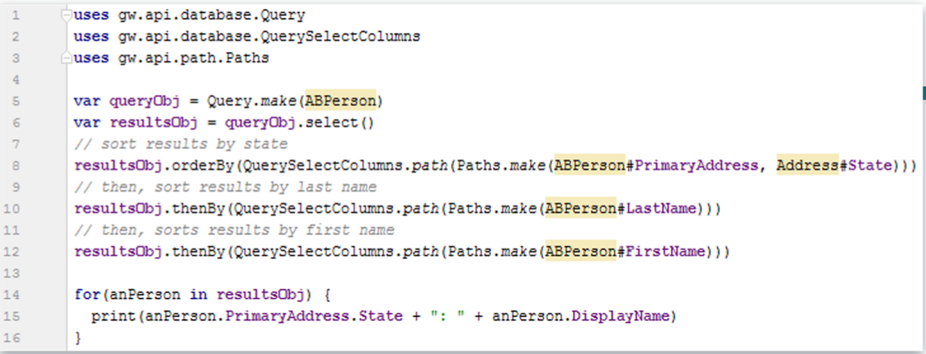
Sorting Results (2 of 2)
Ordering methods all take an object that implements IQuerySelectColumns interface in the package as their one argument
The paths.make method yields an object access path from the primary entity to a simple,non-foreign key,database-backed property
Access path cannot include virttual properties,methods, or calculations
Notes:
Code example
Line 8
Path object traverses foreign key and ends with State property
In this case, the foreign key name does not match the entity name
Lines 10,12
Multiple levels of ordering query results
The query builder APIs support the following ordering methods on result objects.
METHOD DESCRIPTION
orderBy Clears all previous ordering, then orders results by the specified column in ascending order.
orderByDescending Clears all previous order methods, and orders by the specified column in the descending order.
thenBy Orders by the specified column in ascending order. Does not clear previous ordering
thenByDescending Orders by the specified column in descending order. Does not clear previous ordering.

Slide 25
Querying for one result
1 uses gw.api.database.Query
2
3 var output = ""
4 var queryObj = Query.make(ABCompany)
5 queryObj.compare(ABCompany#Name, Relop.Equals, "Albertson's")
6 var resultsObj = queryObj.select().AtMostOneRow
7 output += resultsObj.EmailAddress1
8 print(output)
AtMostOneRow is a property that…
  If a single item exists, returns that single row
  If no item exists, returns null
  If multiple items exist,
  throws exception
Line 6: AtMostOneRow
returns one row, null,
or throws exception
info@Albertsons.com
Notes:
AtMostOneRow is annotated as a property, but it is just the published name for the getAtMostOneRow() method.

Slide 26
DEMO

Slide 27
Demonstration on how to Create Queries with restrictions

Slide 28
LAB

Slide 29
Complete the exercises listed in “Gosu Queries” chapter in the “InsuranceSuite 10 Integration: Kickstart “ work book

Slide 30
  Describe a query object
  Identify various types of query restrictions
  Write Gosu queries to retrieve objects from a Guidewire application
  Iterate through the results of query

Slide 31
Name two ways for viewing the SQL for a query object?
What is the difference between a query object and results object?
What is an example of an AND restriction?
What is an example of an OR restriction?
How do you order query results in descending order?
If you use the AtMostOneRow property for a query object, and the query returns more than one row, what happens?
Notes:
Answers
1) queryObj.toString() or Query.Make(entity).withLogSQL(true).
2) A query object specifies the entity and the query criteria. A results object is a set of one or more entity instances fetched from the Guidewire application. This distinction is helpful for understanding the concept of a query and of set of results. In practice, query results are fetched from the Guidewire application when they are counted, iterated over, or when one object is retrieved.
3) An example of an AND restriction is two or more compare() method comparison predicates for a query object such as:
var queryObj = Query.make(ABCompany)
queryObj.compare(ABCompany#Score, Relop.LessThan, 50)
queryObj.compare(ABCompany#InspectionRequired, Relop.Equals, true)
4) An example of an OR restriction is the or() method with a block of compare() methods such as:
var queryObj = Query.make(ABCompany).withLogSQL(true)
queryObj.or(\ criteria -> {
criteria.compare(ABCompany#Score, Relop.LessThan, 50 )
criteria.compare(ABCompany#InspectionRequired, Relop.Equals, true)
})
5) Use orderByDescending( \ row -> row.FieldName) method.
6) An exception is thrown when a query object with the AtMostOneRow returns more than one object.

Slide 32
THANK YOU

