Slide 1

InsuranceSuite 10 Integration
InsuranceSuite 10 Fundamentals
Messaging Payloads

Slide 2
  Describe the role that message payloads play in messaging
  Use Gosu templates to generate message payloads (for any type of text format)

Slide 3
Lesson Outline
Message payloads
Gosu templates

Slide 4

Message payload
A message payload is data generated in Event Fired rules that is sent to the external system
The payload typically:
  Contains dynamically generated data
  Is formatted based on the needs of the external system
Event Fired Rules
Destination
Entity Event
message payload
xx_message
EventAware
entity
message
context
message
Notes:
A message payload contains static and/or dynamically generated data. For example, the payload for bank account message might contain the bank name, routing number, and account number of the given bank account as comma-separated values. The specific values for the bank name, routing number, and account number must be generated dynamically for each bank account message.

Slide 5
Two easy ways for generating payloads
Gosu templates
  Create formatted strings
  with entity data
XML models
  Strongly typed XML
  with XSD validation
  Supports object graph
Gosu Template
Event Fired Rules
message payload
message payload
xx_message
message
XML
model
Notes:
Gosu template and XML models are not the only ways for generating a message payload, but they are commonly used. Likewise, message payload generation is not purpose of a Gosu template or XML model.
Other features that can be used to generate payloads include:
Manually creating untyped XML using the XmlElement class (as discussed in the "Gosu and XML" lesson)
Manually creating strongly typed XML from an XSD type (as discussed in the "Gosu and XML" lesson)
Gosu string templates (as discussed in the notes in the "Gosu templates" section of this lesson)
Any logic that creates a string suitable for use as a payload.

Slide 6
Lesson Outline
Message payloads
Gosu templates

Slide 7
Gosu template
publicID,ab:68
bankName,FastCash
(publicID) (bankName)
ab:68, FastCash
Gosu Template
A Gosu template is a file that generates dynamic, formatted text based on input parameters
Always evaluates to a string
Accepts any number of input parameters
Evaluates parameters and derived values into text
Supports scriptlet syntax for API calls and control of flow
Notes:
Gosu includes a native template system. Templates are text with embedded Gosu code within a larger block of text. The embedded Gosu code optionally can calculate a value and export the results as text in the location the code appears in the template text.

Slide 8
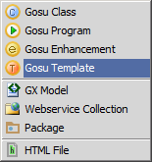
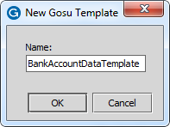
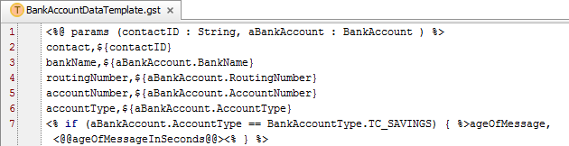
Steps to create a Gosu template
To create a Gosu template:
  Right-click the parent package
  Select New → Gosu Template
  Provide a name for the template
    <entity/description>Template
All Gosu template files have a .gst extension
Notes:
There are two mechanisms to use Gosu Templates: template syntax inside text literals and separate template files. The simplest way to use to templates is to embed Gosu expressions that evaluate at run time and generate text in the place of embedded Gosu expressions.

Slide 9
Gosu Template syntax: parameters
Input parameter declaration syntax:
  <%@ params ( param1 : type, param2 : type, …) %>
Note
  White space and line breaks are rendered in the Gosu Templates
Notes:
At the top of the template, create a parameter definition with the following syntax:<%@ params (paramList)%>. Just like a standard Gosu function, it is possible to define one or more parameters. Parameters can be of any type an in the form of “name : type”. Parameters are comma delimited. Later in the template, it is possible to evaluate the parameter objects.
You can use template expression syntax (${ and }) to evaluate parameters. Template expression syntax returns a result and generates additional text. You can use template scriptlet syntax (<% and %>) to evaluate or reference parameters. Scriptlet syntax only executes Gosu statements.
Except for the line that specifies input parameters, any white space in a template is reflected in the template output.

Slide 10
Gosu Template syntax: expressions
if contactID is "ab:68",
this renders as: contact,ab:68
Template expression syntax
  ${param1} or <%= param1 %>
Static text is outside of a template expression, template parameter, or template scriptlet
  Line 2 → contact, is treated as static text
Notes:
There are two forms of template expression syntax for rendering dynamic text: ${…}, <%=…%>.
${ value to Render } is the preferred syntax. <%= valueToRender %> is an alternative syntax. There is no advantage to using one syntax over the other. For the sake of simplicity, this lesson uses the first syntax exclusively.
Gosu runs your template expression syntax at run time. At compile time, Gosu uses the built-in type checking system to ensure the embedded expression is valid and type safe. For instance, if the expression does not return a value of type String, Gosu attempts to coerce the result to the type String.
You can also use template expression syntax to embed a Gosu expression in String literals (as opposed to having the template text stored in a separate .gst file). This can be useful if there is a relatively short but complex dynamic string that needs to be generated in a method or business rule where having the template in a separate file is less practical. For example, if an Event Fired rule needs to send only a public ID and the number of evaluations, then it might be preferable to write the Event Fired rule like this:
msg = messageContext.createMessage(
publicID,${anABcontact.PublicID}\nNumOfEvals,${anABcontact.VendorEvaluations.length})

Slide 11
Gosu Template syntax: scriptlets
Evaluate scriptlet syntax
  <% if (something=true) { %> … <% } %>
Text within <% and %> evaluated as Gosu at run-time
Scope is across scriptlet tags, e.g Conditional logic, variable assignments, loops, etc.
Notes:
Text enclosed within <% and %> evaluate as Gosu at run-time and are referred to as scriptlet tags. Unlike the alternative expression syntax, there is no equals sign in the opening tag.
The parser evaluates the scriptlet tags in the order that the appear. Scriptlet tags do not generate template output. All plain text between scriptlet tags generates output within the scope and the logic of the scriptlet code. Use this feature to write advanced logic that uses Gosu code that you spread across multiple scriptlet tags. The scope of the Gosu continues across scriptlet tags.
In the sample code, you can observe how the sricptlet functions to add an extra name-value pair to the output when the BankAccount AccountType equals savings.
Acme has a business requirement which states that, when verifying savings accounts, the age of the message must be submitted. Because the age of the message cannot be determined when the message is created, the Gosu template adds a placeholder for late binding: <@@ageOfMessageInSeconds@@>. The name-value pair conveys to the external system the age of the message, but only for savings accounts.
The Sending Messages lesson discusses late binding in more detail.

Slide 12
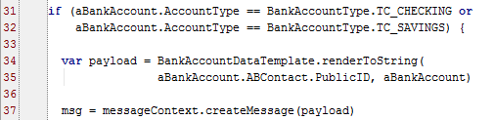
Generating String output using Gosu Template
Syntax
var payload = TemplateName.renderToString(paramList)
TemplateName: the Gosu template class name
TemplateName.renderToString(paramList): returns a serialized string
Notes:
The template is a first-class object in the Gosu type system within its package namespace. Technically, templates are not instantiated as objects. To run a template, reference your template and call the static renderToString() method of the template, and if required, pass any required parameters.
If you first reference a template in a “uses” statement, as in the example above, you do not need to use a fully qualified name later on. Otherwise, the template must be referenced using a fully qualified name, e.g., acme.ta.messaging.bank.BankAccountDataTemplate.

Slide 13
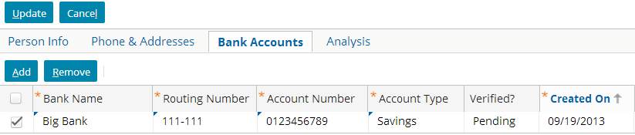
Gosu template payload example
Event Fired Rules
The Request Plugin transformed the payload
Sending payload to console for Message ID 630 as:
contact,ab:5
bankName,Big Bank
routingNumber,111-111
accountNumber,0123456789
accountType,savings
Gosu Template
message payload
message
Notes:
The example above shows the triggering entity in the user interface for a bank account for William Andy whose public ID is ab:5.
The Event Fired Rules determine that the message payload requires an Gosu Template because the Account Type is Checking or Savings

Slide 14
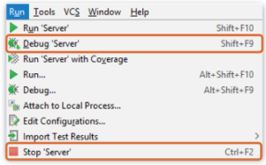
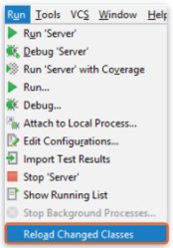
Deploy Code Changes
Restart Server
Reload Changed Classes
New Gosu Template
Modified Gosu Template
Notes:
You can restart the server from Studio by stopping a running server (debug mode is ok) and after the server stops, then running the server again in either Run or Debug mode.

Slide 15
DEMO

Slide 16
In this demo we will see how to use an existing Gosu template to generate String payload with bank account information
We will be using Guidewire TrainingApp studio
Open BankAccountDataTemplate file and examine the input required for it, fields in it
Use Gosu scratch pad to Query the data and use the gosu template to print the String payload

Slide 17
LAB

Slide 18
Complete the exercises listed in “Gosu Templates” chapter in the “InsuranceSuite 10 Integration: Kickstart “ work book

Slide 19
Lesson Objectives Review
You should now be able to:
    Describe the role that message payloads play in messaging
    Use Gosu templates to generate message payloads (for any type of text format)

Slide 20
Review Questions
Identify if each statement about Gosu Templates is True of False.
It can take any number of input values.
It can make use of conditional statements and for loops.
It can include values from both the object that triggered the message event and objects related to the triggering object.
It can be used only for payload generation
Notes:
Answers
1) True.
2) True.
3) Both. Gosu templates can do this either by having the related objects passed to it or by having the triggering object passed to it and using its foreign keys to navigate to the related objects. XML models can do this by including fields from the related objects.
4) False – Gosu Templates can be anywhere.

