Slide 1

InsuranceSuite 10 Integration
Gosu and XML

Slide 2
Lesson Objectives
By the end of this lesson, you should be able to
  Describe the fundamental features of XML
  Describe the basic functionality of the Guidewire XmlElement class
  Import and export untyped XML using Gosu
  Import and export strongly typed XML using Gosu and an XSD
  Identify additional Guidewire tools for working with XML

Slide 3
Lesson Outline
Overview of XML
The XmlElement class
Reading untyped XML
Writing untyped XML
Working with strongly-typed XML
XML Model

Slide 4
XML
1 <?xml version="1.0"?>
2 <config xmlns="http://guidewire.com/config">
3 <param name="CurrencyURL" value="">http://acme.x.com</param>
4 <database name="TADatabase" dbtype="h2" autoupgrade="true">
5 <param name="jdbcURL" value="jdbc:h2:file:ta/db/ta"/>
6 <param name="jdbcURLtest" value="jdbc:h2:file:ta/db/test"/>
7 <param name="stmtPool.enabled" value=" false"/>
8 </database>
9 <security sessiontimeoutsecs="10800"/>
…
636 </config>
Extensible Markup Language (XML) is a
hierarchy data structure designed
to transport and store data
Notes:
In XML, it is illegal to omit the closing tag. All elements must have a closing tag, except for the XML declaration tag. XML tags are case sensitive. Opening and closing tags must be written with the same case. Another word for tags is elements. All XML elements must be properly nested within each other. XML must contain one element that is the parent of all other elements. This element is called the root element. XML elements can have attributes in name/value pairs. The attribute values must always be quoted.
In XML, there are five predefined entities representing special characters. XML requires that you replace these characters with a named references. The five characters are:
" – double quotation mark
& – ampersand
' – apostrophe
< – less than sign
> – greater
For more information on the Extensible Markup Language, refer to the World Wide Web Consortium web page http://www.w3.org/XML.

Slide 5
XML elements
…3 <param name="CurrencyURL" value="">http://acme.x.com</param>
4 <database name="TADatabase" dbtype="h2" autoupgrade="true">
5 <param name="jdbcURL" value="jdbc:h2:file:ta/db/ta"/>
6 <param name="jdbcURLtest" value="jdbc:h2:file:ta/db/test"/>
7 <param name="stmtPool.enabled" value=" false"/>
8 </database>
10 <security sessiontimeoutsecs="10800"/>
XML elements have:
  A case sensitive name
  An opening and closing declaration
  One or more optional attribute name/value pairs
Contents can be Empty, have Text, and/or Child elements
  Line 3 is Text
  Line 4 is Children (5-7)
  Line 10 is Empty
Notes:
An XML element has one of the various types of contents: simple value; one or more child values; mixed complex type containing attributes, elements, and text; or nothing. An attribute is a name/value pair appearing inside the element's tag. Example: Line 10: The sessiontimeoutsecs attribute has a value of 10800.
Simple value example – The contents of the following <greeting /> element is the simple text value "Hello":
<greeting>Hello</greeting>
One or more child elements – The contents of the following <greeting /> element is two <greetingText /> elements:
<greeting>
<greetingText lang="en_US">Hello</greetingText>
<greetingText lang="fr_FR">Bonjour</greetingText>
</greeting>
Mixed complex content – There is both text and an inner <custom /> element within the <greetingText /> element:
<greetingText lang="fr_FR">Bonjour<custom>kiss on each side of face<custom></greetingText>
Nothing – The following "greeting" element has no contents (even though it has attribute):
<greeting lang="la (Latin)"/>

Slide 6
XML namespaces
1 <?xml version="1.0"?>
2 <config xmlns="http://guidewire.com/config
xmlns:ta="http://guidewire.com/configTA">
636 </config>
An XML namespace uniquely identifies one set of element and element attribute definitions
Provides way to avoid element name conflicts among multiples namespaces
Namespace prefix helps identify which definition to use when multiple definitions exist
Example:
  xmlns:ta defines the element prefix <ta:elementName/>
Notes:
In XML, developers often arbitrarily define element names resulting in potential conflicts when trying to mix XML documents from different XML applications.
An example of a conflicting definition is a <quantity> tag. For some items, <quantity> can be defined in weight, such as "<quantity>10</quantity>" representing 10 kilograms of flour. In other cases, <quantity> can be defined in discrete objects, such as "<quantity>10</quantity>" representing 10 mixing bowls. If an XML document is based on both definitions, then any reference to quantity is ambiguous.
You can resolve namespace conflicts by using a prefix identifier in the xmlns attribute. For example, you can qualify one namespace with xmlns:xa defines element <xa:quantity> and xmlns:xb defines element <xb:quantity>.
If an XML document uses elements for which there are no ambiguous definitions, then there is no need to define namespace. However, the use of namespaces are considered a best practice, particularly when you consider that there is no way of knowing whether element definitions created in the future will conflict with definitions that currently exist.
Defining a default namespace for a root (or parent) element means that you do not need to use prefixes in all the child elements. A default namespace has no prefix qualifier in the xmlns attribute. The syntax is xmlns="namespaceURI". The URI is not looked up. The slide example uses a default namespace for the <config /> root element and a namespace with a prefix.

Slide 7
XSDs
1 <?xml version="1.0" encoding="UTF-8"?>
2 <xsd:schema xmlns:xsd="http://www.w3.org/2001/XMLSchema" … >
…4 <xsd:element name="config" >
5 <xsd:complexType>
6 <xsd:choice minOccurs="1" maxOccurs="unbounded">
…8 <xsd:element name="param"
minOccurs="0" maxOccurs="unbounded"/>
12 </xsd:choice>
13 </xsd:complexType>
14 </xsd:element>
…90 <xsd:schema/>
An XSD (XML Schema Document) describes
the structure for elements in one or more
XML documents
  Informs how a XML document can be structured
  Used to validate the structure of a document
Notes:
One can work with XML documents even when there is no XSD. However, an XSD gives you the ability to validate the structure of a given XML document.

Slide 8
Untyped and strongly typed XML
Untyped
Strongly typed
If no XSD exists, then the parsed XML is untyped
If an existing XSD validates and informs the XML, then the parsed XML is strongly typed
Notes:
An XML document can be imported into Guidewire in isolation or through an XSD.
When an XML document is imported in isolation, the imported XML is untyped
When an XML document is imported through an XSD, the imported XML is strongly typed. It is the responsibility of the import code to use the XSD appropriate to a given XML document.

Slide 9
Serialization
01010010
01011010
11001001
01100100
serialization
deserialization
file.xml
file-clone.xml
XML serialization converts XML elements into a sequence of bits to be later deserialized
Serialization logic can be complex for certain data types such as hexadecimal values or images
Notes:
Broadly speaking, serialization is the process of converting a data structure or object into a sequence of bits so that it can be stored in a file or memory buffer, or transmitted across a network connection link to be reconstructed later. When the resulting series of bits is reread according to the serialization format, it can be used to create a semantically identical clone of the original object.
Serializing an object is also called deflating or marshaling an object. Deserialization is the opposite operation and refers to extracting a data structure from a series of bytes. Deserializing an object is often called inflating or unmarshaling.
For some types of values such as integers and strings, the logic needed to serialize the value is fairly straight forward. For other types of values such as dates, hexadecimals, and images, the logic can be much more complicated. When working with XML in Gosu, Guidewire makes use of simple value objects. These objects store the value in question and the logic needed to serialize the value. Simple value objects make it easier to work with values that require complex serialization logic.

Slide 10
Lesson Outline
Overview of XML
The XmlElement class
Reading untyped XML
Writing untyped XML
Working with strongly-typed XML
XML Model

Slide 11
XML and Gosu
file.xml
file.xml
Read and parse data from an XML document into memory
Write information from memory into an XML document
Validate the structure of XML using an XSD
Manipulate untyped and strongly typed XML
Notes:
Gosu has a set of features that let you read, parse data from, and create XML. When working with Gosu and XML, Guidewire recommends using strongly typed XML. Strongly typed XML makes it easier to identify elements and attribute values using less Gosu code because the XSD does the work of validating the XML and not Gosu.

Slide 12
The XmlElement class
1 <?xml version="1.0"?>
2 <config xmlns="http://guidewire.com/config">
3 <param name="CurrencyURL" value="">http://acme.x.com</param>
4 <database name="TADatabase" dbtype="h2" autoupgrade="true">
<config…>
Represent elements from XML
Import XML
Get information about each element
Create and modify elements
Export XML
<param…>
<database…>
Notes:
The XmlElement class lets developers interact with XML in an object-oriented manner. Instead of modifying text data in an XML file, developers can simply manipulate XmlElement objects. You can read in XML data from a file or other sources and parse it into a graph of XML elements. Other sources include data that is of the type java.io.InputStream , java.lang.String, an array of bytes, java.io.Reader, and java.net.URL.
You can export a graph of XML elements as standard XML, for example as an array of bytes containing XML data.

Slide 13
The QName property
1 <?xml version="1.0"?>
2 <config xmlns="http://guidewire.com/config">
3 <param name="CurrencyURL" value="">http://acme.x.com</param>
4 <database name="TADatabase" dbtype="h2" autoupgrade="true">
QName: {http://guidewire.com/config}config
QName: {http://guidewire.com/config}param
QName: {http://guidewire.com/config}database
A QName is a qualified name for an XML element, consisting of a namespace URI and a local part
Notes:
In Gosu, the name of an XmlElement instance is based on the element name. In the slide example, there are three elements named <config>, <param> and <database>.
It is possible for a given XML file to have elements defined in two or more ways. Therefore, if only the element name is used, then you could end up with two XmlElement instances having the same name but different meanings. For example, if a given XML file uses two types of <quantity> elements, one that assumes quantity is specified in units and one that assumes quantity is specified in kilograms, and you have two XmlElement instances each with a name of "quantity", you cannot readily know how to interpret the contents of the element.
To avoid ambiguity, the XmlElement class names an element instances using a qualified name called a QName.
A QName is a qualified name for an XML element that exists in both Java and Gosu. A QName includes both the element name also known as the local part and the XML namespace that defines the element typically using a URI.

Slide 14
Attribute and text properties
1 <?xml version="1.0"?>
2 <config xmlns="http://guidewire.com/config">
3 <param name="CurrencyURL" value="">http://acme.x.com</param>
4 <database name="TADatabase" dbtype="h2" autoupgrade="true">
QName: {http://guidewire.com/config}config
Attributes: xmlns (http://guidewire.com/config)
Text:
QName: {http://guidewire.com/config}param
Attributes: name (CurrencyURL)
Text: http://acme.x.com
QName: {http://guidewire.com/config}database
Attributes: name (TADatabase), dbtype(h2), autoupgrade(true)
Text:
Notes:
A QName defines an element more precisely than using just a String value. A QName contains the following components:
A String value that represents the local part also called the localPart. In the slide example, the local part comes after the close brace -- "}".
A String value that represents the namespace URI that the local part of the name is defined within. In the slide example, the namespace URI comes within the braces.
A suggested prefix name if Gosu later serializes this element. This prefix is not guaranteed upon serialization, since there may be conflicts. In the slide example, there is no prefix.
QNames are specified as instances of the javax.xml.namespace.QName class. The Gosu object that represent the element does not directly contain the child elements or the text content. It is the backing type instance for each element which contains the text content. However, in practice you probably do not need to be aware of this distinction.

Slide 15
XML simple values
<param… >
value: 20141017
logic:
serialization
Every XmlElement and attribute has an associated simple value object
  Purpose of the object is to store the actual value and the logic needed to serialize it
  For data that is not text or numeric, the logic needed to serialize the object can be complex
Object is of type XmlSimpleValue
Notes:
If a given integration point is working with XML that is predominantly text and numeric data, then there is probably no need to work with simple values. The Gosu code can get and set element attributes directly.
However, if a given integration point is working with XML that makes use of dates or more complex values (such as hexadecimal values or images), then the Gosu code should get and set element attributes using the getSimpleValue() and setSimpleValue() methods. Both methods require additional parameters and are therefore more complex to work with. Both methods ensure that values are retrieved correctly and are stored for proper serialization.

Slide 16
Lesson Outline
Overview of XML
The XmlElement class
Reading untyped XML
Writing untyped XML
Working with strongly-typed XML
XML Model

Slide 17
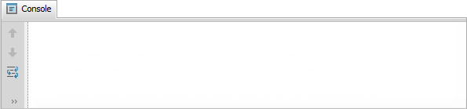
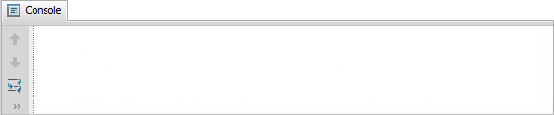
Parse XML without an XSD
6 uses gw.xml.XmlElement
7 uses java.io.File
…14 var filePathInput = "…/examples/xml/exampleUntyped.xml"
…16 var file = new File(filePathInput)
…19 var xml = XmlElement.parse(file)
…22 xml.print()
<?xml version="1.0"?>
<config xmlns="http://guidewire.com/config">
<param name="CurrencyURL" value="">http://acme.x.com</param>
<database name="TADatabase" dbtype="h2" autoupgrade="true">
<param name="jdbcURL" value="jdbc:h2:file:ta/db/ta"/>
XmlElement.parse()
  Parse XML data into a graph of XmlElement objects without an XSD
  Input can be byte[], java.io.File, java.io.InputStream, java.io.Reader, or String
Notes:
In the slide example, there is Gosu code that manipulates untyped XML. You can find this code in TrainingApp in …\configuration\config\examples\xml\
01_Xml_Untyped.CopyToGosuScratchpad.txt
Parsing is the act of converting serialized XML data into a more complex in-memory representation of the data. All the parse methods begin with the parse prefix. There are multiple methods because Gosu supports parsing from several different sources of XML data.
For each source of data, there is an optional method variant that modifies the way Gosu parses the XML. Gosu encapsulates these options in an instance of the type XmlParseOptions. The XmlParseOptions specifies additional schemas that resolve schema components for the input instance XML document. For more information, refer to the Gosu Reference.
For non-XSD-based XML elements, Gosu checks for well-formedness, and if the XML parse options object includes references to other schemas, Gosu validates against those schemas.
Every XmlElement has a print() method, which prints the element's XML, including any child elements. See line 22 in the slide example.

Slide 18

Accessing element properties
…19 var xml = XmlElement.parse(file)
…25 print("QName: " + xml.QName)
26 print("Namespace: " + xml.QName.NamespaceURI)
27 print("Local part: " + xml.QName.LocalPart)
QName: {http://guidewire.com/config}config
Namespace: http://guidewire.com/config
Local part: config
QName property represents a qualified name as defined in the XML specifications
Contains a Namespace URI, local part and prefix
Notes:
An XML element can be nill, which means:
The element exists in the XML file
The element may or may not have attributes
The contents of the element are unknown (null)
Nill XML elements are included when the element is expected, but the value of the element is not known. You can also reference an element's nillness using the Nil property.

Slide 19
Accessing children by index
…19 var xml = XmlElement.parse(file)
…31 print(xml.Children[0].QName)
32 print(xml.Children[1].QName)
33 print(xml.Children[1].Children[1].QName)
{http://guidewire.com/config}param
{http://guidewire.com/config}database
{http://guidewire.com/config}param
Syntax to access a given child element:
parent.Children[x]
Notes:
If an element has no child elements and no text content, the Children property contains an empty list.
If an element has no child elements but has text content, the Children property contains null.

Slide 20
Accessing children by name
…19 var xml = XmlElement.parse(file)
…36 print("Text of database element: " +
37 xml.getChild(new QName("http://guidewire.com/config",
"database")).Text)
38 print("Number of param elements in file: " +
39 xml.getChildren(new QName("http://guidewire.com/config",
"param")).Count)
Text of database element:
Number of param elements in file: 156
Returns only one child with given name syntax
parent.getChild(QName)
Returns a list of elements with given name syntax
parent.getChildren(QName)
Notes:
In the slide example….
Line 36-37: There is only one element whose localPart name is database. Its text is empty. If getChild() finds no element with the given QName, it returns null. If getChild() finds multiple elements with the given QName, it throws a MultipleContentMatchesException exception.
Line 38-39: There is more than one element whose localPart name is param. The count for param elements is 156.

Slide 21
Accessing children by where() methods
…19 var xml = XmlElement.parse(file)
…43 print(xml.Children.where(\el ->
el.QName.LocalPart == "database"))
…45 print(xml.Children.firstWhere(\el ->
el.QName.LocalPart == "database"))
…48 print(xml.Children.singleWhere(\el ->
el.QName.LocalPart == "database"))
[Element {http://guidewire.com/config}database]
Element {http://guidewire.com/config}database
Element {http://guidewire.com/config}database
Retrieve elements that meet any given condition with
where(), firstWhere(), and singleWhere()
Notes:
In the slide example, the are three where() methods. These methods are not unique to the XmlElement class. These methods exist on all Gosu collections.
Use a where() method to find an element based on a condition other than the element's name.
All three where() methods take a block as an input parameter. The block identifies the condition to use when checking against each item in the child list.

Slide 22
Accessing attributes and values
…51 var dbElement = xml.Children.singleWhere(\el ->
el.QName.LocalPart == "database"))
52 print("Attributes: " + dbElement.AttributesNames)
53 print("---------------------------------------")
54 for (attrib in dbElement.AttributeNames) {
55 print(attrib + ": " + dbElement.getAttributeSimpleValue(attrib))
56 }
Attributes: [name, dbtype, autoupgrade]
---------------------------------------
name: Simple value: TADatabase
dbtype: Simple value: h2
autoupgrade: Simple value: true
AttributeNames
  property returns a set of attribute names for the element
getAttributeSimpleValue()
  returns a simple value for an attribute
Notes:
For a given XmlElement, the AttributeNames property returns a set of attribute names for the element. The getAttributeValue() method returns the value of a given named attribute. If the named attribute cannot be found, it returns null.
If an attribute stores a hexadecimal value that is not a simple value, get the attribute's value using the getAttributeSimpleValue() method. This method makes use of the serialization logic inside the attribute's associated simple value object to ensure that the value returned is meaningful.

Slide 23
Accessing element contents
…19 var xml = XmlElement.parse(file)
…58 print(xml.Children[0].QName)
59 print(xml.Children[0].Text)
60 print(xml.Children[0].Children)
61 print("---------------------------------------")
62 print(xml.Children[1].QName)
63 print(xml.Children[1].Text)
64 print(xml.Children[1].Children)
A given XmlElement can have text or child elements but not both
Children indexer starts at 0
Notes:
You can access the text or child elements of an XmlElement using the Text and Children properties respectively. The Children property is a list of XmlElements starting with index 0.
The console output for the code in the slide example is:
{http://guidewire.com/config}param
http://acme.x.com
[]
----------------------
{http://guidewire.com/config}database
[Element {http://guidewire.com/config}param, Element {http://guidewire.com/config}param, Element {http://guidewire.com/config}param, Element {http://guidewire.com/config}param, Element {http://guidewire.com/config}param]

Slide 24
Lesson Outline
Overview of XML
The XmlElement class
Reading untyped XML
Writing untyped XML
Working with strongly-typed XML
XML Model

Slide 25
Modifying an existing XmlElement
…51 var dbElement = xml.Children.singleWhere(\el ->
el.QName.LocalPart == "database"))
…67 print("Original Value: "
+ dbElement.getAttributeSimpleValue("autoupgrade"))
68 dbElement.setAttributeSimpleValue("autoupgrade","false")
…69 print("Current Value: "
+ dbElement.getAttributeSimpleValue("autoupgrade"))
Original value: Simple value: true
Current value: false
XmlElements can be modified using various set...() methods, such as:
  setAttributeValue()
  setText()
Notes:
If an attribute stores a complex such as a binary or hexadecimal value, then you should set the attribute's value using the setAttributeSimpleValue() method. The method makes use of the serialization logic inside the attribute's associated simple value object to ensure that the value stored is meaningful.

Slide 26
Creating new XmlElements (1)
Syntax to create an XmlElement:
new XmlElement(QName)
Syntax to create a QName:
new QName(namespaceURI, localPart, prefix)
new QName(namespaceURI, localPart)
new QName(localPart)
Syntax to create an set attribute values
xmlElement.setAttributeValue("name","value")
Syntax to add child XmlElement to existing XmlElement
xmlElement.addChild(aXmlElement)
Notes:
There are three constructors for QName:
QName constructor specifying the namespace URI, local part, and suggested prefix: QName(String namespaceURI, String localPart, String prefix)
QName constructor specifying the namespace URI and local part (suggested prefix is implicitly empty): QName(String namespaceURI, String localPart)
QName constructor specifying the local part only (the namespace and URL are implicitly empty): QName(String localPart)
You can set the namespace in the QName to the empty namespace, which technically is the constant javax.xml.XMLConstants.NULL_NS_URI. The recommended approach for creating QName objects in the empty namespace is to use the QName constructor that does not take a namespace argument.
When constructing an XmlElement, the name is strictly required and must not be empty.
QNames are used for other purposes in Gosu XML APIs. For example, attributes on an element are names defined within a namespace, even if it is the default namespace for the XML document. Gosu natively represents both attribute names and element names as QNames.

Slide 27
Creating new XmlElements (2)
A new element is not part of a given XML hierarchy until it is added as a child of an element in the hierarchy
…6 uses gw.xml.XmlElement
…9 uses javax.xml.namespace.QName
72 var claimSystem = new XmlElement(new QName(
"http://guidewire.com/config", "claimSystem"))
73 claimSystem.setAttributeValue("URL",
"http://localhost:8880/ab/ContactManager.do")
…75 var claimSystemUser = new XmlElement(new QName(
"http://guidewire.com/config", "param"))
76 claimSystemUser.setAttributeValue("name", "user")
77 claimSystemUser.setAttributeValue("value", "su")
…79 var claimSystemPassword = new XmlElement(new QName(
"http://guidewire.com/config", "param"))
80 claimSystemPassword.setAttributeValue("name", "password")
81 claimSystemPassword.setAttributeValue("value", "gw")
82
83 claimSystem.addChild(claimSystemUser)
84 claimSystem.addChild(claimSystemPassword)
85 xml.addChild(claimSystem)
Notes:
You can set attribute values on a new element both before and after the element is added to the hierarchy. There is also a removeChild() method that lets you remove child elements from a given parent.
In the slide example, the QName constructor specifies the namespace URI and local part (suggested prefix is implicitly empty): QName(String namespaceURI, String localPart).

Slide 28
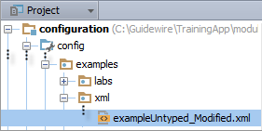
Exporting XML
…6 uses gw.xml.XmlElement
7 uses java.io.File
…10 uses java.io.FileWriter
…11 uses java.io.BufferedWriter
…15 var filePathOutput = "…/examples/xml/exampleUntyped_Modified.xml"
…88 var outputWriter = new BufferedWriter(new FileWriter(
new File(filePathOutput)))
89 outputWriter.write(xml.asUTFString())
90 outputWriter.close()
Original value: Simple value: true
Current value: false
asUTFString() method
  Serializes the element to a String object in UTF-8
XmlSerializationOptions()
  Customize the export
Notes:
Learn more about the multiple methods for exporting XML using Gosu in the Gosu Reference in documentation.
In most cases, it is sufficient to export XML as a UTF string using the asUTFString() method as shown above.
In some situations, it may not be appropriate to export XML as a UTF string. One reason is that UTF strings are usually larger in size than the original data. When to not use asUTFSting() is beyond the scope of this course. If an integration point needs to export XML, then the integration developer should discuss the issue with a Guidewire representative to identify the relevant issues and determine the best approach.
All of the export methods have alternate method signatures that take a serialization options object of type XmlSerializationOptions, which can be used to customize how the export occurs. For more information on serialization options, refer to the Gosu Reference.

Slide 29
Lesson Outline
Overview of XML
The XmlElement class
Reading untyped XML
Writing untyped XML
Working with strongly-typed XML
XML Model

Slide 30
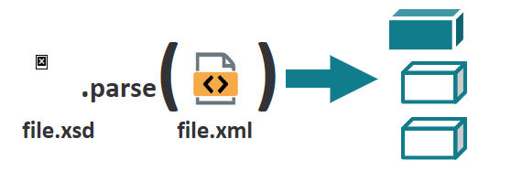
Strongly typed XML
An XML Schema Definition (XSD) describes the structure for elements in one or more XML documents
  Informs how an XML document can be structured
  Used to validate the structure of an XML document
  Offers robust syntax for reading and creating XML elements
Notes:
If the XML has an XML Schema Definitation (XSD) file, you can create, manipulate, or search data with statically-typed nodes that correspond to legal attributes and child elements. If you can provide an XSD file, the XSD approach is much safer. It dramatically reduces errors due to incorrect types or incorrect structure.
One can work with XML documents even when there is no XSD. When an XML document is imported in isolation, the imported XML is untyped.

Slide 31
Strongly typed XML
.parse( )
file.xsd
file.xml
If an existing XSD validates and informs the XML, then the parsed XML is strongly typed
  XSD must be known to Guidewire
  XSD parses the XML document
Offers robust syntax for referencing elements
Validation of the XML against the XSD
  Reading and creating XML

Slide 32
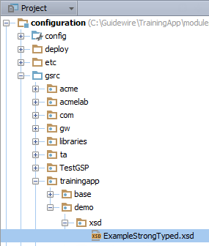
Making an XSD available to Guidewire
\configuration\gsrc\
  Put XSD in a subdirectory of \gsrc
  Subdirectories become part of the package name
During startup, Guidewire reads the XSD and creates type.
There is no way to inject an XSD into the type system at run time.
  The XSD must be known to the application during startup.
Various definitions cause Gosu
to create new types
  <xsd:element />
  <xsd:complexType />
  <xsd:attribute />
Notes:
All the types from the XSD become native Gosu types, including element types and attributes.
All these types appear naturally in the namespace defined by the part of the class hierarchy that you place the XSD.
In other words, you put your XSDs side-by-side next to your Gosu classes and Gosu programs.

Slide 33
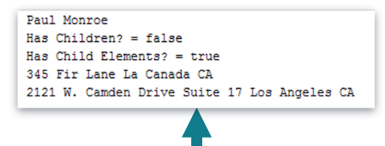
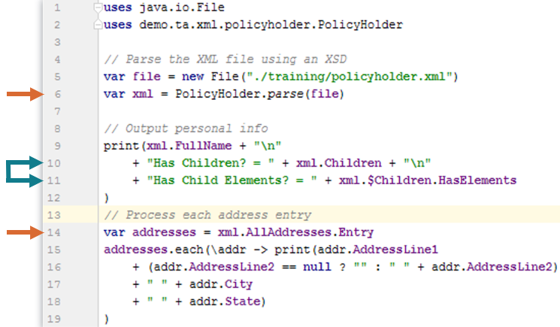
Parsing a strongly typed XML file
Syntax to call the parse method on the XSD type:
xsdFileName.rootElement.parse(xmlToParse)
  xsdFileName : fully qualified name
  rootElement : the XSD root element
Declared elements and attributes in the XSD are available as Gosu Types
  Use dot notation to reference the element types and attributes
Notes:
Code example :
Line 6
The XML File is parsed
Line 10-11
An example of a child element vs an XmlElement property
Line 14
Arrays are represented as a collection of Entry elements
For XSD-based XML elements, Gosu checks how well-formed is the XML in terms of structural errors and validates the XML using the XSD. If the XML is not valid or well formed, Gosu will throw an XMLException.
The main class that represents an XML element is the class XmlElement. An XmlElement object encapsulates the following core :
The element name as a qualified name (QName)
A backing type instance
The nillness of the element
Gosu prevents ambiguity by requiring the special properties of the XmlElement class to have a dollar sign prefix only if the element is XSD-based. To access the childern of an XSD-based element, use the syntax element.$Children for the Children property. To access a custom child element named Children as defined by the XSD, use the syntax element.Children. It is important to understand that property names on an XML element include a dollar sign prefix only if the XML element is an XSD type. If you create an XmlElement element directly, it is not an XSD type. It is an untyped node that used the default type instance which is an instance of the type AnyType. For non-XSD type, there is no need to use the dollar sign prefix beacuse there is no ambiguity between properties that are really part of the type instance, rather than on the XSD type

Slide 34
Parsing a strongly typed XML file
8 uses gw.xml.XmlElement
9 uses java.io.File
14 uses trainingapp.demo.xsd.examplestrongtyped.ExampleStrongTyped
…17 var filePathInput = "…/examples/xml/exampleStrongTyped.xml"
…19 var file = new File(filePathInput)
…22 var xml = ExampleStrongTyped.parse(file)
…25 xml.print()
<?xml version="1.0"?>
<ExampleStrongTyped xmlns="http://www.w3.org/2001/XMLSchema">
<database name="TADatabase" dbtype="h2" autoupgrade="true">
<param name="jdbcURL" value="jdbc:h2:file:ta/db/ta"/>
<param name="jdbcURLtest" value="jdbc:h2:file:ta/db/test"/>
Syntax to call the parse method on the XSD type:
xsdFileName.rootElement.parse(xmlToParse)
Notes:
In the slide example, there is Gosu code that manipulates strongly typed XML. You can find this code in TrainingApp in …\configuration\config\examples\xml\
02_Xml_StrongTyped.CopyToGosuScratchpad.txt
Assume for a moment that you have an XSD file named example.xsd. The root element in this file appears as <xsd:element name="config"> ... </xsd:element>.
To parse an XML file using this XSD in Gosu, all you need is the XSD type to call the parse method that specifies the file to parse as an argument:
example.Config.parse(fileToParse)
example. is the type because the name of the XSD file is example.xsd.
Config. is the root the root element. Gosu capitalizes the first letter when converting the XSD types into Gosu types.
parse(fileToParse)is the method that parses the XML.
For XSD-based XML elements, Gosu checks how well-formed is the XML in terms of structural errors and validates the XML using the XSD. If the XML is not valid or well formed, Gosu will throw an XmlException.

Slide 35

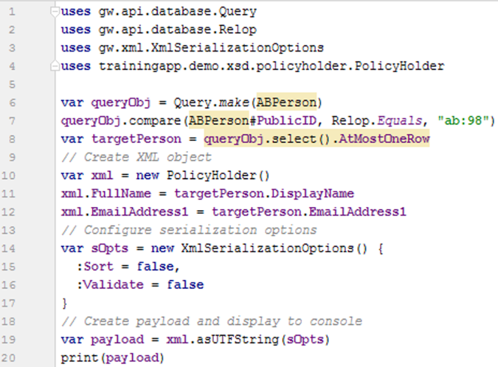
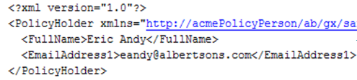
Generate XML using an XSD
Syntax to call the parse method on the XSD type:
xsdFileName.rootElement.parse(xmlToParse)
  xsdFileName : fully qualified name
  rootElement : the XSD root element
Declared elements and attributes in the XSD are available as Gosu Types
  Use dot notation to reference the element types and attributes
Notes:
Code example :
Line 4
Fully qualified name and root element.
Line 10
Create XML object using an XSD.
Line 14
Configure serialization options.

Slide 36

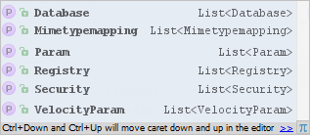
XSD types as Gosu types
8 uses gw.xml.XmlElement
9 uses java.io.File
14 uses trainingapp.demo.xsd.examplestrongtyped.ExampleStrongTyped
…17 var filePathInput = "…/examples/xml/exampleStrongTyped.xml"
…19 var file = new File(filePathInput)
…22 var xml = ExampleStrongTyped.parse(file)
…28 print(xml.Database[0].Name)
…29 print(xml.Param.Count)
Declared elements
and attributes in the
XSD are available
as Gosu types
Use dot notation
to reference the
element types and attributes
Notes:
In the example above, the exampleStrong.xml file has been parsed as strongly typed XML. The parsed XML now has properties that map to the defined elements in the XSD, such as Database, Mimetypemapping, Param, Registry, Security, and VelocityParam. For each XSD element type, the attributes of the element type are also available. Use an indexer to access the attributes if the XSD specifies more than one type being possible.
The ability to access properties on an XML element as defined in the XSD is available only if the XML is strongly typed, that is, only if the XML is parsed from the XSD.

Slide 37
XmlElement property prefix $
…19 var xml = XmlElement.parse(file)
…49 print("QName: " + xml.$QName)
…51 var dbElement = xml.$Children.singleWhere(\el ->
el.QName.LocalPart == "database"))
52 print("Attributes: " + dbElement.AttributesNames)
QName: {http://www.w3.org/2001/XMLSchema}ExampleStrongTyped
---------------------------------------
Attributes: [name, driver, dbtype, printcommands, autoupgrade, checker]
XmlElement property names prefixed with $
  Avoids naming collisions can occur between a property declared in the XSD and an XmlElement’s class-level property
Notes:
If you are working with strongly typed XML, you must prefix every XmlElement property name with a dollar sign ($). The convention prevents ambiguity with properties defined on the XSD type and on the type instance that backs that type. This is by design. For example, in the case that an XSD defines an element’s child element with the literal name of "Children", the is no conflict and the two properties with the same name can co-exist. See lines 49 and 51.
Gosu prevents ambiguity by requiring the special properties to have a dollar sign prefix only if the element is XSD-based. To access the children of an XSD-based element, use the syntax element.$Children for the Children property. To access a custom child element named Children as defined by the XSD, use the syntax element.Children.
It is important to understand that property names on an XML element include a dollar sign prefix only if the XML element is an XSD type. If you create an XmlElement element directly, it is not an XSD type. It is an untyped node that uses the default type instance which is an instance of the type AnyType. For non-XSD type, there is no need to use the dollar sign prefix because there is no ambiguity between properties that are really part of the type instance, rather than on the XSD type. For example, in the slide example, the code in Line 51 directly creates the dbElement variable. Line 52 simply references dbelement.AttributeNames without a dollar sign ($).
The following are type instance property names that appear on an XmlElement with $:
$AttributeNames
$Children
$Class
$Comment
$DeclaredNamespace
$IntrinsicType
$MixedContent - only for elements with an XSD-defined mixed content (tags within text and tags)
$Namespace
$NamespaceContext
$Nil - only for XSD-defined nillable elements.
$QName
$SimpleValue
$Text
$TypeInstance
$Value - only for elements with an XSD-defined simple content
(continued)

Slide 38
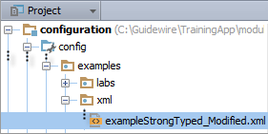
Exporting XML
…6 uses gw.xml.XmlElement
7 uses java.io.File
…10 uses java.io.FileWriter
…11 uses java.io.BufferedWriter
…15 var filePathOutput = "…/xml/exampleStrongTyped_Modified.xml"
…92 var outputWriter = new BufferedWriter(new FileWriter(
new File(filePathOutput)))
93 outputWriter.write(xml.asUTFString())
94 outputWriter.close()
Original value: Simple value: true
Current value: false
asUTFString() method
  Serializes the element to a String object in UTF-8
XmlSerializationOptions()
  Customize the export
Notes:
Learn more about the multiple methods for exporting XML using Gosu in the Gosu Reference in documentation. In most cases, it is sufficient to export XML as a UTF string using the asUTFString() method as shown above.
In some situations, it may not be appropriate to export XML as a UTF string. The situations where this is inappropriate, and the best alternatives to use in these situations, is beyond the scope of this course. If an integration point needs to export XML, then the integration developer should discuss the issue with a Guidewire representative to identify the relevant issues and determine the best approach.
All of the export methods have alternate method signatures that take a serialization options object of type XmlSerializationOptions, which can be used to customize how the export occurs. For more information on serialization options, refer to the Gosu Reference.
The export methods discussed earlier in this lesson for untyped XML are equally relevant for strongly typed XML.

Slide 39
Automatic validation of XML
…22 var xml = ExampleStrongTyped.parse(file)
81 var claimSystem = new XmlElement(new QName(
"http://guidewire.com/config", "claimSystem"))
82 claimSystem.setAttributeValue("URL",
"http://localhost:8880/ab/ContactManager.do")
83 xml.addChild(claimSystem)
…93 var outputWriter2 = new BufferedWriter(new FileWriter(
new File(filePathOutput2)))
94 outputWriter2.write(xml.asUTFString())
95 outputWriter2.close()
XML is validated against the XSD during import and export
Example of invalid XML:
  No claimSystem element defined in the ExampleStrongTyped XSD
  Code throws an exception,. gw.xml.XmlSortException
Notes:
In the slide example, a claimSystem element is added to the XML, but there is no such element type defined in the XSD. Consequently, the XML cannot be exported.

Slide 40
Lesson Outline
Overview of XML
The XmlElement class
Reading untyped XML
Writing untyped XML
Working with strongly-typed XML
XML Model

Slide 41
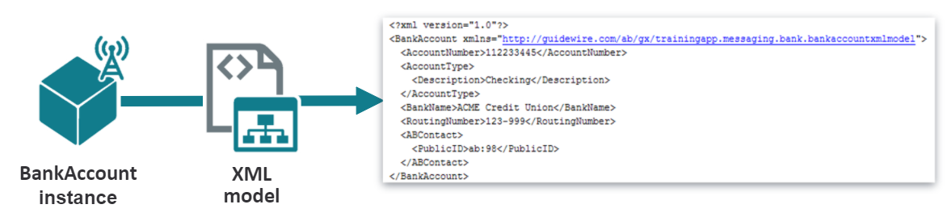
XML Model
An XML model is a file that generates dynamic XML based on an input object
Accepts a single input object and can specify
  XML-formatted values from that object
  XML-formatted values from related objects
This model can be used anytime xml needs to be generated for message payload, web services etc
Notes:
The diagram above represents the input and output for a Guidewire XML Model. The input is a single entity, and the output is XML with values from the entity or entities related to it.
There are several benefits to using a Guidewire XML Model. There is no need to manually create XML which greatly reduces errors. It is also easy to change an XSD when requirements change using a Guidewire XML Model. In addition, Guidewire publishes the XSD under a URL so that definitions are formalized and that a concrete schema exists for transparent development. From the XML model, it is easy to create an object model that can be used during runtime, for example, to automatically generate a message payload and/or optionally generate a payload only if entity fields have changed. In addition, it is possible to not only map Gosu data entities, but Gosu and Java classes.

Slide 42
XML Model
Each model must have a base type which determines the type
of object you pass to the model and the data you can include.
Entity/Data model
Virtual and DB backed properties
Related Entities
Gosu class
Properties
Java class
Properties(getProperty method)
Notes:
You can export business data entities, gosu class data and also select which properties to map to the XML model. For more information, see the topic “The Guidewire XML Model”, in product documentation.

Slide 43
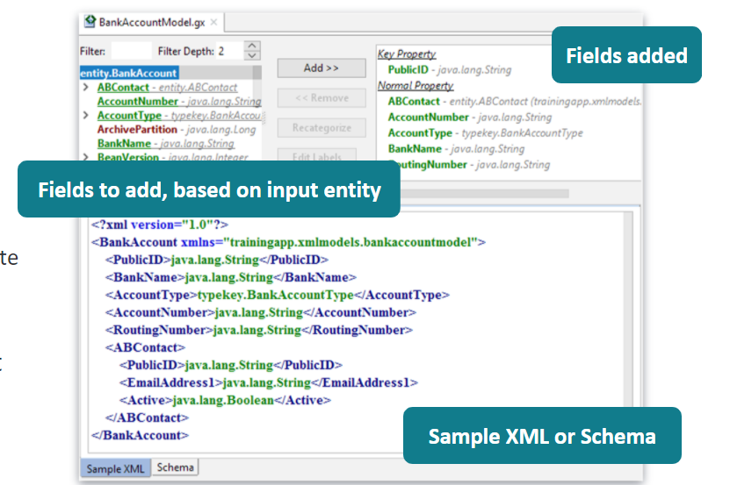
XML modeler editor
XML Modeler editor creates XML Models
  File extension is .gx
Steps to create
  Create GX model
  Add fields to the model
  Use the model to generate the message payload
Notes:
The model’s XSD can be viewed from the Schema tab. When application is running, the XSd is published in the below url
http://<hostname>:<port>/<appCode>/ws/<slash separated package path to model>/<modelName>.gx
Example - http://localhost:8080/ab/ws/demo/xmlmodel/UserModel.gx
Other applications can import this XSD and validate any generated XML against this XSD

Slide 44
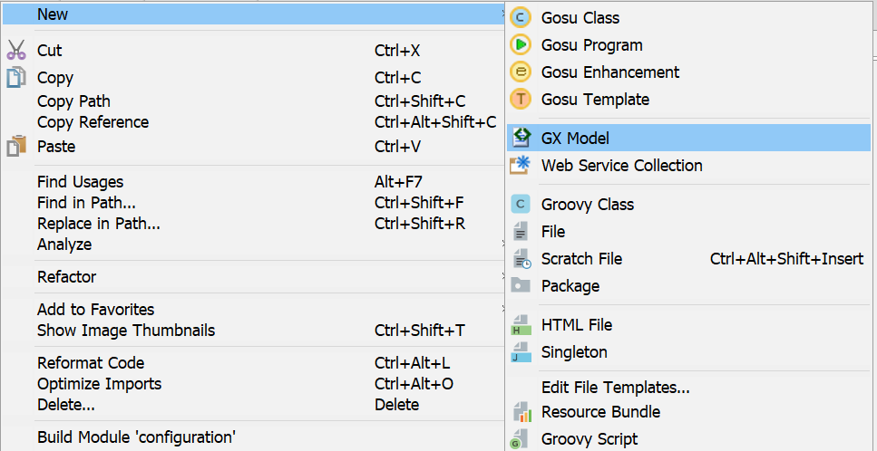
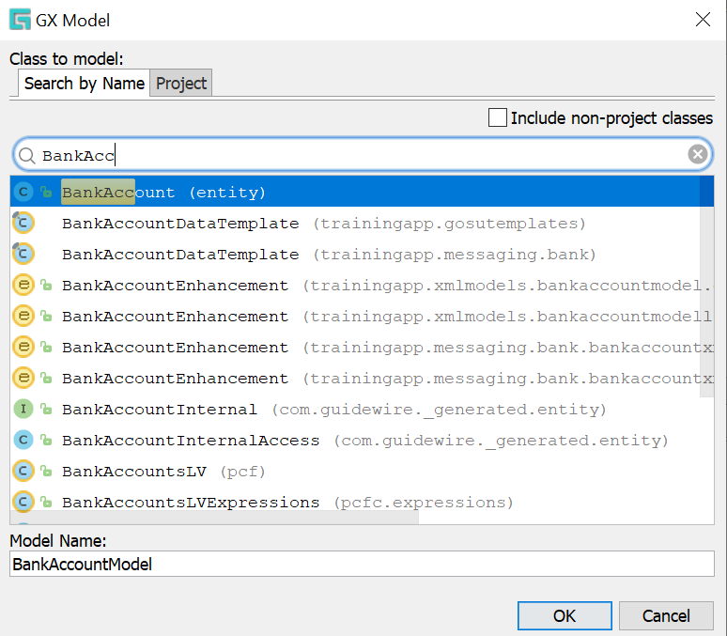
Create the XML model
To create a new XML Model
Right click suitable package under gsrc
Select New →GX model
Specify Entity
Specify Model name
Notes:
Default model name will be based on entity name

Slide 45
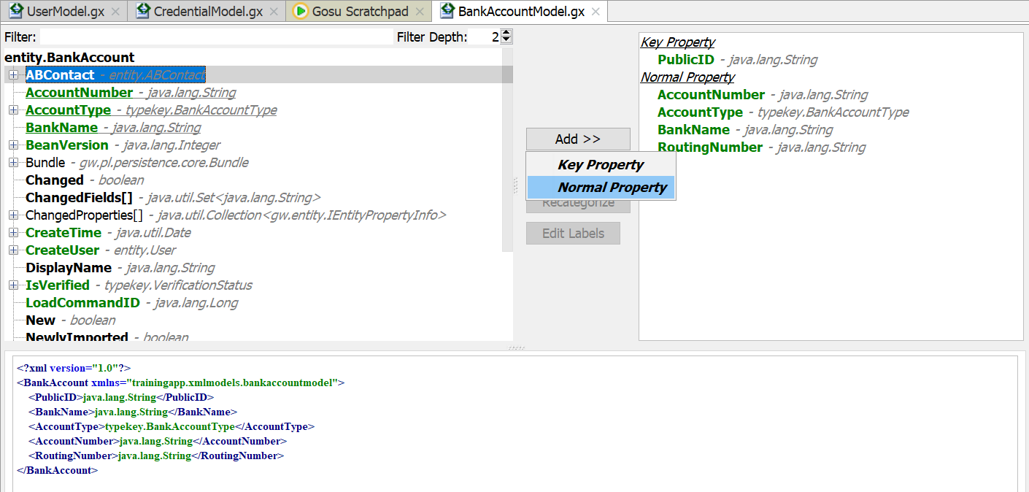
Add fields to the xml model
Select field
Added fields
Select Add and property type
Sample output
Select Field >> Click Add button >> Select property type >>
Select xml model(if applicable) >> Restart server
The bottom screen displays sample XML
Note: Sub object fields appear as Nested element
Notes:
Unbolded fields cannot be added to the model. They represent complex entities that cannot be added. But they can contain subfields that can be added.
Green fields – database backed. Black fields – virtual fields. Underlined fields – already added
Entity fields can be omitted and thus they are not defined in XSD and not exported to the XML
Key Property – Unique identifier for an entity represented in XML. Always exports if that type exports due to changes to that object or subobject. It helps maintain parent/child relationship of GW entities.
Normal Property – Exported when containing instance is exported. Null values are not exported. Default behavior can be configured.
Include an XML model within another XML model
As best practice, avoid selecting multiple levels down in an XML model. Instead create a separate model for the entity and refer it. Once you have the XML model for the second entity, return back to the model you require, browse to property where type is of the other model. Click Add>> Normal property. Studio will open a dialog box that lets you select the relevant XML model. Click the suitable model and OK.
After all properties are added to model, you must generate code that lets you use this XML model in any gosu code.

Slide 46
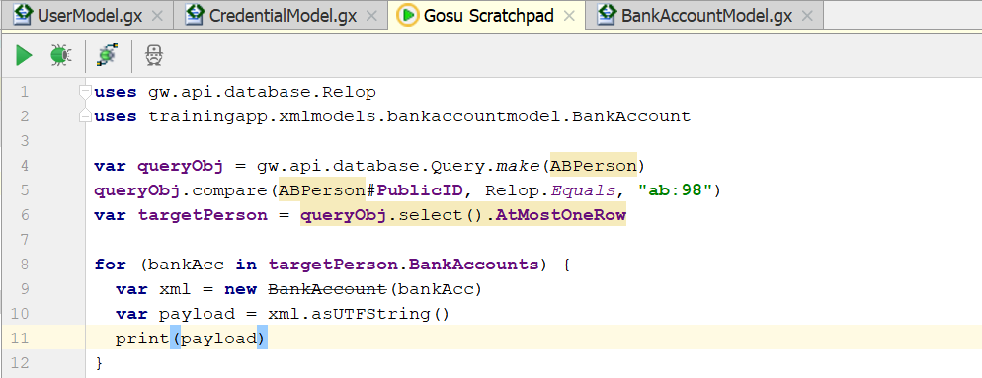
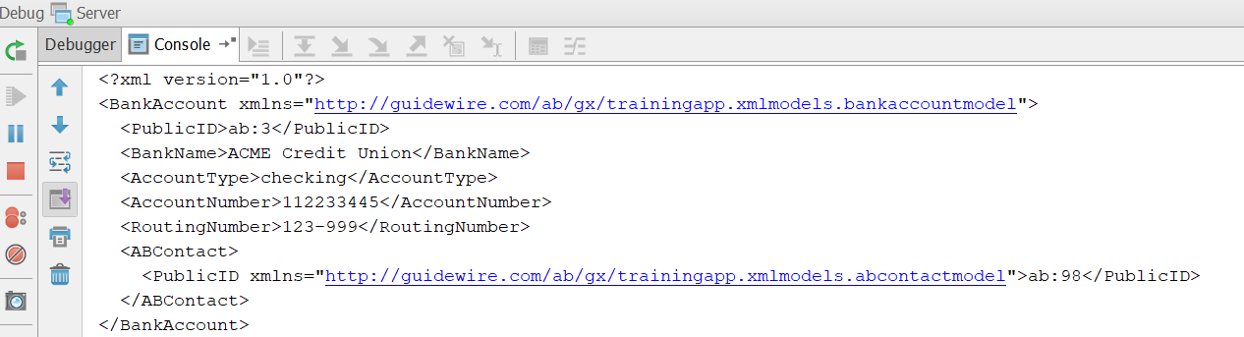
Generating XML output with XML model
Syntax
var xml = new modelName.modeltype(param)
var payload = xml.asUTFString()
Sample snippet
to call model
Model output
Notes:
Create an xml model instance and print the payload as string.
XML model can format output as UTF string or as bytes based on business requirements.
Note that AbContact.Emailaddress1 didn’t generate because it was null

Slide 47
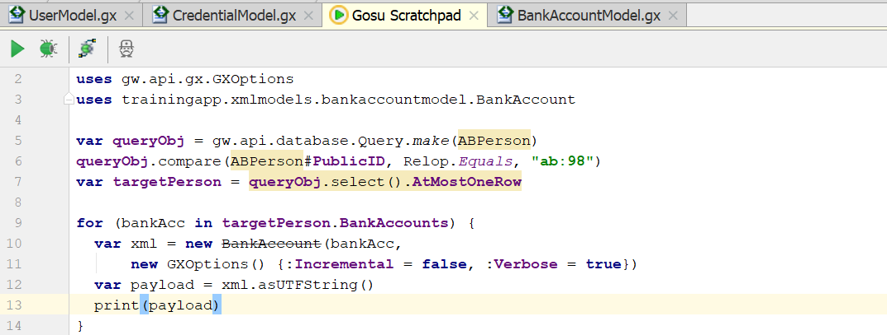
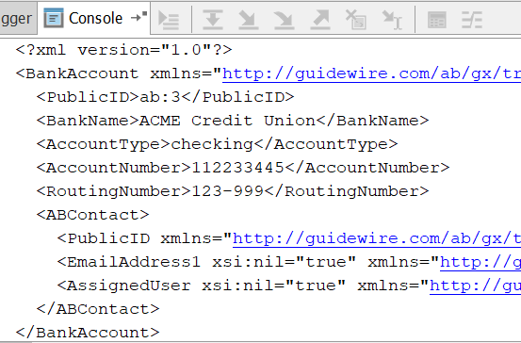
Customizing model output with GXOptions
Syntax
var xml = new modelName.modelType(param1,
new GXOptions(){:option1=value})
Alternate constructor can be used to
Incremental: export only changed properties
Verbose: export properties even if value is null
SuppressExceptions: suppress exceptions thrown during XML construct
Notes:
Every xml model has a default one argument constructor which is the object on which model is based. You can use alternate constructor to add additional GXoptions to change the XML export behavior. GXoption stands for Guidewire XML model options
GXOptions has 3 Boolean properties
Incremental
Default is false
For normal DB backed properties, export properties only if they change
Ignored for virtual and enhancement properties
Even if incremental is set to true, the key property of the root object is always exported even if it has not changes, key property of subjects will only be included if it actually changed.
Verbose
Default is false
Export the element even if value is null
SuppressExceptions
Default is false
Tells gosu to suppress exceptions during XML generation
To get details of the exception, use the eachException method which takes a gosu block

Slide 48
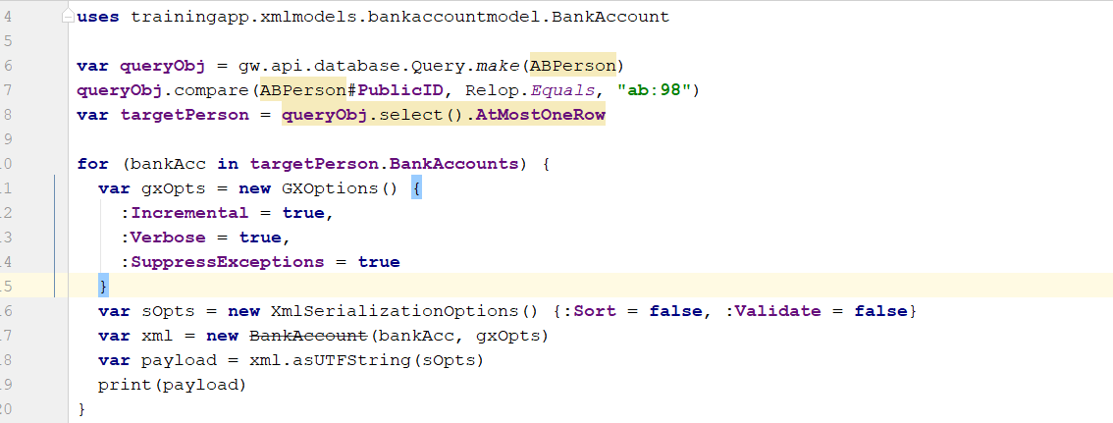
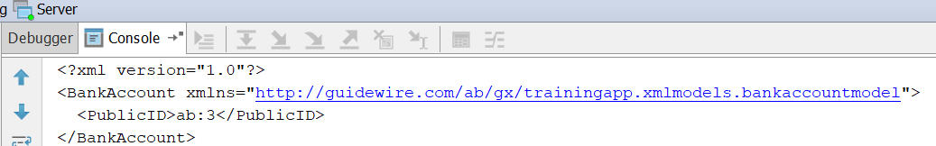
Optimizing XML model output performance
Serialization Options
For large XMLs, make sure to use XMLSerializationOptions object to turn off sorting and validation.
This will improve the performance
Notes:
What is serialization?
Serialization is the process of converting a data structure into a sequence of bits so that it can stored or transmitted. When the resulting series of bits is reread according to the serialization format, it can create an identical clone of the original object. It is also called marshalling an object.
Guidewire makes use of simple value objects. These store the value and logic needed to serialize the value. This makes it easier to work with values that requires complex serialization logic.
XMLSerializationOptions
Sort – ensures order of child element matches XSD. For large XMLs, it requires lots of resources. If XML objects are created in the order specified in the definition, this can be safely turned off. Default is true.
Validate – Validates the XML against XSD if element is based on XSD type. Default is true.

Slide 49
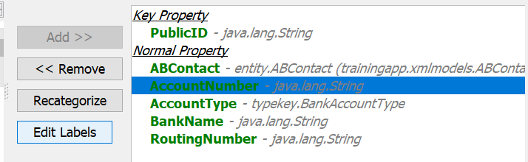
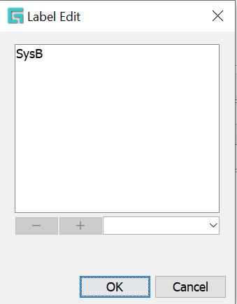
XML Model Labels
Labels enable model’s properties to be filtered
  When instance of model is created only subset of its properties are converted to XML
  Different properties can be included based on the context
Use Case:
  System A needs key property and ABContactNormal property called SysA
  System B needs key property & 4 BankAccount properties called SysB
  With labels, a single model can be used.
    Properties can be assigned multiple labels.
    Multiple systems use same property
Select
Field
Click Edit Label
Add Label

Slide 50
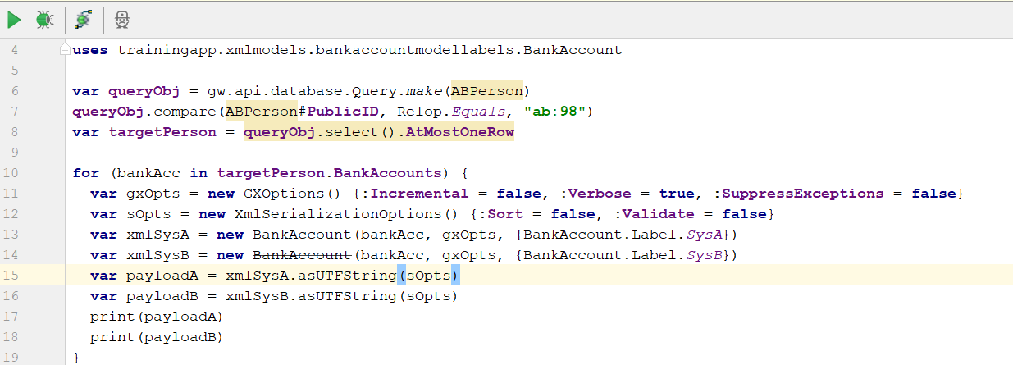
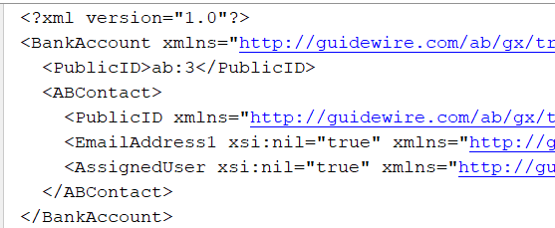
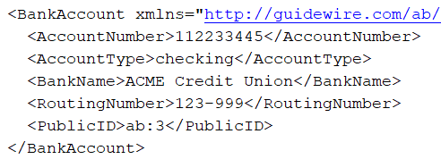
Using XML model Labels
Add label to properties in the model
Pass label parameter to the constructor
SysA output
SysB output
Notes:
In the above example, we have created labels as in the previous slide, and instantiated the models for both systems using the labels
Multiple labels can be combined in a single instance of a model.
example
var modelAB = new BankAccount (bankAccount, , gxOpt, {sysALabel, sysBLabel})
The code for including all labels will be
var labelSysAll=BankAccount.label.default_Label
var xmlSysAll = new BankAccount (bankAccount, , gxOpt, {labelSysAll})

Slide 51
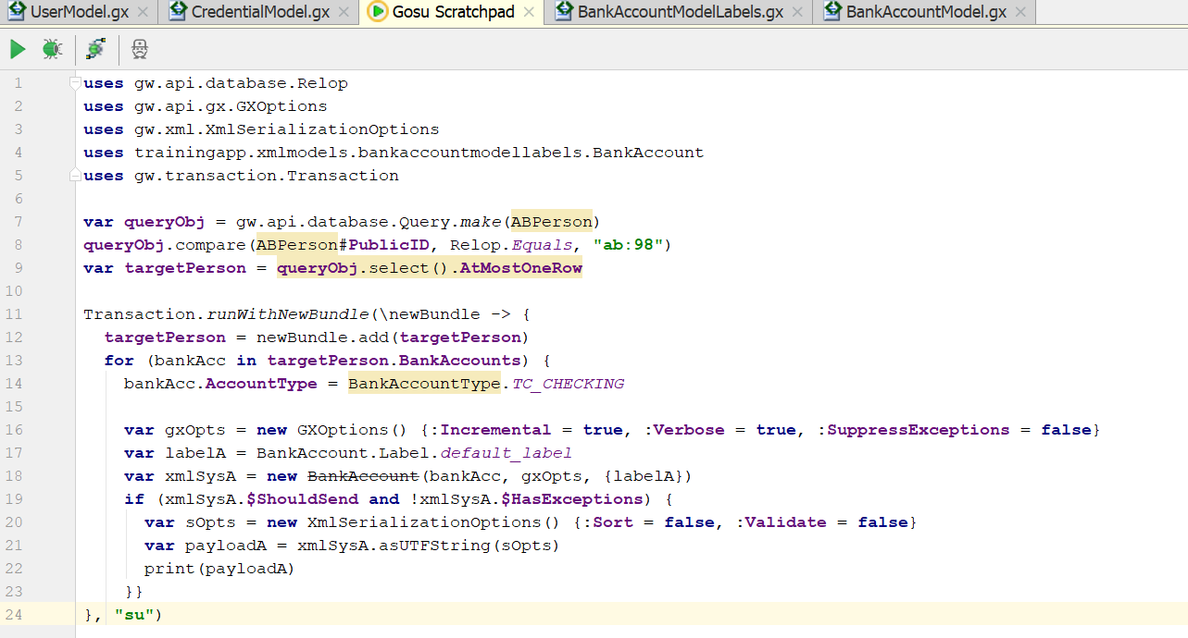
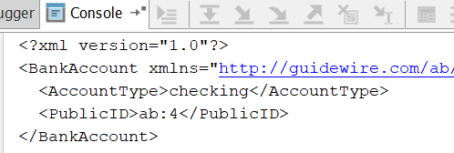
Model Properties
Every model has Boolean properties specific to XML models
$ShouldSend: has at least 1 normal property changed?
$HasExceptions: were exceptions thrown during XML generation?
  This will return true even if GxOptions SuppressException is set to true.
Notes:
In the above example, a bundle is created to demonstrate $ShouldSend propertu.
The bank account type was changed to checking so that at least one normal property is changed
Model Properties
$ShouldSend – Returns true only if at least one mapped field changed in the local database bundle. This does not change based on Incremental or Verbose options. $ShouldSend can be evaluated only if all the properties in the model are data backed. Inclusion of virtual properties in the model will always evaluate $ShouldSend to false.
$HasExceptions – To check if any exceptions occurred during XML generation. Exception setails can be obtained by using eachException method

Slide 52
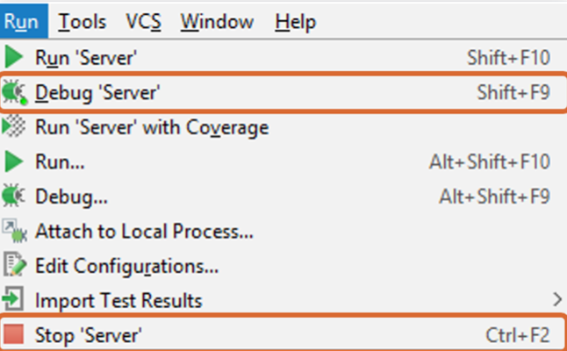
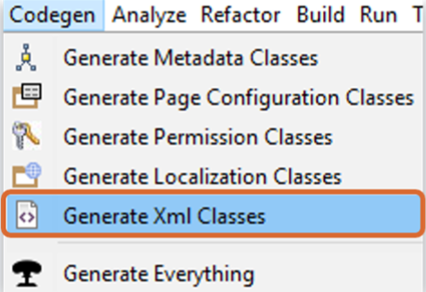
Deploy Code Changes
Restart Server
New XML Model
Generate XML Classes
Modified XML Model

Slide 53
Lesson Objectives review
You should now be able to –
  Describe the fundamental features of XML
  Describe the basic functionality of the Guidewire XmlElement class
  Import and export untyped XML using Gosu
  Import and export strongly typed XML using Gosu and an XSD
  Identify additional Guidewire tools for working with XML
  Use XML modeler to create XML models
  Use XML modeler

Slide 54
DEMO

Slide 55
In this demo we will see how to create XML model from an entity in Studio
We are going to create XML model for User entity for Fields PublicId, User Display name, User name1

Slide 56
LAB

Slide 57
Complete the exercises listed in “XML Modeler and Strongly Typed XML” chapter 6.1 and 6.2 in the “InsuranceSuite 10 Integration: Kick Start “ work book

Slide 58
Review Questions
What is the difference between untyped and strongly typed XML?
Imagine an XML file is parsed without an XSD into a variable called "xml". The first child of the root object is an element named <loadOptions> and there are no other elements with that name. Name two Gosu expressions that would access the <loadOptions> element.
How do you make an XSD known to Guidewire?
Name two features of strongly typed XML that are not available with untyped XML.
Notes:
Answers
1) Untyped XML is XML that is parsed without a known XSD. Strongly typed XML is XML that is parsed using an XSD.
2) xml.Children[0]
xml.getChild(new QName("someURI", "loadOptions"))
3) To make an XSD known to Guidewire, manually place it in a subdirectory of modules\configuration\gsrc. During startup, Guidewire reads the XSD and converts its element and attribute types into native Gosu types.
4) The element types and attributes defined in the XSD are available as properties of the parsed XML; the XML is validated against the XSD during import and export.

Slide 59
Review Questions
Identify if each statement about an XML model is True or False.
It can take any number of input values.
It has a published XSD.
It can make use of conditional statements and for loops.
It can include values from both the object that triggered the message event and objects related to the triggering object.
It can be used only for payload generation
Notes:
Answers
False – XML models always have a single input, which is the object upon which to base the XML to be generated.
True
False
True – XML models can do this by including fields from the related objects in the XML model.
False – XML models can be used anywhere.

Slide 60
Thank you

