Slide 1

InsuranceSuite 10 Integration
INTEGRATION VIEW

Slide 2
Lesson objectives
By the end of this lesson, you should be able to:
  Define purpose of integration view
  Configure integration view schema mapping file and filter
  Generate JSON output
  Generate Xml output

Slide 3
Why use an integration view?
Produce external view of Guidewire domain model
Schema and mapping are explicitly named and versioned
  Different version of the same schema and mapping can co-exists
Output format is specified in the schema
Simple design approach
  Define output schema first and then map the data to output
Notes:
Integration view will eventually replace XML models.

Slide 4
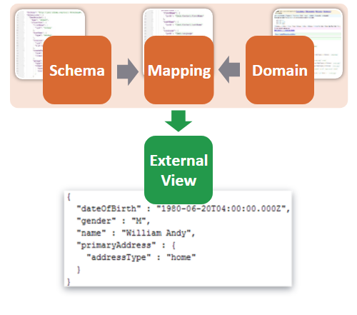
Components involved

Slide 5
Integration view components
Integration view has following components
  Schemas
    JSON schema defines structure of the data.
    Can be targeted my multiple mapping
  Mappers
    Describes how to transform the object such as entity to JSON or xml document conforming to that schema
    Can target only one JSON schema
  Filters
    Optional GraphQL-style filter that whitelist the fields to be materialized and serialized
    These can include virtual fields too
Notes:
JSON
JSON is acronym for “Java script Object Notation”. It is a simple data interchange format
It is primarily used to transfer data between server and web application, as an alternative to xml
It is lighter than xml and it is easier for parse and generate these documents
It is subset of Javascript language
For further reference on json schema you may refer to https://github.com/spacetelescope/understanding-json-schema

Slide 6
Use Case
Requirements
Export the below contact data in either JSON or Xml format
  Name, DOB, Gender, Primary address and its field
Export a subset of data
  Without contact notes
  Contact notes only
Design approach
Define schemas: Create necessary schema file to describe structure of data
Define mappings : Create mapping files to define domain fields to export
Define filters : Create filter files to export subset of contact data

Slide 7
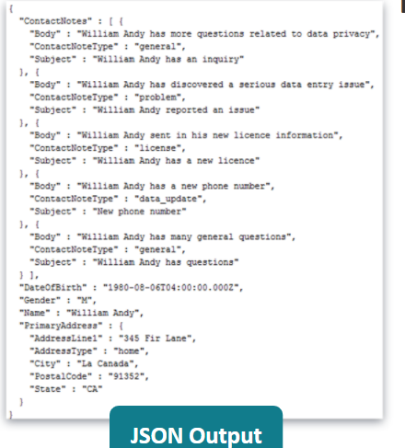
Use Case- Sample output

Slide 8
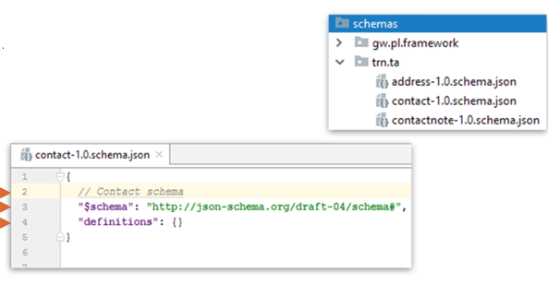
Create a JSON schema
Create a new package under integration.schemas
  config.integration.schemas.<company_code>.<product_code>
Create a new file with following syntax
  <mechanism>-{version}.schema.json
Notes:
Code example:
Line 2 : Comments are not technically allowed in JSON, but it is allowed in Guidewires framework
Line 3 : Every schema file starts with this schema declaration
Line 4: Each definition is defined under definitions
Versioning
User minor versions for backward-compatible changes, in cases where both schemas needs to be used. Use major version for significant and drastic changes. Whether to update the existing version or create a new file is left to the judgement of the developer.
The version portion of the schema can have any number of “.” along with option txt suffix, for example these are some of the valid versions 1.0, 1,1,1.0.1,1.0-2- alpha
JSON Schema
JSON schema (draft 4) document describes how to serialize data, we are using only a subset of the schema
It is used to describe the objects that will be serialized by describing the type of object, & arrays and properties of the object
It can be used in Integration view and in RestAPI’s
A given schema can define any number of objects i.e. can have multiple definitions
Schemas are explicitly named and versioned.
JSON Schema subset
Limited subset of JSON schema
No nested anonymous object types : only top level named types are supported
No nested arrays are supported i.e. arrays should be scalar or object arrays
Properties should have a single type
JSON schemas composition anyOf, JSON Schema
allOf and oneOf is not supported.

Slide 9
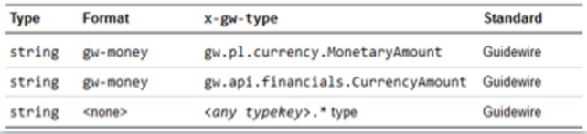
Supported data type
JSON natively supports primitive types : string, number (interpreted as doubles) Boolean, object and array.
  JSON schema (and Swagger) defines an integer type which is nothing but a number with a decimal component of .0
JSON schema (and Swagger) has a format property to describe complex data types: date, numeric types requiring precision, binary data etc.
Custom x-gw-type property is used to represent internal Guidewire types like typekeys, Monetary amount and Currency amount
Notes:
What is swagger?
Swagger is a specification for documenting REST API’s. It is being widely used and a lot of tools understand Swagger schema, including Amazon’s api gateway
Swagger 2.0 defines a number of standard formats that are part of Swagger specification. Insurance suite adopts these and added custom format for data types like fixed-point decimals(i.e. Big Decimals in Java) that weren’t covered. Insurance suite allows special types x-gw-type property in the schema. This can represent internal Guidewire types like typekeys, Monetary amount and Currency amount.
The combination of type, format, and x-gw-type determine the serialization format and the POJO type the input deserializes to.
POJO: This is a plain old Java object
Please refer to the integration guide documentation under JSON schema to know all supported JSON data types and format.

Slide 10
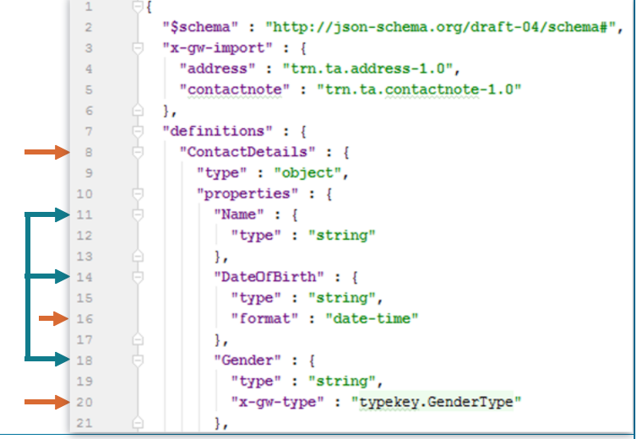
Add Schema definition
  Each definition should define its name, type and properties
  By default JSON schema properties are not null able. On output null properties on JSON object are omitted.
Notes:
Code Example
Line 8 : Definitions name is defined
Line 11 ,14 and 18: Scalar properties are defined
Line 16 : complex property date is defined and its format is also specified
Line 20 : Guidewire custom property is used to define type key
Type-specific Keywords
The type keyword is fundamental to JSON schema. It specifies datatype of schema, json schemas defines following basic types : string, integer, object, array, Boolean, Null, numeric types
About Nulls
JSON has 3 states: null, non-null and undefined.
As a general rule it considers null value as undefined
By default,
JSON schema properties are not nullable.
On output, null properties are omitted. This can be overridden by JsonSerialization options, or by x-gw-serialization in Swagger schema. This should be done with care.
On input, explicitly null properties are not allowed. To allow this you have to specify “x-gw-nullable” : “true” on the property.

Slide 11
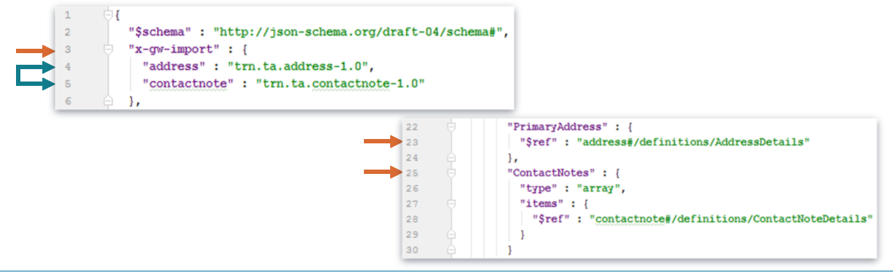
Schema file import
Schema file import allows schema reusability. A shared schema can be defined for common pieces, and that schema can be imported to reference its references.
  If A imports B, the definitions in A and B which has the same name are still two different types.
Notes:
Code Example
Line 3- Custom import property to reference other schemas
Line 4 and 5 – schema aliases and their path
Line 23 : Object property is defined and references the imported schema. Imported schema is reference with #
Line 25 : Array property is defined and references the imported schema.
Imports and Combine
Import and combine both provide units of reuse. A code analogy would be that the combine instruction is the equivalent of subclassing a given class while the import instruction is the equivalent of merely referencing that class in arguments or return types.
Imports always exist in a separate logical namespace. If A imports B, definitions in A and B that have the same name are still two different types.
Combines, on other hand exist in a single namespace. That is, if A combines B, definitions in A that have the same name as definitions in B are combined together to produce a single definition.
From the point of view of downstream systems, everything ends up merged together anyway. Hence, the choice between the import instruction and the combine instruction really comes down to whether you want definitions with the same name to be merged together or not. When you are logically extending a schema, such as creating a customer-specific schema that extends an out of the box schema, you will want the combination behavior. When you are referencing a shared schema authored by another team for another purpose, you probably do not want that behavior. In this case, keep the namespaces separate so that you do not have to worry about name conflicts producing unexpected results.

Slide 12
Define Mappings

Slide 13
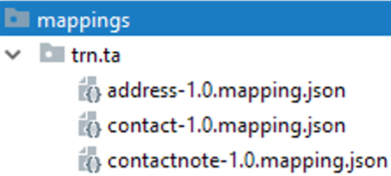
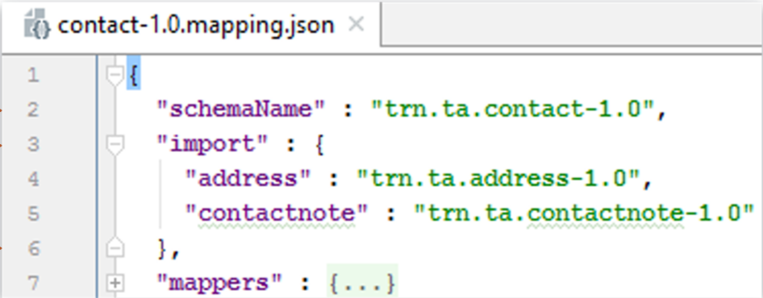
Create a mapping file
Create a new package under integration.mapping
    config.integration.mappings.<company_code>.<product_code>
Create a new file with following syntax:
    <mechanism>-{version}.mapping.json
Notes:
Code example
Line 2
Schema used by mapper file
Line 3
Import other mapper files
Line 6
Define each mapper file under mappers
Just like schema files, mapping files are also named and versioned, and target a specific schema version

Slide 14
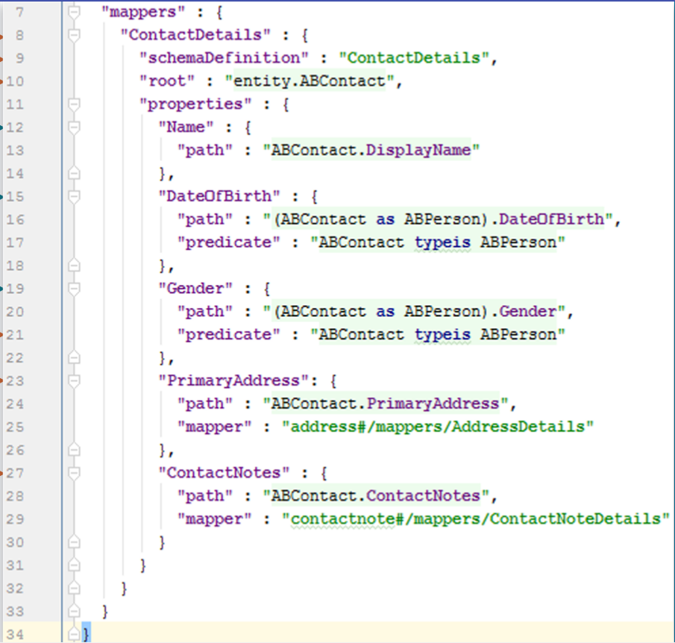
Add Mappers to the mapping file
Each mapper must define its:
  Name
  schema Definition
  root
  properties
    The properties on an integration
    mapper must correspond to
    properties on the associated JSON
    schema definition
    Define how to get the value for
    that property
Notes:
Code Example
Line 8
Mapper name is defined
Line 9
Schema name reference
Line 10
Fully qualified class name where the data comes from
Lines 12,15,19
Scalar properties are defined
Line 21
Predicate property is evaluated before the path expression is evaluated
Line 23
Object property is defined and its corresponding mapper
Line 27
Array property is defined and its corresponding mapper.
path
Each mapping property must specify a "path“ expression, which is a Gosu expression that evaluates to the value that should be used as the output of that schema property. the path expression has a single symbol available to it, with a type equal to the mapper's root type and a name equal to the relative name of that type. For example, if the root type for the mapper is entity.Contact, the path expressions on the mapper's properties will have a single symbol named Contact with a type of entity.Contact. The path expression must evaluate to something appropriate for the referenced schema property:
If the schema property is a scalar property, the path expression must evaluate to something listed as a "java Input Type", based on the schema property's type/format/x-gw-type. For example, if the schema type is "string" and the format is "date-time", the "path" expression must evaluate to something assignable to java.util.Date
If the schema property is an array of scalars, the path expression must evaluate to an iterable or array whose elements can be inputs to the data conversion for the type of the schema property's items
If the schema property is an object property, then the "mapper" property must be specified, and the path expression's return type must be assigned to the root type of the referenced mapper. For example, if the referenced mapper is address#/mappers/address and the Address mapper has root type of entity.Address , the path expression must evaluate to an entity.address or subtype thereof
If the schema property is an object array property, then the mapper property must be specified, and the path expression must evaluate to an iterable or array whose elements can be assigned can be assigned to the root type of the referenced mapper
There's no automatic coercion performed for path expressions; that means that if a schema property is of type "string" with no format or x-gw-type, the Gosu expression must actually to a java.lang.String, with no implicit of toString or anything similar. The path expression can be an arbitrary Gosu expression, so there's no restriction that it be a simple property path: it could also be a method call or static method call or other complex expression.
predicate
The predicate property is an optional boolean (or Boolean) predicate that will be evaluated before the path expression is evaluated. The "predicate" property can return a java.lang.Boolean, but should never null at runtime. If predicate expression evaluates to false, the path expression will never be evaluated, ant the property will be treated as having a null value. The predicate expression can be used to guard the evaluation of the path expression, which can be useful if the output schema flattens subtype columns onto single object. For example, the output schema for Contact may define properties firstName and lastName; in that case, the predicate expression might Contact typeis Person and the path expression could be (Contact as Person).FirstName. Using the predicate expression in the way allows the path expression to downcast directly instead of using a more awkward ternary expression, i.e. "Contact typeis Person?(Contact as person).FirstName:null".
mapper
The mapper property defines the mapper to use when the schema property is an object or array of objects. Mapper references use a similar syntax to schema property references, and are either of the form #/mappers/<name> when the referenced mapper is defined in the same mapping, or <alias>#/mappers/>name> when mapper is in the mapping imported as <alias>.the referenced mapper must have a schemaDefinition property that matches the $ref on the schema property. For example, supposed that the Contact JSON Schema definition has a primaryAddress schema property with a $ref of address#/definitions/Address. In that case, the primaryAddress property on the Contact Integration Mapper should have a mapper import reference schemaDefinition as address.

Slide 15
Define Filters

Slide 16
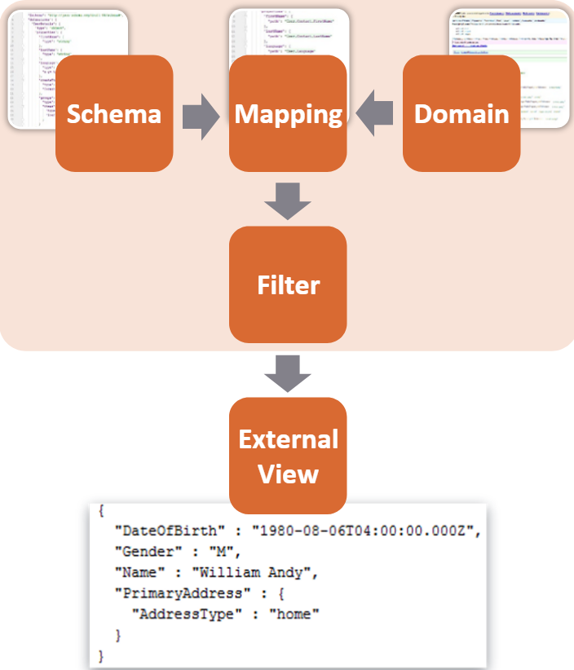
Filters
Filters make use of simplified version of
GraphQL syntax to describe the data to
be fetched
    Serves as a whitelist of the properties that
  should be included for a given invocation of
  a mapping file
Allows reuse of a more complete
schema/mapping for use cases that
only require a subset of that data
    Reduces implementation and maintenance costs
Notes:
It's often the case that two different external systems need substantially similar views of the same data, but not exactly the same thing. This could be two different downstream systems that both need policy information, but which might need different levels of detail about coverage options or transaction data, or it could be two different client systems that want to display a different subset of the data to their end-users. A developer putting together an integration message or building a REST API thus has to decide if they want to create a single schema that represents the superset of data that all such systems might want, or if they should create separate, more targeted schemas that only contain exactly what a particular system or use case requires. Having a single shared schema reduces implementation and maintenance costs, potentially dramatically, but comes at the cost of fetching, processing , and serializing out data that a given client is simply going to ignore.
The Integration Views feature attempts to meet these competing needs by allowing you to specify a filter that gets applied to a schema and mapping file, which serves as a whitelist of the properties that should be included for a given invocation of a mapping file. Properties that are not included as part of a given filter never have their associate path or predicate expressions executed and will not end up in the resulting TransformResult object at all, saving the cost of fetching, processing, and serializing the associated data.
Filters can also be used to create a stable "view" on top of a given schema; by whitelisting the properties desired, newly-added properties will never show up unless the filter is explicitly changed.
Differences from GraphQL Proper
While our filter syntax leverages the basics of GraphQL for the syntax of basic field selection, nested objects/arrays, and fragments, it differs from GraphQL proper in some important ways:
There's no query operation, the query operation is always implied
No mutations are supported
None of our fields accept arguments
Fields cannot be aliased to change the result property's name
Our GraphQL syntax allows for using the original unicode name of schema property, rather than restricting everything to a limited ASCII subset
See https://graphql.org/ and http://facebook.github.io/graphql/October2016/ for more details about the specification.

Slide 17
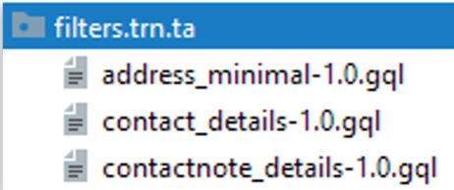
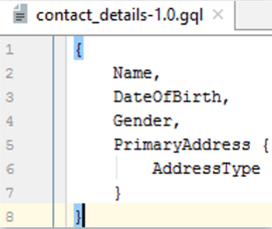
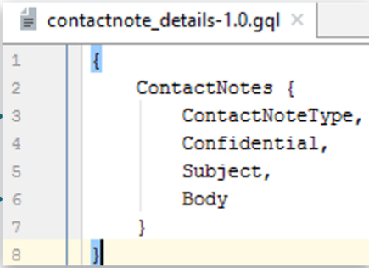
Creating a filter
Create a new package under integration.filters
    config.integration.filters.<company_code>.<product_code>
Create a new file with following syntax:
    <mechanism>-{version}.gql
Code example - exclude contact notes Code example 2 - only contact notes
Notes:
Code example 1 - exclude contact notes
Line 2-4
Properties to include from the Contact object.
Line 6
Property to include from the address object.
Code example 2 - only contact notes
Line 3-6
Properties to include from the contactNotes array object.
A filter is simple declarative whitelist - just type the properties that you want to export

Slide 18
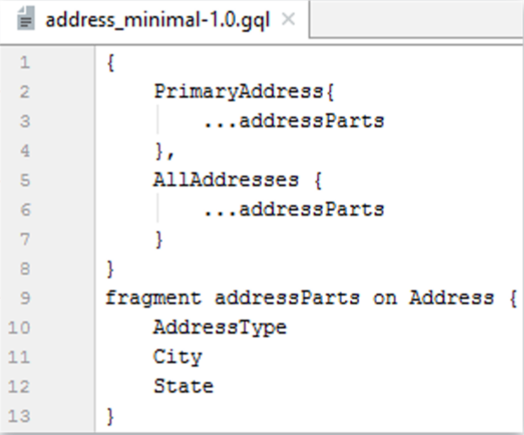
Fragments
A GraphQL feature that allow you to query a
fragment that can be applied to a given object
    Useful in cases where the same sub-object type
    appears within multiple places in the data you want to
    fetch
    For example, a Contact may have both
    PrimaryAddress and AllAddresses properties
    that map to the same Address type
      Define the set of properties you want from
      an Address once, as a fragment
      Reference that fragment in each context that
      you want that same set of properties
Notes:
Code example
Line 2
Referencing PrimaryAddress properties to include using the addressParts fragment.
Line 5
Referencing AllAddresses properties to include using the addressParts fragment.
Line 9
addressParts fragment defined.

Slide 19
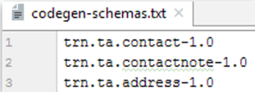
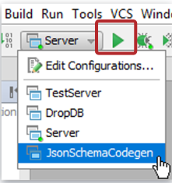
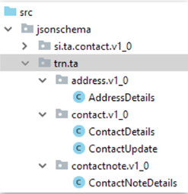
Generate wrapper classes
Add the fully-qualified name of the schema(s) in the codegen-schemas.txt file in schemas package
From the Server drop-down in Studio
select JsonSchemaCodegen
- Execute by selecting Run ‘Server’ icon
Generated wrapper classes will be under
configuration.src.jsonschema
Notes:
Generate wrapper classes
The codegen-schemas.txt file defines, the schemas that JsconSchemaCodegen will process.
Client-side errors (bad types, unknown properties, constraint violations) are detected at parse time and reported. Parsing, deserialization and validation are done in a single step.
Server-side errors (i.e. bad output) will be (optionally) detected during serialization.
The framework works in terms of a JsonObject, which is basically just a Map<String, Object>
JsonObject contains deserialized scalars and objects, i.e. Date, BigDecimal and typekeys, not just javascript primitives
Lists are used for JSON arrays
Wrapper classes
Optionally generated statically-typed classes can wrap the JsonObiect
The framework layers on statically-typed getters and setters
The framework knows how to automatically wrap unwrap them
Wrap a json Object with the static wrap method
Unwrap it back with the instance .unwrap method
You can also parse directly into the wrapper classes via static parse methods
Wrapper classes can also be generated by running gwb jsonSchemaCodegen in a command prompt window.
How to configure JsonSchemaCodegen server in Studio
In Studio, click Run Edit Configuration
Select Server and click Copy Configuration icon
Modify the Name and Main class fields
Name = JsonSchemaCodegen
Main class = com.guidewire.tools.json.JsonSchemaWraperCodegenTool

Slide 20
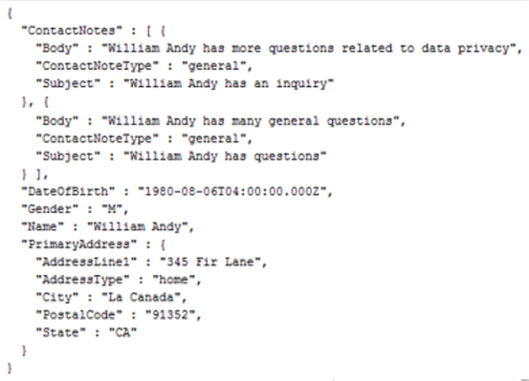

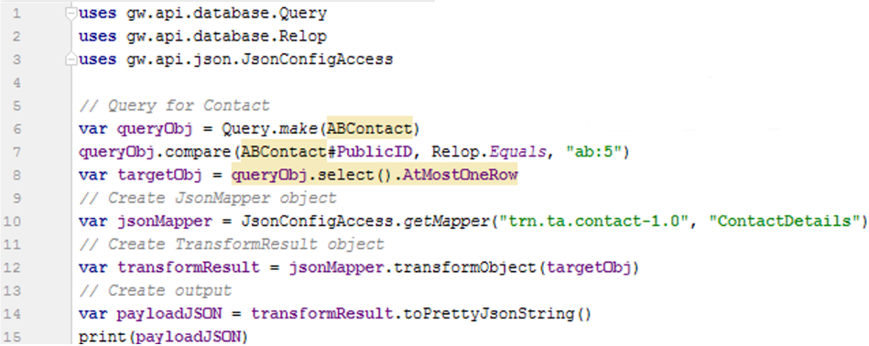
Example 1 – JSON Output
Notes:
Code example
Line 10
Create the Json Mapper object.
Define the fully qualified path to the mapper file.
Define the mapper name.
Line 12
Create the Transform Result object.
Line 14
Create the JSON payload.
toPrettyisonString formats the output in multiple rows.
Json Mapper
The Json Mapper interface provides runtime access to actually execute the mapper. The general way to obtain a Json Mapper instance is by using the JsonConfigAccess class to get a handle to the JsonMapping.
Once you have access to a JsonMapper instance, you can then invoke one of the transformObject or transformObjects method variants to obtain a TransformResult object.
TransformResult
The Transform Result object represents the results of a completed transform call: it contains the result of executing each of the path expressions against the supplied root object. The Transform Result is an
intermediate representation of the data that can then be serialized out to either JSON or XML. The Transform Result object is similar to a Json Object, in that it's mainly a map of property names to values,
but it differs in that each property value embeds information about the JSON Schema property it represents. Serializing out a Json Object requires passing the JSON Schema definition as an argument during
serialization, whereas the TransformResult has schema information already embedded in it and always serializes based on that schema. So you can just invoke methods like toPrettyJsonString or toXmlString directly.
Serialization Options
The various serialization methods on TransformResult objects can take an optional JsonSerializationOptions object, which controls aspects of how the serialization works. By default, serializing a TransformResult will ignore
null properties, null list items, and empty arrays. (Note that this last default is different from default JsonObject serialization. The reason is that entity arrays are never null, and mappings will often be used with entities. You can use the
JsonSerializationOptions to change that serialization behavior, though note that including null properties or elements will require that the associated JSON Schema properties or items be marked as x-gw-nullable.
The JsonSerialization Options can also be used to include some special properties on the root object when the data is serialized, for example the fully-qualified name of the schema. definition, the correlation ID of the current request (if
any), or the timestamp at which the transform was executed. These options are only valid for serialization to JSON. See the javadoc on JsonSerialization Options for more details.
Usage in REST
In REST API implementations, a Transform Result can be returned directly by a handler method or embedded as the entity in a Response object. There's no need to explicitly call any of the serialization methods like toJsonString; the REST
API Framework itself will serialize the Transform Result appropriately based on the negotiated content type of the response.

Slide 21

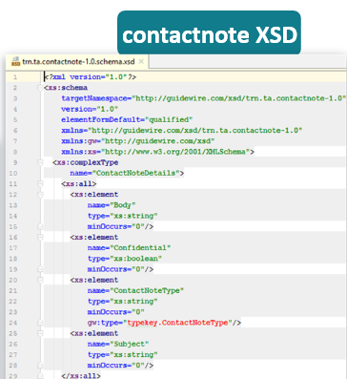
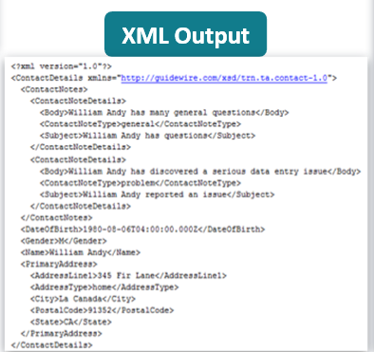
Example 2 – XML Output
Optionally generate XSD
  Execute gwb genExternalSchemas in command prompt window
  Default output directory
    <app>\modules\configuration\build\external-schemas
Notes:
Code example
Line 14
Create XML payload
XML Output
The JsonObject and Transform Result classes both support serialization to XML rather than serialization to JSON. In both cases, exactly the same serialization and validation rules apply to serializing out to XML as to
JSON, it is merely the output format that differs.
To serialize a JsonObject to XML invoke one of the toXmlElement methods and then serialize the XmlElement as desired
To serialize a TransformResult to XML, invoke one of the toXmlElement methods and then serialize the XmlElement as desired, or call one of the toXmlString convenience method
In addition, if a TransformResult on JsonObject is returned from a REST API handler, the REST API Framework will automatically serialize the data to XML if the negotiated content type is "application/xml" or "text/xml".
XSD Translation
The XML that is output from serializing a JsonObject with a schema, or TransformResult (which always has a schema), will conform to the XSD that is produced as a transformation on the JSON Schema. In general, the translation to an XSD follows the following rules:
The generated XSD will have a single namespace of http://guidewire.com/xsd/<schema-fqn> by default; this can be overridden by specifying the x-gw-xml property on the root of the JSON Schema, and setting the namespace attribute
All JSON Schema definitions are translated into XSD complex Types as well as top-level elements that reference those types, i.e. any such element is a legal document root
By default, definition properties are mapped to sub-elements rather than attributes, unless the schema property specifies the x-gw-xml element and sets the attribute property to true
Properties under an element will be unordered in the XML and given an xs:all in the XSD rather than an xs:sequence
The element or attribute name for a property name will have the same name in an XSD as the JSON Schema property, but the name will be adjusted if it is not a legal XML element or attribute name
Arrays will always be wrapped in a container element, with individual elements of the array wrapped in elements. The item elements will default to having a name based on the referenced object definition (if the elements are objects) or have the same name as the containing property (if the elements are scalars). The x-gw-xml element can be specified on the items and given a name property to explicitly name the child elements.
JSON data types will map to equivalent XSD data types, when available
Validation constraints like minLength or maxLength on theproperty will be reproduced in the XSD where possible
A schema definition that contains additional Properties will be mapped into an XSD if no explicitly-named properties are defined on the definition, but will be represented as an xs:any if additionalProperties is mixed with explicitly-named elements

Slide 22
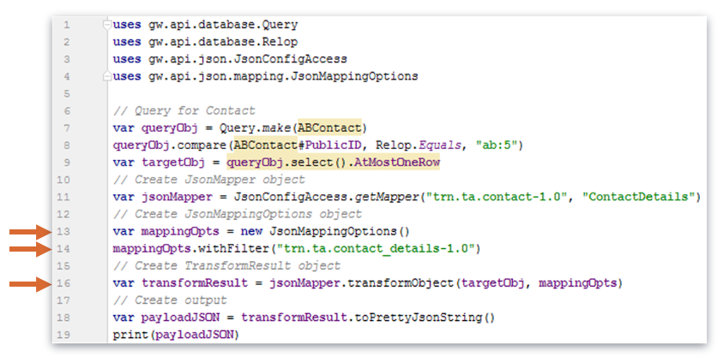
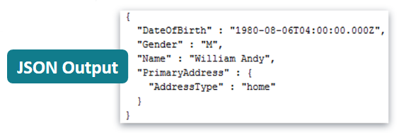
Example 3 – Filtered JSON Output
Notes:
Code example
Line 13
Create the JsonMappingOptions object.
Line 14
Add the filter fully qualified path.
Line 16
Create the TransformResult object with filter applied.
Output
Only filtered fields are exported.
Json Mapping Options
The transformObject methods can optionally take a JsonMappingOptions object that can change some aspects of how the transform is performed. The JsonMappingOptions object is the mechanism for applying a GraphQL filter to the mapping.

Slide 23
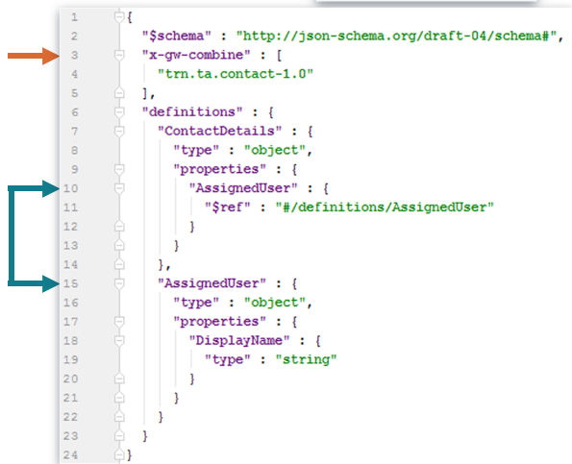
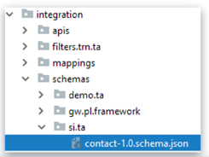
Schema file combination
Schema combination provides a mechanism for reuse of schemas
  Ability to create that logically extends and overrides one or more other schemas
  If A combines [B, C] listed in that order in the combine property
    Contents of B are merged on top of C
    Contents of A are merged on top of the combined schema
      Similar names are merged together to produce a single definition
      Combination cannot remove definitions
    Original schemas are not touched
Notes:
Code example – Succeed Insurance is extending the TrainingApp contact schema
Line 3
Custom combine property used to combine contact schemas.
Lines 10,15
New object property is defined and its corresponding definition.
Composition for Swagger schemas, JSON schemas, and Integration Mappings all works similarly. The combination mechanism for Swagger schemas allows for creating Swagger schemas that combine together
multiple pieces to form a single, logical resulting schema document. The combination mechanism can be used for a number of different purposes:
Simple hierarchical extension – Customers can extend an application schema, which in turn might extend a platform schema.
Content composition - Customers might combine together several different content pieces, for example LOB-specific schemas (Line-Of-Business), along with their own extensions and perhaps a base
schema, i.e. customer extensions + Personal Auto LOB + Business Owner Policy LOB + base policy schema.
Schema aggregation – A large, complex schema can be broken into multiple files that are maintained by different teams, and then aggregated together for publishing as a single logical API with a single,
consistent baseUrl and version.
Minor version changes - A new minor version of 5 schema can use combination to extend the previous major or minor version, minimizing schema duplication and ensuring the changes are backwards-compatiable.
API templates - The API template mechanism implicitly works via combination by implicitly adding the template to the list of combined schemas for a given published schema.
Combination Ordering
The combination mechanism allows for theoretically arbitrary chains of combination, though the combinations must not have any cycles in the graph, i.e. you can't have A combine B B combine C, and C combine
A. Schemas are combined in the order they appear in the x-gw-combine property, and referenced schemas are themselves loaded and combined before processing. To make that more concrete, suppose we
designate Schema A to mean the file as it is on disk and Schema A' to mean the logical schema after it's been combined with everything it references via x-gw-combine. If schema A combines [B, C] and B and C both combine D, we produce A’ from A as follows:
We first load B’ and C’ by combining B with D’ and C with D’
We create a list of the root objects from A, B’ and C’, in that order
We walk the full document tree according to the merge rules defined in 2.1 Swagger Schema File Specification, starting with those root objects. The root objects always exists in all three schemas, but from there it’s possible that a given logical object will appear in one, two or all three of the schemas. For each collection of matching objects, we always consider A (if present), then B’ (if present), then C’ (if present). For example suppose C’ defines a path “/contacts/{contactId}” with a GET operation. If C’ is the only schema that defines that operation, A will inherit the definition from C’ exactly as-is. If B’ also defines that operation, it’s definitions of properties will override the definitions in C’. If A’ also defines that operation, it will override any properties also specified in B’ or C’.
Combination Validation
The combination validation algorithm is fairly complicated to describe; this document won't attempt a full specification of all the validation rules. The general philosophy, however, is that the schema resulting from a
combination should be a logical, backwards-compatible extension of the combined pieces. So if schema A combines schema B, that means:
Schema A should not change the type of a parameter defined in Schema B.
Schema A should not introduce new required parameters to operations defined in Schema B.
Schema A can remove or loosen validation constraints on input parameters defined in Schema B, but shouldn't add or tighten validation constraints.

Slide 24
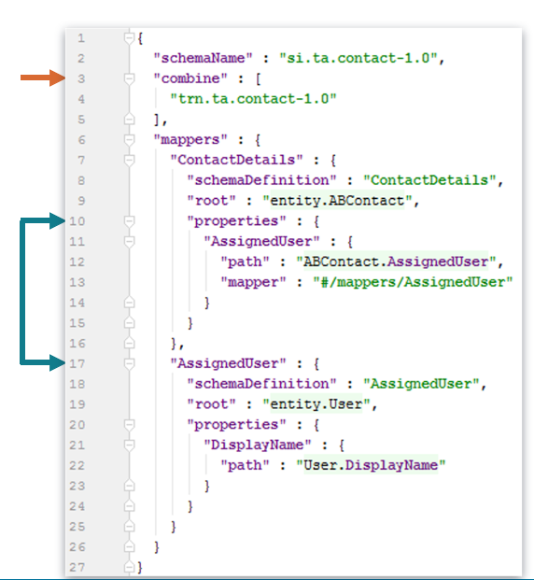
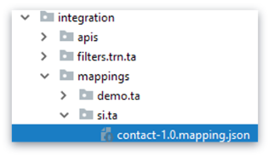
Mapper file combination
Mapper combination provides a mechanism for reuse of mappers
  Combination rules used for
  schemas apply to mappers
Notes:
Code example – Succeed Insurance is extending the Training App contact mapper
Line 3
Combine property used to combine contact mappers.
Lines 10,17
New object property is defined and its corresponding mapper.

Slide 25
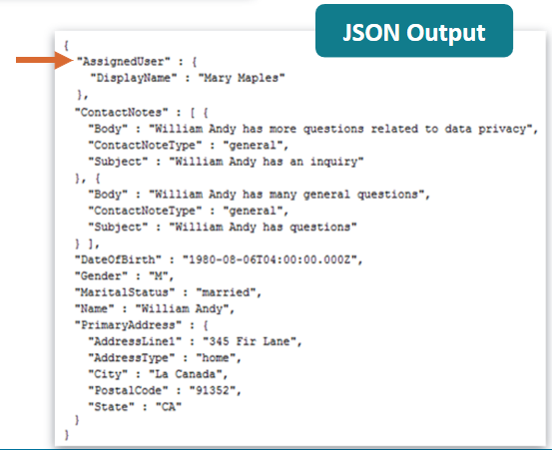
Example 4 – JSON Output using combination
Notes:
Code example
Line 10
JsonMapper object using the new combined schema.
Output
AssignedUser property is combined to JSON output.

Slide 26
Lesson objectives review
You are not able to
  Define purpose of integration view
  Configure integration view schema mapping file and filter
  Generate JSON output
  Generate Xml output
Notes:
Answer: True

Slide 27
DEMO

Slide 28
This video will demonstrate how to create an integration view that will generate an XML and JSON output for the following user data : First Name, Last Name, Job Title, User Name, Locked, Name of each assigned group.
Pre-Requisites
    Training App Guidewire Studio
    Supported web browser

Slide 29
LAB

Slide 30
Complete the exercises listed in “Integration View” chapter in the “InsuranceSuite 10 Integration: Kickstart “ work book

Slide 31
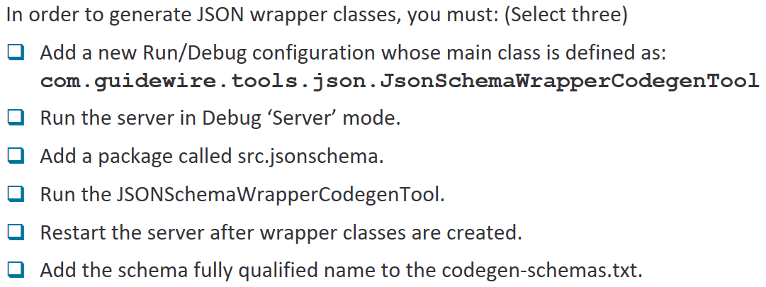
Review Question
Notes:
Answer:
Add a new Run/Debug configuration whose main class is defined as : com.guidewire.tools.json.JsonSchemaWrapperCodegenTool
Run the JSONSchemaWrapperCodegenTool
Add the schema fully qualified name to the codegen-schemas.txt

Slide 32
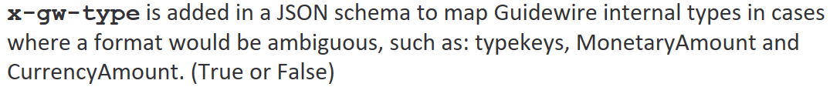
Review Question
Notes:
Answer: True

Slide 33
THANK YOU

