Slide 1
Script Parameters
October 5, 2020
Notes:
Guidewire training materials contain Guidewire proprietary information that is subject to confidentiality and non-disclosure agreements. You agree to use the information in this manual solely for the purpose of training to implement Guidewire software solutions. You also agree not to disclose the information in this manual to third parties or copy this manual without prior written consent from Guidewire. Guidewire training may be given only by Guidewire employees or certified Guidewire partners under the appropriate agreement with Guidewire.

Slide 2
Describe the function of script parameters
Create and update script parameters
Reference script parameters

Slide 3
Script parameter basics
Creating and referencing script parameters
Updating script parameters

Slide 4
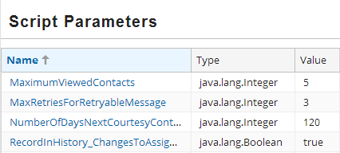
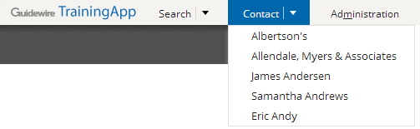
Script parameters
A script parameter is a global variable for a Guidewire application
Configuration developer defines
Reference anywhere as read-only values in Gosu code
Administrator user updates values in user interface
Example:
MaximumViewedContacts value sets the limit to number of contacts in the tab bar menu
Notes:
Script parameters allow developers to avoid hard-coded application constants for the constant may change over time and/or for when an administrator user needs to ability to change a parameter value in the Administration user interface. The result is that developers can reference script parameters in Gosu code while allowing administrator users to change the values.
There are several reasons to create global variables as script parameters: (a) you want a variable that is global in scope across the application that you can change or reset through the application interface, and/or (b) you want a variable to hold a value that you can use in any Gosu expression, and you want to change that value without editing the expression. For instance, script parameters can be used to set initial reserve values for auto glass damage, full body damage, or minor body damage. These initial reserve values can change from year to year.
Guidewire recommends that you use Gosu class variables instead of script parameters to reference values in Gosu expressions. The exception would be if you needed the ability to change the value from the Guidewire application interface.

Slide 5

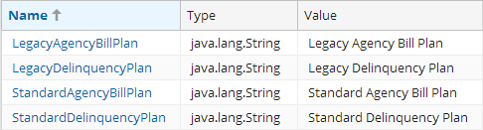

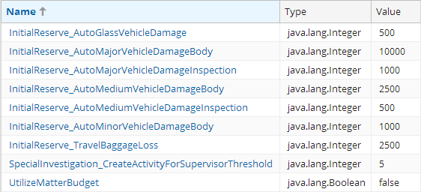


Script parameter examples
BillingCenter
Parameters for delinquency and agency bills
ClaimCenter
Parameters for initial reserves, special investigations, and functionality
PolicyCenter
Parameter for functionality for search tab
Notes:
PolicyCenter 10.0 has a single script parameter to enable a search tab.
BillingCenter 10.0 uses script parameters primarily to manage values pertaining to delinquency and agency bills.
ClaimCenter 10.0 uses script parameters primarily to manage values pertaining to initial reserves.

Slide 6
File and entity
ScriptParameters.xml
ScriptParameter.eti
XML file that defines multiple parameters
Application uses only these defined parameters
Parameters values initially used and when not defined in the database
Defines script parameter instance
When editing a parameter value, administrator user creates entity instance
When defined, application uses parameter values in database, but only for parameters that exist in ScriptParameters.xml
Notes:
If a script parameter exists in the ScriptParameter.xml but not in the Guidewire application database, Guidewire uses the value from the ScriptParameter.xml file.
Only when an Administrator user edits a script parameter value in the user interface does the Guidewire application actually create an instance of a ScriptParameter entity in the database. For a given script parameter, if the parameter values differ between the element in ScriptParameters.xml and the entity instance in the database, the Guidewire application will use the value in the database.
As an alternative, it is also possible to create a ScriptParameter entity with Gosu code. However, only the script parameters defined in the ScriptParameters.xml file are available to edit in the Administration user interface. Only the script parameters defined in the ScriptParameters.xml file are the global variables for the application.

Slide 7
Script parameter basics
Creating and referencing script parameters
Updating script parameters

Slide 8
Steps to create a script parameter
In Guidewire Studio, open ScriptParameters.xml
Create a parameter in XML
Deploy the script parameter
Reference the script parameter

Slide 9
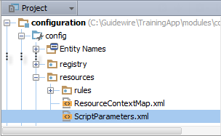
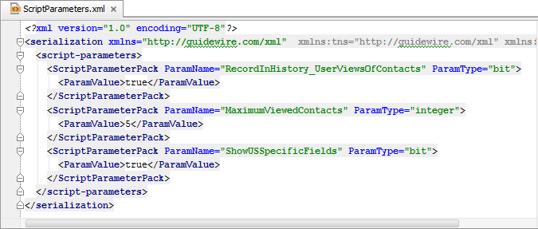
Step 1: Open ScriptParameters.xml
In Project View, select and open ScriptParameters.xml in …\config\resources\
Use the native XML editor to edit the file

Slide 10
Step 2: Create a parameter in XML
…3 <script-parameters>
…16 <ScriptParameterPack ParamName="MaximumViewedContacts" ParamType="integer"> 17 <ParamValue>5</ParamValue> 18 </ScriptParameterPack> …25 </script-parameters>
Add a ScriptParameterPack element
Define the ParamName attribute
Define the ParamType attribute
Add the ParamValue element and an inner value
Notes:
For valid values for ParamType attribute, see the value ScriptParameterType typelist. The values are:
bit
datetime
decimal
group
integer
money
monthlyfrequency
nonnegativeinteger
nonnegativemoney
percentage
percentagedec
phone
positiveinteger
positivemoney
postalcode
risk
speed
user
varchar
weeklyfrequency
year

Slide 11
Step 3: Deploy the script parameter
Restart Server
Reload PCFs
Script Parameter read at start up
ALT+SHIFT+L
Internal debug tools enabled
Internal Tools
Reload → Reload PCF Files
ScriptParameter.xml
ScriptParameter.xml
Notes:
If a script parameter exists in the ScriptParameter.xml but not in the Guidewire application database, Guidewire uses the value from the ScriptParameter.xml file.
In order for Guidewire Studio to recognize new, changed, or deleted script parameters in Gosu code, you must restart Guidewire Studio. Restart the server or reload PCFs to make the new script parameter available to the application. For the application to recognize deleted script parameters, you must also restart the server or reload PCFs. You can restart the server from the application folder command window (gwb stopServer then gwb runServer) or restart the server from Guidewire Studio (Run → Stop then Run 'Server' or Debug 'Server').
It is also possible to reload PCF files using the Guidewire API and/or internal server tools. The Reload PCF command can be found on the Reload page in Internal Tools. To access Internal Tools, you must log in as an administrator user, e.g., su/gw. Then, use ALT+SHIFT+T. In the tab bar, select Internal Tools → Reload. On the Reload page, click the Reload PCF Files button. The Reload PCF Files button calls the static method gw.api.tools.InternalToolsUtil.reloadPCFs().

Slide 12
Step 4: Reference the script parameter
8 class RecentlyViewedContactUtil {
…11 static property get maximumViewedContacts(): int {
12 var value: int = 5
13 if (ScriptParameters.MaximumViewedContacts > 0) {
14 value = ScriptParameters.MaximumViewedContacts
15 }
16 return value
17 }
…56 }
Line 13: Access the script parameter directly
Line 14: Assign the script parameter to local variable if you are concerned about the value being outside of a default range
Notes:
In the slide example, the RecentlyViewedContactUtil is a Gosu class located at …\configuration\gsrc\trainingapp\base\RecentlyViewedContactUtil.gs.
Guidewire recommends that you use Gosu class variables instead of script parameters to reference values in Gosu expressions. The exception would be if you needed the ability to change the value from the Guidewire application interface.
You can reference a script parameter directly. However, if you are concerned about the value range for a given script parameter, then assign the script parameter directly to a local variable with a default value. In addition, if you are referencing the script parameter throughout a Gosu class, consider assigning the variable to a global class variable.

Slide 13
Script parameter basics
Creating and referencing script parameters
Updating script parameters

Slide 14
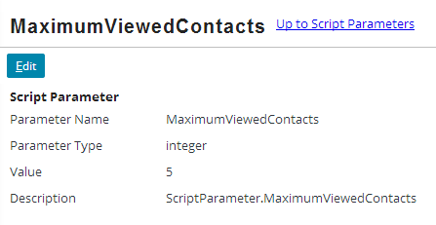
Access the script parameters
Log in as…
Administrator user
User with role that has permissions to access the Administration user interface and manage script parameters
Administration → Utilities → Script Parameters
Click the parameter name in the list view panel
Notes:
To access the script parameter:
Navigate to the Administration → Utilities → Script Parameters.
Click the name of the script parameter in the list view panel.

Slide 15
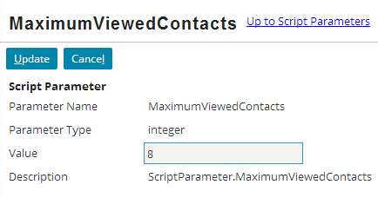
Update a script parameter value
Click Edit → Edit the Value field
Clikc Update
Value changes are immediate and global
Notes:
To update a script parameter:
Navigate to the Administration → Utilities → Script Parameters.
Click the name of the script parameter in the list view panel.
In the detail view panel, click the Edit button.
Edit the Value field.
Click Update.
Changes to script parameter values take effect immediately and are global in scope.

Slide 16
Describe the role of script parameters
Create and update script parameters
Reference script parameters

Slide 17
What is a script parameter and an example of a script parameter?
Why use script parameters?
After you have created a script parameter, what must you do to fully deploy it?
Where can a script parameter be referenced?
How do you reference a script parameter?
How can an administrator user update a script parameters?
If a script parameter's value differs in between the ScriptParameters.xml file and the database, which value does the Guidewire application use?
Notes:
Answers
1) Script parameters act as a global variables where the variable value may change over time and therefore should not be hard-coded. Examples of Guidewire application script parameters include BillingCenter delinquency and agency bill settings and ClaimCenter initial reserve settings.
2) You want a variable that is global in scope across the application that you can change or reset through the application interface, and/or you want a variable to hold a value that you can use in any Gosu expression, and you want to change that value without editing the expression
3) You must restart the server or reload PCFS to deploy the script parameter. In order for Guidewire Studio to recognize the script parameter, you must restart studio.
4) In Gosu code you can reference a script parameter including business rules, enhancements, Gosu classes, and PCF files.
5) You reference the script parameter directly. If you are concerned about the value being outside a range or set of possible values, you can also assign the script parameter to a local variable that has a default value. If using the script parameter throughout a Gosu class or enhancement, you may also assign the script parameter to a global class variable.
6) Administrator users can access the Administration screen for the Script Parameters. In the list view panel, click the script parameter name. In the detail view panel for the script parameter, click Edit. And administrator user can edit the parameter value. Click Update.
7) The Guidewire application uses the script parameter value in the database.

