Slide 1
Subtypes
September 12, 2014
Notes:
Guidewire training materials contain Guidewire proprietary information that is subject to confidentiality and non-disclosure agreements. You agree to use the information in this manual solely for the purpose of training to implement Guidewire software solutions. You also agree not to disclose the information in this manual to third parties or copy this manual without prior written consent from Guidewire. Guidewire training may be given only by Guidewire employees or certified Guidewire partners under the appropriate agreement with Guidewire.

Slide 2
Describe the role of subtypes and supertypes in the data model
Extend an existing subtype entity
Create new a subtype entity
Create a subtype extension

Slide 3
Lesson outline
Subtype basics
Create a subtype entity extension
Create a subtype entity

Slide 4
Subtype entity
A subtype is an entity that is a child to a supertype entity and inherits all fields from the supertype
Example:
ABContact is the supertype
ABCompany is the subtype
ABCompany inherits PrefersContactByEmail from ABContact
ABContact does NOT inherit CanAddEmployees

Slide 5
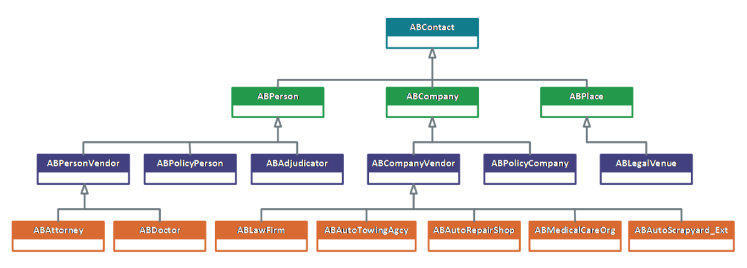
Subtype hierarchy
primary entity
primary subtypes
Notes:
There is one subtype entity excluded for the diagram because it is not directly relevant to the configuration lab work: ABUserContact. ABUserContact represents a TrainingApp user and defines a user's contact details.
ABContacts are organized into a set of subtypes. The organization of the hierarchy helps to model information about contacts. Information common to all contacts can be established at the ABContact level. It is automatically inherited by all of its subtypes. Information specific to an ABPerson can be defined at the ABPerson level. It is inherited by all of its subtypes, but information on the ABPerson subtype is not available to ABCompany or ABPlace.
In the ABContact hierarchy, an ABPolicyPerson is a person who owns a policy issued by the carrier (such as an individual with a personal auto policy). An ABPolicyCompany is a company which owns a policy issued by the carrier (such as a construction company with a workers' compensation policy).
Subtyping is also used within the three primary applications. For example:
BillingCenter's Activity, Plan, and Contact entities
ClaimCenter's Transaction, Incident, and Contact entities
PolicyCenter's Job and Contact entities

Slide 6
Additional parent and subtype examples
All applications
Contact: Person, Company, Place, ...
ClaimCenter
Incident: InjuryIncident, TripIncident, PropertyIncident
Transaction: Payment, Recovery, Reserve, ...
PolicyCenter
Job: Submission, Renewal, Cancellation, Reinstatement, ...
PlanDetail: BillingPlanDetail, PaymentPlanDetail, ...
BillingCenter
Plan: BillingPlan, CommissionPlan, DelinquencyPlan, ...
ChargePattern: ImmediateCharge, ProRataCharge, ...
Notes:
In ClaimCenter:
A transaction is used to denote the movement of money either into a reserve line or from a reserve line to a payment.
An incident reports the details of an incident as it relates to a claim.
In PolicyCenter:
A job is used to manage a policy transaction, which either creates or modifies a policy.
A plan detail is used to manage plans, which typically identify how the insured will be billed for or will pay for the policy. This information is passed to the billing system.
In BillingCenter:
A plan is used to store information about how a billing instruction coming from a policy administration system should be divided into invoices or statements.
A charge pattern is used to divide a charge from the billing instruction (such as a premium for coverages on the policy or a tax mandated by the government) into invoice items.

Slide 7
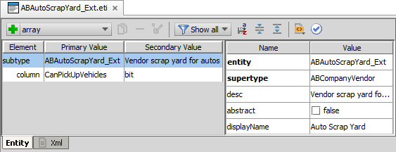
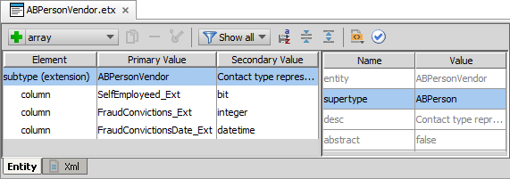
Entity Editor shows subtypes
Element reads as subtype or subtype (extension)
In XML, it is the <subtype/> or <extension />
Attribute pane details supertype entity
Notes:
You can easily identify a subtype in Guidewire Studio using the Entity Editor. The top element will read either subtype or subtype (extension). Not all entities can be extended or subtyped.
If an entity is a used to create new supertype entity, then all subtype entities will use the <subtype /> XML element. If the entity is an extension of an existing subtype entity, then the subtype extension uses the <extension /> element. Both elements <subtype /> and <extension /> share the same set of possible sub-elements.

Slide 8
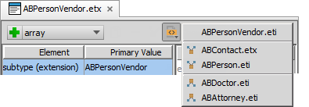
Entity editor toolbar open file navigation
Open file navigation menu details subtype position in hierarchy
Navigate up to parent supertypes
Navigate down to children subtypes
Notes:
In the slide example, ABPersonVendor.etx is a subtype extension of ABPersonVendor.eti. Using the open file navigation menu, you can navigate up to the supertype or down to the child subtype. The open file navigation menu is a quick way to understand how a given subtype or subtype extension relates to a hierarchy of parent supertypes and children subtypes.

Slide 9
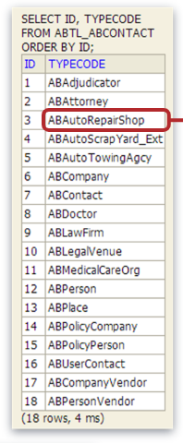
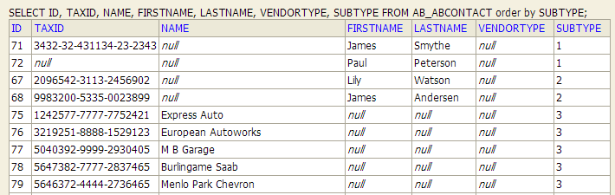
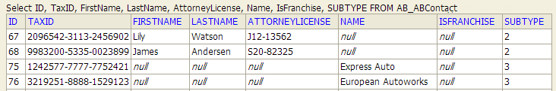
Subtypes in the database
Typelist and entity database tables define supertypes and subtype relationship
ABContact has 17 subtypes
Supertype entity table contains all subtype columns in denomarlized form
Irrelevant columns for subtype are null
ID, Name, TaxID from ABContact
FirstName, LastName from ABPerson
AttorneyLicense from ABAttorney
IsFranchise is from ABAutoRepairShop
Notes:
ABContact is the supertype for the three primary subtypes : ABPerson, ABCompany, and ABPlace. There are 18 subtypes in total for TrainingApp.
For columns not relevant to a given row's subtype, the column contains a null value. Valuesappear For example, Lily Watson is an ABAttorney and therefore the Name column is null value. Similarly, Express Auto, an ABAutorRepairShop, shows null values for FirstName and LastName. TaxID is a field defined in the ABContact entity. Both Express Auto and Lily Watson have TaxID encrypted values.
High degrees of subtyping of a single supertype can result in a highly denormalized database table with many columns and large row sizes. For purists seeking high degrees of normalization in database tables, subtyping will appear abhorrent.
In Guidewire applications, subtypes represent a trade-off between data model configuration flexibility and database performance. High degrees of normalization require numerous joins when querying. In many ways, it can be easier to add columns to a table rather than create more table objects in a database that require numerous joins for queries. In the hypothetical case of normalized entities instead of subtypes, to retrieve all results for all contacts would require numerous union queries.
Not all Guidewire applications rely heavily on subtypes, but ContactManager does, and TrainingApp derives from ContactManager. For many configurators, it may make more sense to avoid subtyping in many cases and simply create separate entities that share common typelists and/or arrays.

Slide 10
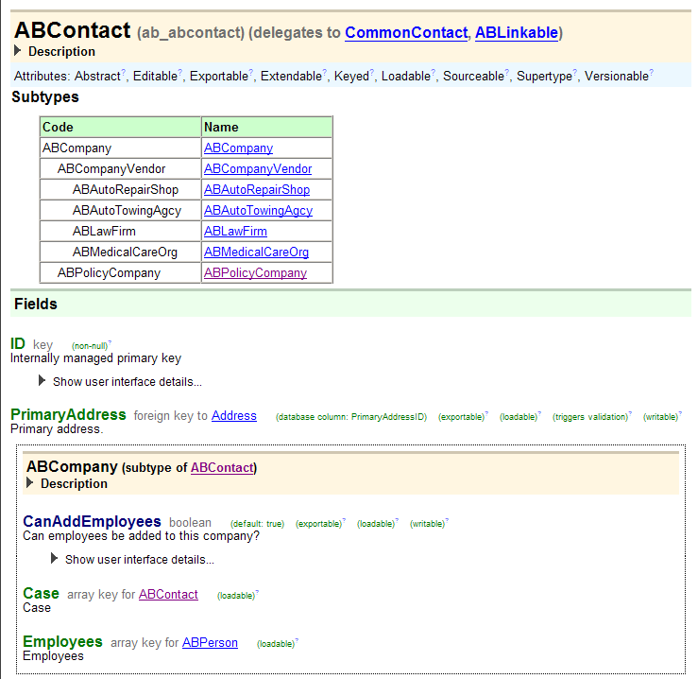
Subtypes in the data dictionary
Parent entity
List of subtypes
Fields at parent level
Fields at subtype level

Slide 11
Subtypes and Gosu classes
configuration
application server
ABContact
Fields … PrefersContactByEmail …
ABCompany
Fields … PrefersContactByEmail CanAddEmployees ...
ab_abcontact
database table row
anABCompany
instance of Gosu class
read from database
save to database
Notes:
In object-oriented design, a class can be extended by a child class or subclass. Every field and method declared at the parent class is added to the child class automatically. In objected-oriented design, subclass extensions from a superclass is called inheritance.
Guidewire subtypes also make use of inheritance. Every subtype has its own internal class. This class inherits all fields and methods of the parent class.
In most cases, a database table corresponds to one data model entity, and therefore one database-backed Gosu class. One exception to this is where subtypes are concerned. If an entity is subtyped, then the database table corresponds to the top-level data model entity and all of its subtype entities. The table then also corresponds to one top-level database-backed Gosu class and all of its subclasses.
In the diagram above, the row in the database table that corresponds to anABCompany is not shown as a continuous strip of gray, but rather as a discontinuous set of gray strips. This is to emphasize the fact that the table for a subtyped entity has columns that do not apply to all subtypes. For example, the ab_abcontact table has columns for FirstName and LastName. These fields only apply to ABContacts that are of type ABPerson. For ABCompanies (such as anABCompany), those columns will have null values.

Slide 12
Subtype limitations
New subtypes inherit from supertype
All elements and attribute defaults
Behavior of its supertype
Only single inheritance
Unable to inherit from multiple supertypes
Can a towing agency repair cars? No.
Can an auto repair shop tow cars? No.
Can you create a single contact that both repairs and tows cars? Yes, but you will need to create a new subtype with duplicate fields!
Notes:
Consider carefully before manipulating your contact hierarchy. A new subtype inherits the attributes and matching behavior of its supertype. Create a new subtype only if you need to treat one set of entities differently from another. As much as possible, limit the number of subtypes for representing an entity.
The main reason to limit creation of new subtypes is that the more you specialize the subtype hierarchy, the more restrictive and the less flexible your model becomes. For example, there are subtypes for AutoRepairShop and AutoTowingAgcy. If you work with an auto repair shop that also does towing, you cannot create a single contact that does both. However, you can add a service for Towing to an auto repair shop contact.
You cannot create a subtype that inherits the fields of both entities. To create the subtype you want, you can select one entity or the other and subtype and then add the fields that are missing from the other entity because of single inheritance.
Additionally, each time you create a new subtype, you must modify PCF files to support both creating the subtype and searching for it. You might also need to make supporting modifications to the screens that reference subtype in terms of modal PCF support.
.

Slide 13
Lesson outline
Subtype basics
Create a subtype entity extension
Create a subtype entity

Slide 14
Steps to create a subtype extension
Navigate to the subtype entity
Create an entity extension file
Add elements (and subelements) and specify attribute values
Optionally regenerate the dictionary
Deploy the subtype extension entity

Slide 15

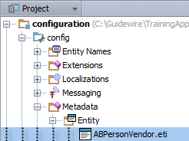
Step 1: Navigate to the subtype entity (1)
CTRL+N
Enter entity name in dialog
Verify in Project View the selection of file in …\Metadata\Entity\
Must be ETI file
Top element reads entity (extension)
XML is <extension />

Slide 16
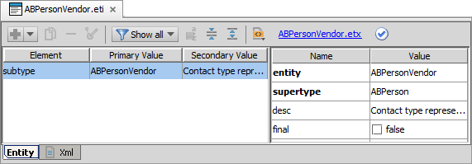
Step 1: Navigate to the subtype entity (2)
View in Entity Editor or Xml Viewer
Entity (ETI) file must be a subtype entity
<subtype /> element
supertype = entity attribute name value
final = false attribute name value
<subtype … entity="ABPersonVendor" final="false" supertype="ABPerson">

Slide 17
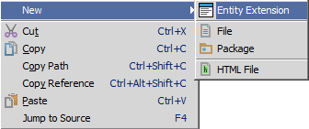
Step 2: Create an entity extension file (1)
Project View → Context menu → New → Entity Extension

Slide 18
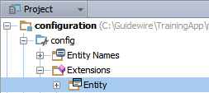
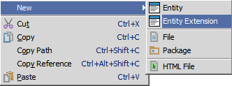
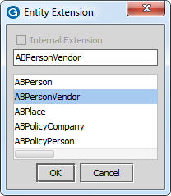
Step 1 and 2 alternative
Select …\Extensions\Entity\
Context menu → New → Entity Extension
In dialog, enter entity name

Slide 19

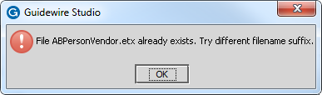
Step 2: Create an entity extension file (2)
For an entity (ETI) in …\Extensions\Entity\
NOT possible to create entity extension (ETX)
Edit the ETI file directly in the Entity Editor
For an entity extension (ETX) in …\Extensions\Entity
NOT possible to create entity extension (ETX)
Edit the ETX file directly in the Entity Editor
Notes:
The default Guidewire Studio settings do not allow for you to create an entity extension of an already existing entity extension.

Slide 20
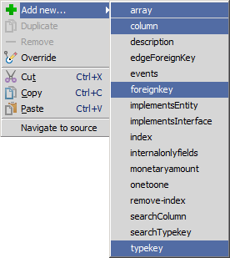
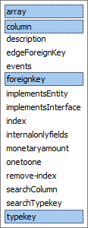
Step 3: Add elements and specify attributes
Toolbar
Select option in dropdown
Click + to add more of same
Context menu
Add new…
Select option in menu
Notes:
The four primary elements listed above are common to entity extension (<extension>), entity declaration (<entity>), subtype extension (<extension>), and subtype declaration (<subtype>).

Slide 21
Common elements to add
Common elements for:
Entity extension, entity, subtype, subtype extension
<array …/>
Define array entity and field
<column …/>
Define data field with defined data type
Bit, datetime, integer, varchar
<foreignkey …/>
Define foreign key field and entity
<typekey …/>
Define typekey and related typelist
Create entity extension field names ending with _Ext
Notes:
The four primary elements listed above are common to entity extension (<extension>), entity declaration (<entity>), subtype extension (<extension>), and subtype declaration (<subtype>).

Slide 22
Step 4: Optionally regenerate dictionary
gwb genDataDictionary
Process builds entire entity model including base and custom entities
Identifies errors in the data model beyond Entity Editor schema validation
C:\Guidewire\TrainingApp>gwb genDataDictionary regen-entity-model-xml: ==================================================== = Running main class: com.guidewire.tools.dictionary.data.EntityModelXmlTool [java] --- Guidewire Entity Model In Xml --- … ERROR Errors found in ABPersonVendor ERROR NoTwoColumnsWithTheSameName - Duplicate property "SelfEmployeed_Ext" found for entity "ABPersonVendor"
Notes:
You can also regenerate the data dictionary to add the new entity to the data dictionary and to check for problems in the data model. Regenerating the data dictionary is not required, but doing so can identify flawed XML in the data model that go beyond schema validation such as certain types of referential integrity.

Slide 23
Step 5: Deploy the subtype entity extension
Restart Server
bin command window
gwb runServer
Or, Guidewire Studio
Run → Stop
Run 'Server' or Debug 'Server'
During start-up
If autoupgrade=true in database-config.xml, then Guidewire attempts to upgrade the database according to the changes in the data model
Entity Extension
Entity Extension

Slide 24
Lesson outline
Subtype basics
Create a subtype entity extension
Create a subtype entity

Slide 25
Steps to create a new subtype
Create the subtype entity file
Add elements and specify attributes
Optionally regenerate the dictionary
Deploy the subtype entity
Notes:
Adding a new subtype is similar to the process of adding an entity. However, it requires details including the subtype specification, and the supertype.

Slide 26
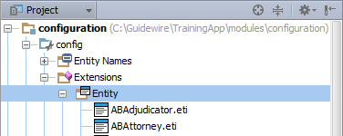
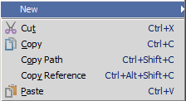
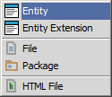
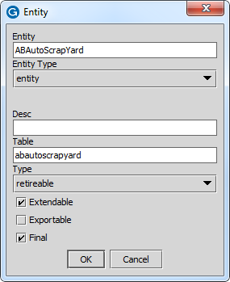
Step 1: Create the subtype entity (1)
In Project View, select …\config \Extensions\Entity
Context menu → New → Entity
Entity dialog
22 character max length
Use CamelCase ending with _Ext
Example: ABPropInspector_Ext
(continued)
Notes:
Guidewire recommends the entity name should be in CamelCase. CamelCase is a style of capitalization in which multiple words are joined together with the first character of each word capitalized. Examples include ClaimCenter and JavaScript. CamelCase is the naming convention recommendation for entities. Guidewire recommends ending the name of an Entity with _Ext to distinguish the entity from base application entities.
For every subtyped entity, Guidewire applications create a virtual typelist accessible to the application as well as physical database table that stores the subtype values. The typelists consist of a set of typecodes, one typecode for each subtype. The "code" of each typecode is the subtype's name.
The Guidewire application server (not Studio, unfortunately) limits typecode code names to 22 characters. Therefore, the name of any given subtype cannot exceed 22 characters. If you do create a subtype with 23 or more characters, any attempt to restart the server or regenerate the data dictionary will fail.

Slide 27
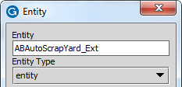
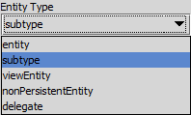
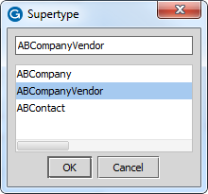
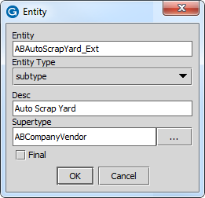
Step 1: Create the subtype entity (2)
For Entity Type, select subtype
Fields change in Entity dialog
Select supertype
In Supertype field, click ellipse (…) to open the Supertype dialog
In dialog, select the parent entity

Slide 28
Step 2: Add elements and specify attributes
Toolbar
Select option in dropdown
Click + to add more of same
Context menu
Add new…
Select option in menu
Notes:
The four primary elements listed above are common to entity extension (<extension>), entity declaration (<entity>), subtype extension (<extension>), and subtype declaration (<subtype>).

Slide 29
Common elements to add
Common elements for:
Entity extension, entity, subtype, subtype extension
<array …/>
Define array entity and field
<column …/>
Define data field with defined data type
Bit, datetime, integer, varchar
<foreignkey …/>
Define foreign key field and entity
<typekey …/>
Define typekey and related typelist
Do NOT create entity field names ending with _Ext
Notes:
The four primary elements listed above are common to entity extension (<extension>), entity declaration (<entity>), subtype extension (<extension>), and subtype declaration (<subtype>).

Slide 30
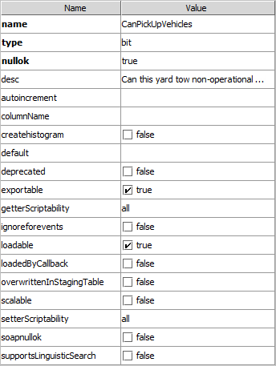
Entity editor: Attribute pane
Name Value columns
For selected element, define attributes
Schema aware values
Boolean controls
Dropdown lists
Attribute styling
Bold for required
Black for editable
Grayed-out for non-editable
Overridden, Inherited, Internal, Default
No default for nullok
Set to true in most cases

Slide 31
Step 4: Deploy the subtype entity
Restart Server
bin command window
gwXX dev-stop
gwXX dev-start
Or, Guidewire Studio
Run → Stop
Run 'Server' or Debug 'Server'
During start-up
If autoupgrade=true in database-config.xml, then Guidewire attempts to upgrade the database according to the changes in the data model
Entity
Entity
Notes:
In Studio, the newly created entity is available to reference immediately. However, the entity is not available to the application server until the server is restarted and the database upgraded.
The automatic database upgrade process occurs only if the database autoupgrade=true attribute is defined in the database-config.xml.
TrainingApp uses an H2 database. Here is the XML definition found in database-config.xml:
<database name="TrainingAppDatabase" dbtype="h2" autoupgrade="true">
<dbcp-connection-pool jdbc-url="jdbc:h2:file:/Guidewire/TrainingApp/db/ta;auto_server=true"/>
</database>
For SQL Server and Oracle, this option is set to false by default.

Slide 32
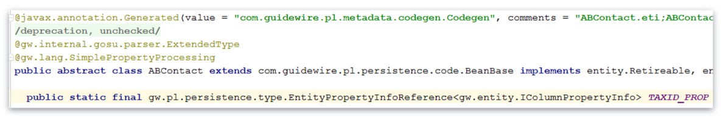
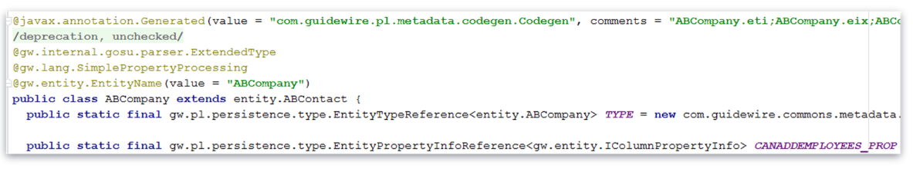
Subtypes and Java classes
Notes:
You can extend another class to inherit methods, fields and properties from a parent class. To do this, use extends keyword after your class name followed by parent class name.
For example – class Tree extends Plant {}. Your class is a subclass (and subtype) of the parent class. The parent class is a superclass (and supertype) of your class

Slide 33
Describe the role of subtypes and supertypes in the data model
Extend an existing subtype entity
Create new a subtype entity
Create a subtype extension

Slide 34
What is a subtype entity? What is the XML element for a subtype entity?
What is a subtype entity extension? What is the XML element for a subtype entity extension?
Describe at least one limitation of relying heavily on subtype hierarchies.
When you create a new subtype, why are you NOT able specify a table name?
If creating a subtype extension and the path to the extension is grayed out and you are unable to click OK, what should you do?
Notes:
Answers
1) A subtype is an entity that is a child to a parent entity and inherits all fields from the parent. <subtype /> is the XML element for a subtype entity.
2) A subtype extension is an entity extension of a subtype entity. <extension /> is the XML element for a subtype extension entity.
3) One major limitation of a subtype hierarchy is that a subtype entity can only have one parent entity and multiple inheritance (two or more direct parents) is not supported. In addition, the subtype always inherits the parents elements, meaning the subtype contains the parent fields. For a deep hierarchy (many levels), this means the lowest child will inherit all the fields of the parents. Deep subtype hierarchies can result in very wide tables that are highly denormalized resulting in poor application performance.
4) You cannot specify a table name because the new subtype data is stored in the same table as the supertype.
5) You should click Cancel and simply edit the existing subtype entity.

