Slide 1
Editable Detail Views
November 20, 2020
Notes:
Guidewire training materials contain Guidewire proprietary information that is subject to confidentiality and non-disclosure agreements. You agree to use the information in this manual solely for the purpose of training to implement Guidewire software solutions. You also agree not to disclose the information in this manual to third parties or copy this manual without prior written consent from Guidewire. Guidewire training may be given only by Guidewire employees or certified Guidewire partners under the appropriate agreement with Guidewire.

Slide 2
Describe how to make a detail view panel editable
Create a toolbar with edit buttons

Slide 3
Discover editability
Configure the editability of a detail view panel

Slide 4
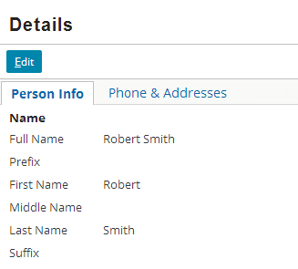
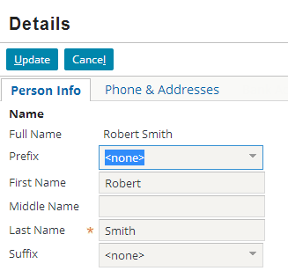
Read-only and edit modes
Read-only
Edit
Input widgets displays root object data and related data
Input widgets allow for editing of root object data and related data
Notes:
A Page location has two properties that influence if the root object is editable: canEdit and startInEditMode. By default, canEdit is not defined and startInEditMode=false.
A root objects entity definition overrides a PCF element attribute configuration. Some entities are defined as readOnly=true. Read-only entities are not editable using the user interface and page configuration files.

Slide 5
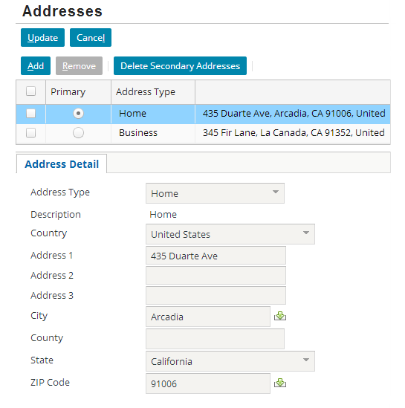
Editable hierarchy
By default, all containers are:
Editable and visible
For widgets to be editable, parent container must also be editable
Editable hierarchy starts with Location
Editable property is undefined
Screen
List Detail Panel
Card View Panel
Detail View Panel
Notes:
In the slide example, the Page location is ABContactAddressesPage. The Page PCF element contains an attribute that defines if the page is editable (canEdit=true).
ABContactAddressesPage declares the Screen container and in addition, declares a Panel Ref that references ABContactADdressesLDV, a List Detail Panel. The List Detail Panel declares a reference to the ABContactAddressCV, a Card View Panel. The Card View Panel defines an inline Detail View Panel.
By default, editability of containers is undefined. The hierarchy of containers inherits the editability of the location.

Slide 6
Editable properties of containers
PCF Element
Widget
Location
Atomic Widget
Container Widget
Some containers can explicitly define editability
Not all containers can define editability
editable = true
Screen
Input Set
Detail View Panel
List View Panel
Screen
Input Set
Card View Panel
Detail View Panel
List Detail Panel
List View Panel
Notes:
Container widgets hold other widgets. Each one can be defined either in its own file or as a child container within some other PCF element file. Not all containers explicitly define the ability of their children.
Some containers have a configurable "editable" property which is a boolean expression which, if false, makes the container widget and all its children read-only. Screen, Input Set, Detail View Panel and List View Panel have an explicit editable property.
List Detail Panel does not have an explicit property to define editability. A List Detail Panel displays a List View Panel followed by a Card View Panel. A selection in the List View Panel can define the object for the Card View Panel.
A Card View Panel does not have an explicit property to define editability. A Card View Panel is a collection of "Cards", or sub-panels, of which only one card at a time is visible. A set of tabs are shown for switching between cards. Often, a card contains or references a detail view panel.
In most cases, containers inherit editability from a location, such as Page (canEdit = true).

Slide 7
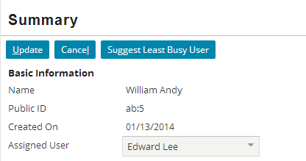
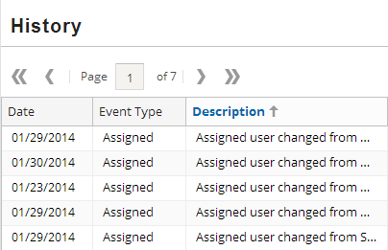
Toolbars
A toolbar is row of data action buttons and other widgets associated with a specific container widget
Direct placement
Screen
Panel Ref
List View Input
Referenced containers
Card View Panel
Detail View Panel
List Detail Panel
List View Panel
Input Set not applicable
Notes:
A toolbar is a row of widgets associated with a container widget that lets the user take action on the data in the container widget.
A toolbar can be directly add to a Screen, Panel Ref, or List View Input. Toolbars can also be associated with Detail View Panels, Card View Panels, List Detail Panels, and List View Panels. However, there is no direct placement or reference with an Input Set. Typically, an Input Set is referenced or placed in an Input Column in a Detail View Panel.
A toolbar has usually has button widgets such as Edit Buttons. When a toolbar is associated with a list view panel, the toolbar may not have any button widgets. In this specific case, the toolbar association may be required to provide button paging controls. Paging button controls allow users to view the list view rows in sizable chunks and "page" through the results. A user can move to the first, last, previous and next page. A user can also specify a specific page number to view.

Slide 8
Toolbar placement: Screen
A Screen is the top-level user interface container for the visible content of a page
By placing a toolbar in a screen, you can add Edit Buttons
Screen
Toolbar
Notes:
There are three places that you can place a toolbar: Screen, Panel Ref, and List View Input.
A Screen is the top-level container widget for the visible content of a page. By placing a toolbar in a screen, you can add edit buttons. When in edit mode, all the input widgets contained within a Screen become editable unless otherwise specified (in a parent container or widget itself) to not be editable.

Slide 9
Toolbar placement: Panel Ref
Toolbar
Panel Ref
List View Panel
A Panel Ref includes a reference to a panel container
Card View Panel, Detail View Panel, List Detail Panel, List View Panel, or Panel Set
Optionally supplies referenced panel with
Title, Toolbar, Instructional text
Notes:
There are three places that you can place a toolbar: Screen, Panel Ref, and List View Input.
A Panel Ref requires a reference to a panel such as a Detail View Panel, List View Panel, Panel Set or Card View Panel. A Panel Ref supplies the referenced panel with title, toolbar or instructional text.

Slide 10
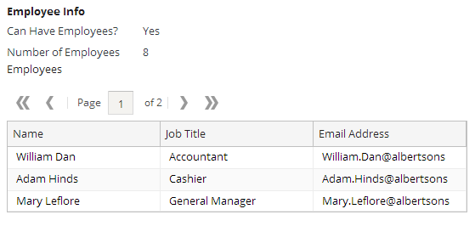
Toolbar placement: List View Input
List View Input
Toolbar
List View Panel
A List View Input references a List View Panel and supplies it with an optional toolbar
If applicable, a toolbar automatically applies paging
Notes:
There are three places that you can place a toolbar: Screen, Panel Ref, and List View Input.
A ListViewInput element references a List View Panel and supplies it with an optional toolbar. Configuring List View Panels is covered later in this course. In the slide example, the page is in read-only mode. The toolbar automatically adds paging of the list in both read-only and edit modes.

Slide 11
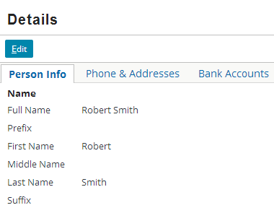
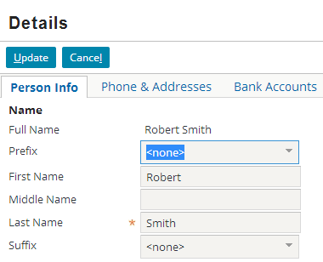
Edit Buttons
The Edit Buttons widget is a pre-defined set of editing controls for a toolbar
Read-only shows Edit
Edit mode shows Update | Cancel

Slide 12
Edit, Update, Cancel
Edit
Update
Cancel
Enter edit mode
Add entry to unsaved menu
Commit changes
Return to read-only
Remove entry from unsaved menu
Discard changes
Return to read-only mode
Remove entry from unsaved menu

Slide 13
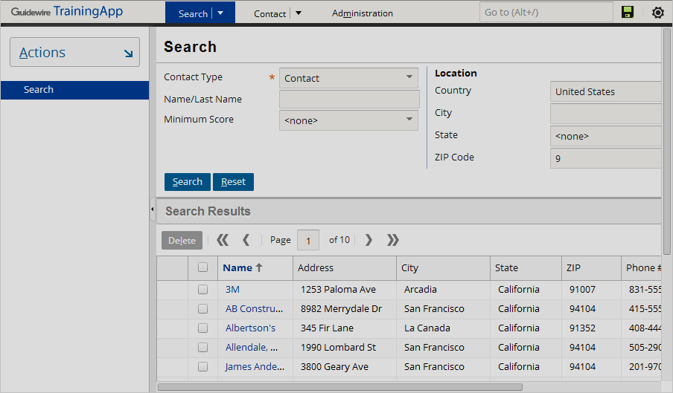
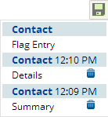
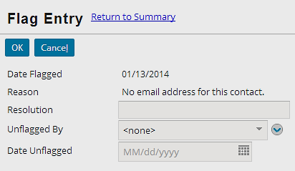
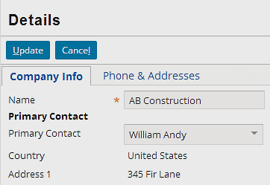
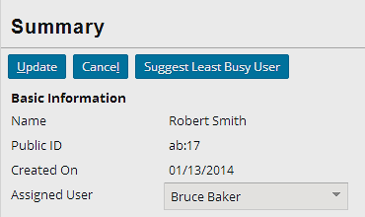
Edit buttons and the unsaved work menu
Click Edit to automatically add object to unsaved work menu
Update or Cancel removes entry
Notes:
Whenever you start editing a data backed object (entity), the Guidewire application automatically adds an entry to the Unsaved Work menu. The entry remains in the Unsaved Work menu until the data is committed (click update) or you log off.
Users can use the Unsaved Work menu to return to unsaved work, even after they navigate away from the current screen.

Slide 14
Discover editability
Configure the editability of a detail view panel

Slide 15
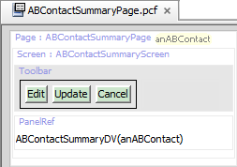
Anatomy of an editable detail view panel
Screen
Toolbar
Edit Buttons
Panel Ref
Referenced detail view panel
Screen is top level container with Toolbar and Edit Buttons
Panel Ref is a child of Screen and references a Detail View Panel
Possible to use inline Detail View Panel instead of Panel Ref
Notes:
In the slide example, editability is set on the Page location in the canEdit property. The ABContactSummaryPage uses a PanelRef element to reference the ABContactSummaryDV detail view panel.

Slide 16
Steps to add edit buttons
Locate top-level screen container
Add toolbar to screen
Add edit buttons to toolbar
Deploy PCFs

Slide 17
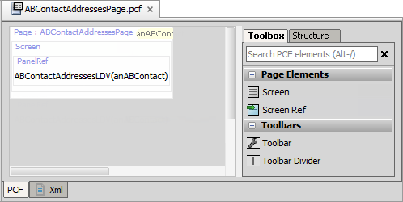
Step 1: Locate top-level screen container
Screen
Screen is a top-level container and is found in a location

Slide 18
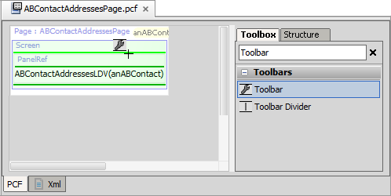
Step 2: Add toolbar to screen
Light green line - current place where new widget will go
Dark green line - places where new widget can go
Add a Toolbar to the top-level Screen element

Slide 19
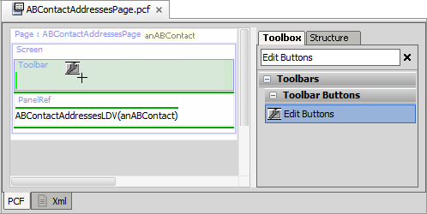
Step 3: Add edit buttons to toolbar
Add the Edit Buttons to the toolbar
Notes:
For edit buttons, it is ideal to add the toolbar to the top-level container and then add the edit buttons to the toolbar.

Slide 20
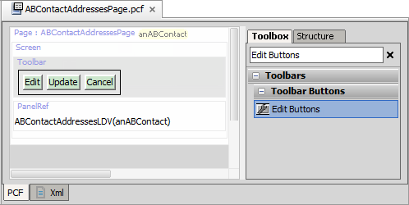
Toolbar with edit buttons
EditButtons widget includes Edit|Update|Cancel buttons
Edit shows in read-only mode
Update and Cancel show in edit mode

Slide 21
Step 4: Deploy PCFs
Restart Server
Reload PCFs
PCFs read at server startup
ALT+SHIFT+L
Internal debug tools enabled
Internal Tools
Reload → Reload PCF Files
Page PCF
Page PCF
Notes:
It is also possible to reload PCF files using the Guidewire API and/or internal server tools. The Reload PCF command can be found on the Reload page in Internal Tools. To access Internal Tools, you must log in as an administrator user, e.g., su/gw. Then, use ALT+SHIFT+T. In the tab bar, select Internal Tools → Reload. On the Reload page, click the Reload PCF Files button. The Reload PCF Files button calls the static method gw.api.tools.InternalToolsUtil.reloadPCFs().

Slide 22
Describe how to make a detail view panel editable
Create a toolbar with edit buttons

Slide 23
A screen with card view panel references a detail view panel. The detail view panel contains a text input widget. To allow the user to edit the text input value, what must be set to editable?
In Studio, can you add Edit Buttons directly to
An inline DetailViewPanel widget?
A detail view panel PCF file?
Where do you typically add a toolbar with edit buttons?
Notes:
Answers
1) The input widget and all of the containers that directly or indirectly contain it must be editable. The editable hierarchy begins with a location PCF Element. Assuming that the Screen declared in a Page location, then the Page location must be editable.
2a) No, you cannot add Edit Buttons directly to a DetailViewPanel widget. Typically, you add a Toolbar to a Screen. Then you add Edit Buttons to the Toolbar. A DetailViewPanel widget can be declared on a Screen.
2b) No, you cannot add Edit Buttons directly to a Detail View Panel PCF file. Typically, you add a Toolbar to a Screen. Then you add Edit Buttons to the Toolbar. A Panel Ref can reference the Detail View Panel PCF file.
3) You add a toolbar with edit buttons typically to the Screen container element.

