Slide 1
Introduction to Guidewire Configuration
November 20, 2020
Notes:
Guidewire training materials contain Guidewire proprietary information that is subject to confidentiality and non-disclosure agreements. You agree to use the information in this manual solely for the purpose of training to implement Guidewire software solutions. You also agree not to disclose the information in this manual to third parties or copy this manual without prior written consent from Guidewire. Guidewire training may be given only by Guidewire employees or certified Guidewire partners under the appropriate agreement with Guidewire.

Slide 2
Describe the product architecture for Guidewire products
Recall the primary components used to configure Guidewire products
Identify the relationship between the Guidewire platform and the Guidewire applications
Explain the basic functionality of TrainingApp
Start a development instance of a Guidewire application
Describe the purpose of Guidewire Studio

Slide 3
Lesson outline
Guidewire product architecture
Guidewire configuration technology
The Guidewire platform
TrainingApp
Starting Guidewire applications
Guidewire Studio

Slide 4

Guidewire 10.0 product landscape
Insurance carriers worldwide use Guidewire core systems as operational systems of record
Core Operations Support
External Access
Monitoring & Guidance
Operational Systems of Record
Data Management & Business Intelligence
Notes:
Guidewire builds software products that help property and casualty (P&C) insurers replace their legacy core systems and transform their business. Guidewire provides core systems and data management/business intelligence tools used by insurers as operational systems of record. Additional products provide support for anytime/anywhere access and guidance and monitoring.
Operational Systems of Record: In the area of Core Operations Support, Guidewire InsuranceSuite provides a complete set of applications to support a carrier's core operations—underwriting, policy administration, billing, and claim management. The slide provides a high-level view of the core Guidewire products. It is not an exhaustive list of all applications and licensed features. Therefore, some features and products, such as ContactManager, Client Data Management, PolicyCenter Rating, PolicyCenter Reinsurance, and the ISO Standards-Based templates, are not shown.
In the area of Data Management and Business Intelligence, Guidewire DataHub is an operational data store that unifies, standardizes, and stores data from a carrier's own systems as well as external sources. Guidewire InfoCenter is a business intelligence warehouse that is purpose-built for P&C insurance. It provides easy-to-use reporting formats for business intelligence, analysis, and enhanced decision making. Using InfoCenter, carriers gain operational insight across the enterprise.
Monitoring and Guidance: Guidewire Live is a network that connects peer insurers, core systems data, external sources of information (such as weather services), and expert tools. Users access Guidewire Live through applications hosted by Guidewire and designed for specific challenges faced by P&C insurance professionals.
External Access: Mobile & Portals is a new set of applications that feature add-on products to the Guidewire core suite, providing self-service transactions through various mobile channels.

Slide 5




Guidewire InsuranceSuite
Create, modify, renew, and cancel policies
Bill policy holders for policies, and pay commissions for policies to producers
Process claims to provide payments to claimants when covered losses occur
Notes:
Guidewire InsuranceSuite 10.0 is a set of three core products that meet the core needs of property and casualty insurance carriers Guidewire offers a set of applications designed to help property and casualty insurance companies expedite their policies, billing, and claim requirements:
ClaimCenter is an application designed to manage the process of reporting, verifying, and making payments on claims against a policy.
PolicyCenter is an application designed to issue, modify, and maintain data about policies.
BillingCenter is an application designed to issue and track the premium payments for policies and associated account charges.
Each application can function by itself, and each can be integrated with the other applications.
PolicyCenter can be integrated with BillingCenter, so that the two applications can share information about the payment expected, the payment schedule, and the possible cancellation of a policy if payments are not received. PolicyCenter can be integrated with ClaimCenter, as ClaimCenter needs information about what was on the policy to determine if a loss is covered, and PolicyCenter needs to know what claims were filed to determine if the policy should be renewed and at what rate. Although less common, BillingCenter can be integrated with ClaimCenter. This is typically done for business situations like subrogation in which the insured suffers a loss that a third party's insurance should pay for. ClaimCenter identifies that subrogation is expected, and BillingCenter manages the invoices sent to the third party's insurance provider.
Depending on the configuration, InusaranceSuite can contain contain other modules: ContactManage, Clident DataManangement, PolicyCenterRating, PolicyCenter Reinsurance, ans Standatads-Based templates.

Slide 6
Guidewire application tier
Application Server
J2EE Application Server
Contains the functional process and business logic
Guidewire supports the following application servers:
WebSphere, WebLogic, Apache Tomcat, JBoss EAP
Jetty (for development only)
Notes:
All Guidewire applications are run within an application server. An application server runs enterprise-wide applications. There are several different types of application servers. The type of application server used by Guidewire applications is a Java Enterprise Edition (Java EE) server. The platform was known as Java 2 Platform, Enterprise Edition or J2EE until the name was changed to Java EE in version 5.
Each Guidewire application is built and commonly deployed as an Web Application Archive (WAR) or Enterprise Application Archive (EAR) file to the application server. It contains all the configuration, operational data and data definition files necessary to execute the application. The application server is typically installed on a dedicated machine that does not host any other aspects of the architecture, such as the database.
This machine must use an operating system supported by your third party application server vendor (or Guidewire, in the case of Apache Tomcat).
Guidewire supports the operating systems for which application servers provide customer support. For details, review the customer-viewable document Platform Matrix.
The Guidewire application (the center box) consists of a set of business rules, a user interface, a set of integration APIs, and a data model. The technology for configuring these application elements is platform-level (and common to all Guidewire applications), but the specific rules, UI, APIs, and data model for each application are distinct.
For the latest and most complete information about the software Guidewire requires and supports, refer to the Guidewire Platform Matrix page found at https://guidewire.custhelp.com/app/resources/products/platform.

Slide 7
The data tier
Database Server
Application Server
J2EE Application Server
Application Database
Data tier contains the business and operational database
Guidewire supports the following RDBMs:
Oracle Enterprise
Microsoft SQL Server
H2 for development only
Notes:
A relational database is a collection of data structures and objects that related to each other. Databases store date in database tables. The operational data for the Guidewire application is stored inside a relational database. This database is typically hosted on a machine other than the machine hosting the Java EE application server.
The war file contains a file named config.xml that specifies which database to connect to and how to establish the connection.
For the latest and most complete information about the software Guidewire requires and supports, refer to the Guidewire Platform Matrix page found at https://guidewire.custhelp.com/app/resources/products/platform.

Slide 8



The Presentation tier
Database Server
Application Server
Web Clients
J2EE Application Server
Application Database
Presentation tier contains the user interface
Modern web browser support the Guidewire user interface
Chrome 28+, Firefox 19+, and IE10+
See Guidewire Platform Matrix
Notes:
End-users connect to the application using a web browser. Chrome is the preferred browser. Each application generates a collection of standard HTML pages that are rendered by the browser. Each application is a server-side application. It dynamically generates the HTML pages and data within those pages. It makes only a minimal use of functionality in the client (the web browser). Because there are no static HTML files, you cannot use the browser's Back button. All navigation is controlled on the server side.
In a development environment, you deploy configuration changes in a variety of ways using Guidewire Studio and/or using the administrative tools in the application user interface. Configuration changes can cover several areas: data model, user interface, and Gosu code. In certain instances, you must stop and start the server. In other situations, you do not need to restart the server. This course will emphasis how and when to deploy new and changed resources.
In a production environment, configuration changes are typically made by rebuilding and redeploying the application's war file. This always involve stopping and restarting the application.
For the latest and most complete information about the software Guidewire requires and supports, refer to the Guidewire Platform Matrix page found at https://guidewire.custhelp.com/app/resources/products/platform.

Slide 9
External systems
Database Server
Application Server
Web Clients
J2EE Application Server
Application Database
Policy Admin.
Authen- tication
Document Storage
Address Book
Check Printing
Notes:
Each application is typically integrated with a number of external systems. The connections to these systems are configured through the application APIs.

Slide 10
Gosu language
Database Server
Application Server
Web Clients
J2EE Application Server
Application Database
Policy Admin.
Authen- tication
Document Storage
Address Book
Check Printing
Notes:
Gosu is an open-source, publicly-available programming language created by Guidewire. It is similar to Java. Gosu is used to specify runtime business logic that:
Executes fundamental application behavior
Manages complex business processes
Specifies dynamic client-side behavior
Gosu can be used to affect behavior throughout the product architecture. This includes:
Application behavior (such as specifying business rule behavior, methods, and entity enhancements)
Client-side behavior in the web browser (such as reflecting the change of the value in one field in some other field)
Data model behavior (such as specifying which fields to concatenate for the "display name" of a given object)
Integration behavior (such as defining the behavior of a web service that responds to requests from external applications)
Guidewire developed Gosu for several reasons. First, there was a desire to have a single syntax that could be used to work with all of the elements relevant to Guidewire products (such as entities, display keys, classes, class enhancements, Java classes, permissions, and script parameters) even though these items have fundamentally distinct internal implementations. There was no existing language that provided this ability. Second, there was a desire to have a code auto-complete feature in Guidewire Studio, the primary tool used to complete Guidewire configuration tasks. This is possible only with a statically-typed language. Most scripting languages, such as JavaScript, Perl, Python, and Ruby, are dynamically-typed.

Slide 11
Lesson outline
Guidewire product architecture
Guidewire configuration technology
The Guidewire platform
TrainingApp
Starting Guidewire applications
Guidewire Studio

Slide 12
Guidewire configuration technology
database
application server
user interface
integration
Guidewire has four core areas of configuration technology
One area of technology for each tier of the architecture
Fourth area of technology for the development of integration points to external systems
Notes:
Three-tier architecture is a client-server architecture in which the functional process logic, data storage and user interface are developed and maintained as independent modules on separate platforms. Three-tier architecture is one of the industry-standard software architectures.

Slide 13
Entities configure data tier
database
application server
user interface
data model entity
ab_abcontact
database table row
Notes:
A data model entity is an abstract definition of a group of objects used by the data tier, such as Address Book contacts, or ABContacts. It defines the information about the objects that must be stored in the database, such as Name, PublicID, and CreateTime. It is defined in a set of one or more XML files.
In most cases, each data model entity corresponds to a table in the database. The data model entity definition defines the table structure. Each instance of the data model entity is stored as one row in the database table.

Slide 14
Gosu configures application tier
database
application server
user interface
data model entity
internal Gosu class
ABContact
Fields Name PublicID CreateTime ...
ab_abcontact
database table row
anAB Contact
Gosu class instance
Notes:
A Gosu class is an abstract definition of a group of objects used by the application tier, such as Address Book contacts, or ABContacts. It defines the information about the objects that must be maintained in the application server's run-time environment, such as Name, PublicID, and CreateTime. It is defined in a set of one or more Gosu files that have a proprietary format and a ".gs" extension.
For every data model entity, the Guidewire application automatically creates an internal Gosu class with the same name. For every field in the data model entity, there is a field in the corresponding internal Gosu class. For example, the ABContact data model entity has a "Name" field, and the internal ABContact Gosu class also has a "Name" field.
Whenever the application needs to work with an instance of a data model entity (which is stored as a row in the corresponding database table), the application creates an instance of the corresponding Gosu class. The information from the database is then read into that instance. For example, if a user searches for the ABContact whose name is "Express Auto", then the application finds the row in the database table for ABContact, creates an instance of the ABContact Gosu class, and reads the data from that row into that instance.

Slide 15
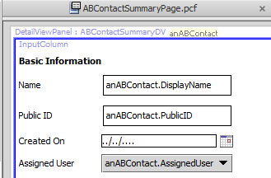
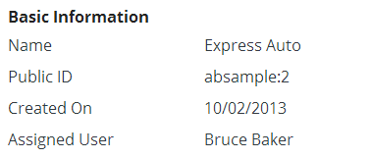
PCFs configure presentation tier
database
application server
user interface
data model entity
internal Gosu class
page configuration file
ABContact
Fields Name PublicID CreateTime ...
User interface form to display and capture business data
ab_abcontact
database table row
anAB Contact
Gosu class instance
Notes:
A PCF (Page Configuration File) is an abstract definition of a form or location used by the user interface tier, such as an "ABContactSummaryDV" detail view used to display information about ABContacts. It defines the information about the objects to be displayed in the user interface, such as a Name field, a PublicID field, and a CreateTime field. It is defined in a set of one or more XML files using the proprietary PCF XML schema definition.
There is a strong correspondence between data model entities and internal Gosu classes. Every data model entity has one internal Gosu class. There isn't necessarily a strong correspondence between internal Gosu classes and PCFs. The data for one Gosu class could be displayed in a single PCF, or it could be displayed across multiple PCFs. The separation of the user interface tier and the application server tier gives developers the freedom to display data in whatever way makes sense to end users without being constrained by how that data is maintained in the application server or how the data is stored in the database.

Slide 16
Database to user interface
database
application server
user interface
data model entity
internal Gosu class
page configuration file
ABContact
Fields Name PublicID CreateTime ...
User interface form to display and capture business data
ab_abcontact
read from db
database table row
display in UI
anAB Contact
Gosu class instance
Notes:
Whenever a user needs to work with an instance of a data model entity, such as the ABContact named "Express Auto":
The application queries for the data row from the database table.
The application creates an instance of the corresponding Gosu class and reads the information into that instance.
The application sends the data in that instance to the web browser. The web browser displays the form as defined in the given PCF and populates the form with data from the instance.

Slide 17
User interface to database
database
application server
user interface
data model entity
internal Gosu class
page configuration file
ABContact
Fields Name PublicID CreateTime ...
User interface form to display and capture business data
ab_abcontact
read from db
database table row
display in UI
anAB Contact
Update db
Modify in UI
Gosu class instance
Notes:
Whenever a user needs to save data, such as changing the name of the ABContact named "Express Auto":
The information is modified in the user interface and then posted to the application server.
The application server inserts data into the database table (if the object being saved in the UI is a new object) or updates data in the database table (if the object being saved in the UI is an existing object that has been modified).
Be aware that there is variation in when data modifications made in the user interface get sent to the application server and/or the database.
In some situations, data in the user interface is …
not immediately sent to the application server (or saved to the database).
sent to the application server but not immediately saved to the database.
sent to the application server and also saved to the database at the same time.
These issues are discussed in more detail later in the course.

Slide 18
Integrate with integration mechanisms
database
application server
user interface
data model entity
internal Gosu class
page configuration file
ABContact
Fields Name PublicID CreateTime ...
ab_abcontact
anAB Contact
integration
predefined plugins web services
messaging startable plugin
Notes:
Guidewire applications share information with external systems using a variety of industry-standard technologies. This can include:
Writing information to or reading information from an operating system file
Writing information to or reading information from an external database
Using remote procedure calls (such as web services) to share data with other applications directly
Using message queues to request data from external systems asynchronously
Guidewire applications have a set of integration mechanisms that make use of the industry-standard technologies listed above. This can include:
Predefined plugins - A predefined plugin is a Gosu or Java class which implements a set of methods called by internal code and is related to fundamental application behavior. For example, the authentication plugin implements methods that define how authentication is executed against an external authentication system, such as an LDAP server.
Web services - A Guidewire web service is written in Gosu. External applications can use it to make synchronous calls to Guidewire. For example, an ABContactAPI web service might allow external systems to retrieve information about a given contact, such as its phone number.
Messaging - Messaging is a Guidewire integration mechanism in which messages are asynchronously sent to external systems in response to the creation or change of business data. For example, you may want to verify a newly created bank account exists with the external financial system. If this verification is not needed immediately, you could use messaging.
Startable plugins - A startable plugin listens for requests from an external system that communicates with Guidewire via a mechanism such as JMS Messaging or TCP/IP. It is triggered by an incoming external request, and it typically processes the message asynchronously. For example, an external system may want to submit payments for a given ABContact. If the payments do not need to be processed immediately, you could process them with a startable plugin.

Slide 19
Lesson outline
Guidewire product architecture
Guidewire configuration technology
The Guidewire platform
TrainingApp
Starting Guidewire applications
Guidewire Studio

Slide 20
The Guidewire platform
ClaimCenter
PolicyCenter
BillingCenter
Data Model
User Inter.
Data Model
User Inter.
Data Model
User Inter.
App. Logic
Int. Mech.
App. Logic
Int. Mech.
App. Logic
Int. Mech.
Guidewire Platform, with a common technology for configuring...
Data Model
User Interface
Application Logic
Integration Mechanisms
Notes:
The Guidewire platform is layer of configuration technology that includes the functionality needed to define a Guidewire applications. For example, it includes:
The technology to define a data model
The technology to define a user interface
The technology to define application logic
The technology to define integration points
Every application uses this common technology to define its own data model, user interface, business logic, and integration points. Each application is distinct, but every application shares common abilities and configuration techniques with all the other applications.

Slide 21
Application specific functionality
ClaimCenter
PolicyCenter
BillingCenter
Finan- cials
Group Access
Product Model
Job- flow
Billing Plan
Payment Plan
Fraud Detection
Claim Maturity
Role Assign.
Policy Validation
Charge Pattern
Delinq. Workflow
Data Model
User Inter.
Data Model
User Inter.
Data Model
User Inter.
App. Logic
Int. Mech.
App. Logic
Int. Mech.
App. Logic
Int. Mech.
Guidewire Platform, with a common technology for configuring...
Data Model
User Interface
Application Logic
Integration Mechanisms
Notes:
Each application also has application-specific functionality. For example:
The PolicyCenter-specific functionality includes:
The product model, which defines products, the policy lines assigned to each product, the coverages and coverables for the product, and the coverage terms for those coverages.
Jobflow, which defines how policy transactions (such as submissions, renewals, changes, and cancellations) are executed.
Role assignment, which defines how users are assigned responsibility for a given account, policy, or policy transaction.
Policy validation, which validates that a given policy is valid, quotable, bindable, or issuable.
The BillingCenter-specific functionality includes:
The management of invoices over the billing cycle from planned to billed to due and ultimately to paid.
The production of provider commission statements for business collected directly from the client and the production and reconciliation of account statements where the provider collects monies due.
The management of processing exceptions and events such as account statement queries. These are known as trouble tickets within BillingCenter.
The management of the escalation cycle invoked when a payment becomes overdue and the account becomes delinquent.

Slide 22
Configuration courses
ClaimCenter
PolicyCenter
BillingCenter
Finan- cials
Claim Validation
Product Model
Job- flow
Billing Plan
Payment Plan
Claim Maturity
AB Integration
Role Assign.
Policy Validation
Charge Pattern
Delinq. Workflow
Application Configuration
Data Model
User Inter.
Data Model
User Inter.
Data Model
User Inter.
App. Logic
Int. Mech.
App. Logic
Int. Mech.
App. Logic
Int. Mech.
Guidewire Platform, with a common technology for configuring...
Fundamental Configuration
Data Model
User Interface
Application Logic
Integration Mechanisms
Notes:
Guidewire Education divides configuration technology into two categories: platform (also known as "fundamental") and "application-specific".
The "fundamental" configuration technology is the technology common to all Guidewire applications. One could think of it as the technology embedded within the Guidewire platform. This courses focuses on the fundamental configuration technology.
The "application-specific" technology is the technology added to each Guidewire application to enable it to do policy-specific, billing-specific, or claim-specific processing.
The integration technology is covered in the "Application Integration" courses. This course does not focus on integration technology.

Slide 23
Lesson outline
Guidewire product architecture
Guidewire configuration technology
The Guidewire platform
TrainingApp
Starting Guidewire applications
Guidewire Studio

Slide 24

TrainingApp
TrainingApp
Developed exclusively for training
Examples of each fundamental configuration feature
Data Model, User Interface, Application Logic, Integration Mechanisms
Small number of entities and screens
Excludes complex functionality
Data Model
User Inter.
App. Logic
Int. Mech.
Guidewire Platform offers technology for configuring...
Data Model
User Interface
Application Logic
Integration Mechanisms
Notes:
TrainingApp is not sold as genuine Guidewire product. It is used and maintained exclusively by Guidewire Education. The training application also has fundamental integration examples. These examples are discussed in the various Application Integration courses. TrainingApp excludes complex functionality designed for policy, billing, and claims processing.

Slide 25
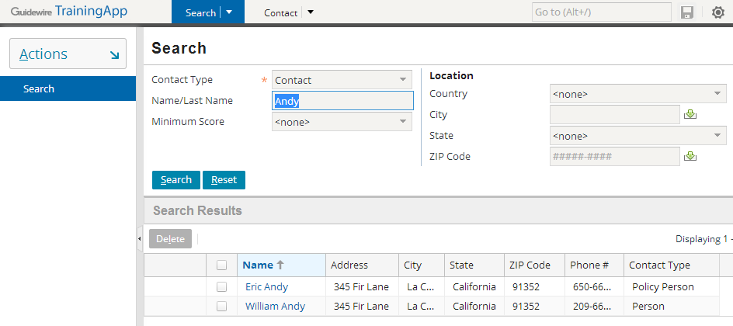
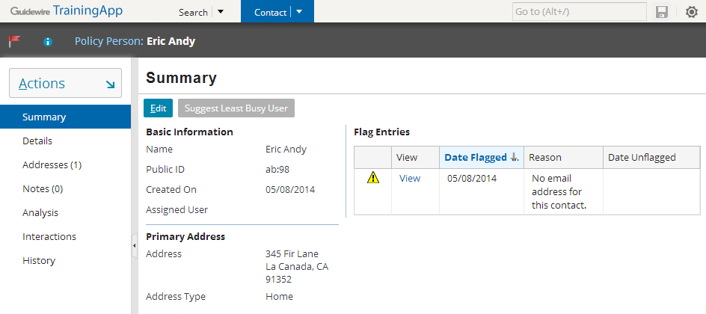
TrainingApp as a mock business solution
Mock business solution for insurance carriers
Designed to function like a contact management application
Stores and manages contacts and related information
Notes:
TrainingApp is based on Guidewire's ContactManager application. However, much of the ContactManager functionality has been removed or simplified to promote the learning of configuration fundamentals.
Users can search for ABContacts on the Search tab. Once an ABContact is selected, it is displayed on the Contact tab.

Slide 26
TrainingApp data model
FinanceManager
ABContact
AllAddresses
Address
History
History Entry
AssignedUser
FlagEntries
Flag Entry
FinancialSummary
ContactNotes
Contact Note
User
BankAccounts
Bank Account
Financial Summary
ServiceEvaluations
Service Evaluation
Notes:
The core of the TrainingApp data model consists of nine entities and a small number of relationships which all center around ABContact.
The ABContact entity stores contacts. ("AB" stands for "Address Book". Many insurance carriers refer to their contact application as an Address Book.) The ABContact entity is subtyped, which is represented in the diagram above by the three small rectangles inside the ABContact rectangle. This is discussed in more detail on the following slide.
The Address entity stores addresses. An ABContact has one to many addresses.
Each contact has a history, which is a list of important occurrences in the life of that contact. The HistoryEntry entity stores a single entry in the ABContact's history. Given that a history entry is created to note the creation of the contact, every ABContact has one to many history entries.
The FlagEntry entity stores a flag entry. A flag entry is an issue pertaining to the ABContact which someone should attend to. An ABContact is "flagged" when it has one or more open flag entries. An ABContact can have zero to many flag entries.
The ContactNote entity stores notes about the ABContact. A contact note is a free-form text entry used to capture miscellaneous information about the contact. An ABContact can have zero to many contact notes.
The BankAccount entity stores bank account information. An ABContact can have zero to many bank accounts.
The Service Evaluation entity stores information about a service evaluation, which evaluates the quality of the service provided by the contact and is most appropriate for vendor contacts such as doctors, lawyers, and auto repair shops. An ABContact can have zero to many service evaluations.
The User entity stores information about TrainingApp users. An ABContact may have zero or one assigned users.
The FinancialSummary entity stores information about an ABContact's financial summary. An ABContact may have zero or one financial summaries.

Slide 27
Subtype hierarchy of ABContact
primary entity
primary subtypes
Notes:
ABContacts are organized into a set of subtypes. The organization of the hierarchy helps to model information about contacts. Information common to all contacts can be established at the ABContact level. It is automatically inherited by all of its subtypes. Information specific to an ABPerson can be put at the ABPerson level. It will be inherited by all of its subtypes, but information on the ABPerson subtype is not available to ABCompany or ABPlace.
In the ABContact hierarchy, an ABPolicyPerson is a person who owns a policy issued by the carrier (such as an individual with a personal auto policy). An ABPolicyCompany is a company that owns a policy issued by the carrier (such as a construction company with a workers' compensation policy).
There is one entity that participates in the hierarchy that does not appear in the diagram above: ABUserContact. This type of contact represents a TrainingApp user and is used to store his or her contact information (such as home phone numbers). It has been excluded because it is not relevant to the configuration work to be done with TrainingApp.
Subtyping is also used within the three primary applications. For example:
BillingCenter's Activity, Plan, and Contact entities
ClaimCenter's Transaction, Incident, and Contact entities
PolicyCenter's Job and Contact entities

Slide 28
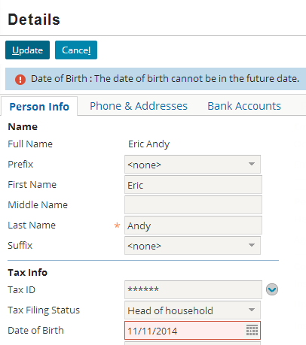
TrainingApp application logic
Gosu language defines application logic
Widget attributes
Static methods in Gosu classes
Enhancements
Business rules
Script parameters
Notes:
The screenshot above shows an example of application logic specified as a widget attribute. The "Date of Birth" widget has a validation expression that identifies the value provided cannot be greater than the current date. If this validation expression fails, then the update is blocked and the message "The data of birth cannot be in the future" is displayed in the user interface.

Slide 29
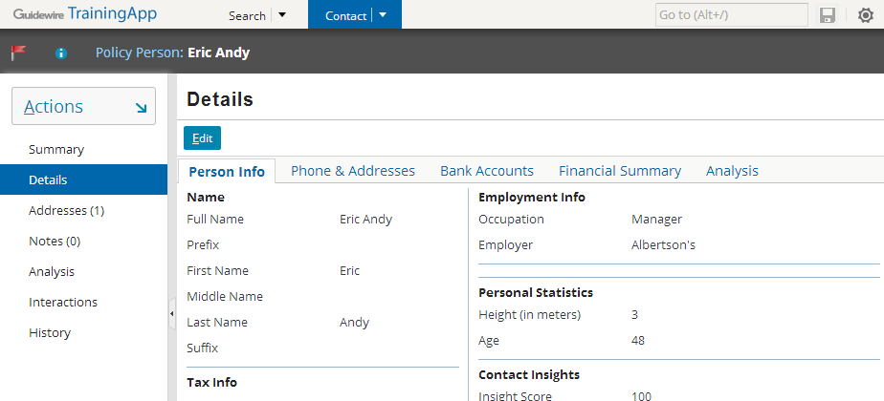
TrainingApp user interface
Show cases common user interface configurations found in many Guidewire applications
Pages, Locations, Panels, Containers, Widgets
Some user interfaces are incomplete by design
Notes:
The TrainingApp user interface is simple and straightforward. When you select the Contact from the tab, you see seven pages for the high-level areas of ABContact information: Summary, Details, Addresses, Notes, Analysis, Interactions, and History.
The Details tab contains a set of cards such as Person Info, Phone & Addresses, Bank Accounts, Financial Summary, Analysis. The Phone & Addresses card appears for all contact types. Not all cards appear for all contact types. For example, contacts that are companies have a Company Info card Certain portions of the user interface have incomplete functionality. Students complete the functionality during one of the Guidewire training courses.
TrainingApp is incomplete by design. Certain portions of the user interface have incomplete functionality. In labs, students will complete and enhance the user interface functionality of TrainingApp.

Slide 30
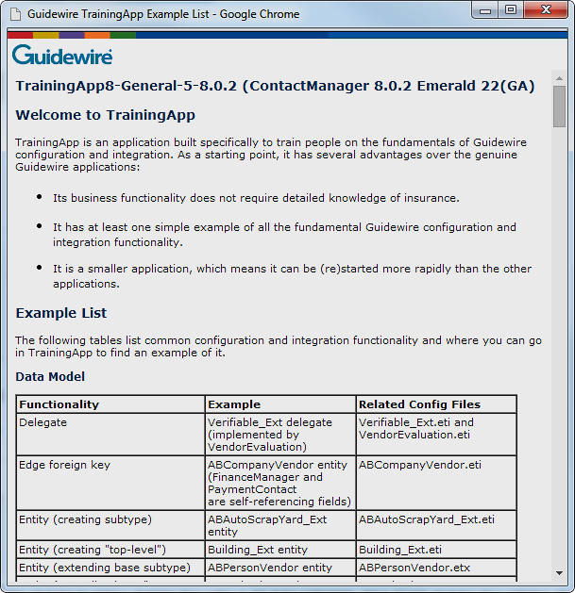
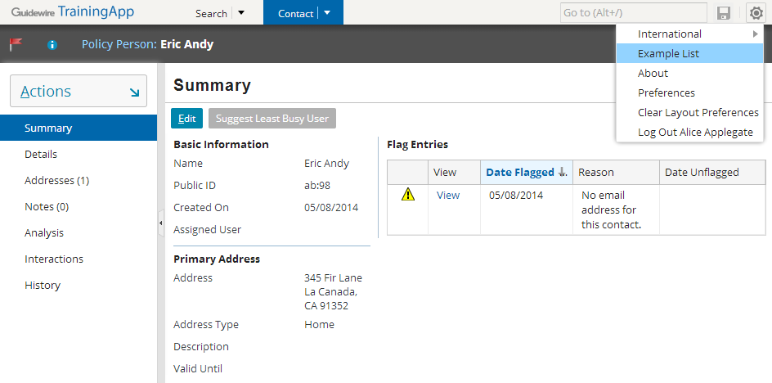
Example List
Settings → Example List
Organized into functionality groups
Data Model, User Interface, Gosu, Cross-Section
Describes example, functionality, and related files
Notes:
TrainingApp also has at least one example of virtually every objective in the Configuration Fundamentals course. To find an example of a specific type of configuration, in Settings, select Example List. The Example List page organizes examples alphabetically within a functionality group: Data Model, User Interface, Gosu, and Cross-Section Functionality.

Slide 31
Guidewire product architecture
Guidewire configuration technology
The Guidewire platform
TrainingApp
Running Guidewire applications
Guidewire Studio

Slide 32
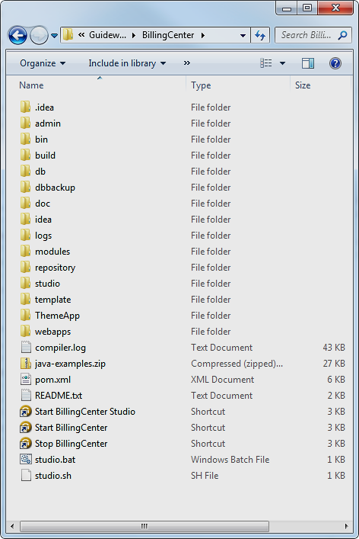
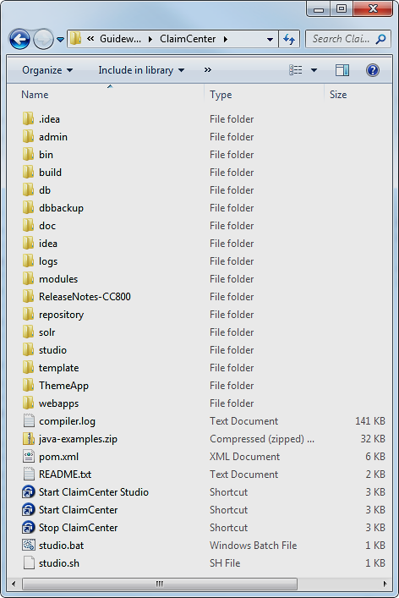
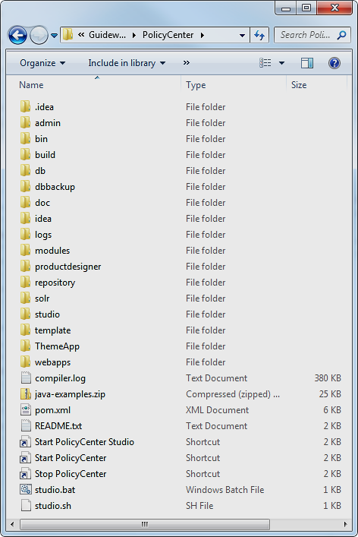



Parallel directory structure
Guidewire applications have a similar directory structure
admin
bin
idea
modules
studio
webapps

Slide 33
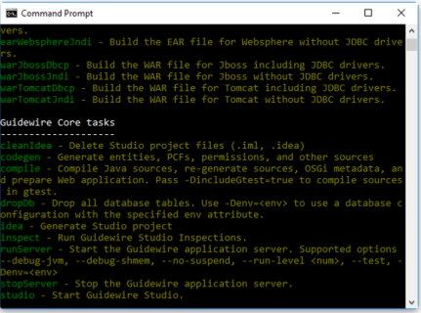


Gradle
InsuranceSuite 10 applications use Gradle
Open source build automation system
Builds upon concepts of Apache Ant
Flexible and Extendable
Run tasks from command prompt -
To view available tasks
run gwb tasks in command prompt window
Notes:
Every application's build.xml file is in <installDirectory>\modules\ant.
Every application's gw--.bat file is in <installDirectory>\bin. The name of the gw batch files varies from application to application:
TrainingApp: gwta.bat
BillingCenter: gwbc.bat
ClaimCenter: gwcc.bat
ContactManager (Address Book): gwab.bat
PolicyCenter: gwpc.bat

Slide 34
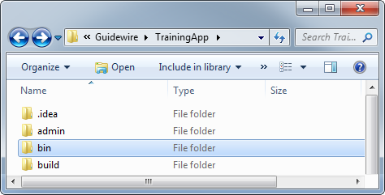
Start Guidewire: gwb runServer
Open a new cmd window in TrainingApp root folder
gwb runServer
Starts sever
" **** [ApplicationName ] ready **** "
When running, all Guidewire applications display to console
TrainingApp "ready" message references ContactManager
Notes:
To start any Guidewire end-user application in development mode:
At a command prompt, navigate to the bin directory of the installation.
Enter gwxx dev-start, where xx is the application's two-letter code.
When the message "***** application ready *****" appears, the application has started.
The command prompt window must remain open while the application is running. You can minimize it, however.
For more information on how to start a Guidewire end-user application in production mode, refer to the Installation Guide for the appropriate application.

Slide 35
Accessing the application
http://hostName:port/appCode
URL syntax to access a Guidewire application for training
Example:
http://localhost:8880/ab/
Application | Application Name | Port | App Code
TrainingApp | ContactManager | 8880 | ab
BillingCenter | BillingCenter | 8580 | bc
ClaimCenter | ClaimCenter | 8080 | cc
ContactManager | ContactManager | 8280 | ab
PolicyCenter | PolicyCenter | 8180 | pc
Notes:
TrainingApp's official application code and application name are "ab" and "ContactManager". This is a hard-coded aspect of Guidewire applications that cannot be customized.

Slide 36
Run in one of two modes
Behavior | Development mode | Production mode
Available in QuickStart instance? | Yes | No
Browser title bar reads… | [DEV mode + build number] + Application | Application
Internal tools access | No restrictions | Restricted by permissions
QuickJump box commands? | Enabled | Disabled
Database exceptions logged at... | Error level | Warning level
Notes:
For every Guidewire application, there is a QuickStart instance that can be run using a Jetty application server and an H2 database. These instances are useful for learning, demo, and development. A QuickStart instance cannot be run in production mode, however.
The Internal Tools interface contains controls for developing and administering Guidewire applications. It can be accessed only if:
The EnableInternalDebugTools parameter in config.xml is set to true.
The server is running in development mode.
To access Internal Tools, enter ALT + SHIFT + T. (It does not matter which user you are logged in as.)
The QuickJump box appears in the upper right-hand corner of the user interface. By default, it contains the text "Go to (Alt+/)". Typically, end users use this box to quickly navigate to various claims, policies, accounts, producers, or contacts. In development mode, however, more powerful commands can be executed. For example, the "run ImportSampleData" command loads sample data into a Guidewire application.
There is no obvious performance overhead to running in development mode—the performance characteristics of a running development server should closely resemble those of the same server in production mode.
Keep in mind that the information on this slide is not exhaustive. There are additional behavior differences that are either more technical in nature or are application-specific. For more information, refer to the Guidewire documentation.

Slide 37
Commonly performed tasks
 | Start Application in Dev Mode | Regenerate Dictionaries | Stop Application
TrainingApp | gwb runServer | gwb genDataDictionary | gwb stopServer
BillingCenter | gwb runServer | gwb genDataDictionary | gwb stopServer
ClaimCenter | gwb runServer | gwb genDataDictionary | gwb stopServer
ContactManager (AddressBook) | gwb runServer | gwb genDataDictionary | gwb stopServer
PolicyCenter | gwb runServer | gwb genDataDictionary | gwb stopServer
Notes:
Every gw batch file and build task it references is prefixed by two-letter codes. The code for each product appears above in red. The code for ContactManager is "ab", which represents "Address Book".
Commonly PerformedTasks:
dev-start starts the given application in development mode.
regen-dictionary regenerates the data dictionary and the security dictionary.
dev-stop stops the application.
Note that—with the exception of the two-letter application code—the method for executing tasks is identical across all applications.

Slide 38
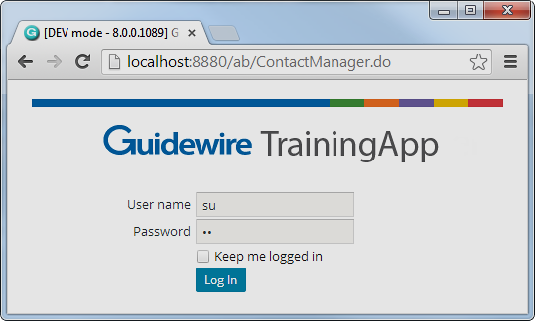
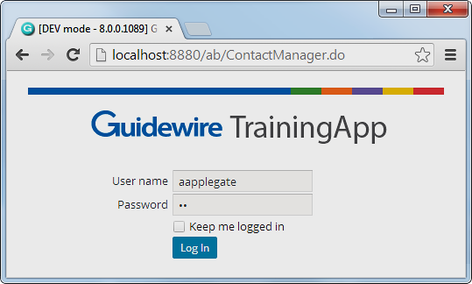
Log in access accounts
Super User account: su/gw
Only in default installation
All permissions
Special capabilities beyond permissions
Alice Applegate account: aapplegate/gw
In sample data for every application
Represents basic end user
Typical permissions for underwriter, adjuster, billing and contact manager
Notes:
Because the Super User account has unique permissions behavior, the account should not be used during testing. All user accounts in Guidewire sample data have an initial password of "gw".
If a user checks the "Keep me logged in" field and logs in, then for the next seven days the user is logged in automatically whenever they navigate to the login page. (This works only if the application is hosted by the same application server.) An explicit logout will clear the "keep me logged in" state.
Note that the "Keep me logged in" functionality writes a cookies to the user's machine. As is the case with cookies, this may expose a security risk if other people get access to the cookie. (For example, someone could copy the cookie to another machine and then log in without entering a user name or password.) If there is a concern about browser cookie theft, administrators should remove this checkbox from the login page.

Slide 39
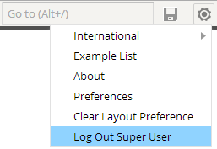
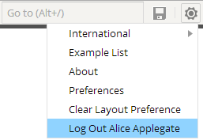
Log out
Click Settings menu
Menu option to Log Out shows the user name
Select Log Out <username>

Slide 40
Stop Guidewire: gwb stopServer
gwb stopServer is a clean shutdown process that safely releases application resources (such as ports)
If application is running in development mode:
Terminate the batch job (CTRL+C, y)
Execute gwb stopServer
If application is running in production mode:
Always stop app by executing gwb stopServer
Notes:
gwXX dev-stop
The gwXX dev-stop command executes a clean shutdown. For example, if the application is in the middle of writing to a file, dev-stop allows the process to complete before the shutdown. gwXX dev-stop also releases all application ports. You can execute a gwXX dev-stop automatically through a script or manually through a second command prompt window.
TrainingApp has a pre-built "Stop TrainingApp" shortcut in the Guidewire/TrainingApp directory that executes a "gwta dev-stop". To execute the command, simply double-click the shortcut.
Terminating the batch job
When you are working in development mode, you can also stop the Guidewire application by terminating the batch job. To do this, press CTRL + C and then respond to the "terminate batch job?" prompt with a "y" (for yes). This has the advantage of keeping the command prompt window open and retaining the history of previously executed commands. This is useful if you need to stop and later restart the application. However, in some cases, the server may not release the port number. When this occurs, you need to execute a gwXX dev-stop before you can restart the application.
You should never terminate the batch job for an instance running in production mode.
Additional notes
The command prompt window must remain open while the application is running. You can minimize it, however.

Slide 41
Lesson outline
Guidewire product architecture
Guidewire configuration technology
The Guidewire platform
TrainingApp
Starting Guidewire applications
Guidewire Studio

Slide 42


About Guidewire Studio
Integrated Developer Environment (IDE)
Gosu, XML, JAVA *
Refactoring
Plugin extensibility
Dynamic type support
Make, run and debug
Guidewire editors
IntelliJ IDEA 12.1.x community edition
No download needed; bundled with application
Physical file based project representation
Represents complete software solution
Support for version control systems, e.g. Git, GitHub, Subversion
* Within the Guidewire application project scope, limitations apply for Java development
Notes:
Guidewire Studio 8.0 is an Integrated Developer Environment (IDE) based on IntelliJ IDEA. Guidewire Studio comes bundled with your application as an application project. Guidewire Studio supports the IntelliJ IDEA directory-based format (.iml) that defines the application project. The file, configuration.iml, defines the base project contents.
A project is the highest level of organization in Guidewire Studio and includes project-wide settings as well as collections of modules and libraries. A project is an organizational unit that represents a complete software solution. With Guidewire Studio 8.0, it is much easier to identify, work with, manage, and version the project related resource. In Guidewire Studio 8.0, there is almost always a 1-to-1 relationship between the item being configured and the underlying file that is stored on the file system. In short, the project reflects the physical file locations on the disk.

Slide 43
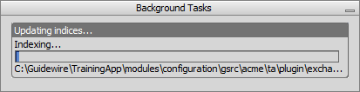
Start Studio: gwb studio
To open the project, run
gwb studio from the command window in root folder
Indexing influences startup times
First time longest
Subsequent starts faster
Possible to work while indexing!
Notes:
In the specific Guidewire application folder root, the .idea directory contains a set of configuration files (.xml). The configuration data for projects and their components is in plain text XML files. Each file contains only a portion of configuration data pertaining to a certain functional area which is reflected in the name of a file, for example, compiler.xml, encodings.xml, modules.xml. These files contain information specific to the project itself, such as names and locations of the project component modules and compiler settings. If using version control for your project, you may want to consider including certain project files.
One exception is the workspace.xml file as this is specific to each individual Guidewire Studio user.
First time start up = Time taken to load the project + finish indexing for the first time.
Second time start up = Time taken to load the project + finish indexing for the second and third times.
In certain cases, you may want to rebuild your indexes. To rebuild you project indexes, you need to clean out the system caches. On the main menu, choose File → Invalidate Caches. Do not open a different app project with Guidewire Studio, use “xx studio” to start a different app. Guidewire Studio memory settings are in memory.properties.

Slide 44
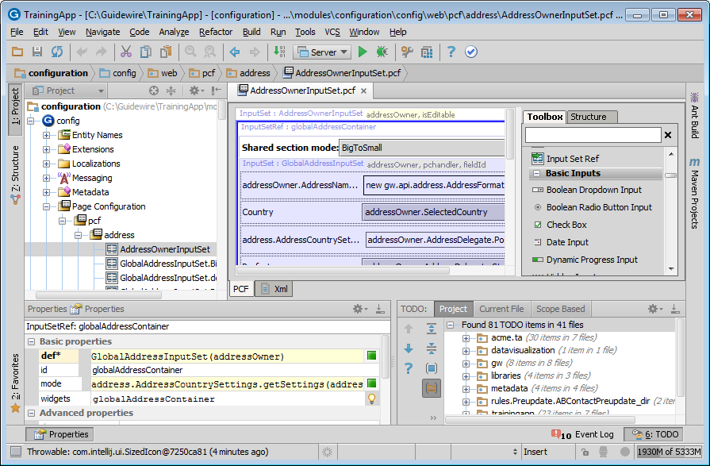
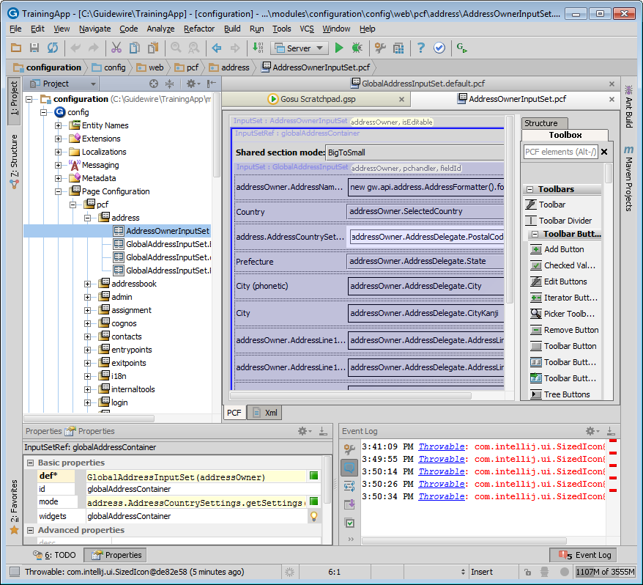
Anatomy of Guidewire Studio
Main menu and toolbar
Navigation bar
Tool Window
Editor
Tool Buttons
Tool Buttons
Tool Window
Tool Window
Tool Buttons
Status Bar
Notes:
1.Menus and toolbars - the main menu and toolbars let you carry out various commands.
2.Navigation bar that helps navigate through the project and open files for editing.
3.The status bar - indicates the status of your project, the entire IDE, and shows various warning and information messages.
4.The editor - here you create and modify the code.
5.Tool windows - secondary windows that provide access to various specific tasks (project management, source code search and navigation, running and debugging, integration with version control systems, etc.).

Slide 45
Main menu and Toolbar
Main menu
Main toolbar
Main menu commands
Open, edit and find files
View tool windows
Navigate class, file, symbol
Analyze dependencies
Refactor and analyze code
Make and rebuild
Run and debug
Gosu Scratchpad
Version control system
Main toolbar buttons
Open, save, and synchronize files
Undo and redo
Cut, copy and paste
Find and replace
Make project
Edit configurations, settings, and structure
Run and debug
Refresh PCF
Gosu Scratchpad
Notes:
Menus and toolbars let you carry out various commands. The main menu and toolbar contain commands that affect the entire project or large portions of it. Most command have an associated keyboard shortcut to enable quicker access to it.
The main menu contains commands for opening, creating projects, refactoring the code, running and debugging applications, keeping files under version control and more.
The main toolbar contains buttons that duplicate the essential commands for quicker access. You can hide the main toolbar, using the checked command on the toolbar context menu.
You can show or hide the main elements of the Guidewire Studio using the View menu.
Descriptions of the actions from all the menus and toolbar buttons are displayed in the left side of the Status bar.
If you know which action you want to perform, but do not know where to find the appropriate command, just press Ctrl+Shift+A and select the desired action from the suggestion list.

Slide 46
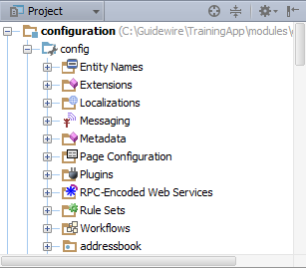
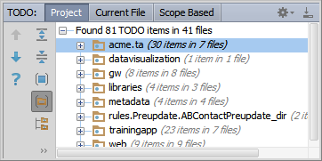
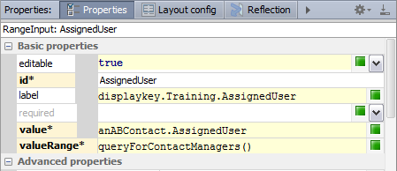

Tool windows
View → Tool Windows
Project
Favorites
TODO
Structure
Properties
Configure your Guidewire Studio environment
Configure window modes
Pinned, Docked, Floating and Split Modes
Notes:
If a given Tool window is in Floating mode, then title bar context menu does not display options for Docked Mode or Split Mode.

Slide 47

Navigation bar
Open with
View → Navigation Bar
ALT+HOME
Always shows the physical file structure names
Alternative to the Project tool window view
Navigate through a project and open files for editing
Notes:
The Navigation bar always shows the physical file structure names for the file open in the Editor.
To show the navigation bar, in the View menu, select the Navigation bar option or press ALT+HOME. To hide the navigation bar, on the View menu, clear the Navigation bar option or click the close icon in the upper-right corner of the Navigation Bar. When the main toolbar is hidden, the Navigation bar shows the run/debug configurator selector, run server, and debug server buttons. If the Navigation bar is already hidden when you press ALT+HOME. it appears in floating mode.
For a type which is internally managed by the Guidewire application, does not expose a physical file, and is open in the Editor, the Navigation bar is empty.

Slide 48
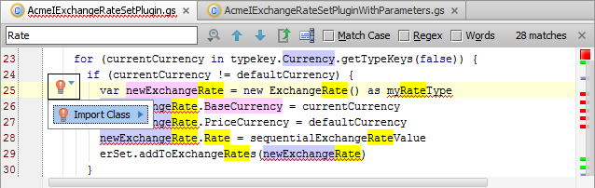
Editor
Document tabs
Find in file
Gutter
Validation side bar
Smart completion
Editor area
Document tabs
Order tabs, switch between files, and split into windows
Editor area
Syntax checker
Smart completion pop-up
Find in file (CTRL+F)
Gutter Area
Line numbers, breakpoints, and icons
Validation side bar
Warnings, errors, comments, TODOs, and highlights
Click to jump to source
Notes:
Guidewire Studio features various editors. It is possible to enable and disable many of the Guidewire Studio Editors. To learn more about working with Guidewire Studio specific editors, refer to the Guidewire Studio Editors lesson.
Editor area: Use this area to type and edit your source code. The editor suggests numerous coding assistance facilities. For example, smart completion pop-up is one of the key editing assistance features that suggests method names, functions, tags and other keywords you are typing.
Gutter area: The left gutter provides additional information about your code and displays the various icons that identify the code structure, bookmarks, breakpoints, scope indicators, change markers and the code folding lines that let you hide arbitrary code blocks.
Gutter icons: Active Gutter Icons you can use to jump between an element's source and usage, for example, collapsing code blocks.
Document tabs: Enable quick navigation across the multiple documents you are working on. Clicking a tab brings its contents to front and makes it available for editing in the active editor. Right click the document tab to open the context menu, CTRL+Click a tab in the editor to navigate to any part of the file path. Select the necessary element in the drop-down, and the corresponding file path is opened in an external browser (e.g., in the Explorer, if your OS is Windows).
Validation side bar / marker bar: This is the bar to the right from the editing area, showing the green, red or yellow box on its top depending on whether your code is okay, or contains errors or warnings. This bar also displays active red, yellow, white, green and blue navigation stripes that let you jump exactly to the erroneous code, changed lines, search results, or TODO items.
Keystrokes: The Escape key (Esc) in any tool window moves the focus to the editor. SHIFT+ESC moves the focus to the editor and also hides the current (or last active) tool window. The F12 key moves the focus from the editor to the last focused tool window.

Slide 49
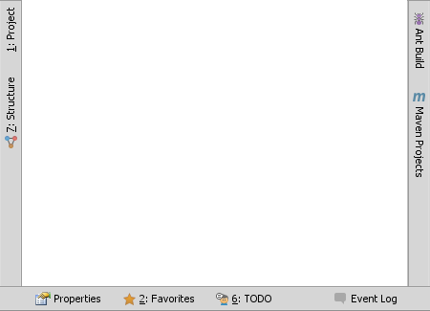
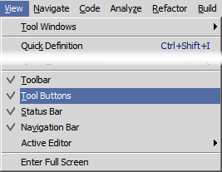
Tool buttons
Toggles open and close specific tool windows
Even if floating and not docked
View → Tool Buttons
Show hidden with ALT+ALT
Toggle hidden tool buttons with Status bar
Notes:
Tool buttons surround the border of the working environment. Tool buttons are easily toggled on and off. You can show the hidden buttons with the ALT+ALT keystroke, but need to hold down the second ALT keystroke.

Slide 50
Status bar
Icon | Description
 | Toggles between showing or hiding tool window bars. ALT+ALT to show hidden tool windows bars.
 | Shows description of a current command or current exception.
 | Opens Background Tasks manager
 | Line number and caret position of cursor in current editor.
 | View and change line endings of the current editor file.
 | View and change encoding of the current file in the editor.
 | Insert key toggles the Insert and Overwrite modes. In the Overwrite mode, the cursor is a rectangle.
 | Indicates if file in the current editor is read-only or writable.
 | Click to edit the code inspection profile settings.
 | Click to show IDE error.
 | Shows the current heap level and memory usage.
Notes:
The status bar indicates the current IDE state and lets you carry out certain environment maintenance tasks.

Slide 51
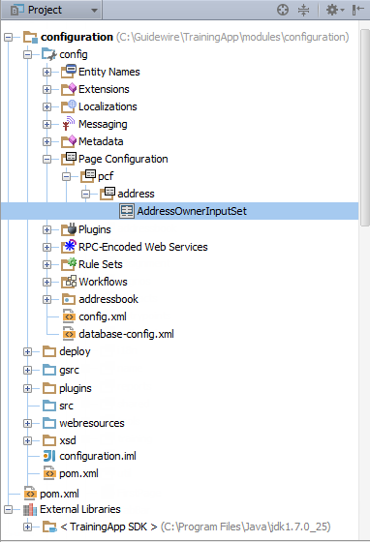
Project Tool Window
Title bar
Open with
View → Tool Window → Project
ALT+1
Project tool button
Title bar
Content pane
Tree views display
Files
Folders
Libraries
SDKs
Content pane
Tree view
Notes:
The Project Tool Window displays physical folders, files, packages, modules, and SDKs, as they exist on disk. In certain cases, a node item in a the hierarchy may use an alias name instead of the physical name. The Navigation bar always shows the physical name and physical path, if it exists.
Within a specific view, the Project Tool Window allows you to perform specific tasks such as creating new directories, packages, files, and classes as well as opening files in the editor and navigating to code.

Slide 52
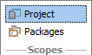
Title bar in Project Tool Window
Scroll from Source
Navigate from file in the Editor to the tree node
Collapse All
Collapses all nodes
Current Configuration
Configure the current view
View modes
Hide
Hide the tool window
Views
Project view (default) shows directory structure and dependencies
Packages view shows package structure and NO dependencies
Notes:
Title buttons include Scroll from Source, Collapse All, Current Configuration, and Hide.
For the open and selected file in the Editor, the Scroll from Source jumps to the specific file in the tree view in the content pane.
Collapse All collapses all folders in the tree view in the content pane.
Use the Current Configuration to open a context menu for configuring the current view and changing the tool window viewing modes. Depending on the viewing mode, the current configuration context menu displays different options than the Title toolbar context menu. Most of the menu items are options that you can enable and disable. Check marked menu options are enabled options.
Click the hide icon to close the tool window.

Slide 53
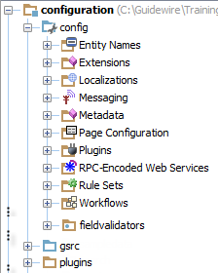
Project view structure
Project files are organized into primary areas of functionality
Data Model
Business Logic
Integration APIs
User Interface
Notes:
The Project View is for TrainingApp 8.0. Some folders and files are removed from the Project View screenshot.

Slide 54
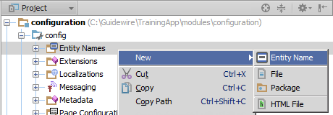
Project view context menu variations
Folder determines context menu options, for example:
\Entity Names\ = Entity Names
\Extensions\Typelist\ = Typelist and Typelist Extensions
\Rules Sets\ = Rules Set Category
Notes:
The file options opens the Register New File Type Association dialog. In most cases, you do not need to associate a new file type with the core configuration setting for Guidewire application in Guidewire Studio.

Slide 55
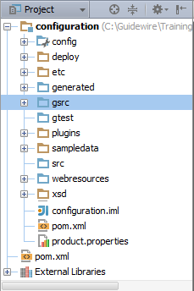
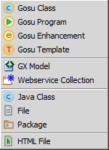
Context menu for \gsrc\
Create your packages, classes, plugins classes, and web services in the \gsrc\ folder
Gosu Class
Gosu Program
Gosu Enhancement
Gosu Template
GX Model
Webservice Collection
Creating Java Class files directly is NOT supported
Notes:
It is possible to add Java classes and JARS to the gsrc directory using file explorer. However, you should not create a Java Class directly in the /gsrc/ folder as this is not supported.

Slide 56
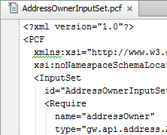
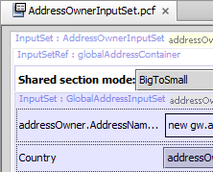
Helpful context menu commands (1)
`
Mark as …
Toggle between editing a file in plain text or with a Guidewire Editor
Plain text has no validation or smart code completion
Notes:
It is possible to switch between using a Guidewire Studio Editor and using the built-in text editor. In certain cases, editing a raw file with a text editor can help fix specific issues, such as highly malformed PCF XML.

Slide 57
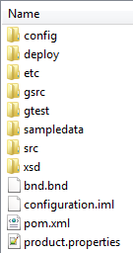
Helpful context menu commands (2)
Revert to Base
Restores file from /modules/base.zip
Replaces the selected file with the original Guidewire application file found in
config
deploy
etc
gsrc
src
Restores only files!
Command not applicable for Rule Sets and Rules
Notes:
You can always determine what is the base configuration for a Guidewire application by looking at the <installDirectory>\modules\base.zip file. Base.zip is a compressed zip file contains the base configuration files for both the platform and the application. The base.zip file is not exposed in the Guidewire Studio project directly. However, for many base application files in Guidewire Studio, you can revert the file back to base file contained in base.zip. Rule folders and files cannot be reverted in Studio back to base. Revert to base only support files and not folders. File and folders both exist, however, in the base.zip file.
It is important to note that rule set categories, rule sets, and rules cannot revert to the original file using the Guidewire Studio revert to base command. However, it is possible to revert to a previous change while using the Show History dialog.

Slide 58

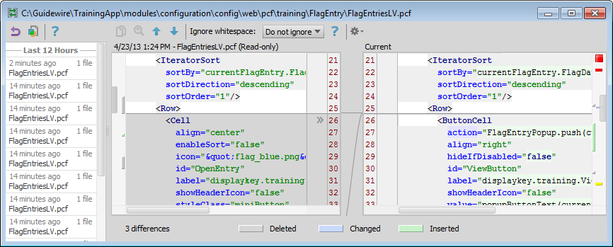
Helpful context menu commands (3)
Local History → Show History
Compare selected version to current
Current pane is editable
Revert to previous change
Use labels to mark points
Notes:
To see your local history of changes in a file, invoke Local History → Show History in the popup menu. You may navigate through different file versions, see the differences and rollback to any previous version. Use the same popup menu item to see the history of changes on a directory. You will never lose any code with this feature!
You can also select Show History from the VCS Operations popup. The keystroke is ALT+`(Back quote)+5 to show the history.

Slide 59
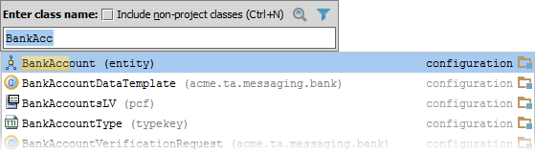
Navigation keystrokes
Navigate
CTRL+N
Class
CTRL+SHIFT+N
File
CTRL+ALT+SHIFT+N
Symbol
Find
CTRL+F
Find in editor
CTRL+SHIFT+F
In path
CTRL+H
View hierarchy
CTRL+E
Recent files
Example: CTRL+N
Notes:
CTRL+N: Use for finding entity, entity name (displayname), library, typelist, pcf, rule, and classes. Some things found are not files, but rather internal items, such as an entity subtype typelist. One way to determine in item is internal or virtual is to see if the Navigation bar is empty.
CTRL+SHIFT+N: Great for finding files like config.xml. Using wildcards (*), e.g., *.wsc, is supported.
CTRL+ALT+SHIFT+N: Find a symbol in related files. This is great for finding which resources contain an enum, method, property, TC_name, etc.
You can bring forward the list of all usages of a class, method or variable across the whole project, and quickly jump to the selected usage. To do that, place the caret at the symbol's name or at its usage in code with ALT+F7 or in a popup frame with Ctrl+ALT+F7. Scroll the list and click the desired usage.
To navigate to the implementation(s) of an abstract method, position the caret at its usage or its name in the declaration and press Ctrl+ALT+B.

Slide 60
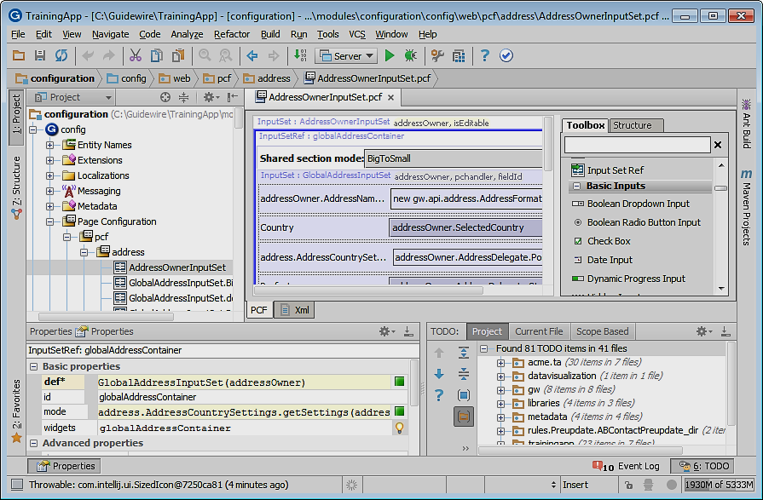
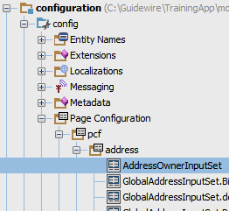
Make, Run, and Debug in Studio!
Make Project
Compiles the solution
Run 'Server'
Starts the application server
Debug 'Server'
Starts the application server in debug mode
Run and Debug have individual console windows
Stop + Run/Debug = Restart server
Notes:
In Guidewire Studio 7, in order to debug an application server, you first need to run the application server in debug mode, start Studio, and then connect to the instance running in debug mode.
In Guidewire Studio 8, simply start Studio. Then, execute the Debug the Server command ALT+SHIFT+F9. If you need to debug your code in Gosu Scratchpad, open Gosu Scratchpad and click Run in Debug Process.
Make Project: All the source files in the entire project that have been modified since the last compilation are compiled. Dependent source files, if appropriate, are also compiled. Additionally, the tasks tied to the compilation or make process on modified sources are performed.

Slide 61
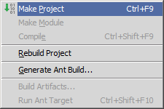
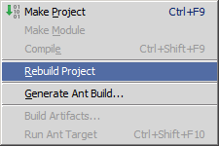
Make and Rebuild project
Make project
Rebuild project
Build → Make project
CTRL+F9
Compiles only modified files since the last compilation
Run → Reload Changed Classes
Available in Debug 'Server'
Build → Rebuild project
All the source files in the project are recompiled
Notes:
Make Project: All the source files in the entire project that have been modified since the last compilation are compiled. Dependent source files, if appropriate, are also compiled. Additionally, the tasks tied to the compilation or make process on modified sources are performed.
Reload Changed Classes: When in Debug 'Server', use this option for hotswapping of changed classes so that the project is made first before reloading classes.
Rebuild Project: All the source files in the project are recompiled. This may be necessary when the classpath entries have changed, for example, SDKs or libraries being used added, removed or altered.

Slide 62
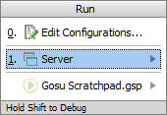
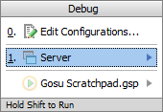
Run and debug server
Run Server ALT+SHIFT+F10
Debug Server ALT+SHIFT+F9
Errors in Messages window
Console information and generated output in Run window
View running instance on Jetty socket and port
Errors in Messages window
Debug window contains
Debugger and Console tabs
Console information and generated output to Console tab in Debug window
View running instance on Jetty socket and port
Notes:
In Guidewire Studio, you can run, debug (and test) your Guidewire application without leaving Guidewire Studio. You can run or debug your project by selecting the Run Server and/or Debug Server menu commands. In certain cases, you can use the SHIFT+F10 keystroke to Run Server and SHIFT+F9 keystroke to Debug Server. However, if you are actively working in Gosu Scratchpad (run/debug/stop), these keystrokes will run and debug, respectively, the code in Gosu Scratchpad! For this reason, you may want to use ALT+SHIFT+F10 and ALT+SHIFT+F9 to open the respective dialogs to run and debug the server instance for your project.
The console information and the generated output are displayed in the Run tool window or the Debug tool window in the Console tab.
The debugger enables you to execute your application step by step, examine program information related to variables, watches, or threads, and change your program without leaving Guidewire Studio. Prior to launching the debugger session, it makes sense to set breakpoints that cause the debugger to suspend the application or take some other actions when breakpoints are reached in code.

Slide 63
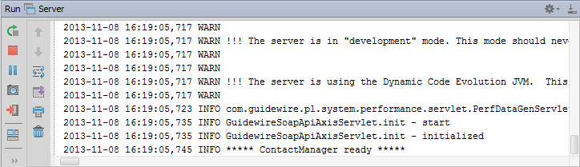
Run Tool Window
ALT+4
Opens Run window
View Run 'Server' application log
Same as console window output
View console output
Gutter commands
Stop server, (Re)run server, Pause Output, Exit run

Slide 64

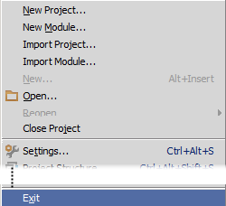
Exit Studio: File → Exit
Do NOT close the project
File → Exit
To properly exit studio
Or, in the Bin command window, enter the exit command

Slide 65
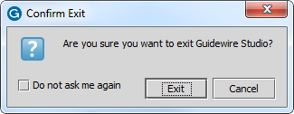
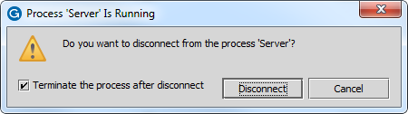
Exiting studio while 'Server' running
File → Exit
Confirm Exit dialog
Process 'Server' is Running dialog
Run 'Server' or Debug 'Server' process still running
To kill the process
Check Terminate the process after the disconnect check box
Click Disconnect
Notes:
If you uncheck the Terminate the process after disconnect check box and then disconnect, the process will remain running in the background meaning that the Guidewire application remains running. This might be your desired intent. However, if you restart studio without killing the process first and try and run or debug the server again, Studio will invoke a BindException. You can manually kill the process using Windows Task Manager in Windows.

Slide 66
Describe the product architecture for Guidewire products
Recall the primary components used to configure Guidewire products
Identify the relationship between the Guidewire platform and the Guidewire applications
Explain the basic functionality of TrainingApp
Start a development instance of a Guidewire application
Describe the purpose of Guidewire Studio

Slide 67
What are the three tiers in the Guidewire application architecture?
What are the four fundamental areas of Guidewire configuration technology?
In which fundamental area of configuration are the following used?
Page configuration files (PCFs)?
Web services, messaging, and plugins?
Gosu?
Data model entities?
How do you start a Guidewire application?
How do you stop a Guidewire application?
Notes:
Answers
1) Data, application, presentation (or user interface)
2) Data model, user interface, business logic, integration mechanisms
3a) User interface
3b) Integration mechanisms
3c) Business logic
3d) Data model
4) Open a command prompt, navigate to the application \bin directory, and execute the start command ("gwXX dev-start" or "gwXX studio").
5) Close the command prompt (or, in the case of Studio, the application window)

