Slide 1
Introduction to the Data Model
Oct 20, 2020
Notes:
Guidewire training materials contain Guidewire proprietary information that is subject to confidentiality and non-disclosure agreements. You agree to use the information in this manual solely for the purpose of training to implement Guidewire software solutions. You also agree not to disclose the information in this manual to third parties or copy this manual without prior written consent from Guidewire. Guidewire training may be given only by Guidewire employees or certified Guidewire partners under the appropriate agreement with Guidewire.

Slide 2
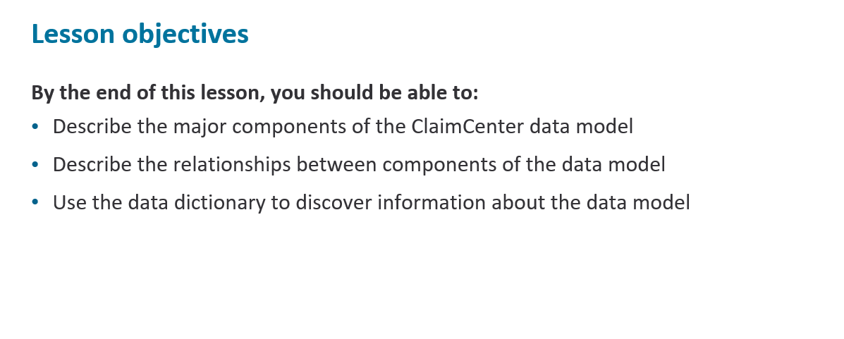

Slide 3
What is a data model
The Data Dictionary
Objects and the data model

Slide 4
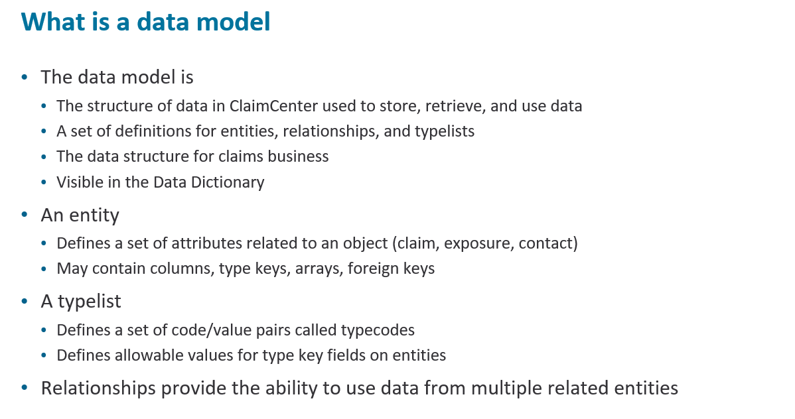
Notes:
The data model in ClaimCenter is a data structure that ClaimCenter uses to store, retrieve and use data. The data is logically grouped into objects called entities. Each entity maintains fields or properties specific to the group of data it represents. For example, the activity entity maintains data pertaining to activities. It also maintains relationships to other entities, as needed. An activity may be related to a claim, exposure or a matter. These relationships provide ClaimCenter the ability to use data from multiple entities in a meaningful way.
A typelist is similar to a reference or lookup table in other applications. For example, every claim has a status, which is stored as a reference to a typelist, whose values include draft, open, and closed.

Slide 5
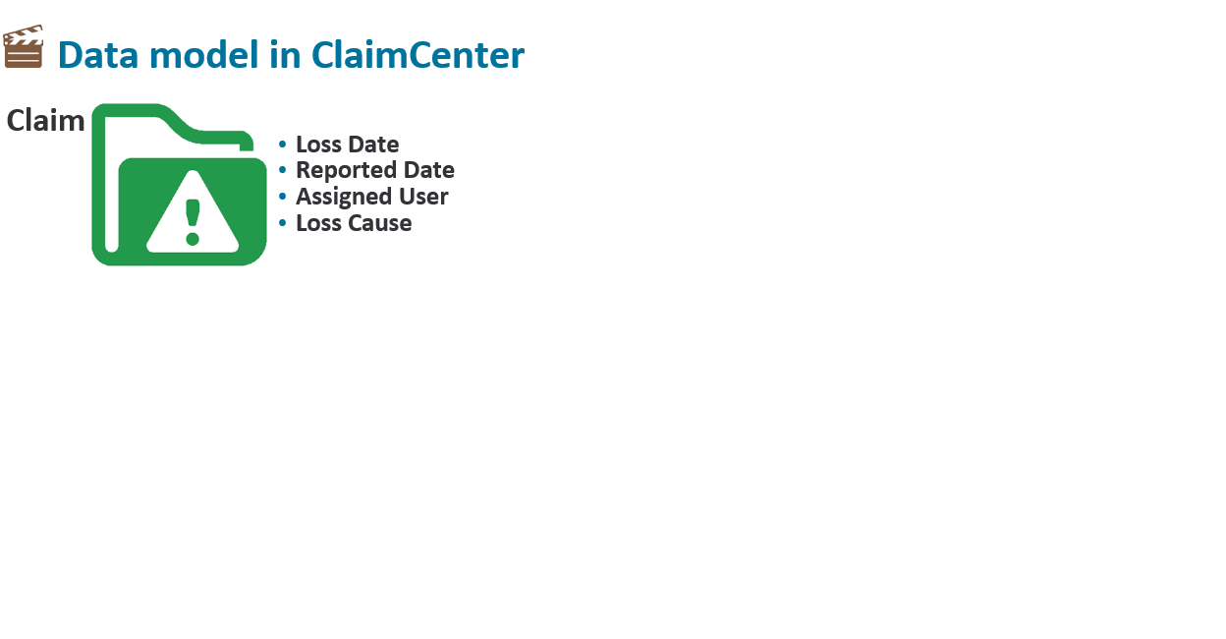
The main entity in ClaimCenter is the Claim.
Anything of significance that happens in ClaimCenter will somehow relate to the claim entity.
Although the claim is a major entity, most of the information on a claim is derived from relationships to other entities.
Some basic data that relates directly to the claim is the Loss Date, Reported Date, Loss Cause, Description.
.

Slide 6
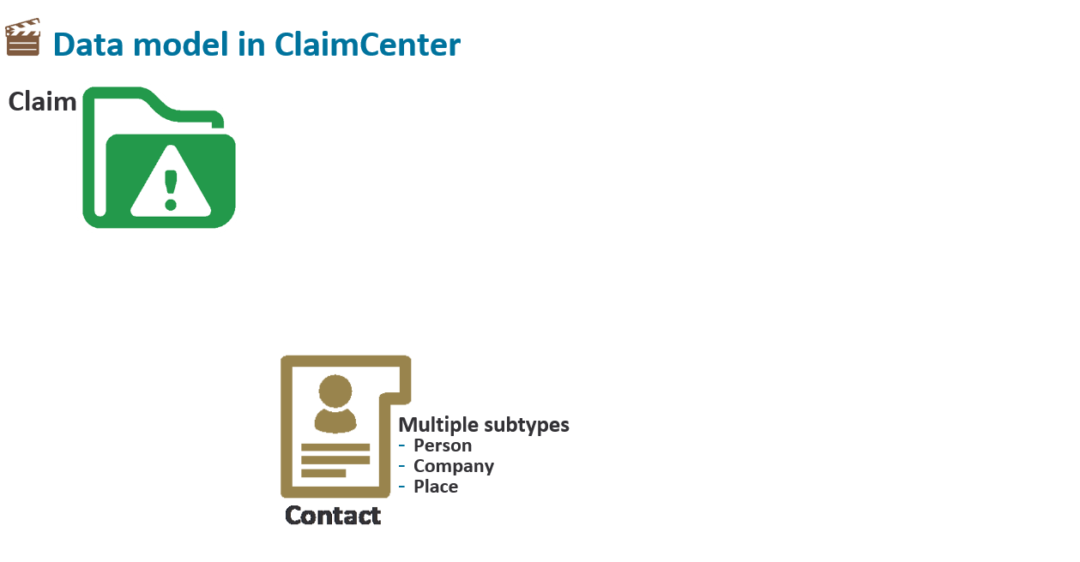
The Contact entity stores information about contacts of interest to the business.
Contacts are usually a person, organization or vendor who has a relationship to a claim.
Commonly used types of contacts are Person, Company and Place.
.
Notes:
The Contact entity stores information about contacts of interest to the business. Contacts are usually a person, organization or vendor who has a relationship to a claim. Commonly used types of contacts are Person, Company and Place.

Slide 7
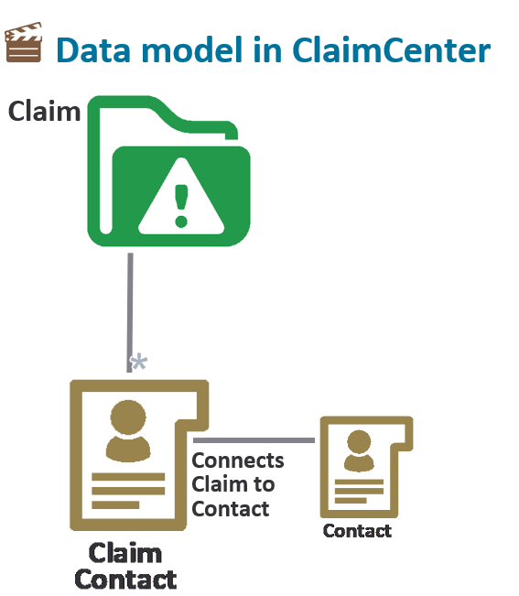
ClaimContact exists to manage the multiple relationships a Contact may have with a claim.
The relationship of Contact to ClaimContact is one to one, which means that a single Contact may be related to only one ClaimContact.
If a contact has multiple relationships to a claim, there will be multiple ClaimContact rows to reflect those relationships.
Notes:
For example, a contact on an automobile accident may be an injured party, a witness, or a reporter.

Slide 8
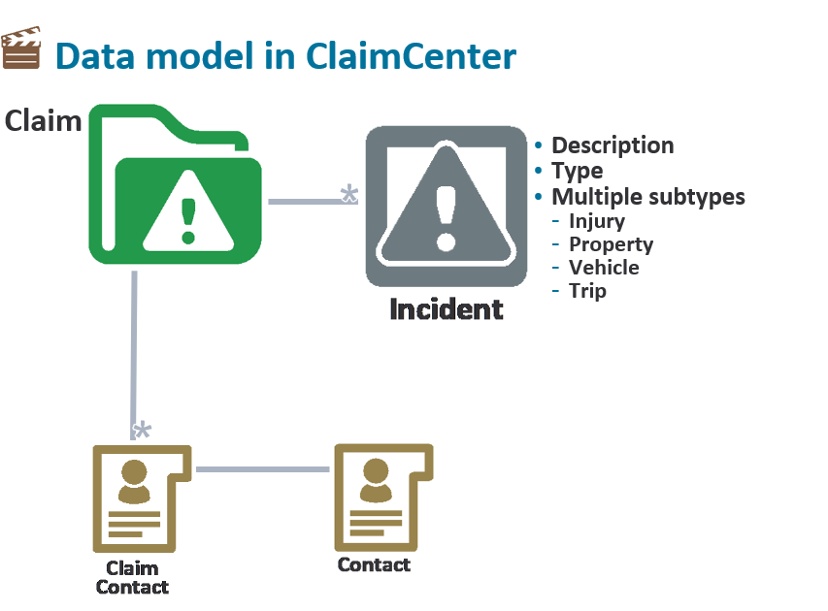
Notes:
An incident is an item that was lost or damaged, such as a vehicle, property, or person suffering one or more injuries. An incident may belong to the insured or to a third party, which would involve liability coverage. Incidents are typically captured when the claim is first created. Some information about incidents may need to be gathered later, but the most ideal circumstance involves an intake process where all the information about the "what“ or incident is captured. A claim may have multiple incidents. For example, a vehicle accident may have several vehicles involved, each one would be an incident. If there were injured parties, each injured party would also be an additional incident on the claim.

Slide 9
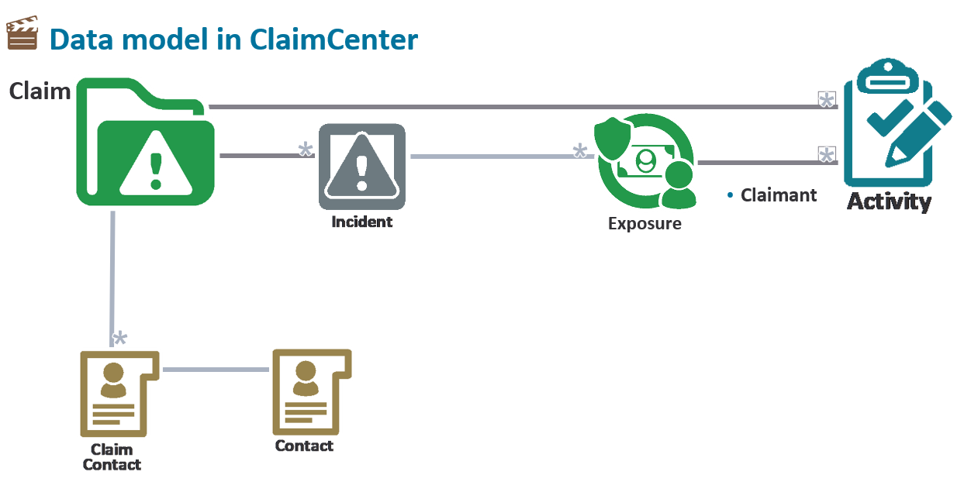
Notes:
Exposures are the mechanism used by ClaimCenter to track the progress of each possible compensation payment for a loss.
In Policy Administration Systems, an underwriter looks at possible coverages as exposures. In ClaimCenter, an exposure is used to track possible payments. Exposures associate a claimant with a particular policy coverage and coverage subtype.
Activities are tasks required to process a claim. Each activity is a single task that can be assigned to a person and completed, including work that cannot be completed directly in ClaimCenter. ClaimCenter tracks the assignment and completion of all activities to ensure that the claim is handled correctly. Activities store information about what needs to be done, who does it, and a history of the activity after it is completed. Activities themselves do not store the results of the work. Completing an externally stored, signed agreement document, adding a note to summarize investigation results, and contacting the insured are some common activity examples.

Slide 10
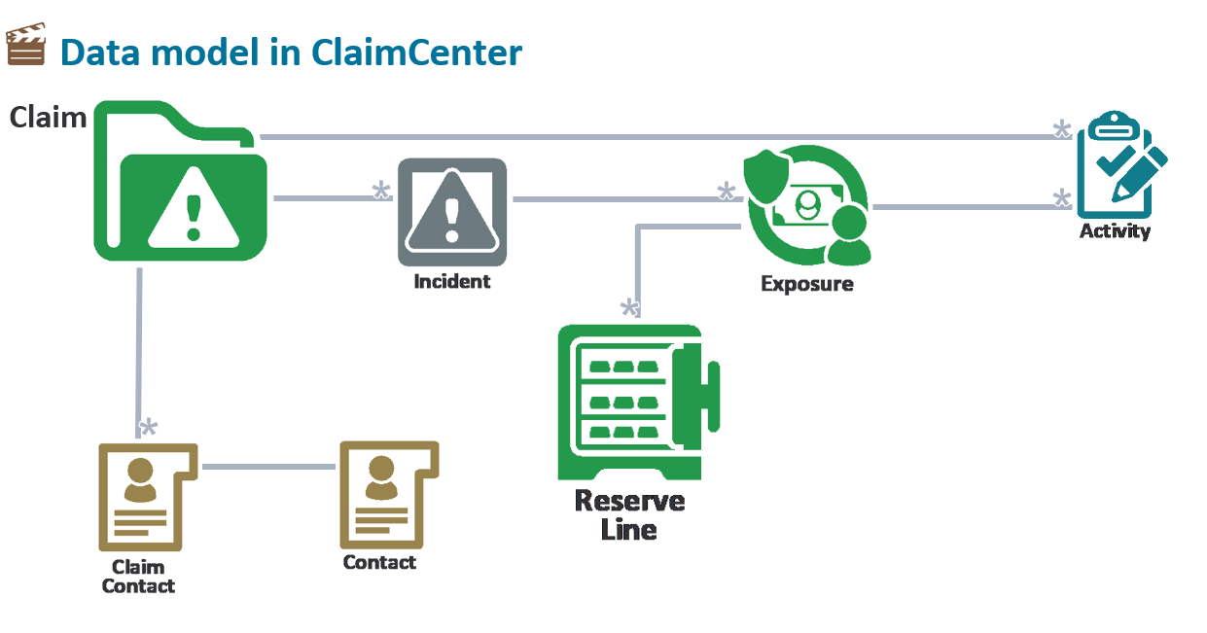
Notes:
A reserve line is an amount of money set aside for expected payments related to a given exposure. A reserve line can be thought of as an account set aside for one specific aspect of exposure processing containing both credits and debits. Every exposure ultimately has one or more reserve lines. An exposure may have a single reserve line, however, it could also have several reserve lines if there are multiple sets of money for different purposes that must be tracked. For example, an exposure for a collision coverage could have a separate reserve lines for auto body damage to make the claimant whole, and an expense reserve line for the cost of doing business, such as performing inspections.

Slide 11
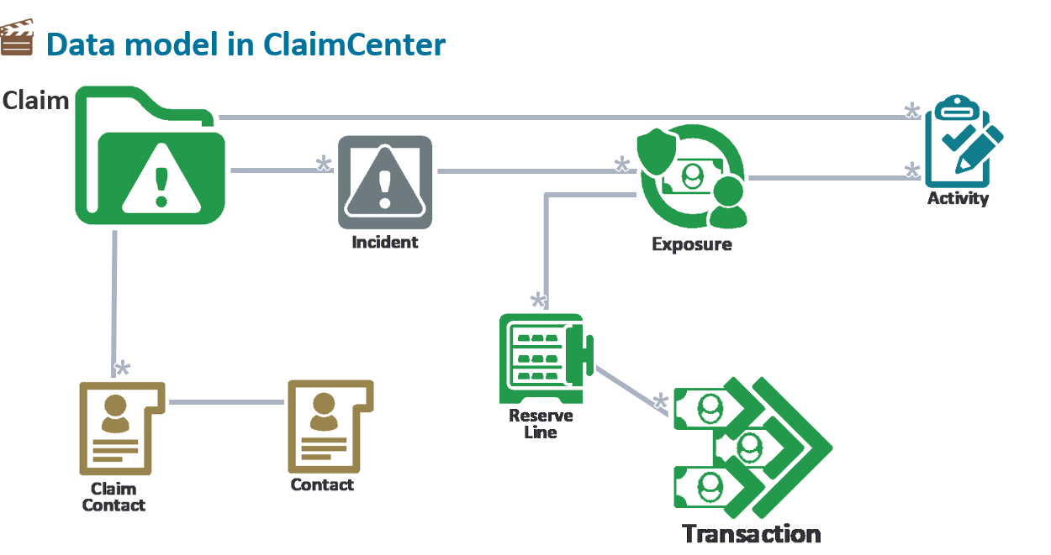
Notes:
A transaction tracks a single financial event, including credits and debits to the reserve line. A credit to a reserve line occurs when an adjuster increases the available reserves. A reserve increase would occur if the original reserve amount is not high enough to cover the loss. One example of a debit to the reserve line is a payment is made against that reserve line. The credits minus the debits results in the total remaining reserve line.

Slide 12
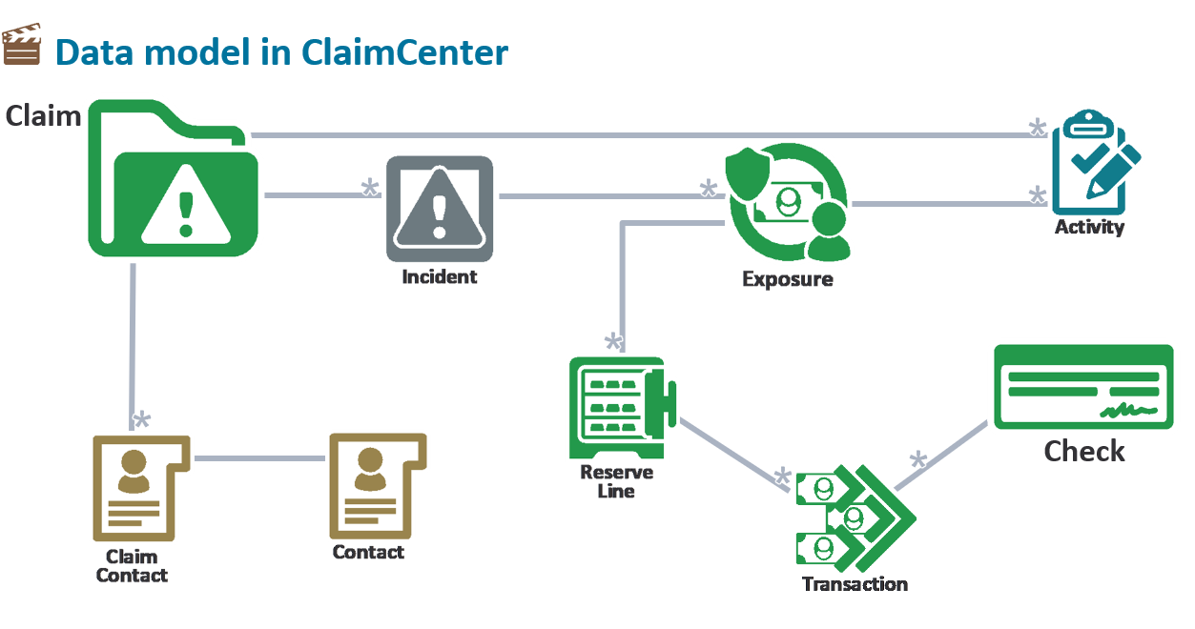
Notes:
The check entity holds information specific to a payment. Although the term used here is check, it actually means any form of payment including physical paper checks or electronic fund transfers. Along with the relationships to the transaction and claim contact, it maintains information such as PayTo, GrossAmount, BankAccount, and CheckInstructions.

Slide 13
What is a data model
The Data Dictionary
Objects and the data model

Slide 14
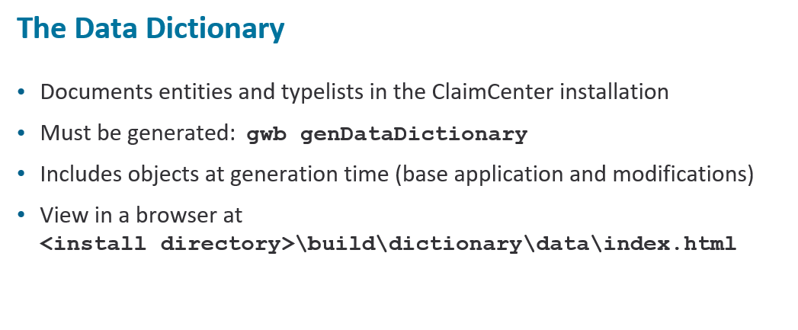
Notes:
The ClaimCenter Data Dictionary documents all the entities and typelists in a ClaimCenter installation. The dictionary documents both the base ClaimCenter data model and your extensions, provided that you regenerate it following any data model customization. Using the Data Dictionary, you can view information about each entity or typelist.
The Data Dictionary must be manually generated after installing Guidewire ClaimCenter. Guidewire strongly recommends that you perform this task as part of the installation process. Also, as the data model is extended, it is important that the Data Dictionary be regenerated in order to include your extensions in the data dictionary. To generate the ClaimCenter Data Dictionary, run gwb genDataDictionary using a command line from the ClaimCenter directory. ClaimCenter stores the Data Dictionary in<install directory>/build/dictionary/data/. To view the Data Dictionary, open the index.html file in that directory.

Slide 15
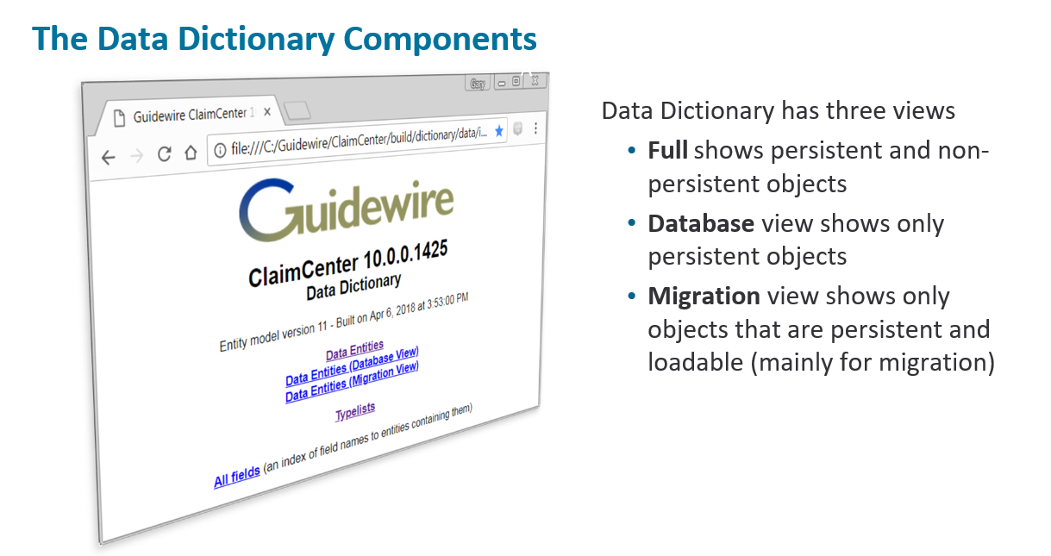
Notes:
The Data Dictionary contains three kinds of data entity views: full, database, and migration. The Data Entities link is the full view.
•The full view shows both the persistent and virtual (non-persistent) entities, and includes columns, typekeys, arrays, foreign keys, derived arrays, derived properties, and subtypes for each entity,
•The database view shows all non-virtual, or persistent, entities and their definitions.
•The migration view shows only persistent, loadable entities, columns and their definitions. The columns createUserId and createTime are examples of non-loadable columns. This view is used primarily for developing migration plans for legacy systems

Slide 16
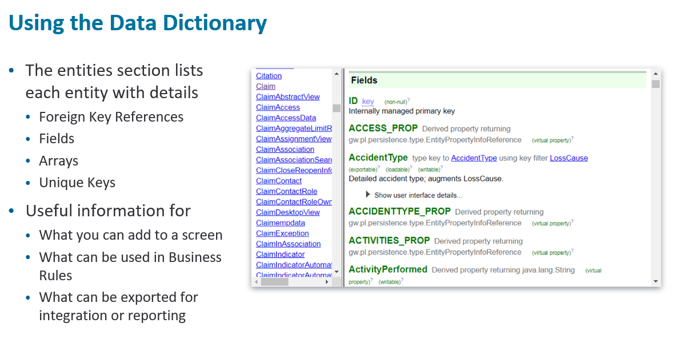
Notes:
The Data Dictionary provides details about each entity and TypeList used in ClaimCenter. Those details are useful to understand how each part of a claim, maintained on separate entities, relates to the others. It is also useful to know the details (fields, arrays, foreign keys) that are on each of the entities. Those aspects are useful when deciding what fields you can add to a view (or screen), use in Business Rules or what you can export for integration or reporting.

Slide 17
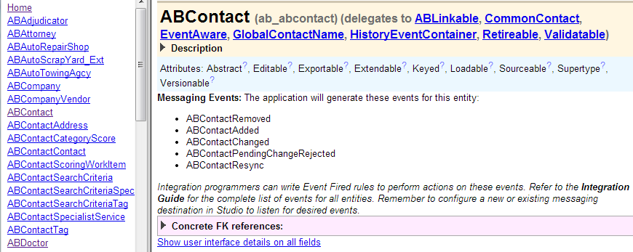
Entities in the Data Dictionary
Entities section lists each entity and information about it
To view information about given entity, click its name
Hyperlink document is fully navigable
Notes:
To view the Data Entities section of the data dictionary, click the "Data Entities" link on the Data Dictionary home page.

Slide 18
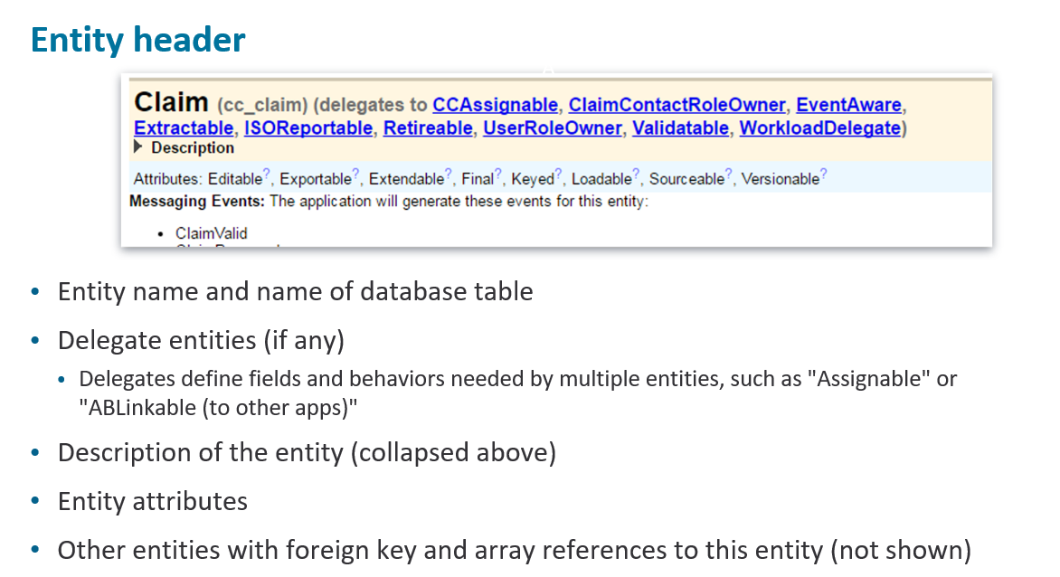
Notes:
The Data Dictionary shows details about the selected entity, showing the name of the entity and the associated database table along with any delegates it may have. A delegate is an abstract entity that defines a set of fields and methods needed by other entities to enable a specific behavior. Any entity that needs that behavior is assigned that delegate entity. For example, ClaimCenter has four entities that can be assigned to users: claim, exposure, activity and matter. It also has an assignable delegate entity that contains the fields and methods needed for assignment (AssignedUser and AssignedGroup). The entities claim, exposure, activity, and matter all delegate to this entity, therefore, all have the fields and methods required for assignment. The dictionary also shows a list of attributes within the entity as well as other entities which have a foreign key reference to the entity.

Slide 19
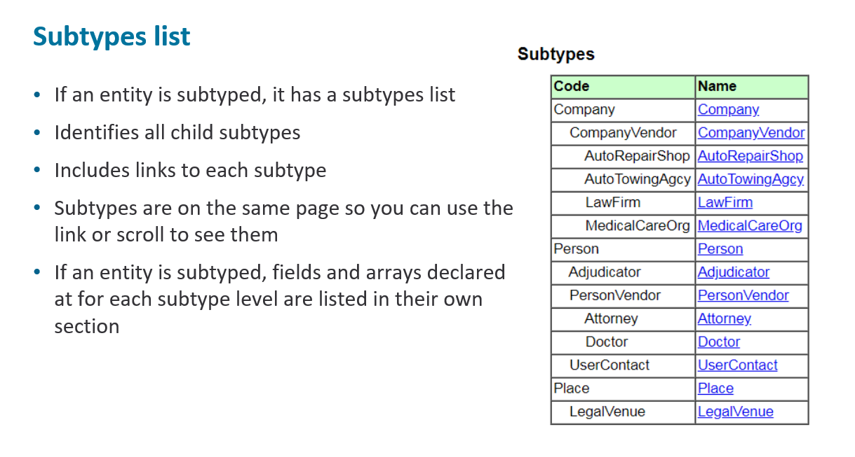
Notes:
The full, database, and migration views separate entity subtypes from the main entity supertype. A supertype relates to a subtype in a parent-child relationship. This example shows the Contact entity and all of its subtypes. The Contact entity has three (3) subtypes: Company, Person, and Place. Company is subtyped as CompanyVendor, which is further subtyped. Person is subtyped as Adjudicator, PersonVendor, and UserContact.
Subtypes, like PersonVendor, inherit all of the attributes of their supertype and have attributes that are specific to that subtype, in this case, PersonVendor

Slide 20
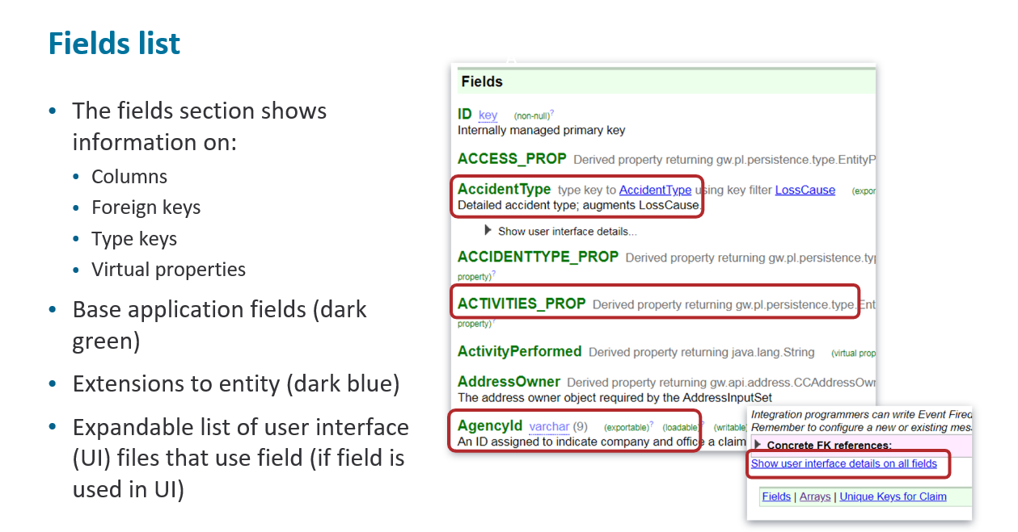
Notes:
On the entity page, there is a section for Fields which shows information about each field on the entity. It includes columns, foreign keys, type keys and virtual properties. Properties that are part of the base application are shown in dark green, whereas entity extensions are shown in dark blue. If a property is virtual, then its data type is listed as "Derived property returning some data type“.
The dictionary also includes a link to show all of the User Interface (UI) elements that use a specific property. When that link is selected, each field used in the user interface includes a table that shows the specific screen, the label, and the value of the property on the screen.

Slide 21
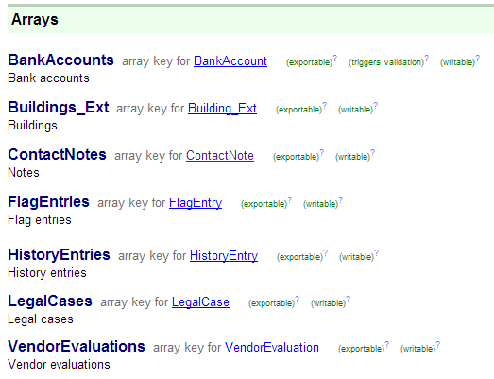
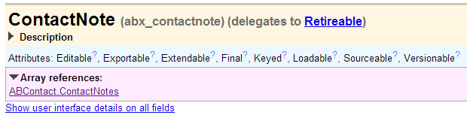
Arrays
Each array includes a link to an entity stored within an array
Data dictionary shows the linkage

Slide 22
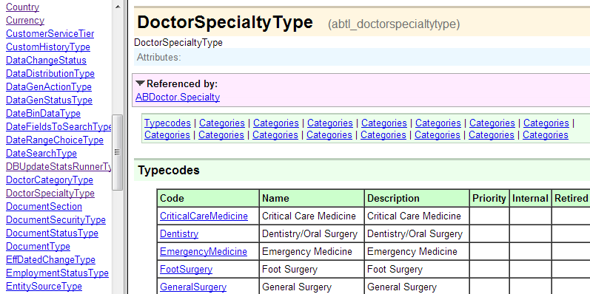
Typelists in the Data Dictionary
Typelists section lists each typelist and its typecodes
To view information about given typelist, click its name
Notes:
To view the Typelists section of the data dictionary, click the Typelists link on the Data Dictionary home page.
You can view the typecode and name for all elements in the list. You can also access typelists from the main page or from a typekey field.

Slide 23
What is a data model
The Data Dictionary
Objects and the data model

Slide 24
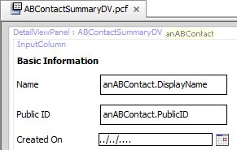

Data model entities in application architecture
database
application server
user interface
data model entity
internal Gosu class
page configuration file
ABContact
ABContact
Fields Name PublicID CreateTime ...
UI form with data
ab_abcontact
read from db
display in UI
Database table row
anABContact
update to db
modify in UI
instance of Gosu class
Notes:
For every data model entity, the application automatically creates an internal Gosu class with the same name. For every field in the data model entity, there is a field in the corresponding internal Gosu class. For example, the ABContact data model entity has a "FaxPhone" field, and the internal ABContact Gosu class also has a "FaxPhone" field.
The Gosu classes that map to data model entities are internal and cannot be manipulated directly. However, it is possible to add things to them indirectly.
You can add fields to base application entities as discussed in the "Extending Base Entities" lesson.
You can add fields to a custom entity as discussed in the "Creating New Entities" lesson.
You can add methods to any entity as discussed in the "Enhancements" lesson.
Gosu classes that are automatically created from data model entities are sometimes referred to as "database-backed classes" because these classes have corresponding database tables, and instances of these classes can be saved to the database. Whenever a row is read from a database table, an instance of the corresponding Gosu class is created, and the data is placed into that instance. The data in this instance can then be displayed in the user interface and modified by the user prior to saving the data. Whenever the data in a run-time instance of a database-backed class is changed and saved, that data gets written to the corresponding database table. If the data was initially read from the database (such as when a user looks for an existing ABContact and then modifies it), the existing database row is updated to reflect the changes. If the data was created entirely in the run-time environment (such as when a user creates a new ABContact), then a new row is inserted into the database table.
It is also possible to create Gosu classes that are not database-backed. Instances of those classes can be created and modified during runtime, but they cannot be saved to the database. These types of classes are discussed in detail in the "Gosu Classes" lesson.

Slide 25
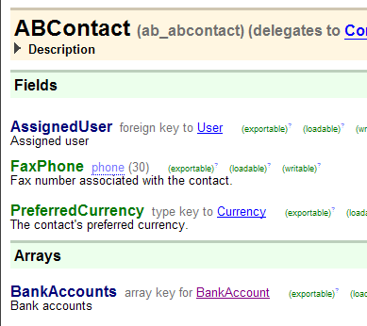
Dot notation
Dot notation is a Gosu language syntax used to identify data objects and properties
Starts with object and ends with field, related object, or related array
Relies on data model
Not used to configure data model
Available for User Interface configuration and Gosu classes
Examples include data fields, object collections, and methods
anABContact.FaxPhone
Notes:
Dot notation is a language syntax used to identify data elements such as text fields, related objects or collections of objects. The syntax is not used in data model configuration itself. It is useful to mention at this point in time because the data model definition informs the possible dot notation expressions for referencing entity data in code.

Slide 26
Dot notation syntax
Referencing data field on given object
object.field
anABContact.FaxPhone
Referencing field on related object
object.foreignKey.field
anABContact.AssignedUser.JobTitle
anABContact
FaxPhone
anABContact
(User object)
AssignedUser
JobTitle

Slide 27
Dot notation syntax (2)
Referencing array on given object
object.array
anABContact.BankAccounts
Referencing field at subtype level
(object as subtype).field
(anABContact as ABPerson).DateOfBirth
anABContact
(array of BankAccount objects)
BankAccounts
anABContact
ABPerson
DateOfBirth
Notes:
Referencing fields at the subtype level is discussed in detail in the "Subtypes" lesson and in the "Atomic Widgets" lesson.

Slide 28
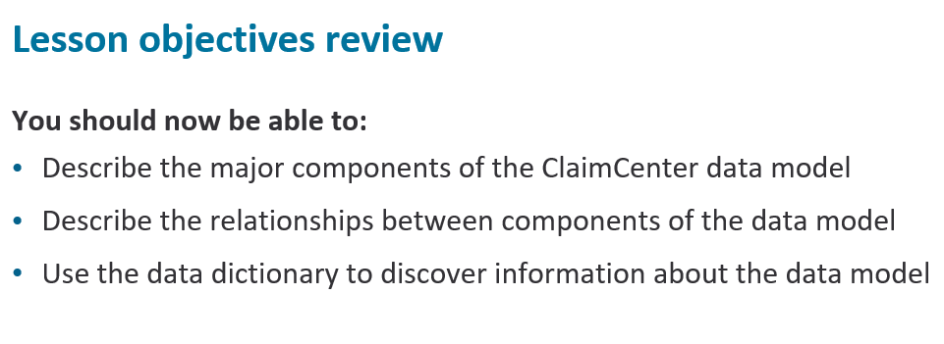
Reference entity fields using dot notation

Slide 29
HowdoesClaimCentermanageacontactthathasmultiplerelationshipstoaclaim?
What is an incident ?
What is an exposure ?
Notes:
Answers
1. Through the ClaimContact entity
2. An incident is an item that was lost or damaged, Such as a vehicle ,property or person suffering one or more injuries
3. Exposures arte the mechanism used by ClaimCenter to track the progress of each possible payment in compensation for a loss

