Slide 1
Cloud Automation Manager

Slide 2
Project Objective
To capture the events , incidence and correlation by using IBM Cloud Automation Manager and convey the same to the clients by using IBM Watson.

Slide 3
Functional Requirements
Leveraging IBM Cloud Event Manager to capture the events like low storage, thrashing, crashing of containers etc. and direct them to deployed service instances of Cloud Automation Manager.
Develop a conversation BOT by using IBM Watson API’s that can process natural language queries regarding the health status of the provisioned Virtual Machines, containers. Publishing errors and warnings to the user and respond to different events received from event manager.

Slide 4
Infrastructure :
IBM Cloud Private (ICP):
IBM Cloud Private is a reliable and scalable cloud platform that runs on infrastructure.
It’s built on open-source frameworks, like containers, Kubernetes and Cloud Foundry, with common services for self-service deployment, monitoring, logging and security, as well as a portfolio of middleware, data and analytics.
Cloud Automation Manager(CAM) :
IBM Cloud Automation Manager (CAM) is a cloud management solution on IBM Cloud Private (ICP) for deploying cloud infrastructure with an optimised user experience. This infrastructure can be present across different cloud providers.
CAM helps to create and edit templates and services that implement common business patterns and to deploy them in cloud environment.

Slide 5
Infrastructure :
IBM Cloud Event management :
Provides the ability to promptly and automatically identify, triage/ assess, events and incidents and used to investigate, diagnose & resolve prioritized incidents.
IBM Watson API :
IBM Watson Assistant is a question-and-answer system that provides a dialog interaction between the conversation system and users.
Simple and easy-to-use interface
Connects to messaging channels
Knows what your bot is missing
Provide complex responses

Slide 6
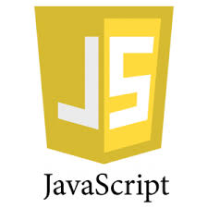
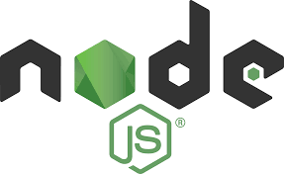

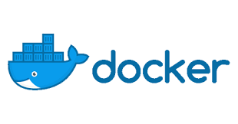
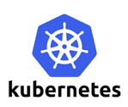
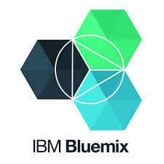
Tech Stack

Slide 7
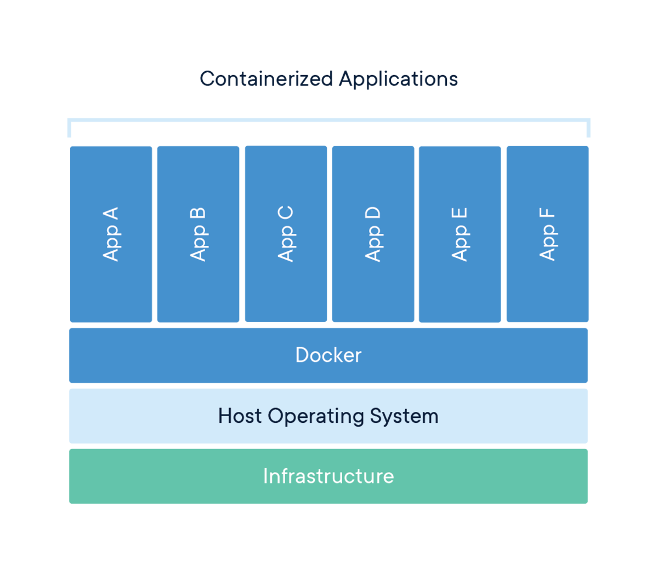
Docker
Docker : A tool designed to make it easier to create, deploy, and run applications by using containers.
Containers : allow a developer to package up an application with all of the parts it needs, such as libraries and other dependencies, and ship it all out as one package.
Docker containers that run on Docker Engine are:
Standard
Lightweight
Secure

Slide 8
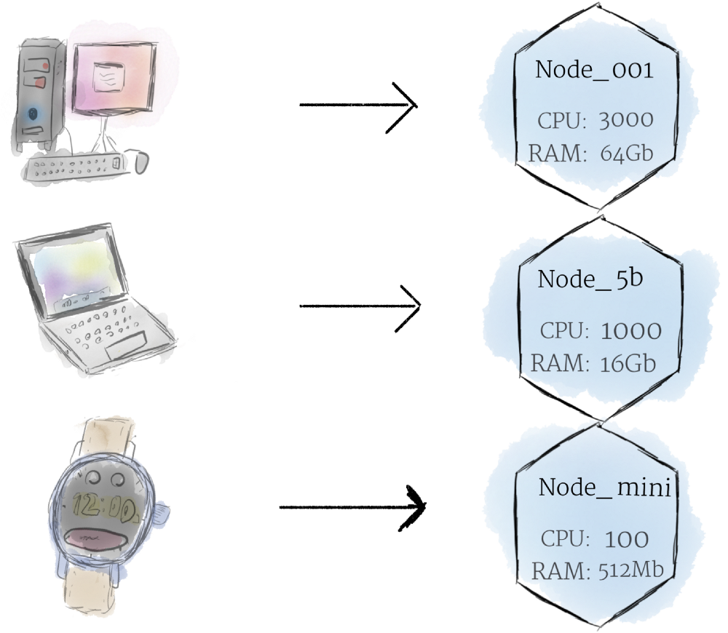
Kubernetes
Kubernetes is an open-source container-orchestration system for automating deployment, scaling and management of containerized applications.
Hardware:
Nodes:
the smallest unit of computing hardware in Kubernetes. It is a representation as a single working machine in your cluster.
In most production systems, node will likely be either a physical machine in datacenter, or virtual machine hosted on a cloud provider.

Slide 9
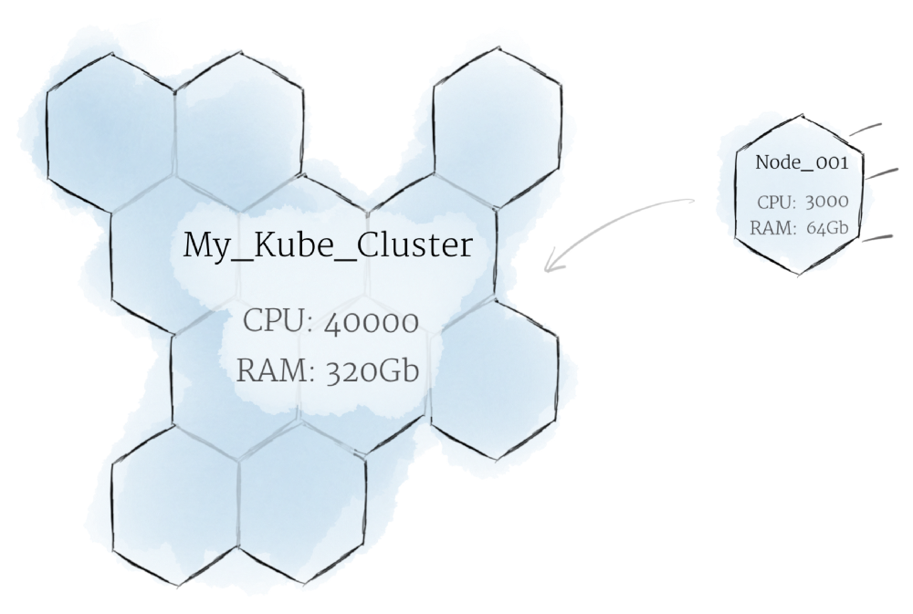
Kubernetes
Kubernetes is an open-source container-orchestration system for automating deployment, scaling and management of containerized applications.
Hardware:
Cluster: Collection of Nodes.
Nodes pool together their resources to form a more powerful machine.
When you deploy programs onto the cluster, it intelligently handles distributing work to the individual nodes for you. If any nodes are added or removed, the cluster will shift around work as necessary.

Slide 10
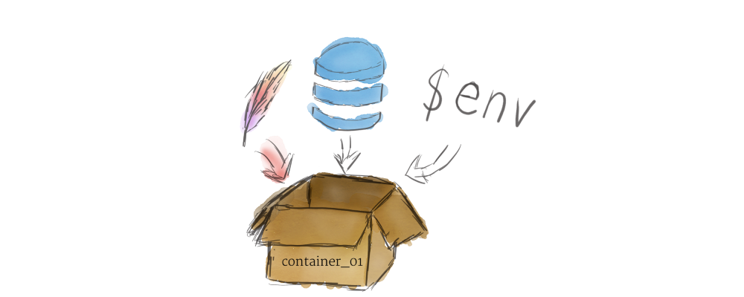
Kubernetes
Kubernetes is an open-source container-orchestration system for automating deployment, scaling and management of containerized applications.
Software:
Containers:
A container is a standard unit of software that packages up code and all its dependencies so the application runs quickly and reliably from one computing environment to another.

Slide 11
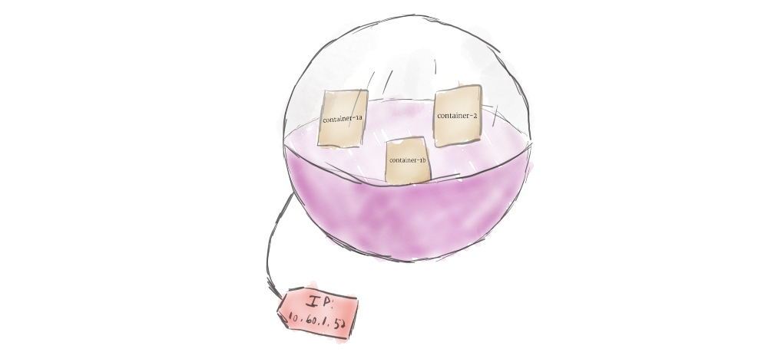
Kubernetes
Kubernetes is an open-source container-orchestration system for automating deployment, scaling and management of containerized applications.
Software:
Pods : unit of replication in Kubernetes.
Kubernetes doesn’t run containers directly; instead it wraps one or more containers into a higher-level structure called a pod.
Containers in the same pod will share the same resources and local network. Containers can easily communicate with other containers in the same pod as though they were on the same machine while maintaining a degree of isolation from others.

Slide 12
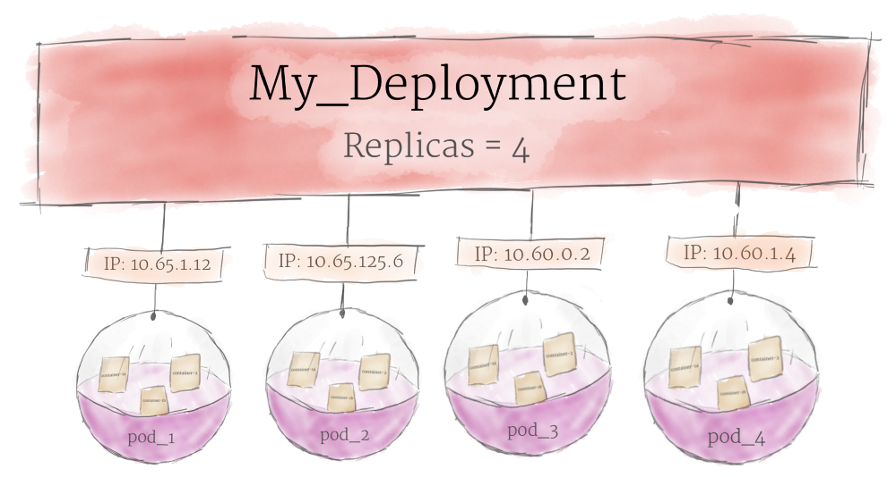
Kubernetes
Kubernetes is an open-source container-orchestration system for automating deployment, scaling and management of containerized applications.
Software:
Deployments :
pods are managed by one more layer of abstraction: the deployment.
deployment is added to the cluster to declare how many replicas of a pod should be running at a time.
If a pod dies, the deployment will automatically re-create it.

Slide 13
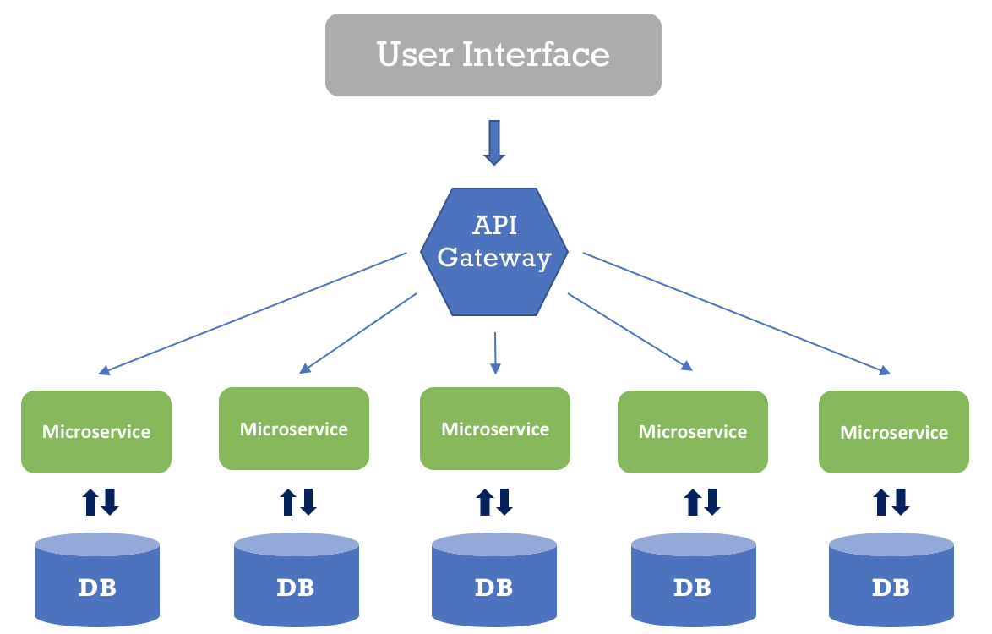
Micro Services
The central idea behind microservices concept:
Applications become easier to build and maintain when they are broken down into smaller, composable pieces which work together.
Each component is continuously developed and separately maintained, and the application is then simply the sum of its constituent components.

Slide 14
IBM Bluemix
IBM Bluemix is a cloud platform as a service developed by IBM.
Supports several programming languages and services as well as integrated DevOps to build, run, deploy and manage applications on the cloud.
Enables to rapidly create, deploy, and manage cloud applications.
Bluemix provides a dashboard to create, view, and manage applications and services as well as monitor application's resource usage.

Slide 15
JavaScript ,Nodejs And LoopBack
JavaScript :
an object-oriented computer programming language commonly used to create interactive effects within web browsers.
Node Js :
Node.js is a platform built on Chrome's JavaScript runtime for easily building fast and scalable network applications.
Loopback:
It is open source Node.js framework that enables you to quickly create dynamic end to end REST APIs and connect to backend systems such as databases, SOAP or REST services.

Slide 16
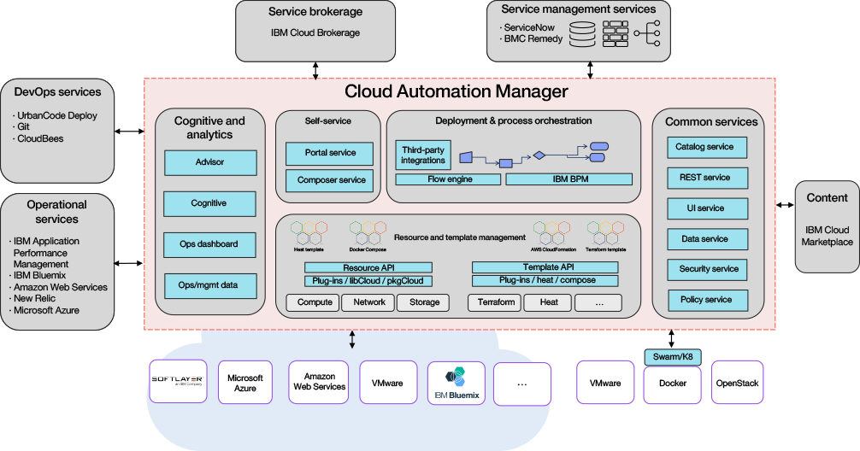
Architecture

Slide 17
Project Workflow
Start
Capturing Events
Configuring incoming integrations
Managing users and groups
Use REST API
Managing Outgoing integrations
Managing Schedules
Managing Runbooks
Analysis of pattern to predict probable events in future and implement particular policy to avoid it.
End

Slide 18
Advantages :
Identifying Problems
Allows users to see how multiple events from different sources are related and communicate the client regarding it through chatbot.
Incident Prioritization
Seeing the most mission-critical incidents in prioritized order allows your team to focus attention and action effectively.
Centralized Knowledge Base for DevOps
Access to runbook guidance created by subject matter experts across multiple regions and time zones, empowers your team to solve complex and routine problems faster.

Slide 19
Future Scope
Analysis of event data in order to derive pattern and gain meaningful insights.
A failure prediction based on predictive analytics models can identify an upcoming failure condition in advance
Based on this, action can be taken to manage the cloud efficitently.

Slide 20
Conclusion
The starting point for this solution is the IBM Cloud Automation Manager product on Bluemix.
The platforms includes cognitive capabilities for human-computer interaction and cognitive cloud operations.

Slide 21
References
1. https://www.ibm.com/support/knowledgecenter/en/SS2L37/product_welcome_cloud_automation_manager.html
2. https://www.ibm.com/support/knowledgecenter/SSURRN/com.ibm.cem.doc/index.html
3. https://console.bluemix.net/docs/services/conversation/getting-started.html#gettingstarted

Slide 22
Thank You
B150204380
B150204382
B150204394
B150204400

