Slide 1

Predictive Modeling and Analysis of Health
Insurance Claims Using Machine Learning
Vidya Sri-BL.EN.U4CSE22120
Sripriya-BL.EN.U4CSE22121
Likhitha Sri-BL.EN.U4CSE22125
Department of Computer Science & Engineering,
Amrita School of Engineering, Bengaluru

Slide 2
Overview
Introduction
Problem Statement
Background and Motivation
Literature Review
System Architecture
Methodology
Results and Analysis
Conclusion
Future Work
References
AGENDA

Slide 3
Introduction
Importance of Claims Forecasting in Insurance: Claims forecasting is essential for setting appropriate premiums, managing financial risks, and ensuring the profitability of insurance companies. Accurate predictions prevent underpricing or overpricing, impacting long-term profitability, business planning, and solvency capital.
Traditional vs. Machine Learning Approaches: Traditional claims forecasting relies on historical patterns and probability distributions, categorizing claims into small (frequent) and large (severe) events. Machine Learning (ML) techniques like SVM, Decision Trees, Random Forests, and Boosting provide greater accuracy. These methods enhance predictions and help identify key variables in insurance portfolios.
Advantages of ML in Insurance: ML improves fraud detection, client engagement, and operational efficiency in insurance. Significant examples include a healthcare readmission prediction model with 90.69% accuracy and fraud detection in India’s health insurance sector. Innovations like the Automated Doctor Machine in rural India highlight ML’s broader potential in healthcare and insurance.
INTRODUCTION

Slide 4
PROBLEM STATEMENT
Accurately forecasting health insurance claims is critical for determining appropriate premiums, managing financial risks, and ensuring profitability. Traditional methods relying on historical patterns often fail to capture complex relationships in claims behavior, leading to underpricing or overpricing and impacting long-term sustainability. The need for more precise predictions has driven the exploration of machine learning (ML) techniques, which can handle intricate patterns, identify key influencing variables, and enhance operational efficiency. This study addresses the challenge of improving claims forecasting accuracy using ML algorithms to optimize pricing, manage risk, and support data-driven decision-making in health insurance.

Slide 5
BACKROUND AND MOTIVATION
Health insurance is crucial for protecting individuals and businesses from financial burdens caused by medical expenses. Accurately forecasting claims is vital for setting fair premiums, managing risks, and ensuring profitability. Traditional methods often fail to capture complex claims patterns, leading to underpricing or overpricing, which can result in financial losses or customer dissatisfaction. Machine learning (ML) offers advanced capabilities to address these challenges by analyzing intricate relationships and providing more accurate predictions. Algorithms like Ridge Regression and Random Forest process large datasets, identify key factors, and optimize pricing strategies. By adopting ML, insurers can enhance operational efficiency, improve customer satisfaction, and maintain profitability in a competitive market.

Slide 6
LITERATURE REVIEW
Machine Learning and Predictive Analytics in Insurance: ML models like XGBoost, Gradient Boosting, and Random Forest improve premium prediction, with XGBoost showing the best performance. ANN-based regression and Stochastic Gradient Boosting offer high accuracy in healthcare costs and premiums, while SHAP and ICE plots enhance model interpretability.
Big Data and Technological Innovations in Healthcare: Big Data Analytics is revolutionizing healthcare by automating processes, improving clinical support, and streamlining operations, but it also raises ethical concerns like patient privacy and data security, particularly with IoT, blockchain, and SARIMA models.
Health Insurance Applications and Challenges: Predictive tools like data mining and regression algorithms help detect fraud, predict hospitalizations, and create tailored policies for SMEs, while advanced technologies like SMART cards and personalized policies tackle operational, ethical, and patient-centric insurance challenges.

Slide 7
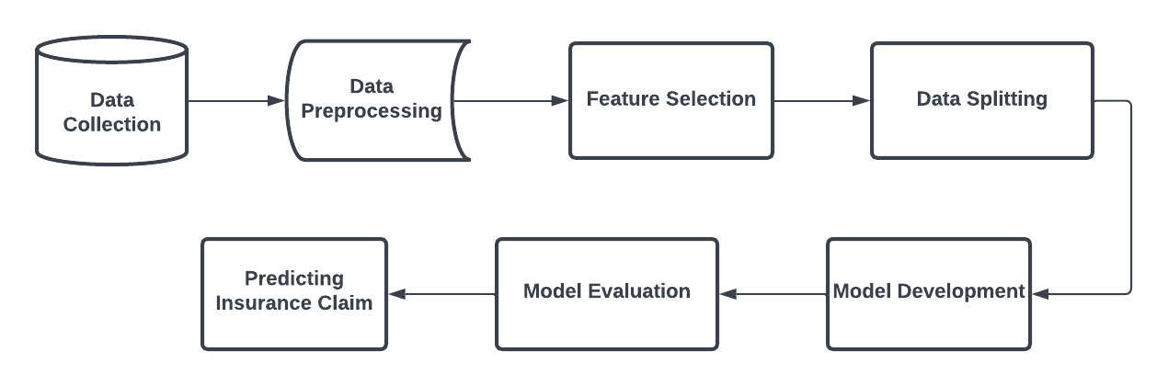
System Architecture

Slide 8
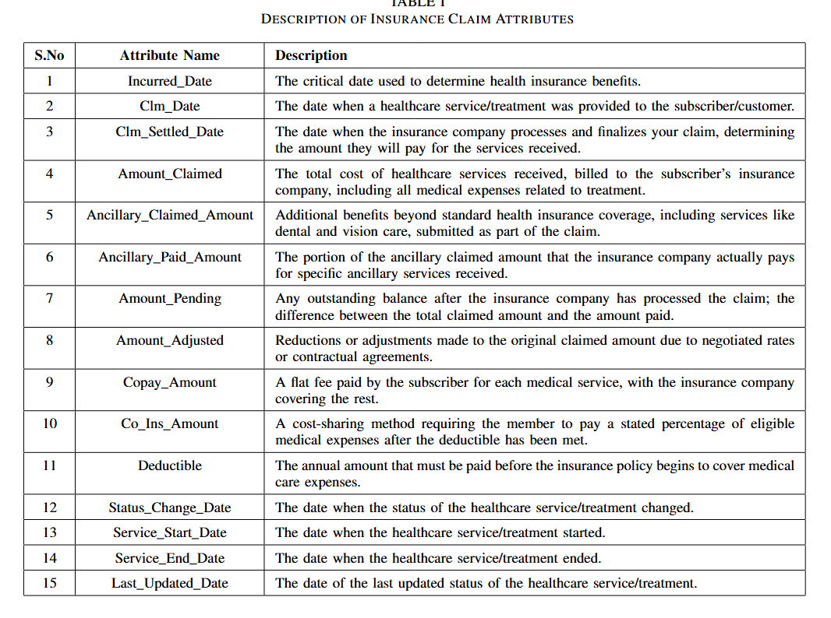

Slide 9
METHODOLOGY
Data Collection and Integration: The dataset is gathered from diverse sources including claims, policyholder demographics, and financial transactions, and integrated into a centralized system.
Data Preprocessing: Redundant, irrelevant, or missing data were addressed through techniques like imputation (mean/median), outlier detection (Z-score, IQR), and categorical encoding to ensure data quality for further analysis.
Descriptive Statistics: The distribution of key variables, such as Amount Claimed, Ancillary Claimed Amount, and Amount Paid, was analyzed using mean, variance, skewness, kurtosis, and range to understand data characteristics and variability.
Feature Selection: Features were selected through correlation analysis, Recursive Feature Elimination (RFE), Random Forest, and Lasso Regression to ensure that only meaningful variables were included, reducing multicollinearity and improving model performance.

Slide 10
5. Regression Analysis: Various machine learning models, including Ridge Regression, Lasso Regression, Decision Tree, Random Forest, and others, were applied to predict the amount paid for insurance claims, using metrics like MSE, RMSE, and R² to assess performance.
6. Model Performance Evaluation: Ridge Regression was identified as the most effective model, achieving near-perfect R² (1.0) and extremely low Mean MSE, demonstrating minimal error and excellent fit to the data.
7. Key Predictors: The Amount Claimed and Ancillary Paid Amount were identified as the most influential features in predicting the target variable, Amount Paid.
8. SHAP Analysis: SHAP values revealed that Amount Claimed and Amount Adjusted had the most positive influence on the predictions, while CoPay Amount and Ancillary Claimed Amount exerted a negative impact on the model’s output.

Slide 11
RESULT AND ANALYSIS:
Descriptive Statistics Overview: The data shows significant variability across several variables, with the Amount Claimed (mean = 1021.82) having a wide distribution and rightward skew, suggesting potential outliers. Ancillary Claimed Amount (mean = 201.63) has a higher skew, while Amount Adjusted (mean = 196.83) exhibits a more balanced distribution. Amount Paid (mean = 615.62) also has high variability, reflecting a wide range of paid claim amounts.
Regression Model Performance: Ridge Regression outperforms all models with a near-perfect R² of 0.92 and minimal error, followed closely by Lasso Regression Extra Trees, Decision Tree, and Random Forest show strong generalization but with slightly higher errors. AdaBoost performs the weakest, with the highest Mean MSE and RMSE.
Feature Importance via Line Analysis:Amount Claimed and Ancillary Paid Amount are the most influential features in the prediction model. Changes in these variables significantly impact the model’s output, making them strong predictors of the target variable.

Slide 12
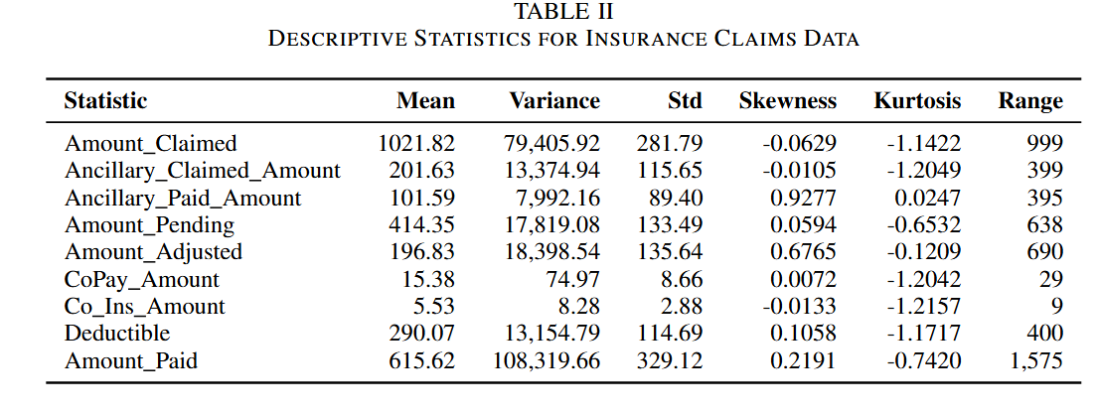
Results and Analysis
RESULT AND ANALYSIS:

Slide 13
RESULT AND ANALYSIS:
lts and Analysis
SHAP Analysis: Amount Claimed and Amount Adjusted are the most influential features in the model, significantly driving the predictions toward higher values. On the other hand, CoPay Amount and Ancillary Claimed Amount exert a negative influence, pulling the model’s predictions lower. This highlights the varying impacts of different features on the overall prediction, with some pushing the outcome higher and others reducing it.
Model Evaluation: Ridge Regression stands out as the most accurate model, offering near-perfect predictions with a minimal Mean Squared Error (MSE) and Root Mean Squared Error (RMSE). The Lasso Regression model is also highly effective, though it has slightly higher error values compared to Ridge.
Understanding of Model performance: The combination of Ridge Regression’s strong performance with SHAP provides a clear understanding of which features most influence the model’s predictions. This insight helps in understanding how different aspects of the claim data contribute to the final decision, offering actionable insights into the factors that matter most in predicting insurance claim outcomes.

Slide 14
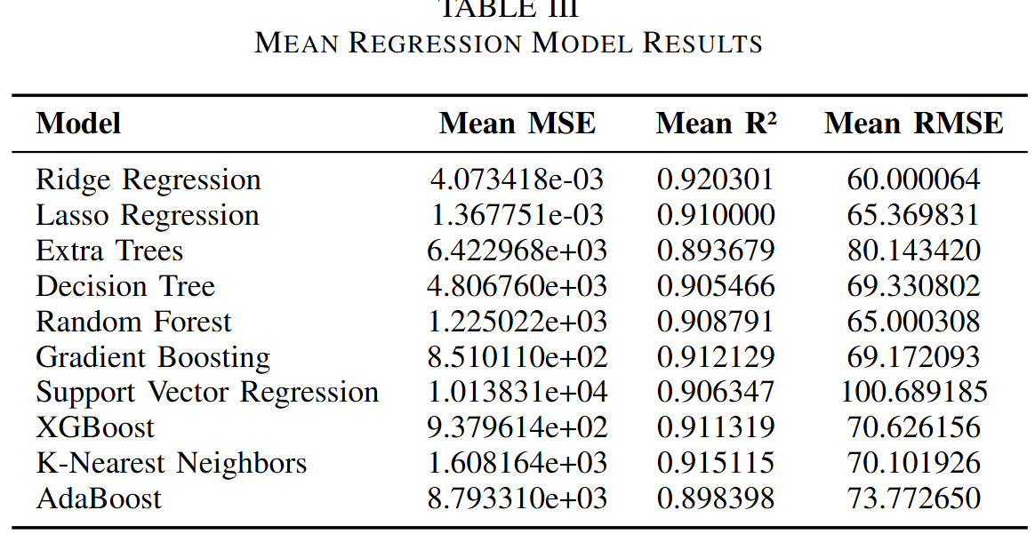
RESULT AND ANALYSIS:

Slide 15
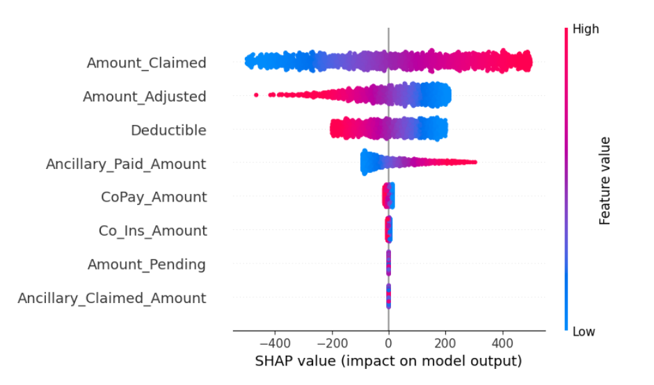
RESULT AND ANALYSIS:

Slide 16
Conclusions
CONCLUSION
Ridge Regression emerged as the top-performing model, achieving a near-perfect R² of 0.92, indicating an excellent fit with minimal error. Lasso Regression also performed highly, but slightly lagged behind Ridge due to a higher Mean MSE. Models like Random Forest and Extra Trees showed strong generalization performance, though with marginally higher errors. Key predictors in the model included Amount Claimed and Amount Adjusted, which strongly influenced the final predictions, driving them toward higher values. Conversely, features such as CoPay Amount and Ancillary Claimed Amount had a negative impact on the model’s predictions, pulling the output lower.

Slide 17
Future Works
FUTURE WORKS
It could focus on refining feature selection and engineering techniques to improve model performance, particularly for variables like CoPay Amount and Ancillary Claimed Amount, which showed negative impacts. By applying advanced methods such as automated feature selection or leveraging domain-specific insights, the prediction accuracy can be further enhanced. Additionally, although Ridge Regression performed excellently, exploring more sophisticated models like deep learning or advanced ensemble methods may improve predictions, especially in handling complex, non-linear relationships in insurance claim data. These efforts could lead to even more precise and reliable outcomes in predicting insurance claims.

Slide 18
Refernces
REFERENCES
[1] Seely, S., 2018. Eight Use Cases for Machine Learning in Insurance. Azure. Available online: https://azure. microsoft. com/en-us/blog/eight-use-cases-for-machine-learning-in-insurance/(accessed on 28 December 2022).
[2] N. J. Ravindran and P. Gopalakrishnan, ”Predictive Analysis for Healthcare Sector Using Big data Technology,” 2018 Second International Conference on Green Computing and Internet of Things (ICGCIoT), Bangalore, India, 2018, pp. 326-331, doi: 10.1109/ICGCIoT.2018.8753090.
[3] Sankar, K.H. and Shyam, A.V., Customer Ethics In Health Insurance Claims: A Study Using Genetic Algorithm.
[4] Aswath, G.I., Vasudevan, S.K. and Sampath, N., 2020. A frugal and innovative telemedicine approach for rural India–automated doctor machine. International Journal of Medical Engineering and Informatics, 12(3), pp.278-290.
[5] Orji, U. and Ukwandu, E., 2024. Machine learning for an explainable cost prediction of medical insurance. Machine Learning with Applications, 15, p.100516.
[6] Kaushik, K., Bhardwaj, A., Dwivedi, A.D. and Singh, R., 2022. Machine learning-based regression framework to predict health insurance premiums. International journal of environmental research and public health, 19(13), p.7898.
[7] Ogugua, J.O., Onwumere, C., Arowoogun, J.O., Anyanwu, E.C., Odilibe, I.P. and Akomolafe, O., 2024. Data science in public health: A review of predictive analytics for disease control in the USA and Africa. World Journal of Advanced Research and Reviews, 21(1), pp.2753-2769.
[8] Kandula, A.R., Kalyanapu, S., Rayapalli, S.N., Veerabathina, K.R.,Modugumudi, V. and Kanikella, S.R., 2024, March. Medical Insurance Predictive Modelling: An Analysis of Machine Learning Methods. In
2024 IEEE International Conference on Interdisciplinary Approaches in Technology and Management for Social Innovation (IATMSI) (Vol. 2,pp. 1-5). IEEE.
[9] Arowoogun, J.O., Babawarun, O., Chidi, R., Adeniyi, A.O. and Okolo,C.A., 2024. A comprehensive review of data analytics in healthcare management: Leveraging big data for decision-making. World Journal of Advanced Research and Reviews, 21(2), pp.1810-1821.
[10] Ibeh, C.V., Elufioye, O.A., Olorunsogo, T., Asuzu, O.F., Nduubuisi, N.L. and Daraojimba, A.I., 2024. Data analytics in healthcare: A review of patient-centric approaches and healthcare delivery. World Journal of Advanced Research and Reviews, 21(2), pp.1750-1760.

Slide 19
References
[11] Padmapriya, S.T. and Parthasarathy, S., 2024. Ethical data collection for medical image analysis: A structured approach. Asian Bioethics Review,16(1), pp.95-108.
[12] Hu, Z., Qin, X., Chen, K., Huang, Y.N., Wang, R.S., Tung, T.H., Chuang,Y.C. and Wang, B.L., 2024. Chinese Health Insurance in the Digital Era: Bibliometric Study. Interactive Journal of Medical Research, 13(1),p.e52020.
[13] Ahmed, A., Xi, R., Hou, M., Shah, S.A. and Hameed, S., 2023. Harnessing big data analytics for healthcare: A comprehensive review of frameworks, implications, applications, and impacts. IEEE Access.
[14] Singh, R.K., Agrawal, S., Sahu, A. and Kazancoglu, Y., 2023. Strategic issues of big data analytics applications for managing health-care sector: a systematic literature review and future research agenda. The TQM Journal, 35(1), pp.262-291.
[15] Y. Xie et al., ”Predicting Days in Hospital Using Health Insurance Claims,” in IEEE Journal of Biomedical and Health Informatics, vol. 19, no. 4, pp. 1224-1233, July 2015, doi: 10.1109/JBHI.2015.2402692.
[16] H. Yang, ”Is Supplementary Health Insurance an Effective Supplement to Basic Health Insurance in China? a Two-part Model and Quantile Approach,” 2021 International Conference on Public Management and Intelligent Society (PMIS), Shanghai, China, 2021, pp. 308-311, doi:10.1109/PMIS52742.2021.00075.
[17] S. Gupta and P. Tripathi, ”An emerging trend of big data analytics with health insurance in India,” 2016 International Conference on Innovation and Challenges in Cyber Security (ICICCS-INBUSH), Greater Noida, India, 2016, pp. 64-69, doi: 10.1109/ICICCS.2016.7542360.
[18] A. Gurbaxani and R. Raman, ”Perception of SMEs in India towards Employee Health Insurance Plan,” 2022 International Conference on Sustainable Islamic Business and Finance (SIBF), Sakhir, Bahrain, 2022, pp. 205-208, doi: 10.1109/SIBF56821.2022.9939961.
[19] A. Ivanovi´c and P. Rakovi´c, ”E-health Card Information System: Case Study Health Insurance Fund of Montenegro,” 2019 8th Mediterranean Conference on Embedded Computing (MECO), Budva, Montenegro, 2019, pp. 1-5, doi: 10.1109/MECO.2019.8760284.
[20] Kareem, S., Ahmad, R.B. and Sarlan, A.B., 2017, November. Framework for the identification of fraudulent health insurance claims using association rule mining. In 2017 IEEE Conference on Big Data and Analytics (ICBDA) (pp. 99-104). IEEE.
[21] M. R. Islam et al., ”MHIVis: Visual Analytics for Exploring Mental Illness of Policyholders in Life Insurance Industry,” 2020 7th International Conference on Behavioural and Social Computing (BESC), Bournemouth, United Kingdom, 2020, pp. 1-4, doi:10.1109/BESC51023.2020.9348301.

Slide 20
References
[22] A. Vinora, V. Surya, E. Lloyds, B. Kathir Pandian, R. N. Deborah and A. Gobinath, ”An Efficient Health Insurance Prediction System using Machine learning,” 2023 International Conference on Innovative Computing, Intelligent Communication and Smart Electrical Systems (ICSES), Chennai, India, 2023, pp. 1-5, doi: 10.1109/IC-SES60034.2023.10465334.
[23] P. Singh, K. D. Singh, V. Tripathi and V. Chaudhari, ”Use of Ensemble Based Approach to Predict Health Insurance Premium at Early Stage,” 2022 International Conference on Computational Intelligence and Sustainable Engineering Solutions (CISES), Greater Noida, India, 2022, pp.566-569, doi: 10.1109/CISES54857.2022.9844398.
[24] Inayatulloh, R. Toyib, E. Sahputra, Y. Reswan, Y. Darmi and Meisyarah, ”Adoption Block Chain Technology and Internet of Thing for Medical Record in Health Insurance,” 2022 13th International Conference on Information and Communication Technology Convergence (ICTC), Jeju Island, Korea, Republic of, 2022, pp. 1539-1542, doi:10.1109/ICTC55196.2022.9952723.
[25] K. W. Wedanage, R. Wickramasuriya, K. T. Win and P. Perez, ”Forecasting healthcare cost in Australia using health insurance claims data,” 2021 17th International Computer Engineering Conference (ICENCO), Cairo, Egypt, 2021, pp. 35-39, doi: 10.1109/ICENCO49852.2021.9698885.
[26] Y. Xu and M. Shi, ”Research on optimal mixed health insurance contact based on risk sharing,” 2016 International Conference on Industrial Economics System and Industrial Security Engineering (IEIS), Sydney, NSW, Australia, 2016, pp. 1-5, doi: 10.1109/IEIS.2016.7551880.
[27] L. Xiaoqun and L. Run, ”An Improved K-means Clustering Model Based on Support Vector Machine for Health Insurance Cost Prediction,” 2022 IEEE 2nd International Conference on Electronic Technology, Communication and Information (ICETCI), Changchun, China, 2022,pp. 521-525, doi: 10.1109/ICETCI55101.2022.9832085.
[28] H. Pingping, ”Analysis of Urban Employee Basic Medical Insurance in Beijing,” 2023 16th International Conference Management of large-scale system development (MLSD), Moscow, Russian Federation, 2023, pp.1-5, doi: 10.1109/MLSD58227.2023.10303931.

Slide 21
Thank You!

