Slide 1


Slide 2
Agenda :
About V-Learn & Proposal – Quick View
Transforming Fragmented Telemetry into Executive Insight
Rapid Engagement Growth Dictates a Microlearning Mandate
Healthy Top-of-Funnel with throughput with untapped Mid-Funnel Potential
Churn Risk is not systemic. It is a Localized Geographic Anamoly
Exceptional Instructional Baselines Provide a Blueprint for Scaling
High Efficacy however Assessment Uniformity requires Recallibration
Interventions – Blue Print
Further Recommendations to Improve Learner Engagement

Slide 3
V-Learn - Project Background :
V-Learn, an Edtech Platform is empowering learners to become better in their career paths. However, currently facing the day-to-day challenges in the following key areas :
• Limited visibility into Daily Active User trends and how students accessed the platform (laptop, mobile, ortablet)
• Delayed reporting on course completion, drop rate, and assessment performance.
• Lack of consistent metrics across academic, product, and instructor-facing teams.
• Limited ability to compare learner outcomes across regions, course categories, and difficulty levels.
• Difficulty identifying which learners were at high risk of disengaging or dropping a course.
• Manual reporting processes that reduced speed, accuracy, and scalability.
V-Learn, an EdTech platform Needs :
A suite of interactive Power BI dashboards focused on improving student engagement, course completion, and learner retention.
To start with, V Learn identified five role-focused key areas
Student Engagement,
Course Completion,
Instructor & Content Performance,
Assessment & Quiz Performance
Risk Assessment
For supporting better academic decisions, product improvements, and retention strategies

Slide 4
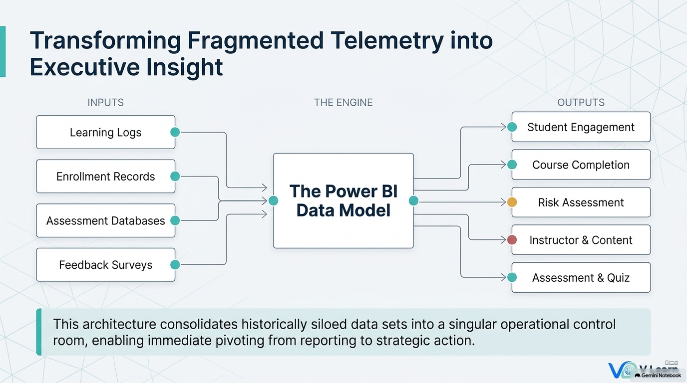

Slide 5
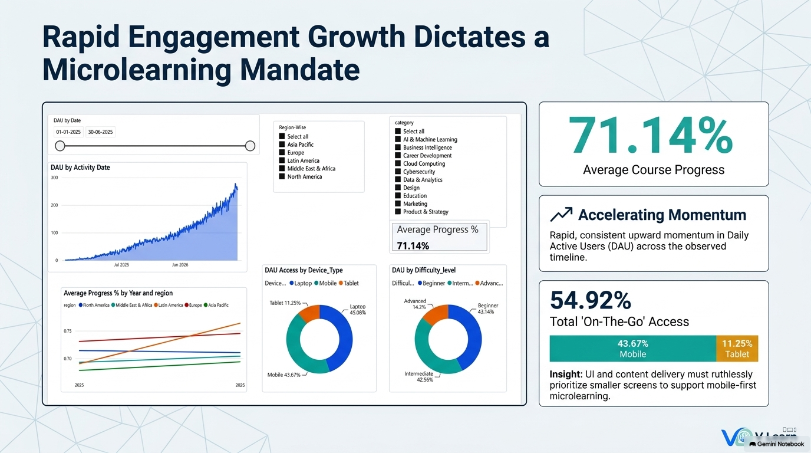

Slide 6
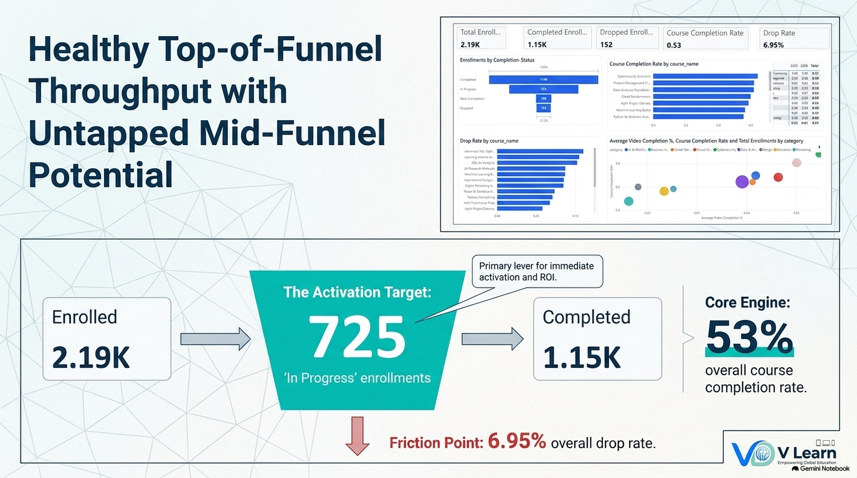

Slide 7
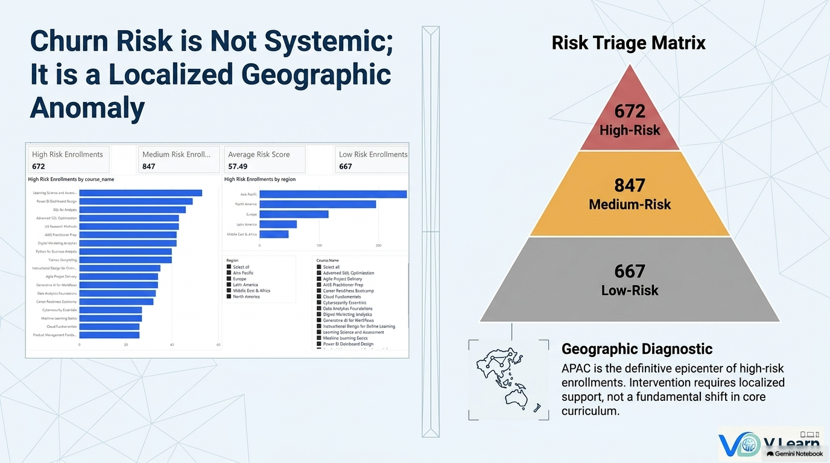

Slide 8
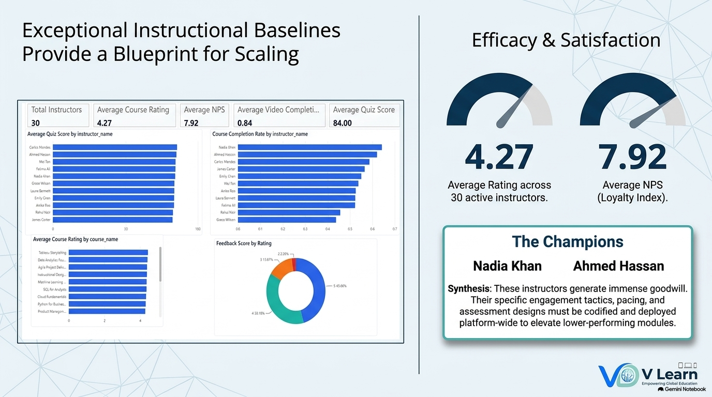

Slide 9
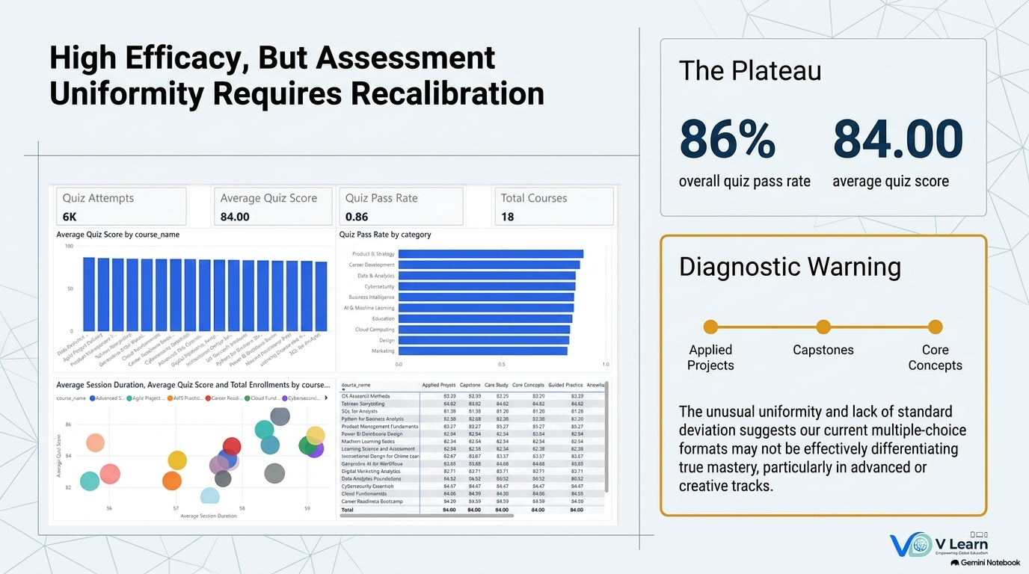

Slide 10
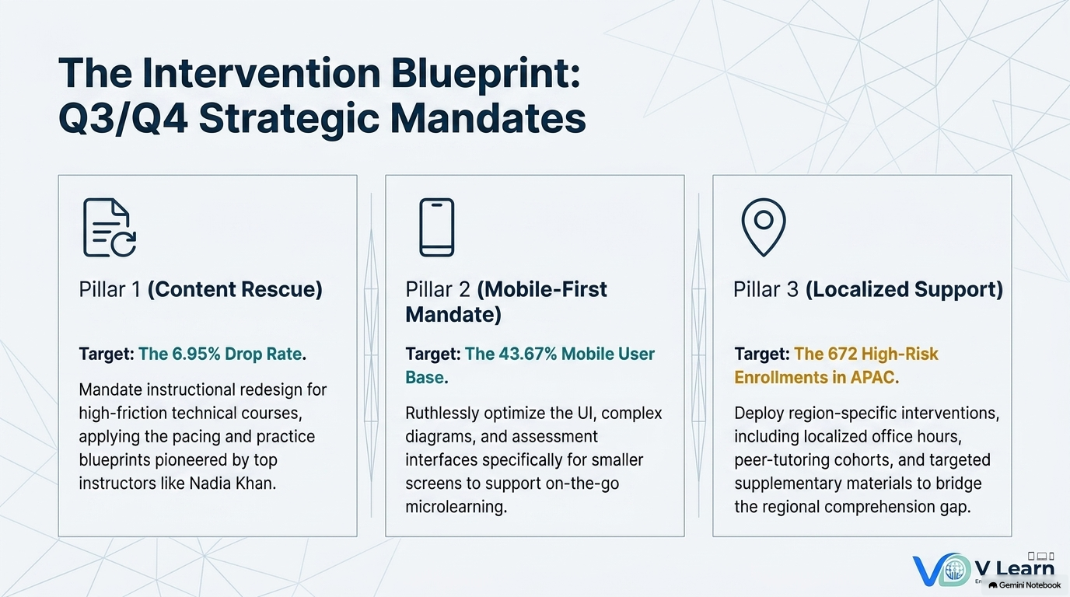

Slide 11
V-Learn – Next Growth Phase – a Snapshot of Recommendation
Develop an Enterprise-level Tracker App on a wider scale using the Artificial Intelligence & Machine Learning Models (AI&ML)
Plan a Phase-wise roll-out for development and adoption for Better Business Performance and Student Learning Outcomes
Thank You & Lets Hope for the Best

