Slide 1
Intelligent Song Recommendation
Under the guidance of
-Constantin Konstantopoulos
Prepared by
-Ashish Dass
-Chand Teckchandani
-Vidya Viswakumar

Slide 2
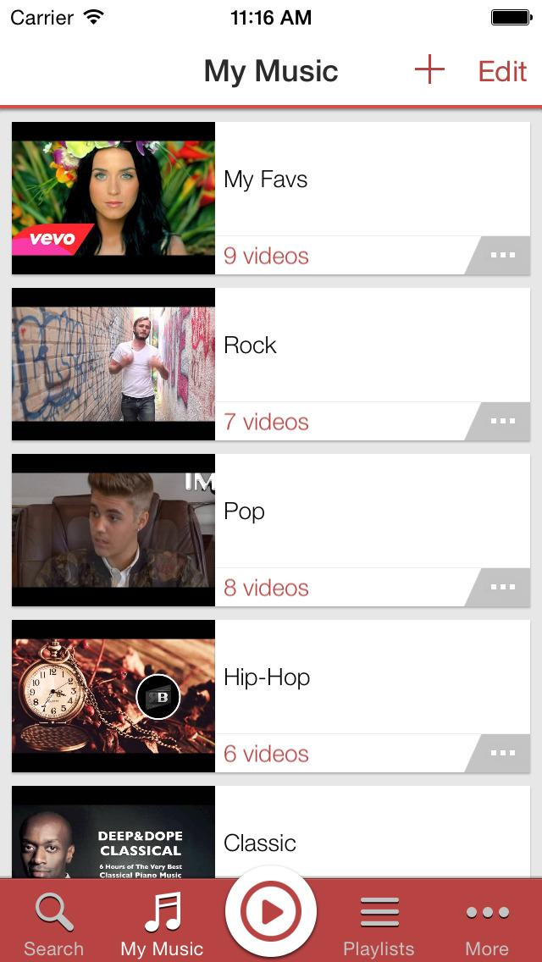
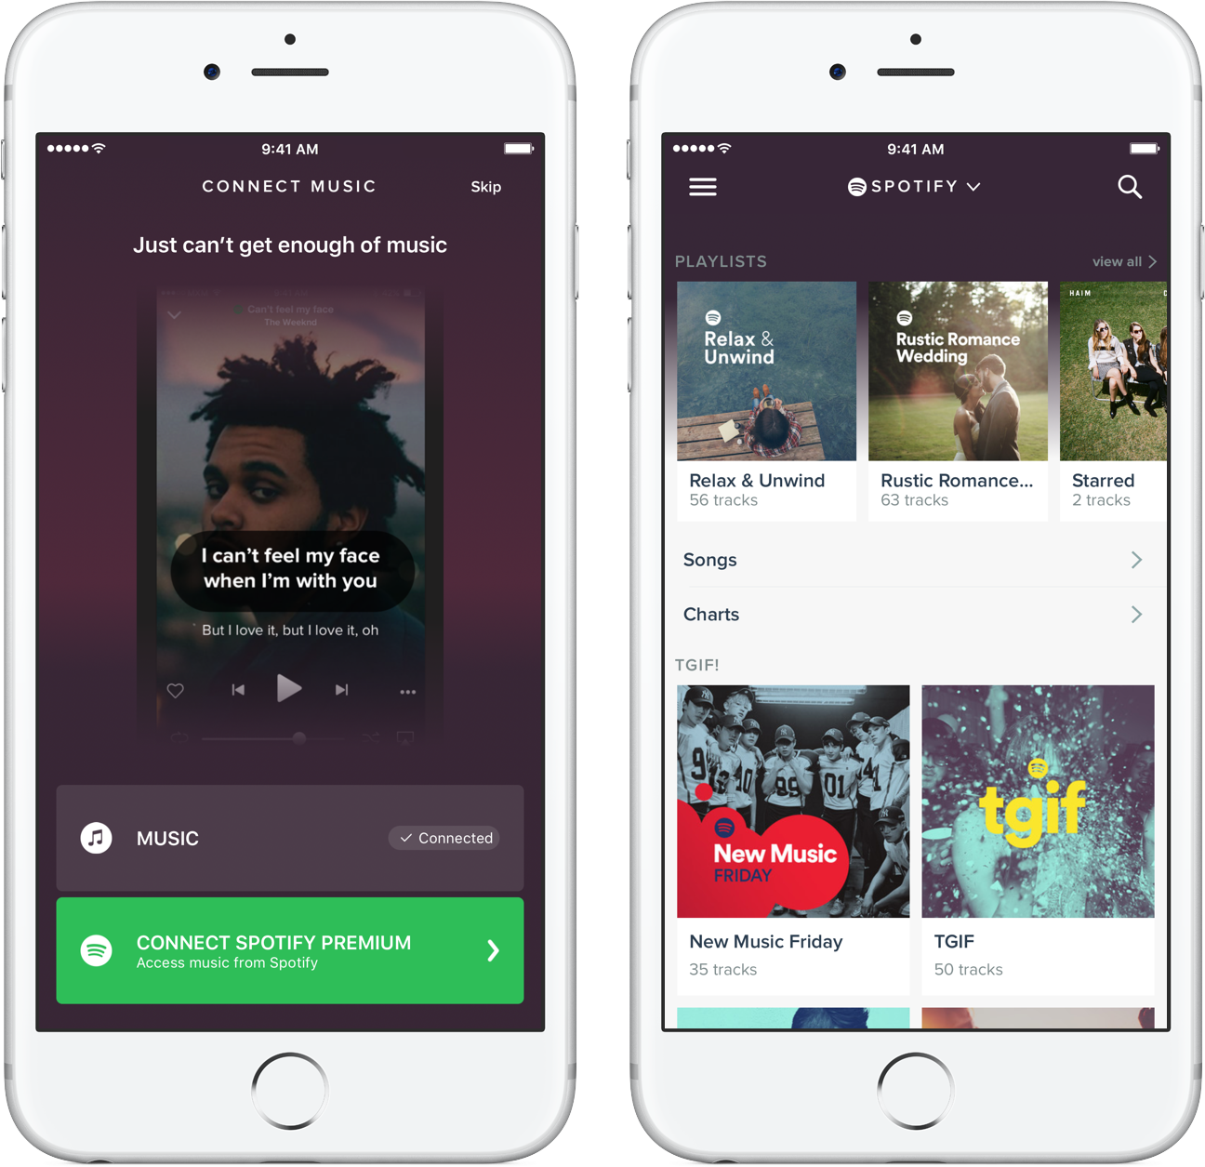
Power of Big Data and Cloud
15k songs
~64 GB
1M songs

Slide 3
Big data processing
Not only processing, but also when building an entire pipeline with an end goal, we need to do:
Capture, storage, search, share
Recommend, visualize, analyze
Trend detection

Slide 4

Why is Music Recommendation so important ?
Less engagement with user
Heavy reliance on suggestions
High contextual usage
Passionate users to customize their playlists

Slide 5
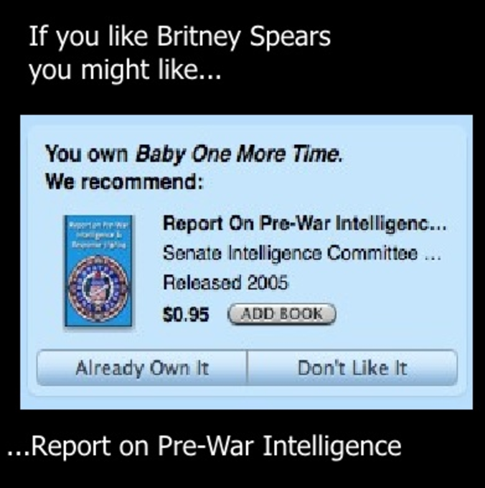


Music Recommendation is broken !

Slide 6
What makes for a good recommendation platform ?
Relevance
Transparent
Contextual
Reach
Notes:
Relevance – user user similarity OR item item similarity based
Transparent – in terms of we will tell you what influences these suggestions
Contextual – if its related to an activity, like channels of – workout, running, party
Reach – connect to audience where there is still an equal freedom of searches and handling of ‘Cold start Problem’

Slide 7
What we offer ? Beyond similarity
A single one-stop platform which provides
Mood based recommendation using a tone analyzer
Trending playlist recommendation
Similar users based recommendation

Slide 8
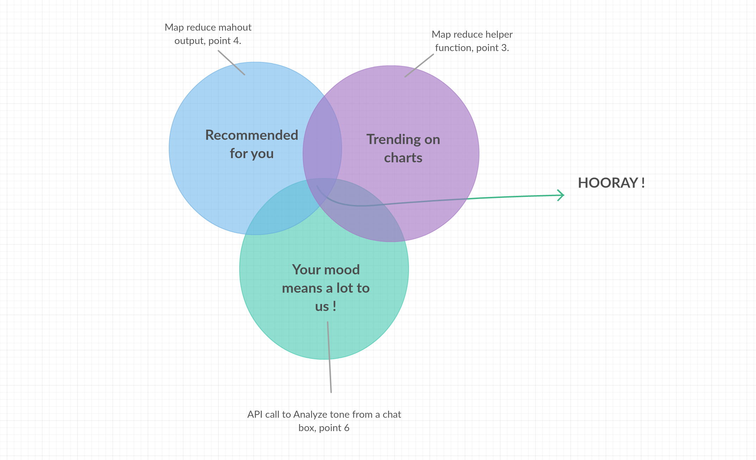
Continued…

Slide 9
Models used
Mahout recommendation using PearsonCorrelationSimilarity
Mahout recommendation using EuclideanDistanceSimilarity
Matchbox recommendation on Azure ML Studio
K-means clustering to classify and cluster genres of songs
IBM Watson’s Bluemix API for Tone analyzer

Slide 10
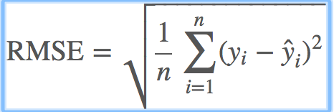
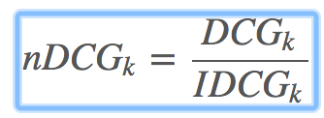
Evaluation
1. Evaluation of models is based on the RMSE(Root mean squared error) and amplifies and severely punishes large errors
2. Normalized discounted cumulative gain (NDCG) measures the performance of a recommendation system based on the graded relevance of the recommended entities
It varies from 0.0 to 1.0, with 1.0 representing the ideal ranking of the entities

Slide 11
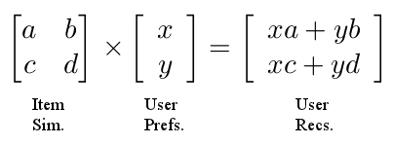
Apache Mahout
Mahout supports:
Recommendation – recommend items based on user’s behavior using Collaborative filtering
It is the process of filtering for information or patterns using techniques involving collaboration among multiple agents, viewpoints, data sources
Applications of collaborative filtering typically involve very large data sets

Slide 12
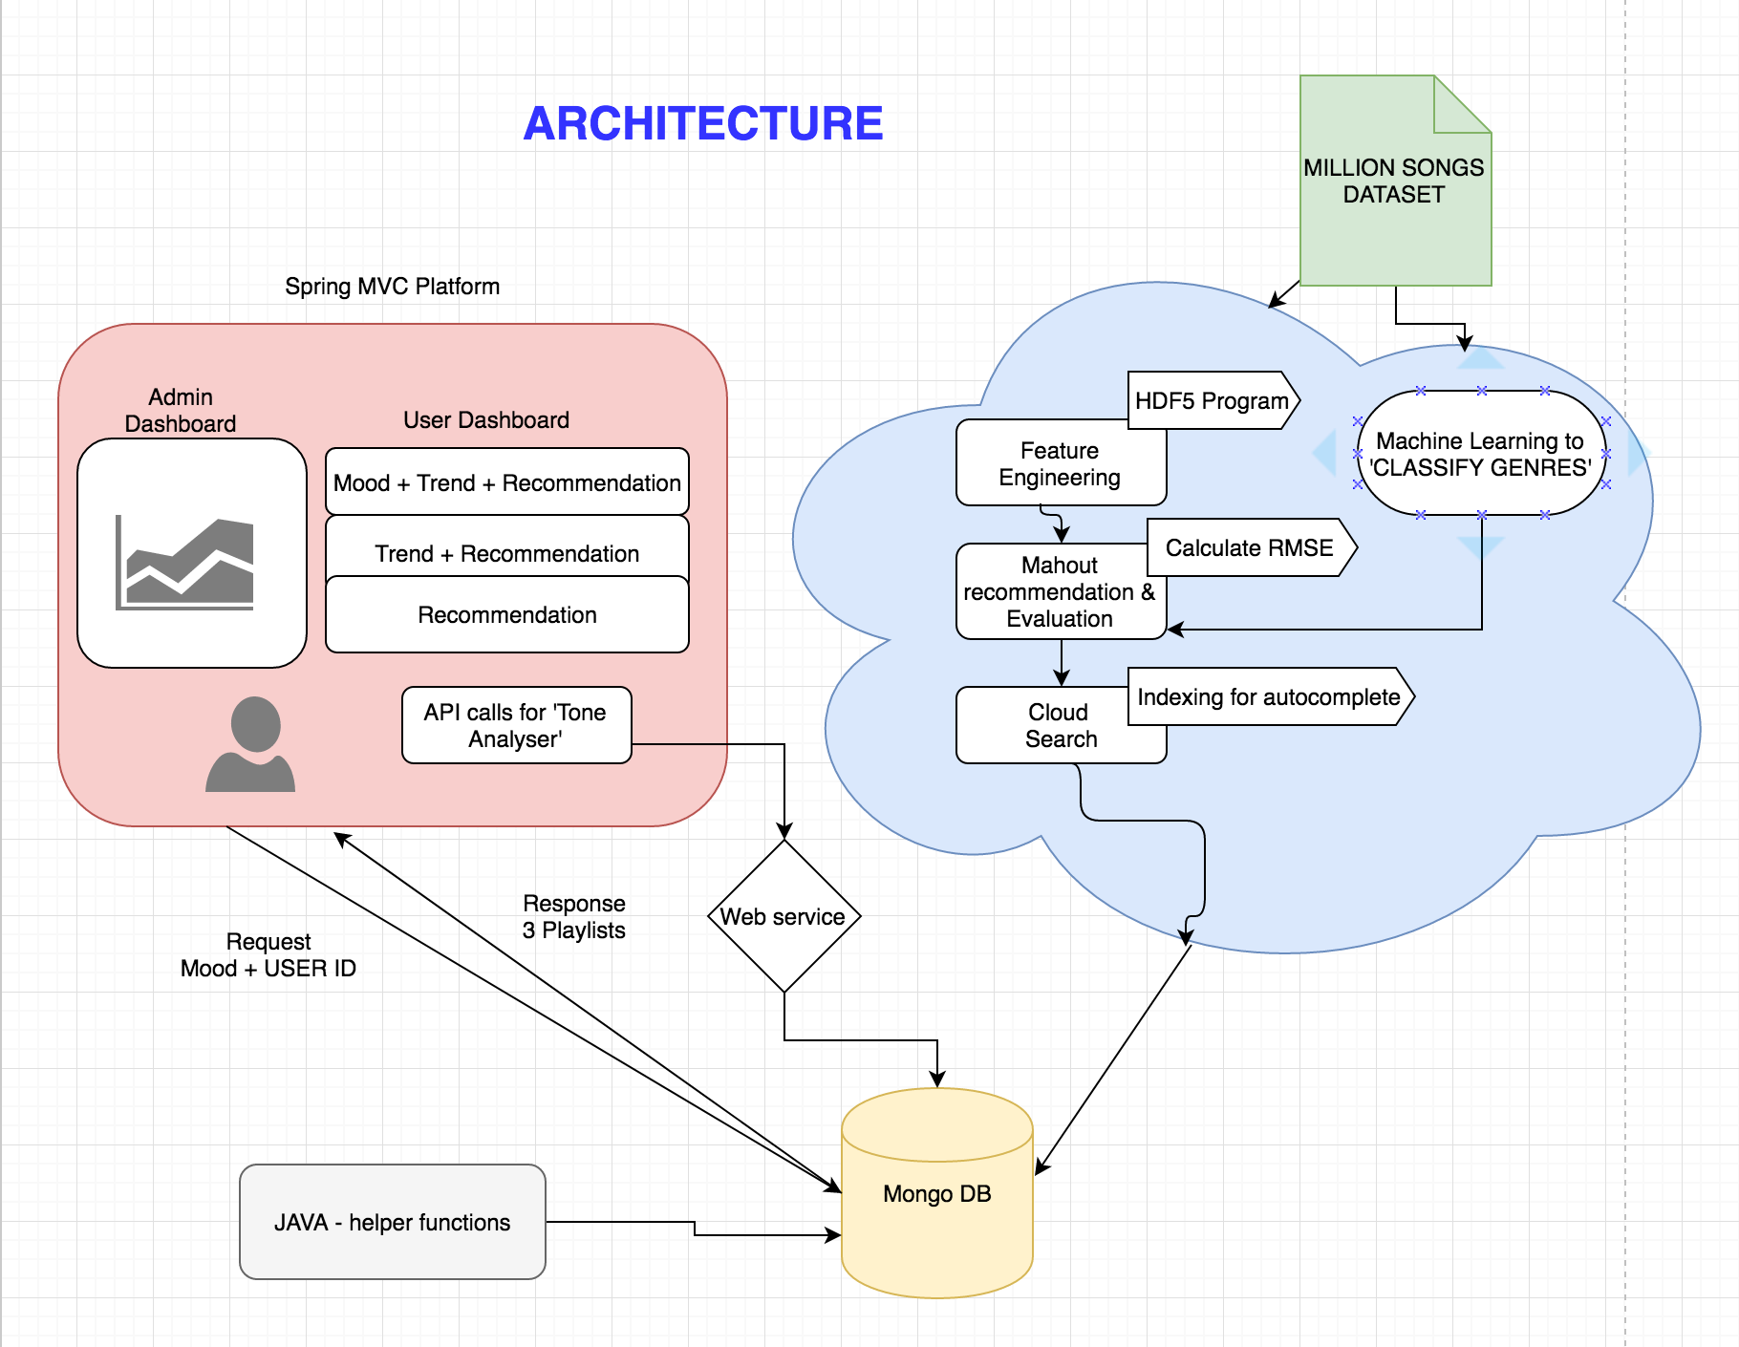
Platform for web service

Slide 13
Features
1. Users can feed their current mood using:
Mood emoticons
Text box
2. Users can perform a fast search leveraging the AWS cloud search, on
‘Song title’, ‘artist name’ , ‘artist location’, ‘song release year’
3. Admins can visualize the complex big data
Interactive visualizations on a dashboard
Take targeted actions based on Demographics of users/artists

Slide 14
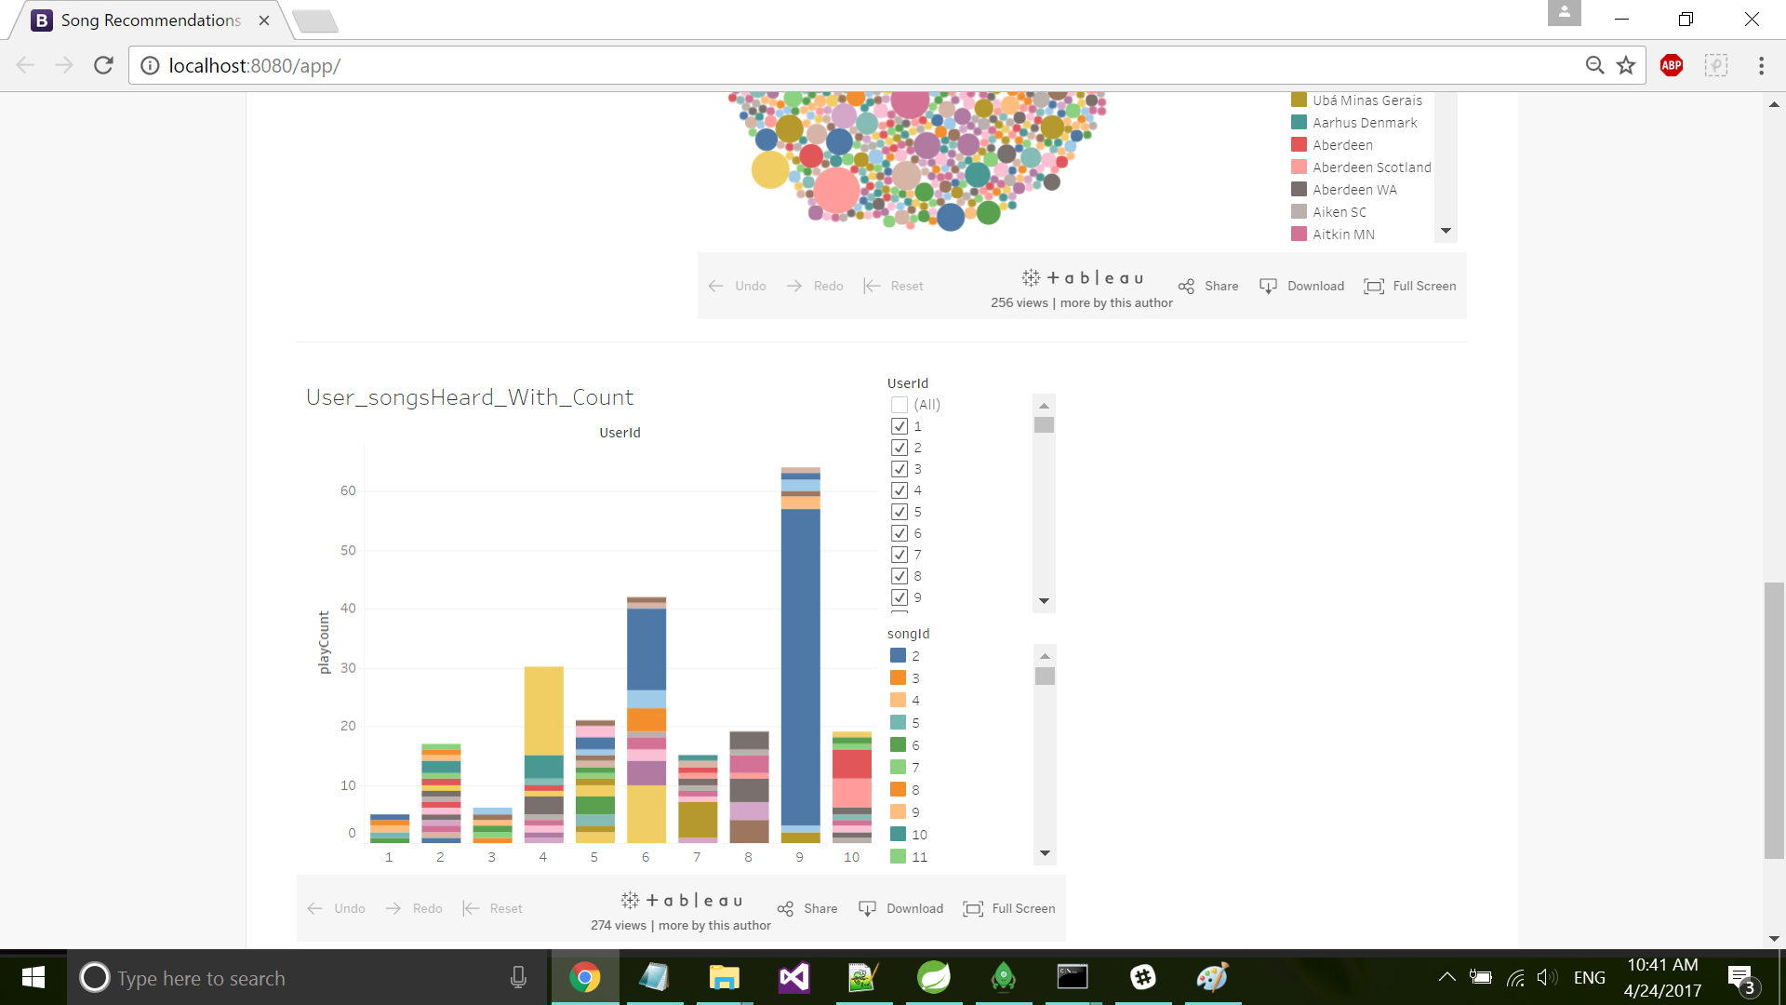
Tableau Integration
Published the tableau workbooks and sheets on Tableau Public Server
Every dashboard is being rendered live and is interactive, which is hosted on public server and is associated with a URL

Slide 15
Challenges
1. Cold start problem –
promoting new songs
Recommending unpopular songs
2. Need of STANDARDIZED Datasets
3. Limitation of historical data uptil now to apply other machine learning algorithms like Deep Learning and ARIMA
4. Artist tags

Slide 16

DEMO

Slide 17

Thank you !
Q&A

