Slide 1


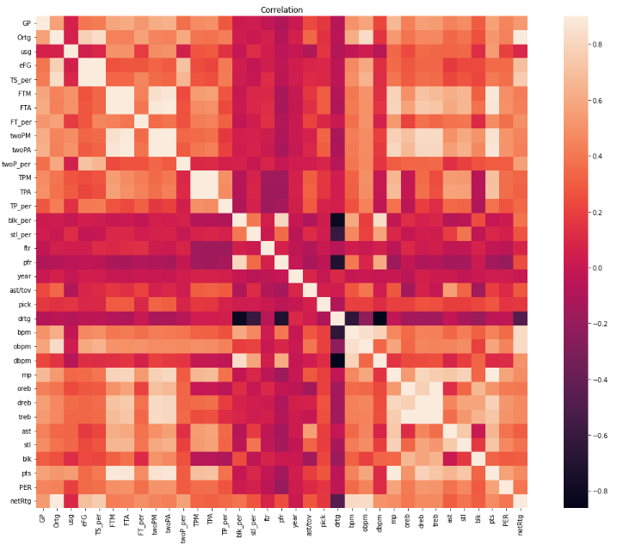
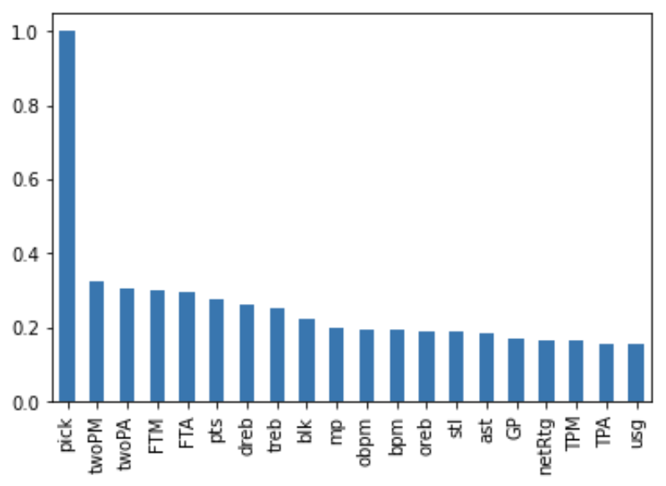
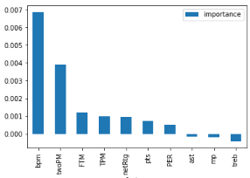
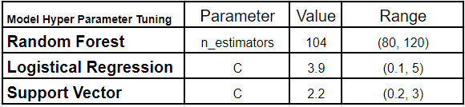
Classification of Highly Valued Stats and Metrics Between
Drafted and Non-Drafted NCAA Basketball Players
Liam Shen, Vidyut Ramanan, Jasmine Duong, John Mehlenbacher
DS3000 Final Project
Abstract
Methodology
Results & Evaluation
The Impacts
The NBA draft is often an unknown gamble, as players drafted high sometimes fail, and players drafted low sometimes succeed. Hundreds, if not thousands, of college basketball years declare for the draft, with only 60 players hearing their name called on draft night. Each player is different, with different playstyles, and with varying amounts of success within college. This project aims to categorize college success and identify the stats or metrics that are most important for a college basketball player with dreams of getting drafted into the NBA.
Acquisition
Our dataset was obtained from Kaggle in the form of a csv file. This data was originally collected on Basketball Reference and organized by a Kaggle user, and we decided to further clean and analyze that dataset since it was a large dataset containing all college NCAA basketball players and their stats from 2009 – 2021.
Preparation
In our EDA process, we first deemed the columns of interested, which were mostly on-court stats (i.e. pts, ast, treb), and metrics (i.e. BPM, Ortg, drtg). We then dropped null columns, and changed the data types of all remaining columns from an Image type into a usable type for calculations. Furthermore, to test the importance of metrics compared to on-court stats, we added two essential metrics for player performance. The PER, or Player Efficiency Rating, was calculated using a linear formula derived from the league averages[2], and players with no minutes were automatically set to 0 as that meant they did not play. The netRtg, or net rating, was calculating by subtracting drtg from Ortg, hence calculating a player’s impact on both ends of the court, per 100 possessions[3]. Next, we encoded the draft class, in order to determine a player was drafted or not, with a drafted player set to 1, and an undrafted player set to 0. Afterwards, we dropped rows with any players with null values, as they most likely did not gain any stats in certain columns. Lastly, we sorted the data so that only the final season, which is often a player’s best season, and season before they declare for the NBA draft, was used.
Feature Selection
To deem important correlations between stats and metrics, we used a correlation heat map. These correlations allowed us to choose the best attributes to train our data on. However, in order to use a proper mix of metrics and stats, an even amount of both were chosen, as a result of a bar graph visualization. twoPM had the highest correlation with pick at around 0.32. The images below illustrate the heatmap and bar graph with correlation values with pick.
Model Selection
We are trying to predict if players are drafted or not based on their stats which is essentially a classification problem. We chose to examine Random Forest Classification, Logistical Regression, and Support Vector Classification for our models. First we set aside the data from the year 2020 and 2021. Then we utilized train test split with a 70/30 split on the remaining data to train our models and we used GridSearchSV to tune hyper parameters. For the Random Forrest Classification we tuned n-estimators and we tuned the C value for the other two models. We evaluated the accuracy of the models using the score function and displayed the classification report to determine how well the model could classify if players that were drafted and players that weren’t. Furthermore, we analyzed the mean_train_score and mean_test_score for the GridSearch to check for overfitting. Finally we tested the models using the 2020 and 2021 data to evaluate their performance on new data.
Random Assortment Testing Results
We trained our models using 10 features, bpm, PER, netRtg, pts, mp, twoPM, FTM, TPM, treb, ast. For our initial train test split, the Random Forest Classification model performed the best with an accuracy score of 0.98. It was able to predict the not drafted players with 0.98 precision and the drafted with 0.73 precision. Then the Logistical Regression model had an accuracy of 0.98 and a precision of 0.98 for not drafted players, but it had a lower precision of 0.64 for drafted players. Finally the SVC model had an accuracy of 0.98 and a precision of 0.97 for not drafted players, but it had a precision of 0 for drafted payers, meaning it was not accurate in classifying drafted players. Overall, all the models were very accurate, however they were also all more precise in classifying not drafted players than drafted players. This did not skew the overall accuracy of the model because there are much more players that are not drafted so that category carries more weight.
Standard Draft Class Testing Results
We also wanted to see how our models would perform on a standard draft class so we tested our model on data from the years of 2020 and 2021. The models performed similarly in accuracy as before, but the precision for drafted and not drafted players was different. The Random Forest model’s performance did not change. The Logistical Regression model decreased in drafted player precision to 0.36 and the Support Vector model increased to 0.67 for drafted precision. The models were still able to perform well overall with the new data but there was some variation in the performance. This can be attributed to variations in the data. Since a only a small portion of players actually get drafted, the precision is more likely to be skewed by incorrect classifications. The players not drafted on the other hand are much greater in number and this the precious stays consistent.
We concluded that the Random Forrest model was the best for predicting the classifications of players as it had the highest performance overall.
Evaluation
We derived to feature importance from the model using the permutation importance function. The importance of the features are graphed below with BPM being the most important. These results demonstrate that metrics are essential for players wanting to be drafted, and it is not the pure on-court stats, but rather the unseen effect of a player on the court that accurately details whether a player is drafted or not. However, it also clear that scoring is still highly regarded among NBA teams, as baskets made are all ranked above other measures offense such assists.
Potential Impacts
Players looking to make the jump to the NBA may focus more on their hustle and efficiency on the court, rather than pure on-court stats. As box-plus minus is a player’s effect on the court, player’s who don’t often make as much splashy plays will be much more highly valued when being drafted. Furthermore, teams looking to draft players may focus more on the metrics rather and effect on a team rather than their individual stats.
Benefiters
Both college players and NBA teams looking to draft players will benefit from this model, as players learn to focus on stats that more heavily influence whether they are drafted, and NBA teams will focus more on metric based statistics such as BPM and netRtg, as well as scoring.
.
Introduction
The NBA draft is often a shot in the dark based on the stats and metrics of college basketball players that stand out above others. This may be points scored per game, or assists given out pre game, but many players often specialize in one category of stats/metrics, each with different ways of playing the game of basketball.
Problem
However, there have been notable college superstars that were drafted very high, who became failures in the NBA, while there have also been undrafted players, with very few stats that stood out, that have become fantastic basketball players. The most basic of stats that are measured are often pts, ast, and treb, which signify the points, assists, and rebound per game[3]. Furthermore, players may have different roles and playstyles within a team, so one stat must be valued above another.
The issue with these stats is that it doesn’t take into account the effect the player has relative to the game. Underlying metrics such as PER, and BPM may have a bigger impact on a player being drafted or not, when compared to aforementioned stats.[5] And despite this, player’s each year with outstanding metrics still fail in the NBA, leading us to the problem: what stats or metrics are the most important for college players wanting to be drafted?
Motivation & Objectives
While we had varying degrees of knowledge of each sport, we all agreed that sports can be a gold mine for data science. Sports are great for data because every single second is measured and recorded for every single player in every game. Our goal is accurately categorize the stats and metrics that have the most value in the probability of getting drafted. With such extensive data resources readily available, we have the tools to analyze college statistics for individual players to find the strongest measure of performance.
Our objective is to clean the NCAA dataset to accurately identify trends.. We want further level the playing field to college athletes looking to take their career to the next level that may not have conventionally high statistics.
Conclusion
We deviated from the initial proposed project plan, as we determined that determining the stats or metrics that made a college basketball successful, would help to identify the skills needed to help succeed in the NBA as well.
Goals & Objectives
Aside from pure skills, there are still good players in the league who are not the best at any given skill, but they are great at the mental side of the game which cannot be quantified[4]. We sought out to try and use pure data to take the “human” out of it and see if it is possible to find good players to draft based off of this mental aspect as well as physical side of the game. Our model was able to accurately predict if a player will get drafted just based off of their college stats. While this may not be revolutionary, it does set a baseline for what an NBA player should look like stat-wise. This allows scouts to compile a list of players who will be drafted, and they can evaluate other parts from there. It does eliminate a lot of the unnecessary scouting and resources spent on players who will not make it to the league. At the end of the day, however, it may be impossible to determine a player’s success just from college statistics because many players continue to develop skills in the NBA.
Future Improvements
As we focused more classifying stats and metrics that determine whether a player is drafted or not, a future improvement will be to make a regressor model, using the important values from the classification models, that can accurately predict a player’s future stats such as pts, as well as the level success they will achieve in the NBA. In order to do this, we would need an NBA dataset, and track each drafted player’s first three seasons in the NBA and predict the NCAA player’s future stats in the NBA based off of that training data.
Random Assortment
Standard 2020 & 2021 Draft Classes
Model | Random Forest | Logistical Regression | Support Vector
Accuracy Score | 0.98 | 0.98 | 0.98
Not Drafted Precision | 0.98 | 0.Q8 | 0.97
Drafted Precision | 0.73 | 0.64 | 0
Model | Random Forest | Logistical Regression | Support Vector
Accuracy Score | 0.99 | 0.98 | 0.99
Not Drafted Precision | 0.99 | 0.99 | 0.99
Drafted Precision | 0.72 | 0.36 | 0.67
Works Related
References
Predicting the NBA amateur player draft: Discussed metric and stats used to predict the actual draft picks of an NBA draft class. Their analysis deemed that players who are viewed as ‘scorers’ within college are drafted higher. [1]
Measuring Emotional Intelligence & Performance: Discussed the effect of the mental side of the game, and how underlying metrics such as BPM, PER, and Win/Shares are a more accurate representation of player performance. [5]
[1] Berri, David J., Stacey L. Brook, and Aju J. Fenn. "From college to the pros: Predicting the NBA amateur player draft."
Journal of Productivity Analysis 35.1 (2011): 25-35.
[2] Fein, Zach. “Cracking the Code: How to Calculate Hollinger's per without All the Mess.” Bleacher Report, Bleacher
Report, 3 Oct. 2017, https://bleacherreport.com/articles/113144-cracking-the-code-how-to-calculate-hollingers-
per-without-all-the-mess.
[3] Kubatko, Justin, et al. "A starting point for analyzing basketball statistics." Journal of quantitative analysis in sports 3.3
(2007).
[4] Metulini, Rodolfo, and Mael Le Carre. "Measuring sport performances under pressure by classification trees with
application to basketball shooting." Journal of Applied Statistics 47.12 (2020): 2120-2135.
[5] Zizzi, Samuel, Heather Deaner, and Douglas Hirschhorn. "The relationship between emotional intelligence and
performance among college basketball players." Journal of applied sport Psychology 15.3 (2003): 262-269.

