Slide 1

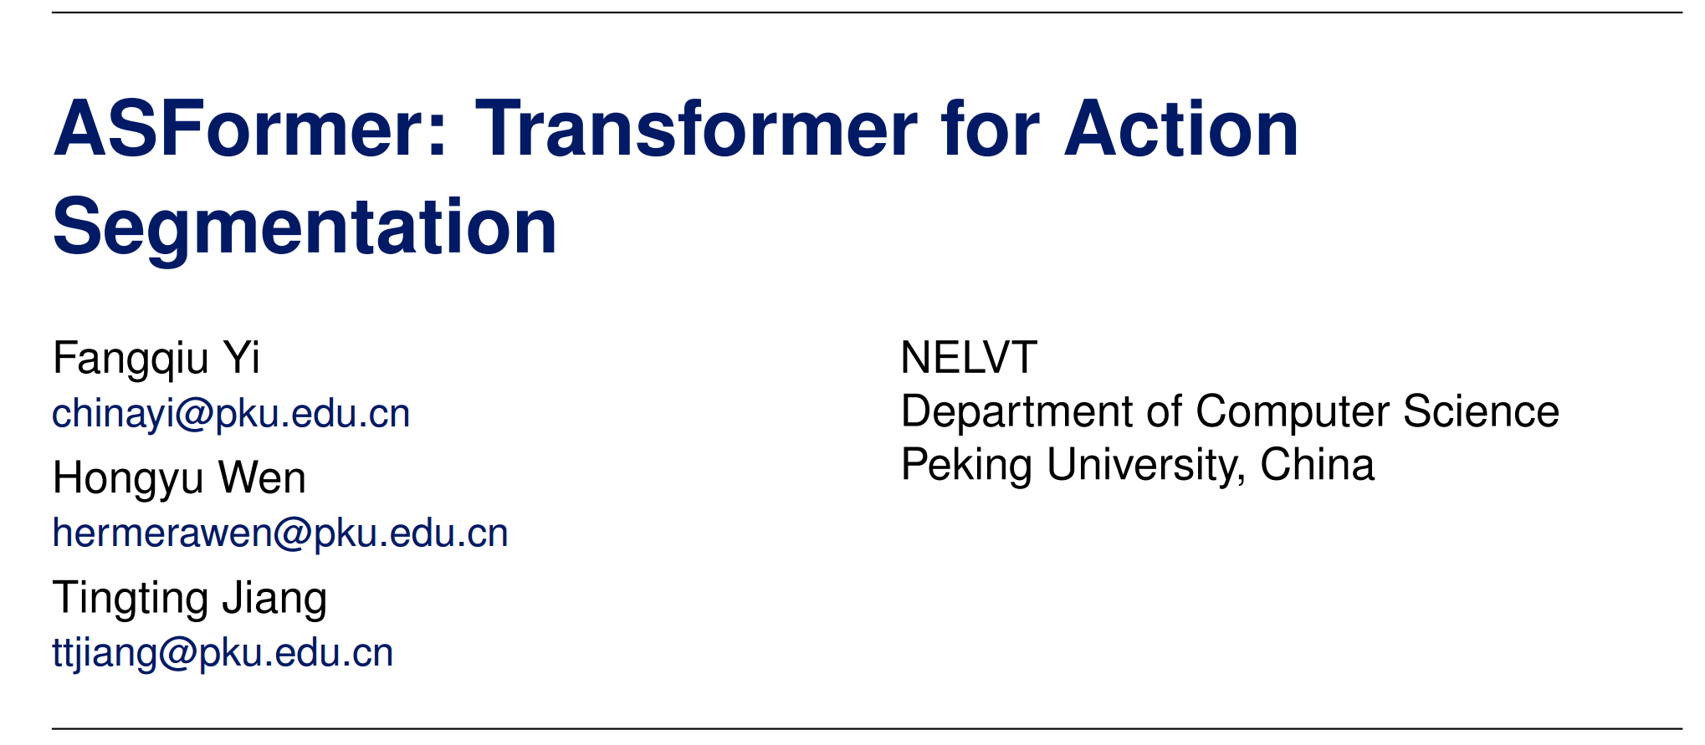
Notes:
Hi, welcome to this video. I am Fangqiu Yi from peking university.
In this video, I am going to introduce our work for the action segmentation task with transformer.

Slide 2
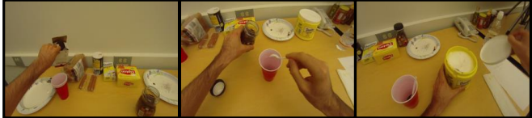
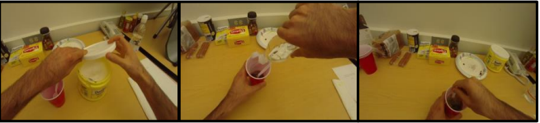
Action Segmentation
Input: Long video
…
Output: action label for each frame
Notes:
Action Segmentation is a challenging problem in video understanding. the goal is to assign an action label for each frame in a long video.
#### The results of Action Segmentation can be further used as input to various applications, such as video understanding or video indexing.

Slide 3
Motivation
The strong ability of Transformer-based models in modeling relations among elements
Notes:
In Recent year, many studies show the ability of transformer in modeling relations among elements, which, in our perspective, will be highly effective for the action segmentation task.

Slide 4
Motivation
Three challenges for Transformer to solve the action segmentation task
Small training sets
Long image sequence
The refinement demand
Not sufficient for training Transformer with free inductive-bias.
50, 28 videos in 50Salads and GTEA datasets.
Unstable training process with slow convergence speed.
The videos last from 1 to 6 minutes.
The decoder structure is not designed for such usage.
Related works usually apply an additional model to refine the initial predictions.
Notes:
However, we find that there are three challenges for transformer to solve the action segmentation task. Such as the Small training sets for training transformer, and the unstable training process on long image sequences, or the sepicial demand to refine the initial predictions.

Slide 5
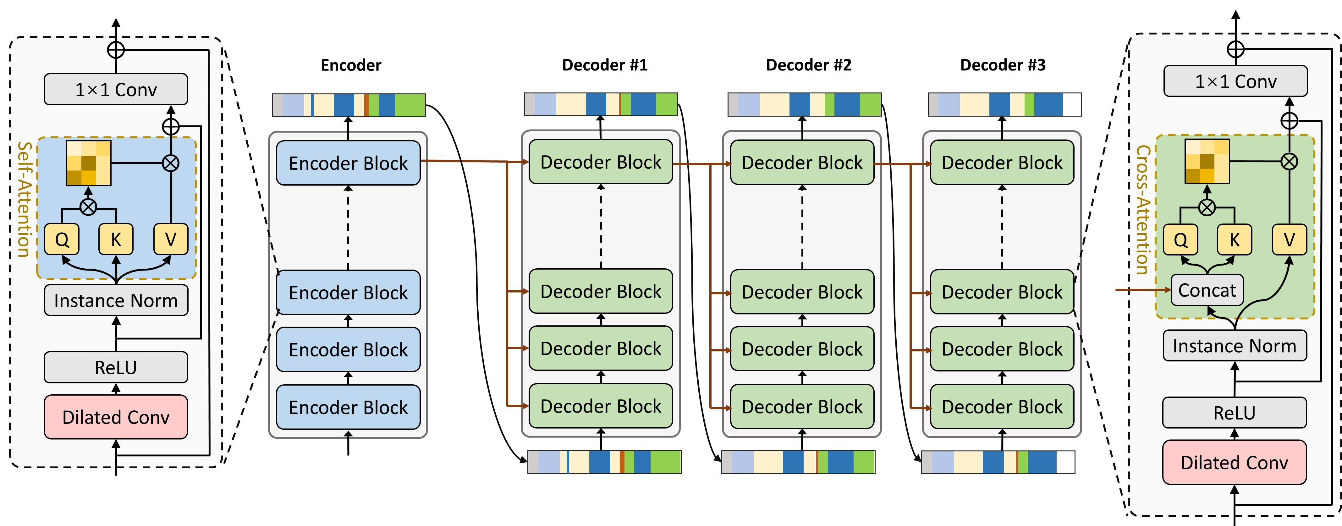
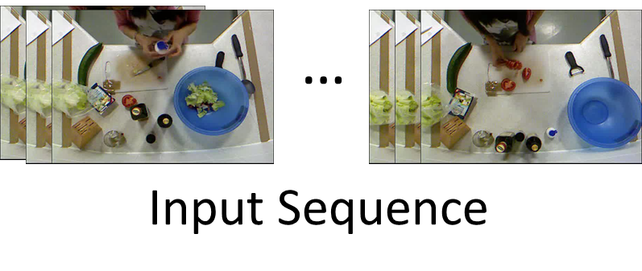
ASFormer: Transformer for Action Segmentation
I3D
Notes:
In this paper, we propose ASFormer to address the above challenges.

Slide 6
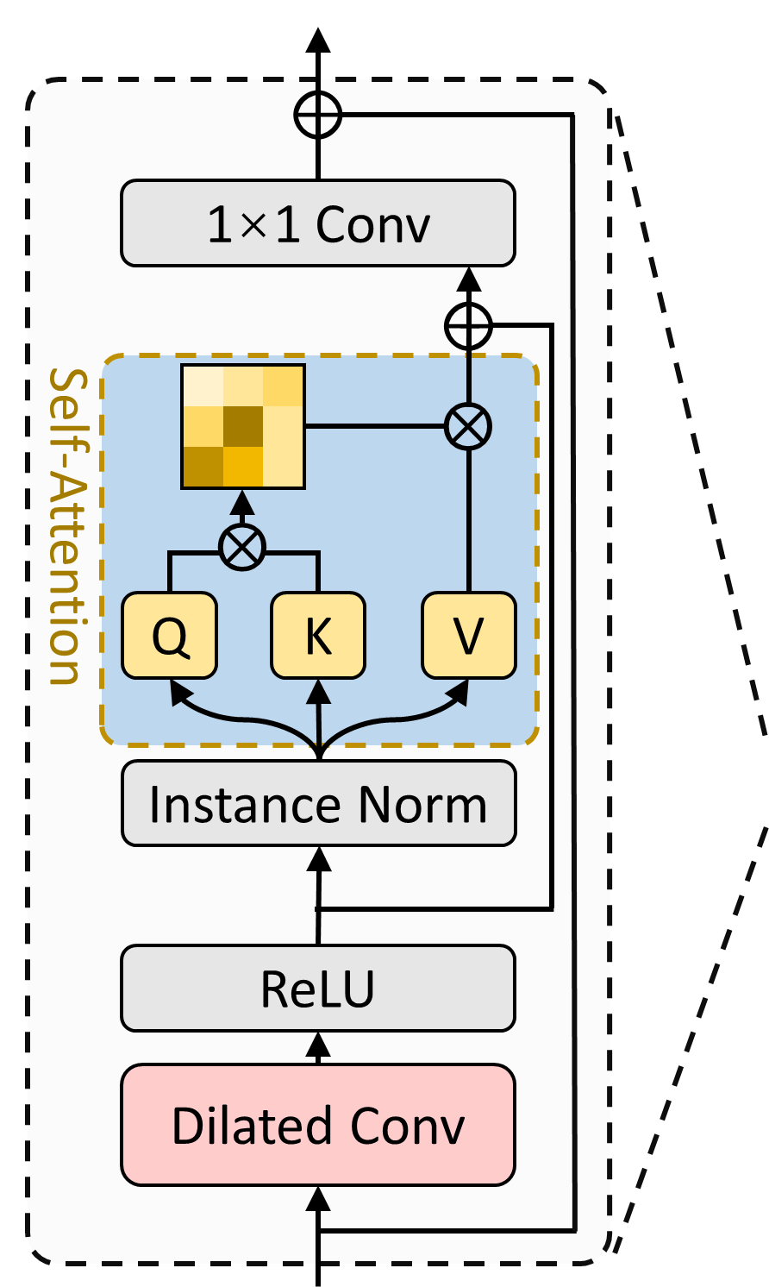
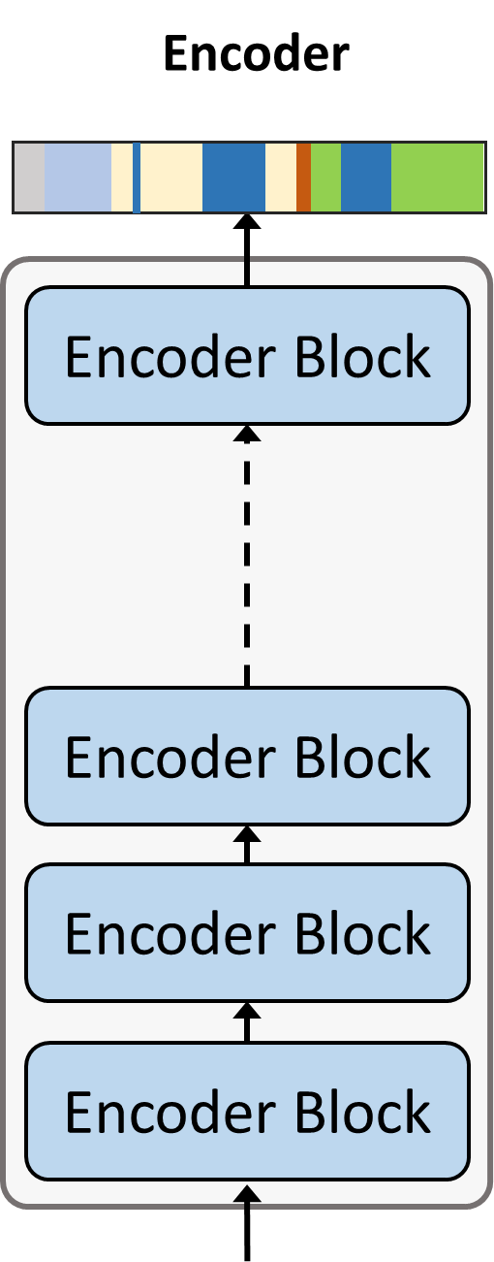
ASFormer: Transformer for Action Segmentation
I3D
Notes:
First of all, the input sequence is passed to the encoder part to produce initial predictions. The encoder part consists of serials of encoder blocks.

Slide 7
ASFormer: Transformer for Action Segmentation
Restrained with a pre-defined hierarchical representation pattern
Bring in local connectivity inductive bias for continuous action
I3D
Notes:
There are two main characteristics in the encoder block. Firstly, we apply the temporal convolution as the feed-forward layer. We assume that the local connectivity of temporal convolution is beneficial for the continuous actions, which helps the model generalize well with small training sets. Secondly, we constrain each self-attention layer with a pre-defined hierarchical pattern, which forces the low-level self-attention layers to focus on the local relations at first and then gradually enlarges their receptive fields.
#### Such hierarchical representation pattern achieves faster convergence speed and higher performance as our experiment shows.

Slide 8
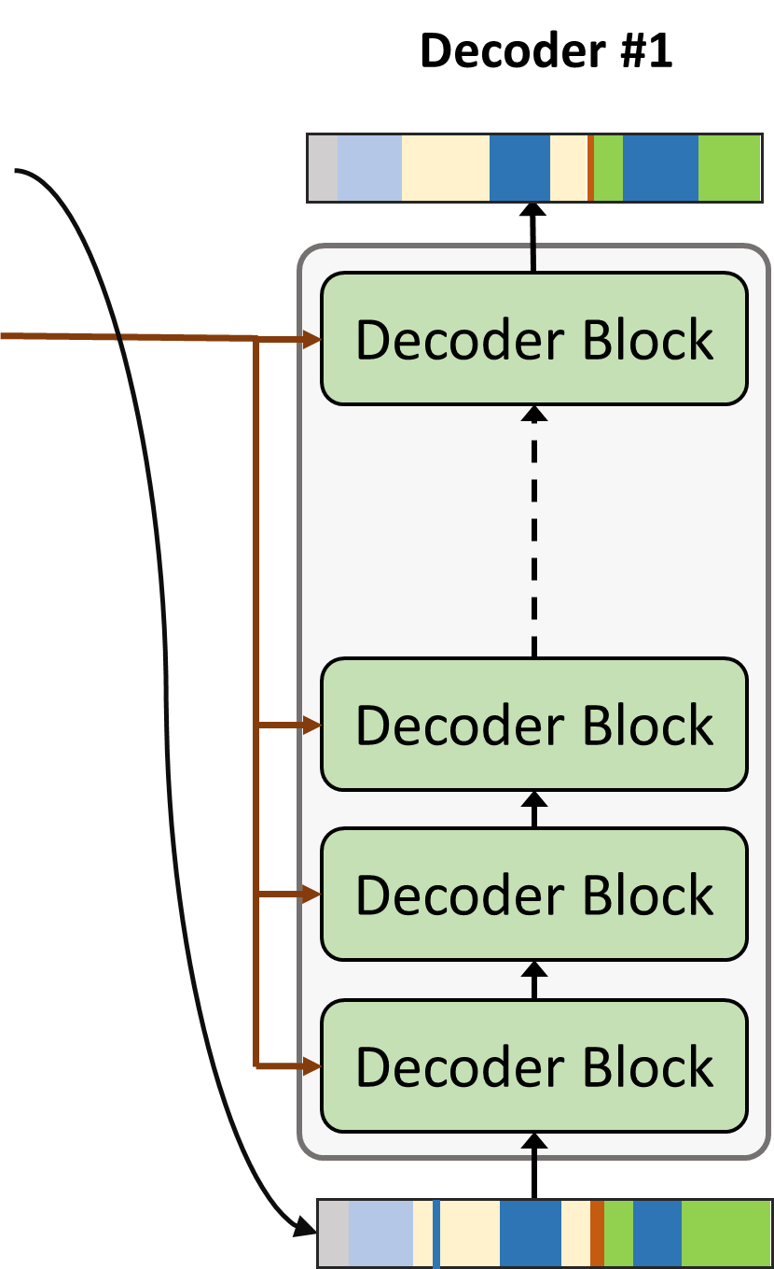
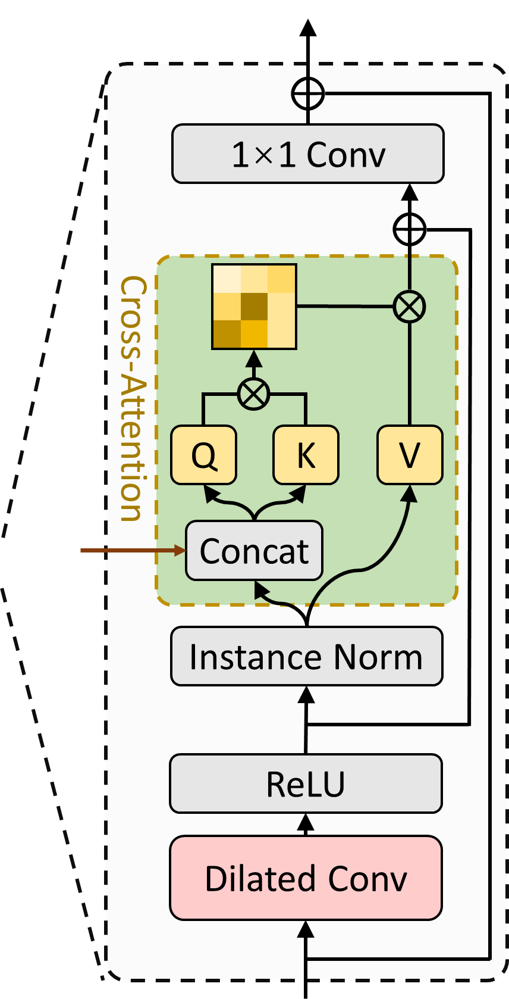
ASFormer: Transformer for Action Segmentation
“Query” for information to perform the refinement
I3D
Notes:
As the Temporal relations among multiple action segments play an important role in the action segmentation task, the initial predictions will be passed to the decoder for the refinement demand. The decoder block has the similar structure with the encoder block, but with a carefully designed cross-attention layer, which allows the decoder to “Query” for information to perform the refinement.

Slide 9
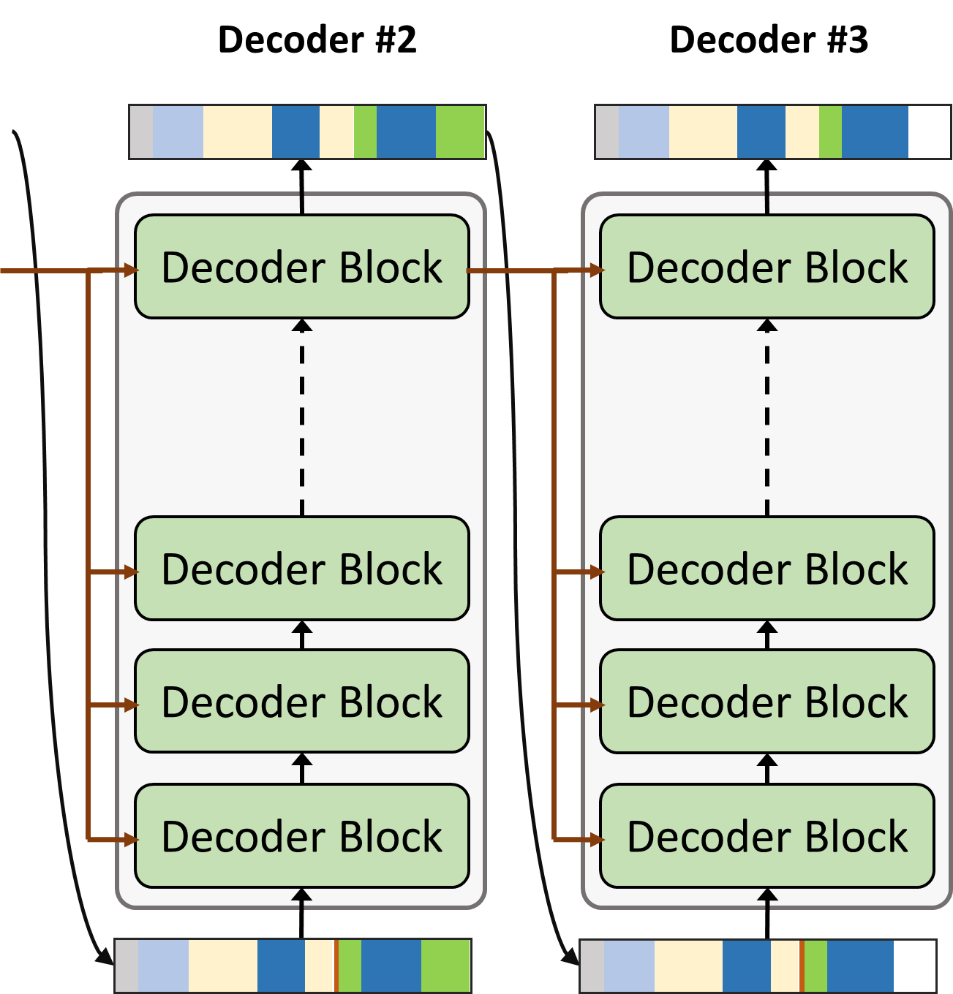
ASFormer: Transformer for Action Segmentation
Final Predictions
I3D
Notes:
Naturally, we then expand the single decoder to a multiple version to perform iterative refinement.

Slide 10
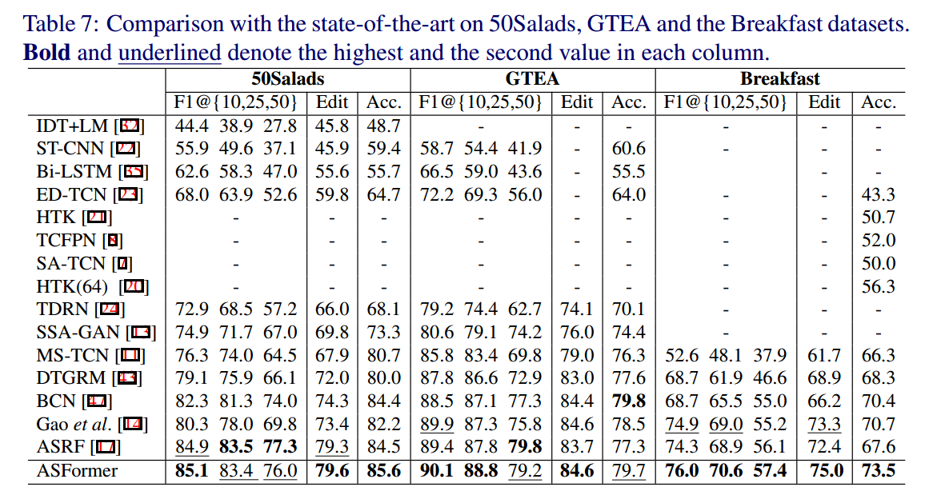
Experiments
Comparison with State-Of-The-Art
Notes:
Here comes the comparison with other works. We achieve state-of-the-art results on three public benchmarks.

Slide 11
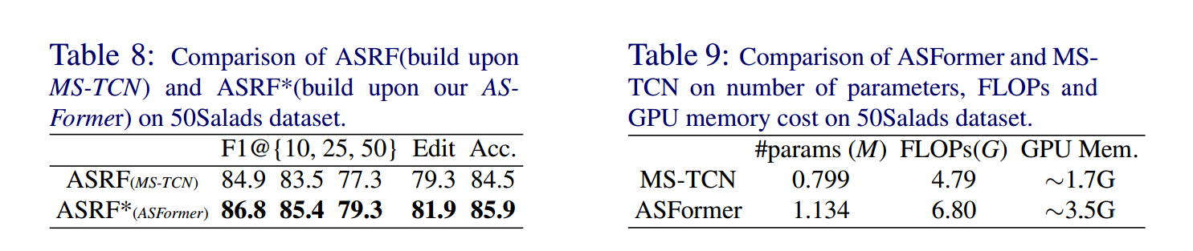
Experiments
Comparison as a backbone
Notes:
Our Asformer also provides an alternative backbone choice for the community. As shown in tab. 8, we replace the MS-TCN backbone in one of recent work with our asformer and achieve better performance. Further, we also compare of the MS-TCN with our ASFORMER in terms of the computation cost in Tab.9., where additional computational burden of our ASFormer is acceptable with the modern chips.

Slide 12
Thanks
Code is available at https://github.com/ChinaYi/ASFormer
Notes:
Thanks for watching and welcome to read our paper for more details.

Slide 13
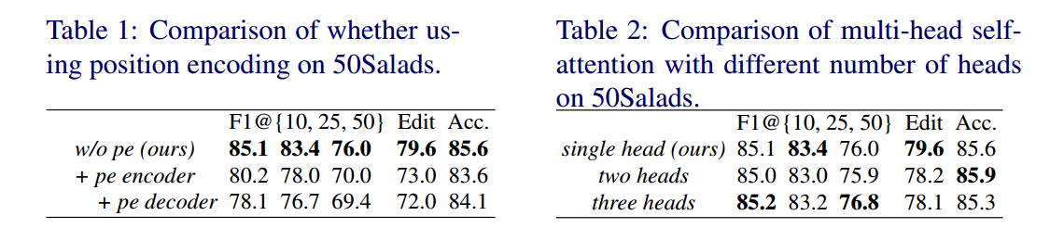
Experiments
The introduction of temporal convolution makes our model free from position encoding and multi-head self-attention.
Notes:
Here is the experiments part. tab.1 and tab.2 show that temporal convolution makes our model free from position encoding and multi-head self-attention.

Slide 14
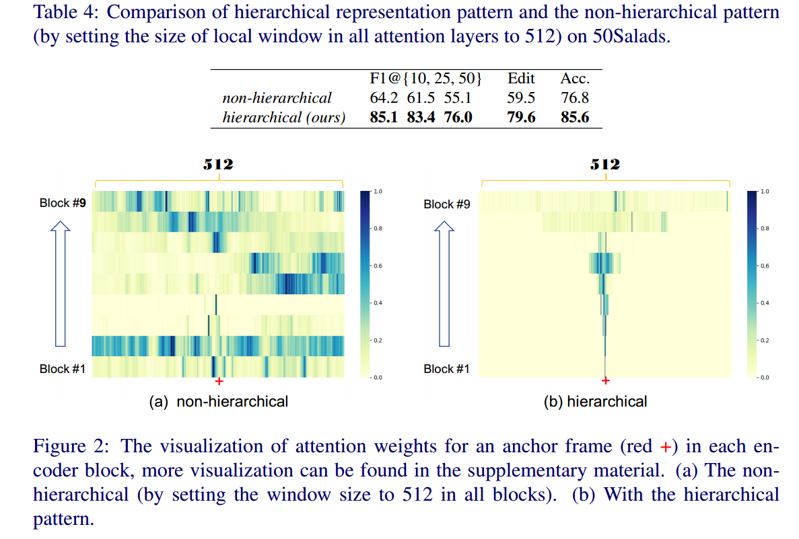
Experiments
Effect of the hierarchical representation pattern
Notes:
The hierarchical representation pattern also contributes a lot. As show in the tab.4, With out the hierarchical representation pattern , the performance drops a lot. Further, we visualize the attention weights in Fig.2, which clearly shows that the attention weights tends to be trivial uniform distribution without the hierarchical pattern.

Slide 15
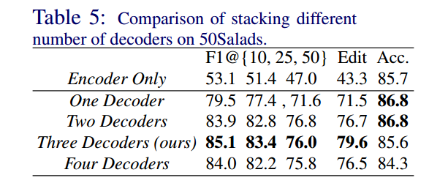
Experiments
Effect of the decoders
Notes:
Meanwhile, the carefully designed decoders also take advantage of temporal relations for refinement, as show in the tab.5

