Slide 1

OSMO: Online Specific Models for Occlusion in Multiple Object Tracking under Surveillance Scene
Xu Gao, Tingting Jiang
Peking University
10/2018

Slide 2
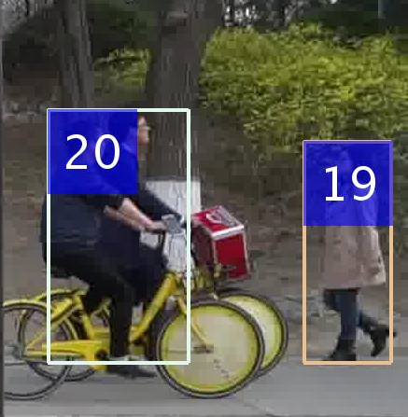
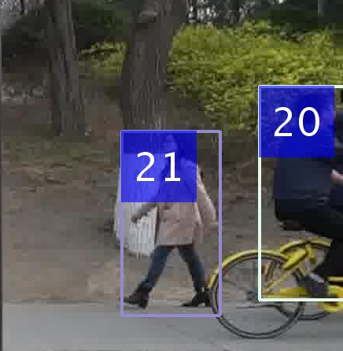
Problem and Challenges
Problem: MOT in surveillance scene
Challenges
Inter-Object Occlusion
ID Switch!
Frame 01
Frame 10

Slide 3
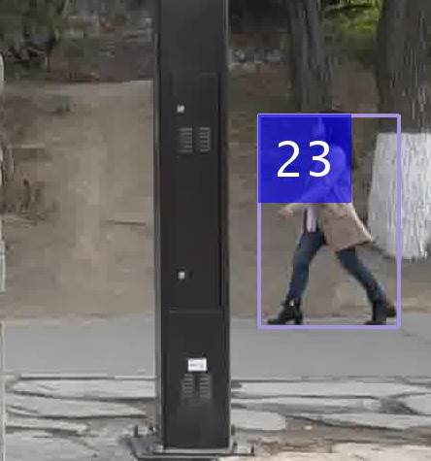
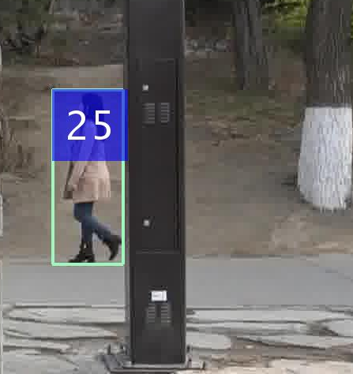
Problem and Challenges
Problem: MOT in surveillance scene
Challenges
Inter-Object Occlusion
Obstacle Occlusion
ID Switch!
Frame 51
Frame 60

Slide 4
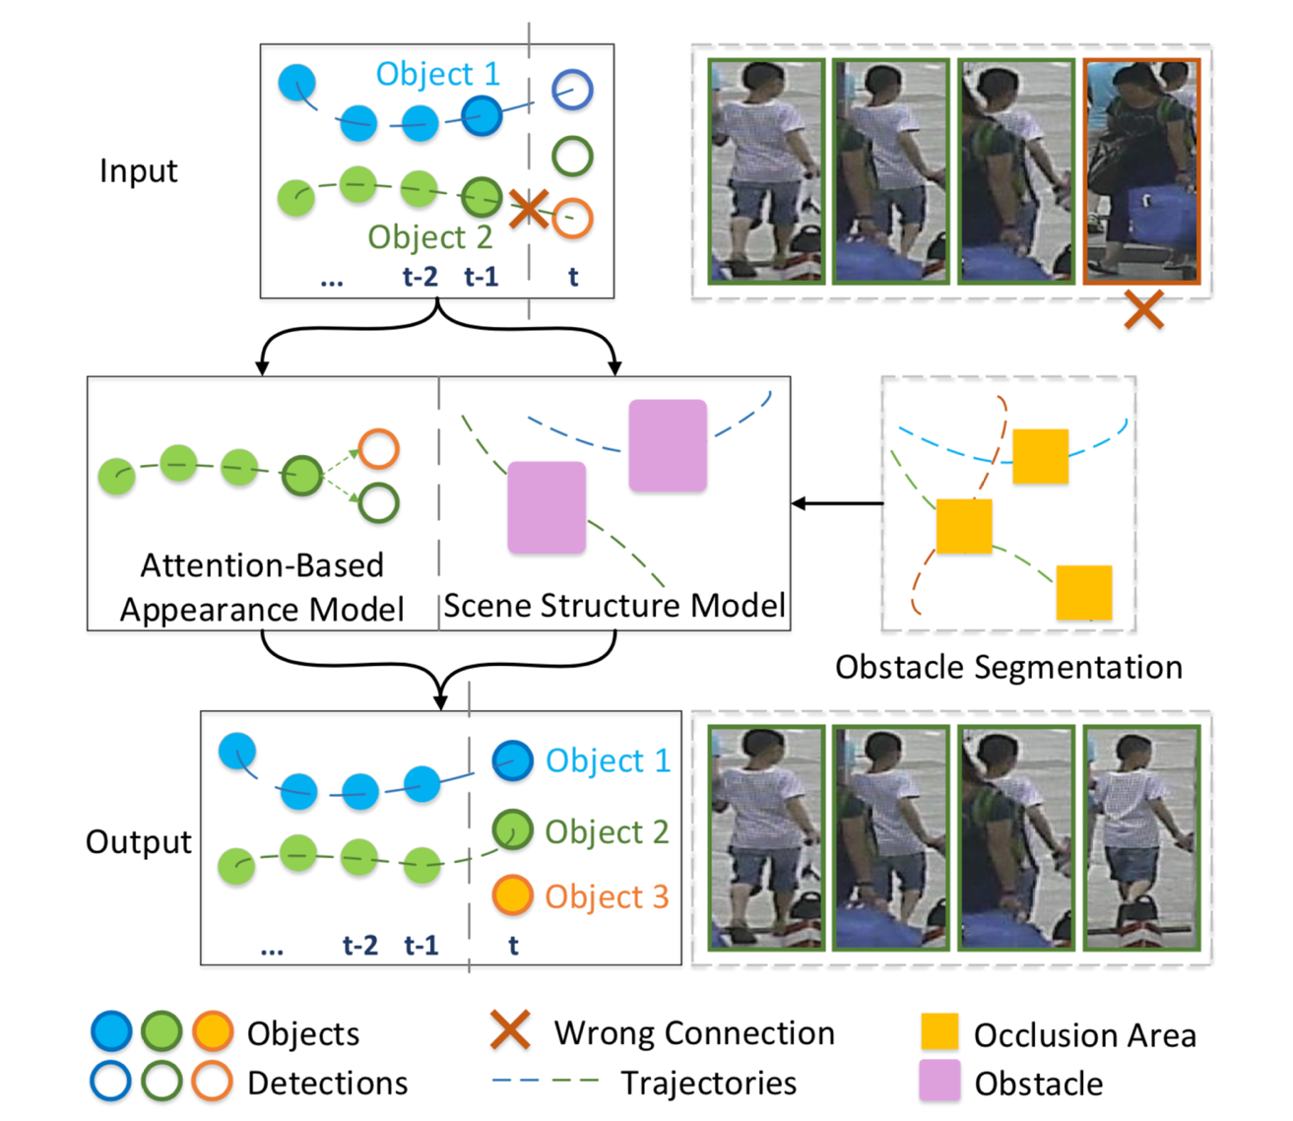
Our Method
An attention-based appearance model
A scene structure model
An obstacle map segmentation method

Slide 5
Location: Crystal Ballroom Lobby
Tuesday 23 October
16:30 – 18:00

