Slide 1




ECCV 2022
2D Amodal Instance Segmentation Guided
by 3D Shape Prior
Zhixuan Li^{1,2}, Weining Ye², Tingting Jiang^{1,2}, and Tiejun Huang²
¹ Advanced Institute of Information Technology, Peking University, Hangzhou, China
² National Engineering Research Center of Visual Technology, School of Computer Science,
Peking University, Beijing, China
Notes:
Hi, everyone. My name is Zhixuan Li. Our team is from Peking University, China.
Today I want to introduce our paper named “2D Amodal Instance Segmentation Guided by 3D Shape Prior“.

Slide 2
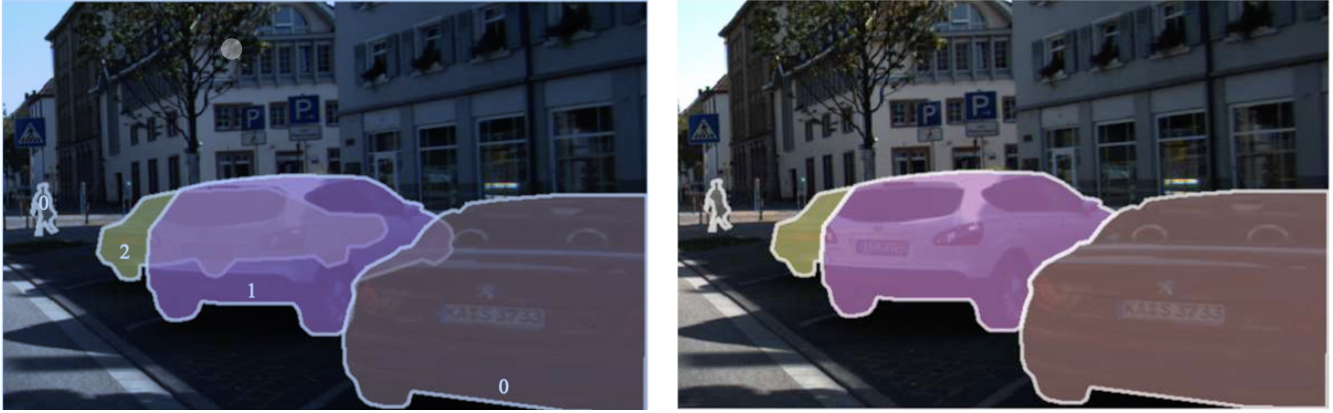
What is Amodal Instance Segmentation?
Amodal Instance Segmentation (AIS)
Shapes of visible and invisible regions are both predicted
(a) Amodal Instance Segmentation
(b) Visible Instance Segmentation
Notes:
At present, visible instance segmentation has been widely studied. Amodal instance segmentation is a more challenging task than visible instance segmentation.
Amodal instance segmentation aims to predict the complete mask of the occluded instance, including both visible and invisible regions. Amodal instance segmentation can be called as AIS for short.

Slide 3
Problems in existing AIS method
Learn 2D amodal shapes in 2D space
The real shape in 3D space is not learned
Hard to generalize to new viewpoint
Notes:
There are several problems reserved in existing amodal instance segmentation methods.
For example:
All existing AIS methods learn 2D amodal shapes in 2D space
Which means the real shape of each object in the 3D space is not learned
Therefore, for a new viewpoint which has not appeared in the training dataset, existing AIS methods are hard to generalize to the new viewpoints of the same 3D object.

Slide 4
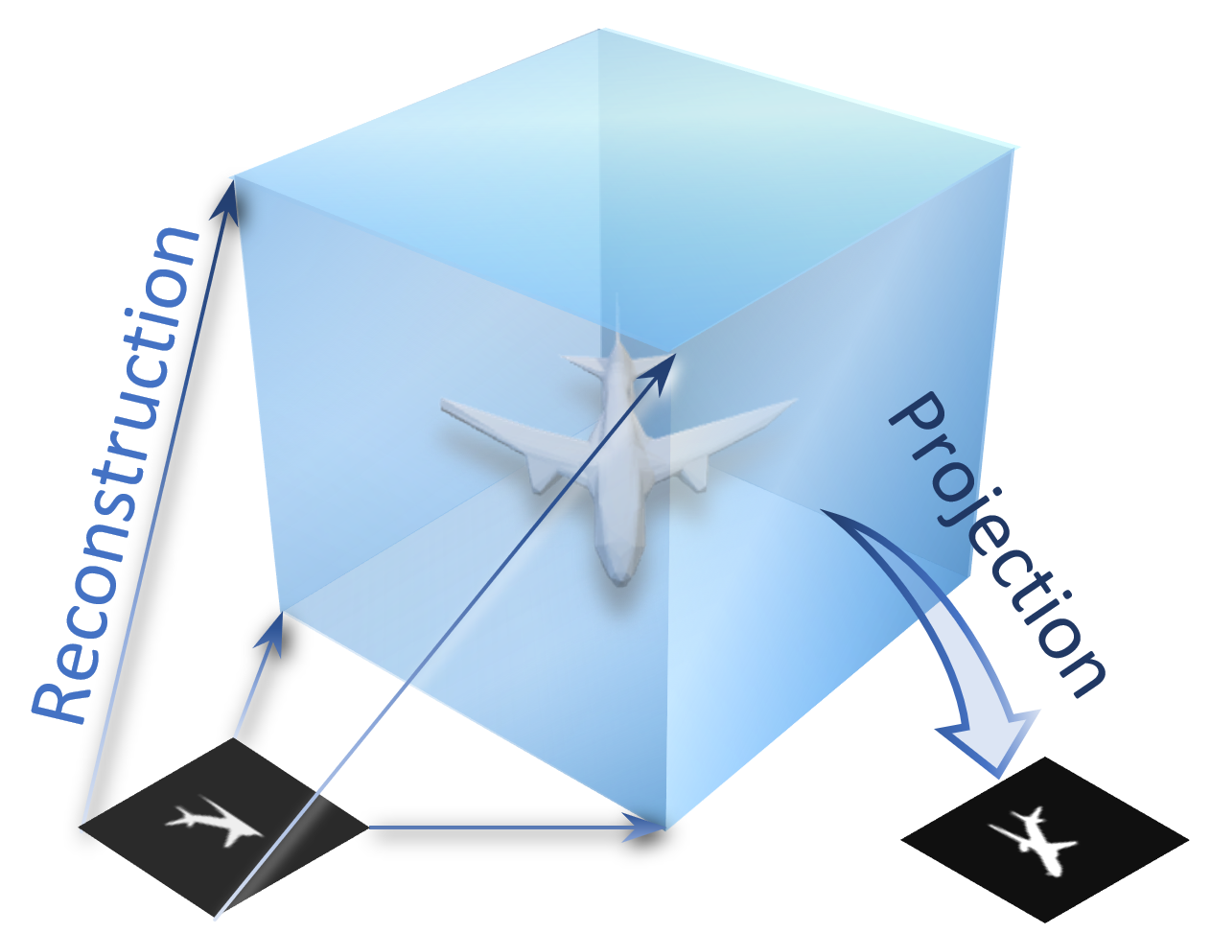
Observation
2D amodal mask is the projection of 3D model
3D model can be reconstructed from 2D instances
Notes:
We are motivated by two simple observations.
First, 2D amodal mask is the projection of 3D model
Second, 3D model can be reconstructed from 2D instances
Therefore, in this paper, we aim to build a bridge between the 2D occluded mask and the 3D completed object by using unsupervised 3D reconstruction.

Slide 5
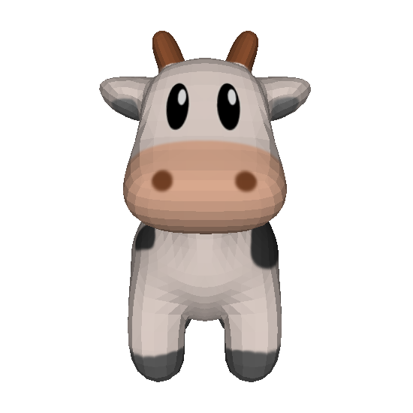
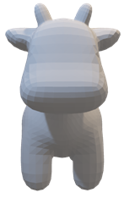

Unsupervised 3D reconstruction
Input Image
Predicted Shape
Predicted Mask
Ground-truth
Mask
3D Shape Network
Differentiable
Renderer
Notes:
The unsupervised 3D reconstruction framework takes an 2D image as input.
Then the 3D shape network reconstructs the 3D model from the 2D image.
Next the differentiable renderer projects the 3D model to the 2D mask.
Finally, the ground-truth 2D mask is used for supervision.
The entire framework does not need the ground-truth 3D model.

Slide 6
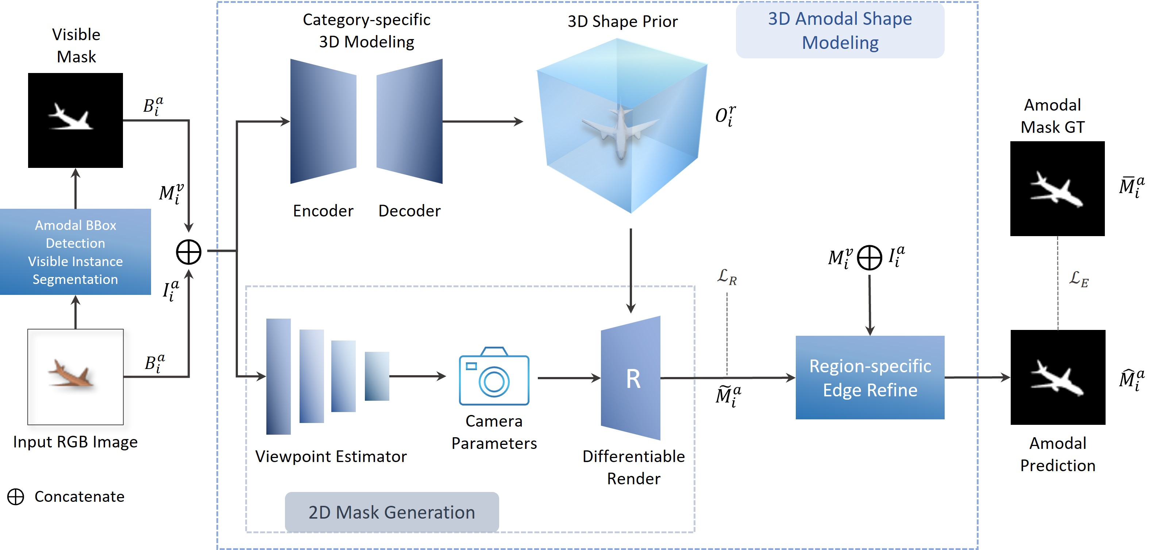
Overview of our method
Notes:
This is the overview framework of our method.
Our method contains five steps. The orders are from left to right.

Slide 7
Overview of our method
Step 1
Amodal bounding box detection
Visible instance segmentation
Notes:
In the first step, for each image which contains several instances, the amodal bounding boxes are detected and the visible masks are segmented.

Slide 8
Overview of our method
Step 2
Single-view Unsupervised 3D Reconstruction for learning the 3D shape prior
The ground truth of 3D model are not used
Notes:
In the second step, an encoder-decoder is used to learn the 3D shape prior from the 2D visible mask and appearance feature of each instance.

Slide 9
Overview of our method
Step 3
Unsupervised Learning for Viewpoint Estimation
Notes:
In the third step, the viewpoint estimator predicts the camera parameters of each object. The camera parameters represents the viewpoint to observe and project the 3D object.

Slide 10
Overview of our method
Step 4
Differentiable Render for Projecting from 3D model to 2D mask
Notes:
In the fourth step, the differentiable render projects the 3D shape prior model to the 2D space, to obtain the coarse 2D amodal mask.

Slide 11
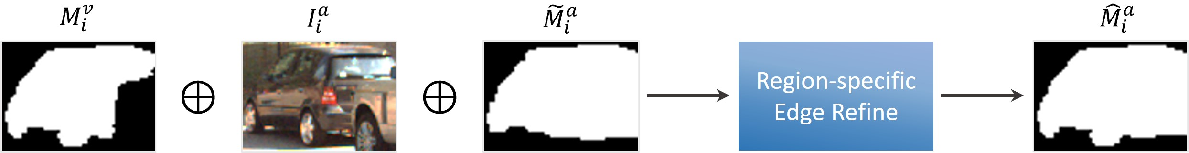
Overview of our method
Step 5
Refinement for the edge
Notes:
Finally, in the fifth step, the region-specific edge refine module further improves the quality of the predicted amodal mask to obtain the final prediction.

Slide 12
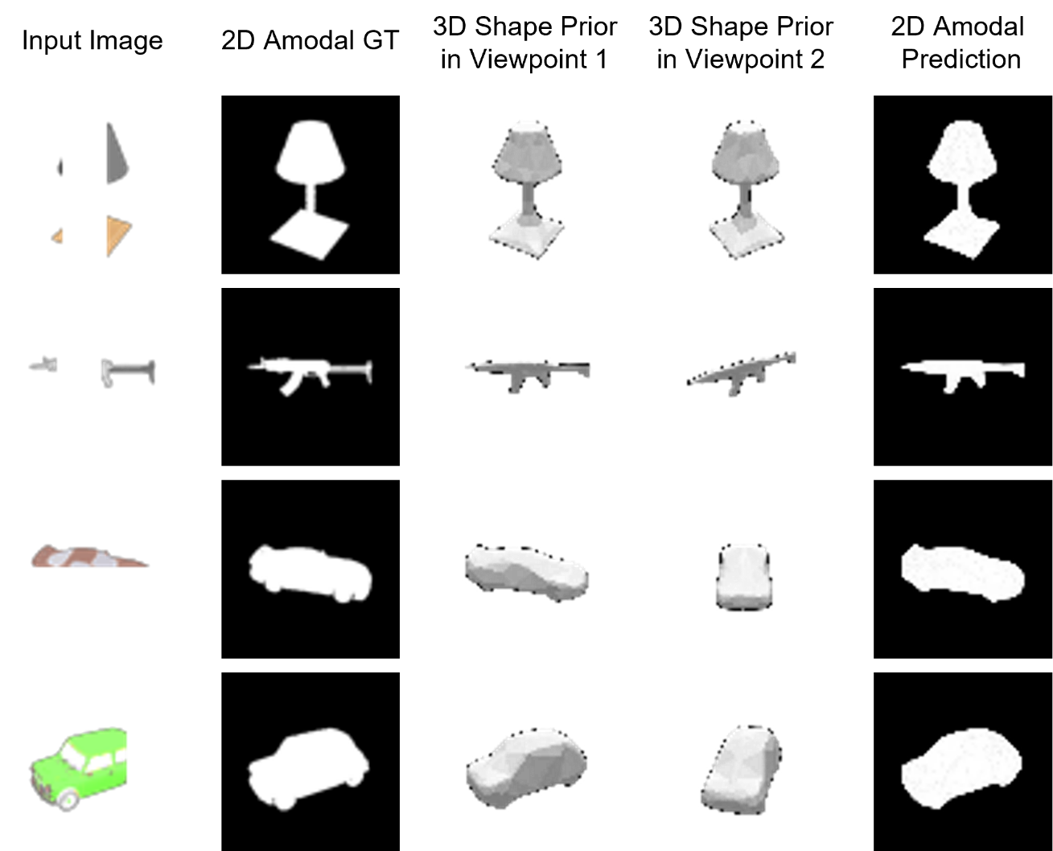
Experiment
Conducted on four challenging datasets
ShapeNet
COCOA-cls
D2SA
KINS
Qualitative result on the ShapeNet dataset
Notes:
We have conducted experiments on four challenging datasets, including ShapeNet, COCOA-cls, D2SA and KINS.
The qualitative result on the ShapeNet dataset are shown in the right side.
For each instance, our method can predict both the 3D shape prior model and the 2D amodal mask.

Slide 13
Thanks for watching!
Email: zhixuanli@pku.edu.cn
Notes:
Thanks for your watching!

