Slide 1






Towards Unified Surgical Skill Assessment
Daochang Liu, Qiyue Li, Tingting Jiang, Yizhou Wang, Rulin Miao, Fei Shan, Ziyu Li
Notes:
Hi, welcome to this video. I am daochang Liu from peking university.
In this video, I am going to introduce our framework for automatic surgical skill assessment.

Slide 2
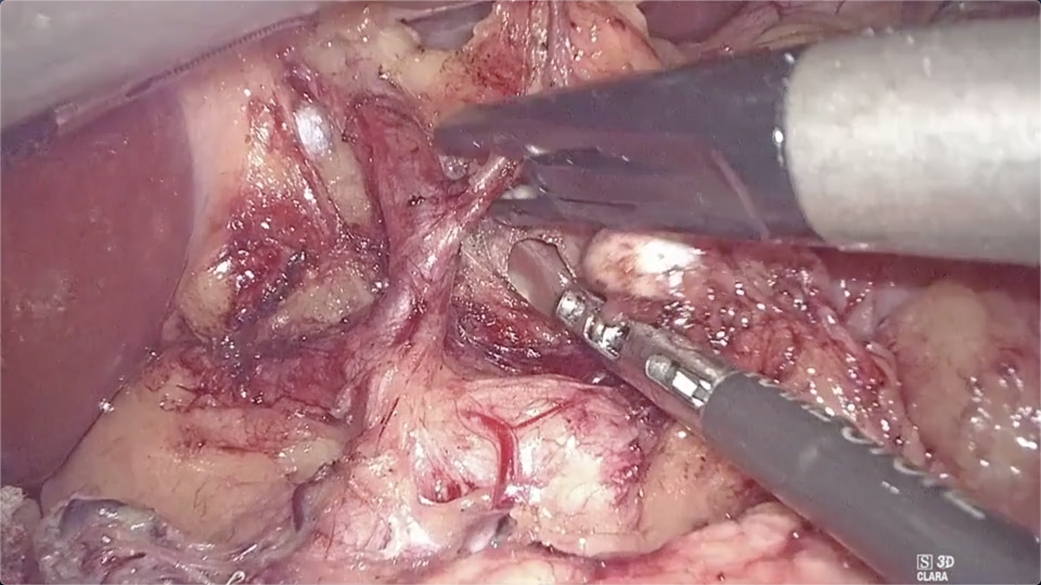
Automatic Surgical Skill Assessment
Input: Surgical Video
Output: Skill Score
3.6 / 5.0
Laparoscopic camera
Surgical robots
External devices
Technical metrics
Procedural metrics
Other metrics
Notes:
The task is to automatically predict how well a surgery is performed using the video of the surgery.
The input can be videos captured by the built-in cameras in surgical devices or other external cameras.
And the output will be some skill scores in terms of technical skills, procedural skills or others.

Slide 3
Automatic Surgical Skill Assessment
Input: Surgical Video
Output: Skill Score
3.6 / 5.0
Laparoscopic camera
Surgical robots
External devices
Technical metrics
Procedural metrics
Other metrics
Why automatic skill assessment
Applications
Crucial for patient safety
Laborious manual assessment
Enormous videos from ORs
Efficient surgical training
Surgical quality control
Automatic surgical robots
Notes:
The motivation of automatic skill assessment is that surgical skills are very important for the patients, but also very time-consuming to assess manually.
Using surgical videos and computer vision techniques could be a good way to automate this process, and it could have applications in surgical training, quality control, and the design of automatic surgical robots.

Slide 4
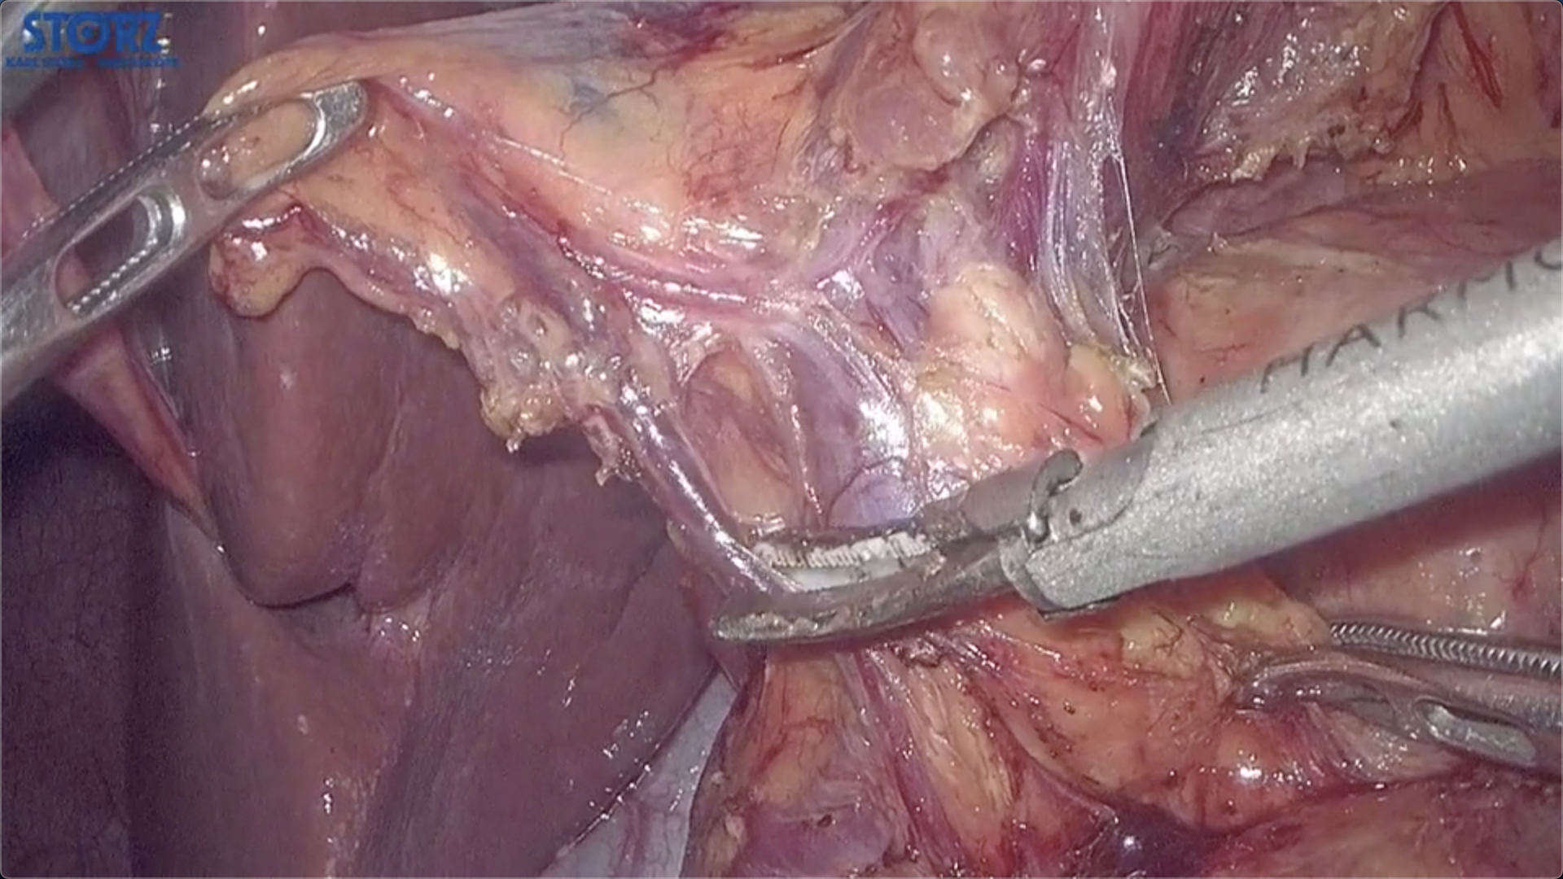
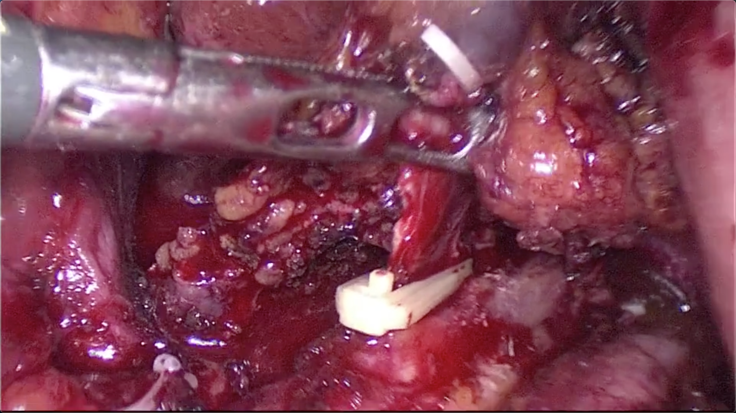
Different Aspects of Surgical Skills
Tool Usage
Field Clearness
e.g., Skill Proxy
Event Pattern
High Skill
Low Skill
Tool Movement
Dissection Area
Procedural Event
Adverse Event
Notes:
Surgical skill assessment is a difficult task because surgical skills are very complex and have many aspects.
In this project, we discuss a lot with our partner surgeons and identify three important aspects of surgical skills that are suitable
for automatic assessment.

Slide 5
Different Aspects of Surgical Skills
Tool Usage
Field Clearness
e.g., Skill Proxy
Event Pattern
High Skill
Low Skill
Tool Movement
Dissection Area
Procedural Event
Adverse Event
Notes:
The first one is the usage of surgical tools, which could tell us about the instrument proficiency and motion efficiency of the surgeon.
The second aspect to use surgical field clearness as a skill proxy.
And the third aspect is the pattern of the events during the surgery, which is related to the surgeon’s knowledge about the procedure.
In summary, a high-skilled surgeon is more likely to have a smooth and focused tool trajectory, a good visibility of the surgical field, and a linear pattern of events.

Slide 6
Multi-Path Framework for Surgical Skill Assessment
Surgical Video
Notes:
After knowing these different aspects of surgical skills, we propose a multi-path framework for automatic skill assessment, which tries to incorporate all the aspects together.

Slide 7
Multi-Path Framework for Surgical Skill Assessment
Each path takes care of a skill aspect, with four paths in total (Visual, Tool, Proxy, Event)
Path 1
Surgical Video
Path 2
Notes:
The input to our framework is a surgical video,and there are multiple paths.
Each path takes care of a skill aspect, and there are four paths in total, corresponding to tools, proxies, events and a visual baseline.

Slide 8


Multi-Path Framework for Surgical Skill Assessment
Each path takes care of a skill aspect, with four paths in total (Visual, Tool, Proxy, Event)
Path 1
Input Feature
$$X_{1}$$
Surgical Video
Path 2
$$X_{2}$$
Input Feature
Notes:
In each path, features, that are specific to each aspect, are extracted from the video,

Slide 9





Multi-Path Framework for Surgical Skill Assessment
Each path takes care of a skill aspect, with four paths in total (Visual, Tool, Proxy, Event)
Path 1
Input Feature
$$X_{1}$$
$${\overline{X}}_{1}$$
$$φ$$
Encoding Function
$$φ_{1}$$
Embedding
Surgical Video
Embedding
$$φ_{2}$$
Path 2
$$X_{2}$$
$${\overline{X}}_{2}$$
Input Feature
Notes:
And then embedded by some encoding functions.

Slide 10





Multi-Path Framework for Surgical Skill Assessment
Each path takes care of a skill aspect, with four paths in total (Visual, Tool, Proxy, Event)
Path 1
Input Feature
$$X_{1}$$
$${\overline{X}}_{1}$$
$$φ$$
Encoding Function
Score Function
$$φ_{1}$$
$$λ_{1}$$
Embedding
$$S_{1}$$
$$λ$$
Score Sequence
Surgical Video
Embedding
$$φ_{2}$$
$$λ_{2}$$
$$S_{2}$$
Path 2
$$X_{2}$$
$${\overline{X}}_{2}$$
Score Sequence
Input Feature
Notes:
The embeddings are then passed into some score functions to get a score sequence in each path, which indicates how well the surgery is performed at every time step.

Slide 11


Multi-Path Framework for Surgical Skill Assessment
Each path takes care of a skill aspect, with four paths in total (Visual, Tool, Proxy, Event)
Path 1
Input Feature
$$X_{1}$$
$${\overline{X}}_{1}$$
$$φ$$
Encoding Function
Score Function
$$φ_{1}$$
$$λ_{1}$$
Embedding
$$S_{1}$$
$$λ$$
Score Sequence
Surgical Video
Path Dependency Module
$$ψ$$
$$ψ$$
Aggregation Function
Embedding
$$φ_{2}$$
$$λ_{2}$$
$$S_{2}$$
Path 2
$$X_{2}$$
$${\overline{X}}_{2}$$
Score Sequence
Input Feature
Modeling the relationships among aspects
Notes:
On the other hand, the input features are gathered in a path dependency module to model the relationships among aspects.

Slide 12





Multi-Path Framework for Surgical Skill Assessment
Each path takes care of a skill aspect, with four paths in total (Visual, Tool, Proxy, Event)
Path 1
Input Feature
$$X_{1}$$
$${\overline{X}}_{1}$$
$$φ$$
Encoding Function
Score Function
$$φ_{1}$$
$$λ_{1}$$
Embedding
$$S_{1}$$
$$λ$$
Score Sequence
Surgical Video
Path Dependency Module
$$ω_{1}$$
$$W_{1}$$
$$ψ$$
Weight Sequence
$$ω_{2}$$
$$W_{2}$$
Weight Sequence
$$ψ$$
Aggregation Function
Weight Function
Embedding
$$ω$$
$$φ_{2}$$
$$λ_{2}$$
$$S_{2}$$
Path 2
$$X_{2}$$
$${\overline{X}}_{2}$$
Score Sequence
Input Feature
Modeling the relationships among aspects
Notes:
The aggregation of the features will be passed into some weight functions to get a weigh sequence for each path, which indicates the importance at every time step.

Slide 13

Multi-Path Framework for Surgical Skill Assessment
Each path takes care of a skill aspect, with four paths in total (Visual, Tool, Proxy, Event)
Path 1
Input Feature
$$X_{1}$$
$${\overline{X}}_{1}$$
$$φ$$
Encoding Function
Score Function
$$φ_{1}$$
$$λ_{1}$$
Embedding
$$S_{1}$$
$$λ$$
Score Sequence
Surgical Video
Path Dependency Module
$$ω_{1}$$
$$W_{1}$$
Skill Score
$$ψ$$
Weight Sequence
$$q$$
MSE Loss
$$ω_{2}$$
$$W_{2}$$
Weight Sequence
$$ψ$$
Aggregation Function
Weight Function
Embedding
$$ω$$
$$φ_{2}$$
$$λ_{2}$$
$$S_{2}$$
Path 2
$$X_{2}$$
$${\overline{X}}_{2}$$
Score Sequence
Input Feature
Modeling the relationships among aspects
Temporal attention mechanism and multi-path fusion
Notes:
Then, the scores are weighted by the weight sequence and fused across paths to get the final video-level skill prediction.

Slide 14





Multi-Path Framework for Surgical Skill Assessment
Each path takes care of a skill aspect, with four paths in total (Visual, Tool, Proxy, Event)
$$σ_{1}$$
$$F_{1}$$
Contrastive Loss
Predicted Embedding
Path 1
Input Feature
$$X_{1}$$
$${\overline{X}}_{1}$$
$$φ$$
Encoding Function
Score Function
$$φ_{1}$$
$$λ_{1}$$
Embedding
$$S_{1}$$
$$λ$$
Score Sequence
Surgical Video
Path Dependency Module
$$ω_{1}$$
$$W_{1}$$
Skill Score
$$ψ$$
Weight Sequence
$$q$$
MSE Loss
$$ω_{2}$$
$$W_{2}$$
Weight Sequence
$$ψ$$
Aggregation Function
Weight Function
Predicting Function
Embedding
$$ω$$
$$φ_{2}$$
$$λ_{2}$$
$$S_{2}$$
$$σ$$
Path 2
$$X_{2}$$
$${\overline{X}}_{2}$$
Score Sequence
Input Feature
$$σ_{2}$$
Predicted Embedding
Contrastive Loss
Modeling the relationships among aspects
$$F_{2}$$
To alleviate the scarcity of annotated data
Temporal attention mechanism and multi-path fusion
Notes:
Besides, we use contrastive learning to handle the lack of labeled data, by letting the model predict the future based on the past.
Ok, so far is for our multi-path framework.

Slide 15
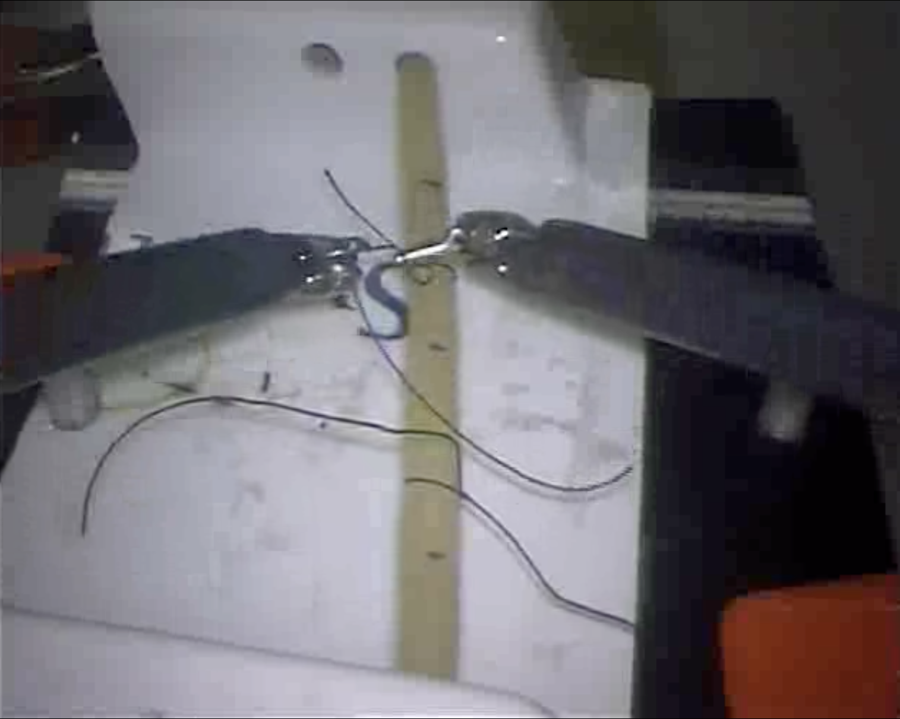
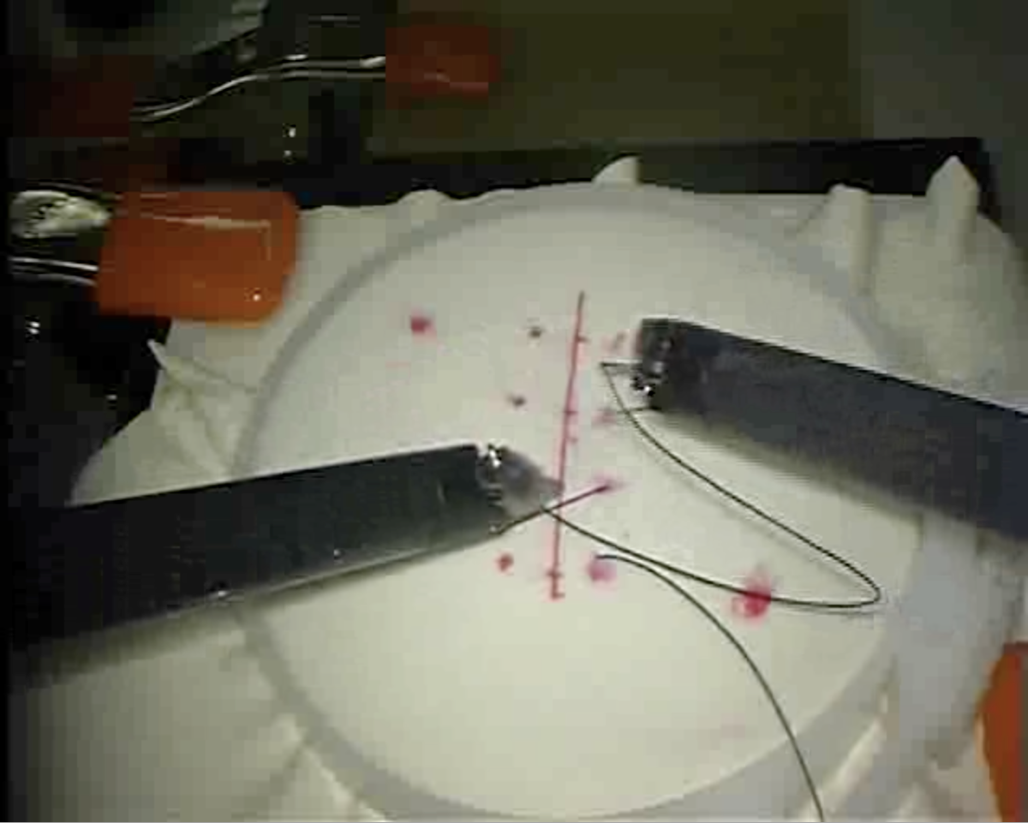
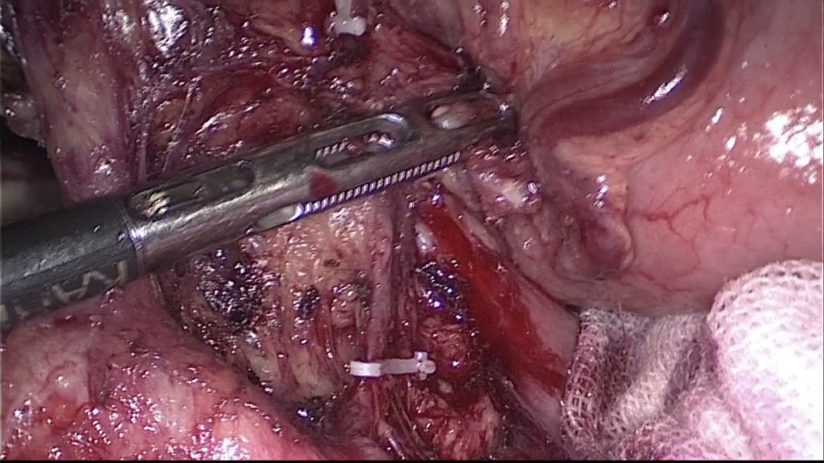
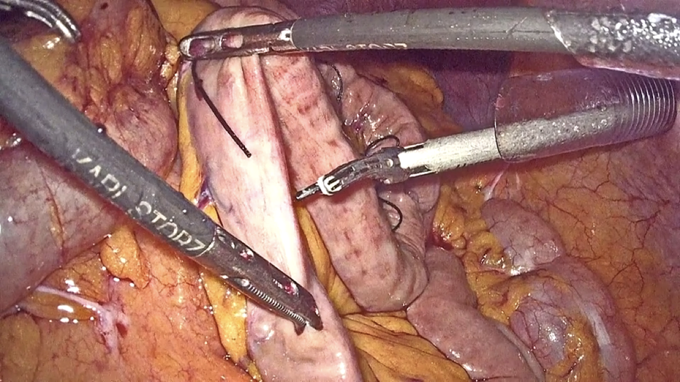
Dataset
Simulated Dataset (JIGSAWS)
Our Clinical Dataset
Benchtop model
Da Vinci surgical robot
Suturing / Needing-passing / Knot-tying
In vivo
Laparoscopic video
Gastrectomy
Notes:
The proposed framework is evaluated on two surgical datasets, one is a public dataset of simulated suturing, needing-passing and knot-tying, the other is our clinical dataset of laparoscopic Gastrectomy.

Slide 16
Our Clinical Data
Dataset Statistics
Detailed Event Annotation (41 Classes)
20 gastrectomy videos
Captured by laparoscopy
199 minutes per video
7 OSATS skill metrics
13 coarse-grained procedural events
13 fine-grained procedural events
8 adverse events and 2 repair events
5 video recording events

Slide 17
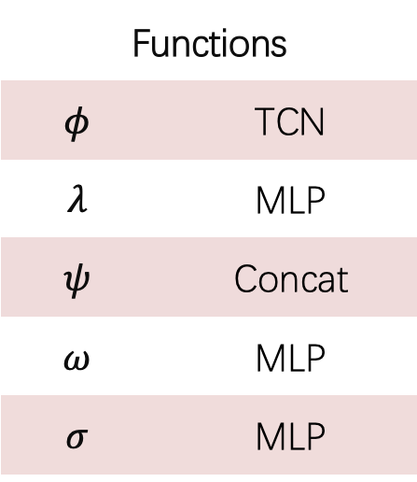
Framework Instantiation
Instantiation
Path Input Features
Functions
$$φ$$ | TCN
$$λ$$ | MLP
$$ψ$$ | Concat
$$ω$$ | MLP
$$σ$$ | MLP
 | Simulated Data | Clinical Data
Visual | Image-Net pretrained ResNet features
Tool | Robotic kinematics | Histograms of tool masks
Proxy | Task completion time | Field clearness [Liu et al.]
Event | Gesture predictions from MS-TCN | Event predictions from MS-TCN

Slide 18
Experiments
Effects of Paths
V: Visual T: Tool P: Proxy E: Event
Simulated Data
Clinical Data
Notes:
In the experiment, we compared the performance between each single path and combinations of multiple paths.

Slide 19
Experiments
Effects of Paths
V: Visual T: Tool P: Proxy E: Event
Simulated Data
Clinical Data
Notes:
On both of the simulated and clinical datasets, we found that using multiple paths is better than using single path.

Slide 20
Experiments
Comparisons to State-of-the-Art
Bars with the same color can be directly compared in each plot
Simulated Data
Clinical Data
Notes:
Our framework is also compared to some state-of-the-art methods.
In these two plots, bars with the same color can be directly compared.

Slide 21
Experiments
Comparisons to State-of-the-Art
Bars with the same color can be directly compared in each plot
Simulated Data
Clinical Data
Notes:
In each colored group, our framework has the best performance.

Slide 22
Conclusion
Conclusion
A flexible multi-path framework to assess surgical skills
Effective on both simulated and clinical surgery data
Future Works
More paths and better functions
More labeled clinical data from ORs
Code Released at github.com/Finspire13
Notes:
Then come to our conclusion, we proposed a flexible multi-path framework to assess surgical skills, which is effective on both simulated and clinical surgeries.
Future works could focus on using more paths and better functions in the framework.
It also very important to have more labeled clinical data for both learning and evaluation.

Slide 23
Thank You!
Liu is Looking for job:
…
Notes:
Thanks for watching and welcome to post your questions and read our paper for more details.

