Slide 1



Multi-level Relationship Capture Network for
Automated Skin Lesion Recognition
Zihao Liu, Ruiqin Xiong, and Tingting Jiang

Slide 2
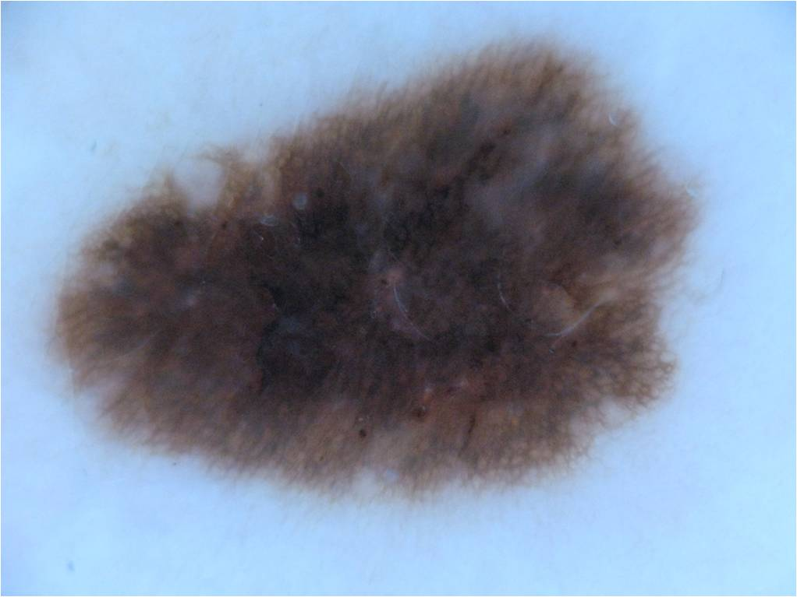
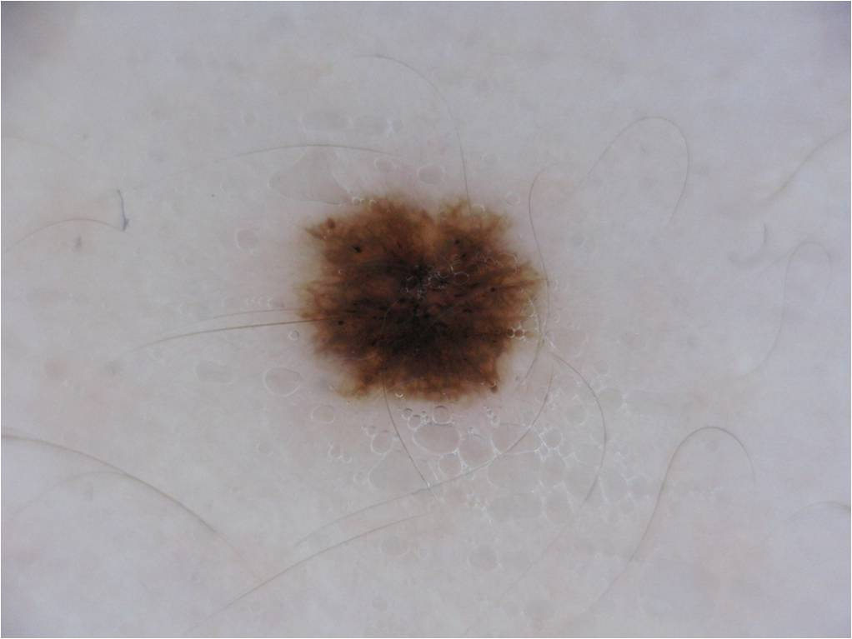
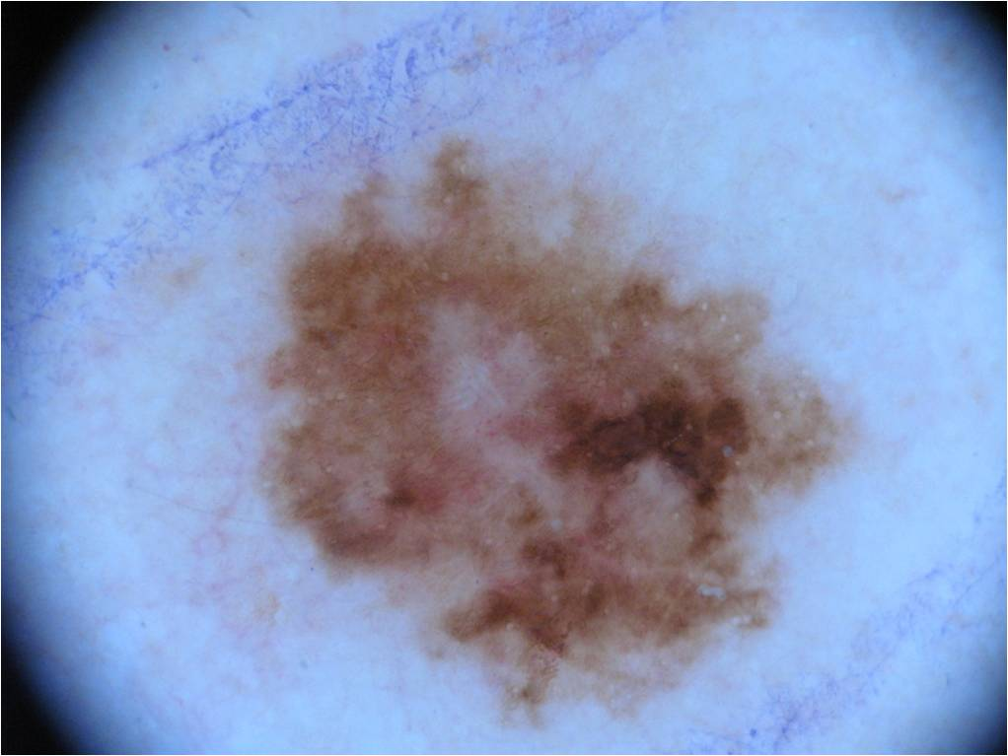
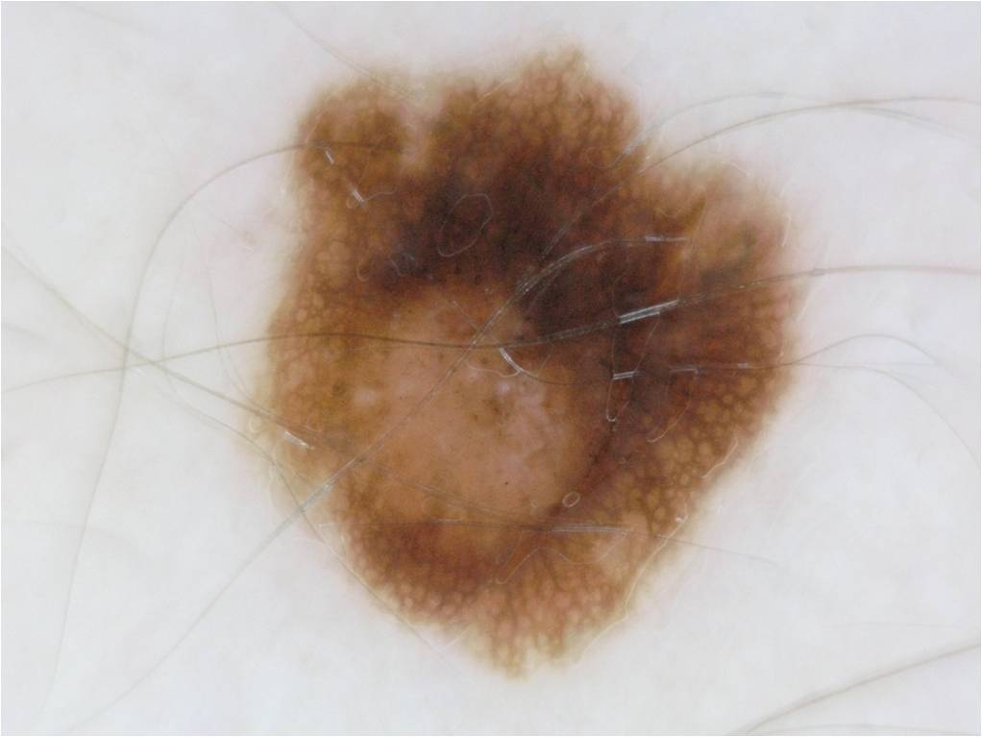
Skin lesion classification
Melanoma
Dermatofibroma
Nevus
…
Dermoscopy image
CNN model
Classification result

Slide 3
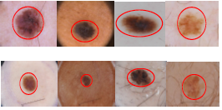
Motivation
Region-level relationship challenge for skin lesion classification
Tool Motion vs. Clearness of Operating Field (COF):
Tool Motion: Difficult or expensive to obtain in clinical setting
Clearness of Operating Field (COF): Only rely on video recordings from the laparoscopic camera
Robotic kinematics
External sensors
Visual tracking
Suggested by surgical experts.

Slide 4
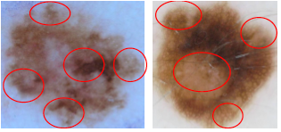
Motivation
Region-level relationship challenge for skin lesion classification
Tool Motion vs. Clearness of Operating Field (COF):
Tool Motion: Difficult or expensive to obtain in clinical setting
Clearness of Operating Field (COF): Only rely on video recordings from the laparoscopic camera
Robotic kinematics
External sensors
Visual tracking
Suggested by surgical experts.

Slide 5
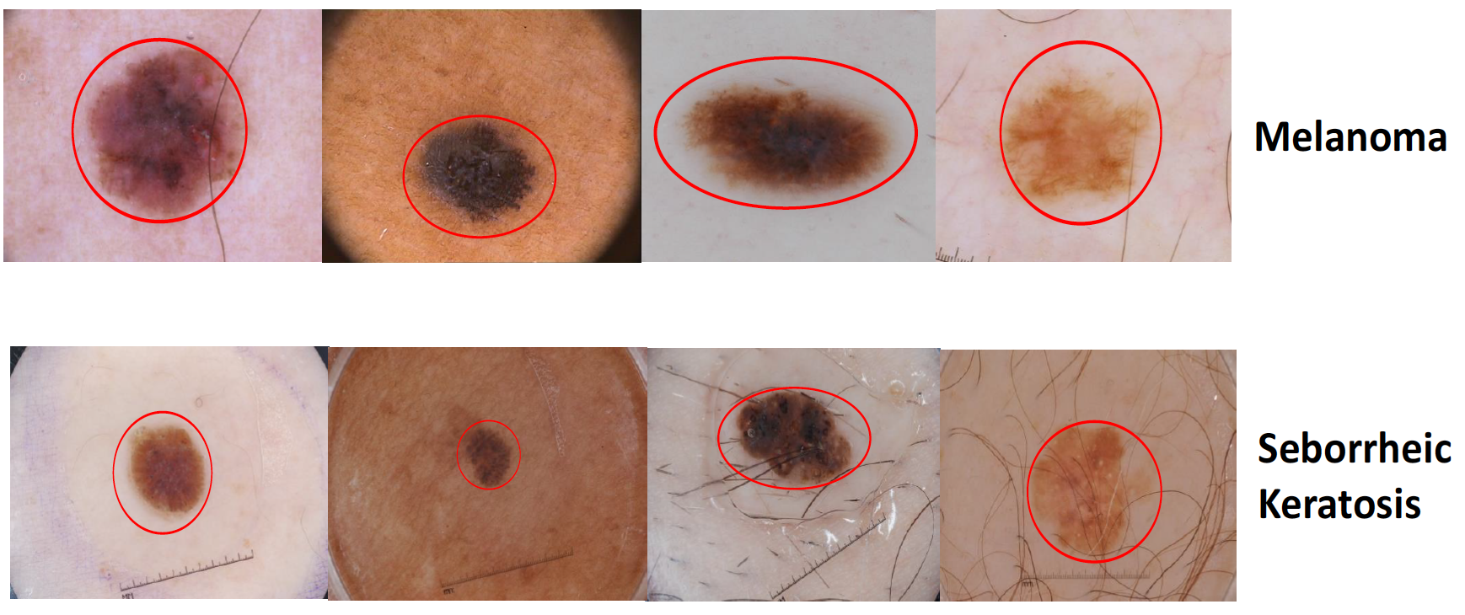
Motivation
Image-level relationship challenge for skin lesion classification
Tool Motion vs. Clearness of Operating Field (COF):
Tool Motion: Difficult or expensive to obtain in clinical setting
Clearness of Operating Field (COF): Only rely on video recordings from the laparoscopic camera
Robotic kinematics
External sensors
Visual tracking
Suggested by surgical experts.

Slide 6
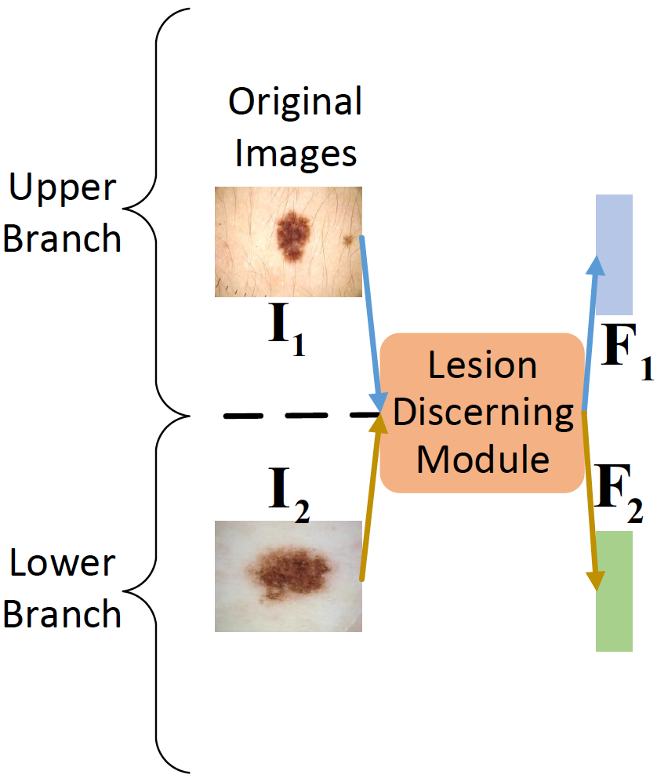
Multi-level Relationship Capture Network

Slide 7
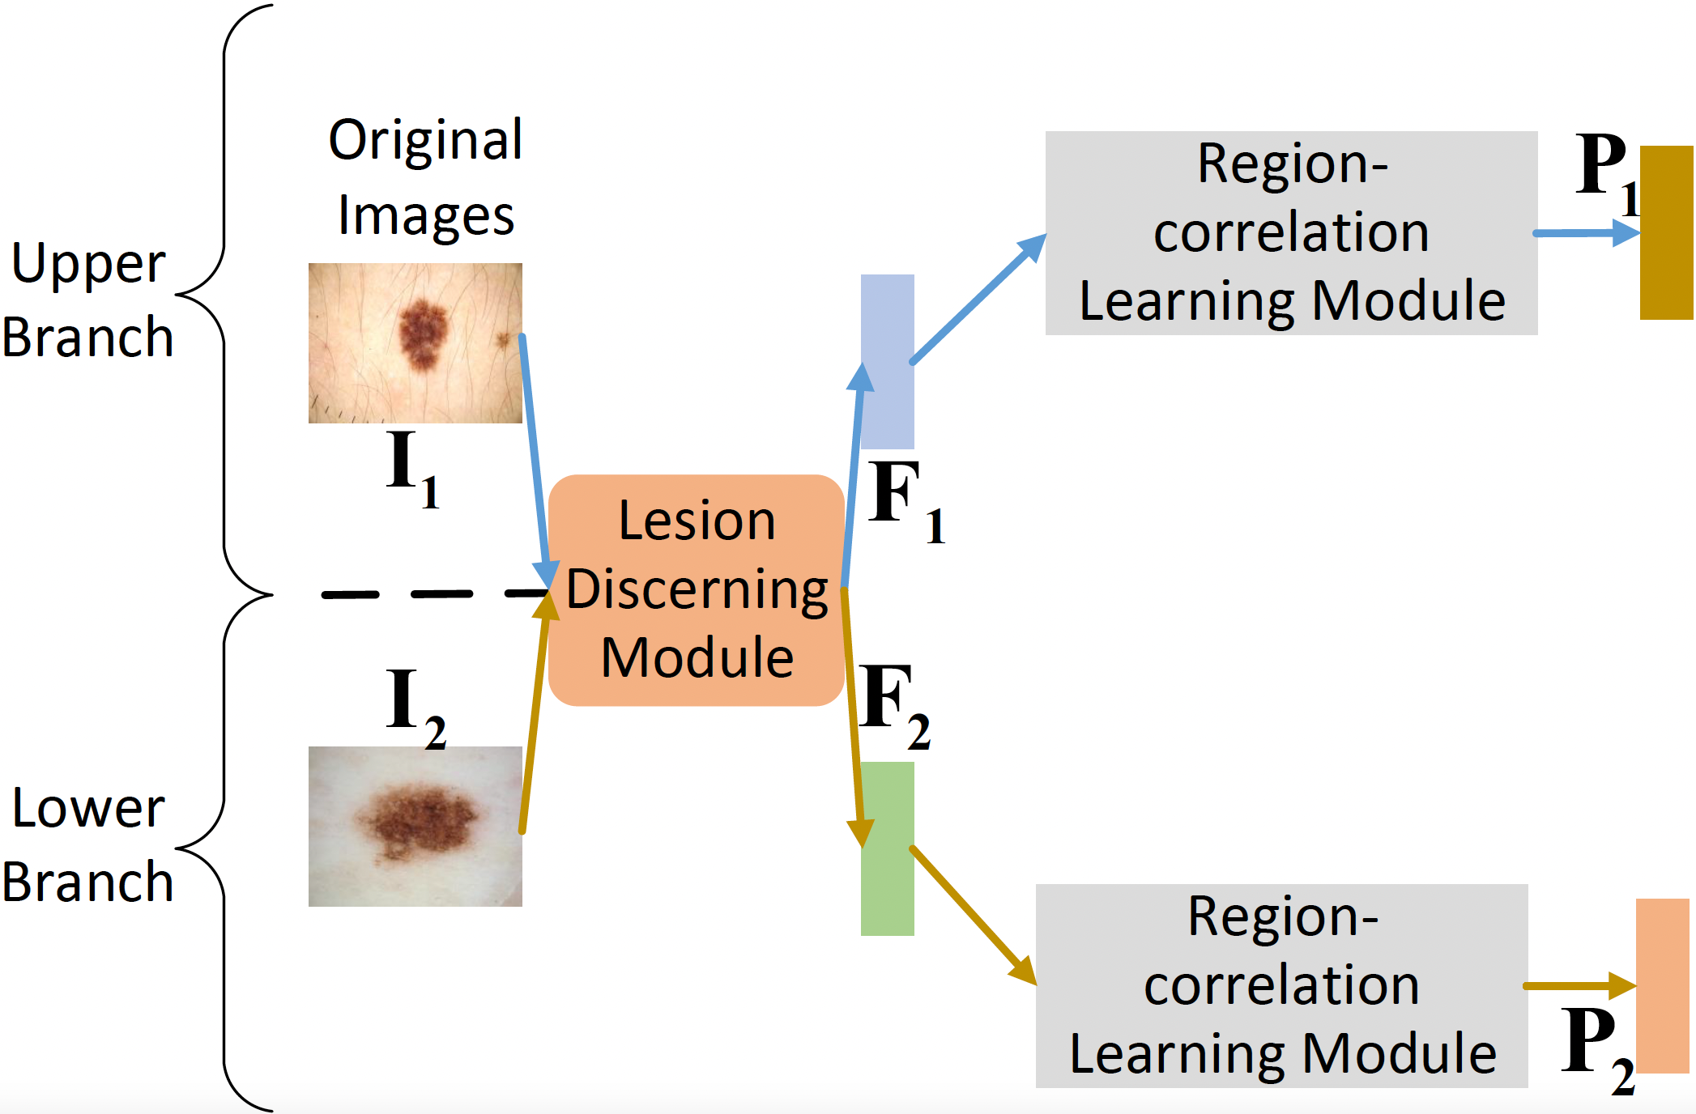
Multi-level Relationship Capture Network

Slide 8
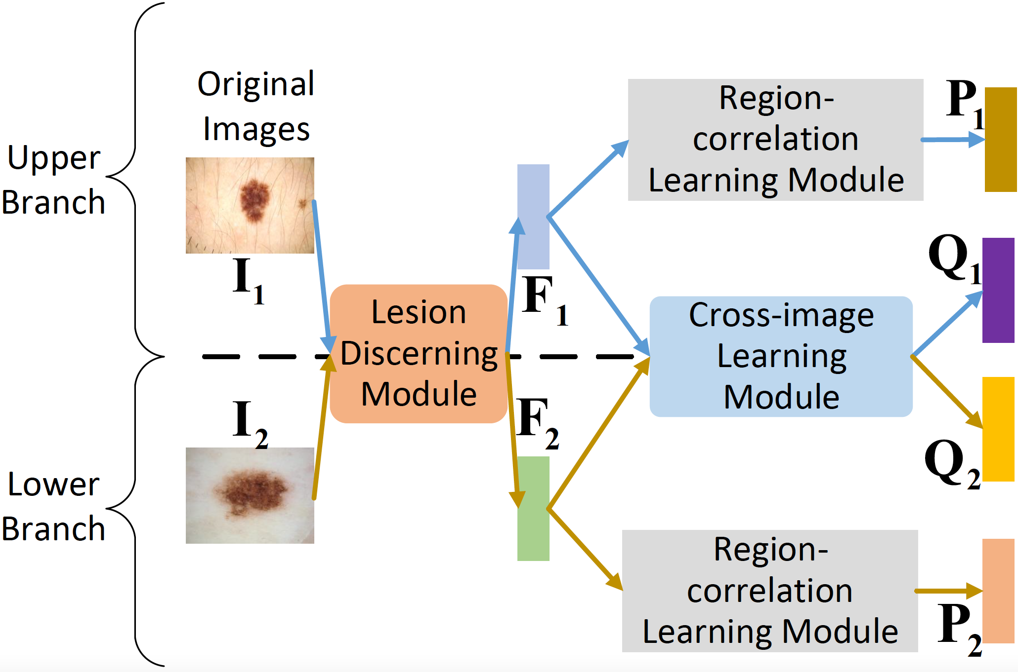
Multi-level Relationship Capture Network

Slide 9
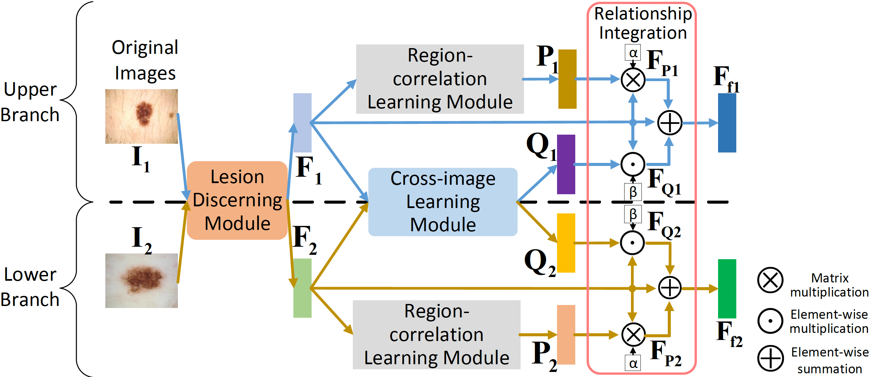
Multi-level Relationship Capture Network

Slide 10
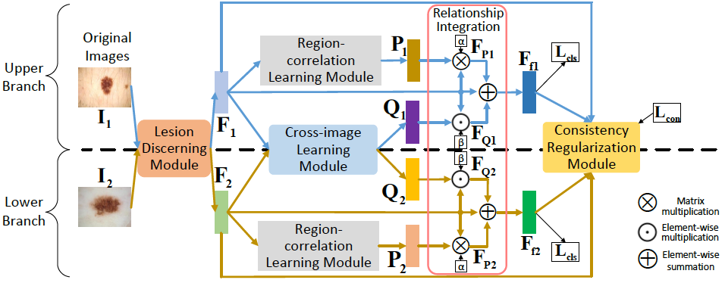
Multi-level Relationship Capture Network

Slide 11
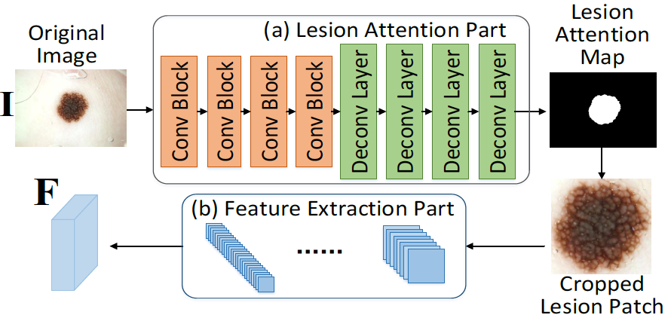
Multi-level Relationship Capture Network
Lesion Discerning Module

Slide 12
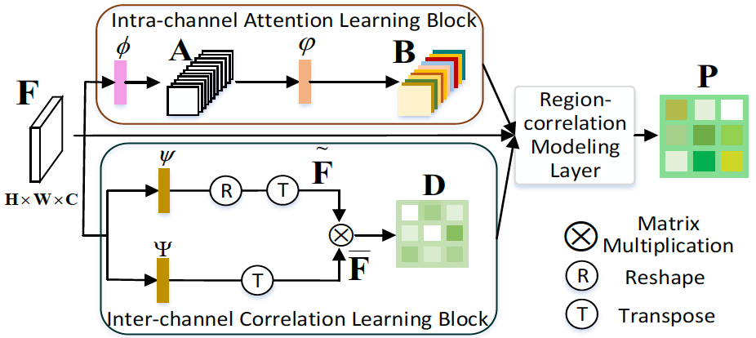
Multi-level Relationship Capture Network
Region Correlation Learning Module

Slide 13
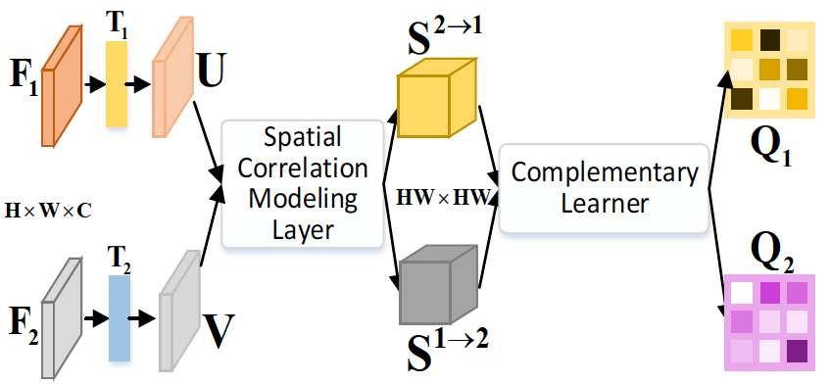
Multi-level Relationship Capture Network
Cross-image Learning Module

Slide 14
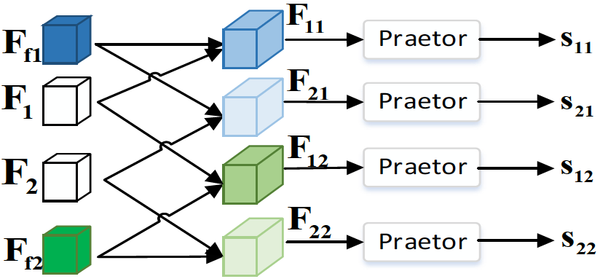
Multi-level Relationship Capture Network
Consistency Regularization Module

Slide 15
Dataset
ISIC 2016 challenge dataset
2 Classes: melanoma or non-melanoma
Task: Binary classification
ISIC 2017 challenge dataset
3 Classes: melanoma, nevus and seborrheic keratosis
Two subtasks:
Distinguish between melanoma and the others
Distinguish between seborrheic keratosis and the others

Slide 16
Dataset
ISIC 2019 challenge dataset
8 Classes: melanoma, Melanocytic nevus, Basal cell carcinoma, Actinic keratosis, Benign keratosis, Dermatofibroma, Vascular lesion, Squamous cell carcinoma
Task: Classify the disease each image belongs to

Slide 17
Evaluation Metrics
Average Precision(AP)
Accuracy(ACC)
Area under the receiver operating characteristic curve(AUC)
Sensitivity(SE)
Specificity(SP)

Slide 18
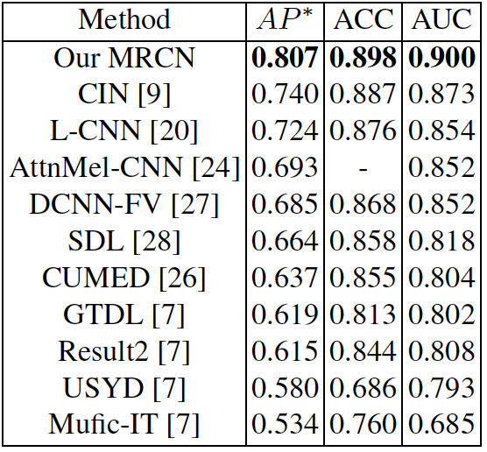
Experiments
ISIC 2016 challenge dataset

Slide 19
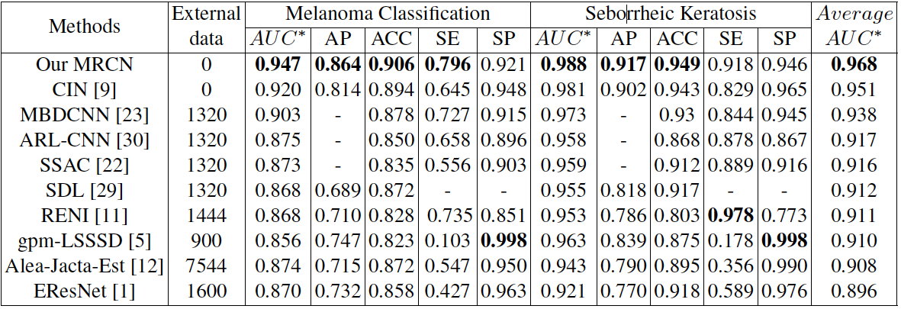
Experiments
ISIC 2017 challenge dataset

Slide 20
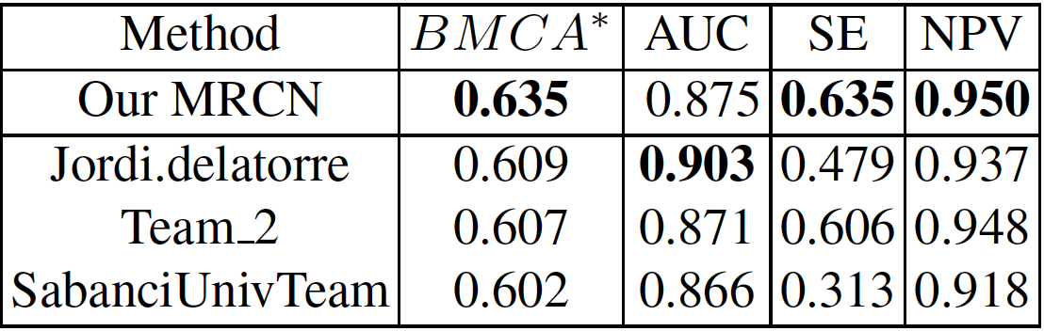
Experiments
ISIC 2019 challenge dataset

Slide 21
Conclusion
Contribution
The first method to mine the relationship both at the image level and the region level
Two newly designed modules are proposed
SOTA performance on three datasets
Future work
More discussions for each module
More comparison with the top-ranking methods

Slide 22
Thank You !

