Slide 1
Global Co-occurrence Feature Learning and Active Coordinate System Conversion for Skeleton-based Action Recognition
Sheng Li, Tingting Jiang, Tiejun Huang, Yonghong Tian
NELVT, Department of Computer Science, Peking University, China

Slide 2

Background
Task
input
Model
output
Action classes
Human skeleton

Slide 3
Background
Task
score
input
Model
output
Action classes
drinking
Human skeleton

Slide 4
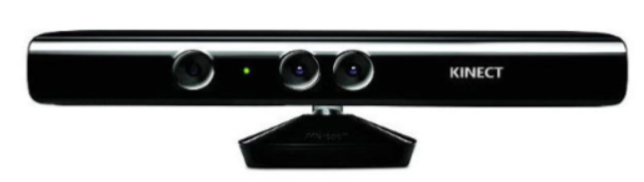
Background
Task
score
input
Model
output
Action classes
drinking
Human skeleton
Data Sources
Depth-sensor

Slide 5
Related work
Methods
Handicraft
RNN
Fusion
CNN
GNN (GCN)
2017
2018
2019

Slide 6

Related work
Methods
Routing
CVPR2019
AS-GCN
GCNs:
AAAI2019
ST-GCN
AGC
AAAI2018
Motif
SLR
CVPR2019
ECCV2018
AAAI2019
IJCAI2018
CNNs:
HCN
SkeleMotion
MTLN
MANs
AVSS2019
CVPR2017
IJCAI2018
RNNs:
CVPR2016
VA-LSTM

Slide 7
Proposed method
Pipeline

Slide 8
Proposed method
Pipeline
1） Active Coordinate System Conversion (ACSC)

Slide 9
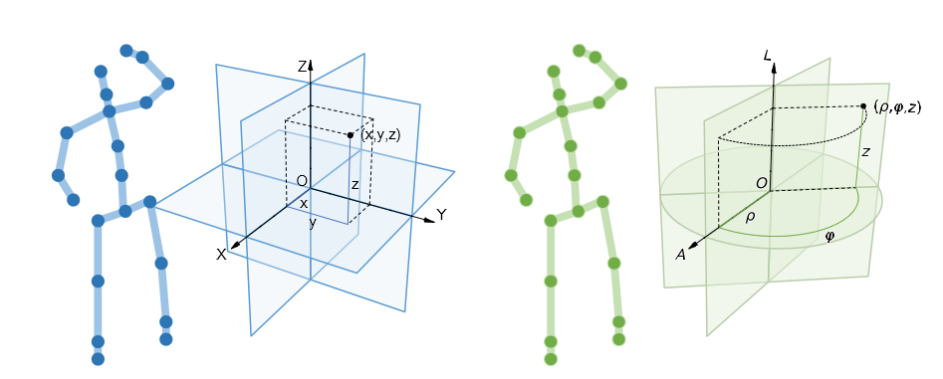
Proposed method
Pipeline
1） Active Coordinate System Conversion (ACSC)
ACSC
Cartesian coordinate system
New coordinate system

Slide 10
Proposed method
Pipeline
2) Spatio-temporal-unit Feature Enhancement (STUFE)

Slide 11
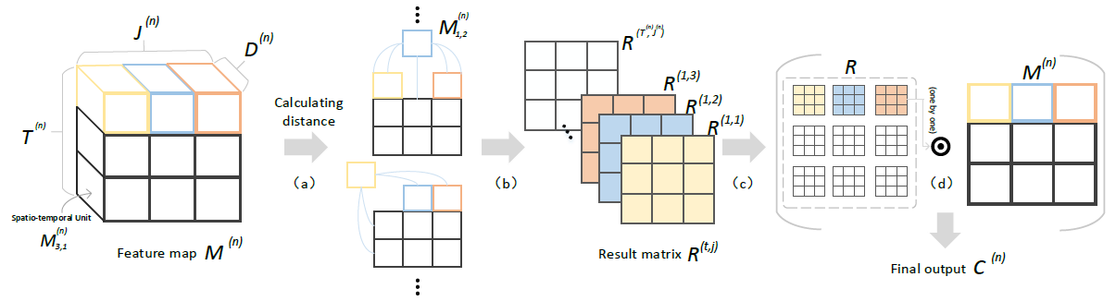
Proposed method
Pipeline
2) Spatio-temporal-unit Feature Enhancement (STUFE)

Slide 12
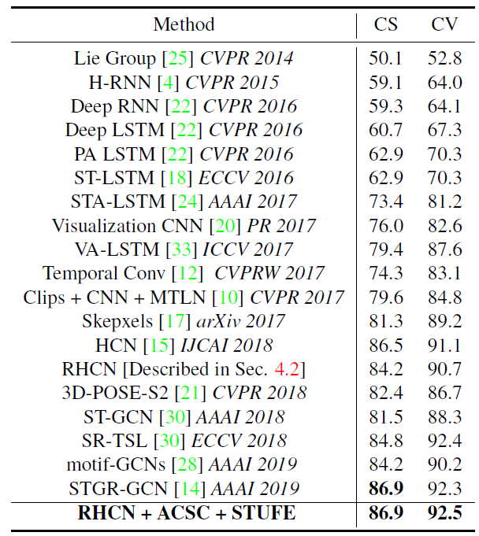
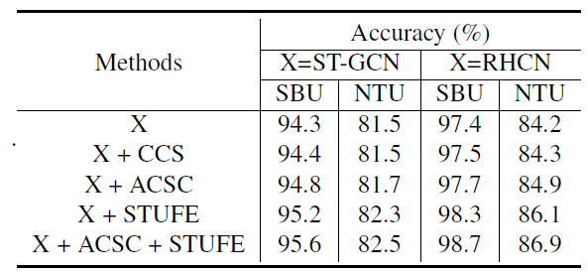
Experiments
Result

Slide 13
Thanks！

