Slide 1
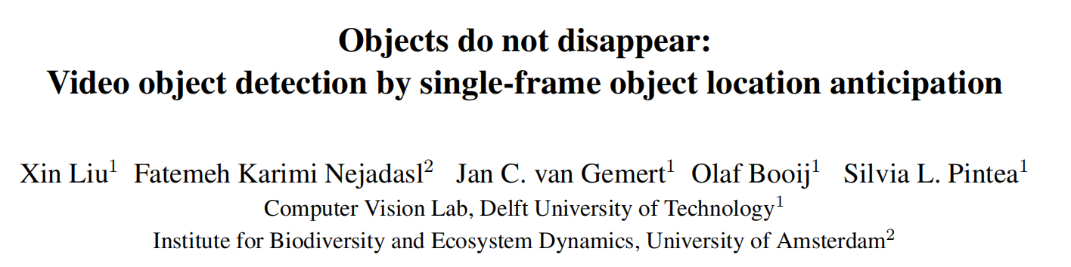
Notes:
代尔夫特理工大学&阿姆斯特丹大学 @荷兰

Slide 2
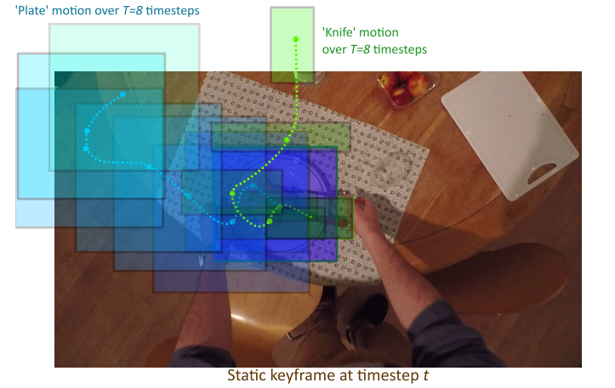
视频目标检测
任务：对视频帧进行目标检测
发现：时序连续性带来的帧冗余
方法：利用少数关键帧预测目标的运动轨迹
运动轨迹：连续 T 帧物体位置

Slide 3
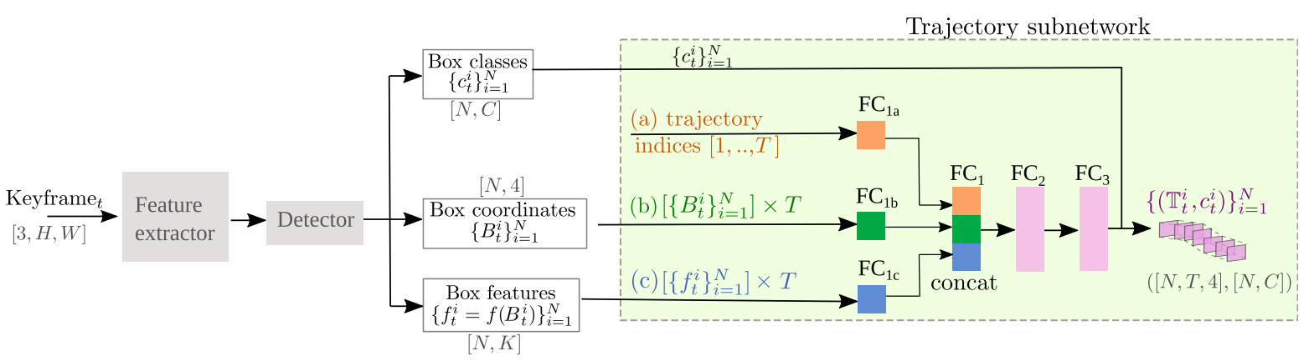
网络框架
关键帧目标检测+目标轨迹预测

Slide 4
关键帧目标检测
检测框、检测框类别、检测框特征

Slide 5
目标轨迹预测
输入：序号向量 + 检测框位置 × T + 检测框特征 × T
输出：当前帧中 N 个检测框的后续位置 N×T×4

Slide 6
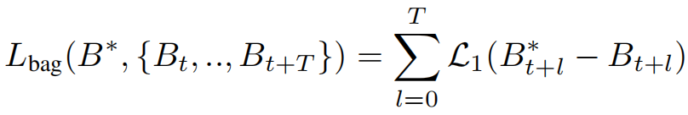
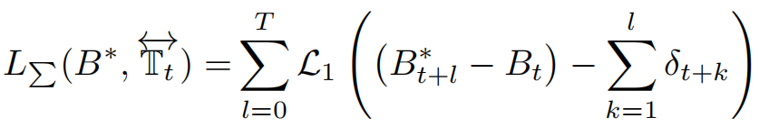
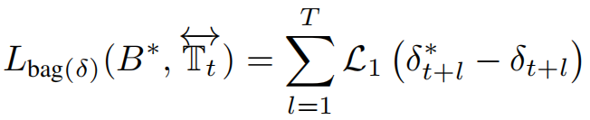
损失函数
约束后续 T 帧的检测框预测正确：
约束后续 T 帧中目标的位置连续变化：
如果预测检测框，则上述约束相同，故约束检测框变化值
修改第一个约束：

Slide 7
稀疏标记情况
稀疏标记：只有关键帧检测框GT，无中间帧检测框GT
利用线性插值或抛物线在两关键帧间生成运动伪标签
利用伪标签对轨迹进行约束

Slide 8
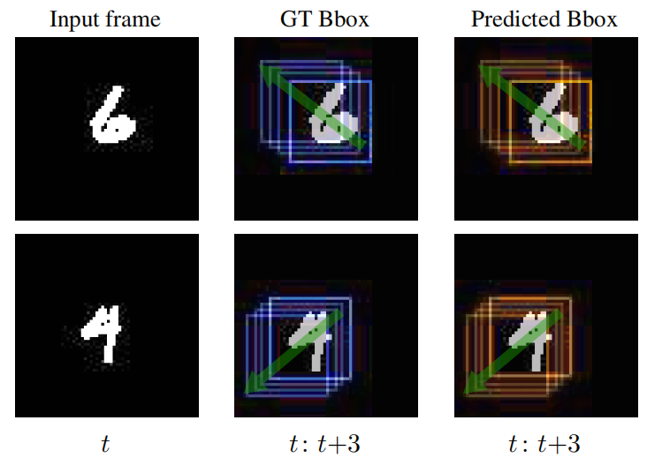
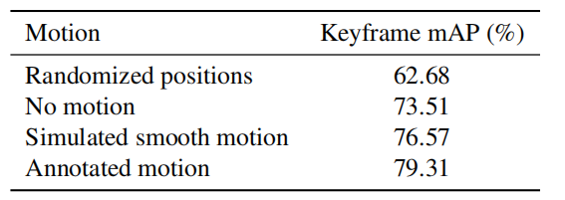
方法有效性验证实验
数据集：组合 MNIST 数据集与线性运动生成数据集 MovingDigits
轨迹预测 IOU 为 0.95，可以较好预测数字轨迹
意外之喜：轨迹约束会提升关键帧检测性能

Slide 9
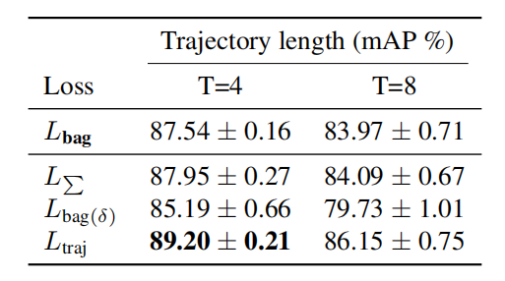
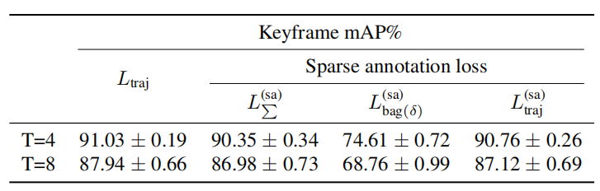
损失函数消融实验
数据集：ImageNet VID 子集
检测框约束未考虑连续性
连续性约束会累计预测偏差

Slide 10
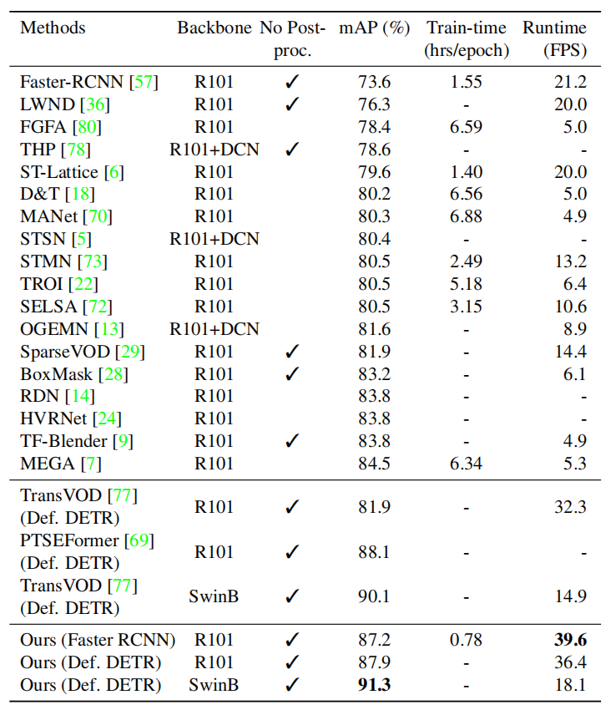
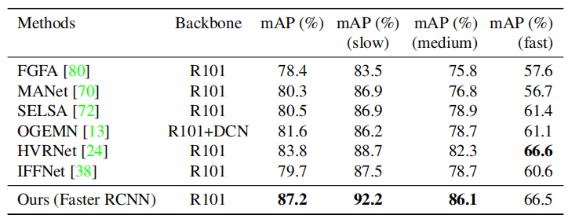
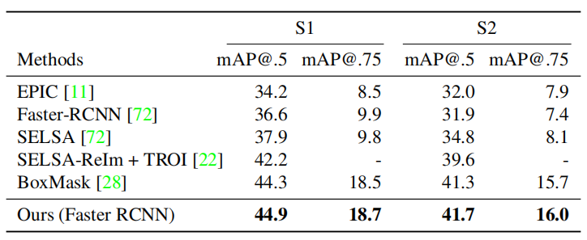
SOTA 比较实验
数据集：ImageNet VID 子集 & EPIC KITCHENS-55

Slide 11
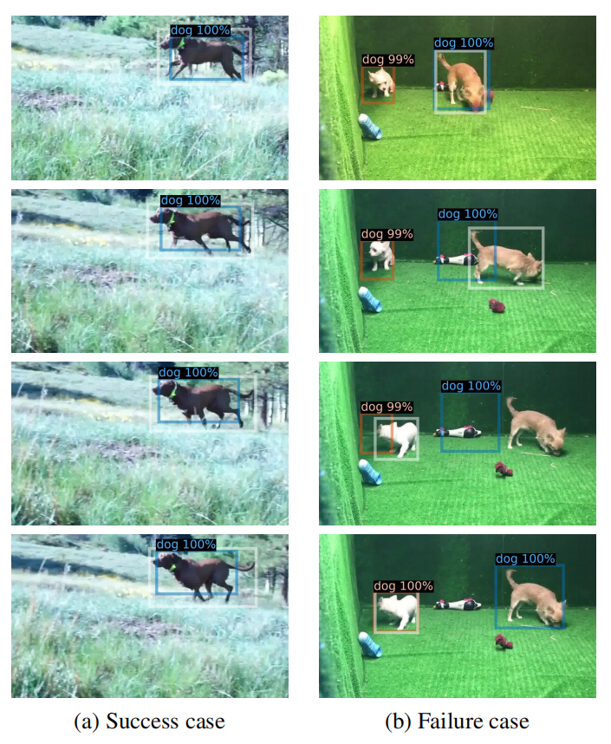
可视化

Slide 12
Abstract
Objects in videos are typically characterized by continuous smooth motion. We exploit continuous smooth motion in three ways. 1) Improved accuracy by using object motion as an additional source of supervision, which we obtain by anticipating object locations from a static keyframe. 2) Improved efficiency by only doing the expensive feature computations on a small subset of all frames. Because neighboring video frames are often redundant, we only compute features for a single static keyframe and predict object locations in subsequent frames. 3) Reduced annotation cost, where we only annotate the keyframe and use smooth pseudo-motion between keyframes. We demonstrate computational efficiency, annotation efficiency, and improved mean average precision compared to the state-of-the-art on four datasets: ImageNet VID, EPIC KITCHENS-55, YouTube-BoundingBoxes and Waymo Open dataset.
上来直接介绍本文动机：视频中的物体运动都是连续平滑运动。接着说明本文利用此特性完成的三件事：
1. 通过添加轨迹约束提升关键帧的检测性能（意外之喜）；
2. 提升视频中目标检测的效率，只对关键帧进行特征提取即可；
3. 降低标注难度，稀疏标注下此方法依然可以对中间帧物体轨迹进行预测。

Slide 13
Abstract
Objects in videos are typically characterized by continuous smooth motion. We exploit continuous smooth motion in three ways. 1) Improved accuracy by using object motion as an additional source of supervision, which we obtain by anticipating object locations from a static keyframe. 2) Improved efficiency by only doing the expensive feature computations on a small subset of all frames. Because neighboring video frames are often redundant, we only compute features for a single static keyframe and predict object locations in subsequent frames. 3) Reduced annotation cost, where we only annotate the keyframe and use smooth pseudo-motion between keyframes. We demonstrate computational efficiency, annotation efficiency, and improved mean average precision compared to the state-of-the-art on four datasets: ImageNet VID, EPIC KITCHENS-55, YouTube-BoundingBoxes and Waymo Open dataset.
介绍实验结果，在多个数据集上都取得了性能、效率、标注效率上的优势。

Slide 14
Introduction 1/3
Humans assume object permanence: blink your eyes, and the world is still there. Similarly, video frames are redundant, and missing some frames when watching a movie does not drastically change the scene. Actually, for the parts that did change, if these parts changed coherently, they might hint at a sense of objectness, as hypothesized by the Gestalt law of common fate.
首先阐述视频帧在时序上的连续性

Slide 15
Introduction 2/3
As illustrated in Fig. 1, here we explore these observations in the context of video object detection in three ways: 1) Improved accuracy by exploiting an additional source of supervision: the coherent motion from the law of common fate; by predicting object motion from a static image. 2) Improved efficiency by exploiting redundancy to reduce computational cost by only processing sampled keyframes and predict object motion for the missing frames in-between. 3) Reduced annotation cost by only annotating sampled keyframes. Thus, we improve accuracy and save computation and annotation time by simply skipping the feature computation and/or the annotation for a large majority of the frames.
重述摘要中的三点

Slide 16
Introduction 3/3
We make the following contributions: (i) A video object detection method that samples static keyframes and predicts object motion for unseen future frames. (ii) Computational efficiency, as our method only extracts features for sampled static keyframes; (iii) Data efficiency, as we use sparse annotations only at the sampled keyframes, hallucinating motion in-between these sparse annotations. (iv) Our extensive experimental results on ImageNet-VID [58], EPIC KITCHENS-55 [11], YouTube-BoundingBoxes [56] and Waymo Open dataset [15] show that our approach improves accuracy over the state-of-the-art methods, while being faster at both training and inference time.
说明文章贡献：
1. 利用关键帧预测中间帧物体位置
2. 计算效率高，只需要提取关键帧特征
3. 标注效率高，允许稀疏标注
4. 在多个数据集中表现较好

