Slide 1
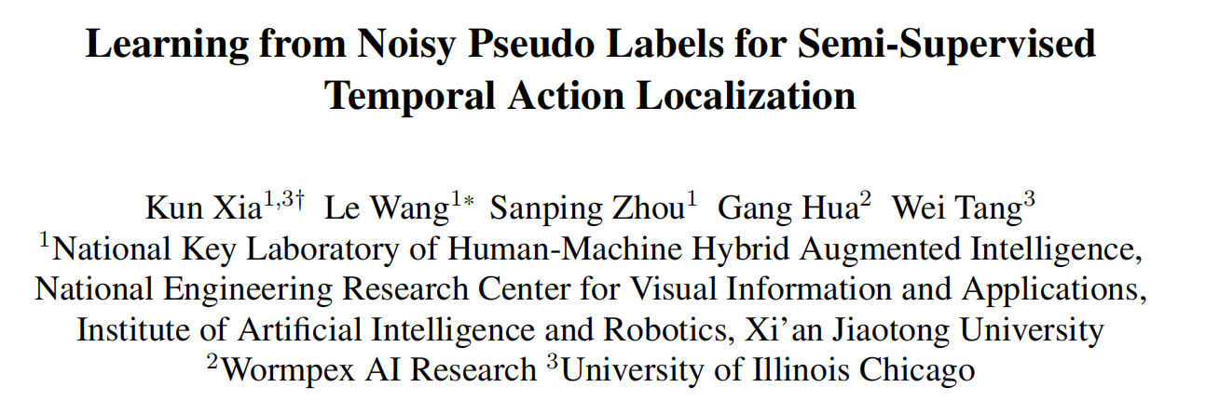

Slide 2
半监督时间动作定位
训练集包含标记视频与未标记视频，标记方式为帧级标注
常见训练方式：
1. 以标记视频为训练集，GT为监督信号，全监督方式训练模型
2. 以模型预测结果为未标记视频的伪标签
2. 以未标记视频为训练集，伪标签为监督信号，自监督方式调整模型
存在问题：伪标签存在噪声，即伪标签的位置偏差以及类别错误

Slide 3
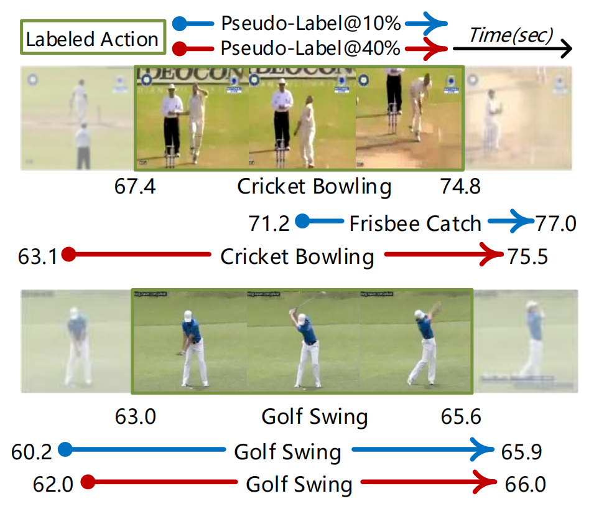
半监督时间动作定位
存在问题：伪标签存在噪声，即伪标签的位置偏差以及类别错误

Slide 4
半监督时间动作定位
存在问题：伪标签存在噪声，即伪标签的位置偏差以及类别错误
解决方法：以一种更合理的方式筛选伪标签
1. 提出一种新的伪标签排序方式
2. 提出一种新的伪标签筛选方式
3. 提出一种新的损失函数用以自监督训练

Slide 5

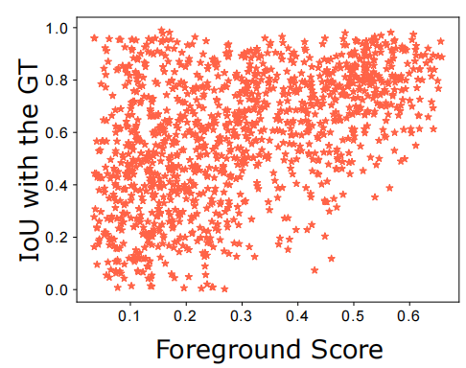
伪标签排序
问题：位置偏差与类别错误
排序依据：边界可靠性与语义置信度
如何度量边界可靠性？
仅仅依靠伪标签中的置信度信息可行吗？

Slide 6


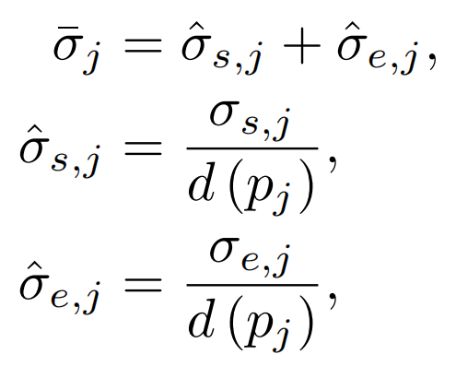
伪标签排序
原则：对应同一个运动实例的多个伪标签，边界应一致
方法：对于伪标签 ，考察其邻域内的伪标签 边界是否一致
边界稳定性度量：

Slide 7
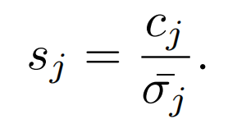
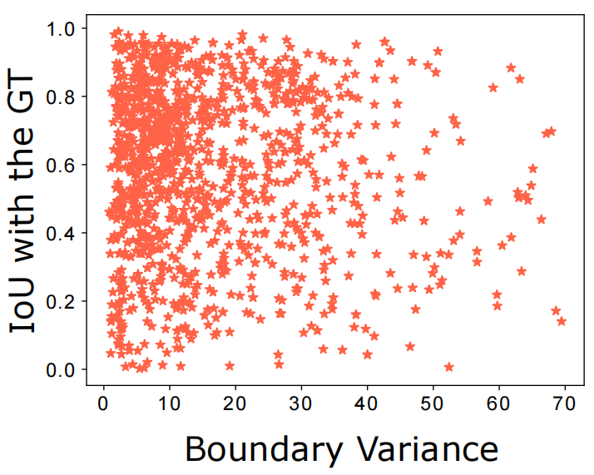
伪标签排序
标签度量：语义置信度 + 边界稳定性
边界稳定性度量与真实IOU的相关性：

Slide 8
伪标签筛选
以往筛选方式：置信阈值/样本数量
存在问题：类别错误带来的类不均衡
1. 错将 B 类预测为 A 类
2. A 类在标记视频子集中出现次数频繁，整体置信度较高
上述两种情况都会导致 A 类比例较高
解决方法：通过后验概率规范各类别伪标签分布

Slide 9
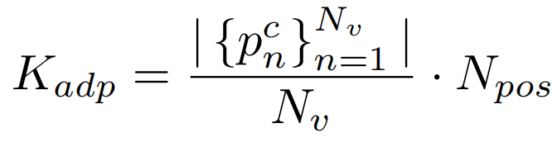


伪标签筛选
解决方法：通过后验概率规范各类别伪标签分布
其中 为伪标签总数， 为最终筛选得到的伪标签总数

Slide 10
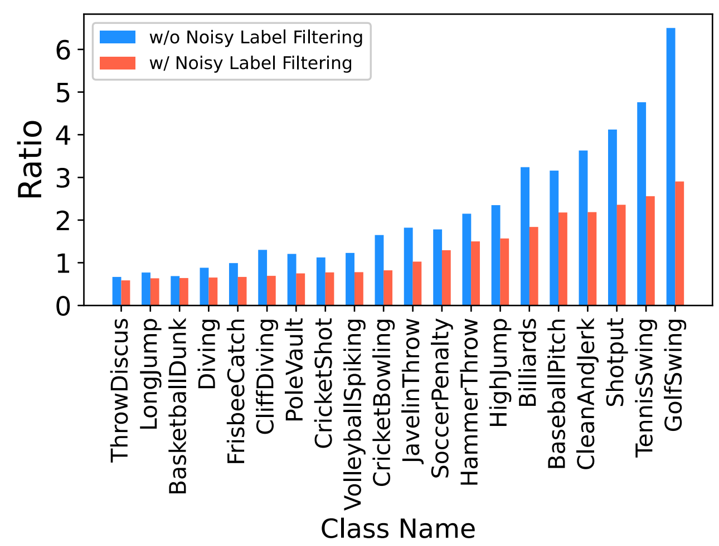
伪标签筛选
解决方法：通过后验概率规范各类别伪标签分布

Slide 11
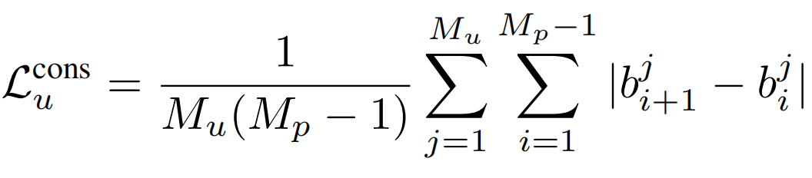


损失函数
惩罚同一动作实例对应的伪标签边界不一致的情况
其中 为视频中动作实例的数量， 为此动作实例中包含的伪标签数量

Slide 12
实验部分
数据集： THUMOS14 & ActivityNet v1.3
指标：mAP at IOU

Slide 13
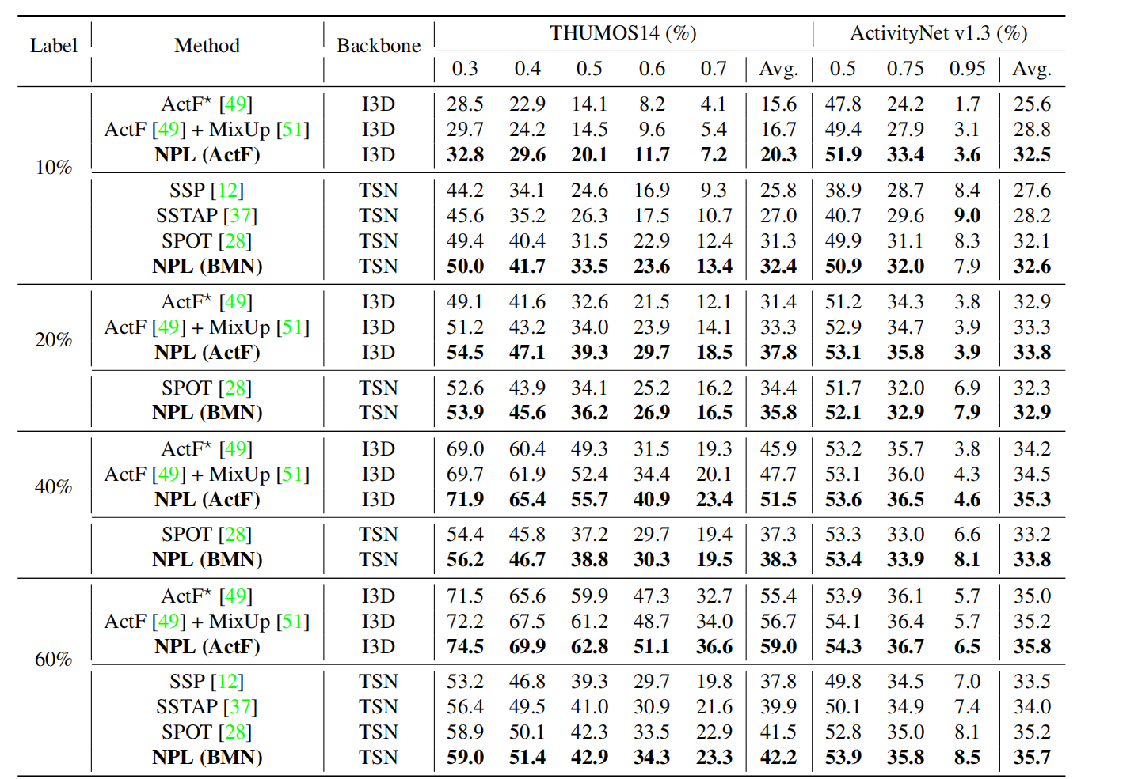
SOTA 对比

Slide 14
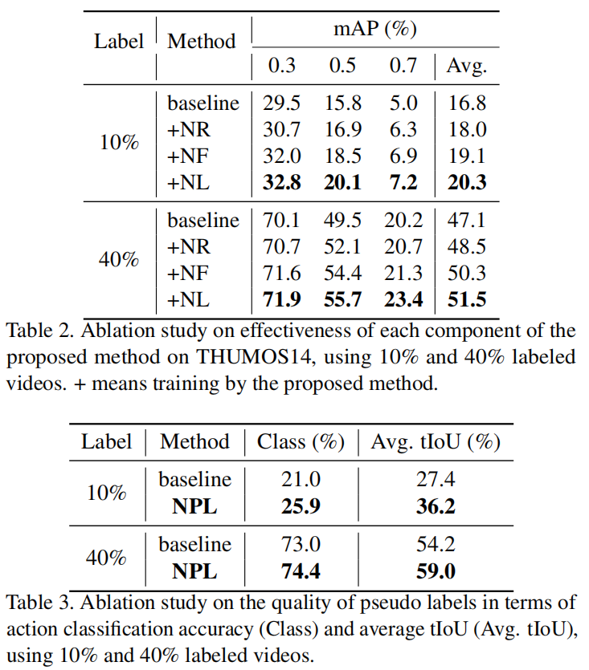
消融实验

Slide 15
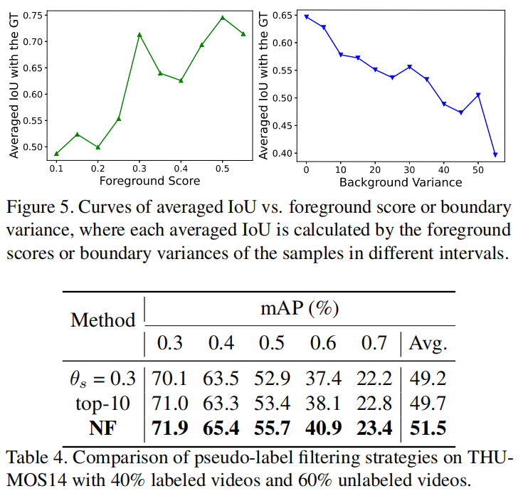
消融实验

Slide 16
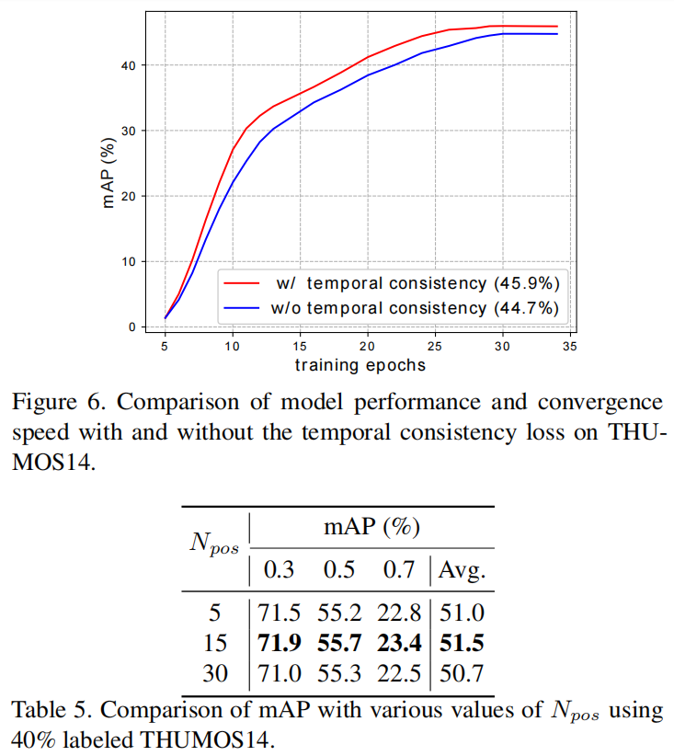
消融实验

Slide 17
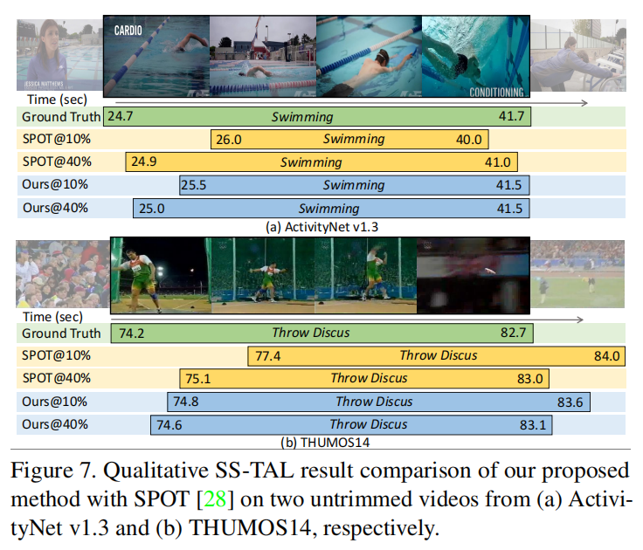
可视化

Slide 18
结论
偏工程向的文章，给出了一种筛选伪标签的方法
半监督方式对于数据集拓展是个好办法

Slide 19
Abstract
Semi-Supervised Temporal Action Localization (SS-TAL) aims to improve the generalization ability of action detectors with large-scale unlabeled videos. Albeit the recent advancement, one of the major challenges still remains: noisy pseudo labels hinder efficient learning on abundant unlabeled videos, embodied as location biases and category errors. In this paper, we dive deep into such an important but understudied dilemma. To this end, we propose a unified framework, termed Noisy Pseudo-Label Learning, to handle both location biases and category errors. Specifically, our method is featured with (1) Noisy Label Ranking to rank pseudo labels based on the semantic confidence and boundary reliability, (2) Noisy Label Filtering to address the class-imbalance problem of pseudo labels caused by category errors, (3) Noisy Label Learning to penalize inconsistent boundary predictions to achieve noise-tolerant learning for heavy location biases. As a result, our method could effectively handle the label noise problem and improve the utilization of a large amount of unlabeled videos. Extensive experiments on THUMOS14 and ActivityNet v1.3 demonstrate the effectiveness of our method.
介绍半监督时间动作定位任务

Slide 20
Abstract
Semi-Supervised Temporal Action Localization (SS-TAL) aims to improve the generalization ability of action detectors with large-scale unlabeled videos. Albeit the recent advancement, one of the major challenges still remains: noisy pseudo labels hinder efficient learning on abundant unlabeled videos, embodied as location biases and category errors. In this paper, we dive deep into such an important but understudied dilemma. To this end, we propose a unified framework, termed Noisy Pseudo-Label Learning, to handle both location biases and category errors. Specifically, our method is featured with (1) Noisy Label Ranking to rank pseudo labels based on the semantic confidence and boundary reliability, (2) Noisy Label Filtering to address the class-imbalance problem of pseudo labels caused by category errors, (3) Noisy Label Learning to penalize inconsistent boundary predictions to achieve noise-tolerant learning for heavy location biases. As a result, our method could effectively handle the label noise problem and improve the utilization of a large amount of unlabeled videos. Extensive experiments on THUMOS14 and ActivityNet v1.3 demonstrate the effectiveness of our method.
指出问题所在：伪标签噪声阻碍了模型性能的发展

Slide 21
Abstract
Semi-Supervised Temporal Action Localization (SS-TAL) aims to improve the generalization ability of action detectors with large-scale unlabeled videos. Albeit the recent advancement, one of the major challenges still remains: noisy pseudo labels hinder efficient learning on abundant unlabeled videos, embodied as location biases and category errors. In this paper, we dive deep into such an important but understudied dilemma. To this end, we propose a unified framework, termed Noisy Pseudo-Label Learning, to handle both location biases and category errors. Specifically, our method is featured with (1) Noisy Label Ranking to rank pseudo labels based on the semantic confidence and boundary reliability, (2) Noisy Label Filtering to address the class-imbalance problem of pseudo labels caused by category errors, (3) Noisy Label Learning to penalize inconsistent boundary predictions to achieve noise-tolerant learning for heavy location biases. As a result, our method could effectively handle the label noise problem and improve the utilization of a large amount of unlabeled videos. Extensive experiments on THUMOS14 and ActivityNet v1.3 demonstrate the effectiveness of our method.
介绍本文提出的方法，分为三个部分：
1. 伪标签排序
2. 伪标签筛选
3. 噪声容忍的训练方式（损失函数）

Slide 22
Abstract
Semi-Supervised Temporal Action Localization (SS-TAL) aims to improve the generalization ability of action detectors with large-scale unlabeled videos. Albeit the recent advancement, one of the major challenges still remains: noisy pseudo labels hinder efficient learning on abundant unlabeled videos, embodied as location biases and category errors. In this paper, we dive deep into such an important but understudied dilemma. To this end, we propose a unified framework, termed Noisy Pseudo-Label Learning, to handle both location biases and category errors. Specifically, our method is featured with (1) Noisy Label Ranking to rank pseudo labels based on the semantic confidence and boundary reliability, (2) Noisy Label Filtering to address the class-imbalance problem of pseudo labels caused by category errors, (3) Noisy Label Learning to penalize inconsistent boundary predictions to achieve noise-tolerant learning for heavy location biases. As a result, our method could effectively handle the label noise problem and improve the utilization of a large amount of unlabeled videos. Extensive experiments on THUMOS14 and ActivityNet v1.3 demonstrate the effectiveness of our method.
实验结果说明，本文提出方法确实降低了伪标签的噪声，并且在两个数据集上性能都是最好

Slide 23
Introduction 1/7
Temporal Action Localization (TAL) aims at detecting action instances of interest in an untrimmed video by locating their temporal boundaries and recognizing their action categories. Most existing TAL methods rely on dense temporal annotations for the training videos. However, labeling human actions is very tedious and time-consuming. As a remedy, Semi-Supervised TAL (SS-TAL) requires only a few labeled videos in conjunction with a large amount of unlabeled videos. It has attracted growing attention in academia and industry.
从时间动作定位任务，引出半监督时间动作定位任务

Slide 24
Introduction 2/7
Existing SS-TAL methods [12, 37, 28] are based on consistency regularization or self-training. Consistency-based methods [12, 37] aim to generate consistent action proposals for the same video subject to different augmentations, e.g., time warping [12] and temporal feature shift [37]. In contrast, the self-training-based method [28] achieves new state-of-the-art performance by alternating between pseudo-labeling and re-training. It focuses on designing a proposal-free framework to address proposal error propagation from [12, 37] but neglects the important role of pseudo labels. Albeit its advancement, label noise still remains a core challenge, hindering efficient learning on abundant unlabeled videos. From Figure 1, we can observe that label noise commonly leads to two intractable issues, i.e., location bias and category error, which become worse as the amount of labeled videos decreases. As a result, noisy pseudo labels will significantly degrade the performance of SS-TAL.
介绍目前的两类方法：
1. 基于一致性的方法（对比学习），要求经过不同数据增强后的同一视频，预测结果相同；
2. 基于自训练的方法，先利用已标记数据训练模型，再通过模型生成未标记数据的伪标签，而后用伪标签对模型进行调整，也是本文的基线方法。

Slide 25
Introduction 2/7
Existing SS-TAL methods [12, 37, 28] are based on consistency regularization or self-training. Consistency-based methods [12, 37] aim to generate consistent action proposals for the same video subject to different augmentations, e.g., time warping [12] and temporal feature shift [37]. In contrast, the self-training-based method [28] achieves new state-of-the-art performance by alternating between pseudo-labeling and re-training. It focuses on designing a proposal-free framework to address proposal error propagation from [12, 37] but neglects the important role of pseudo labels. Albeit its advancement, label noise still remains a core challenge, hindering efficient learning on abundant unlabeled videos. From Figure 1, we can observe that label noise commonly leads to two intractable issues, i.e., location bias and category error, which become worse as the amount of labeled videos decreases. As a result, noisy pseudo labels will significantly degrade the performance of SS-TAL.
指出目前方法都没有解决的问题：伪标签存在噪声会影响模型训练。并指出噪声分为位置偏差与类别错误

Slide 26
Introduction 3/7
In this paper, we propose a Noisy Pseudo-Label Learning (NPL) framework tailored for SS-TAL to combat detrimental label noise. It follows the self-training paradigm that alternates between pseudo-labeling and model training. But unlike all previous self-training methods, our NPL includes three novel components, termed Noisy Label Ranking, Noisy Label Filtering, and Noisy Label Learning, respectively, which alleviate the negative effects caused by location biases and category errors in a unified framework.
介绍文章方法框架，分为三个部分：
1. 伪标签排序
2. 伪标签筛选
3. 噪声容忍的训练方式

Slide 27
Introduction 4/7
First, Noisy Label Ranking aims to rank and select high quality pseudo labels based on both semantic confidence and boundary reliability. Classification scores have been widely used in self-training to measure the quality of pseudo labels, but they only reflect semantic confidence and fail to account for localization reliability. To close this gap, we explicitly model the localization reliability of a detected action instance in an unlabeled video as the variance of the boundary predictions from dense snippets within the action. We then introduce a new integrated metric of semantic confidence and boundary reliability to rank the pseudo labels.
介绍伪标签排序方法
以往的排序方法只依靠标签的前景得分，但这只考虑了语义置信度，而没有考虑位置稳定性。本文量化了位置稳定性并提出了新的排序方式。

Slide 28
Introduction 5/7
Second, Noisy Label Filtering aims at addressing the class-imbalance problem in noisy pseudo labels. Owing to the category error, the class-imbalance problem occurs regardless of whether pseudo labels are sampled based on a confidence threshold or the number of samples. The model will be dominated by redundant noisy pseudo labels in training, especially for the ones of category errors, and further harm its generalization ability. To address this issue, we introduce an adaptive filtering strategy to regularize the distribution of pseudo labels and adaptively assign class-balanced pseudo labels to unlabeled videos.
介绍伪标签筛选方式
提出问题：类别预测错误会导致伪标签类别不平衡，影响后续训练。本文提出自适应筛选方式，规范伪标签分布。

Slide 29
Introduction 6/7
Last, Noisy Label Learning aims to improve the robustness of training to location bias. While noisy label ranking and filtering can improve the quality of sampled pseudo labels, location bias will not be removed completely. Training on biased boundary labels hinders the convergence of the model and further impedes accurate action localization. To this end, we propose a noise-tolerant training algorithm based on an unsupervised temporal consistency loss, which penalizes inconsistent predictions from adjacent action frames.
介绍噪声容忍的训练方式
尽管通过前面两部分的排序与筛选，伪标签的质量已经有所提高，但是位置偏差还不能完全排除。因此设计了约束边界一致性的损失函数，帮助模型训练。

Slide 30
Introduction 7/7
The main contributions are summarized as follows:
• This paper introduces a Noisy Pseudo-Label Learning (NPL) framework tailored for SS-TAL, which handles both the location bias and category error in a unified framework. Extensive experiments conducted onTHUMOS14 [13] and ActivityNet v1.3 [2] demonstrate the effectiveness of the proposed method.
• We propose a Noisy Label Ranking method to rank and select high-quality pseudo labels based on a new integrated metric of semantic confidence and boundary reliability.
• We propose a Noisy Label Filtering method to tackle the largely ignored class-imbalance problem in pseudo labels based on a new adaptive filtering strategy.
• We introduce a Noisy Label Learning method, which adopts an unsupervised temporal consistency loss to penalize inconsistent predictions from adjacent frames for noise-tolerant learning.
列举本文贡献：
1. 提出框架，性能sota
2. 提出新的伪标签排序方式
3. 提出新的伪标签筛选方式
4. 提出新的噪声容忍训练方式

