Slide 1
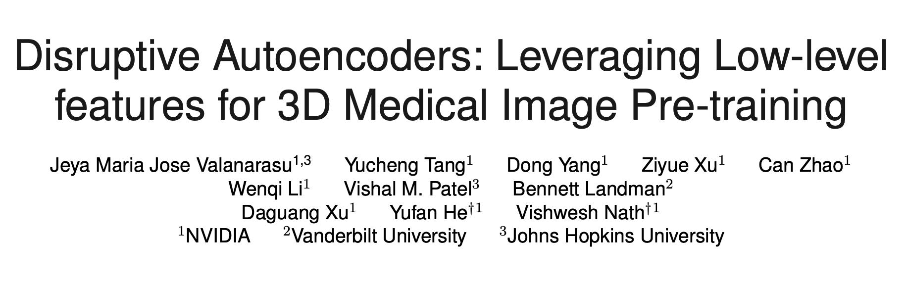
Arxiv 2023

Slide 2
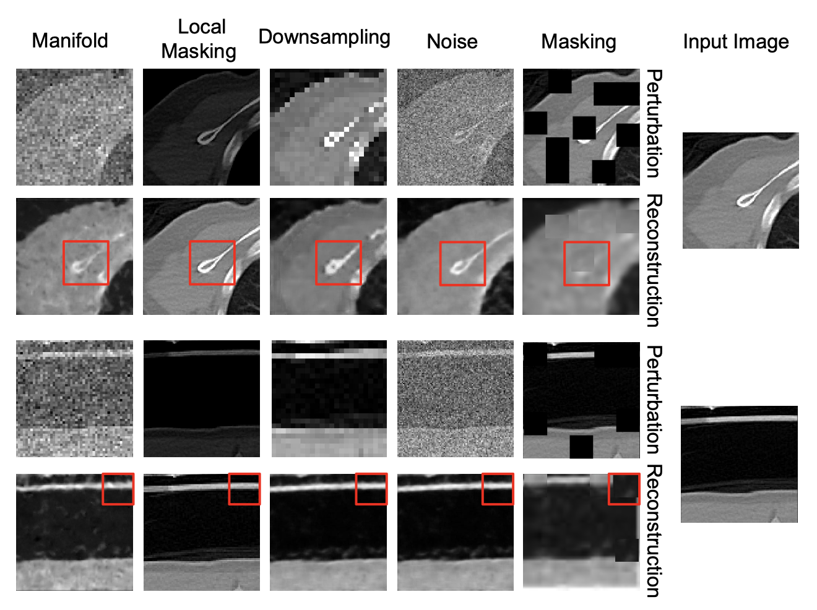

Slide 3
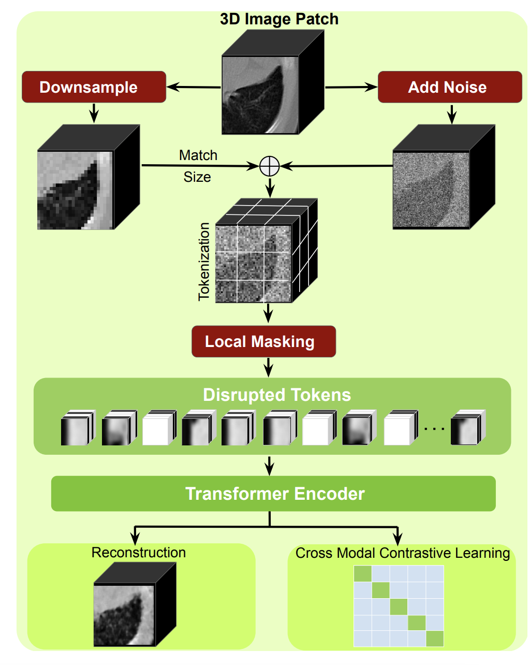
Disruptive Autoencoders

Slide 4
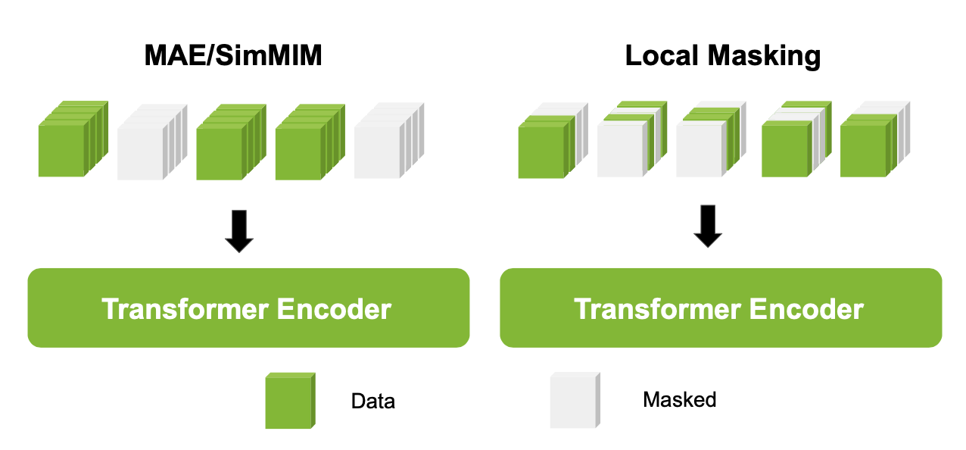
Local Masking

Slide 5



Slide 6
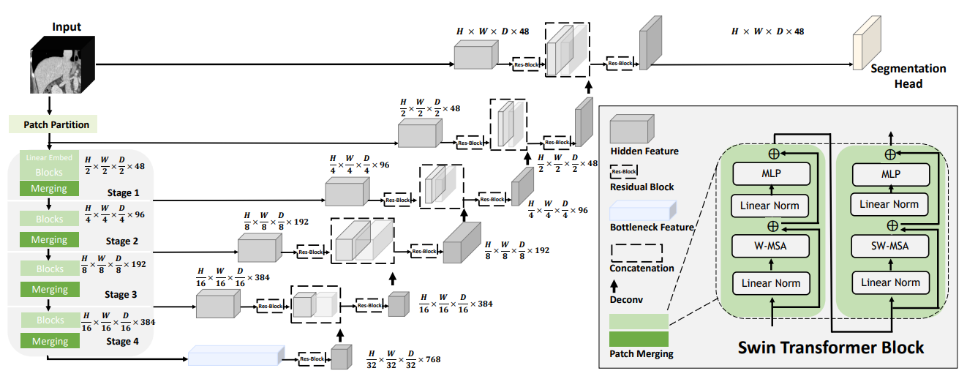

Training
Swin UNETR
Finetuning: Dice loss

Slide 7
Experiments
Pre-training Dataset
Combine BraTS21, LUNA16, TCIA Covid19, HNSCC, TCIA Colon, and LiDC
The corresponding number of 3D volumes for brain, chest, abdomen and head/neck volumes are 1310 × 4 (4 modalities), 2018, 1520 and 1223, respectively. The number of brain MRI volumes of each modalities T1, T2, T1ce and FLAIR is 1,310.
Finetuning Datasets:
BTCV, FeTA

Slide 8
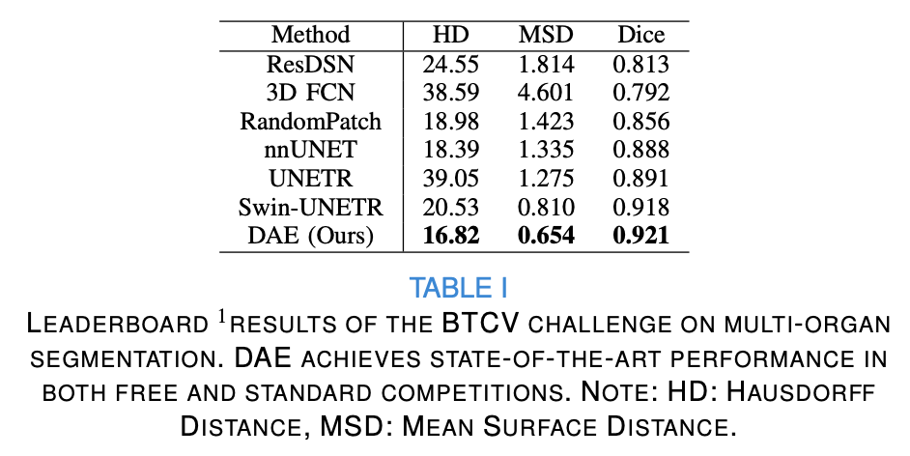
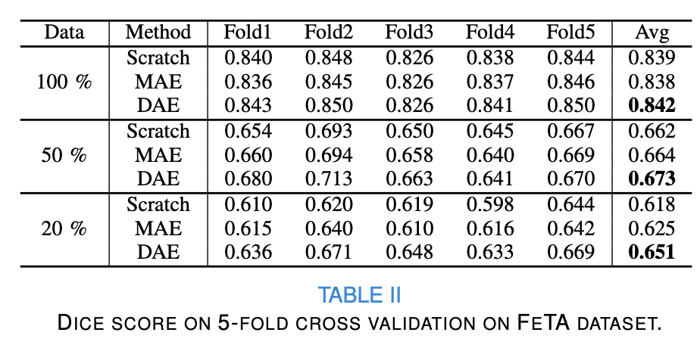
Results

Slide 9
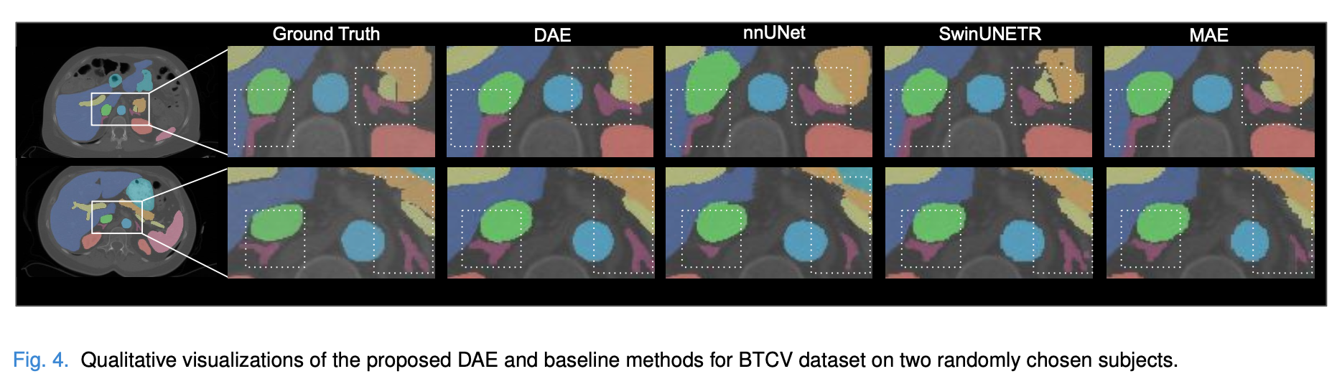
Results

Slide 10
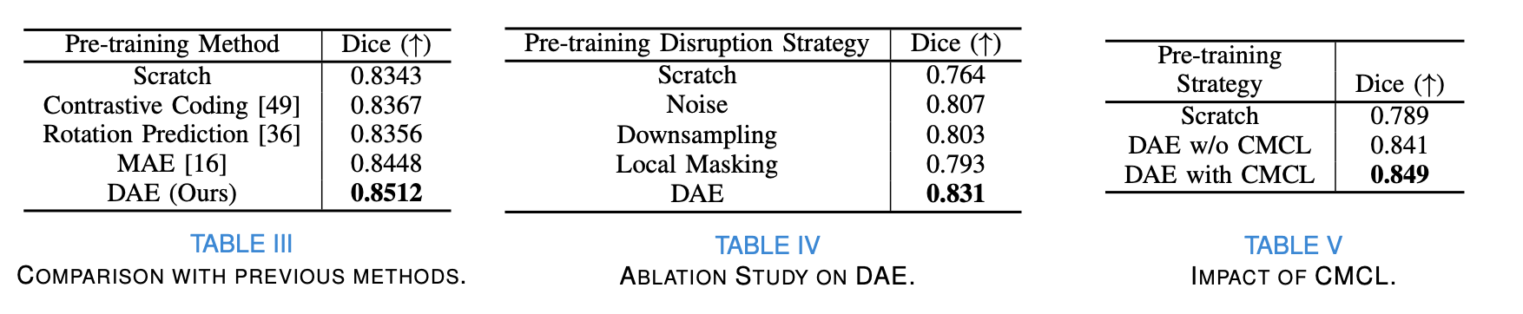
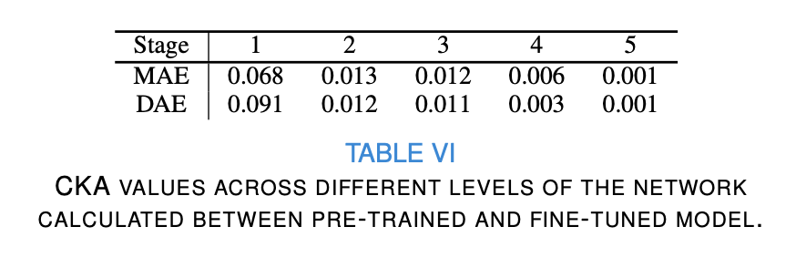
Ablation Study

Slide 11
Abstract
Harnessing the power of pre-training on large-scale datasets like ImageNet forms a fundamental building block for the progress of representation learning- driven solutions in computer vision. Medical images are inherently different from natural images as they are acquired in the form of many modalities (CT, MR, PET, Ultrasound etc.) and contain granulated information like tissue, lesion, organs etc. These characteristics of medical images require special attention towards learning features representative of local context. In this work, we focus on designing an effective pre-training framework for 3D radiology images. First, we propose a new masking strategy called local masking where the masking is performed across channel embeddings instead of tokens to improve the learning of local feature representations. We combine this with classical low-level perturbations like adding noise and down- sampling to further enable low-level representation learning. To this end, we introduce Disruptive Autoencoders, a pre-training framework that attempts to reconstruct the original image from disruptions created by a combination of local masking and low-level perturbations. Additionally, we also devise a cross-modal contrastive loss (CMCL) to accommodate the pre-training of multiple modalities in a single framework. We curate a large-scale dataset to enable pre-training of 3D medical radiology images (MRI and CT). The proposed pre-training framework is tested across multiple downstream tasks and achieves state-of-the-art performance. Notably, our proposed method tops the public test leaderboard of BTCV multi-organ segmentation challenge.

Slide 12
Introduction 1/6
Inception of transformers [1], [2] has led to a significant shift from convolution neural network (ConvNet) based methods [3]–[5] to transformer-based methods [2], [6]–[9] for many computer vision applications. However, the fact that pre-training plays an irreplaceable role in model development has not changed in the past decade [10]. Model weight initialization is an important step in training deep neural networks [11] as good starting weights are necessary for efficient training towards a particular task. In the ConvNet era, pre-training on the ImageNet dataset [12] played a significant role in developing models for various downstream tasks. Most of the network architectures offer ImageNet weights as the starting weights for further training. In Vision Transformer (ViT) [2], pre-training is proved to be even more fruitful due to its higher model capacity. It was observed that pre-training ViT on large-scale datasets like JFT300M [13] could provide superior performance than pre-training on ImageNet. Curation and collection of such large-scale datasets is thus pivotal to advancement of various computer vision sub-fields.

Slide 13
Introduction 2/6
Pre-training for natural computer vision tasks is usually not constricted by the availability of data as natural images are abundant and there is no scarcity and less restrictions in obtaining them. Unfortunately, the same does not translate to medical images as they are scarce (acquisition cost is high) and also difficult to obtain (requires specialized hardware). There is complexity involved to release them publicly due to heavy privacy regulations [14]. There have been recent efforts in creating a large-scale dataset for medical imaging [15], there still does not publicly exist a high-resolution dataset containing multiple modalities. It should be noted that while natural images are in general standardized RGB, medical images acquired by different modalities through different manufacturers’ hardware with different acquisition parameters can differ significantly from each other. The characteristics of medical images are dependent on several factors, including modalities used for the specific diagnostic task, and the site where the image is acquired. Hence it is extremely challenging to build a generic pre-training framework for medical images that is capable of factoring in multiple possible variations simultaneously.

Slide 14
Introduction 3/6
Recently, masked image modelling methods [16] have gained significant traction as an efficient self-supervised pre- training framework. They are used to develop robust pre-trained models that can generalize well to the downstream tasks. Masked Auto-Encoders MAEs learn a feature representation by trying to reconstruct the original image while masking out randomly selected tokens in the input space. MAEs are designed specifically for transformers as masked tokens help reduce the computation. However, improvements are needed in medical imaging domain: while trying to adopt vanilla MAEs for medical images, we observed that although MAEs do lead to a performance boost for further finetuning, the reconstructions were poor and most of the anatomical structures were missing after reconstruction. For example, in Fig. 2 (left), it can be seen that MAEs cannot reconstruct the bones and other fine structures. This has also been observed in some recent works [17], [18]. Unlike natural images, most of the vital information in medical images are in the fine details (e.g. small lesions, finer boundaries of organs, tiny structures of bones that need to be delineated etc). To solve such tasks which require understanding fine details in an image, the focus is usually on extracting meaningful low-level features. In the context of features in different levels, computer vision tasks can be broadly classified into - low, mid, and high-level tasks depending on the type of information needed to solve the task. High level tasks like object recognition [19] and scene understanding [20] usually need a semantic understanding of the image. Low-level tasks like edge detection and image matching on the other hand, require a more fine understanding of the image. The type of features extracted by a deep network to solve low-level tasks are usually different from features extracted to solve high-level tasks [21], [22]. Since MAEs can be considered as a form of inpainting [23] which is regarded as a high-level task; most of the features extracted are mid to high-level features resulting in a coarse reconstruction as we observed in the outcome. This makes MAEs sub-optimal for pre-training medical images as features representative of crucial low-level information go missing.

Slide 15
Introduction 4/6
In this work, we focus on designing an effective pipeline for pre-training on 3D medical volumes. First, we design a new pre-training strategy that is better than MAEs at extracting low-level details. MAEs mask tokens at different places at a global level, making it difficult for the network to predict reconstructions while preserving local details. To this end, we introduce local masking where we do not mask at the token dimension but at the channel embedding dimension. Unlike MAEs, certain amount of masking is done to all tokens as only the channel embeddings are perturbed (visualized in Fig. 1 and 3). In this way, we mask out certain portion of information for all tokens throughout the input, helping the network reconstruct sharp details and learn better local context. We also explore using various low-level vision tasks like de-noising and super-resolution for pre-training. We observe that these tasks help extract better low-level features and result in sharper reconstructions. In summary, we introduce Disruptive Autoencoders (DAE) where we first create a combination of these perturbations (local masking, downsampling, and adding noise) to disrupt the tokens (visualized in Fig. 1). Then, an autoencoder is trained to reconstruct the original medical volume from these disrupted tokens. DAEs result in sharper reconstructions, and a better performance on downstream tasks. We also devise a contrastive loss for our framework in such a way it can discriminate between the features extracted from different modalities. This cross modal contrastive loss (CMCL) pulls together features of the same modality and pushes apart features of different modalities. In this way, the pre-training strategy extracts diverse features from different modalities while maintaining an awareness of each modality.

Slide 16
Introduction 5/6
To evaluate our proposed method DAE we curate a pre-training dataset of radiology images. The dataset includes 5 modalities: Computed Tomography (CT) and 4 modalities of Magnetic Resonance Imaging (MRI) (T1, T2, FLAIR, T1ce). We use this collection of 10,050 individual 3D volumes for pre-training. All selected datasets are public so that the pre-trained weights can be used as a better initialization as compared to random for future MR and CT radiology tasks. We conduct experiments on multiple segmentation baselines to validate the effectiveness of our proposed pre-training method.

Slide 17
Introduction 6/6
In summary, the following are the major contributions of this work:
• We propose Local Masking, a new masking strategy which helps learn useful features to reconstruct local details like small anatomical and functional structures.
• We introduce Disruptive Autoencoders, which aim to reconstruct the original volume from tokens disrupted from a combination of low-level perturbations such as local masking, downsampling, and adding noise.
• Our framework proposes using a single pre-trained weight for various downstream tasks even for different modalities.
• We curate a public pre-training dataset for CT and MRI radiology images with over 10,000 3D volumes and conduct extensive experiments on multiple segmentation datasets and show state-of-the-art performance. The pipeline achieves best performance on a public multi- organ segmentation challenge leaderboard.

