Slide 1
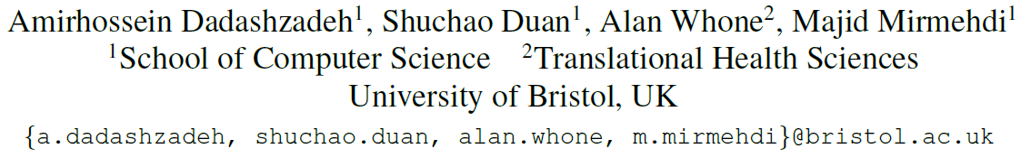
PECoP: Parameter Efficient Continual Pretraining for Action Quality Assessment
WACV 2024

Slide 2
Background
AQA methods: insufficient quantities of annotated data for training
Extra effort is needed to produce very precise labels, e.g. Parkinson’s Disease (PD) severity assessment
Common solution: start with a model that is originally pretrained on a large source dataset
Problem: domain/task discrepancy between action classification and action assessment
For example, in PD action performance scoring, one or two interruptions during the regular rhythm of a patient’s movement performing an action can result in a different quality score and this is in contrast to the source pretraining task, where subtle or even more pronounced differences in performing an action should not affect action classification
Notes:
AQA methods are affected by insufficient quantities of annotated data for training deep networks [36]. This is further exacerbated when extra effort is needed to produce very precise labels, e.g. for health-related applications, such as Parkinson’s Disease (PD) severity assessment
AQA方法受到深度网络训练中标注数据数量不足的影响[36]。当需要额外的努力来产生非常精确的标签时，这种情况会进一步加剧，例如用于与健康相关的应用，如帕金森病(PD)严重程度评估
start with a model that is originally pretrained on a large source dataset
从最初在大型源数据集上预训练的模型开始
domain/task discrepancy between action classification and action assessment. For example, in PD action performance scoring, one or two interruptions during the regular rhythm of a patient’s movement performing an action can result in a different quality score and this is in contrast to the source pretraining task, where subtle or even more pronounced differences in performing an action should not affect action classification [29].
AQA方法受到深度网络训练中标注数据数量不足的影响[36]。当需要额外的努力来产生非常精确的标签时，这种情况会进一步加剧，例如对于与健康相关的应用，例如帕金森病(PD)严重性评估，动作分类和动作评估之间的域/任务差异。例如，在PD动作表现评分中，在患者执行动作的正常运动节奏中出现一次或两次中断可能导致不同的质量评分，这与源预训练任务相反，在源预训练任务中，执行动作的细微甚至更明显的差异不应影响动作分类[29]。

Slide 3
Background
Continual pretraining: enhance learning via in-domain self-supervised pretraining to handle domain shift problems
Instead of continual pretraining of the entire model parameter set, we take advantage of adapter-based tuning to reduce the cost of storage and model pretraining on in-domain data while preserving the knowledge obtained through the initial pretraining on domain-general data
Adapter: lightweight bottleneck modules which were designed for Transformer architectures for NLP tasks to conduct parameter-efficient transfer learning for downstream tasks
No work yet to study the effect of Adapters in 3D CNNs, and our proposed approach fills this gap

Slide 4
Introduction
Pretraining to Finetuning: further pretrain using domain-specific unlabeled data, i.e. continual pretraining - computationally prohibitive or impractical
BatchNorm tuning: equip the pretrained model with domain-specific information by only updating the affine parameters of BatchNorm layers - fail on those AQA datasets that are relatively small and more domain-specific, such as JIGSAWS
Adapter-based methods: add a Parameter-Efficient Continual Pretraining (PECoP) adaptation stage to the traditional AQA transfer learning workflow that can efficiently adapt the domain-general pretrained model for the downstream AQA task
3D-Adapter, a lightweight convolutional bottleneck block, insert into a pretrained 3D CNN
Learns domain-specific spatiotemporal knowledge via a self-supervised learning (SSL) approach

Slide 5
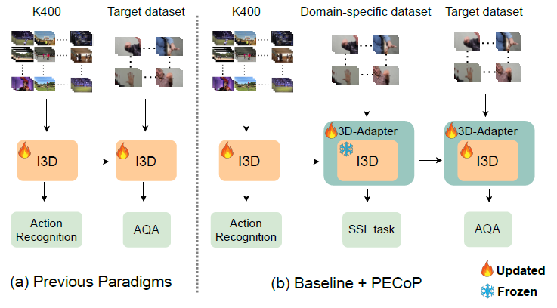
Introduction
Notes:
Figure 1. (a) Previous works directly transfer the model pretrained on domain-general data to AQA downstream tasks with target data fine-tuning, (b) in our proposed PECoP framework, the pretrained model continues to learn towards a specific AQA task through an additional pretraining stage, where only a small set of 3D-Adapter parameters are updated on unlabeled domain-specific data in a SSL approach, while the baseline model’s weights remain frozen.
图1所示。(a)以前的工作直接将在领域通用数据上预训练的模型转移到具有目标数据微调的AQA下游任务，(b)在我们提出的PECoP框架中，预训练模型通过额外的预训练阶段继续学习特定的AQA任务，其中只有一小部分3D-Adapter参数以SSL方法更新未标记的领域特定数据，而基线模型的权重保持冻结。

Slide 6
Introduction
Pretraining to Finetuning: further pretrain using domain-specific unlabeled data, i.e. continual pretraining - computationally prohibitive or impractical
BatchNorm tuning: equip the pretrained model with domain-specific information by only updating the affine parameters of BatchNorm layers - fail on those AQA datasets that are relatively small and more domain-specific, such as JIGSAWS
Adapter-based methods: add a Parameter-Efficient Continual Pretraining (PECoP) adaptation stage to the traditional AQA transfer learning workflow that can efficiently adapt the domain-general pretrained model for the downstream AQA task
3D-Adapter, a lightweight convolutional bottleneck block, insert into a pretrained 3D CNN
Learns domain-specific spatiotemporal knowledge via a self-supervised learning (SSL) approach

Slide 7
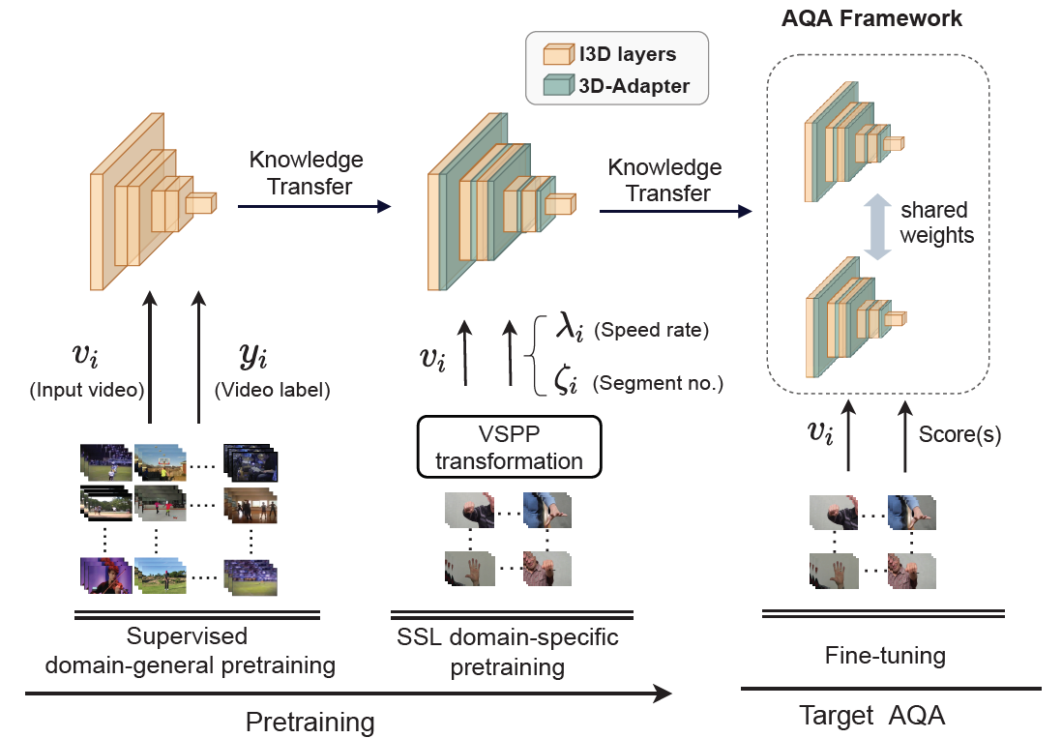
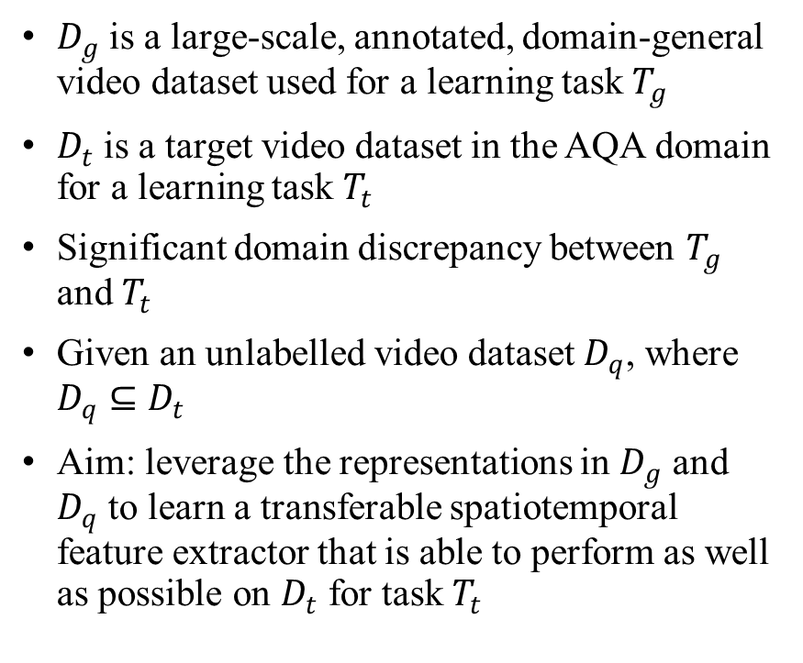
Method
$D_{g}$ is a large-scale, annotated, domain-general video dataset used for a learning task $T_{g}$
$D_{t}$ is a target video dataset in the AQA domain for a learning task $T_{t}$
Significant domain discrepancy between $T_{g}$ and $T_{t}$
Given an unlabelled video dataset $D_{q}$, where $D_{q}⊆D_{t}$
Aim: leverage the representations in $D_{g}$ and $D_{q}$ to learn a transferable spatiotemporal feature extractor that is able to perform as well as possible on $D_{t}$ for task $T_{t}$

Slide 8
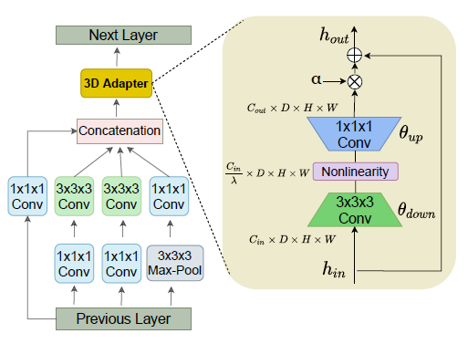
Method
Domain-general pretraining
A pretrained backbone model, one trained on a large video dataset, e.g. an I3D model supervised on K400
In-domain SSL continual pretraining
Equip our K400 pretrained model with randomly initialised 3D-Adapter modules
Self-supervised learning, Video Segment Pace Prediction (VSPP) as an SSL pretext task
Supervised fine-tuning
CoRe, USDL/MUSDL, and TSA to be enhanced with
Notes:
temporally explore a video clip and predict the index and speed of a segment within a clip that is sampled at a different speed rate. It was shown in [8] that VSPP is more suited to video motion events than previous video playback prediction tasks [2, 5, 13, 43] by way of much faster convergence
时序上探索一个视频片段，并预测在一个片段中以不同的速度采样的片段的索引和速度。文献[8]表明，与之前的视频播放预测任务[2,5,13,43]相比，VSPP以更快的收敛速度更适合视频运动事件

Slide 9
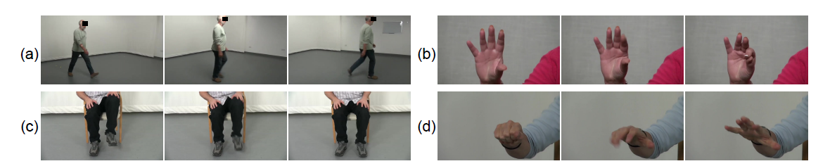
Experiments
Datasets
MTL-AQA, JIGSAWS, FineDiving, PD4T
2931 videos, 30 PD patients, 41 to 72 years old, Unified Parkinson’s Disease Rating Scale (UPDRS) quality scores ranging from 0 (normal) to 4 (severe)
25fps, 1920×1080 (reduced to 854x480
30 subjects, 22 for training and 8 for testing

Slide 10
Experiments
Device: Nvidia RTX 3090TI GPU
Initialization: I3D model with K400 pretrained weights
Classification head: two randomly initialized FC layers
Data augmentation: randomly crop the video clips to 224 × 224 followed by horizontal flip and colour jittering of each frame
Input clip length: 32

Slide 11
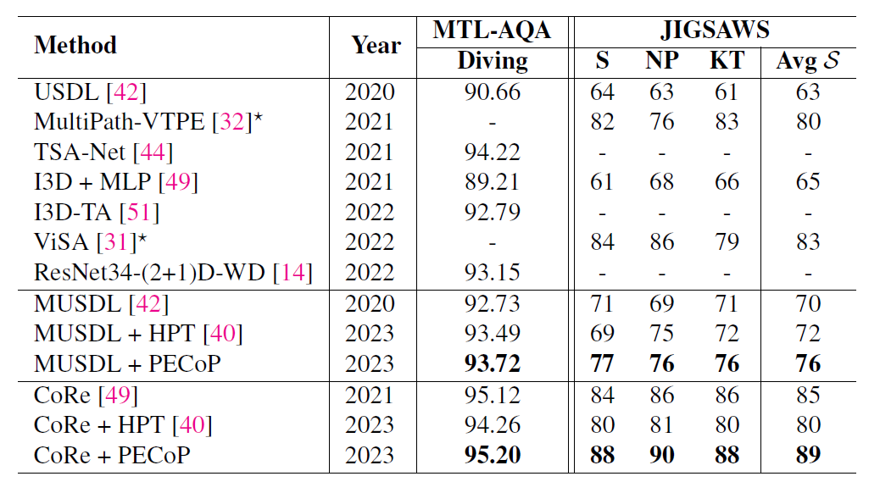
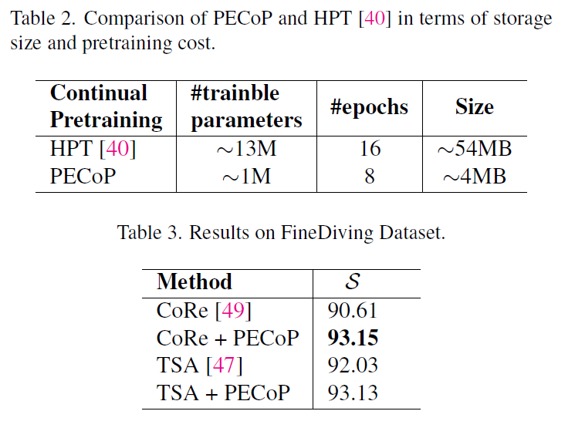
Experiments
Notes:
with and without continual pretraining. ⋆ ViSA [31] and MultiPath-VTPE [32] are customised towards surgical skill assessment and not general AQA tasks.

Slide 12
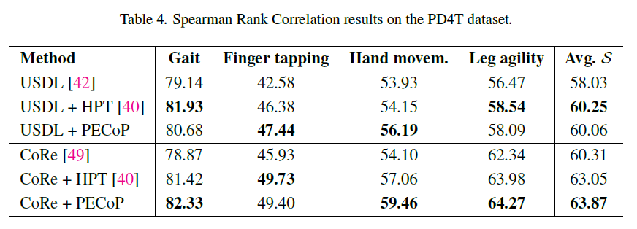
Experiments
Slight advantage for HPT is likely due to its greater model capacity for handling the complex patterns in the PD4T dataset
Notes:
HPT performs marginally better (↑ 2.22%) when added to USDL. We assume this slight advantage for HPT is likely due to its greater model capacity for handling the complex patterns in the PD4T dataset

Slide 13
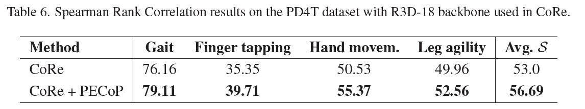
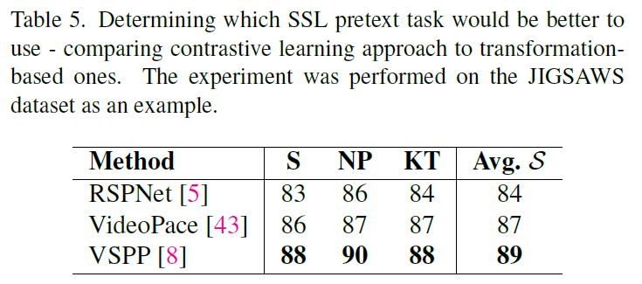
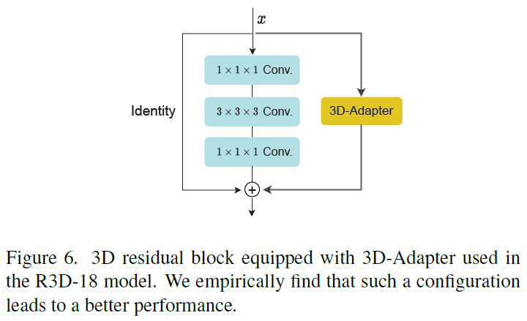
Ablation Study
Different SSL Methods
3D-Adapters for ResNet

Slide 14
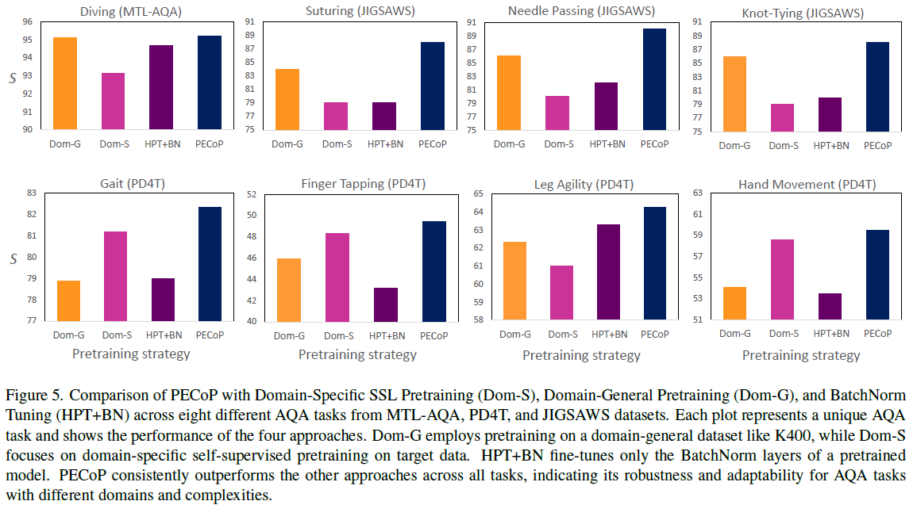
Ablation Study
BatchNorm (BN) Tuning: only updating the affine parameters of BatchNorm layers, while other pretrained parameters are frozen
HPT+BN v.s. Dom-G
Dom-S v.s. Dom-G
Notes:
particularly by a large margin on the tasks within PD4T and JIGSAWS datasets.
Further, we observe that, HPT+BN performs significantly worse than Dom-G alone on the all three tasks within JIGSAWS dataset. This suggests that the BN affine parameters, β and γ, generally have a negative impact on downstream AQA tasks when facing a significant domain shift. This happens because β and γ are tuned to the feature distribution of the source domain. When these parameters are applied to a significantly different target domain, they fail to correctly adjust feature statistics, resulting in a misalignment between the source and target domains. This issue becomes worse in smaller target datasets, as the limited number of examples makes it harder for the model to learn the true feature distribution, increasing the risk of overfitting.
此外，我们观察到，在JIGSAWS数据集中，HPT+BN在这三个任务上的表现明显低于单独使用Dom-G。这表明，当面临显著的结构域转移时，BN仿射参数β和γ通常会对下游AQA任务产生负面影响。这是因为β和γ被调谐到源域的特征分布。当这些参数应用于一个明显不同的目标域时，它们不能正确地调整特征统计，导致源域和目标域之间的不对齐。这个问题在较小的目标数据集中变得更糟，因为有限的样本数量使模型更难学习真实的特征分布，增加了过拟合的风险。
Dom-S performs variably. It fared worse than Dom-G on MTL-AQA, but exceeds Dom-G in nearly all PD4T tasks. This discrepancy suggests that direct transfer from the K400 dataset may not be ideal for PD4T tasks due to a significant domain gap.
Dom-S的性能是可变的。它在MTL-AQA上的表现不如Dom-G，但在几乎所有PD4T任务上都超过了Dom-G。这种差异表明，由于存在显著的域差距，直接从K400数据集传输数据可能不适合PD4T任务。
Dom-S also performs poorly on all JIGSAWS tasks, implying that self-supervised pretraining from scratch on smaller datasets is sub-optimal
Dom-S在所有JIGSAWS任务上的表现也很差，这意味着在较小的数据集上从头开始的自我监督预训练是次优的

Slide 15
Ablation Study
BatchNorm (BN) Tuning: only updating the affine parameters (a coefficient and a bias) of BatchNorm layers, while other pretrained parameters are frozen
HPT+BN v.s. Dom-G
Dom-S v.s. Dom-G
Notes:
particularly by a large margin on the tasks within PD4T and JIGSAWS datasets.
Further, we observe that, HPT+BN performs significantly worse than Dom-G alone on the all three tasks within JIGSAWS dataset. This suggests that the BN affine parameters, β and γ, generally have a negative impact on downstream AQA tasks when facing a significant domain shift. This happens because β and γ are tuned to the feature distribution of the source domain. When these parameters are applied to a significantly different target domain, they fail to correctly adjust feature statistics, resulting in a misalignment between the source and target domains. This issue becomes worse in smaller target datasets, as the limited number of examples makes it harder for the model to learn the true feature distribution, increasing the risk of overfitting.
此外，我们观察到，在JIGSAWS数据集中，HPT+BN在这三个任务上的表现明显低于单独使用Dom-G。这表明，当面临显著的结构域转移时，BN仿射参数β和γ通常会对下游AQA任务产生负面影响。这是因为β和γ被调谐到源域的特征分布。当这些参数应用于一个明显不同的目标域时，它们不能正确地调整特征统计，导致源域和目标域之间的不对齐。这个问题在较小的目标数据集中变得更糟，因为有限的样本数量使模型更难学习真实的特征分布，增加了过拟合的风险。
Dom-S performs variably. It fared worse than Dom-G on MTL-AQA, but exceeds Dom-G in nearly all PD4T tasks. This discrepancy suggests that direct transfer from the K400 dataset may not be ideal for PD4T tasks due to a significant domain gap.
Dom-S的性能是可变的。它在MTL-AQA上的表现不如Dom-G，但在几乎所有PD4T任务上都超过了Dom-G。这种差异表明，由于存在显著的域差距，直接从K400数据集传输数据可能不适合PD4T任务。
Dom-S also performs poorly on all JIGSAWS tasks, implying that self-supervised pretraining from scratch on smaller datasets is sub-optimal
Dom-S在所有JIGSAWS任务上的表现也很差，这意味着在较小的数据集上从头开始的自我监督预训练是次优的

Slide 16
Ablation Study
BatchNorm (BN) Tuning: only updating the affine parameters of BatchNorm layers, while other pretrained parameters are frozen
HPT+BN v.s. Dom-G
Dom-S v.s. Dom-G
Notes:
particularly by a large margin on the tasks within PD4T and JIGSAWS datasets.
Further, we observe that, HPT+BN performs significantly worse than Dom-G alone on the all three tasks within JIGSAWS dataset. This suggests that the BN affine parameters, β and γ, generally have a negative impact on downstream AQA tasks when facing a significant domain shift. This happens because β and γ are tuned to the feature distribution of the source domain. When these parameters are applied to a significantly different target domain, they fail to correctly adjust feature statistics, resulting in a misalignment between the source and target domains. This issue becomes worse in smaller target datasets, as the limited number of examples makes it harder for the model to learn the true feature distribution, increasing the risk of overfitting.
此外，我们观察到，在JIGSAWS数据集中，HPT+BN在这三个任务上的表现明显低于单独使用Dom-G。这表明，当面临显著的结构域转移时，BN仿射参数β和γ通常会对下游AQA任务产生负面影响。这是因为β和γ被调谐到源域的特征分布。当这些参数应用于一个明显不同的目标域时，它们不能正确地调整特征统计，导致源域和目标域之间的不对齐。这个问题在较小的目标数据集中变得更糟，因为有限的样本数量使模型更难学习真实的特征分布，增加了过拟合的风险。
Dom-S performs variably. It fared worse than Dom-G on MTL-AQA, but exceeds Dom-G in nearly all PD4T tasks. This discrepancy suggests that direct transfer from the K400 dataset may not be ideal for PD4T tasks due to a significant domain gap.
Dom-S的性能是可变的。它在MTL-AQA上的表现不如Dom-G，但在几乎所有PD4T任务上都超过了Dom-G。这种差异表明，由于存在显著的域差距，直接从K400数据集传输数据可能不适合PD4T任务。
Dom-S also performs poorly on all JIGSAWS tasks, implying that self-supervised pretraining from scratch on smaller datasets is sub-optimal
Dom-S在所有JIGSAWS任务上的表现也很差，这意味着在较小的数据集上从头开始的自我监督预训练是次优的

Slide 17
Conclusions
A parameter-efficient continual pretraining workflow to enhance the efficiency of target tasks.
Integrate a 3D-Adapter layer for the first time for 3D CNNs for video analysis.
A new annotated AQA dataset, PD4T
Extensive experiments and ablations

Slide 18
Writing

Slide 19
The limited availability of labelled data in Action Quality Assessment (AQA), has forced previous works to finetune their models pretrained on large-scale domain-general datasets. This common approach results in weak generalisation, particularly when there is a significant domain shift. We propose a novel, parameter efficient, continual pretraining framework, PECoP, to reduce such domain shift via an additional pretraining stage. In PECoP, we introduce 3D-Adapters, inserted into the pretrained model, to learn spatiotemporal, in-domain information via self-supervised learning where only the adapter modules’ parameters are updated. We demonstrate PECoP’s ability to enhance the performance of recent state-of-the-art methods (MUSDL, CoRe, and TSA) applied to AQA, leading to considerable improvements on benchmark datasets, JIGSAWS (↑ 6.0%), MTL-AQA (↑ 0.99%), and FineDiving (↑ 2.54%). We also present a new Parkinson’s Disease dataset, PD4T, of real patients performing four various actions, where we surpass (↑ 3.56%) the state-of-the-art in comparison. Our code, pretrained models, and the PD4T dataset are available at https://github.com/Plrbear/PECoP.
Challenge & Previous work
Our Method
Experiments
Dataset
Resource

Slide 20
Introduction – 1/6
The analysis and evaluation of the quality of human action performance have a rich application in various real-world scenarios, such as sports events [42, 47, 49], healthcare [9, 32], and skill assessment [35, 38]. Despite recent advances [9,18,28,36,42,46,47,49], AQA methods are affected by insufficient quantities of annotated data for training deep networks [36]. This is further exacerbated when extra effort is needed to produce very precise labels, e.g. for health-related applications, such as Parkinson’s Disease (PD) severity assessment [9, 12, 33, 34]. A common solution to address such problems is to start with a model that is originally pretrained on a large source dataset, commonly Kinetics-400 [27] (K400), and finetune it on one’s target AQA dataset [42, 47, 49] (see Fig 1(a)). While better than training from scratch, deploying such pretrained models is sub-optimal for AQA, due to the domain/task discrepancy between action classification and action assessment. For example, in PD action performance scoring, one or two interruptions during the regular rhythm of a patient’s movement performing an action can result in a different quality score and this is in contrast to the source pretraining task, where subtle or even more pronounced differences in performing an action should not affect action classification [29].
介绍任务应用
挑战：数据和标注
之前的工作
不足+举例

Slide 21
Introduction – 2/6
A promising route to address the shortcomings of this direct jump from classical pretraining to finetuning can be to further pretrain using domain-specific unlabeled data, i.e. continual pretraining – a strategy that has had a remarkable impact in natural language processing (NLP) [19, 20, 45] and recently in image/object classification [1, 40]. When it comes to video-domain tasks (e.g. as in AQA), this additional pretraining stage on in-domain data may be computationally prohibitive or impractical, due to the requirement for updating all parameters and storing pretrained parameter sets for each separate task.
解决方法
但不能直接用于AQA

Slide 22
Introduction – 3/6
BatchNorm tuning [15, 40] could be used to equip the pretrained model with domain-specific information by only updating the affine parameters of BatchNorm layers, while other pretrained parameters are frozen. Although this technique can greatly reduce the number of trainable parameters, we show that in a continual pretraining framework it can fail on those AQA datasets that are relatively small and more domain-specific, such as JIGSAWS [16].
解决方法
但一些AQA任务不适用

Slide 23
Introduction – 4/6
In this paper, we propose adding a Parameter-Efficient Continual Pretraining (PECoP) adaptation stage to the traditional AQA transfer learning workflow that can efficiently adapt the domain-general pretrained model for the downstream AQA task. Inspired by adapter-based methods which have recently achieved strong results with transformer architectures on NLP benchmarks [22, 24, 25, 39], we present 3D-Adapter, a lightweight convolutional bottleneck block which is inserted into a pretrained 3D CNN (e.g. I3D inception modules [3]) and learns domain-specific spatiotemporal knowledge via a self-supervised learning (SSL) approach. During domain-specific pretraining, only the adapter parameters are updated while the original weights of the pretrained model are frozen to allow a high degree of parameter-sharing (see Fig. 1(b)). This greatly reduces the computational and storage costs of conventional continual pretraining, and also prevents overfitting by alleviating catastrophic forgetting [24].
本文贡献
Motivation & 方法
方法细节
方法优势

Slide 24
Introduction – 5/6
To evaluate our method, we present experiments on three public AQA benchmarks, MTL-AQA [37], JIGSAWS [16] and FineDiving [47]. We also provide comparative results on a new Parkinson’s Disease dataset, PD4T, comprising four different PD motor-function tasks by real patients. Our results clearly demonstrate that the proposed continual pretraining approach PECoP can boost the robustness of recent SOTA AQA methods, i.e. TSA [47], CoRe [30] and USDL/MUSDL [42], by a considerable margin.
数据集
结果

Slide 25
Introduction – 6/6
In summary, the contributions of this work are:
• We propose a parameter-efficient continual pretraining workflow to enhance the efficiency of target tasks.
• We integrate a 3D-Adapter layer for the first time for 3D CNNs for video analysis.
• We introduce a new annotated AQA dataset, PD4T, for the vision community to evaluate various actions performed by actual Parkinson’s disease patients.
• We present extensive experiments and ablations to demonstrate that recent state-of-the-art AQA methods can significantly benefit from our proposed continual pretraining approach.
本文贡献

