Slide 1
Keep Your Eye on the Best: Contrastive Regression Transformer for Skill Assessment in Robotic Surgery
IEEE ROBOTICS AND AUTOMATION LETTERS

Slide 2
Background
Manual GRS scores have considerable variation (6-30), while the accompanying videos have mostly similar appearance and context
Challenging :
Distinguish between these scores using only the total score value for supervision
Inherent dimensionality reduction of the regression task
Recently, the contrastive regression mechanism showed promise in a similar task of action quality assessment (AQA)
Encourages the features to encode the difference among different videos.
Notes:
手动GRS评分有相当大的差异(6-30)，而随附的视频大多具有相似的外观和背景挑战:仅使用总分值来区分这些分数，以便进行监督回归任务固有的降维近年来，对比回归机制在类似的行动质量评价(AQA)任务中显示出前景。鼓励功能编码不同视频之间的差异。

Slide 3
Background
A novel Contrastive Regression Transformer model, Contra-Sformer
Focuses specifically on structuring features to express the level of similarity that each surgical execution (i.e., test video) exhibits when compared to a reference one.
Keeping the eye on the best and using it as reference, our model learns how the performance in the input video spatio-temporally deviates from the reference
Regression model is optimized for estimating the difference in the GRS score between the two executions.
Notes:
一种新的对比回归变压器模型——逆变变压器特别关注结构特征，以表达每个手术执行(即测试视频)与参考视频相比所展示的相似程度。我们的模型关注最佳视频并将其作为参考，学习输入视频的表现在时空上如何偏离参考对回归模型进行了优化，用于估计两次执行之间GRS评分的差异。

Slide 4
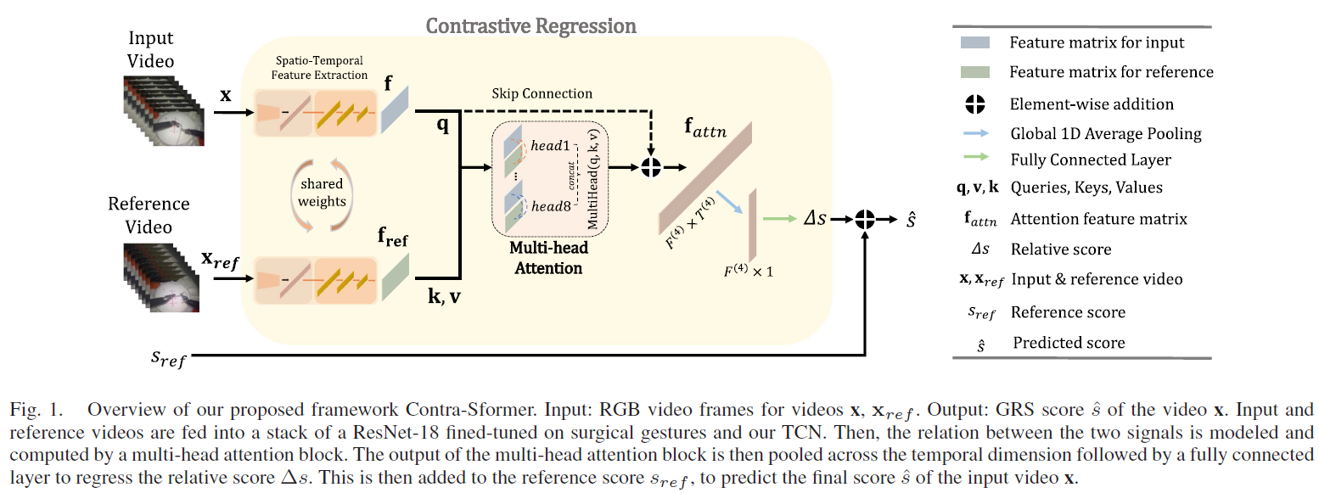
Framework

Slide 5
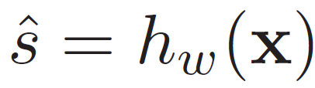
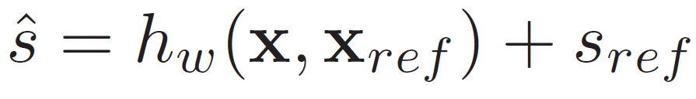
Method
Contrastive Regression From the Best
Typically
This work
A contrastive regression framework that estimates the relative score between an input test video and a reference video instead of regressing to the absolute score of the input
Reference video: Execution with the highest available GRS score in the dataset (for each task)
Mark: all reference videos are free of major mistakes (e.g., dropping the needle), that may affect the modeling of the similarity/deviation between input and reference.

Slide 6
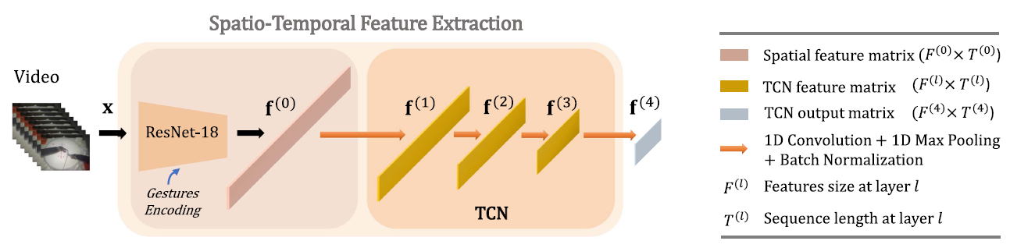

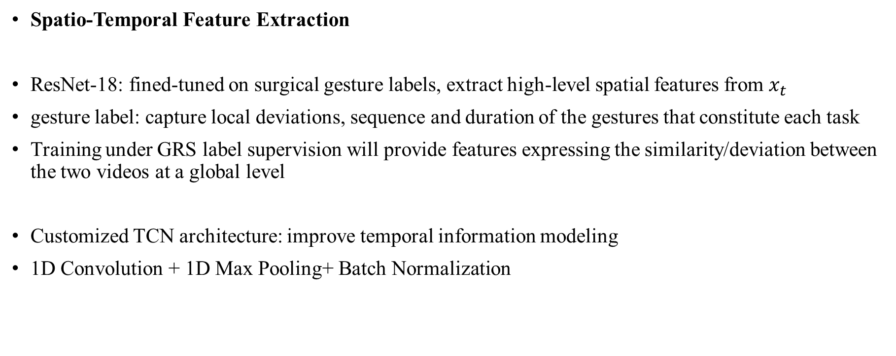
Method
Spatio-Temporal Feature Extraction
ResNet-18: fined-tuned on surgical gesture labels, extract high-level spatial features from $x_{t}$
gesture label: capture local deviations, sequence and duration of the gestures that constitute each task
Training under GRS label supervision will provide features expressing the similarity/deviation between the two videos at a global level
Customized TCN architecture: improve temporal information modeling
1D Convolution + 1D Max Pooling+ Batch Normalization
Notes:
使用每帧手势标签进行训练，从而生成捕获帧级局部偏差的特征，涉及构成每个任务的手势的顺序和持续时间
在GRS标签监督下的训练将提供在全球层面上表达两个视频之间相似/偏差的特征。

Slide 7
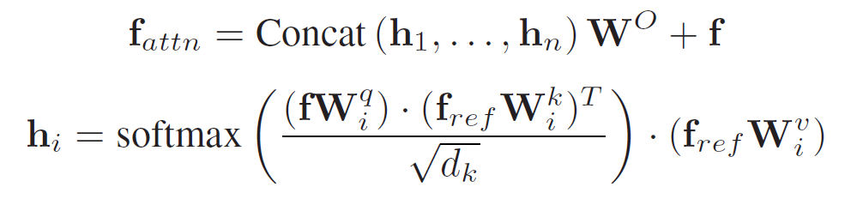
Method
Relation Modeling Via Action-Aware Transformer
Straightforward way: Concatenate feature vectors and use for regression
This work: Explicitly model the relation by computing the similarity function between corresponding high-level feature vectors
Relation modeling: Multi-head attention(8 heads, hidden dim 16, no dropout) Transformer
fully connected layer to compute the relative score
Notes:
However, simple concatenation does not encourage the generation of features representing the differences between the two videos.
不鼓励生成表示两个视频之间差异的特征

Slide 8

Method
Training Procedure
End-to end
Loss: Mean Squared Error (MSE) and Mean Absolute Error (MAE)
A two-step process:
First, feature encoder: trained using gesture labels and fixed using the weights corresponding to the minimum cross-entropy loss → high-level representation of the video
Feature as inputs to the TCN, trained jointly with the rest of the network in an end-to-end manner
Whole video sequences, instead of frame clips, are used as inputs

Slide 9
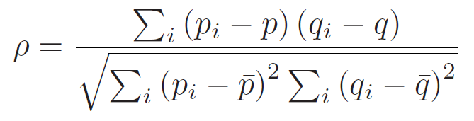
Experiments
Dataset: JIGSAWS
Cross-validation schemes: Leave-One-Supertrial-Out (LOSO), Leave-One-User-Out (LOUO), random 4-Fold scheme
evaluation metric: SROCC
Resized: 240 × 240, center cropped at 224 × 224
Augmentation: Random Horizontal Flip with p = 0.1 and Random Rotation of ±5 deg are used for KT and NP
FPS: 5 Hz

Slide 10
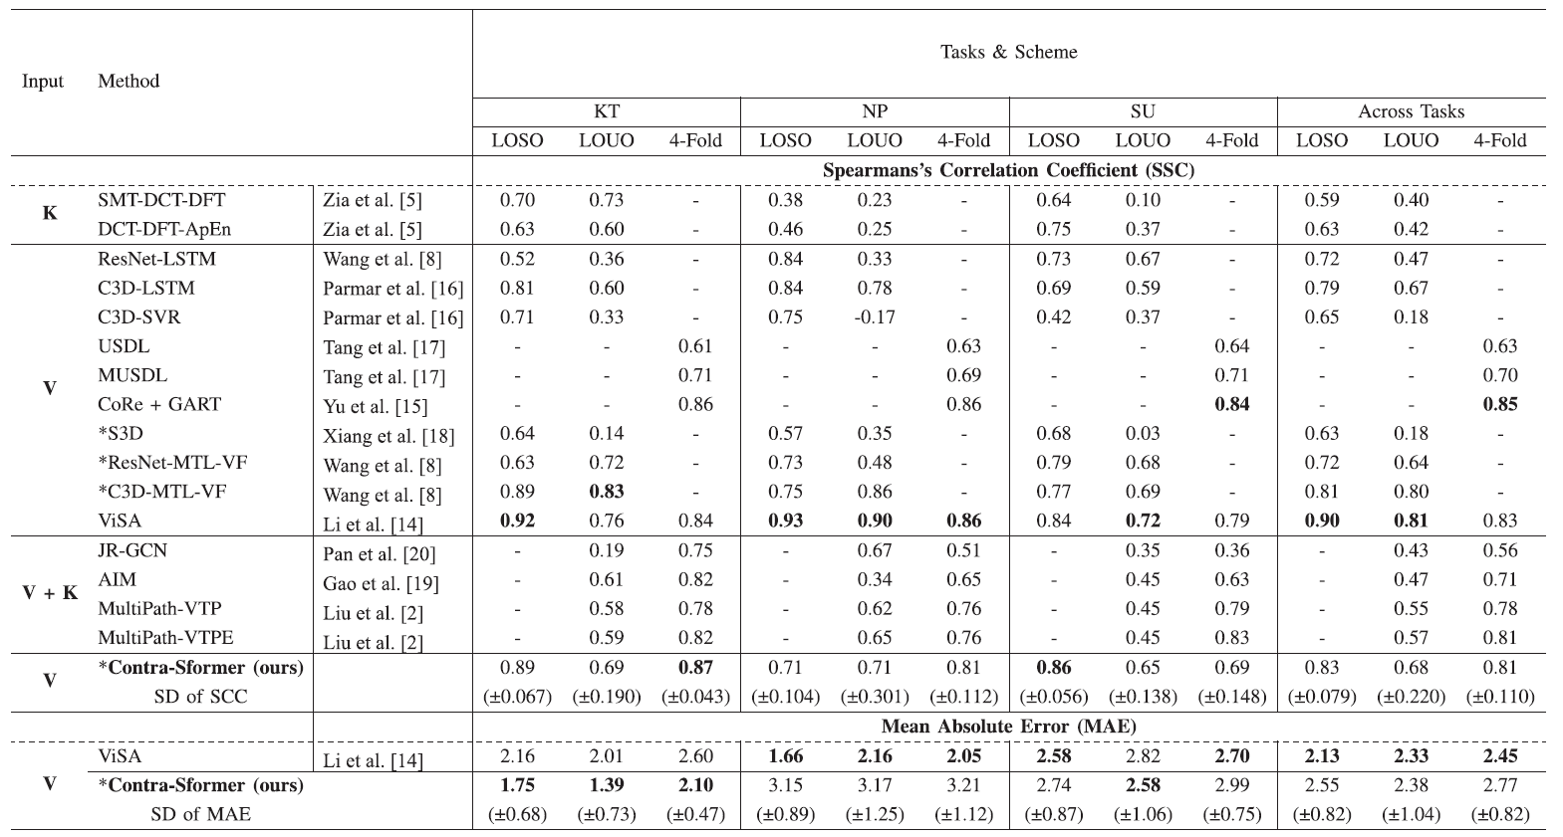
Experiments

Slide 11
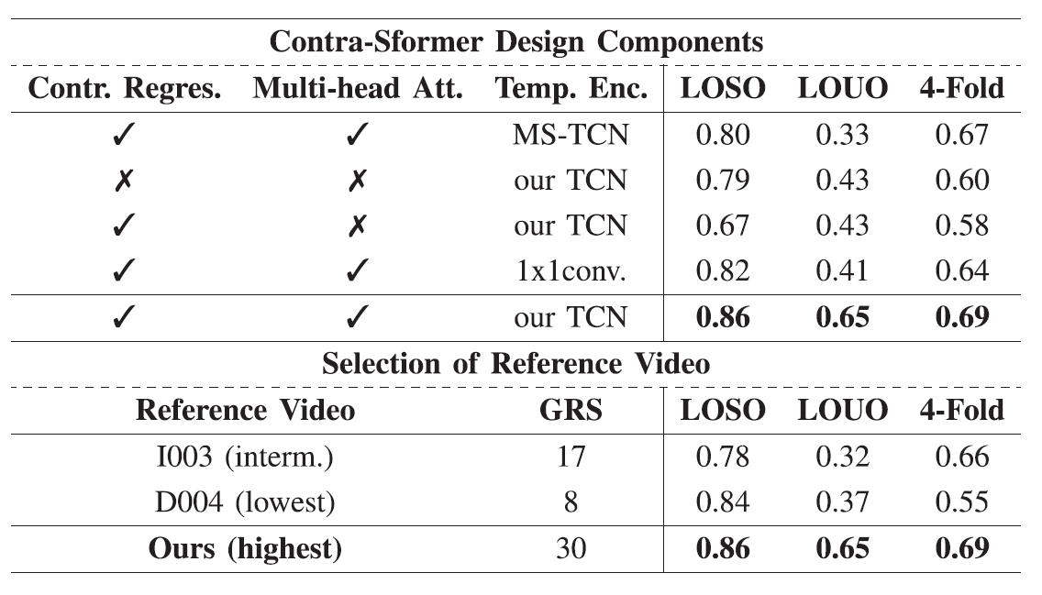
Ablation Study
key design components
Selection of the reference video

Slide 12
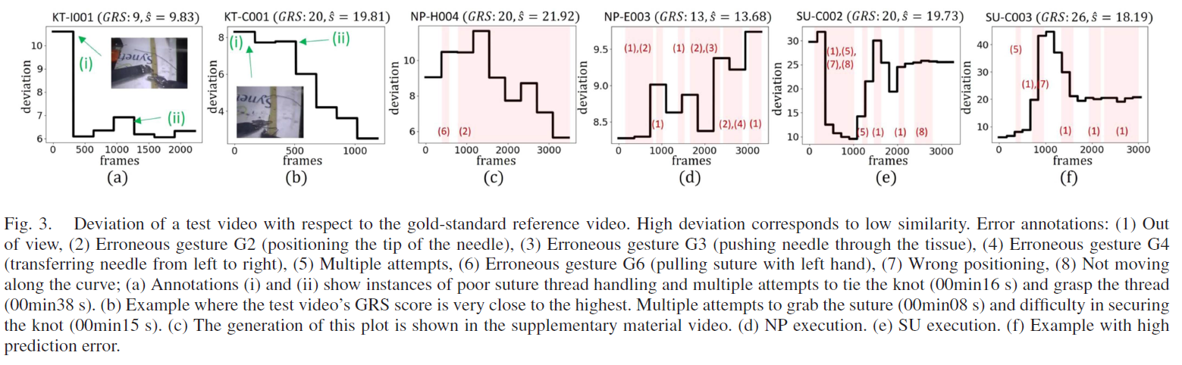
Visualizing the Deviation
Procedural errors: any deviation from an ideal sequence of surgical gestures
Executional errors: poor/failed manipulation of gestures within the task (e.g., needle drop, multiple attempts)

Slide 13
Conclusions
Formulate the regression task based on the skill-similarity/deviation of the test videos compared to a gold-standard reference
Transformer fusion model
Action segmentation as finetune task

Slide 14
Writing

Slide 15
This letter proposes a novel video-based, contrastive regression architecture, Contra-Sformer, for automated surgical skill assessment in robot-assisted surgery. The proposed framework is structured to capture the differences in the surgical performance, between a test video and a reference video which represents optimal surgical execution. A feature extractor combining a spatial component (ResNet-18), supervised on frame-level with gesture labels, and a temporal component (TCN), generates spatiotemporal feature matrices of the test and reference videos. These are then fed into an action-aware Transformer with multi-head attention that produces inter-video contrastive features at frame level, representative of the skill similarity/deviation between the two videos. Moments of sub-optimal performance can be identified and temporally localized in the obtained feature vectors, which are ultimately used to regress the manually assigned skill scores. Validated on the JIGSAWS dataset, Contra-Sformer achieves competitive performance (Spearman 0.65–0.89), with a normalized mean absolute error between 5.8%-13.4% on all tasks and across validation setups.
Method & Task
Motivation
Detailed modules
Effect of modules
Experiment

Slide 16
Introduction – 1/6
ROBOT-ASSISTED minimally invasive surgery (RMIS) is firmly established in clinical practice, offering enhanced visualization and manipulability compared to standard laparoscopy [1]. Operative performance assessment is a fundamental element of surgical education and practice, and similar to other surgical specialties, significant efforts have been devoted towards standardized objective skill assessment systems for RMIS [2]. Global rating scales (GRS) such as the Objective Structured Assessment of Technical Skills (OSATS) are established assessment tools. The OSATS comprise a list of core procedural components (e.g., handling of instruments, and respect for tissue), assessed and scored on a Likert-style (typically 5-point) scale. Summing the individual GRS components produces an overall performance score (7-35 for OSATS [3]). Each component is assigned a score based on performance characteristics. For example, “time and motion” is scored with 5 when there is economy of movement, maximum efficiency and optimal outcome [3]. Nevertheless, RMIS evaluation with GRS is time-consuming, laborious and inherently subjective as different evaluators may assess GRS items differently. To address these limitations, several works have developed computational methods that evaluate surgical execution by processing intraoperative information (e.g., surgical video and robot kinematics) [4].
介绍任务应用
人工标注方法
不足
引出前人工作

Slide 17
Introduction – 2/6
Automated surgical skill assessment in RMIS can have a profound impact, streamlining the evaluation process, overcoming the need for manual assessment, and eliminating subjectivity [5]. Modeling optimal surgical execution can also introduce performance awareness in the design of actuation and control policies towards automation of surgical tasks where robotic systems mimic the performance of expert surgeons [1], [4]. The release of the JHU-ISI Gesture and Skill Assessment Working Set (JIGSAWS) [6] containing synchronized kinematics and video captured using the da Vinci Surgical System, alongside atomic gestures and Global Rating Scale (GRS) score annotations (range of 6-30), provided the first structured benchmark to support activity in this space. Several methods for GRS estimation have been developed and validated on JIGSAWS. Initial works utilized kinematic data to regress the GRS score
自动化手术评价的好处
介绍数据集
数据集的可靠性

Slide 18
Introduction – 3/6
Initial works utilized kinematic data to regress the GRS score by exploring different types of holistic features [5], and temporal convolutional neural networks (TCNs) [7]. Reported outcomes indicate that modeling surgical skills to regress GRS scores only using kinematic cues is challenging (Spearman’s coefficient: 0.38-0.73). Furthermore, kinematic data are rarely available in real-world RMIS practice. More recent works propose video- or hybrid-based methods, leveraging spatial and temporal feature encoders to extract discriminative features or by usingmulti-task architectures [8], [9], [10], [11], [12], [13], [14], [15], [16], [17], [18]. Tang et al. propose an uncertainty-aware score distribution method based on 3D Convolutional Neural Networks (CNNs), where a distribution of different scores, instead of a single one, acts as the supervisory signal [17]. This method achieves good performance on JIGSAWS and other datasets (AQA-7 and MTL-AQA). Employing surgical gesture information (e.g ., pushing needle through the tissue, orienting needle) can be beneficial for capturing the subtle differences across time, during execution by different surgeons [8].
最初的方法和不足
最近的方法
方法1

Slide 19
Introduction – 3/6
Wang et al. propose a multi-task learning framework, with primary task the GRS score prediction, and auxiliary tasks of gesture recognition and expertise classification [8]. Li et al. developed ViSA, reporting state-of-the-art performance on JIGSAWS. To model tool-tissue interaction,ViSA clusters local semantic features, produced by a 3D CNN, to generate abstract features for each group (e.g., tools, tissue and background). These are fed to Bidirectional LSTMs and regress the GRS score [14].Multimodal methods combining video and kinematics have also been proposed [2], [19], [20]. Liu et al. propose a unified multi-path framework for surgical skill assessment,with each path focusing onmodeling a different aspect of skill (e.g., semantic visual features, tools, events) [2]. Video features (extracted by ResNet-101), kinematic data, and gesture probabilities (obtained from an MS-TCN) are used. The model is supervised with regression loss and a self-supervised contrastive loss, achieving promising performance (see Table I).
最近的方法
方法2
方法3
方法4

Slide 20
Introduction – 4/6
Previous works attempt to directly regress the skill score for the target surgical video from its extracted feature vectors [8], [9], [10], [14], [16], [17], [18]. However, the manual GRS scores in JIGSAWS have considerable variation (6-30), while the accompanying videos have mostly similar appearance and context. Thus, it is challenging for deep models to robustly learn to distinguish between these scores, using only the total score value for supervision. We argue that the inherent dimensionality reduction of the regression task makes it very challenging to structure a model to learn representations that capture the subtle differences observed across the videos. Recently, the contrastive regression mechanism showed promise in a similar task of action quality assessment (AQA) [15]. Instead of learning representations that describe the skill score of a specific video, contrastive regression encourages the features to encode the difference among different videos.
之前工作总结
不足
动机-任务属性
动机-方法好用

Slide 21
Introduction – 5/6
In this letter, we propose a novel Contrastive Regression Transformer model, Contra-Sformer, for surgical skill assessment (formulated as a GRS regression task). Contra-Sformer focuses specifically on structuring features to express the level of similarity that each surgical execution (i.e., test video) exhibits when compared to a reference one. Unlike [15], where the reference video is randomly selected according to the coarse category of the input test video, we set the reference video as the one with the highest assessment score for this particular surgical task. This is motivated by the current surgical training paradigm: an expert surgeon assesses a surgical execution by comparing it to an ideal execution, and deducing points when perceiving deviations. Therefore, keeping the eye on the best and using it as reference, our model learns how the performance in the input video spatio-temporally deviates from the reference. In Contra-Sformer, the regression model is optimized for estimating the difference in the GRS score between the two executions.
我们的方法
主要解决的问题
和baseline比较
Motivation
效果（点题）
方法

Slide 22
Introduction – 5/6
We argue that by following this contrastive approach we obtain more discriminative and robust features, that are able to better generalize to the varied GRS scores among the different operators. Spatio-temporal feature extraction is implemented with a ResNet-18 and an enhanced TCN architecture. To capture similarities/deviations, we take advantage of the self-attention mechanism and use a multi-head attention block. With this modeling, we aim to encourage the generation of rich intra-video, action and skill-related features, as well as multi-aspect (tool usage, respect for tissue), inter-video features modeled by multi-head attention. Different to [15] where the two signals (i.e. reference, test) are combined with simple concatenation, we introduce multi-head attention to model similarity/deviation between videos. Also, in our work the action knowledge is implicitly embedded in the model by fine-tuning the feature extractor on atomic gestures. That allows the generation of gesture-related features, which help assess skill. This approach is different than others that use multi-task [2], [8] or segment-aware architectures [18] to encode action knowledge.
效果
具体实现1
作用1
与baseline对比
具体实现2
作用2

Slide 23
Introduction – 6/6
We evaluate the Contra-Sformer with Spearman’s correlation coefficient (SCC) and Mean Absolute Error (MAE) on three tasks and three cross-validation schemes on JIGSAWS. We also validate the learned features for their ability to represent skill similarity/deviation with ground truth error labels as defined in [21]. Our method achieves competitive performance compared to the state-of-the-art with a 5.8%–13.4% normalized MAE, outperforming current methods on the knot-tying and suturing tasks. Our main contributions are summarized as follows:
1) Propose a novel contrastive regression framework for surgical skill assessment, integrating surgical domain knowledge by contrasting test inputs with a reference, selected as the optimal execution (highest GRS score).
2) Derive frame-level spatio-temporal features embedding action/gesture information, combining ResNet-18 outputs with a new temporal convolution network (TCN).
3) Propose multi-head attention to model the similarity/deviation between the input test and reference video. We show that moments of skill deviation/similarity can be identified from the derived spatio-temporal features.
4) Perform detailed analysis on the prediction error and introduce the MAE to complement SCC for evaluating regression performance of GRS score prediction in JIGSAWS.
实验
结果
贡献1：framework
贡献2：embedding module
贡献3：fusion module
贡献4：analysis

