Slide 1
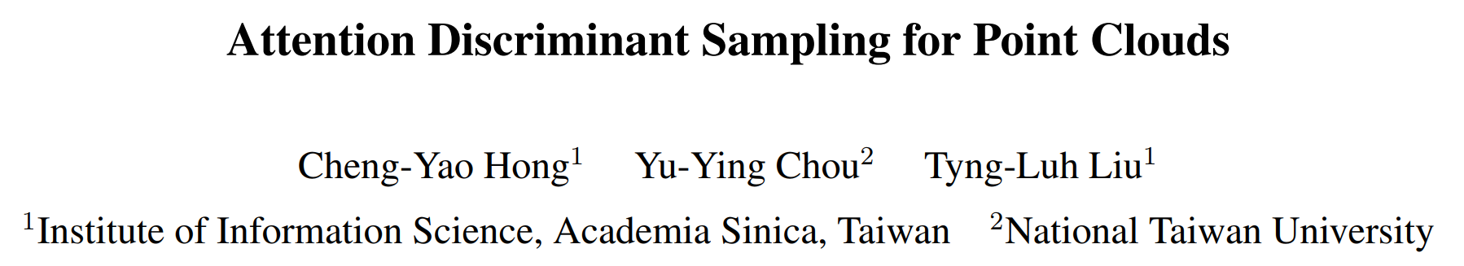
ICCV-2023

Slide 2
Background
Form：depth image、voxel、 mesh、 pointcloud
Knotty problem：irregular & unstructured data
projecting point clouds to depth images、voxelization
PointNet 、 PointNet++ 、 etc.
The way to sample point cloud matters

Slide 3
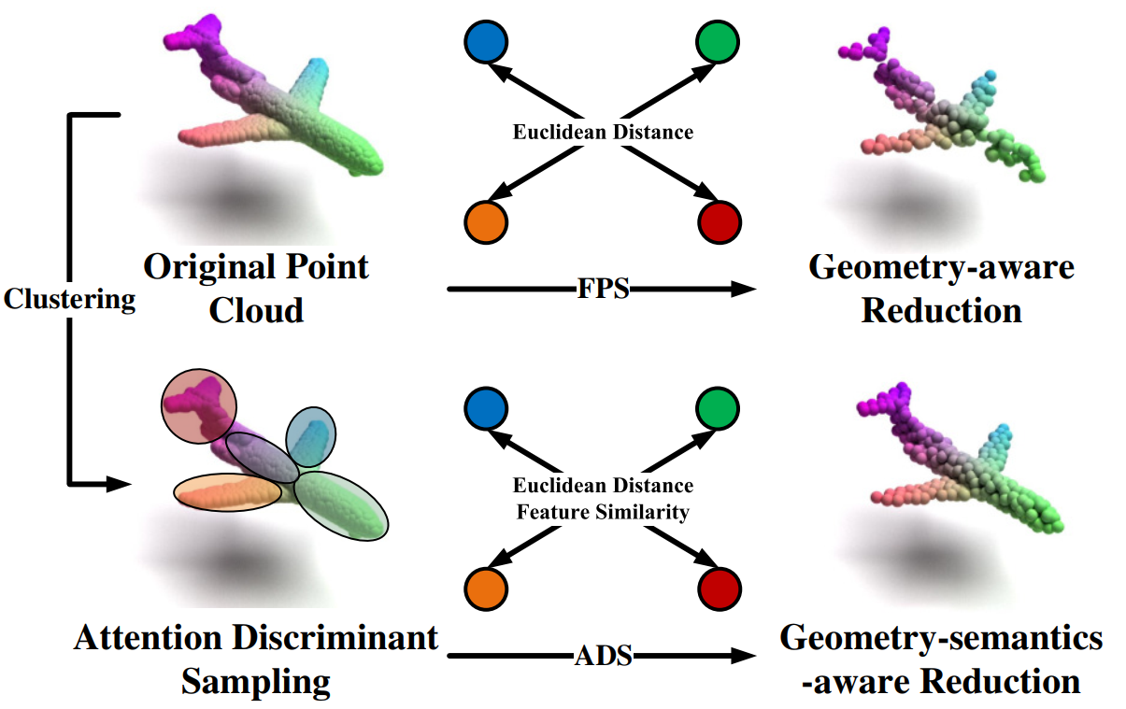
Motivation
Point cloud sampling is an essential step for designing practical solutions to the respective 3-D computer vision applications
Better representation with accurate semantic information
structure-aware point cloud sampling

Slide 4
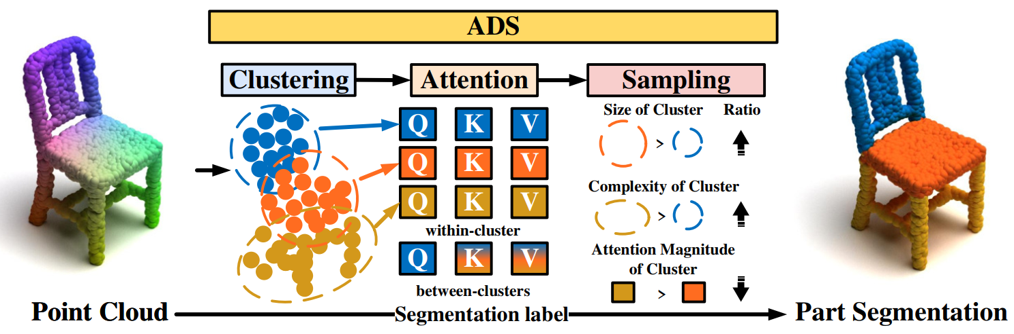
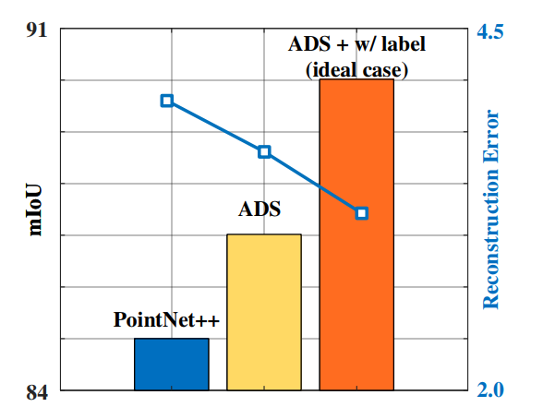
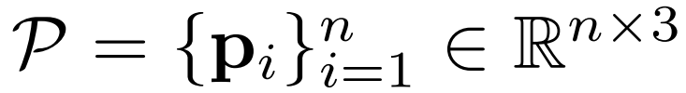
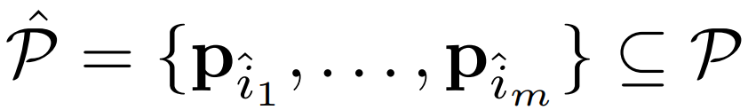
Method

Slide 5
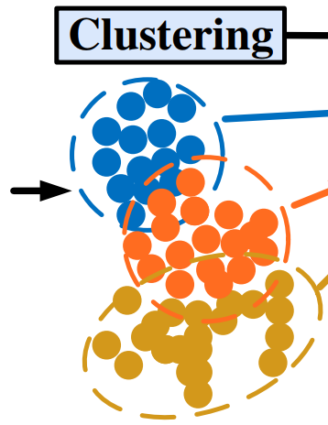
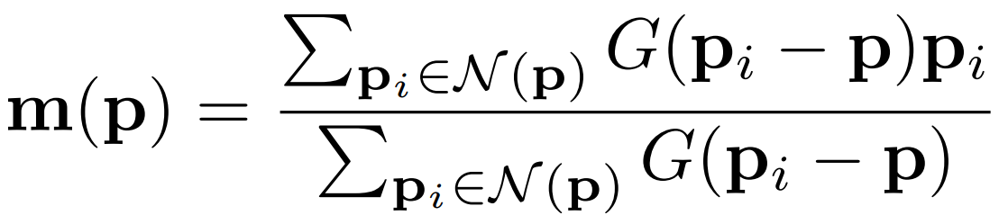
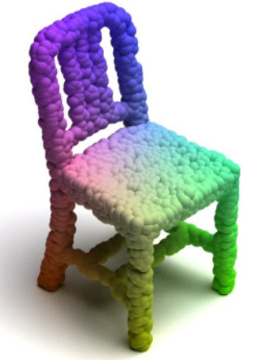

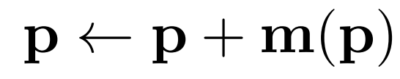
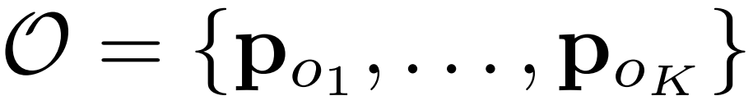
Cluster

Slide 6

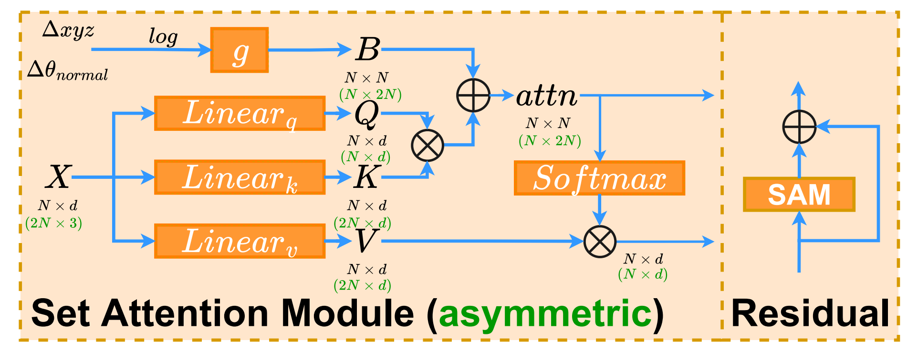
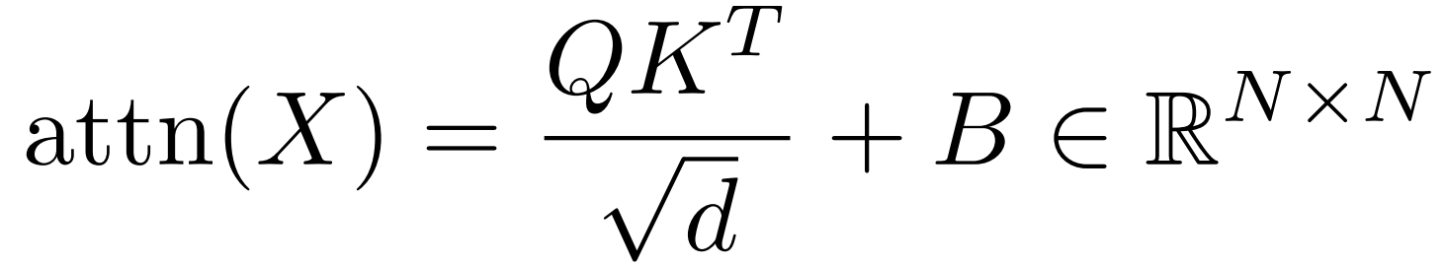
Attention

Slide 7
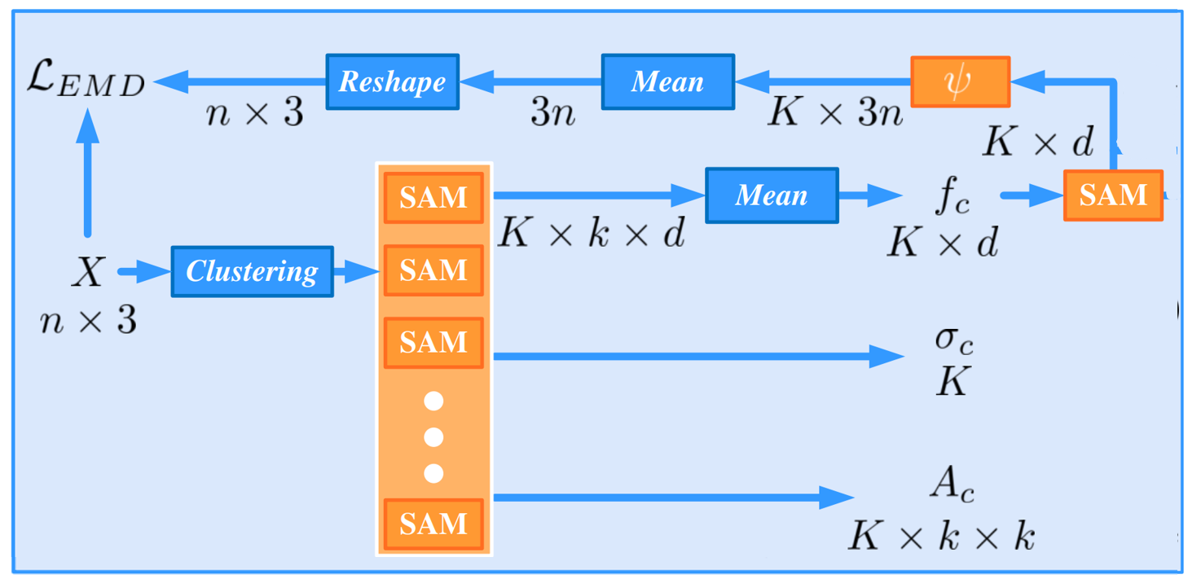









Attention on Cluster
Within-cluster
Between-cluster

Slide 8


Attention on Cluster

Slide 9
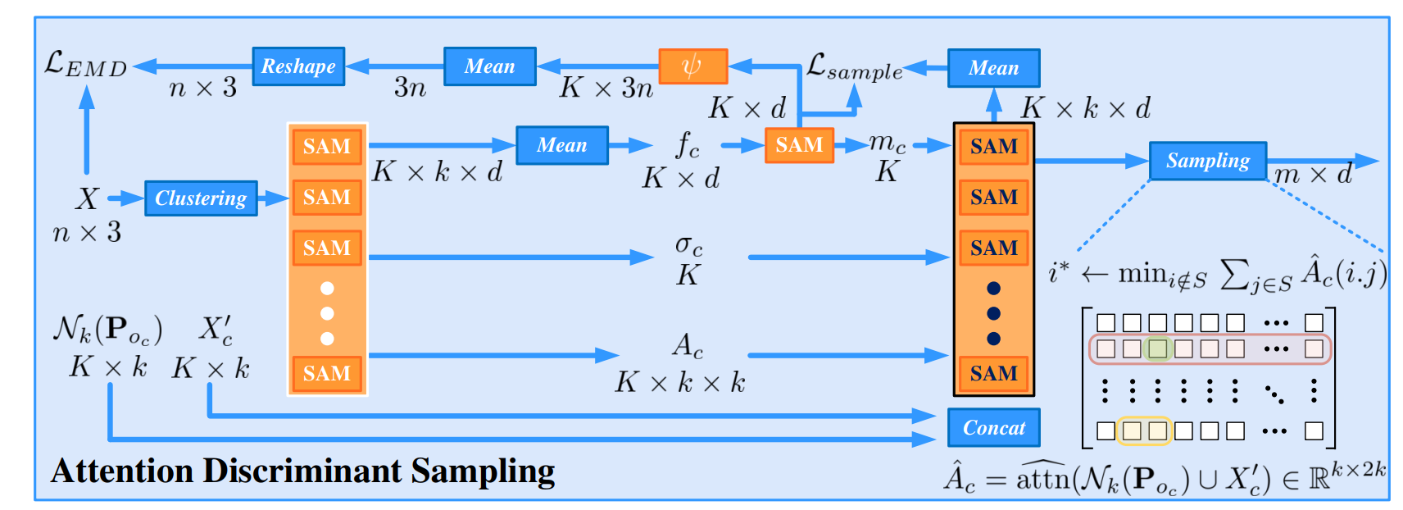




Sampling
quantity
How

Slide 10


Sampling

Slide 11
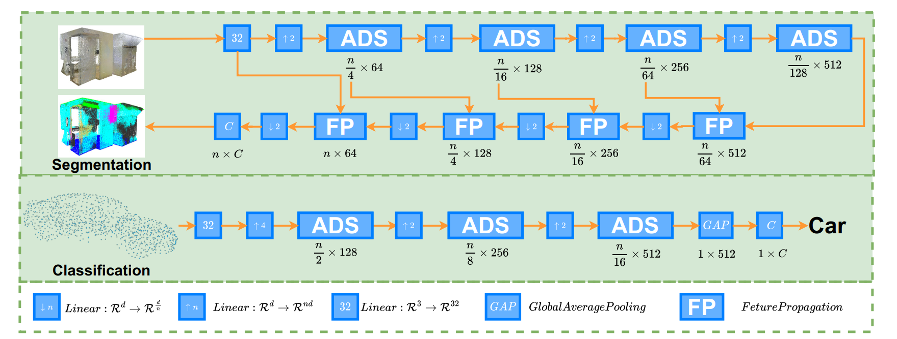
Specific Tasks

Slide 12
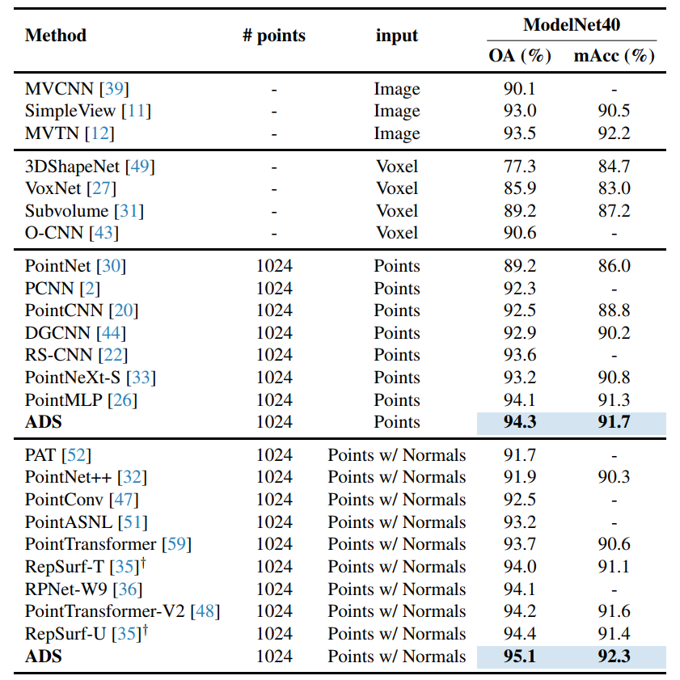
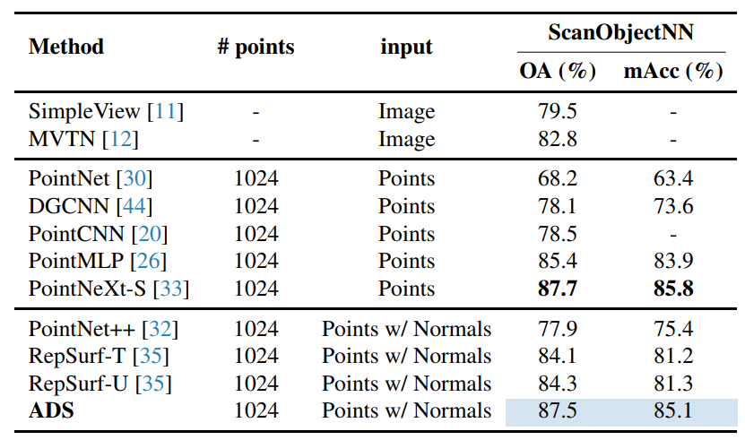
Experiment
Classification

Slide 13
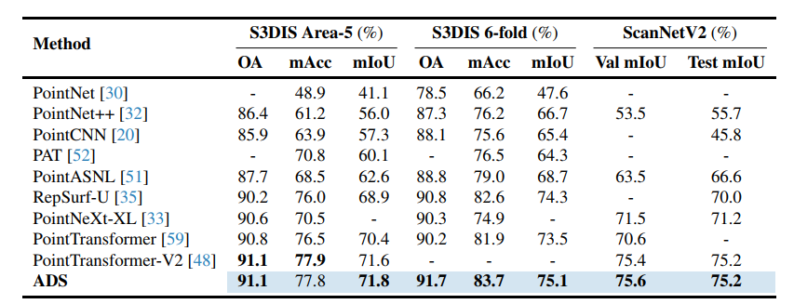
Experiment
Semantic Segmentation

Slide 14
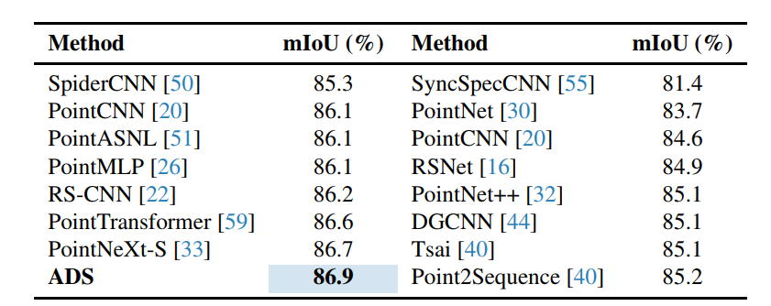
Experiment
Part Segmentation

Slide 15
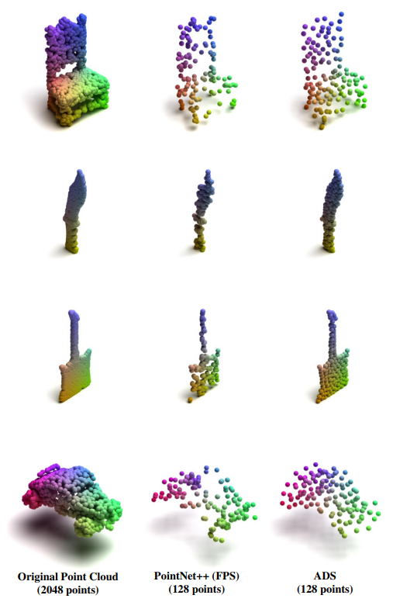
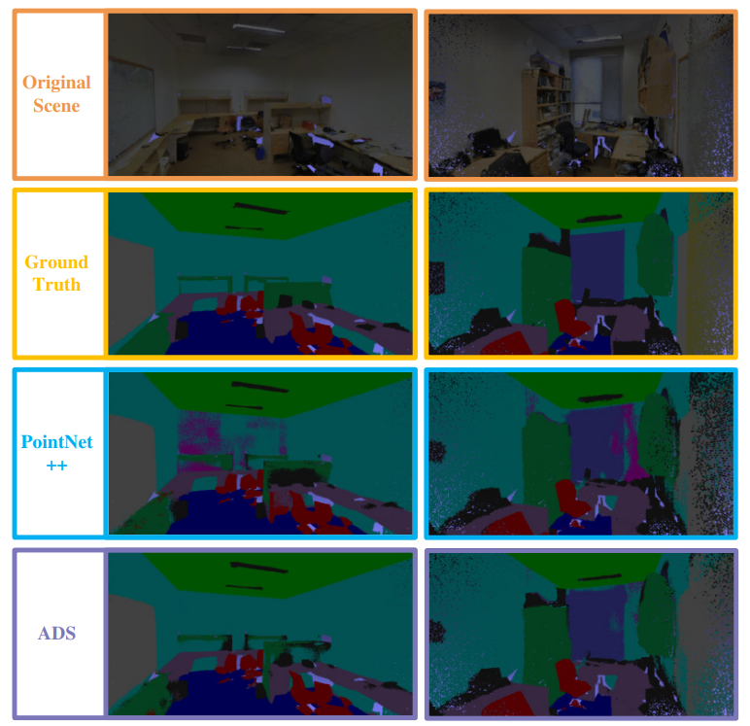
Visualization

Slide 16
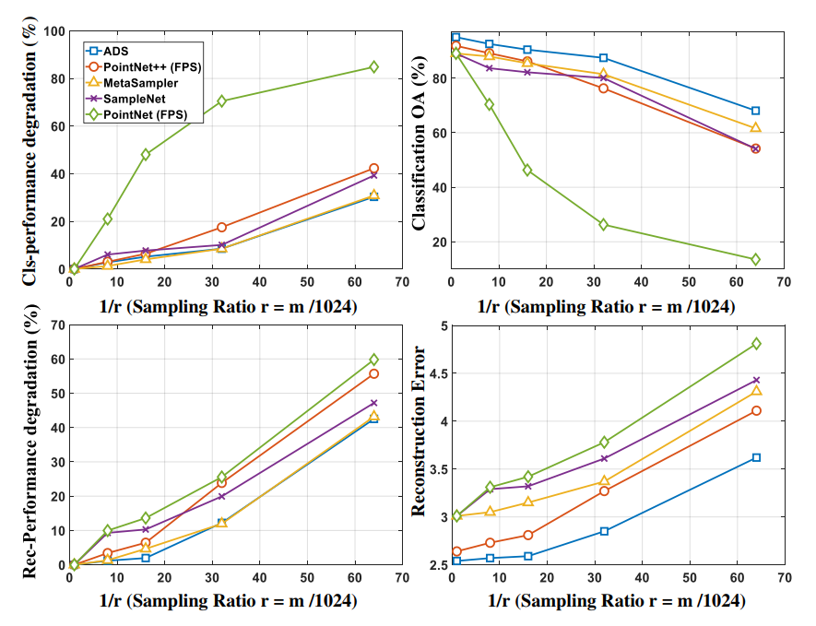
Ablation Study
Sampling Ratio

Slide 17
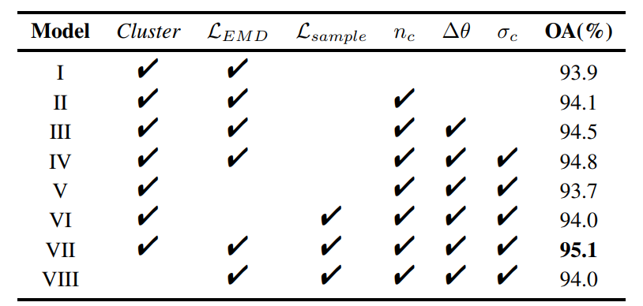
Ablation Study
Components

Slide 18
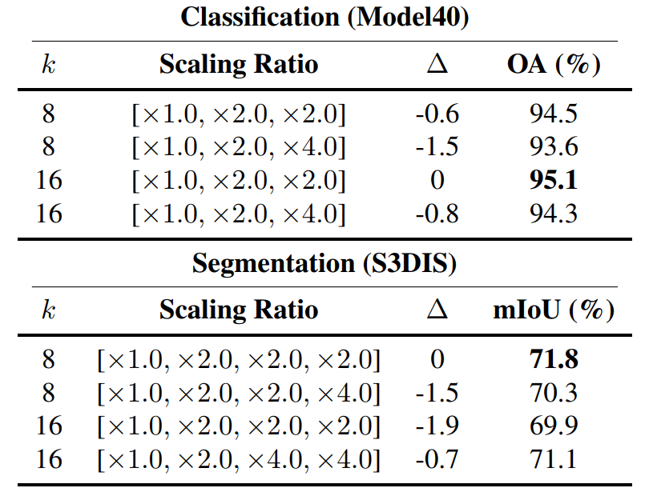
Ablation Study
k-neighbor

Slide 19
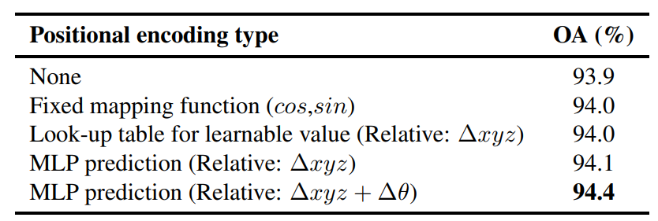
Ablation Study
Position Encoding

Slide 20
Conclusion
Method clearly explained
Sufficient experiments and ablations
Lack of visual comparison

Slide 21
Writing

Slide 22
Abstract
This paper describes an attention-driven approach to 3-D point cloud sampling. We establish our method based on a structure-aware attention discriminant analysis that explores geometric and semantic relations embodied among points and their clusters. The proposed attention discriminant sampling (ADS) starts by efficiently decomposing a given point cloud into clusters to implicitly encode its structural and geometric relatedness among points. By treating each cluster as a structural component, ADS then draws on evaluating two levels of self-attention: within-cluster and between-cluster. The former reflects the semantic complexity entailed by the learned features of points within each cluster, while the latter reveals the semantic similarity between clusters. Driven by structurally preserving the point distribution, these two aspects of self-attention help avoid sampling redundancy and decide the number of sampled points in each cluster.
开篇点题

Slide 23
Abstract
This paper describes an attention-driven approach to 3-D point cloud sampling. We establish our method based on a structure-aware attention discriminant analysis that explores geometric and semantic relations embodied among points and their clusters. The proposed attention discriminant sampling (ADS) starts by efficiently decomposing a given point cloud into clusters to implicitly encode its structural and geometric relatedness among points. By treating each cluster as a structural component, ADS then draws on evaluating two levels of self-attention: within-cluster and between-cluster. The former reflects the semantic complexity entailed by the learned features of points within each cluster, while the latter reveals the semantic similarity between clusters. Driven by structurally preserving the point distribution, these two aspects of self-attention help avoid sampling redundancy and decide the number of sampled points in each cluster.
方法&目的

Slide 24
Abstract
This paper describes an attention-driven approach to 3-D point cloud sampling. We establish our method based on a structure-aware attention discriminant analysis that explores geometric and semantic relations embodied among points and their clusters. The proposed attention discriminant sampling (ADS) starts by efficiently decomposing a given point cloud into clusters to implicitly encode its structural and geometric relatedness among points. By treating each cluster as a structural component, ADS then draws on evaluating two levels of self-attention: within-cluster and between-cluster. The former reflects the semantic complexity entailed by the learned features of points within each cluster, while the latter reveals the semantic similarity between clusters. Driven by structurally preserving the point distribution, these two aspects of self-attention help avoid sampling redundancy and decide the number of sampled points in each cluster.
怎么做：
聚类得到结构和几何信息
类内和类间自注意力

Slide 25
Abstract
This paper describes an attention-driven approach to 3-D point cloud sampling. We establish our method based on a structure-aware attention discriminant analysis that explores geometric and semantic relations embodied among points and their clusters. The proposed attention discriminant sampling (ADS) starts by efficiently decomposing a given point cloud into clusters to implicitly encode its structural and geometric relatedness among points. By treating each cluster as a structural component, ADS then draws on evaluating two levels of self-attention: within-cluster and between-cluster. The former reflects the semantic complexity entailed by the learned features of points within each cluster, while the latter reveals the semantic similarity between clusters. Driven by structurally preserving the point distribution, these two aspects of self-attention help avoid sampling redundancy and decide the number of sampled points in each cluster.
怎么做：
聚类得到结构和几何信息
类内和类间自注意力

Slide 26
Abstract
This paper describes an attention-driven approach to 3-D point cloud sampling. We establish our method based on a structure-aware attention discriminant analysis that explores geometric and semantic relations embodied among points and their clusters. The proposed attention discriminant sampling (ADS) starts by efficiently decomposing a given point cloud into clusters to implicitly encode its structural and geometric relatedness among points. By treating each cluster as a structural component, ADS then draws on evaluating two levels of self-attention: within-cluster and between-cluster. The former reflects the semantic complexity entailed by the learned features of points within each cluster, while the latter reveals the semantic similarity between clusters. Driven by structurally preserving the point distribution, these two aspects of self-attention help avoid sampling redundancy and decide the number of sampled points in each cluster.
两者特点作用
类内复杂度&类间相似度

Slide 27
Abstract
This paper describes an attention-driven approach to 3-D point cloud sampling. We establish our method based on a structure-aware attention discriminant analysis that explores geometric and semantic relations embodied among points and their clusters. The proposed attention discriminant sampling (ADS) starts by efficiently decomposing a given point cloud into clusters to implicitly encode its structural and geometric relatedness among points. By treating each cluster as a structural component, ADS then draws on evaluating two levels of self-attention: within-cluster and between-cluster. The former reflects the semantic complexity entailed by the learned features of points within each cluster, while the latter reveals the semantic similarity between clusters. Driven by structurally preserving the point distribution, these two aspects of self-attention help avoid sampling redundancy and decide the number of sampled points in each cluster.
两者特点作用
类内复杂度&类间相似度
指导采样策略

Slide 28
Abstract
Extensive experiments demonstrate that ADS significantly improves classification performance to 95.1% on ModelNet40 and 87.5% on ScanObjectNN and achieves 86.9% mIoU on ShapeNet Part Segmentation. For scene segmentation, ADS yields 91.1% accuracy on S3DIS with higher mIoU to the state-of-the-art and 75.6% mIoU on ScanNetV2. Furthermore, ADS surpasses the state-of-the-art with 55.0% mAP50 on ScanNetV2 object detection.
性能描述

Slide 29
Abstract
重心在方法描述
缺乏背景介绍

Slide 30
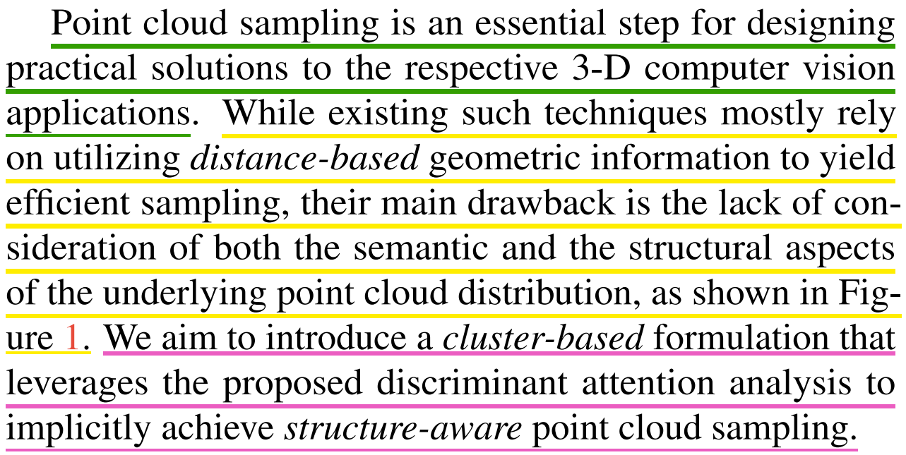
Intro - 1
——
强调点云采样的重要性
——
当前方法的不足
——
提出本文方法

Slide 31
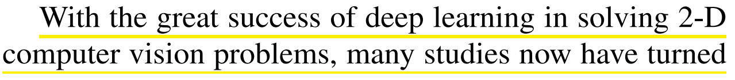
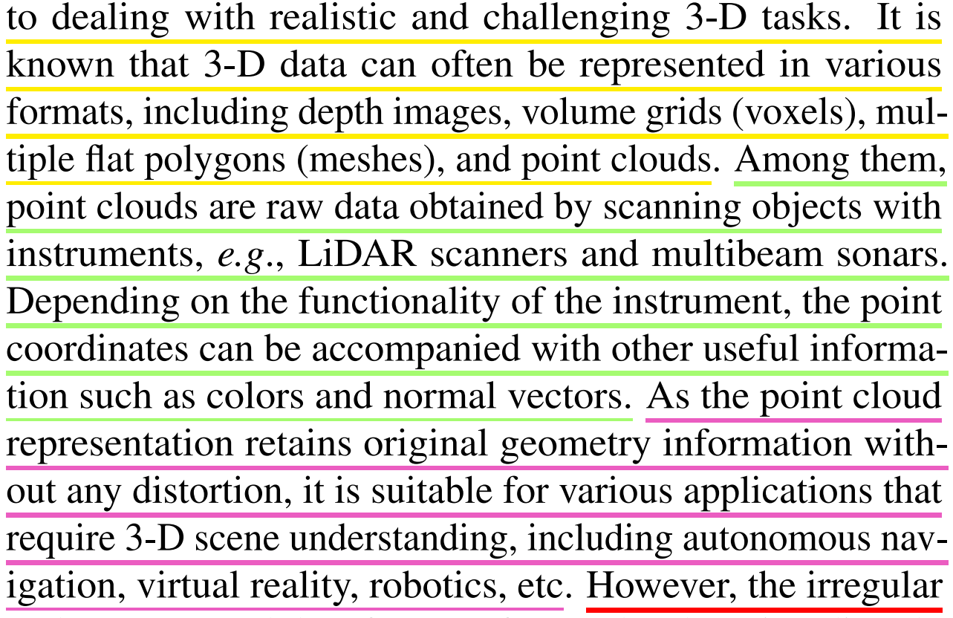
Intro - 2
——
简单介绍三维视觉任务
——
点云数据来源及特点
——
点云优势-几何信息

Slide 32
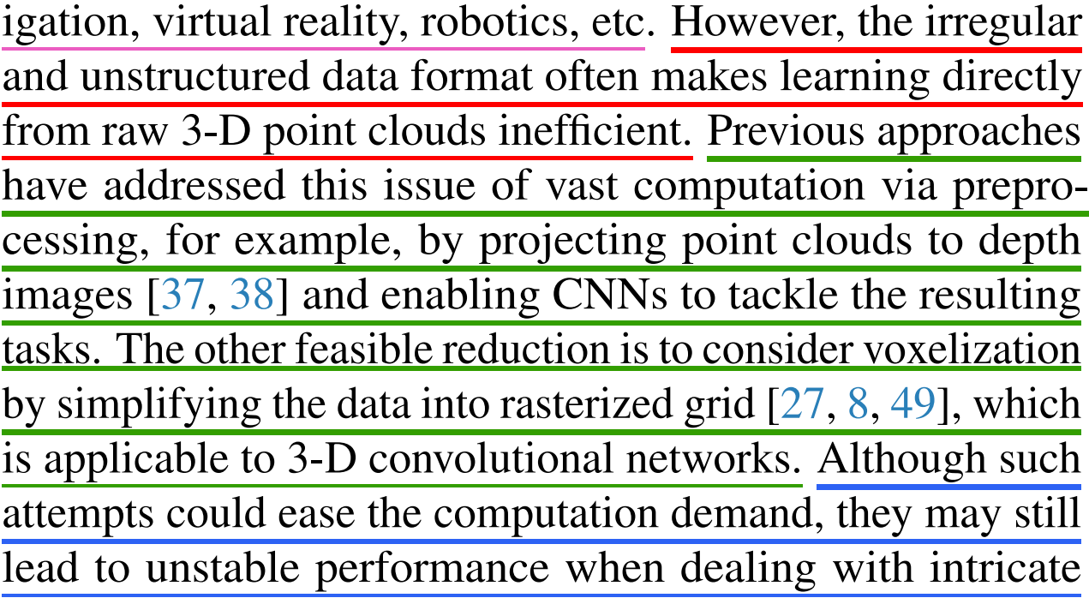
Intro - 2
——
点云学习难点
——
已有的通过预处理的不同尝试
——
他们的不足

Slide 33
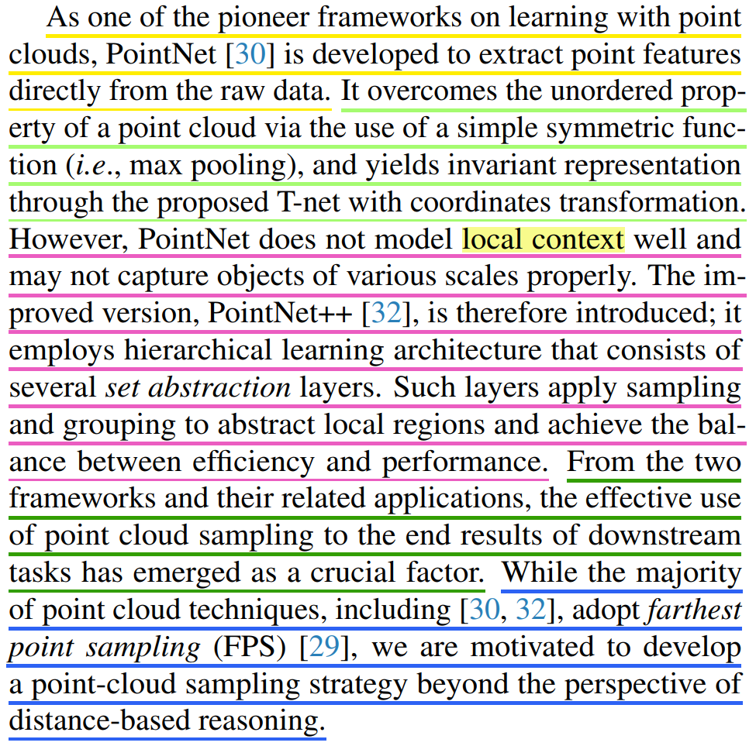
Intro - 3
——
应直接处理点云原始数据
——
解决了无序的问题，得到不变的表征
——
缺点和改进
——
总结规律-有效的采样很重要
——
从采样入手得到动机

Slide 34
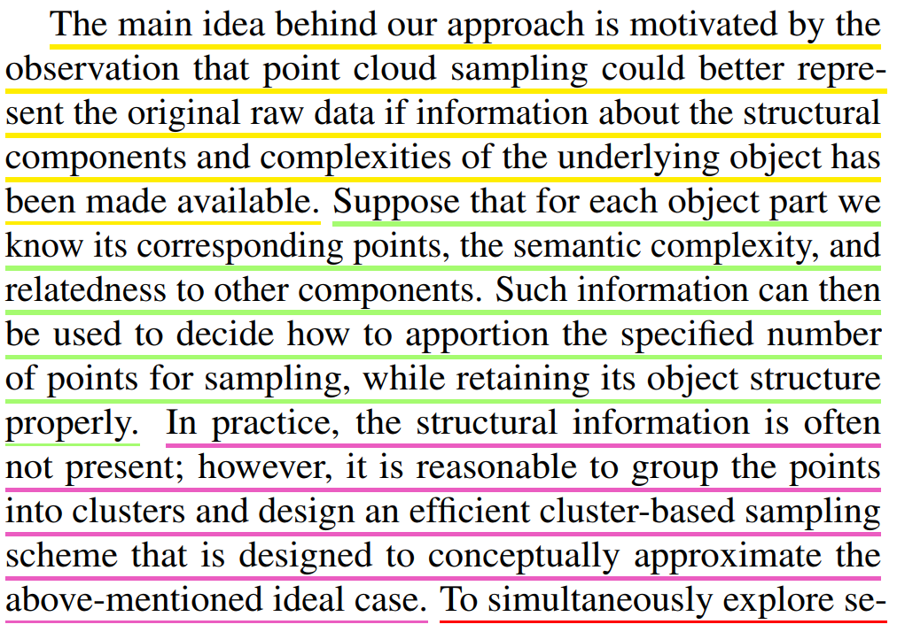
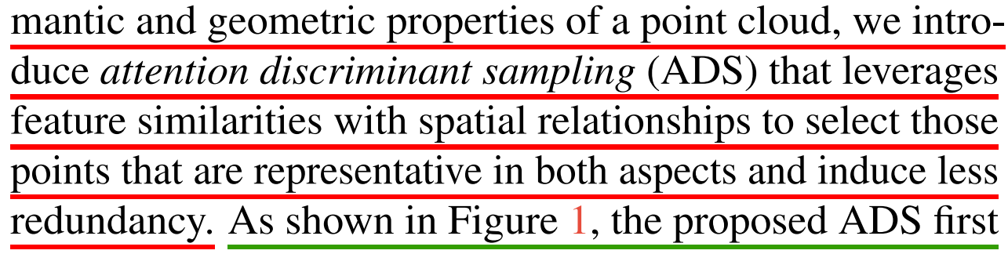
Intro - 4
——
接续上一段结尾，更详细说明动机
——
感知部分结构和复杂性相对于目标的一致性
——
如何去实现，给出核心思路
——
对本文方法及特点的描述

Slide 35
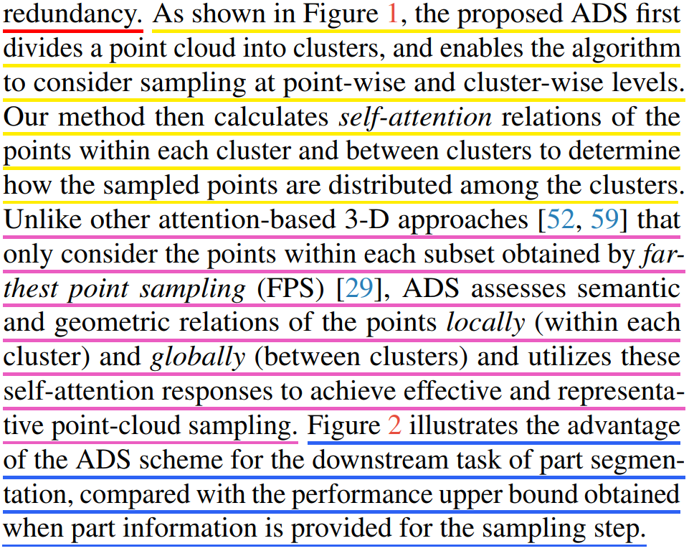
Intro - 4
——
处理的流程
——
和已有方法的主要区别
——
给出例证

Slide 36
Intro
对问题的描述清晰，给出足够的动机
过多描述背景，对于方法细节不够

