Slide 1
Understanding Zero-Shot Adversarial Robustness for Large-Scale Models
ICLR 2023
Chengzhi Mao^{1∗} Scott Geng^{1∗} Junfeng Yang¹ Xin Wang² Carl Vondrick¹
Columbia University¹, Microsoft Research²

Slide 2
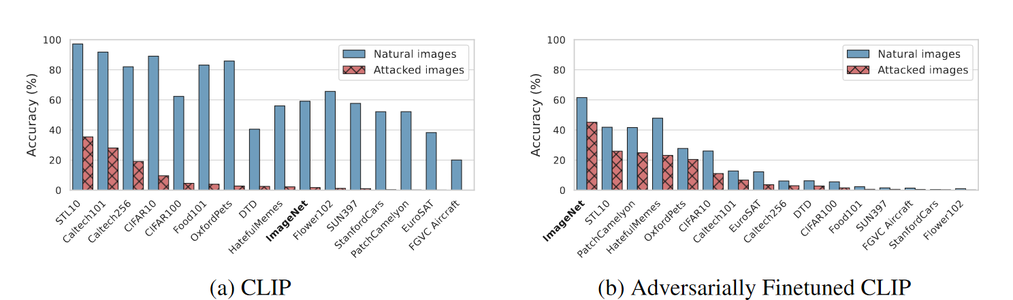
Problem Setup
Can we achieve zero-shot transferability for adversarial robustness, even if the model has never been trained on the unknown tasks?
Adaptation
Zero-shot
Adversarial Robustness
two key factors:
Adaptation Method
Training Objectives

Slide 3
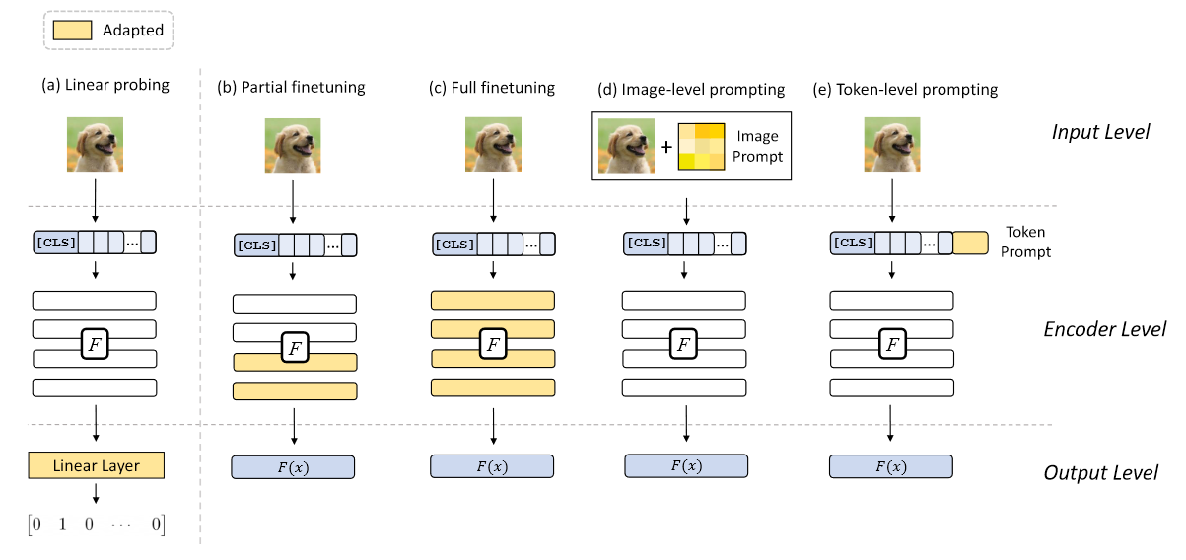
Adaptation Method
FT
VPT

Slide 4

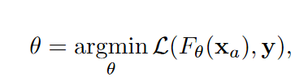

Training Objective
Standard Adversarial Training
AT on CLIP
linear classification head $C_{φ}$
$L(C_{φ}(F_{θ}(x_{a})), y)$
Notes:
对于分类问题，考虑标准的对抗性训练，就是首先通过最大化交叉熵损失生成对抗样本x_a，然后用x_a训练模型，最小化交叉熵损失函数；
把标准的对抗性训练适配到CLIP上，在image encoder后接一个分类头，先固定encoder去训练分类头，然后把分类头固定对encoder的参数做对抗性训练

Slide 5
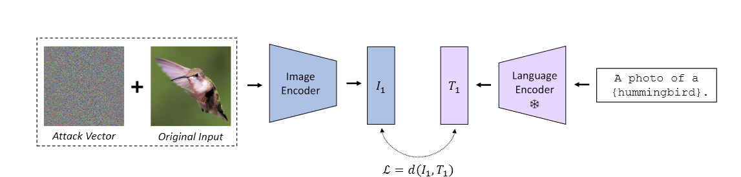
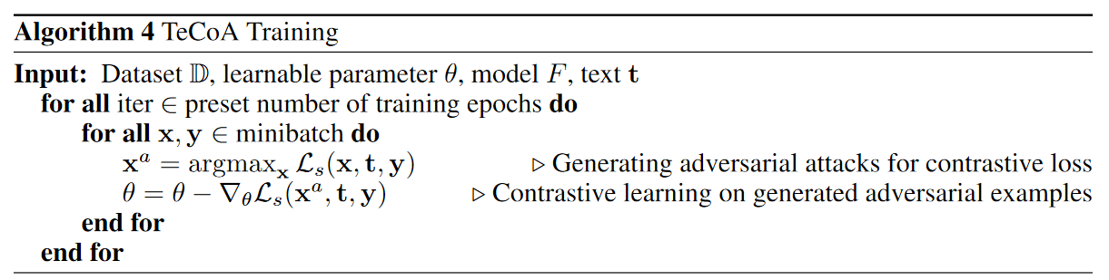
Training Objective
Text-guided Contrastive Adversarial Training (TeCoA)
Notes:
TeCoA的训练框架中，首先是对图片采用PGD攻击来最大化文字和图片间的对比损失，构造图像对抗样本，然后用对抗样本训练image encoder, 而在训练过程中text encoder不参与训练，只起到文本对齐的作用

Slide 6
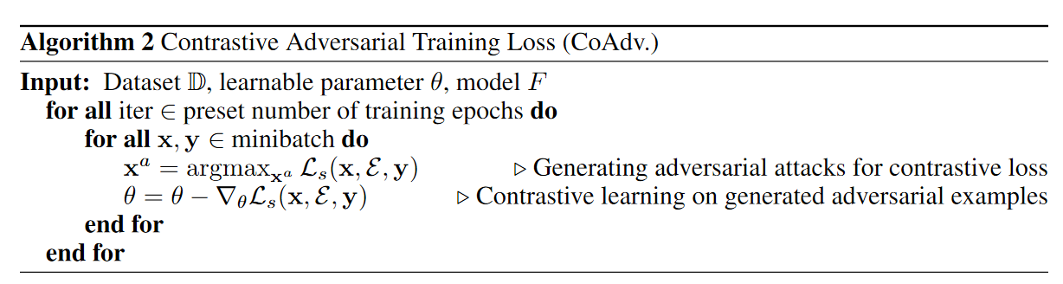
Training Objective
Contrastive Adversarial Training Loss (CoAdv.)
representation
Random embedding initialization
class:
hummingbird
Notes:
第一种CoAdv，也是基于对比学习的方式，这里是把刚刚用text encoder编码的文本换成了一个随机的人为设计的类别表示，具体来说对于每个类别通过随机初始化确定一个对应的编码，用这个编码来代表这个类别，然后和teekow一样，先通过最大化对比损失来生成对抗样本，然后用样本训练image encoder

Slide 7
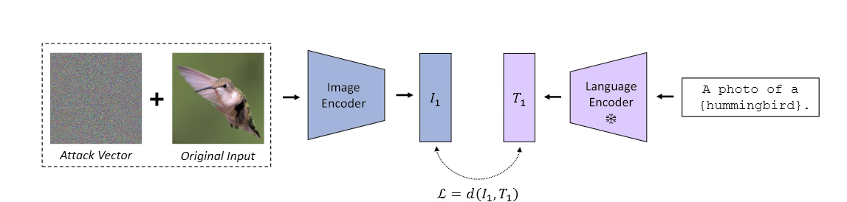
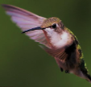
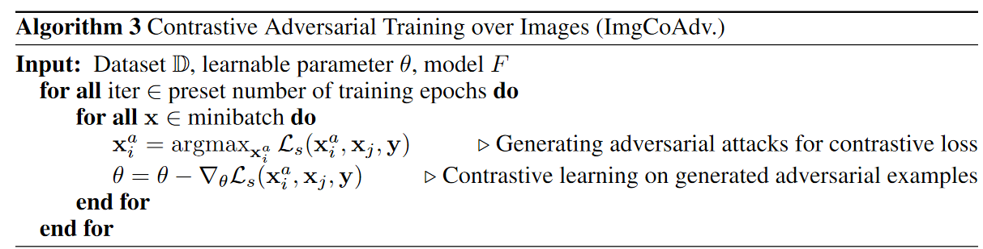

Training Objective
Contrastive Adversarial Training over images (ImgCoAdv.)
I
$$L$$
I’
transformation
Notes:
第三种方法是图片和图片自身的对比学习，这里对于一张图片，做不同的图像变换后，将由同一张图片变换得到的两张图记为一对，对其中一张图像做攻击作为对抗样本，将攻击过和未攻击的图片分别经过image encoder提特征，通过最小化同一组图片间的对比损失来训练image encoder

Slide 8
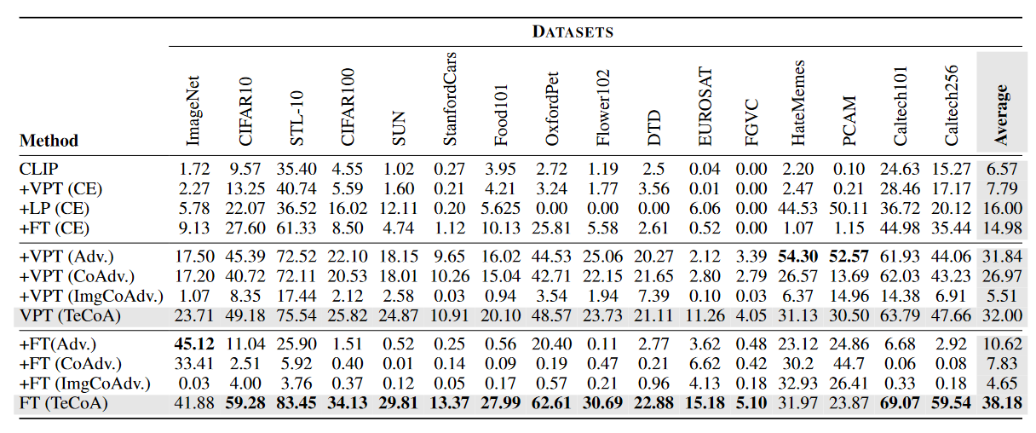
Experiments
Contrastive Learning v.s. Text guided
FT v.s. VPT
PGD, 100step, 1/255
Notes:
总体表现最好的是全参数微调+TeCoA，平均准确率最高
通过TeCoA和其余两种基于对比学习的方法CoAdv, ImgCoAdv 来看，TeCoA效果好主要是因为引入了文本的对齐，而不是对比学习的范式本身
另外注意到全参数微调和Visual prompt tuning的性能，VPT在除了TeCoA以外的损失函数上都更有优势

Slide 9
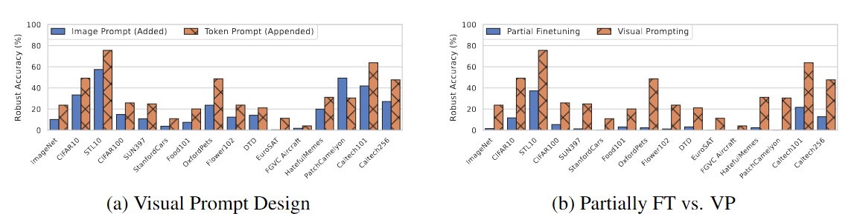
Experiments
add visual prompt to the input image v.s.
append prompt token to the input sequence
optimize the same amount of parameters in partial finetuning and VP
Notes:
这里左边对比了不同的visual prompt tuning的方式，蓝色是在image上加prompt，橙色是在embedding层token后面加prompt，从结果来看在token层额外加prompt的效果更好
右边对比了部分微调和vpt的效果，这里部分微调是限制了微调的参数量，保证FT和VP能够训练的参数量一致，可以发现在打开同样参数量的前提下，VP的效果好于FT，说明VP总的来说是更高效的适配方式

Slide 10
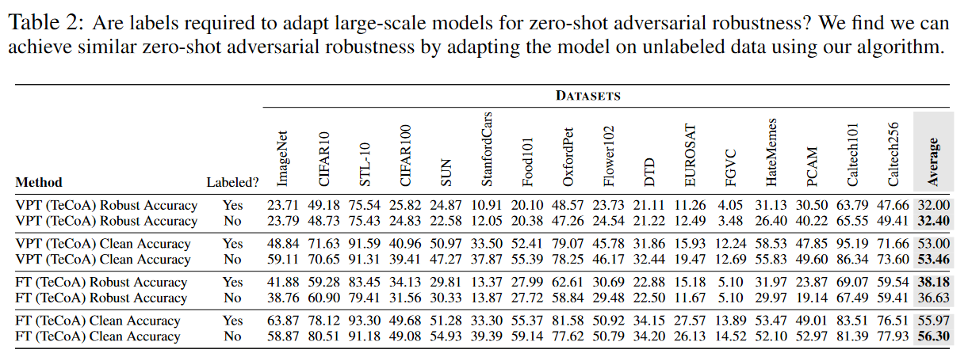
Experiments
pseudo text label
Notes:
之后作者考虑到无标签的数据，对于TeCoA, 作者又提出了对于无标签图片的训练方式，这里的做法是先用CLIP本身的图片-文本对齐能力，对所有可能的分类标签都去计算一个相似度，然后取相似度最高的标签作为伪标签训练，生成伪标签的方式和有标签的训练能够达到相当的性能，说明标签在本文提出的TeCoA框架中也不是必需的

Slide 11
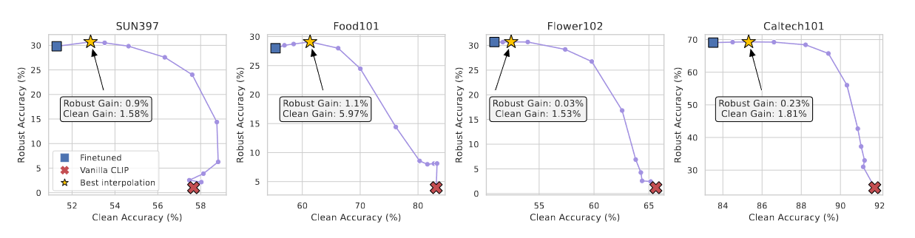
Experiments
Balancing model robustness and clean accuracy via weight interpolation
Notes:
通过权重插值的方式来缓解这种trade-off，经过插值发现在合理的插值点，可以使得模型的robust accuracy和clean accuracy都有一定程度的改善，在一定程度上缓解了这个trade-off的问题

Slide 12
Abstract(1/2)
Pretrained large-scale vision-language models like CLIP have exhibited strong generalization over unseen tasks. Yet imperceptible adversarial perturbations can significantly reduce CLIP’s performance on new tasks. In this work, we identify and explore the problem of adapting large-scale models for zero-shot adversarial robustness. We first identify two key factors during model adaption—training losses and adaptation methods—that affect the model’s zero-shot adversarial robustness.
动机
零样本分类, 对抗鲁棒性
两个重点方面：损失函数和适配方法

Slide 13
Abstract(2/2)
主要方法：文本引导的对比学习对抗训练
We then propose a text-guided contrastive adversarial training loss, which aligns the text embeddings and the adversarial visual features with contrastive learning on a small set of training data. We apply this training loss to two adaption methods, model finetuning and visual prompt tuning. We find that visual prompt tuning is more effective in the absence of texts, while finetuning wins in the existence of text guidance. Overall, our approach significantly improves the zero-shot adversarial robustness over CLIP, seeing an average improvement of 31 points over ImageNet and 15 zero-shot datasets. Our code and model is available at github.com/cvlab-columbia/ZSRobust4FoundationModel.
两种适配方法：模型微调和视觉prompt微调
效果

Slide 14
Introduction(1/5)
Large-scale models trained on vision and language data—also known as foundation models— have emerged as a universal backbone for tackling many recognition problems in computer vision, graphics and robotics. One of the key advantages of foundation models is zero-shot generalization, where the models use just a single textual description to recognize new visual categories with high accuracy. Since those large-scale models are powerful, they will continue to be used in many critical applications, where it is important to make them reliable. However, robustness under adversarial examples remains a challenge, where an imperceptible pattern can be combined with the image to cause recognition failures, where attack on foundation models can consequently corrupt the downstream applications.
视觉-语言基础模型的被广泛作为骨干网络应用
零样本泛化能力
在对抗样本下的鲁棒性仍是问题
Notes:
介绍背景，引出本文研究问题

Slide 15
Introduction(2/5)
Due to the importance of this problem, there is a large literature that investigates adversarial robustness for neural networks. The most common approach for adversarial defense is to learn the model through adversarial training, which involves augmenting the training set with mined adversarial examples that fool the image classifier. Adversarial training has been validated to improve robustness on the task that the mined examples come from, but it often comes at a cost of generalization. However, our world is vast and naturally open, and only evaluating adversarial robustness on the learned tasks is limited. Can we achieve zero-shot transferability for adversarial robustness, even if the model has never been trained on the unknown tasks?
对抗性训练存在鲁棒性-泛化能力的trade-off
本文的目标，提升对抗样本鲁棒性的同时保持模型的泛化能力
Notes:
研究问题存在的困难，本研究的目标

Slide 16
Introduction(3/5)
In this paper, we study this important yet under-explored problem, zero-shot adversarial robustness of large-scale vision-language models. We start our investigation with the state-of-the-art CLIP model, which has been shown to be effective in zero-shot recognition tasks. We find that simply adding an imperceptible vector to the image (≤ 1/255) can subvert CLIP’s prediction (see Figure 1a). If we follow the standard adversarial training defense paradigm to finetune CLIP on the ImageNet training set, we observe that the adapted CLIP has improved adversarial robustness on the ImageNet validation set, but comes at the cost of significantly reduced accuracy on unseen datasets and classes (Figure 1b). Standard adversarial training backfires on CLIP as it fails to retain the model’s zero-shot generalization ability.
CLIP易受对抗性攻击影响
观察到CLIP经过标准的对抗性训练后泛化能力大大降低
Notes:
以CLIP为实验对象，观察到的实验现象，引出后面本文方法的必要性

Slide 17
Introduction(4/5)
Adaptation methods and training objectives are the two major factors for adapting a large-scale model. First, besides finetuning the whole model, we seek an alternative adaptation method—visual prompt tuning—which adapts the inputs instead of the parameters of the model. Visual prompt tuning (VPT) is an emerging light-weight adaptation method that learns a visual prompt which is added to the input image, where we use visual prompt to instruct the model to be robust against adversaries. Second, we find that the standard adversarial training objective ignores the visual-language alignment in CLIP’s pretrained representation space, causing the model to lose zero-shot capability. We then propose a text-guided contrastive adversarial training (TeCoA) loss, dubbed as Tekoa (tee·kow), which maximizes the similarity of the adversarial visual features and the correct text embeddings with contrastive learning. Since the adapted visual features continue to align well with the text features, the model adapted with TeCoA can maximally retain the original zero-shot generalization of CLIP while enjoying improved adversarial robustness.
在微调方式和损失函数两方面的创新：
VPT（视觉prompt微调）
标准对抗性训练的问题
文本指导的对比对抗性训练（TeCoA)

Slide 18
Introduction(5/5)
We conduct an extensive evaluation on 15 zero-shot image datasets, offering a holistic study of the zero-shot adversarial robustness problem. This is especially important given that large-scale vision models are emerging as infrastructure and are deploying to critical applications. We find that the lightweight VPT is noticeably more effective than model finetuning when textual information is unavailable. When texts are used during adaptation, both VPT and finetuning using our TeCoA loss have drastically improved zero-shot adversarial robustness compared to baselines. Finetuning has higher gains than VPT as more parameters are tuned. Our best performing model with the TeCoA loss can improve adversarial robustness over CLIP by an average of 31% across the datasets. Our method also works on unlabeled images, allowing for better robustness with a large amount of unlabeled data. Our work establish a new and important benchmark, zero-shot adversarial robustness, for future work to evaluate on. We release all models and code.
15个图像分类数据集上做zero-shot评测
效果：平均提升31%的鲁棒准确率
无需标签的训练方式
Notes:
本文的研究是开创性的 ，为后面的研究提出了一个新的benchmark，

