Slide 1
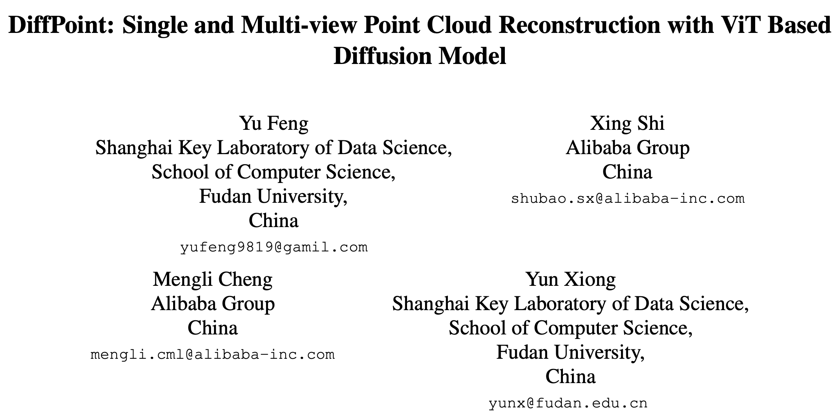
Arxiv 2024

Slide 2
Introduction
Diffusion + ViT
ViT
expressive and context-aware representation
多元输入
Diffusion
local intricacies and dependencies within data

Slide 3
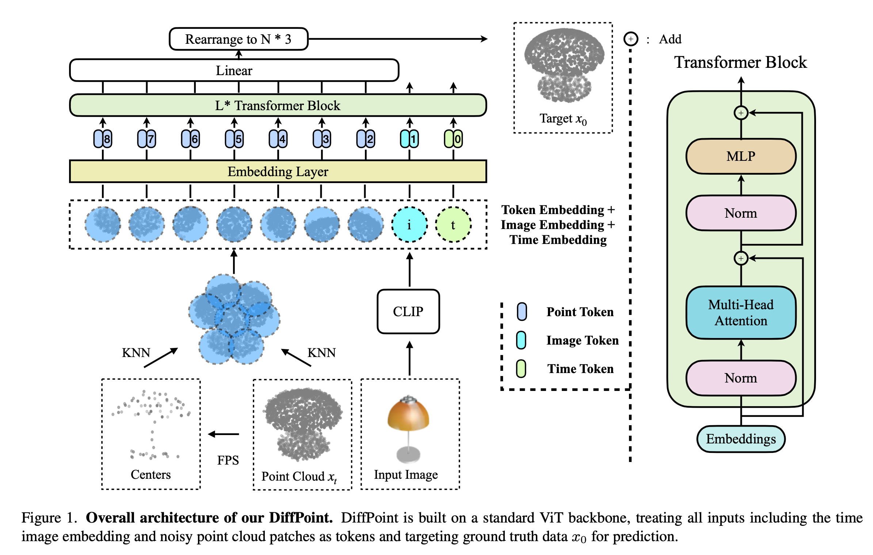
DiffPoint

Slide 4
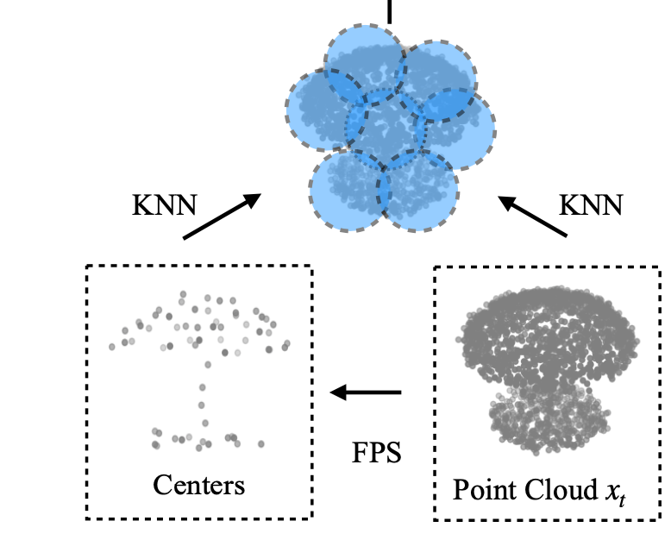
Point Cloud Splitting and Embedding
Farthest Point Sampling (FPS)
K-Nearest Neighborhood (KNN) algorithm
64 patches
32 points/patch

Slide 5
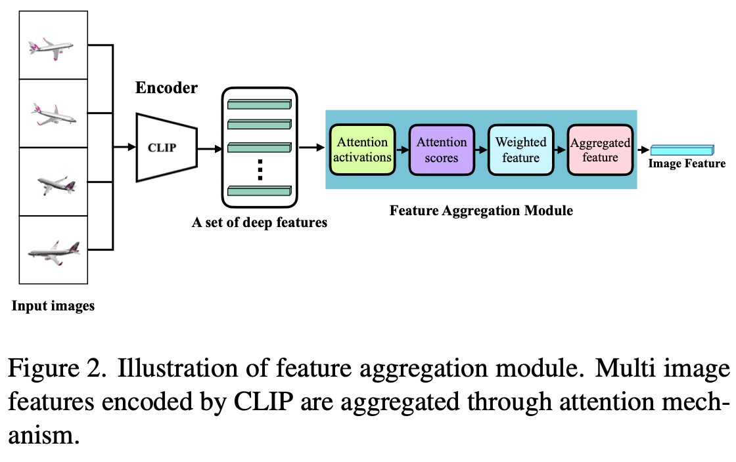
Image Embedding and Feature Aggregation

Slide 6
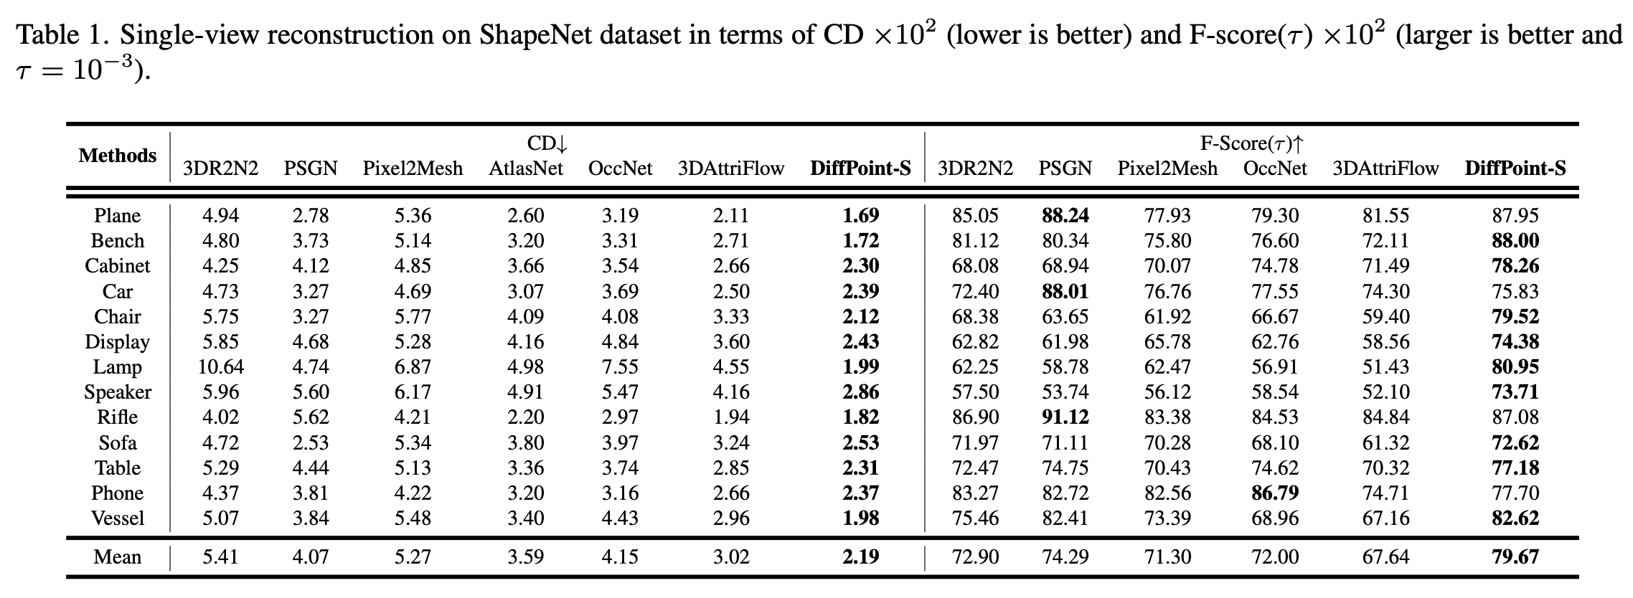
Single-view Reconstruction

Slide 7
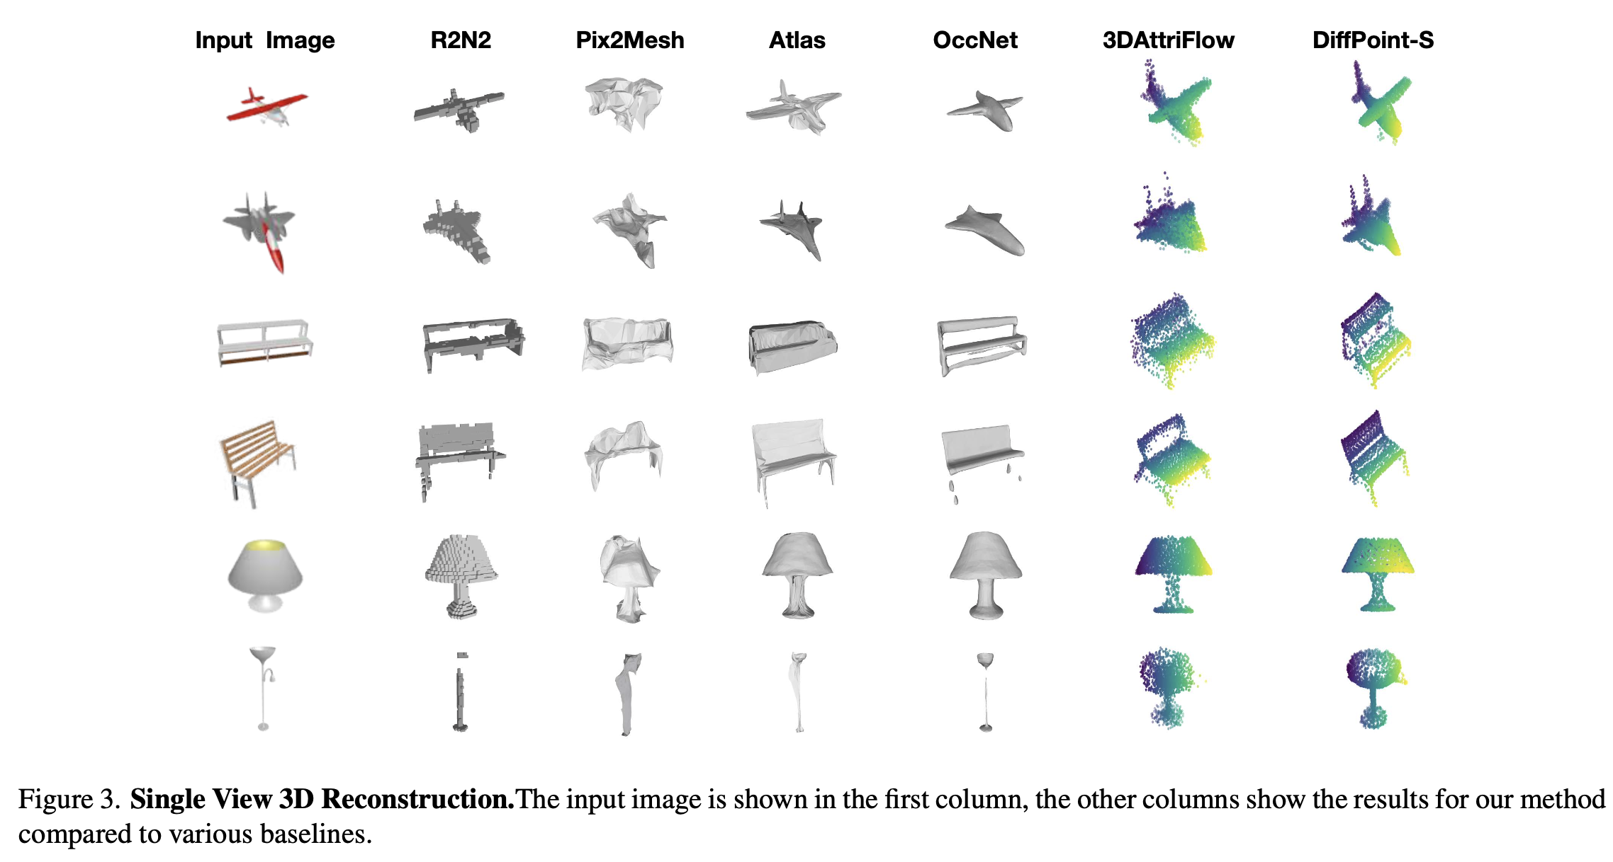

Slide 8
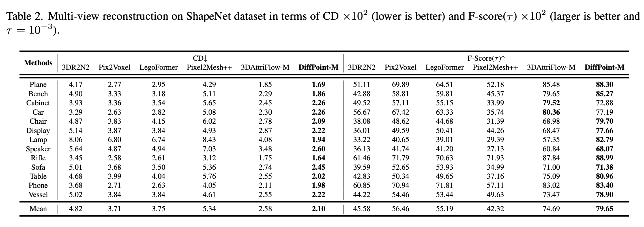
Multi-view Reconstruction

Slide 9
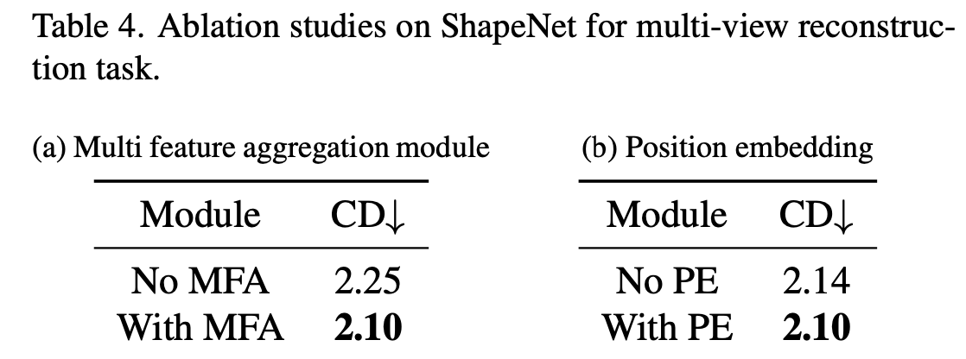
Ablation Study

Slide 10
Conclusion
Diffusion + ViT 三维重建的新思路
Multi 不如 Single?
实验有点少

Slide 11
Abstract
As the task of 2D-to-3D reconstruction has gained significant attention in various real-world scenarios, it becomes crucial to be able to generate high-quality point clouds. Despite the recent success of deep learning models in generating point clouds, there are still challenges in producing high-fidelity results due to the disparities between images and point clouds. While vision transformers (ViT) and diffusion models have shown promise in various vision tasks, their benefits for reconstructing point clouds from images have not been demonstrated yet. In this paper, we first propose a neat and powerful architecture called DiffPoint that combines ViT and diffusion models for the task of point cloud reconstruction. At each diffusion step, we divide the noisy point clouds into irregular patches. Then, using a standard ViT backbone that treats all inputs as tokens (including time information, image embeddings, and noisy patches), we train our model to predict target points based on input images. We evaluate DiffPoint on both single-view and multi-view reconstruction tasks and achieve state-of- the-art results. Additionally, we introduce a unified and flexible feature fusion module for aggregating image features from single or multiple input images. Furthermore, our work demonstrates the feasibility of applying unified architectures across languages and images to improve 3D reconstruction tasks.
点云生成的重要性以及充满挑战

Slide 12
Abstract
As the task of 2D-to-3D reconstruction has gained significant attention in various real-world scenarios, it becomes crucial to be able to generate high-quality point clouds. Despite the recent success of deep learning models in generating point clouds, there are still challenges in producing high-fidelity results due to the disparities between images and point clouds. While vision transformers (ViT) and diffusion models have shown promise in various vision tasks, their benefits for reconstructing point clouds from images have not been demonstrated yet. In this paper, we first propose a neat and powerful architecture called DiffPoint that combines ViT and diffusion models for the task of point cloud reconstruction. At each diffusion step, we divide the noisy point clouds into irregular patches. Then, using a standard ViT backbone that treats all inputs as tokens (including time information, image embeddings, and noisy patches), we train our model to predict target points based on input images. We evaluate DiffPoint on both single-view and multi-view reconstruction tasks and achieve state-of- the-art results. Additionally, we introduce a unified and flexible feature fusion module for aggregating image features from single or multiple input images. Furthermore, our work demonstrates the feasibility of applying unified architectures across languages and images to improve 3D reconstruction tasks.
ViT, Diffusion很成功,但没有被用到2D生成3D点云中

Slide 13
Abstract
As the task of 2D-to-3D reconstruction has gained significant attention in various real-world scenarios, it becomes crucial to be able to generate high-quality point clouds. Despite the recent success of deep learning models in generating point clouds, there are still challenges in producing high-fidelity results due to the disparities between images and point clouds. While vision transformers (ViT) and diffusion models have shown promise in various vision tasks, their benefits for reconstructing point clouds from images have not been demonstrated yet. In this paper, we first propose a neat and powerful architecture called DiffPoint that combines ViT and diffusion models for the task of point cloud reconstruction. At each diffusion step, we divide the noisy point clouds into irregular patches. Then, using a standard ViT backbone that treats all inputs as tokens (including time information, image embeddings, and noisy patches), we train our model to predict target points based on input images. We evaluate DiffPoint on both single-view and multi-view reconstruction tasks and achieve state-of- the-art results. Additionally, we introduce a unified and flexible feature fusion module for aggregating image features from single or multiple input images. Furthermore, our work demonstrates the feasibility of applying unified architectures across languages and images to improve 3D reconstruction tasks.
本文提出DiffPoint

Slide 14
Abstract
As the task of 2D-to-3D reconstruction has gained significant attention in various real-world scenarios, it becomes crucial to be able to generate high-quality point clouds. Despite the recent success of deep learning models in generating point clouds, there are still challenges in producing high-fidelity results due to the disparities between images and point clouds. While vision transformers (ViT) and diffusion models have shown promise in various vision tasks, their benefits for reconstructing point clouds from images have not been demonstrated yet. In this paper, we first propose a neat and powerful architecture called DiffPoint that combines ViT and diffusion models for the task of point cloud reconstruction. At each diffusion step, we divide the noisy point clouds into irregular patches. Then, using a standard ViT backbone that treats all inputs as tokens (including time information, image embeddings, and noisy patches), we train our model to predict target points based on input images. We evaluate DiffPoint on both single-view and multi-view reconstruction tasks and achieve state-of- the-art results. Additionally, we introduce a unified and flexible feature fusion module for aggregating image features from single or multiple input images. Furthermore, our work demonstrates the feasibility of applying unified architectures across languages and images to improve 3D reconstruction tasks.
具体做法

Slide 15
Abstract
As the task of 2D-to-3D reconstruction has gained significant attention in various real-world scenarios, it becomes crucial to be able to generate high-quality point clouds. Despite the recent success of deep learning models in generating point clouds, there are still challenges in producing high-fidelity results due to the disparities between images and point clouds. While vision transformers (ViT) and diffusion models have shown promise in various vision tasks, their benefits for reconstructing point clouds from images have not been demonstrated yet. In this paper, we first propose a neat and powerful architecture called DiffPoint that combines ViT and diffusion models for the task of point cloud reconstruction. At each diffusion step, we divide the noisy point clouds into irregular patches. Then, using a standard ViT backbone that treats all inputs as tokens (including time information, image embeddings, and noisy patches), we train our model to predict target points based on input images. We evaluate DiffPoint on both single-view and multi-view reconstruction tasks and achieve state-of- the-art results. Additionally, we introduce a unified and flexible feature fusion module for aggregating image features from single or multiple input images. Furthermore, our work demonstrates the feasibility of applying unified architectures across languages and images to improve 3D reconstruction tasks.
在单视角和多视角中都获得了SOTA

Slide 16
Abstract
As the task of 2D-to-3D reconstruction has gained significant attention in various real-world scenarios, it becomes crucial to be able to generate high-quality point clouds. Despite the recent success of deep learning models in generating point clouds, there are still challenges in producing high-fidelity results due to the disparities between images and point clouds. While vision transformers (ViT) and diffusion models have shown promise in various vision tasks, their benefits for reconstructing point clouds from images have not been demonstrated yet. In this paper, we first propose a neat and powerful architecture called DiffPoint that combines ViT and diffusion models for the task of point cloud reconstruction. At each diffusion step, we divide the noisy point clouds into irregular patches. Then, using a standard ViT backbone that treats all inputs as tokens (including time information, image embeddings, and noisy patches), we train our model to predict target points based on input images. We evaluate DiffPoint on both single-view and multi-view reconstruction tasks and achieve state-of- the-art results. Additionally, we introduce a unified and flexible feature fusion module for aggregating image features from single or multiple input images. Furthermore, our work demonstrates the feasibility of applying unified architectures across languages and images to improve 3D reconstruction tasks.
用feature fusion module融合多视角图片

Slide 17
Abstract
As the task of 2D-to-3D reconstruction has gained significant attention in various real-world scenarios, it becomes crucial to be able to generate high-quality point clouds. Despite the recent success of deep learning models in generating point clouds, there are still challenges in producing high-fidelity results due to the disparities between images and point clouds. While vision transformers (ViT) and diffusion models have shown promise in various vision tasks, their benefits for reconstructing point clouds from images have not been demonstrated yet. In this paper, we first propose a neat and powerful architecture called DiffPoint that combines ViT and diffusion models for the task of point cloud reconstruction. At each diffusion step, we divide the noisy point clouds into irregular patches. Then, using a standard ViT backbone that treats all inputs as tokens (including time information, image embeddings, and noisy patches), we train our model to predict target points based on input images. We evaluate DiffPoint on both single-view and multi-view reconstruction tasks and achieve state-of- the-art results. Additionally, we introduce a unified and flexible feature fusion module for aggregating image features from single or multiple input images. Furthermore, our work demonstrates the feasibility of applying unified architectures across languages and images to improve 3D reconstruction tasks.
利用多模态大模型提高重建性能

Slide 18
Introduction 1
In recent years, the field of 3D computer vision has seen a surge of interest in converting 2D images into 3D models, a process known as 2D-to-3D reconstruction. This technique aims to generate a three-dimensional representation of an object from one or more two-dimensional images. Its applications are widespread, including robotics [27], autonomous driving [17, 20], virtual reality [25]. However, the main challenge of this task lies in establishing accurate feature matching between the 2D images and the 3D output, primarily due to their inherent differences. To address this challenge, deep learning models for 3D reconstruction have made significant advancements in terms of quality and flexibility. Existing models can be broadly categorized into three types based on the explicit representation of 3D data: voxel- based models [7, 57–59], mesh-based models [33, 50, 53], and point-based models [13, 54]. While voxel-based reresentations suffer from high memory costs at high resolutions and meshes struggle to model inner or irregular structures, point clouds offer lightweight storage consumption and are capable of representing various complex shapes. In this paper, we focus on point-based reconstruction.
2D→3D的重要性以及应用
任务的挑战性
已有重建方法按3D表示的分类

Slide 19
Introduction 2-1
Though these methods achieve some success to some extent, the 2D-to-3D reconstruction task is still suffering from the following problem: how to find an effective way to reduce the disparities between images and 3D shapes for reconstructing accurate results. Most previous methods follow the standard encoder-decoder structure, in which image features are treated as additional information and limited semantic information can be conveyed to the 3D decoder. As a result, these methods fail to reconstruct satisfactory results. Driven by scaling models on large datasets, diffusion models have shown great success in various tasks. Diffusion models have emerged as highly effective generative models, showcasing exceptional performance in not only image synthesis but also the generation of 3D shapes based on point clouds. Diffusion models show potential to be adopted for 3D reconstruction.
目前2D-3D方法的主要问题是如何减小2D和3D之间的不一致
已有方法大多都是用encoder-decoder方法，将image feature 输入到3D decoder中
Diffusion的成功展示了他在3D 重建中的前景。

Slide 20
Introduction 2-2
However, existing point-based diffusion models cannot fully solve the problem above. These methods, implemented with MLP [26] and PVCNN [64, 65], also treat image embeddings as additional information and fail to fully explore visual information. Moreover, DPM based on MLP struggles to reconstruct complex structure shapes. For Point-Voxel CNN (PVCNN) based diffusion models [64, 65], they require huge memory and computation costs to implement voxel convolution operation. On the other hand, vision transformers (ViT) [11] have shown promise in various vision tasks due to their flexible backbone. However, directly applying ViT to point cloud reconstruction may also suffer from the following problem: while ViT is excellent at capturing global context, it may struggle with capturing fine-grained local details in images. Point cloud data demands a granular understanding of individual point positions and features, which the traditional attention mechanisms in ViT, optimized for grid-like image structures, might not adequately address. In a word, existing point-based diffusion models and ViT cannot be directly solve the problem above.
已有point-based diffusion方法的问题
另一方面，ViT在视觉任务中比较成功
但不能直接利用ViT来重建，因为点云需要很多local的特征，而ViT更多关注于全局的上下文信息。

Slide 21
Introduction 3-1
In this paper, we combine diffusion model and ViT to propose DiffPoint, a neat and flexible ViT-based diffusion architecture for point cloud reconstruction. The diffusion model excels in capturing local intricacies and dependencies within data, providing a complementary capability to ViT’s global context awareness. Directly extending ViT and diffusion models to point cloud is, however, technically highly nontrivial: unlike images, point clouds consist of discrete points in 3D space, making it impossible to divide them into patches directly. To address this issue, we follow the design methodology of PointMAE [34] and Point-BERT [62], where point cloud are divided into irregular patches through Farthest Point Sampling (FPS) and K-Nearest Neighborhood (KNN) algorithm. These divided patches are then encoded into token embeddings using a lightweight encoder called PointNet [38].
本文将Diffusion和ViT两者结合起来，diffusion可以补充ViT对local的缺失
点云和image不同，很难直接分成patches
用FPS和KNN来分patches

Slide 22
Introduction 3-2
Inspired by CLIP’s ability to learn robust representations capturing both semantics and style in images, we leverage these representations for point cloud reconstruction. The input images are encoded with CLIP into image embeddings. Similar to U-ViT [1], we treat all inputs including the time, image embedding, noisy points patches as tokens that interact within the same feature space. To sum up, combining diffusion models with ViT may address the problem above: a) The ViT backbone in diffusion models helps in creating a more expressive and context-aware representation of features in which hierarchical attention mechanisms of ViT capture both global and local information effectively; b) ViT’s token-based approach allows for the assimilation of diverse information, including time, image embeddings, and patches, effectively bridging the gap between different modalities. Besides, we introduce a unified multi feature aggregation module for single and multi-view tasks ensuring consistency in the model architecture.
利用CLIP提取图像特征
将time，图像特征，点云patch作为统一特征空间的token输入
结合diffusion和ViT解决了两个问题，一个是local和global，一个是多模态输入
此外，还提出了多视角特征融合模块，来实现多视角重建

Slide 23
Introduction 4
We evaluate our DiffPoint in both single and multi-view reconstruction tasks. Our results on popular benchmark ShapeNet [5] suggests that DiffPoint is capable of reconstruct high-fidelity point clouds, outperforming multiple state-of-the-art methods. Furthermore, we extend DiffPoint to a more complicated and diverse dataset OBJAVERSE- LVIS [8], demonstrating the powerful modeling capabilities of DiffPoint and the potential to migrate to large-scale 3D datasets.
在ShapeNet实现了SOTA，同时在更复杂更大的数据集OBJAVERSE-LVIS是那个也表现不错

Slide 24
Introduction 5
The main contributions of this paper are summarized as follows:
• We explore 3D point cloud reconstruction and introduce a novel architecture, DiffPoint, which combines diffusion models with ViT. DiffPoint enhances image feature representation and connects the 2D and 3D domains. Our work marks the first use of ViT-based diffusion models for 3D point cloud reconstruction.
• We propose a unified module for aggregating multiple features, which can be used for single and multi-view reconstruction tasks ensuring consistency in the model architecture for both tasks.
• Our model demonstrates state-of-the-art performance in reconstructing 3D shapes from both single-view and multi-view perspectives, with exceptional modeling capabilities confirmed through additional experiments on OBJAVERSE-LVIS.
本文的贡献
提出DiffPoint，结合了diffusion和ViT
提出了多视角特征融合模块
单视角和多视角的性能在ShapeNet都是SOTA

