Slide 1

MedLSAM: Localize and Segment Anything Model for 3D Medical Images
Ruohua Shi
2024/1/5

Slide 2
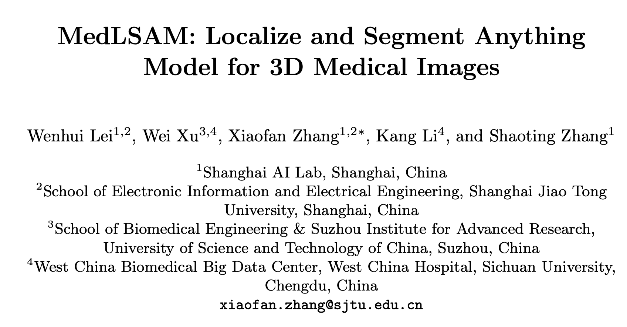

Slide 3
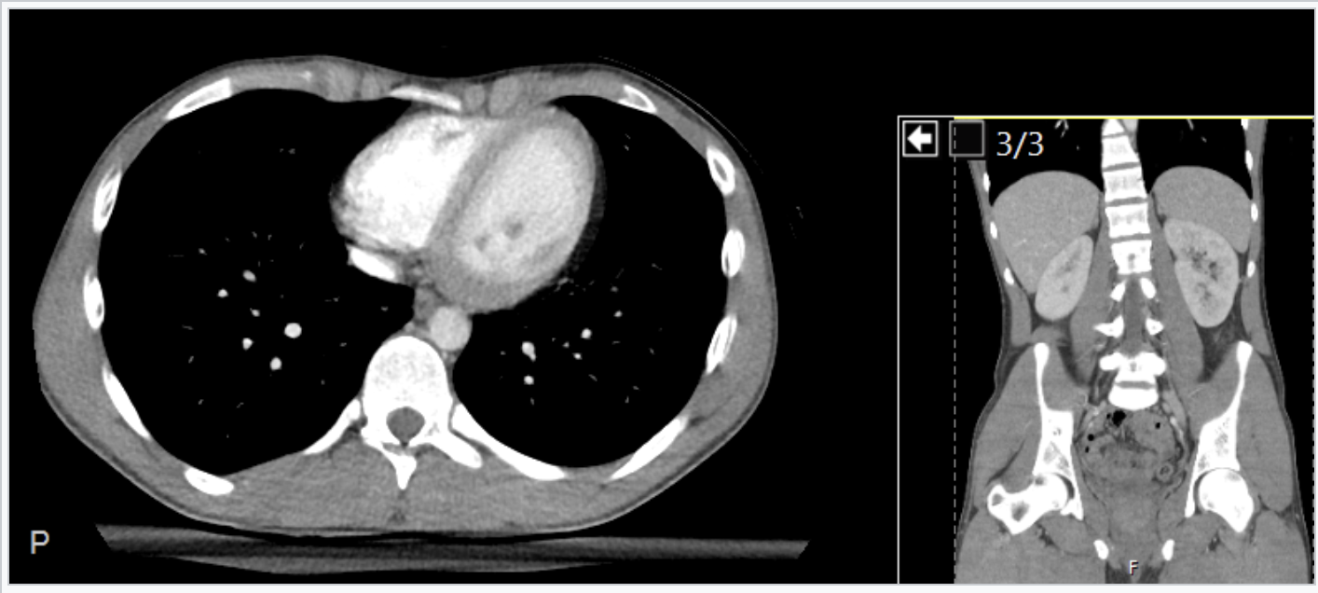
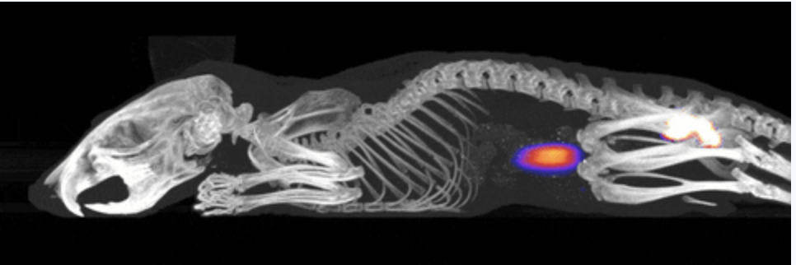
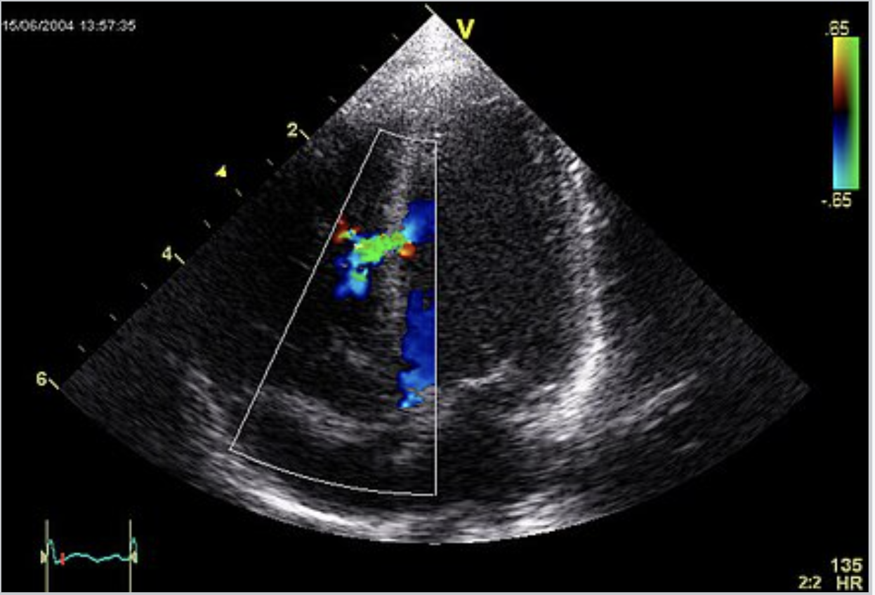
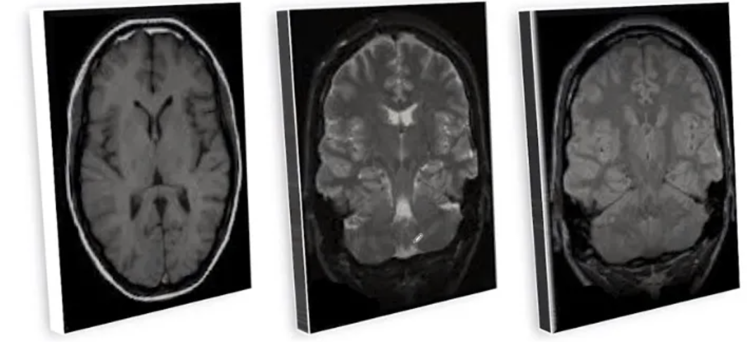
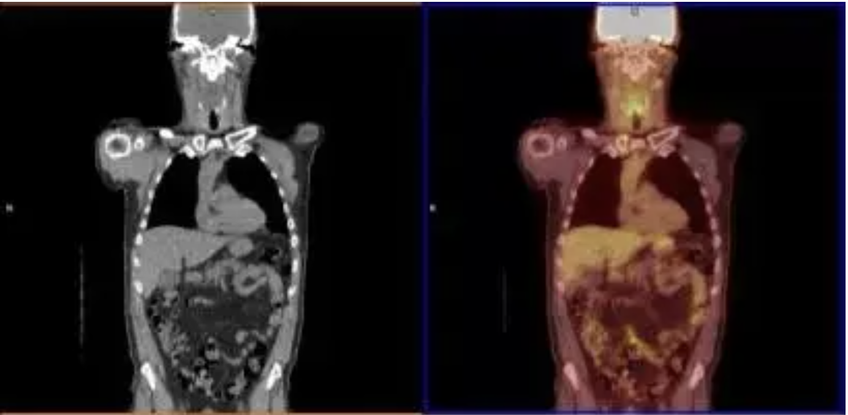
3D Medical Image Datasets
NMI
X-CT
3D Medical Images
UI
MRI
PET

Slide 4
MedLSAM
SAM
Model
Fine-tuning
Medical
Model
Annotation
Goal：
Reduce the annotation workload
2D-3D

Slide 5
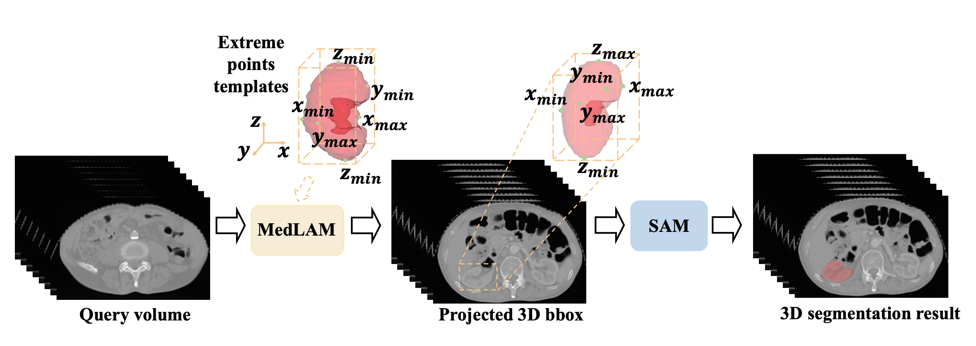
Pipeline
few-shot localization framework
SAM/MedSAM

Slide 6
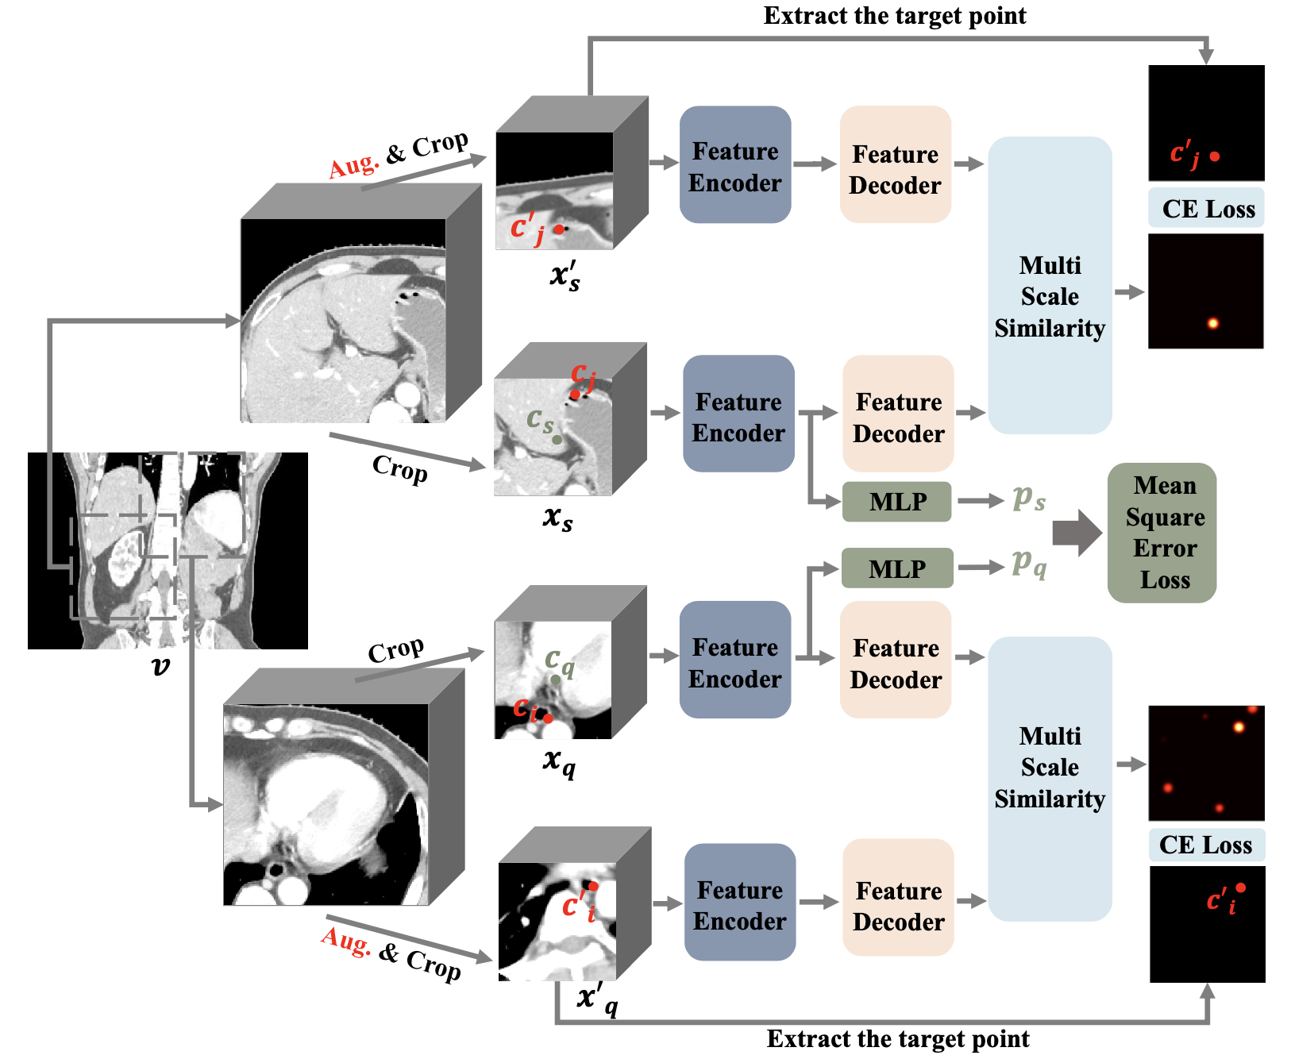
MedLAM

Slide 7
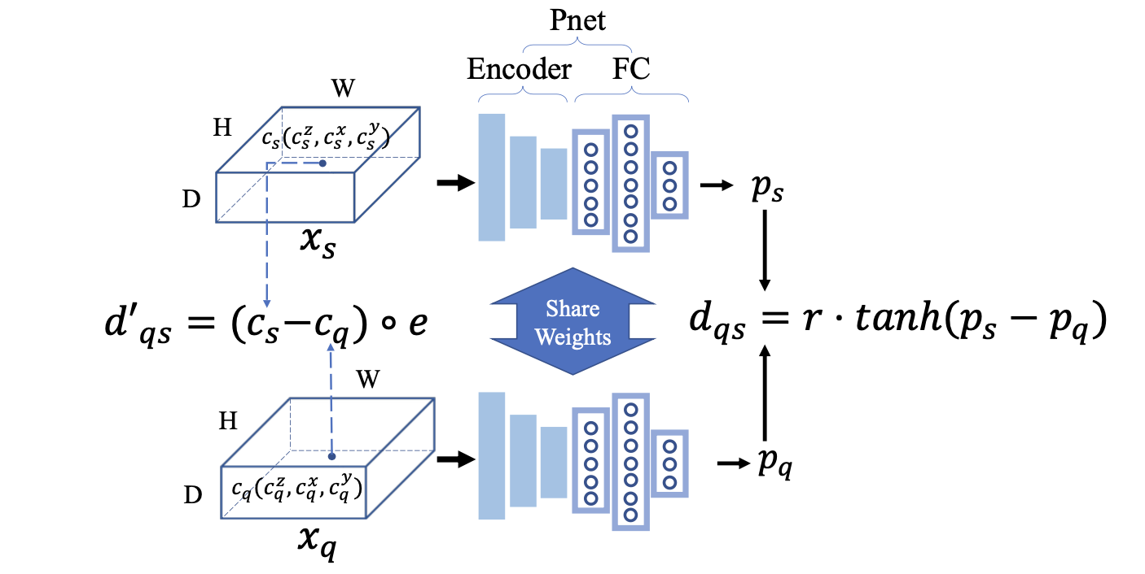
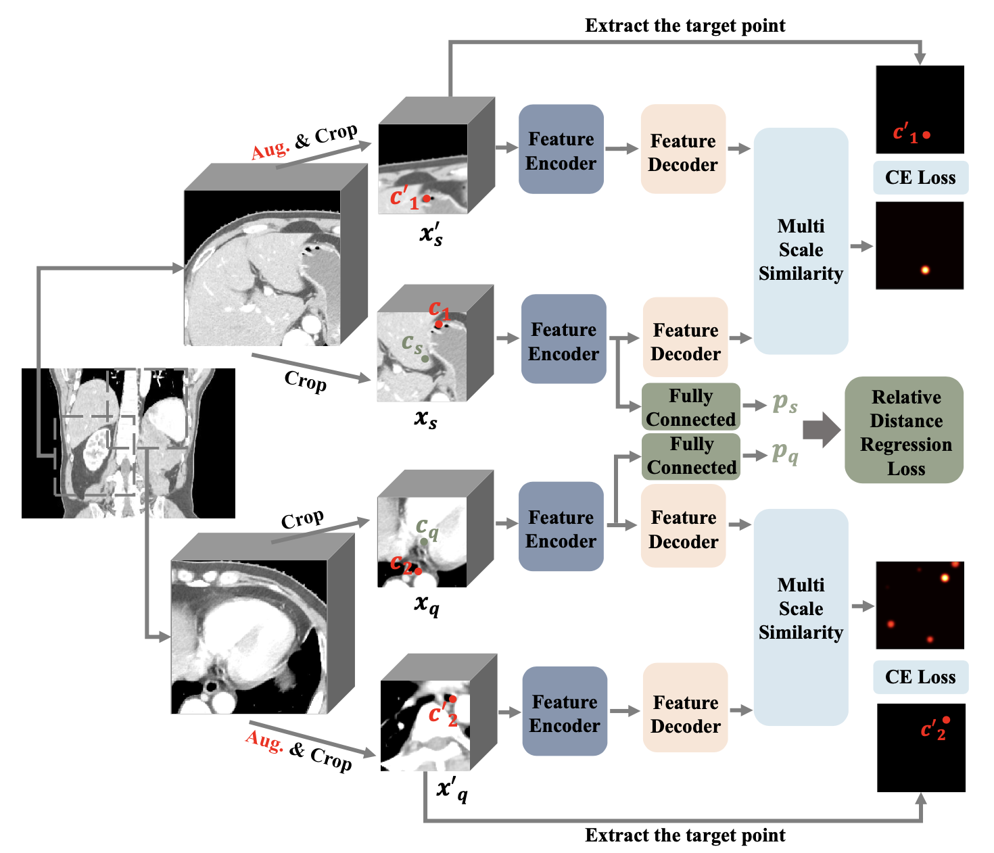
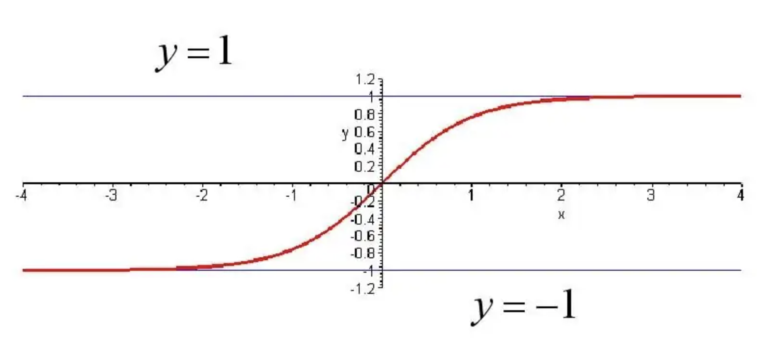

Unified Anatomical Mapping (UAM)
predict the 3D offset between the query patch x_{q} and the support patch x_{s}

Slide 8
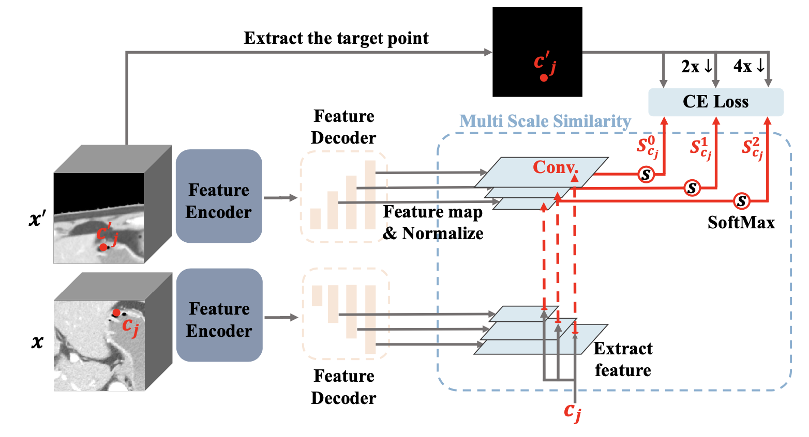
Multi Scale Similarity (MSS)

Slide 9
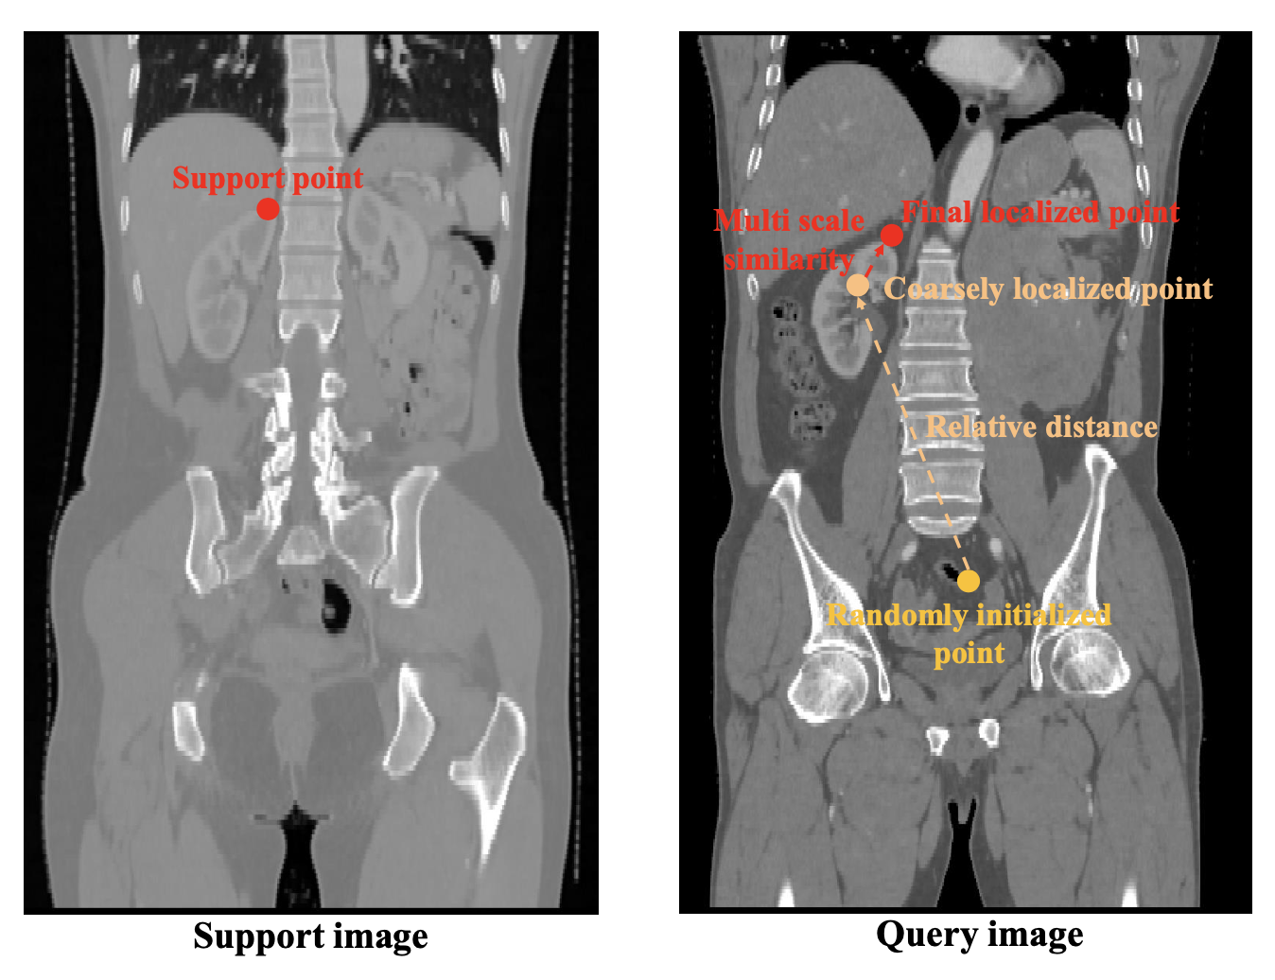
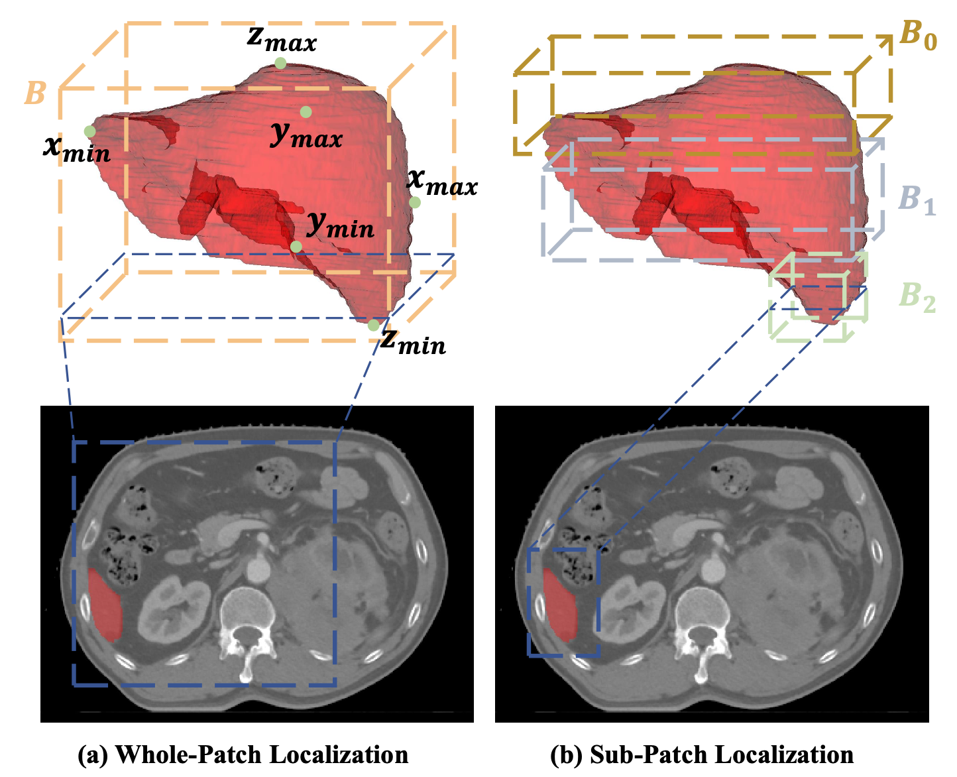
Inference of MedLSAM

Slide 10
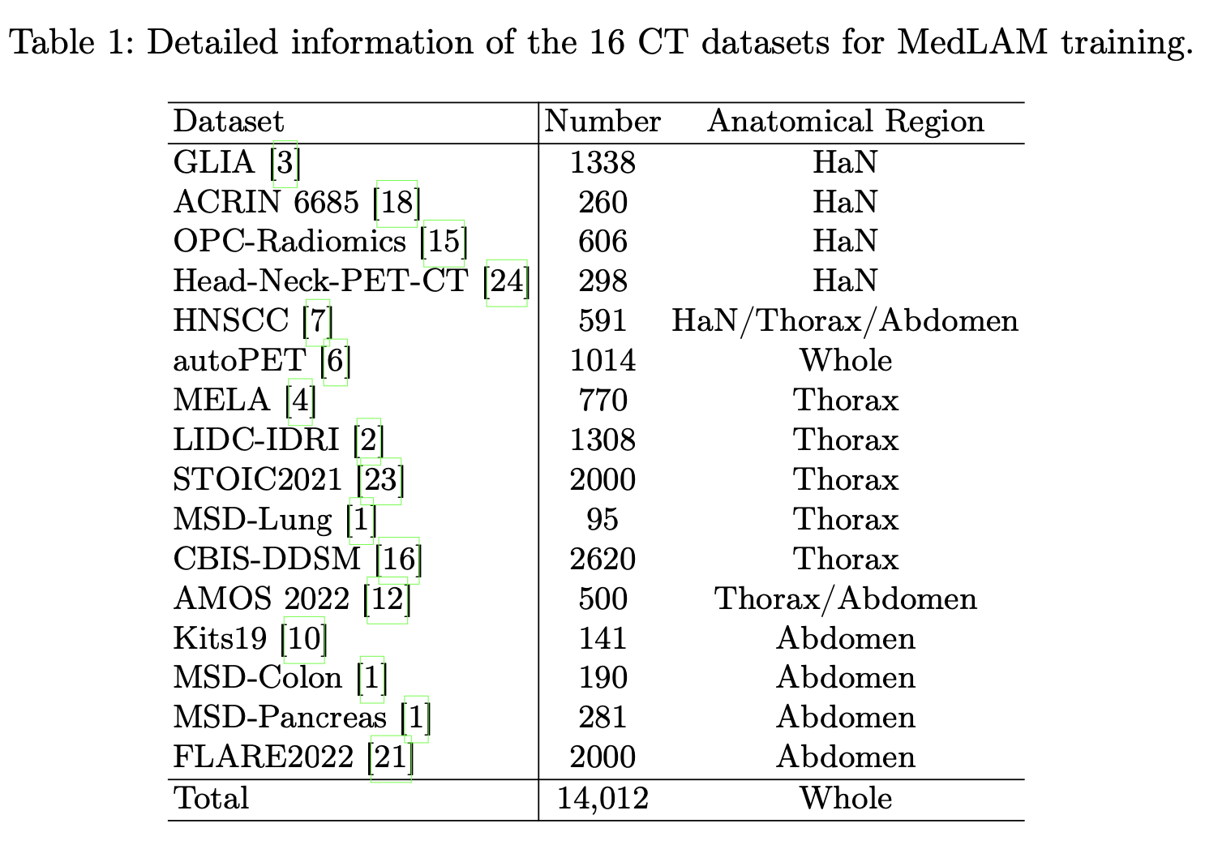
Datasets
Test:
1) StructSeg19 Task1
22 HaN organs with 50 scans
2) WORD
16 abdomen organs with 120 scans
头颈
头颈/胸/腹
胸
胸/腹
腹

Slide 11
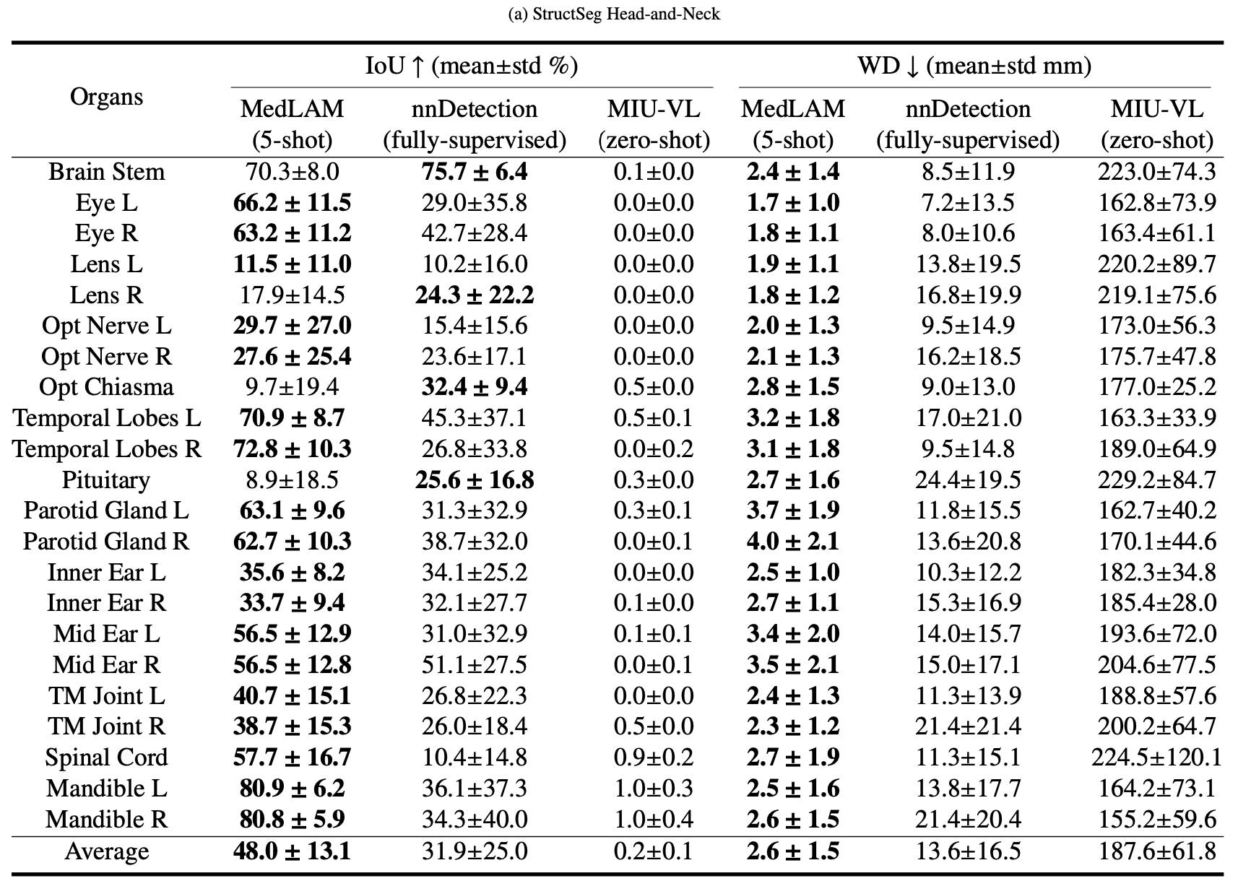
Results

Slide 12
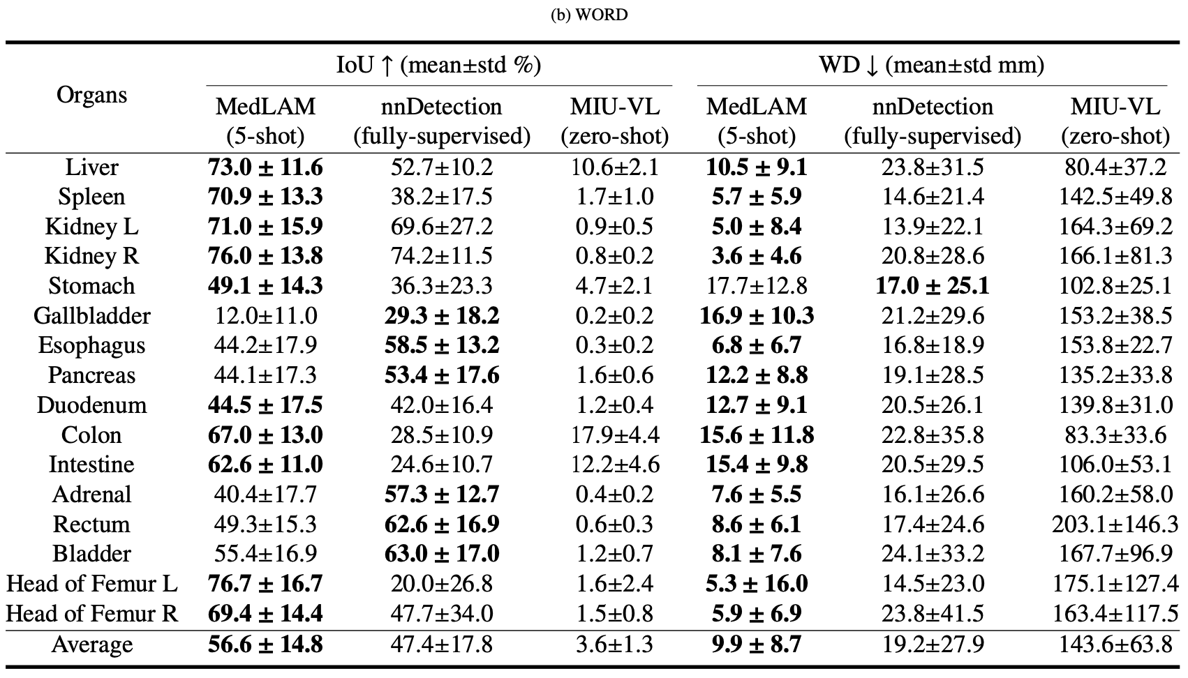
Results

Slide 13
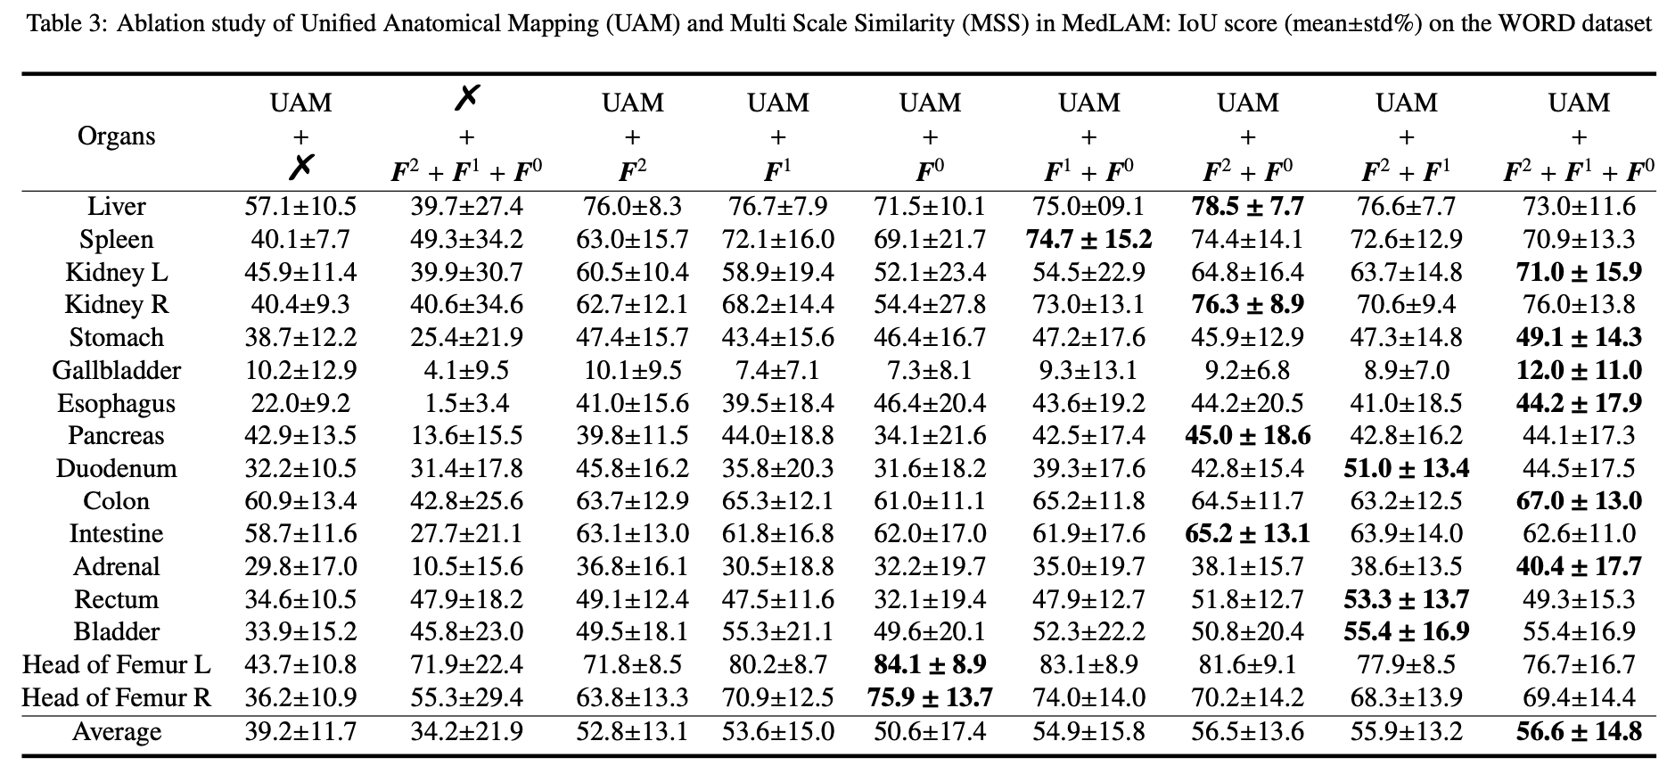
Results

Slide 14
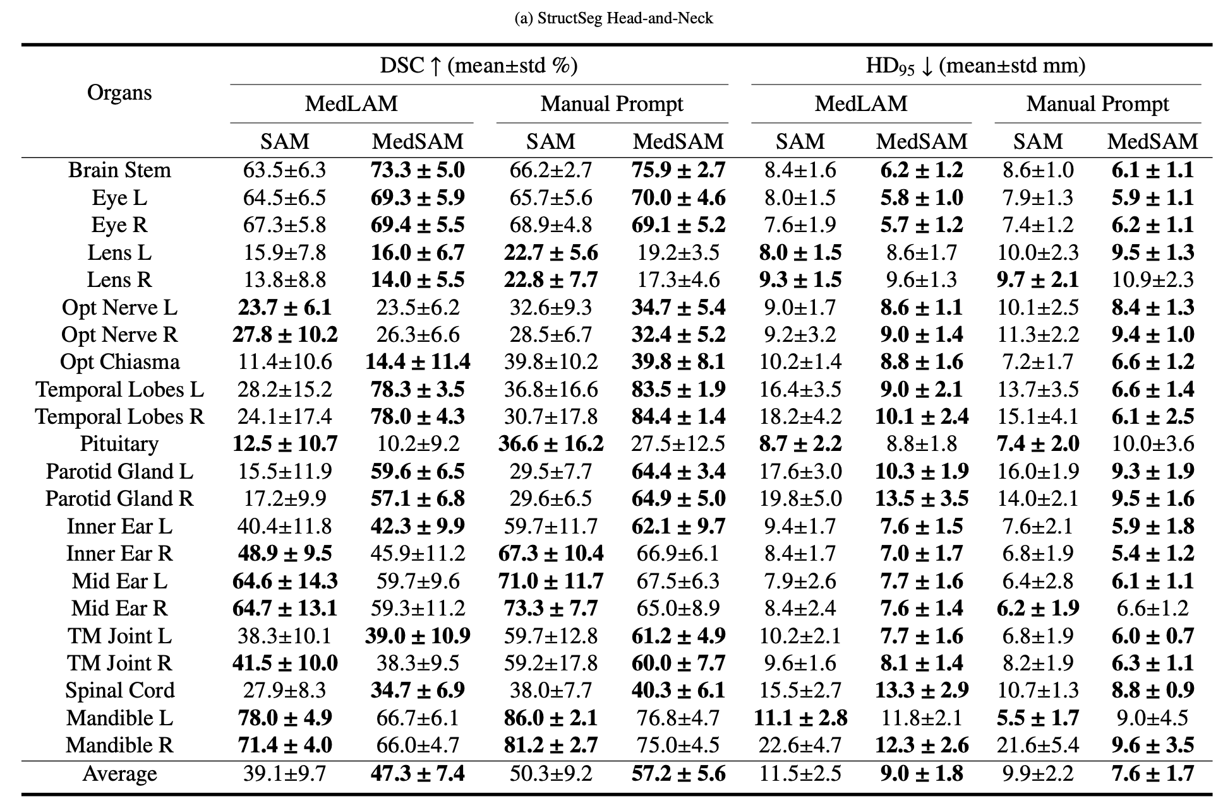
Results

Slide 15
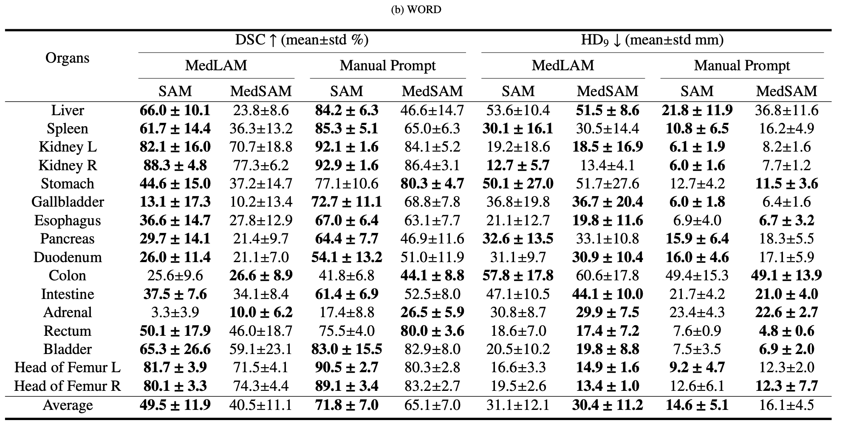
Results

Slide 16
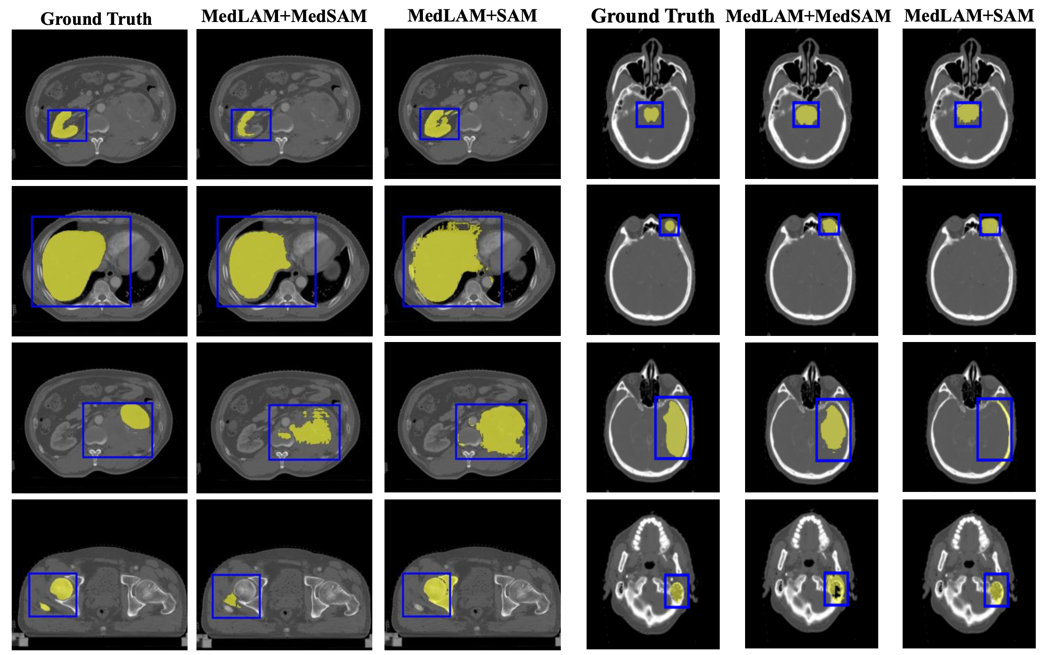

Slide 17
Discussion
+ A solution for alleviating the annotation workload
- Typically for CT images with fixed locations
- 2D slice, not real 3D

Slide 18
Writing
Abstract.
The Segment Anything Model (SAM) has recently emerged as a groundbreaking model in the field of image segmentation. Nevertheless, both the original SAM and its medical adaptations necessitate slice-by-slice annotations, which directly increase the annotation workload with the size of the dataset. We propose MedLSAM to address this issue, ensuring a constant annotation workload irrespective of dataset size and thereby simplifying the annotation process. // Our model introduces a 3D localization foundation model capable of localizing any target anatomical part within the body. To achieve this, we develop a Localize Anything Model for 3D Medical Images (MedLAM), utilizing two self-supervision tasks: unified anatomical mapping (UAM) and multi-scale similarity (MSS) across a comprehensive dataset of 14,012 CT scans. We then establish a methodology for accurate segmentation by integrating MedLAM with SAM. By annotating several extreme points across three directions on a few templates, our model can autonomously identify the target anatomical region on all data scheduled for annotation. This allows our framework to generate a 2D bbox for every slice of the image, which is then leveraged by SAM to carry out segmentation. We carried out comprehensive experiments on two 3D datasets encompassing 38 distinct organs. // Our findings are twofold: 1) MedLAM is capable of directly localizing any anatomical structure using just a few template scans, yet its performance surpasses that of fully supervised models; 2) MedLSAM not only aligns closely with the performance of SAM and its specialized medical adaptations with manual prompts but achieves this with minimal reliance on extreme point annotations across the entire dataset. Furthermore, MedLAM has the potential to be seamlessly integrated with future 3D SAM models, paving the way for enhanced performance. Our code is public at https://github.com/openmedlab/MedLSAM.

Slide 19
Writing
Introduction-1 foundational models
Recently, there has been an increasing interest in the field of computer vision to develop large-scale foundational models that can concurrently address multiple visual tasks, such as image classification, object detection, and image segmentation. For instance, CLIP (Radford et al., 2021), aligning a vast number of images and text pairs collected from the web, could recognize new visual categories using text prompts. Similarly, GLIP (Li et al., 2022; Zhang et al., 2022), which integrates object detection with phrase grounding in pre-training using web- sourced image-text pairs, boasts strong zero-shot and few-shot transferability in object-level detection tasks. On the segmentation front, the Segment Anything Model (SAM) (Kirillov et al., 2023) has recently demonstrated remarkable capabilities in a broad range of segmentation tasks with appropriate prompts, e.g. points, bounding box (bbox) and text.

Slide 20
Writing
Introduction-2 pre-training/fine-tune in medical domain
As foundational models increasingly demonstrate their prowess in general computer vision tasks, the medical imaging domain, characterized by limited image availability and high annotation costs, is taking keen notice of their potential. Such challenges in medical imaging underscore the pressing need for foundational models, drawing greater attention from researchers (Zhang and Metaxas, 2023). Some studies have endeavored to design self-supervised learning tasks tailored to dataset characteristics, pre-training on a vast amount of unlabeled data, and then fine-tuning on specific downstream tasks to achieve commendable results (Wang et al., 2023; Zhou et al., 2023; Vorontsov et al., 2023). In contrast, other works have focused on pre-training with large annotated datasets, either to fine-tune on new tasks (Huang et al., 2023b) or to enable direct segmentation without the necessity of further training or fine- tuning (Butoi et al., 2023). Overall, these models offer myriad advantages: they simplify the development process, reduce dependence on voluminously labeled datasets, and bolster patient data privacy.

Slide 21
Writing
Introduction-3 still need much manual annotation
In the field of segmentation, models such as SAM and its medical adaptations (Wu et al., 2023; Ma and Wang, 2023; Cheng et al., 2023; He et al., 2023b; Huang et al., 2023a; He et al., 2023a; Zhang and Liu, 2023; Mazurowski et al., 2023; Zhang and Jiao, 2023) have demonstrated significant potential. Both Huang et al. (2023a) and Cheng et al. (2023) have collected extensive medical image datasets and conducted comprehensive testing on SAM. They discovered that, while SAM exhibits remarkable performance on certain objects and modalities, it is less effective or even fails in other scenarios. This inconsistency arises from SAM’s primary training on natural images. To enhance SAM’s generalization in medical imaging, studies like Wu et al. (2023); Ma and Wang (2023) have finetuned the original SAM using a large annotated medical image dataset, thereby validating its improved performance over the base SAM model in test datasets. Despite these advancements, the models still require manual prompts, such as labeled points or bounding boxes, which remains a substantial limitation due to the associated time and financial implications.

Slide 22
Writing
Introduction-4 propose to develop a localization model
In scenarios requiring manual annotation prompts, annotating 3D images proves especially time-consuming and labor-intensive. A single 3D scan often contains dozens or even hundreds of slices. When each slice comprises multiple tar- get structures, the annotation requirements for the entire 3D scan grow exponentially(Wang et al., 2018; Lei et al., 2019). To eliminate this vast annotation demand and facilitate the use of SAM and its medical variants on 3D data, an effective approach would be to automatically generate suitable prompts for the data awaiting annotation. While this could be achieved by training a detector specifically for the categories to be annotated, it introduces the additional burden of annotating data for detector training, and the detectable categories remain fixed (Baumgartner et al., 2021). A more optimal solution would be to develop a universal localization model for 3D medical images. This model would only require users to provide minimal annotations to specify the category of interest, allowing for direct localization of the desired target in any dataset without further training.

Slide 23
Writing
Introduction-5 limitation
However, to the best of our knowledge, foundational models specifically tailored for 3D medical image localization are still limited. In the domain of 2D medical image localization, MIUVL (Qin et al., 2022) stands out as a pioneering effort. This approach ingeniously marries pre-trained vision-language models with medical text prompts to facilitate object detection in medical imaging. However, the application of these pre-trained models to specialized medical imaging domains, particularly 3D modalities like CT scans, remains challenging. This limitation is attributable to a significant domain gap, as these models were originally trained on 2D natural images.

Slide 24
Writing
Introduction-6 solution overall
In response to the lack of localization foundation models for 3D medical images and the persistent need for extensive interaction in SAM, we introduce MedLSAM in this paper. MedLSAM is an automated medical image segmentation solution that combines the Localize Anything Model for 3D Medical Image (MedLAM), a dedicated 3D localization foundation module designed for localizing any anatomical structure using a few prompts, with existing segmentation foundation models. As illustrated in Fig. 1, MedLSAM employs a two-stage methodology. The first stage involves MedLAM to automatically identify the positions of target structures within volumetric medical images. In the subsequent stage, the SAM model uses the bboxes from the first stage to achieve precise image segmentation. The result is a fully autonomous pipeline that eliminates the need for manual intervention.

Slide 25
Writing
Introduction-7 solution for localize
The localization foundation model, MedLAM, is an extension of our conference version (Lei et al., 2021) and is premised on the observation that the spatial distribution of organs maintains strong similarities across different individuals. And we assume that there exists a standard anatomical coordinate system, in which the same anatomy part in different people shares similar coordinates. Therefore, we can localize the targeted anatomy structure with a similar coordinate in the unannotated scan. In our previous version, the model was trained separately for different anatomical structures, each using only a few dozen scan images. In contrast, this current study significantly expands the dataset to include 14,012 CT scans from 16 different datasets. This allows us to train a unified, comprehensive model capable of localizing any structure across the entire body. The training process involves a projection network that predicts the 3D physical offsets between any two patches within the same image, thereby mapping every part of the scans onto a shared 3D latent coordinate system.

Slide 26
Writing
Introduction-8 solution for segment
For the segmentation stage, we employ the original SAM and the well-established MedSAM (Ma and Wang, 2023) as the foundation for our segmentation process. MedSAM, previously fine-tuned on a comprehensive collection of medical image datasets, has exhibited considerable performance in 2D and 3D medical image segmentation tasks. The use of such a robust model bolsters the reliability and effectiveness of our proposed pipeline.

Slide 27
Writing
Introduction-9 contribution
Our contributions can be summarized as follows:
- We introduce MedLSAM, the first completely automated medical adaptation of the SAM model. It not only eliminates the need for manual intervention but also propels the develop- ment of fully automated foundational segmentation models in medical image analysis. To the best of our knowledge, this is the first work to achieve complete automation in medical image segmentation by integrating the SAM model;
- Addressing the gap in localization foundation models for 3D medical imaging, we present MedLAM. This model, an extension of our prior conference work (Lei et al., 2021), in- corporates pixel-level self-supervised tasks and is trained on a comprehensive dataset of 14,012 CT scans covering the entire body. As a result, it’s capable of directly localizing any anatomical structure within the human body and surpassing the fully- supervised model by a significant margin;
- We validate the effectiveness of MedLSAM on two 3D datasets that span 38 organs. As showcased in Table 2, our localization foundation model, MedLAM, exhibits localization accuracy that not only significantly outperforms existing medical localization foundational models but also rivals the performance of fully-supervised models. Concurrently, as demonstrated in Table 4, MedLSAM aligns with the performance of SAM and its medical adaptations, substantially reducing the reliance on manual annotations. To further the research in foundational models for medical imaging, we have made all our models and codes publicly available.

