Slide 1
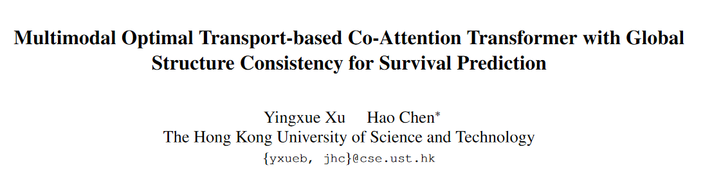
ICCV2023(oral)

Slide 2
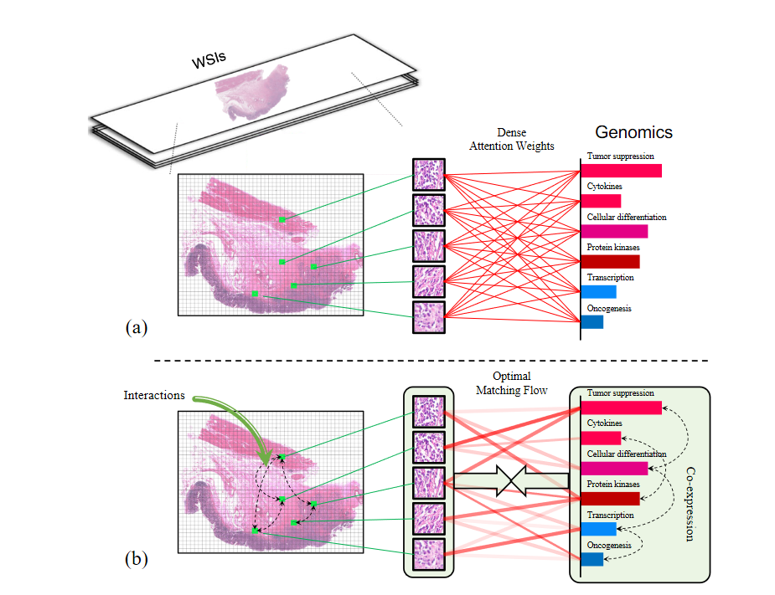
Motivation
Survival prediction
WSI（全视野切片）+ genomic data
previous method: genomics guided co-attention
proposed method: optimal transport matching flow
Notes:
两种模态的数据，全视野切片，基因组数据；

Slide 3
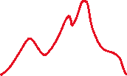

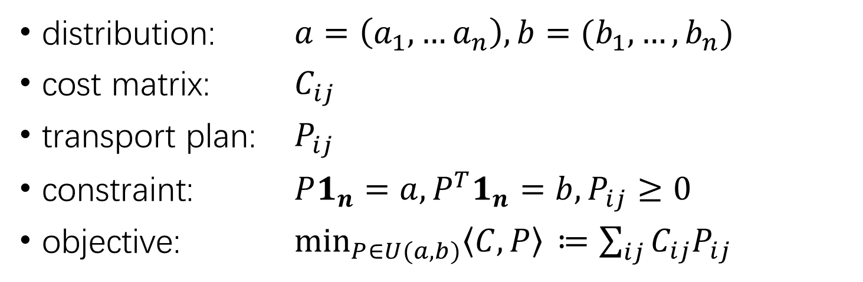
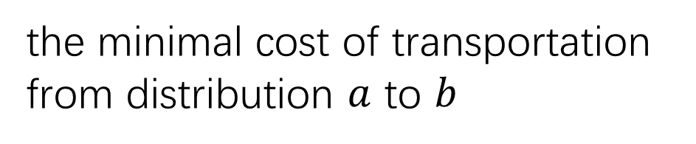
Optimal Transport
the minimal cost of transportation from distribution $a$ to $b$
distribution: $a=\left(a_{1},…a_{n}\right), b=(b_{1},…,b_{n})$
cost matrix: $C_{ij}$
transport plan: $P_{ij}$
constraint: $P1_{n}=a, P^{T}1_{n}=b, P_{ij}≥0$
objective: $\min_{P∈U(a,b)}\left\langle C,P\right\rangle{ ≔\sum_{ij}{C_{ij}P_{ij}}}$

Slide 4
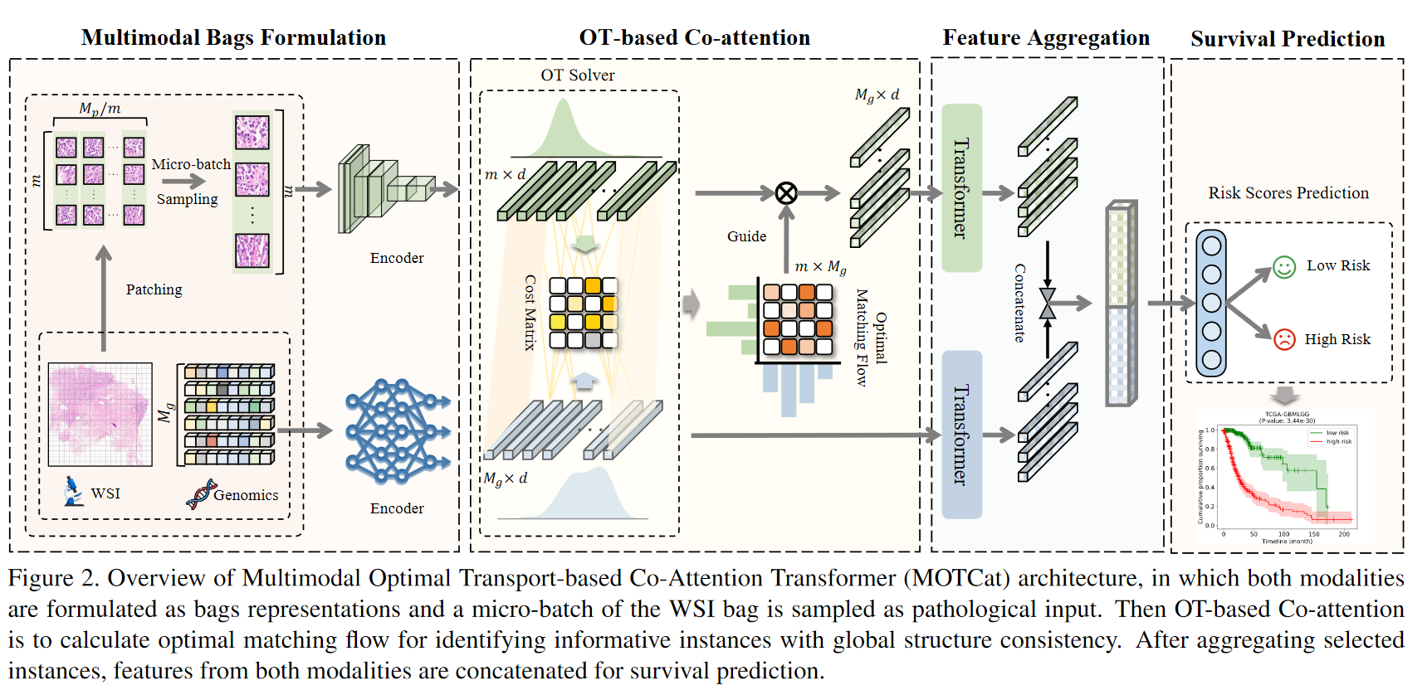
Method
Notes:
对WSI图像进行分块操作，将图像分成Mp个patch，对应的基因数据Mg个序列，每个序列对应一种基因特征；

Slide 5


Method

Slide 6
Method

Slide 7
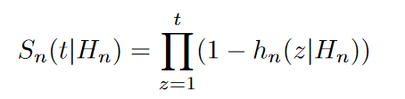
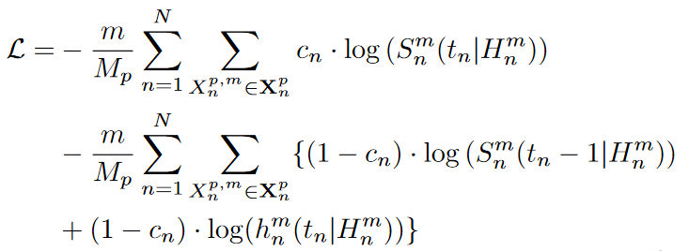
Method
Notes:
把生存期划分为几个事件段，分别预测每个时间段内病人死亡的条件概率，风险函数

Slide 8
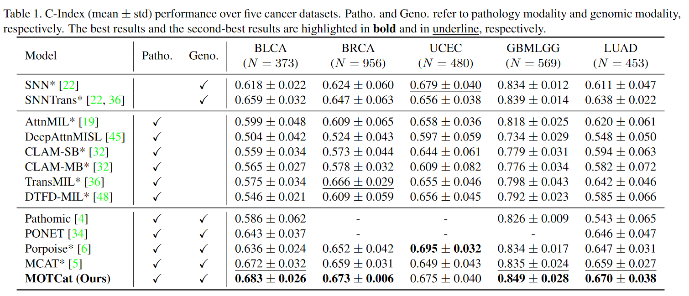
Experiments
5 public cancer datasets from The Cancer Genome Atlas (TCGA)

Slide 9
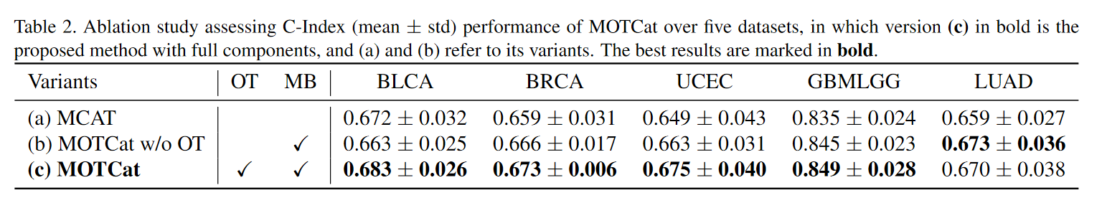
Ablation Study
Micro-batch
Optimal Transport
(a) MCAT
(b) MCAT + micro-batch
(c) MCAT + micro-batch + OT= MOTCat

Slide 10
Abstract(1/2)
Survival prediction is a complicated ordinal regression task that aims to predict the ranking risk of death, which generally benefits from the integration of histology and genomic data. Despite the progress in joint learning from pathology and genomics, existing methods still suffer from challenging issues: 1) Due to the large size of pathological images, it is difficult to effectively represent the gigapixel whole slide images (WSIs). 2) Interactions within tumor microenvironment (TME) in histology are essential for survival analysis. Although current approaches attempt to model these interactions via co-attention between histology and genomic data, they focus on only dense local similarity across modalities, which fails to capture global consistency between potential structures, i.e. TME-related interactions of histology and co-expression of genomic data.
WSI/基因组预测生存期的挑战：
1.WSI图片像素高，如何有效表示
2.肿瘤微环境对于生存分析的重要性
Notes:
；两个主要挑战：第一是WSI图像的像素很高，如何去有效表示大量的信息；第二是肿瘤微环境对于生存分析具有重要作用

Slide 11
Abstract(1/2)
Survival prediction is a complicated ordinal regression task that aims to predict the ranking risk of death, which generally benefits from the integration of histology and genomic data. Despite the progress in joint learning from pathology and genomics, existing methods still suffer from challenging issues: 1) Due to the large size of pathological images, it is difficult to effectively represent the gigapixel whole slide images (WSIs). 2) Interactions within tumor microenvironment (TME) in histology are essential for survival analysis. Although current approaches attempt to model these interactions via co-attention between histology and genomic data, they focus on only dense local similarity across modalities, which fails to capture global consistency between potential structures, i.e. TME-related interactions of histology and co-expression of genomic data.
现存方法仅能够关注到模态间的局部相似性，却忽略了病理图片/基因数据中的全局一致性

Slide 12
Abstract(2/2)
To address these challenges, we propose a Multimodal Optimal Transport-based Co-Attention Transformer framework with global structure consistency, in which optimal transport (OT) is applied to match patches of a WSI and genes embeddings for selecting informative patches to represent the gigapixel WSI. More importantly, OT-based co-attention provides a global awareness to effectively capture structural interactions within TME for survival prediction. To overcome high computational complexity of OT, we propose a robust and efficient implementation over micro-batch of WSI patches by approximating the original OT with unbalanced mini-batch OT. Extensive experiments show the superiority of our method on five benchmark datasets compared to the state-of-the-art methods. The code is released.
本文提出的方法：基于OT的跨模态匹配机制；

Slide 13
Abstract(2/2)
To address these challenges, we propose a Multimodal Optimal Transport-based Co-Attention Transformer framework with global structure consistency, in which optimal transport (OT) is applied to match patches of a WSI and genes embeddings for selecting informative patches to represent the gigapixel WSI. More importantly, OT-based co-attention provides a global awareness to effectively capture structural interactions within TME for survival prediction. To overcome high computational complexity of OT, we propose a robust and efficient implementation over micro-batch of WSI patches by approximating the original OT with unbalanced mini-batch OT. Extensive experiments show the superiority of our method on five benchmark datasets compared to the state-of-the-art methods. The code is released.
基于OT的共注意力的优势：能够捕获全局信息
通过micro-batch方法降低OT计算的开销
效果好：多个数据集达到SOTA

Slide 14
Introduction(1/7)
任务背景
Survival prediction is a complex ordinal regression task that aims to estimate the relative risk of death in cancer prognosis, which generally integrates the manual assessment of qualitative morphological information from pathology data and quantitative molecular profiles from genomic data in clinical settings. Despite recent advances in multimodal learning for histology and genomics, there still exists several open issues. Among others, one daunting challenge is to capture key information from heterogeneous modalities for effective fusion. Particularly, due to the large size of about 500,000 × 500,000 pixels, it is challenging to effectively represent gigapixel whole slide images without losing key information. Furthermore, visual concepts of tumor microenvironment (TME) within pathological images are verified to have significant associations with survival analysis in various cancer types, e.g. cellular components including fibroblast cells and various immune cells that can alter cancer cell behaviors. However, the TME-related patches occupy only a tiny proportion of the entire WSI, leading to a fine grained visual recognition problem that is indiscernible by conventional multimodal learning.
生存期预测涉及到多种模态的病理数据和分子学数据的评估
Notes:
Introduction-abstract的扩写；首先介绍任务背景

Slide 15
Introduction(1/7)
Survival prediction is a complex ordinal regression task that aims to estimate the relative risk of death in cancer prognosis, which generally integrates the manual assessment of qualitative morphological information from pathology data and quantitative molecular profiles from genomic data in clinical settings. Despite recent advances in multimodal learning for histology and genomics, there still exists several open issues. Among others, one daunting challenge is to capture key information from heterogeneous modalities for effective fusion. Particularly, due to the large size of about 500,000 × 500,000 pixels, it is challenging to effectively represent gigapixel whole slide images without losing key information. Furthermore, visual concepts of tumor microenvironment (TME) within pathological images are verified to have significant associations with survival analysis in various cancer types, e.g. cellular components including fibroblast cells and various immune cells that can alter cancer cell behaviors. However, the TME-related patches occupy only a tiny proportion of the entire WSI, leading to a fine grained visual recognition problem that is indiscernible by conventional multimodal learning.
面临的主要挑战是如何捕获不同模态中的关键信息进行有效融合
1.WSI高像素的有效表征
2.如何鉴别出和肿瘤微环境相关的切片部位

Slide 16
Introduction(2/7)
研究现状
Recently attention-based multiple instance learning (MIL) has provided a typical solution to identify informative instances, in which a WSI is formulated as a bag of patches (instances) and an attention score is assigned for each instance as a weight for selection. In multimodal learning, genomic data has been applied to guide the selection of TME-related instances by co-attention mechanism across modalities, as genes expression might correspond to some morphological characteristics revealed in pathological TME. They densely calculate similarity scores for each pair of pathology and genomic instances as weights of selection to capture fine-grained visual information in WSIs, as shown in Fig. 1 (a). However, this type of approaches with a local view may not thoroughly learn information about TME, since they ignore global potential structure within modality, e.g. interactions within TME for histology and co-expression for genomics.
MIL提供了分析WSI的方式，将其切分成若干patch, 每个patch分配一个注意力权重

Slide 17
Introduction(2/7)
Recently attention-based multiple instance learning (MIL) has provided a typical solution to identify informative instances, in which a WSI is formulated as a bag of patches (instances) and an attention score is assigned for each instance as a weight for selection. In multimodal learning, genomic data has been applied to guide the selection of TME-related instances by co-attention mechanism across modalities, as genes expression might correspond to some morphological characteristics revealed in pathological TME. They densely calculate similarity scores for each pair of pathology and genomic instances as weights of selection to capture fine-grained visual information in WSIs, as shown in Fig. 1 (a). However, this type of approaches with a local view may not thoroughly learn information about TME, since they ignore global potential structure within modality, e.g. interactions within TME for histology and co-expression for genomics.
多模态学习中，通过计算基因组数据和组织切片间的权重分数，作为选择重要区域的依据

Slide 18
Introduction(2/7)
Recently attention-based multiple instance learning (MIL) has provided a typical solution to identify informative instances, in which a WSI is formulated as a bag of patches (instances) and an attention score is assigned for each instance as a weight for selection. In multimodal learning, genomic data has been applied to guide the selection of TME-related instances by co-attention mechanism across modalities, as genes expression might correspond to some morphological characteristics revealed in pathological TME. They densely calculate similarity scores for each pair of pathology and genomic instances as weights of selection to capture fine-grained visual information in WSIs, as shown in Fig. 1 (a). However, this type of approaches with a local view may not thoroughly learn information about TME, since they ignore global potential structure within modality, e.g. interactions within TME for histology and co-expression for genomics.
然而，这种方法忽略了每个模态中的全局结构

Slide 19
Introduction(3/7)
Fruitful works demonstrate that the interactions within TME are important indicators affecting survival outcomes, e.g. co-occurrence of tumor cells with tumor-infiltrating lymphocytes (TILs) of the immune system is a positive prognostic indicator. However, these collaborative components in TME might be spatially dispersed throughout the entire WSI, which indicates long-range structural associations in WSI, as shown in Fig. 1 (b). On the other hand, genes co-expression also suggests a potential structure. There might be intrinsic consistency between these two potential structures, as some studies have verified that genomic mutations can alter normal functions and biological processes of TILs within TME. By leveraging the global consistency between their potential structures to match histology and genomic data, it is more likely to identify TME-related patches from WSIs. However, existing co-attention-based multimodal learning focuses on only dense local similarity, neglecting the global coherence of potential structures.
研究表明肿瘤微环境对生存预测的重要性，而和TME相关的区域可能分散在WSI中，指示了WSI中各区域间的全局联系，同时，这种联系也存在于基因表达中。
现有的基于共注意力的方法只关注局部相似性，忽略了全局结构
Notes:
进一步说明现存方法的问题；TME的重要性

Slide 20
Introduction(4/7)
To address these challenges, we propose a Multimodal Optimal Transport-based Co-Attention Transformer (MOTCat) framework with global structure consistency, in which optimal transport-based co-attention is applied to match instances between histology and genomics from a global perspective, as shown in Fig. 1 (b). Optimal transport (OT), as a structural matching approach, is able to generate an optimal matching solution with the overall minimum matching cost, based on local pairwise cost between instances of histology and genomics. As a result, instances of a WSI that have high global structure consistency with genes co-expressions can be identified to represent the WSI. These instances might be more strongly associated with TME that contributes to survival prediction. In this way, the aforementioned two challenges can be addressed by OT-based Co-Attention simultaneously.
本文提出了基于最优传输的模态间匹配机制，通过这种匹配可以识别出和TME高度相关的组织切片区域

Slide 21
Introduction(4/7)
本文方法
To address these challenges, we propose a Multimodal Optimal Transport-based Co-Attention Transformer (MOTCat) framework with global structure consistency, in which optimal transport-based co-attention is applied to match instances between histology and genomics from a global perspective, as shown in Fig. 1 (b). Optimal transport (OT), as a structural matching approach, is able to generate an optimal matching solution with the overall minimum matching cost, based on local pairwise cost between instances of histology and genomics. As a result, instances of a WSI that have high global structure consistency with genes co-expressions can be identified to represent the WSI. These instances might be more strongly associated with TME that contributes to survival prediction. In this way, the aforementioned two challenges can be addressed by OT-based Co-Attention simultaneously.
本文提出了基于最优传输的模态间匹配机制，通过这种匹配可以识别出和TME高度相关的组织切片区域
OT的思想，为什么适用于WSI和基因组预测生存期的任务
Notes:
简单介绍OT的思想，为什么OT适用于这个生存期预测的任务

Slide 22
Introduction(5/7)
Compared with the conventional co-attention mechanism, the advantages of the proposed OT-based co-attention are three-fold. First, optimal transport provides the instances matching process with global awareness. Marginal constraints of total mass equality enforce a trade-off of instances within modality for transporting during optimization, instead of only considering the local similarity of pairwise instances as conventional co-attention does. It enables the modeling of structural interactions of WSIs and co-expressions of genomics, which is beneficial to survival prediction. Second, the learned patch-level attention score is not a rigorous metric for selecting informative instances under weak supervision, i.e. slide-level survival time, especially with only a small number of WSI samples. As an alternative, the optimal matching flow is the rigorous closed-form solution to OT problem without accessing any label, achieved by solving the Linear Programming problem. Last, the optimal matching flow provides a transformation between two modalities under preserving the potential structure, which reduces cross-modal heterogeneity gap.
基于OT方法的三方面优势：
1.OT的建模思路能够保证考虑到模态的全局信息
2.OT本身具有良好的性质：通过求解线性规划问题，在弱监督、少量样本的条件下相比于注意力机制有优势
3.OT在保持每个模态结构的前提下实现了两种模态之间的转换，减小了跨模态的异质性差距

Slide 23
Introduction(6/7)
Nevertheless, due to a massive number of patches from gigapixel WSIs, OT-based co-attention might suffer from high computational complexity, preventing from applying OT to pathology data in practice. To address this, we propose a robust and efficient implementation of OT-based co-attention for matching histology and genomics. Specifically, we split all instances of a WSI into a subset termed Micro-Batch and get the averaged result as a proxy to approximate the solution to the original OT problem over all instances by unbalanced optimal transport, which can provide a more robust approximation to the subset sampling with the theoretical and experimental guarantee.
关于OT计算的开销问题，通过将WSI实例集合分成若干个micro-batch来降低计算复杂度

Slide 24
Introduction(7/7)
It is worth noting that the proposed method is a generalized multimodal learning framework that captures potential structure across modalities with global structure consistency. The contributions of this work are summarized as follows:
(1) we propose a novel multimodal OT-based Co-Attention Transformer with global structure consistency, where OT-based co-attention is used to identify informative instances by global optimal matching, which allows modeling interactions of histology and co-expression of genomics.
(2) We propose a robust and efficient implementation of OT-based co-attention over Micro-Batch.
(3) Extensive experiments on five benchmark datasets show significant improvement over state-of-the-art methods.
指出本文提出的基于OT的方法是一种通用的多模态学习方法
本文贡献：
1.提出一种全新的基于OT的共注意力模型；
2.提出了该方法的高效的实现方式，利用micro-batch提高计算效率
3.多个个数据集上实验超过SOTA

