Slide 1
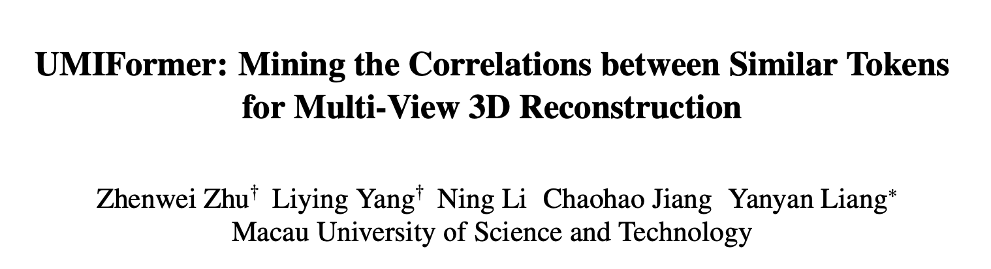
ICCV 2023

Slide 2
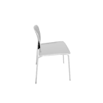
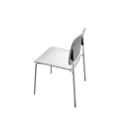
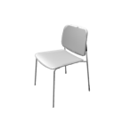
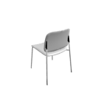
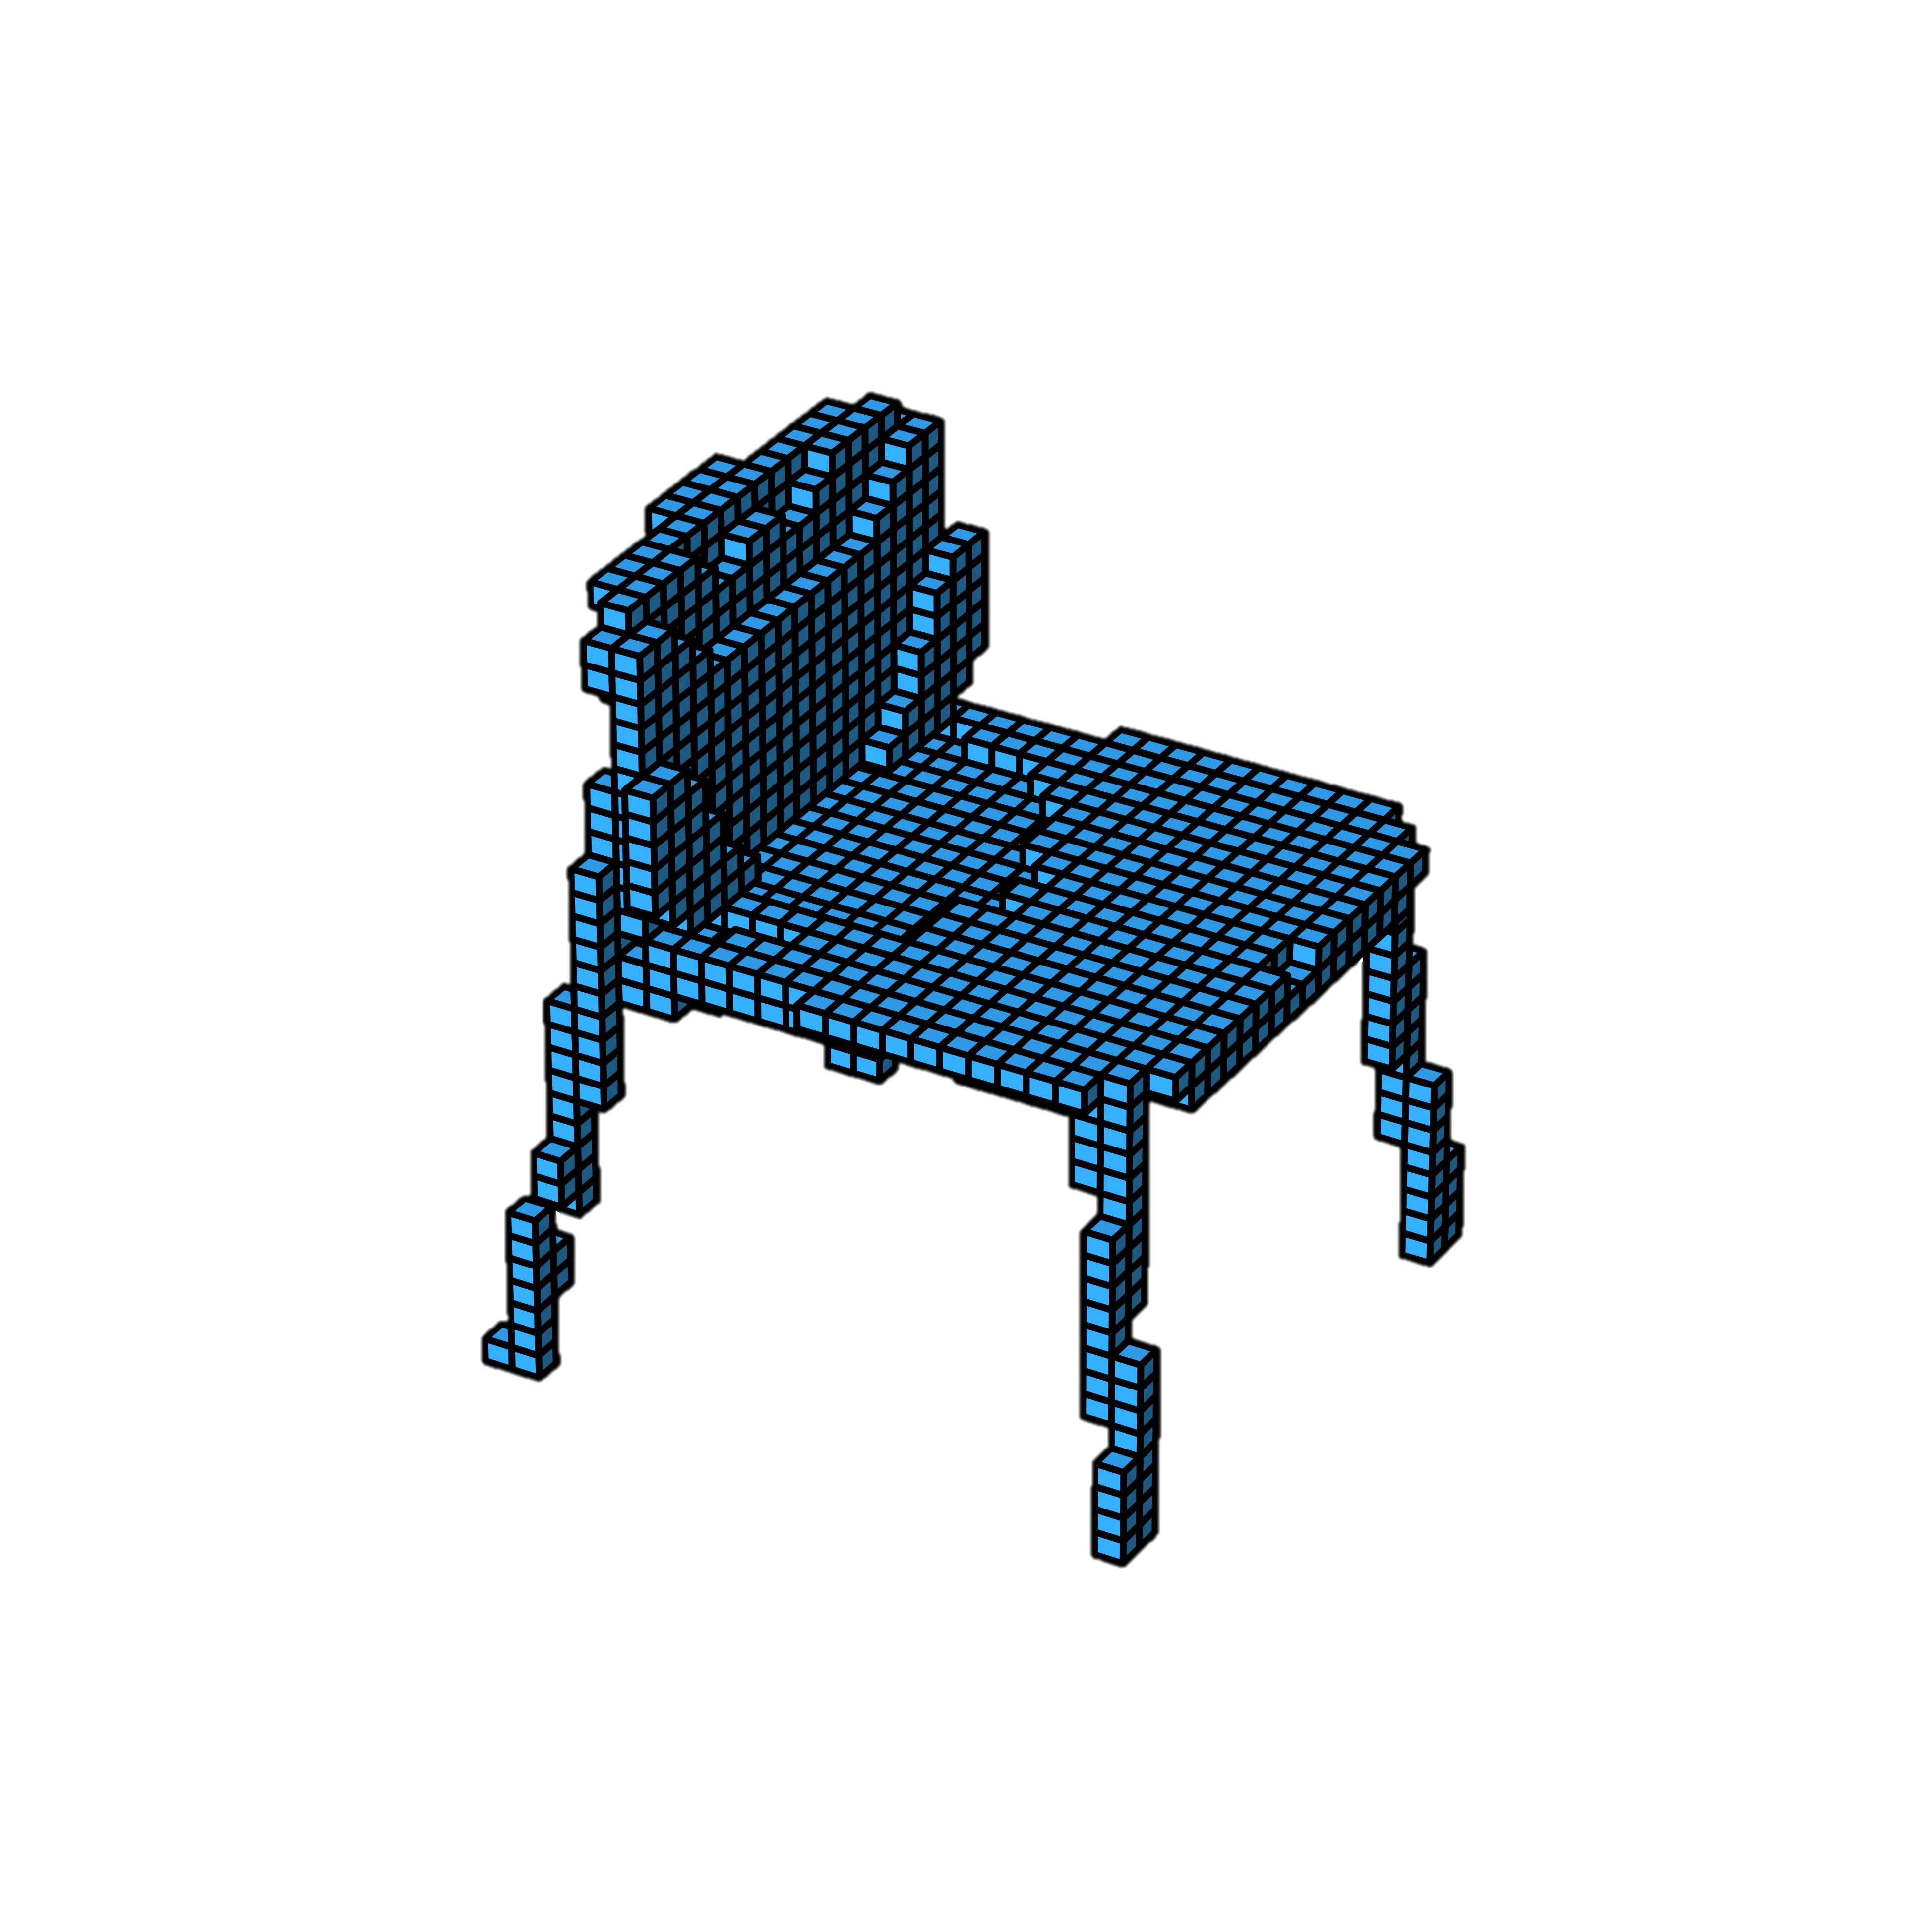
三维重建
… ….
输入：
单视角
多视角
三维模型表示（输出）：
体素
Mesh
点云
深度图像
SDF (Signed Distance Function)

Slide 3
多视角三维体素重建
Two steps：
image feature extraction
shape reconstruction
本文主要是优化第一步

Slide 4
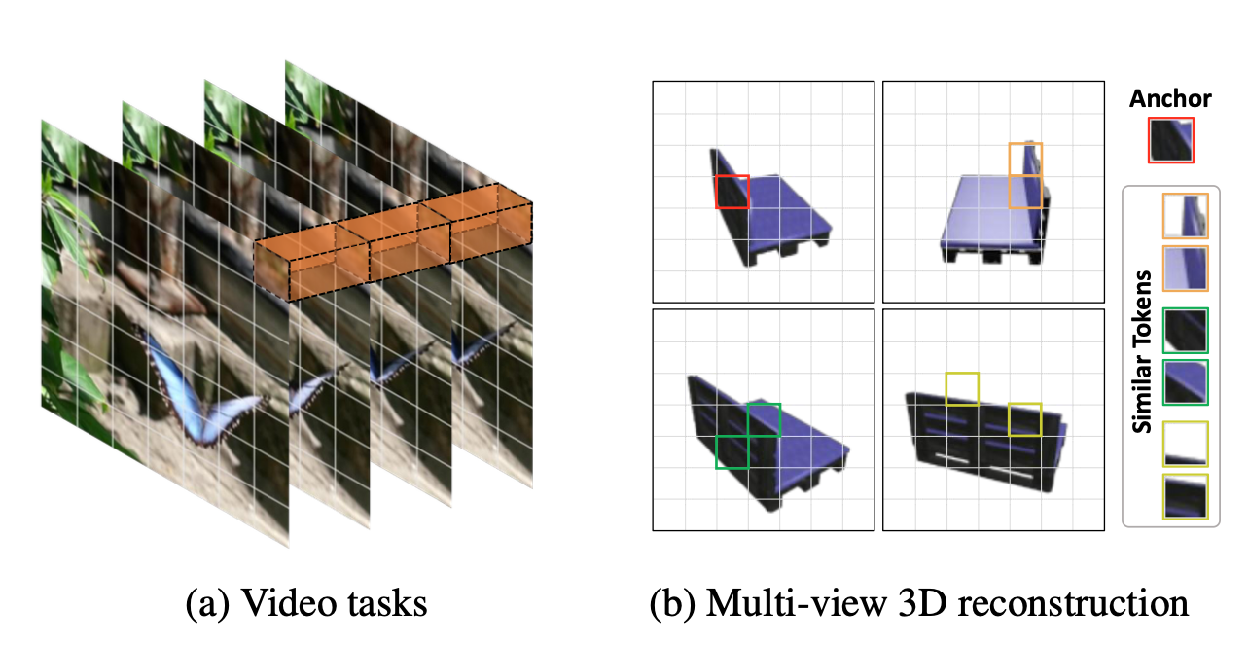
Motivation
Video task 同样以多张图片作为输入
用ViT分别提取空间特征和时间特征
取得了很好的效果
而我们的输入图片没有时间连续性
通过寻找相似的token

Slide 5
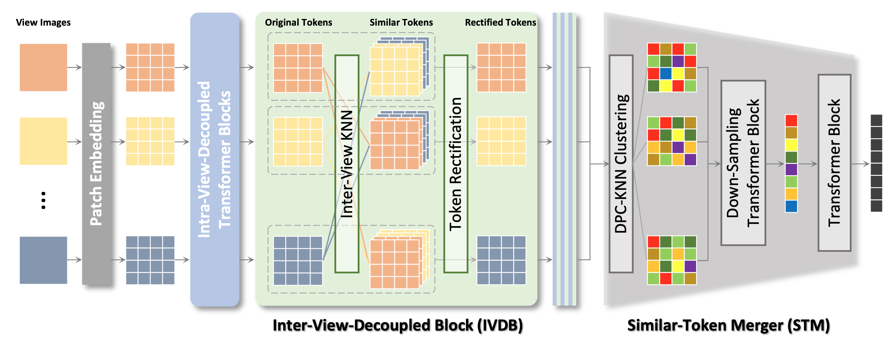
Feature Extraction in UMIFormer

Slide 6
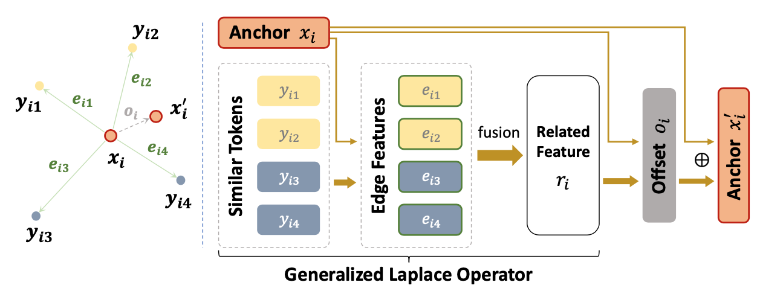
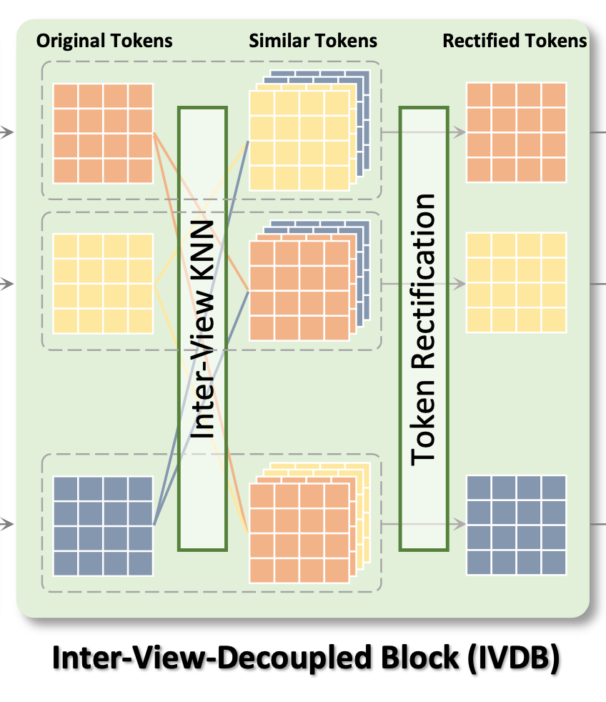
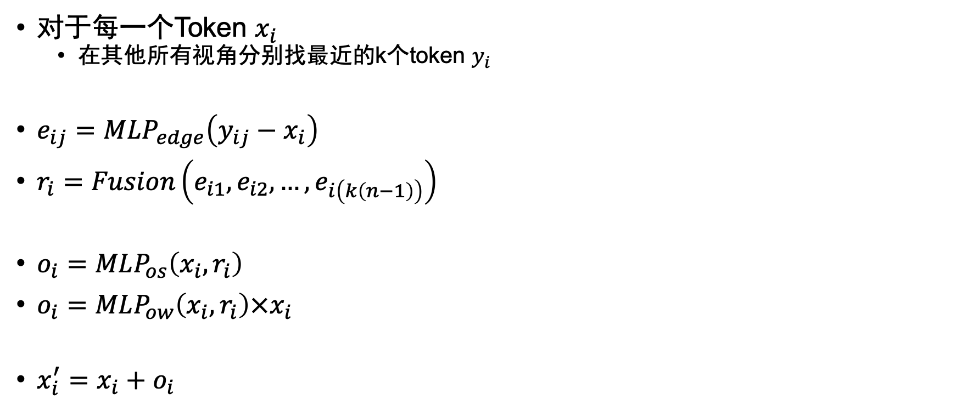
IVDB
对于每一个Token $x_{i}$
在其他所有视角分别找最近的k个token $y_{i}$
$e_{ij}=MLP_{edge}\left(y_{ij}−x_{i}\right)$
$r_{i}=Fusion\left(e_{i1}, e_{i2},…,e_{i\left(k\left(n−1\right)\right)}\right)$
$o_{i}=MLP_{os}\left(x_{i}, r_{i}\right)$
$o_{i}=MLP_{ow}\left(x_{i},r_{i}\right)×x_{i}$
$x_{i}^{′}=x_{i}+o_{i}$

Slide 7
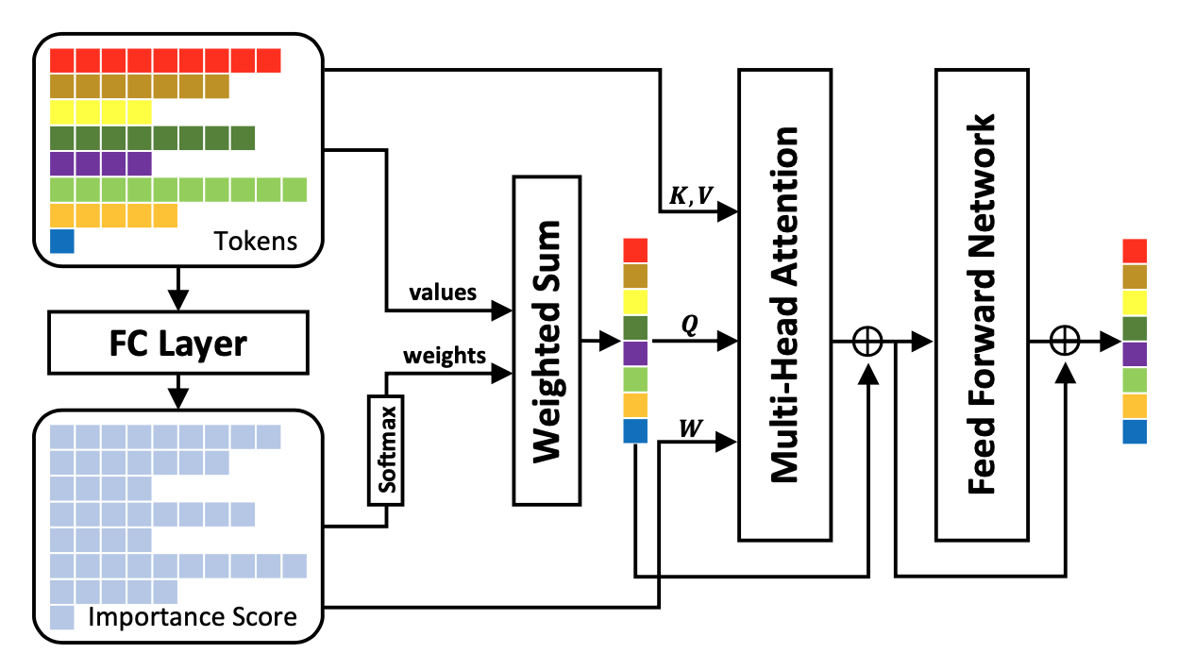

Similar-Token Merger
经过IVDB后，token之间的信息有很多冗余，需要压缩token
用 DPC-KNN 聚类将token分成g类
$Attention\left(Q,K,V,W\right)=softmax\left(\frac{QK^{T}}{\sqrt{d_{k}}}+W\right)V$

Slide 8
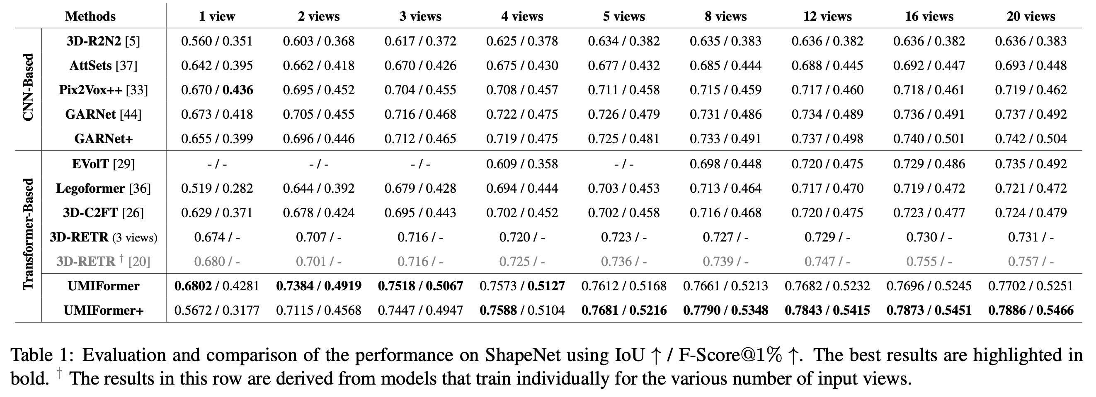
Experiments

Slide 9
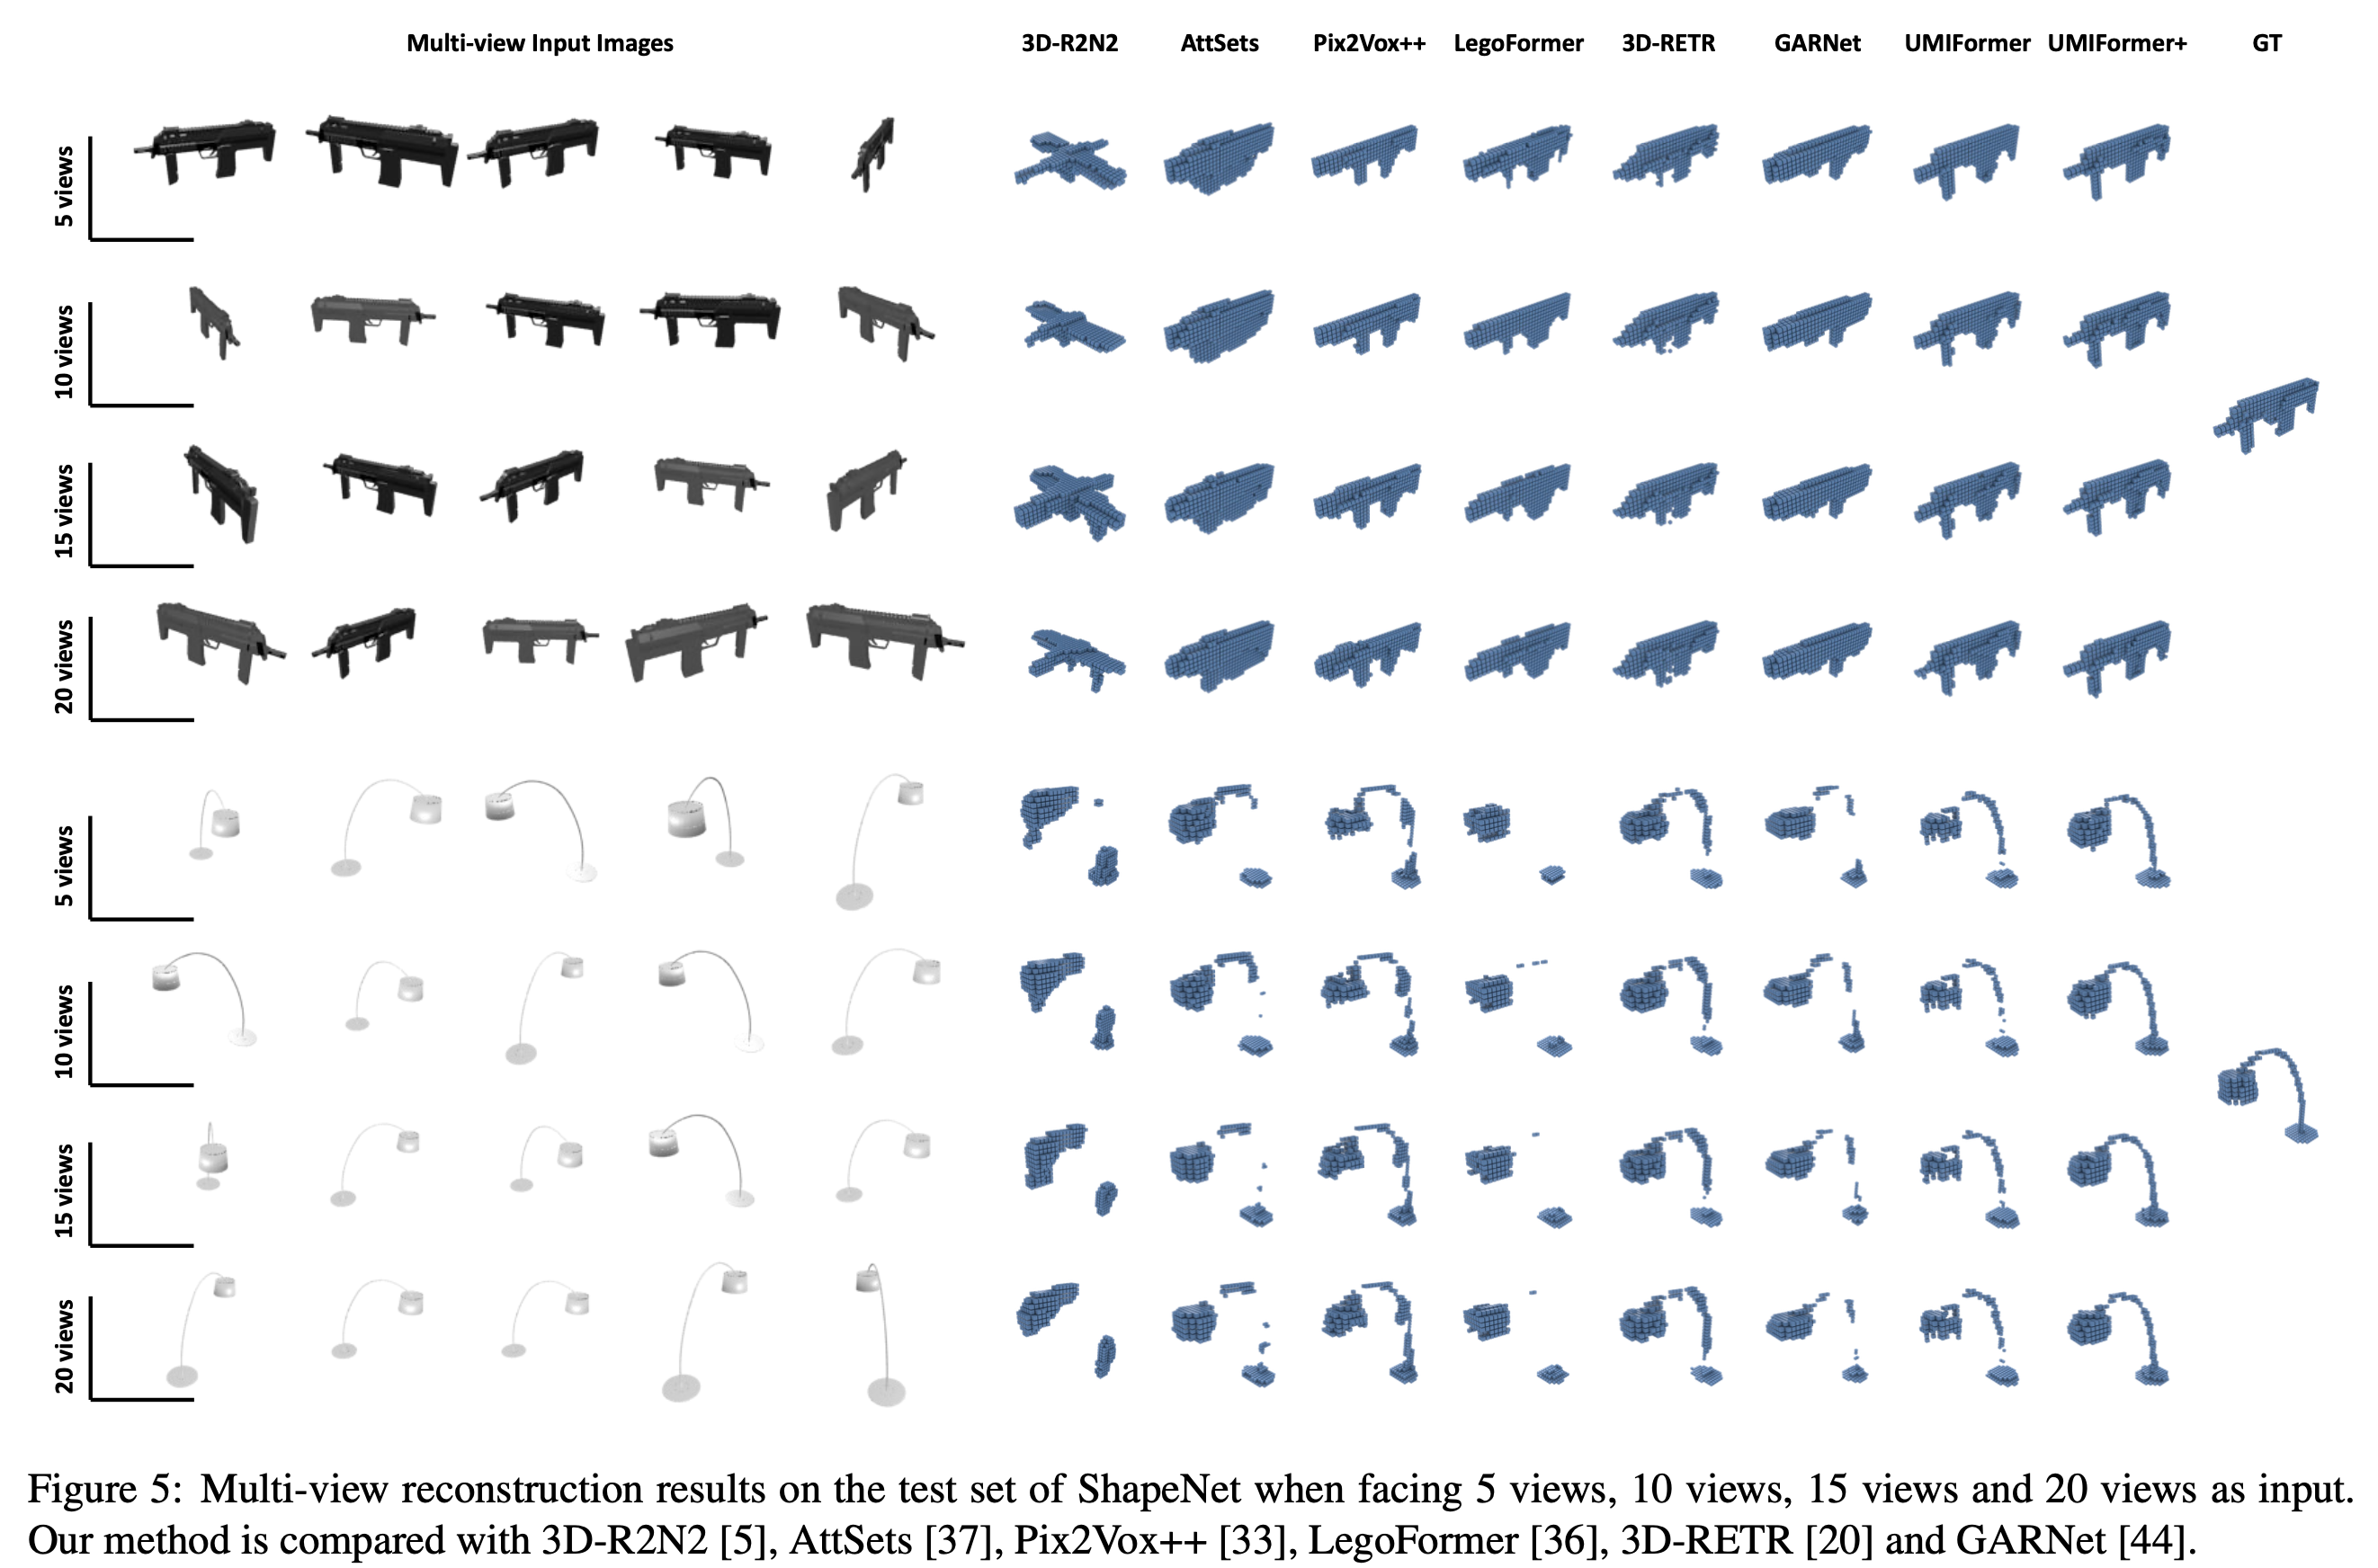

Slide 10
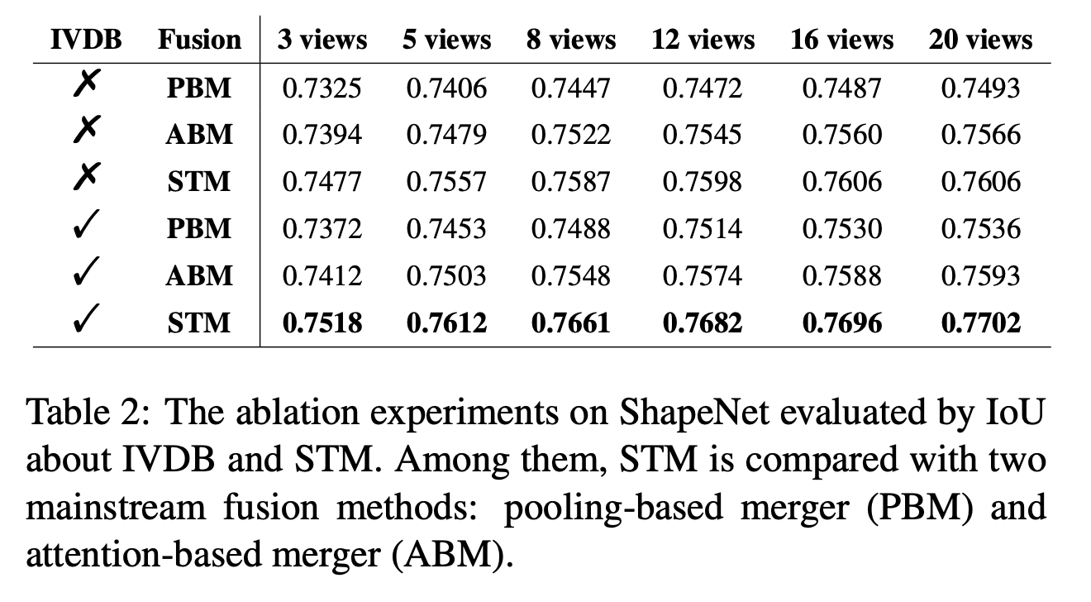
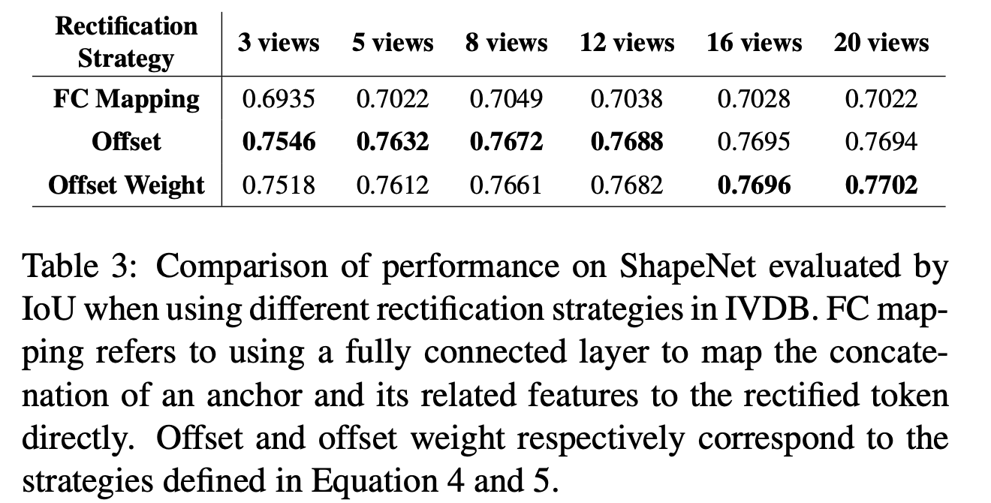
Ablation Study

Slide 11
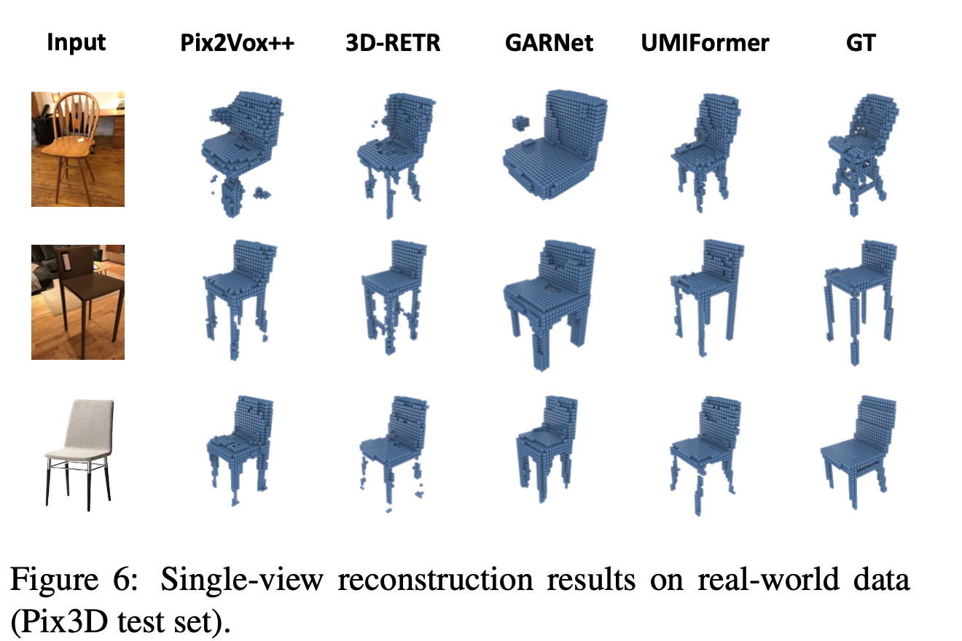
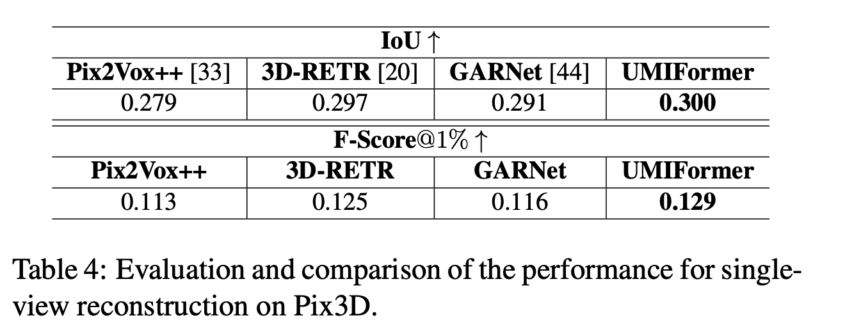
Single View

Slide 12
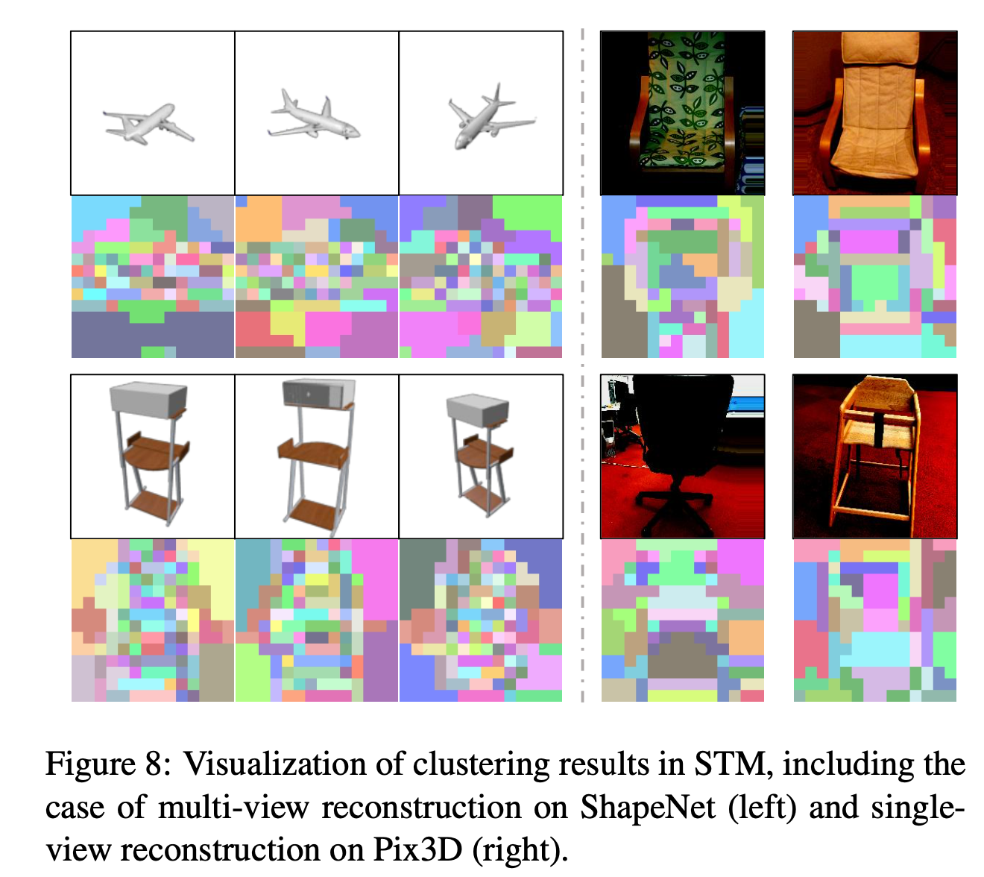
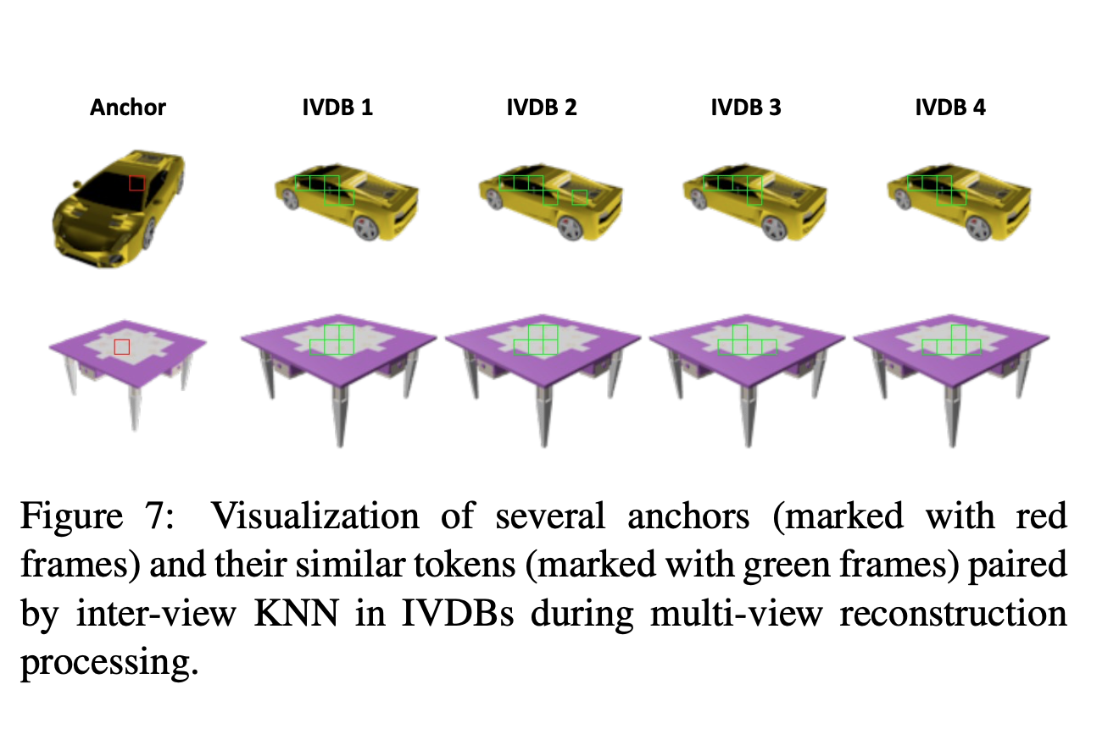
Visualization

Slide 13
Conclusion
通过token相似性增强了视角之间的特征关联
通过聚类压缩token
视角多时很消耗内存和时间
视角少时IVDB很难发挥作用

Slide 14
Abstract
In recent years, many video tasks have achieved breakthroughs by utilizing the vision transformer and establishing spatial-temporal decoupling for feature extraction. Although multi-view 3D reconstruction also faces multiple images as input, it cannot immediately inherit their success due to completely ambiguous associations between unstructured views. There is not usable prior relationship, which is similar to the temporally-coherence property in a video. To solve this problem, we propose a novel transformer network for Unstructured Multiple Images (UMIFormer). It exploits transformer blocks for decoupled intra-view encoding and designed blocks for token rectification that mine the correlation between similar tokens from different views to achieve decoupled inter- view encoding. Afterward, all tokens acquired from various branches are compressed into a fixed-size compact representation while preserving rich information for reconstruction by leveraging the similarities between tokens. We empirically demonstrate on ShapeNet and confirm that our decoupled learning method is adaptable for unstructured multiple images. Meanwhile, the experiments also verify our model outperforms existing SOTA methods by a large margin.
介绍视频任务利用vision transformer取得了很大的进展

Slide 15
Abstract
In recent years, many video tasks have achieved breakthroughs by utilizing the vision transformer and establishing spatial-temporal decoupling for feature extraction. Although multi-view 3D reconstruction also faces multiple images as input, it cannot immediately inherit their success due to completely ambiguous associations between unstructured views. There is not usable prior relationship, which is similar to the temporally-coherence property in a video. To solve this problem, we propose a novel transformer network for Unstructured Multiple Images (UMIFormer). It exploits transformer blocks for decoupled intra-view encoding and designed blocks for token rectification that mine the correlation between similar tokens from different views to achieve decoupled inter- view encoding. Afterward, all tokens acquired from various branches are compressed into a fixed-size compact representation while preserving rich information for reconstruction by leveraging the similarities between tokens. We empirically demonstrate on ShapeNet and confirm that our decoupled learning method is adaptable for unstructured multiple images. Meanwhile, the experiments also verify our model outperforms existing SOTA methods by a large margin.
相同之处在于输入多张图片
不同之处为图片没有时间的连续性

Slide 16
Abstract
In recent years, many video tasks have achieved breakthroughs by utilizing the vision transformer and establishing spatial-temporal decoupling for feature extraction. Although multi-view 3D reconstruction also faces multiple images as input, it cannot immediately inherit their success due to completely ambiguous associations between unstructured views. There is not usable prior relationship, which is similar to the temporally-coherence property in a video. To solve this problem, we propose a novel transformer network for Unstructured Multiple Images (UMIFormer). It exploits transformer blocks for decoupled intra-view encoding and designed blocks for token rectification that mine the correlation between similar tokens from different views to achieve decoupled inter- view encoding. Afterward, all tokens acquired from various branches are compressed into a fixed-size compact representation while preserving rich information for reconstruction by leveraging the similarities between tokens. We empirically demonstrate on ShapeNet and confirm that our decoupled learning method is adaptable for unstructured multiple images. Meanwhile, the experiments also verify our model outperforms existing SOTA methods by a large margin.
引出UMIFormer
探索不同视角的Token间的相似性来提升视角间的联系
然后将所有视角的token压缩

Slide 17
Abstract
In recent years, many video tasks have achieved breakthroughs by utilizing the vision transformer and establishing spatial-temporal decoupling for feature extraction. Although multi-view 3D reconstruction also faces multiple images as input, it cannot immediately inherit their success due to completely ambiguous associations between unstructured views. There is not usable prior relationship, which is similar to the temporally-coherence property in a video. To solve this problem, we propose a novel transformer network for Unstructured Multiple Images (UMIFormer). It exploits transformer blocks for decoupled intra-view encoding and designed blocks for token rectification that mine the correlation between similar tokens from different views to achieve decoupled inter- view encoding. Afterward, all tokens acquired from various branches are compressed into a fixed-size compact representation while preserving rich information for reconstruction by leveraging the similarities between tokens. We empirically demonstrate on ShapeNet and confirm that our decoupled learning method is adaptable for unstructured multiple images. Meanwhile, the experiments also verify our model outperforms existing SOTA methods by a large margin.
实验结果

Slide 18
Introduction 1
3D reconstruction, which lifts 2D view images to a 3D representation of an object, is a challenging problem. It plays an important role in numerous technologies, including intelligent driving, augmented reality and robotics. In the situation of single-view input, previous works have attempted to improve performance by strengthening the network capabilities [9, 30, 21, 13, 35] and leveraging the geometric information as priors knowledge [38, 39, 34]. However, for multi-view reconstruction, researchers concentrate on how to extract sufficient feature representation for the object shape from unstructured multiple images [5, 32, 37, 33, 29]. This paper is devoted to multi-view 3D reconstruction using the voxel representation.
介绍三维重建任务应用
分别介绍单视角和多视角的一般方法
说明本文任务是多视角三维体素重建

Slide 19
Introduction 2
In our investigation, the deep-learning-based algorithms for multi-view reconstruction typically involve two steps: feature extraction and shape reconstruction. The latter is generally accomplished using a 3D decoder module, while there are various solutions for the former including CNN- based and transformer-based methods.
说明多视角三维重建的一般步骤
特征提取+重建形状
不同的方法对于特征提取有不同的解决方式，引出下文

Slide 20
Introduction 3
CNN-based methods usually separate the feature extraction process into two stages. The first stage exploits a backbone network to encode on intra-view-dimension while the second stage processing on inter-view-dimension aggregate the features obtained from different views. The fusion method can be a pooling layer [22, 19, 10], a recurrent unit [5, 11, 16] or an attention operator [37]. In addition, Pix2Vox series [32, 33] put merger after decoder, which directly fusion the voxels predicted from different views, and also achieve good results. To realize the merger adapting the global state, GARNet [44] sets up two fusion modules, which are located before and after the decoder respectively.
介绍CNN-based 的一般做法
先提取每个视角的特征
再融合所有视角的特征

Slide 21
Introduction 4
Transformer-based methods [29, 36, 26] that can directly handle views as a sequence also attend global awareness. It takes natural advantage of the architecture to couple the procedures for intra-image and inter-image feature extraction. However, such approaches work poorly when facing few views as input since the size of the extracted feature is too small to hold enough information. In contrast, 3D-RETR [20] exploits transformer on the intra-view dimension and then aggregates the features from different views using an adaptive pooling layer. It is essentially the same method as before [22] but with a more advanced backbone network. The success of this method reminds us that the power of vision transformer (ViT) [6] for the representation of views cannot be understated.
Transformer优势在于有处理序列的自然优势，因此有方法直接将多视角当作序列，但视角少时表现很差
另一种方式是用transformer来提取每个视角的特征，这类方法相对比较成功，引出了ViT的有效性

Slide 22
Introduction 5
In video tasks that also face multiple images as input, recent works [1, 2, 14] have produced good performance using ViT as a spatially-decoupled feature extractor and additionally establish a temporally-decoupled feature extractor. They benefit from the fact that video frames are temporally coherent (as shown in Figure 1a). These approaches, however, cannot be directly transferred to our task since multi-view reconstruction should deal with unstructured multiple images without prior positional correspondence.
说明video task使用ViT获得了很大的成功，提取了时间和空间的特征。
但video task有时间连续性，无法直接借鉴到我们的任务中

Slide 23
Introduction 6
To address this problem, we propose a novel inter-view- decoupled block (IVDB) based on mining the correlation between similar patches from different views (as shown in Figure 1b). It can be inserted between the blocks of ViT to create a transformer encoder for unstructured multiple images. This model maintains the advantages of ViT initialization pre-trained on large-scale datasets while alternating decoupling the intra- and inter-view encoding processes. Moreover, by clustering the tokens according to their similarities and exploiting a down-sampling transformer block, the tokens from all branches are compressed into a fixed- size compact representation, ensuring relatively steady performance for the varying number of views input.
为了解决没有连续性的问题，提出了IVDB，来寻找视角之间的相似性。

Slide 24
Introduction 7
In detail, our contributions are as follows:
To our best knowledge, we are the first to propose a transformer network that alternates decoupled intra- and inter-view feature extraction for multi-view 3D reconstruction, a problem facing unstructured multiple images as input.
Leveraging the correlations between similar tokens, we proposes a novel inter-view-decoupled block (IVDB) that rectifies the tokens according to the related information from other views and a similar-token merger (STM) that compresses the features from all branches.
Experiments on ShapeNet [4] verify that our method achieves performance better than previous SOTA methods by a large margin and has the potential to be more robust for multi-view reconstruction when increasing training consumption.
本文的贡献
第一个用transformer来分别提取视角内和视角间的特征
提出了IVDB和STM
效果好

