Slide 1
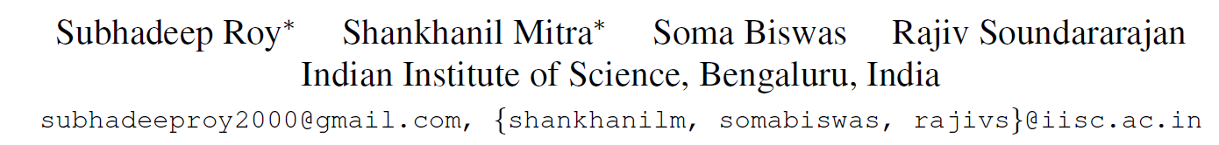
Test Time Adaptation for Blind Image Quality Assessment
ICCV 2023
Notes:
盲图像质量评价的测试时间自适应
印度科学研究所，班加罗尔，印度

Slide 2
Backgrounds
IQA:
IQA models often have poor generalization ability and find it difficult to perform well
under such shifts.
TTA：
Test time adaptation (TTA) has emerged as an important approach to address
distributional shifts at test time.
Main contribution:
The design of self-supervised auxiliary tasks to enable TTA for IQA.
Notes:
IQA面对的图像非常多样化，需要处理几种不同的失真和分布变化。IQA模型通常泛化能力较差。
测试时适应(TTA)已成为解决测试时分布变化的重要方法。
但是为IQA设计TTA有很多挑战。用于TTA的典型损失，如熵最小化，不适用于IQA。TTA的设计基本是针对图像分类任务的，对于IQA这类回归任务是不适用的。
本文的主要贡献是设计辅助任务，使TTA能够用于IQA。

Slide 3
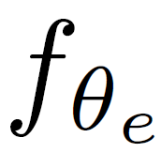
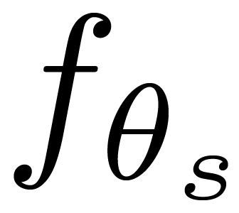
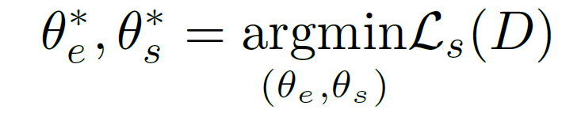
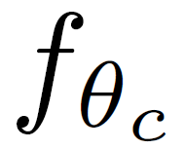
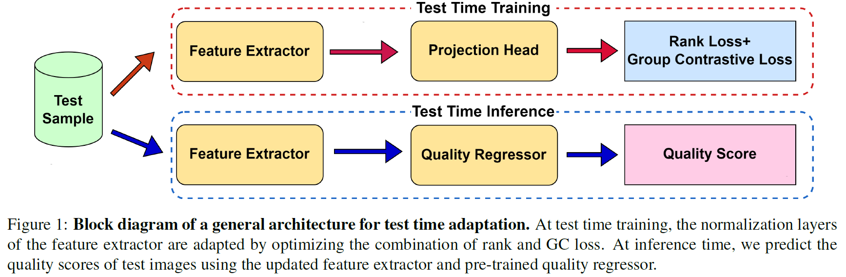
Architecture for TTA
Feature Extractor : Only update the parameters of batch normalization in a lower dimensional space.
Projection Head : Low-rank mapping (256 dimensions).
Quality Regressor : Parameters are frozen
Notes:
整个过程可以这样来理解：首先在一个源域或者源数据集上训练了一个IQA模型（模型包括特征提取器和质量预测器），现在测试和推理的阶段是在另一个源域或者源数据集进行的。由于原数据集和目前的数据集室友一定的分布差异的，因此TTA的目的就是通过一个自监督的训练方法来提高泛化性。
整个训练和推理过程的图示，在自监督训练过程中，测试样本通过预训练模型的特征提取器提取特征，再通过一个映射头（新增的层）降低特征维度到256维，通过设计好的自监督损失（这里是Rank loss和Group Contrastive Loss）来优化映射头的参数和特征提取器中Batch Normalization的参数，其他参数冻结保持不变。（类似于低秩学习+稀疏微调的组合）
在推理时，使用更新的特征提取器和预训练模型的质量回归器来预测测试图像的质量分数。
下面我们详细说明Rank loss和Group Contrastive Loss两个自监督损失怎么设计的。

Slide 4
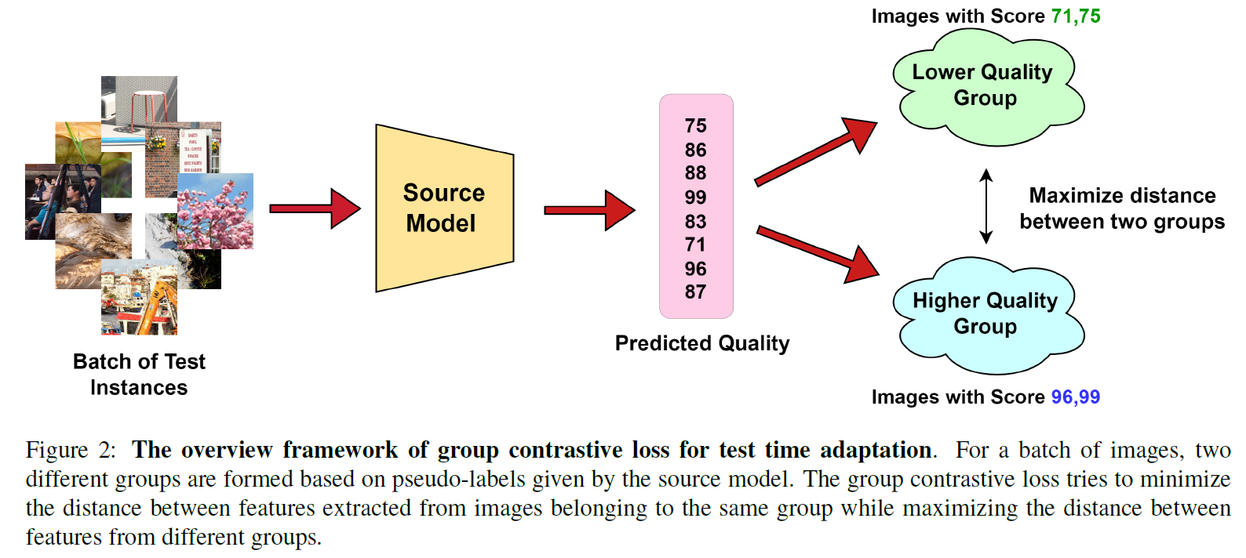
Group Contrastive Loss
Notes:
首先是Group Contrastive Loss
对于一个batch中的图像，首先通过预训练好的模型给出他们的伪标签，根据伪标签的大小把这些图像组成两个不同的组（质量分数较高的放在一组，较低的放在一组，居中的图像不归属于两者组中的任意一个组）。群体对比损失试图将同一组图像中提取的特征之间的距离最小化，而将不同组图像中提取的特征之间的距离最大化。
GC学习损失背后的假设是，来自相同质量组的图像应该在较低维空间中给出相似的特征表示，而来自不同组的图像的特征应该差异很大。因此训练的时候来自同一组的图像对作为一对正样本，来自不同组的图像对作为一对负样本。

Slide 5
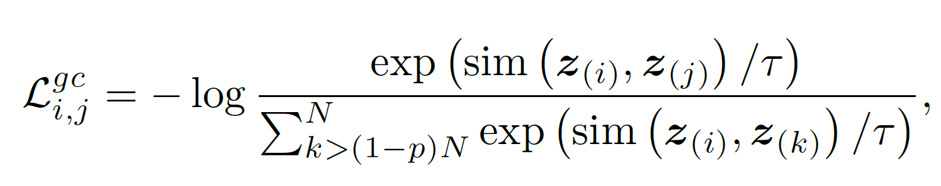
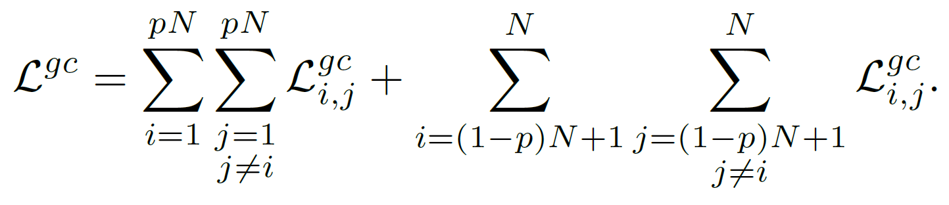
Group Contrastive Loss
Use a modified NT-Xent contrastive loss as the objective Function of Group Contrastive Loss :
Notes:
计算方式:
使用改进的NT-Xent对比损失作为的目标函数。第一个公式中，N是batchsize的大小，p是一个0-0.5之间的参数。假设zi和zj是来自相同group的样本的特征，k>(1-p)N代表的是来自于质量高的那个组。第二个公式中，通过最小化该目标函数，可以让来自相同组的样本特征尽可能的接近。

Slide 6
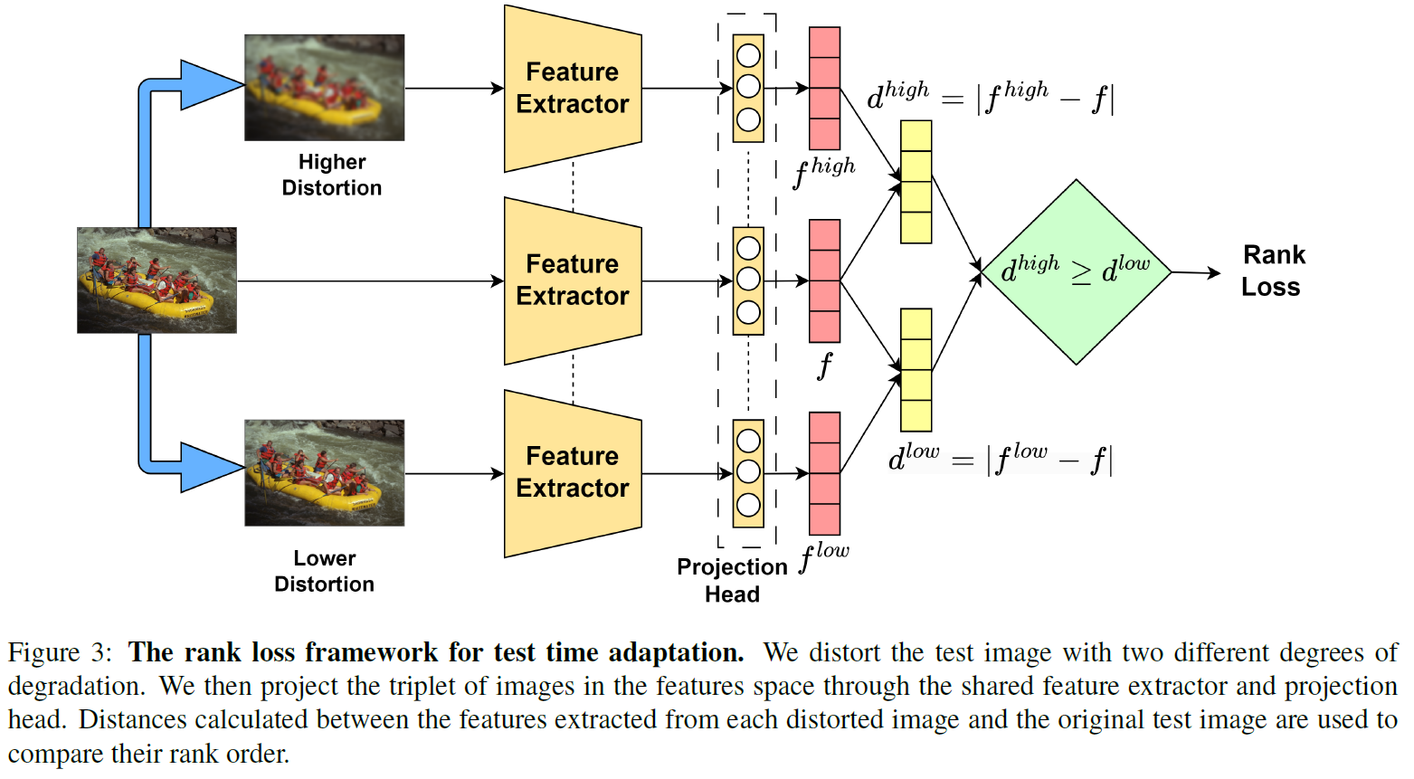
Rank Loss
Notes:
测试时间自适应的秩损失框架。
对于每一幅图片，用两种不同程度的失真来处理图像，一个是更严重的失真，一个是轻微的失真。然后，我们通过当前的特征提取器和映射头获取三个图像的低纬特征表示。轻微失真图像的特征和原图的特征的距离应该很小，严重失真图像的特征和原图的特征的距离应该很大，以此来构建排序损失。

Slide 7
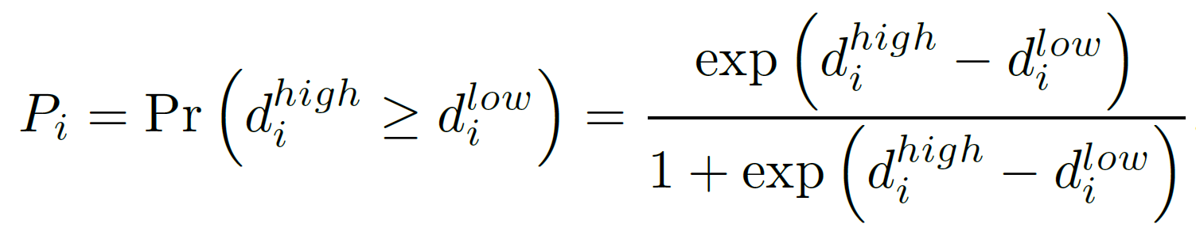
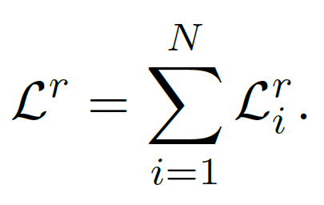
Rank Loss
The probability of achieving this order is estimated by passing the difference in distances through a sigmoid function as :
Use binary cross-entropy loss between true label and the predicted probability to obtain the rank loss as：
Overall rank loss：
Notes:
实现这个排序的概率是通过sigmoid函数考虑距离差来估计的。
使用真实标签¯Pi = 1和预测概率Pi之间的二元交叉熵损失来获得Loss损失：
若batchsize为N，总的秩损失为

Slide 8
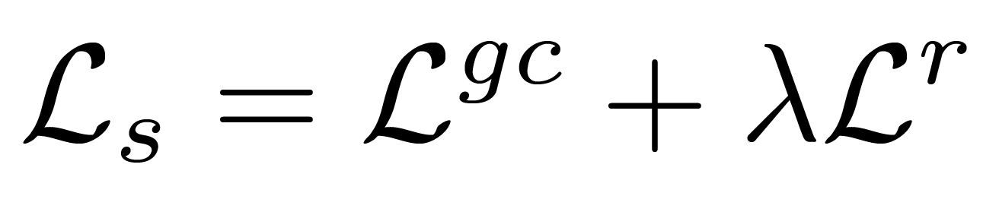
TTA objective function
Overall self-supervised TTA objective function is a combination of both the rank and GC loss：
Notes:
整体自监督TTA目标函数是Rank和GC损失的组合

Slide 9
Experiments
Databases
Models：TReS , MUSIQ , HyperIQA , and MetaIQA.
Evaluation Criteria: PLCC & SROCC
Databases | Type | Quantity
LIVEFB (TReS , MUSIQ , HyperIQA ) | Pre-train | 1162
TID2013 & KADID-10k (MetaIQA) |  | 10073
LIVE-IQA | TTA-test | 779
CID2013 |  | 866
PIPAL
KonIQ-10k
Notes:
评估指标是PLCC 和 SRCC，实验中用到的模型是TReS , MUSIQ , HyperIQA , MetaIQA四种，其中TReS , MUSIQ , HyperIQA 是在LIVEFB
上预训练好的，MetaIQA是在TID2013 & KADID-10k预训练好的。
通过TTA-IQA，让这些模型在LIVE-IQA，CID2013，PIPAL，KonIQ-10k这四个数据集上进行测试。

Slide 10
Experiments
Details
hyper-parameters | values
lambda | 1
tau | 1
p | 0.25
patch | 224×224
Learning rate | 0.001
epochs | 3
Batch size | 8
Notes:
一些实验细节

Slide 11
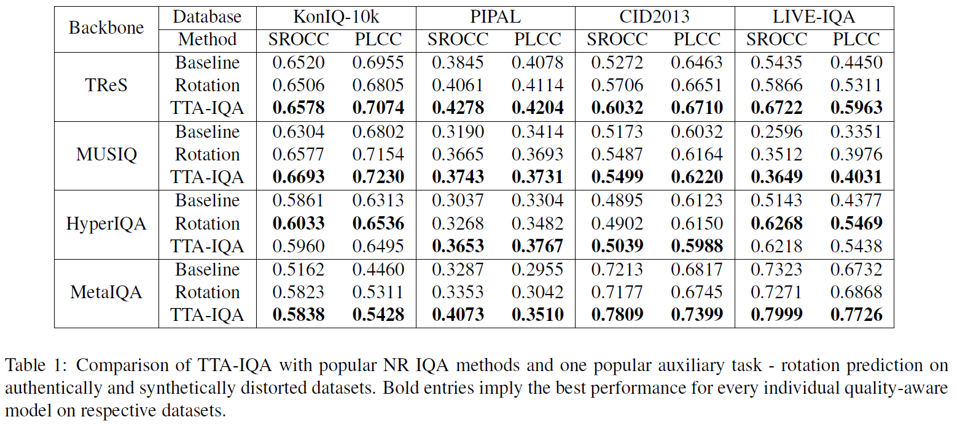
Experiments
Performance Evaluation
Notes:
表1显示了所提出方法在使用四个IQA模型的四个测试数据集上的性能。除了源模型，还比较了旋转预测作为TTA中的辅助任务的效果。
我们观察到，结合rank和GC损失的TTA-IQA在所有情况下都优于源模型，大部分也比旋转预测方法的效果好。其中PIPAL数据集与LIVEFB数据集(其中三个模型是在LIVEFB数据集上训练的)有很大的分布变化。

Slide 12
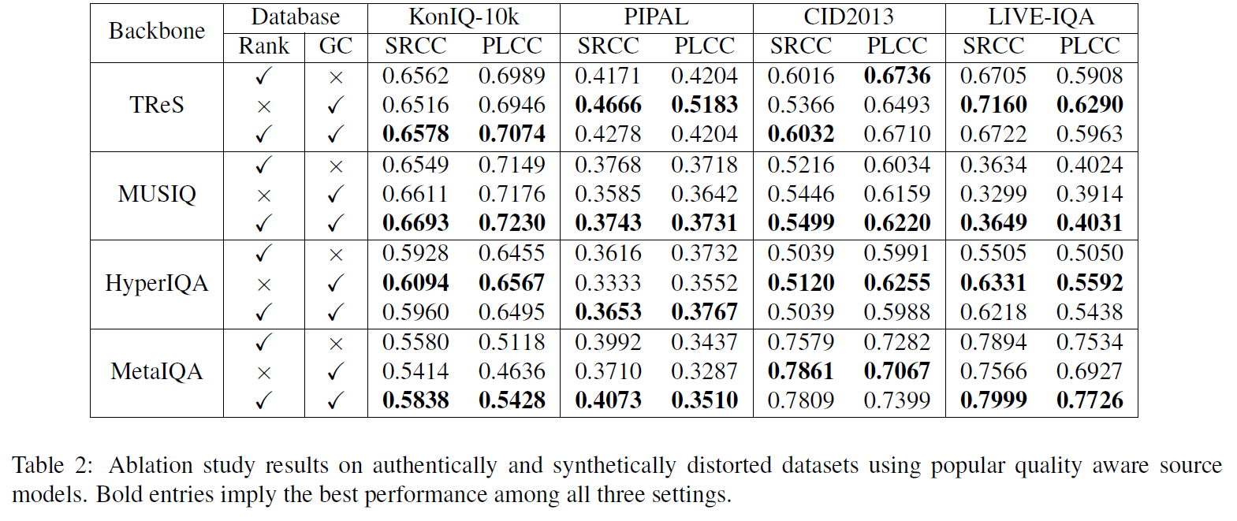
Experiments
Ablation Study
Notes:
表2中对两种损失进行了消融实验。从结果中我们可以看出，rank损失和GC损失分别总是在源模型上得到改进。
此外，在大多数评估场景中，rank和GC损失的组合提供了比单独损失更好的性能。即使在组合loss达到次优性能的情况下，其性能也非常接近最佳性能。
后面的实验，作者是单独使用TReS方法在所有四个数据集上展示结果。

Slide 13
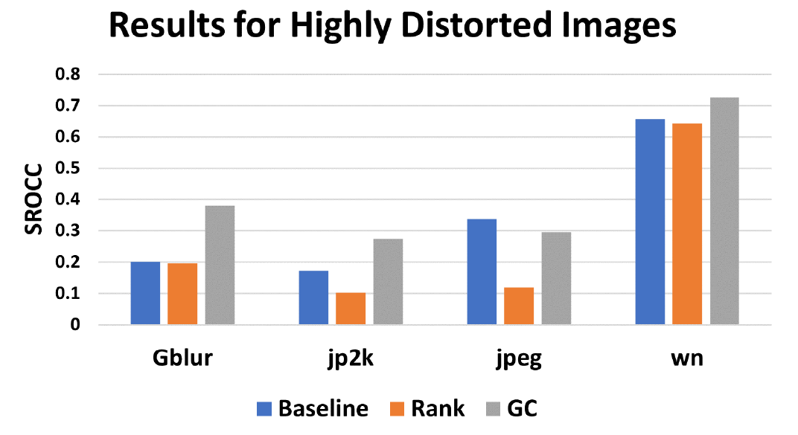
Experiments
Ablation Study
Scenarios where the GC loss is particularly more useful than the rank loss:
If the test image is extremely distorted, none of the different kinds of distortion types can create much difference in the perceptual quality of the two degraded versions.
Notes:
这里讨论了GC损失比Rank损失更有用的场景。如果测试图像失真十分严重，针对各种失真类型，模型都不能在两个失真版本的感知质量上产生太大的差异。这时候GC损失比Rank损失更有效。
实验中，考虑了LIVE-IQA数据集中不同失真类型的失真严重的图像(对应于大于70的平均主观得分差异 (Differential mean opinion score, DMOS)，DMOS越小越好)。分别用Rank和GC损失做TTA的训练。图中这些图像的SROCC性能显示，Rank loss不是很有效。然而，GC loss在这种情况下表现得很好。

Slide 14
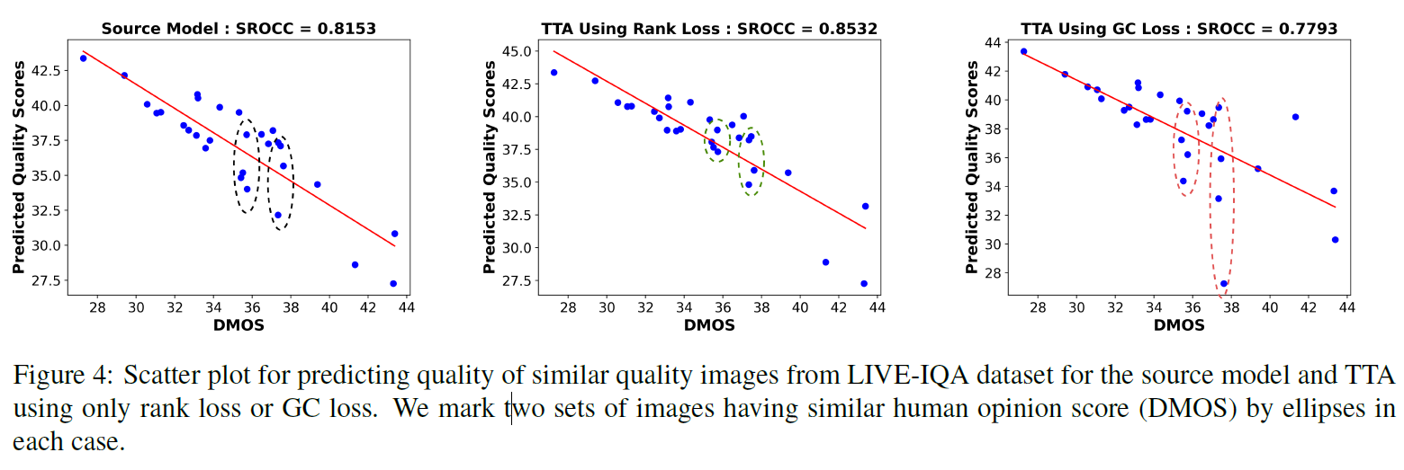
Experiments
Ablation Study
Scenarios where the rank loss is more useful than the GC loss: images with similar quality.
Notes:
作者还讨论了Rank损失比GC损失更有用的场景。为了说明这个想法，从LIVE-IQA数据集中选择一些DMOS在28-44之间的图像（质量分数比较接近）。我们使用GC和Rank损失来训练这组图像的TTA模型。
从图4中，我们观察到，Rank损失比GC损失效果更好。
直观地说，当输入图像具有相似的质量时，源模型给出的伪标签可能是有噪声的，从而导致不准确地将图像分为低质量组和高质量组。这可能会对GC损耗产生不利影响。

Slide 15
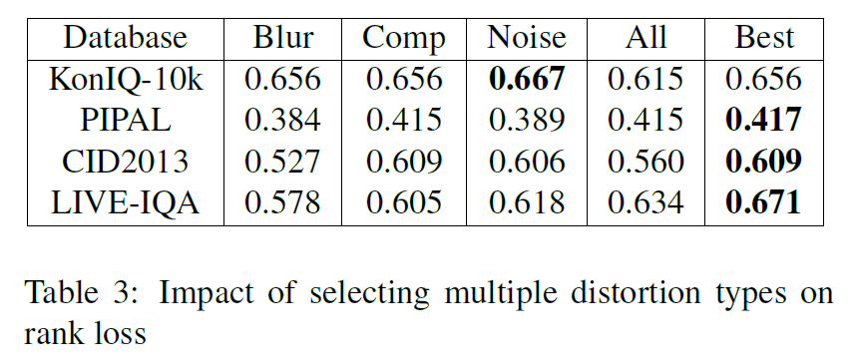
Experiments
Ablation Study
Effect of Selecting Multiple Distortion Types in the Rank Loss:
Only one of the distortion types is used in the rank loss,
all the three types are used to obtain three loss terms which are summed together to update the model
only one of the distortion types (with the maximal difference) is chosen
Notes:
这里探讨了失真类型的选择方法对Rank loss的影响。三种方案，一是随机选择一种失真类型，二是使用各种失真类型得到多个损失项，将它们加在一起来更新模型，最后一种是只选择让模型评估的MOS结果差异最大的那种失真类型。可以看出第三种方式最有效。

Slide 16
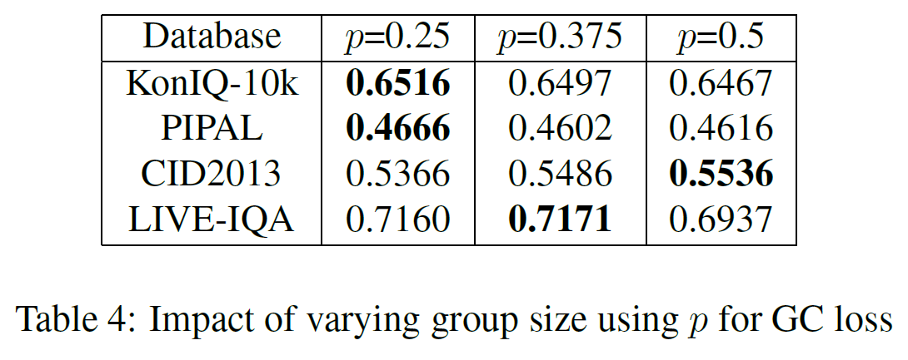
Experiments
Ablation Study
Selection of Group Size by Varying p:
For a batch size of 8, possible choices of the group size are 2, 3, 4 corresponding to p = 0.25, 0.375, 0.5 respectively.
Notes:
考虑了group大小的影响。
我们探索了不同的p值来构建GC损失。batchsize为8时，group大小的可能的选择分别为2、3、4，对应于p = 0.25、0.375、0.5。从表中观察到不同p值的性能大致相似，p = 0.25时性能略好。这是因为随着p的增加，group更大，在质量方面可能不那么具有区分性了，导致表现略差。

Slide 17
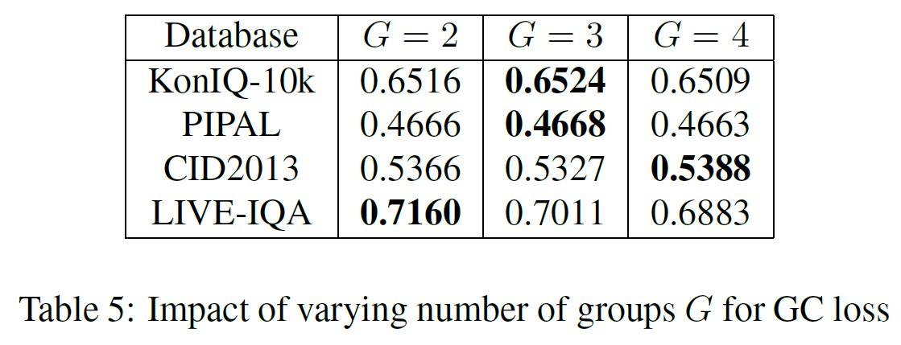
Experiments
Ablation Study
Selection of Number of Groups for GC Loss:
cluster the images in a batch into multiple groups and apply the GC loss between every pair of groups and sum the loss terms
Notes:
选择GC损失的组数。在我们的公式中，我们只定义两个对比组之间的GC损失。原则上，我们可以将GC损失的概念扩展到多个组。具体来说，可以将一批图像聚类成多个组，并在每对组之间应用GC损失并对损失项求和。可以看出组的数量G对性能的影响不大。

Slide 18
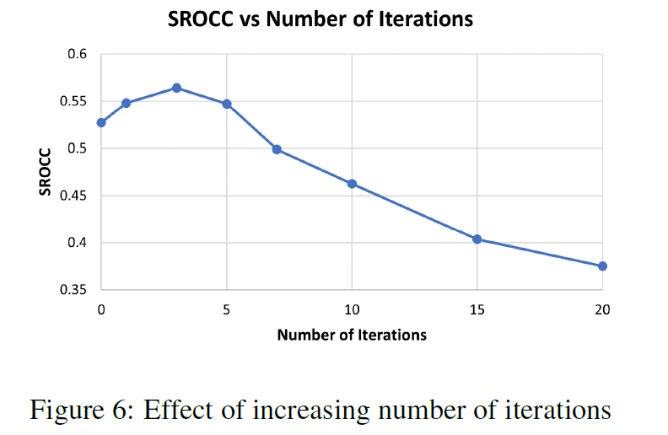
Experiments
Ablation Study
Choice of Number of Iterations for Learning Auxiliary Task:
Figure 6 shows that the performance on CID2013 dataset is fairly robust until 4 iterations. Beyond that, the model overfits the auxiliary task and leads to poor performance at test time.
Notes:
研究了TTA期间参数更新迭代次数的影响。图中显示，模型性能在4次迭代之前相当稳健。之后性能下降，这是因为模型会过度拟合辅助任务，导致测试时的性能不佳。

Slide 19
Conclusion
Test time adaptation has become very popular due to its simplicity and the lack of need for end-to-end training. This work is perhaps one of the first attempts to design the method of TTA in the context of blind IQA.
This paper formulates novel self-supervised auxiliary tasks using the rank and group contrastive losses, which can learn quality-aware information from the test data.
The proposed TTA-IQA method can outperform existing state-of-the-art methods because of the adaptation at test time.
Notes:
这项工作可能是在盲IQA背景下设计TTA方法的第一次尝试之一。
本文提出了一种新的自监督辅助任务，利用秩和群对比损失从测试数据中学习质量感知信息。
由于在测试时的自适应，所提出的TTA-IQA方法优于现有的先进方法。

Slide 20
Writing
Abstract
Introduction

Slide 21
ABSTRACT
While the design of blind image quality assessment (IQA) algorithms has improved significantly, the distribution shift between the training and testing scenarios often leads to a poor performance of these methods at inference time. This motivates the study of test time adaptation (TTA) techniques to improve their performance at inference time. Existing auxiliary tasks and loss functions used for TTA may not be relevant for quality-aware adaptation of the pre-trained model. In this work, we introduce two novel quality-relevant auxiliary tasks at the batch and sample levels to enable TTA for blind IQA. In particular, we introduce a group contrastive loss at the batch level and a relative rank loss at the sample level to make the model quality aware and adapt to the target data. Our experiments reveal that even using a small batch of images from the test distribution helps achieve significant improvement in performance by updating the batch normalization statistics of the source model.
研究背景研和现状：BIQA任务中，训练和测试场景之间的分布变化往往导致在推理时的模型性能不佳。

Slide 22
ABSTRACT
While the design of blind image quality assessment (IQA) algorithms has improved significantly, the distribution shift between the training and testing scenarios often leads to a poor performance of these methods at inference time. This motivates the study of test time adaptation (TTA) techniques to improve their performance at inference time. Existing auxiliary tasks and loss functions used for TTA may not be relevant for quality-aware adaptation of the pre-trained model. In this work, we introduce two novel quality-relevant auxiliary tasks at the batch and sample levels to enable TTA for blind IQA. In particular, we introduce a group contrastive loss at the batch level and a relative rank loss at the sample level to make the model quality aware and adapt to the target data. Our experiments reveal that even using a small batch of images from the test distribution helps achieve significant improvement in performance by updating the batch normalization statistics of the source model.
研究动机：测试时间适应(TTA)技术可以提高模型在推理时的性能。然而，现有的用于TTA辅助任务和损失函数不适用于IQA问题的域适应。

Slide 23
ABSTRACT
While the design of blind image quality assessment (IQA) algorithms has improved significantly, the distribution shift between the training and testing scenarios often leads to a poor performance of these methods at inference time. This motivates the study of test time adaptation (TTA) techniques to improve their performance at inference time. Existing auxiliary tasks and loss functions used for TTA may not be relevant for quality-aware adaptation of the pre-trained model. In this work, we introduce two novel quality-relevant auxiliary tasks at the batch and sample levels to enable TTA for blind IQA. In particular, we introduce a group contrastive loss at the batch level and a relative rank loss at the sample level to make the model quality aware and adapt to the target data. Our experiments reveal that even using a small batch of images from the test distribution helps achieve significant improvement in performance by updating the batch normalization statistics of the source model.
全文主题：在批量水平和样本水平上分别引入了两个新的与质量相关的辅助任务，以实现BIQA的TTA。

Slide 24
ABSTRACT
While the design of blind image quality assessment (IQA) algorithms has improved significantly, the distribution shift between the training and testing scenarios often leads to a poor performance of these methods at inference time. This motivates the study of test time adaptation (TTA) techniques to improve their performance at inference time. Existing auxiliary tasks and loss functions used for TTA may not be relevant for quality-aware adaptation of the pre-trained model. In this work, we introduce two novel quality-relevant auxiliary tasks at the batch and sample levels to enable TTA for blind IQA. In particular, we introduce a group contrastive loss at the batch level and a relative rank loss at the sample level to make the model quality aware and adapt to the target data. Our experiments reveal that even using a small batch of images from the test distribution helps achieve significant improvement in performance by updating the batch normalization statistics of the source model.
所提方法的2个部分：
批水平：引入了群体对比损失。
样本水平：引入了相对秩损失。
从而使模型具有质量意识并适应目标数据。

Slide 25
ABSTRACT
While the design of blind image quality assessment (IQA) algorithms has improved significantly, the distribution shift between the training and testing scenarios often leads to a poor performance of these methods at inference time. This motivates the study of test time adaptation (TTA) techniques to improve their performance at inference time. Existing auxiliary tasks and loss functions used for TTA may not be relevant for quality-aware adaptation of the pre-trained model. In this work, we introduce two novel quality-relevant auxiliary tasks at the batch and sample levels to enable TTA for blind IQA. In particular, we introduce a group contrastive loss at the batch level and a relative rank loss at the sample level to make the model quality aware and adapt to the target data. Our experiments reveal that even using a small batch of images from the test distribution helps achieve significant improvement in performance by updating the batch normalization statistics of the source model.
实验效果

Slide 26
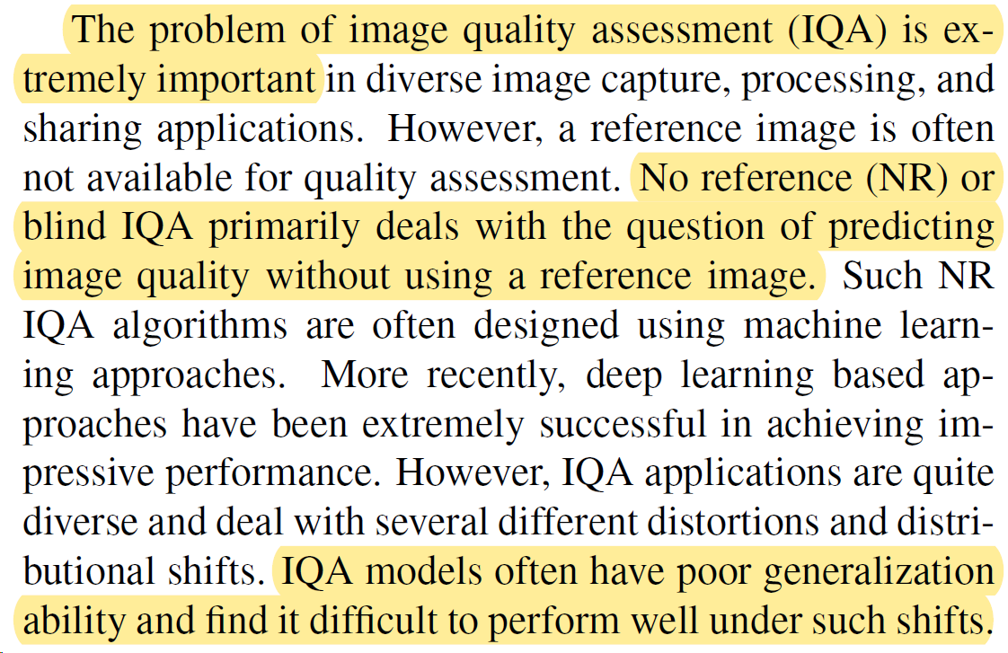
Introduction – 1/5
研究背景（IQA的问题）：
在各个应用中，图像质量评估(IQA)问题非常重要。
特地指出NR-IQA模型的意义：无需参考图像，本文所讨论的内容也是针对NR-IQA的。
IQA模型通常泛化能力较差，很难在这种变化下表现良好。

Slide 27
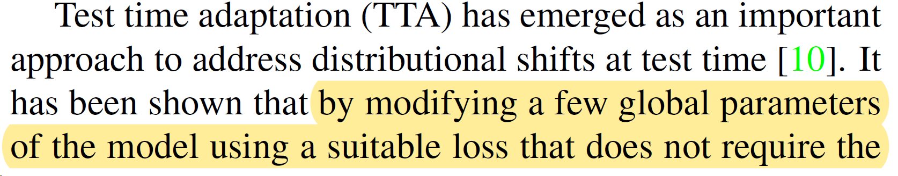
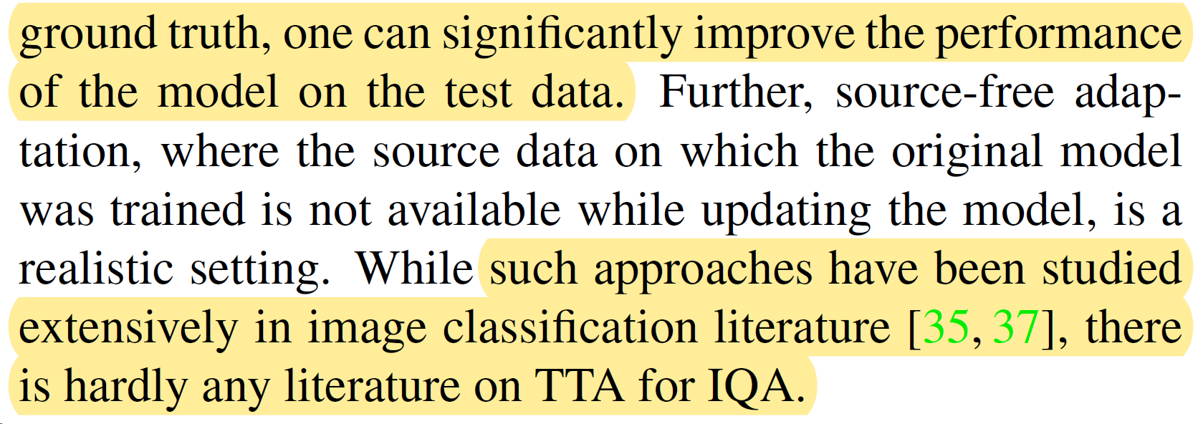
Introduction – 2/5
研究动机（TTA+IQA）：
TTA：通过使用合适的损失来修改模型的几个全局参数，而不需要地面真值，可以显着提高模型在测试数据上的性能。
虽然这些方法在图像分类文献中得到了广泛的研究，但几乎没有关于IQA的TTA的文献。

Slide 28
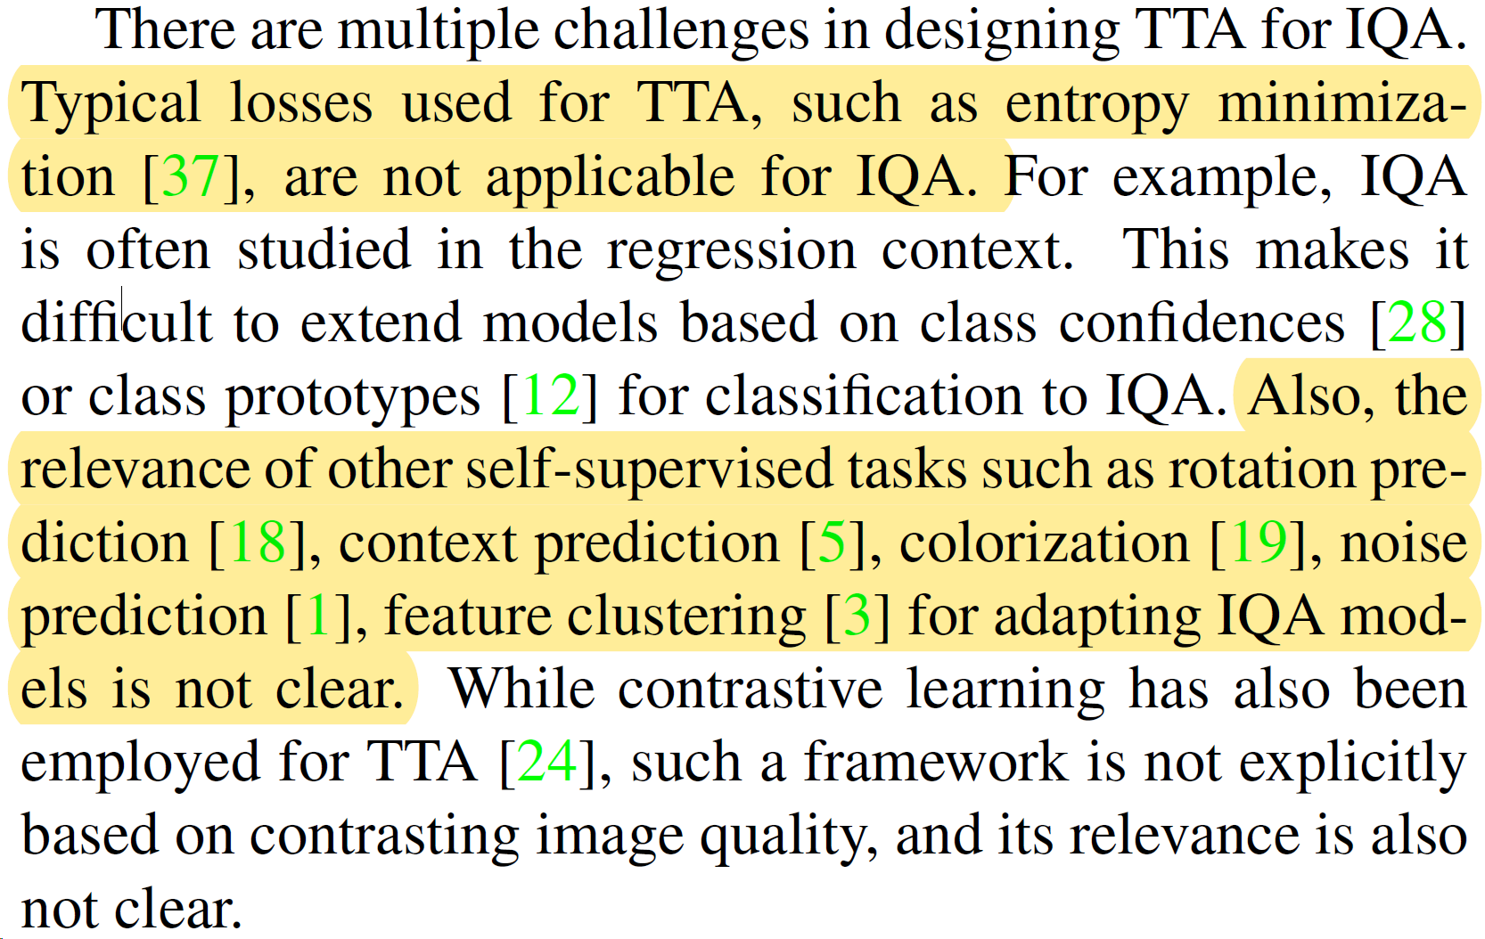
Introduction – 3/5
TTA+IQA的挑战：
挑战1：用于TTA的典型损失，如熵最小化，不适用于IQA。
挑战2：其他自监督任务(如旋转预测、上下文预、着色、噪声预测、特征聚类)与适应IQA模型的相关性尚不清楚。

Slide 29
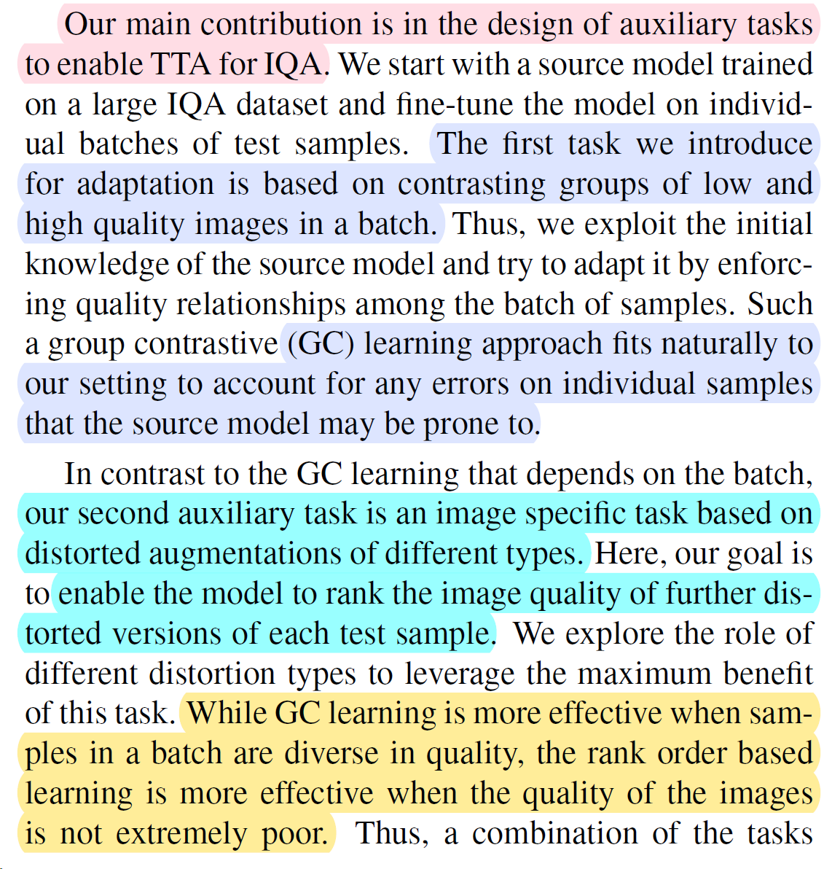
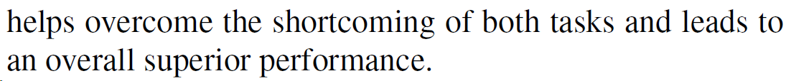
Introduction – 4/5
本文提出的方法
引入的第一个自适应任务是基于一批低质量和高质量图像的对比组，以解释源模型可能容易出现的单个样本上的任何错误。
引入的第二个辅助任务是基于不同类型的扭曲增强的图像特定任务。其目标是使模型能够对每个测试样本的进一步失真版本的图像质量进行排序。
结论：当一批样本质量不同时，GC学习更有效，而当图像质量都不是很差(质量分数接近)时，基于秩序的学习更有效。

Slide 30
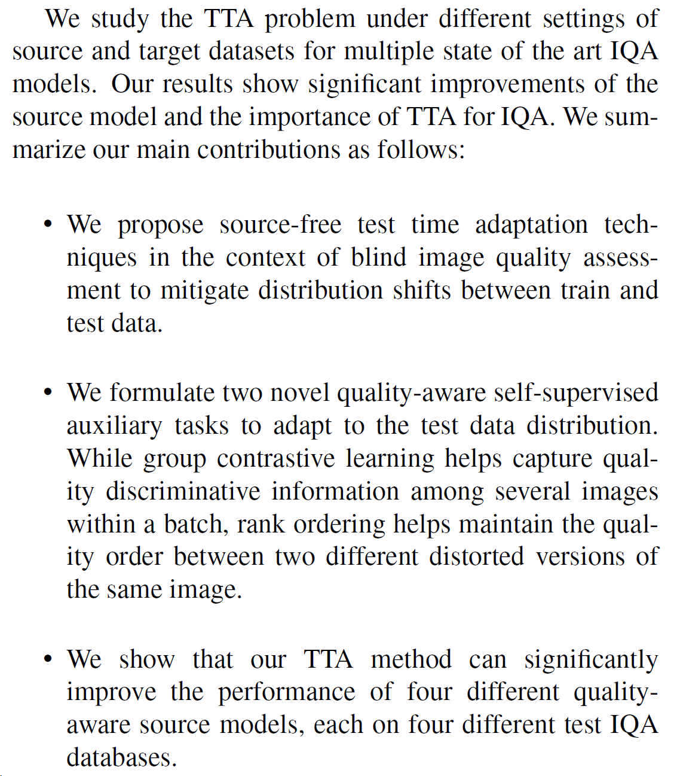
Introduction – 5/5
贡献总结
（1）提出了在BIQA背景下的无源的TTA技术，以减轻训练和测试数据之间的分布变化的影响。
（2）制定了两个新的质量意识自监督辅助任务，以适应测试数据的分布。i) 群体对比学习有助于捕获一批图像中多个图像之间的质量判别信息; ii) 排序有助于保持同一图像的两个不同失真版本之间的质量顺序。
（3）实验结果表明，该TTA方法可以显著提高四种不同的质量感知源模型的性能。

Slide 31
THANKS

