Slide 1
Re-IQA: Unsupervised Learning for Image Quality Assessment in the Wild
CVPR 2023
Notes:
德克萨斯大学奥斯汀分校
图像与视频工程实验室

Slide 2
Backgrounds
There is no unsupervised learning method for BIQA in the wild;
Image content affects quality perception (As shown in Figure 2);
Main contribution:
Learn low level quality-aware image representations that are complementary to high
level features representative of image content.

Slide 3
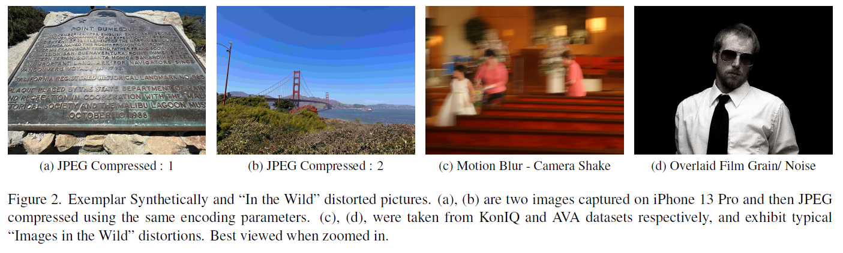
Backgrounds
Picture distortion perception is content dependent, and is heavily affected by content related perceptual processes like masking.
Perceived quality does not correlate well with image metadata like resolution, file size, color profile, or compression ratio.

Slide 4
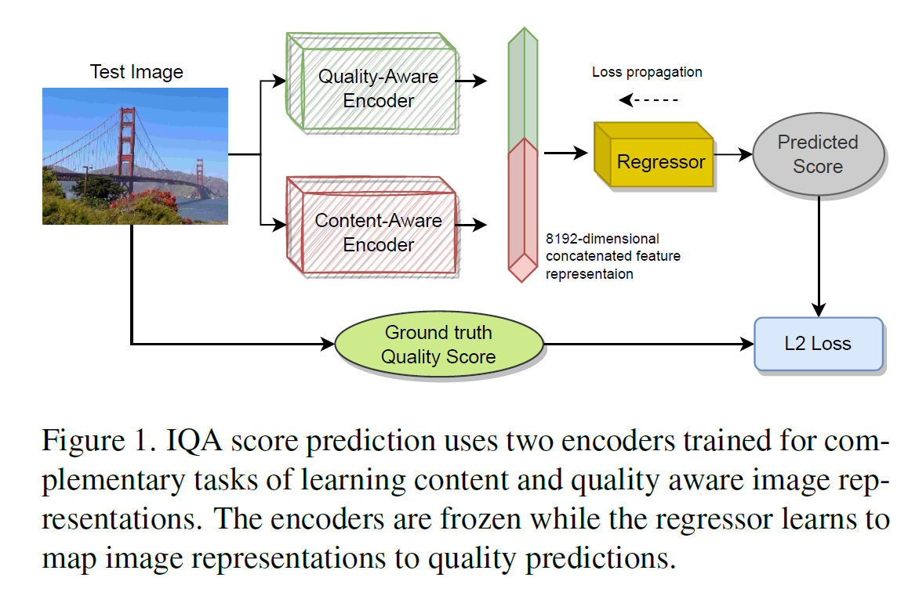
Three Processing Phases in Re-IQA
Phase 1 :
Training a ResNet50 encoder using contrastive learning of high-level image information
Phase 2 :
Training a ResNet50 encoder using contrastive learning of low-level image information
Phase 3 :
Use the pre-trained encoders with frozen weights as image representation generation backbones, which supply features to a low-complexity regression model that is trained to conduct image quality prediction

Slide 5
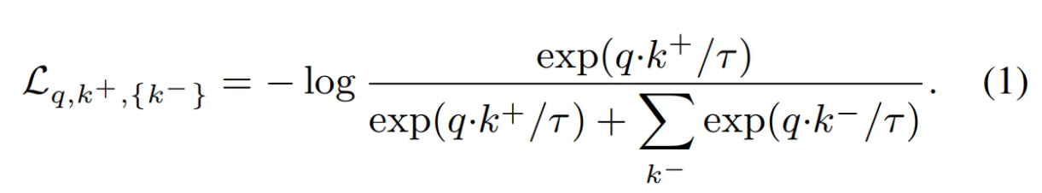

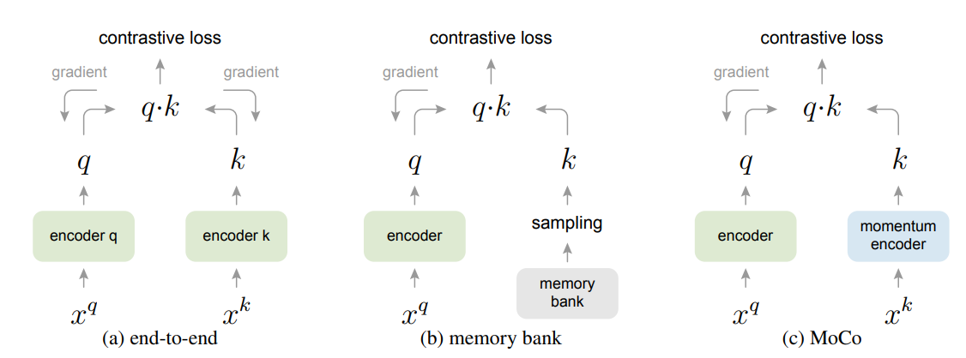
Phase 1 : Content Aware
Method :
Only use the original MoCo-v2 [1] framework to generate content-aware image representations.
[1] Chen, X., Fan, H., Girshick, R., & He, K. (2020). Improved baselines with momentum contrastive learning. arXiv preprint arXiv:2003.04297.
Notes:
借鉴了SimCLR的一些即插即用的方法（增加MLP头+更强的数据增强）

Slide 6
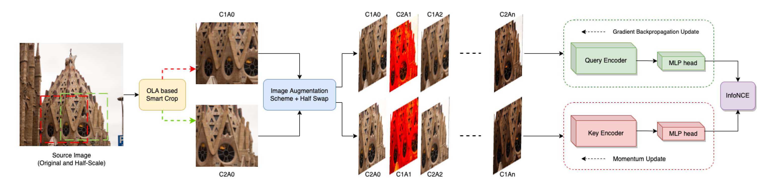
Phase 2 : Quality Aware
Method :
① MoCo-v2 + ② Image Augmentation + ③ Intra-pair image Swapping scheme.
Goal : Modeling a feature space wherein all images having similar degrees of perceptual quality fall closer to one another than to images having different perceptual qualities.
Notes:
借鉴了SimCLR的一些即插即用的方法（增加MLP头+更强的数据增强）

Slide 7
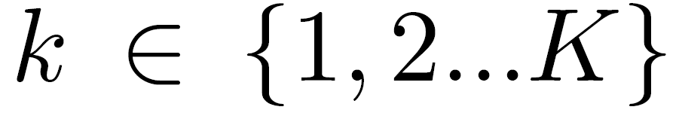
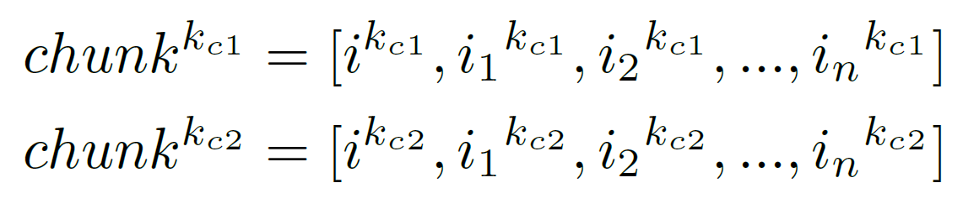
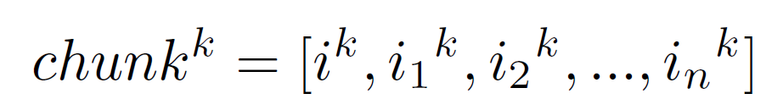

Phase 2 : Quality Aware
Method :
① MoCo-v2 + ② Image Augmentation + ③ Intra-pair image Swapping scheme.
Goal : Modeling a feature space wherein all images having similar degrees of perceptual quality fall closer to one another than to images having different perceptual qualities.
Image Augmentation
source image：$i^{k}$,
distorted versions
overlapping area
(OLA) crop
Notes:
借鉴了SimCLR的一些即插即用的方法（增加MLP头+更强的数据增强）

Slide 8
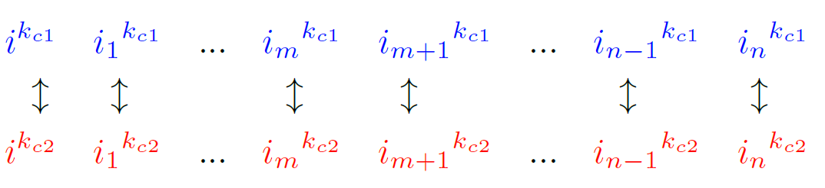
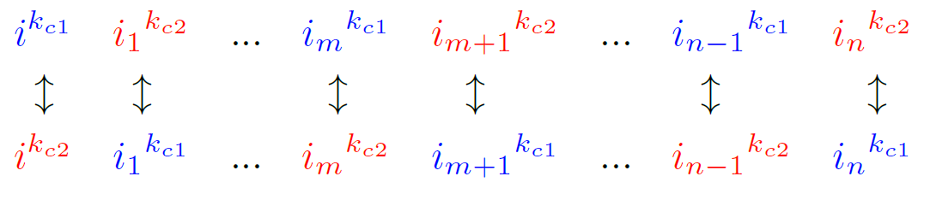
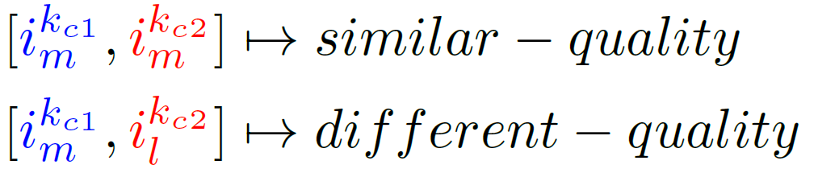
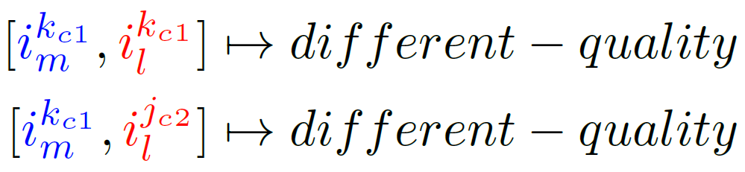
Phase 2 : Quality Aware
Method :
① MoCo-v2 + ② Image Augmentation + ③ Intra-pair image Swapping scheme.
Goal : Modeling a feature space wherein all images having similar degrees of perceptual quality fall closer to one another than to images having different perceptual qualities.
2. Intra-pair image Swappingn
Phase 2 : IQA Regression
Only train the low-complexity regressor head while evaluating.

Slide 9
Experiments
Training Databases
Evaluation Databases
Evaluation Criteria: PLCC & SROCC
ImageNet : containing approximately 1.28 million images across 1000 classes.
Pristine Images : KADIS - 140K images.
Authentically Distorted Images:
(a) AVA - 255K images, (b) COCO - 330K images, (c) CERTH-Blur - 2450 images, (d) VOC - 33K images.
Training Datasets: Pristine Images + Authentically Distorted Images.
Authentic Distortions (Images in the Wild): KonIQ, CLIVE, FLIVE, SPAQ.
Synthetic Distortions: LIVE, CSIQ, TID-2013, KADID-10K.
Notes:
评估指标是PLCC 和 SRCC，实验中用到的模型是TReS , MUSIQ , HyperIQA , MetaIQA四种，其中TReS , MUSIQ , HyperIQA 是在LIVEFB
上预训练好的，MetaIQA是在TID2013 & KADID-10k预训练好的。
通过TTA-IQA，让这些模型在LIVE-IQA，CID2013，PIPAL，KonIQ-10k这四个数据集上进行测试。

Slide 10
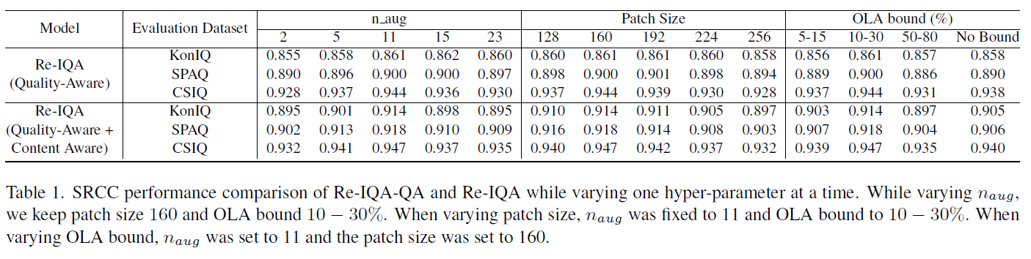
Experiments
1. Ablation Study
Each dataset was randomly divided into 70%, 10% and 20% corresponding to training, validation and test sets, respectively.
The performance variation of Re-IQA-QA (quality aware module only) and Re-IQA against percentage OverLap Area, patch-sizes, and the number of image distortion augmentations is depicted in Table 1.
Notes:
一些实验细节

Slide 11
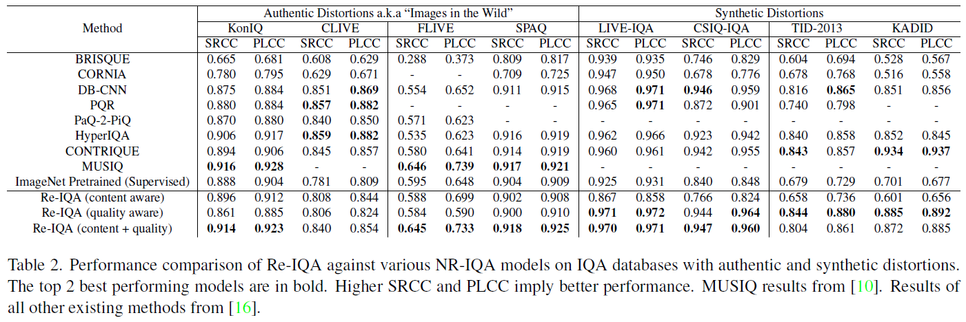
Experiments
2. Performances
“Mixture of Experts” approach in Re-IQA enables us to learn robust high-level image content and low-level quality aware representations independently.
Notes:
一些实验细节

Slide 12
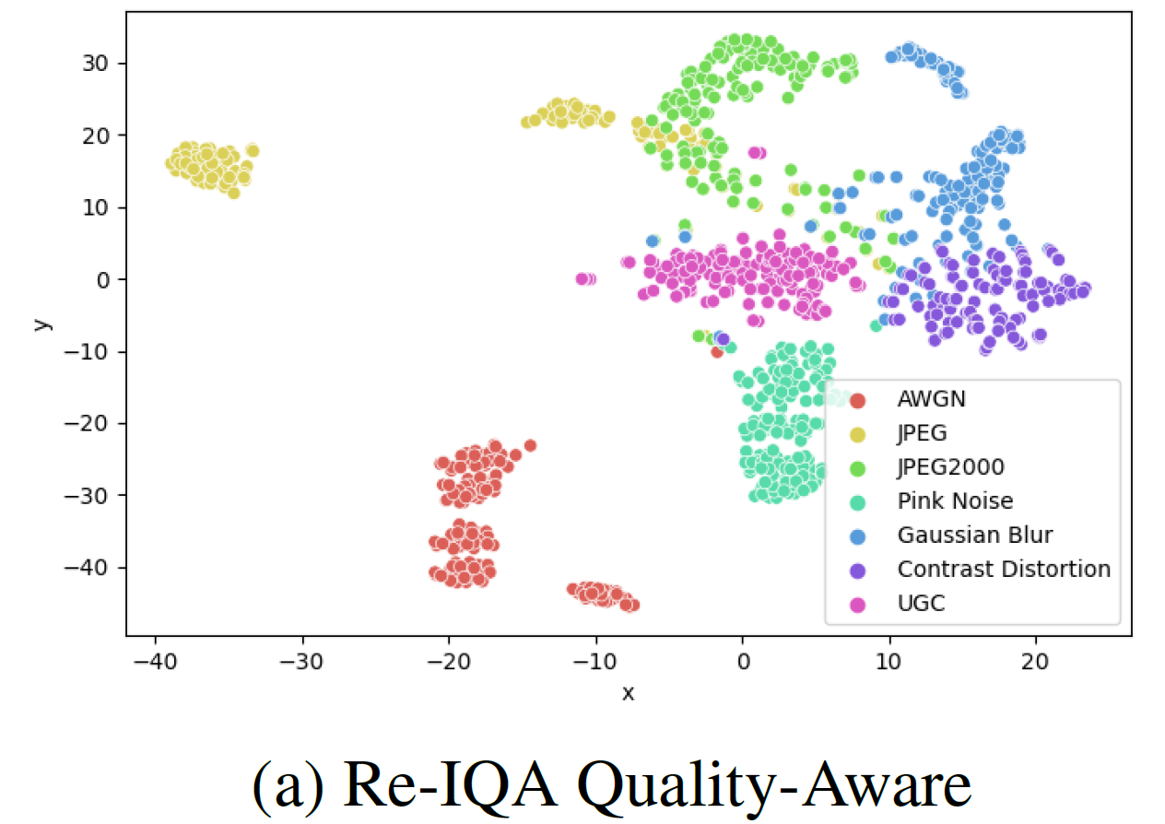
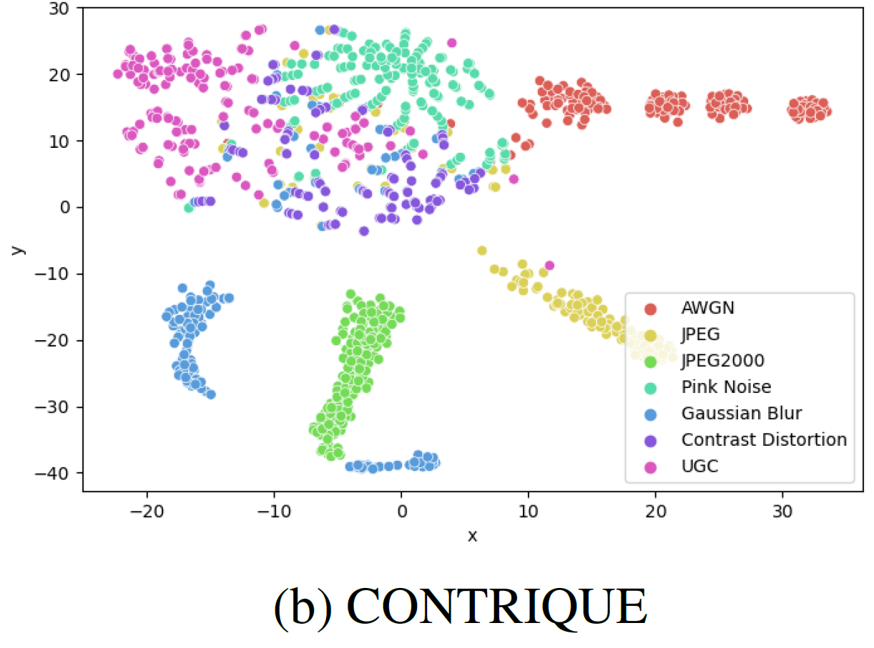
Experiments
3. Visualization
Comparison of 2D TSNE Visualization of learned representations of 1016 images sampled from KonIQ (UGC - #150) and CSIQ (Synthetic Distortions - #866) between Re-IQA Quality Aware sub-module and CONTRIQUE. Best viewed zoomed in.
Notes:
一些实验细节

Slide 13
Conclusion
This paper developed a holistic approach to Image quality Assessment by individually targeting the impact of content and distortion on the overall image quality score.
NR-IQA for “Images in the Wild” benefits significantly from content aware image representations, especially when learned in an unsupervised setting.
This work aims to demonstrate that complementary content and image quality-aware features can be learned and, when combined, achieve competitive performance across all evaluated IQA databases.
Notes:
这项工作可能是在盲IQA背景下设计TTA方法的第一次尝试之一。
本文提出了一种新的自监督辅助任务，利用秩和群对比损失从测试数据中学习质量感知信息。
由于在测试时的自适应，所提出的TTA-IQA方法优于现有的先进方法。

Slide 14
Writing
Abstract
Introduction

Slide 15
ABSTRACT
Automatic Perceptual Image Quality Assessment is a challenging problem that impacts billions of internet, and social media users daily. To advance research in this field, we propose a Mixture of Experts approach to train two separate encoders to learn high-level content and low-level image quality features in an unsupervised setting. The unique novelty of our approach is its ability to generate low-level representations of image quality that are complementary to high-level features representing image content. We refer to the framework used to train the two encoders as Re-IQA. For Image Quality Assessment in the Wild, we deploy the complementary low and high-level image representations obtained from the Re-IQA framework to train a linear regression model, which is used to map the image representations to the ground truth quality scores, refer Figure 1. Our method achieves state-of-the-art performance on multiple large-scale image quality assessment databases containing both real and synthetic distortions, demonstrating how deep neural networks can be trained in an unsupervised setting to produce perceptually relevant representations. We conclude from our experiments that the low and high-level features obtained are indeed complementary and positively impact the performance of the linear regressor. A public release of all the codes associated with this work will be made available on GitHub.
研究背景：自动感知IQA是一个具有挑战性的问题，应用广泛。

Slide 16
ABSTRACT
Automatic Perceptual Image Quality Assessment is a challenging problem that impacts billions of internet, and social media users daily. To advance research in this field, we propose a Mixture of Experts approach to train two separate encoders to learn high-level content and low-level image quality features in an unsupervised setting. The unique novelty of our approach is its ability to generate low-level representations of image quality that are complementary to high-level features representing image content. We refer to the framework used to train the two encoders as Re-IQA. For Image Quality Assessment in the Wild, we deploy the complementary low and high-level image representations obtained from the Re-IQA framework to train a linear regression model, which is used to map the image representations to the ground truth quality scores, refer Figure 1. Our method achieves state-of-the-art performance on multiple large-scale image quality assessment databases containing both real and synthetic distortions, demonstrating how deep neural networks can be trained in an unsupervised setting to produce perceptually relevant representations. We conclude from our experiments that the low and high-level features obtained are indeed complementary and positively impact the performance of the linear regressor. A public release of all the codes associated with this work will be made available on GitHub.
本文方法概括：训练两个独立的编码器，以在无监督环境中学习高级内容和低级图像质量特征。

Slide 17
ABSTRACT
Automatic Perceptual Image Quality Assessment is a challenging problem that impacts billions of internet, and social media users daily. To advance research in this field, we propose a Mixture of Experts approach to train two separate encoders to learn high-level content and low-level image quality features in an unsupervised setting. The unique novelty of our approach is its ability to generate low-level representations of image quality that are complementary to high-level features representing image content. We refer to the framework used to train the two encoders as Re-IQA. For Image Quality Assessment in the Wild, we deploy the complementary low and high-level image representations obtained from the Re-IQA framework to train a linear regression model, which is used to map the image representations to the ground truth quality scores, refer Figure 1. Our method achieves state-of-the-art performance on multiple large-scale image quality assessment databases containing both real and synthetic distortions, demonstrating how deep neural networks can be trained in an unsupervised setting to produce perceptually relevant representations. We conclude from our experiments that the low and high-level features obtained are indeed complementary and positively impact the performance of the linear regressor. A public release of all the codes associated with this work will be made available on GitHub.
方法特点和名称：生成图像质量的低级表示，与表示图像内容的高级特征相补充。称为Re-IQA。

Slide 18
ABSTRACT
Automatic Perceptual Image Quality Assessment is a challenging problem that impacts billions of internet, and social media users daily. To advance research in this field, we propose a Mixture of Experts approach to train two separate encoders to learn high-level content and low-level image quality features in an unsupervised setting. The unique novelty of our approach is its ability to generate low-level representations of image quality that are complementary to high-level features representing image content. We refer to the framework used to train the two encoders as Re-IQA. For Image Quality Assessment in the Wild, we deploy the complementary low and high-level image representations obtained from the Re-IQA framework to train a linear regression model, which is used to map the image representations to the ground truth quality scores, refer Figure 1. Our method achieves state-of-the-art performance on multiple large-scale image quality assessment databases containing both real and synthetic distortions, demonstrating how deep neural networks can be trained in an unsupervised setting to produce perceptually relevant representations. We conclude from our experiments that the low and high-level features obtained are indeed complementary and positively impact the performance of the linear regressor. A public release of all the codes associated with this work will be made available on GitHub.
针对真实失真图像得训练流程：利用从Re-IQA框架中获得的互补的低级和高级图像表示来训练线性回归模型。

Slide 19
ABSTRACT
Automatic Perceptual Image Quality Assessment is a challenging problem that impacts billions of internet, and social media users daily. To advance research in this field, we propose a Mixture of Experts approach to train two separate encoders to learn high-level content and low-level image quality features in an unsupervised setting. The unique novelty of our approach is its ability to generate low-level representations of image quality that are complementary to high-level features representing image content. We refer to the framework used to train the two encoders as Re-IQA. For Image Quality Assessment in the Wild, we deploy the complementary low and high-level image representations obtained from the Re-IQA framework to train a linear regression model, which is used to map the image representations to the ground truth quality scores, refer Figure 1. Our method achieves state-of-the-art performance on multiple large-scale image quality assessment databases containing both real and synthetic distortions, demonstrating how deep neural networks can be trained in an unsupervised setting to produce perceptually relevant representations. We conclude from our experiments that the low and high-level features obtained are indeed complementary and positively impact the performance of the linear regressor. A public release of all the codes associated with this work will be made available on GitHub.
实验效果

Slide 20
ABSTRACT
Automatic Perceptual Image Quality Assessment is a challenging problem that impacts billions of internet, and social media users daily. To advance research in this field, we propose a Mixture of Experts approach to train two separate encoders to learn high-level content and low-level image quality features in an unsupervised setting. The unique novelty of our approach is its ability to generate low-level representations of image quality that are complementary to high-level features representing image content. We refer to the framework used to train the two encoders as Re-IQA. For Image Quality Assessment in the Wild, we deploy the complementary low and high-level image representations obtained from the Re-IQA framework to train a linear regression model, which is used to map the image representations to the ground truth quality scores, refer Figure 1. Our method achieves state-of-the-art performance on multiple large-scale image quality assessment databases containing both real and synthetic distortions, demonstrating how deep neural networks can be trained in an unsupervised setting to produce perceptually relevant representations. We conclude from our experiments that the low and high-level features obtained are indeed complementary and positively impact the performance of the linear regressor. A public release of all the codes associated with this work will be made available on GitHub.
强调结论：低级特征和高级特征是互补的，并积极影响线性回归器的性能。
Notes:
摘要写的一般，太冗余了

Slide 21
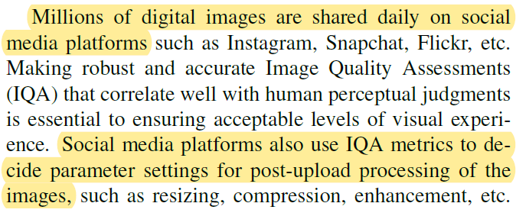
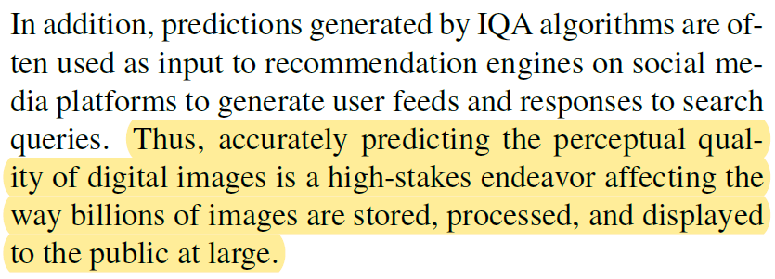
Introduction – 1/5
研究背景：
在各种社交媒体平台上，每天有数百万张数字图像被分享。
社交媒体平台也使用IQA指标来决定图像上传后处理的参数设置，如调整大小、压缩、增强等。
准确预测数字图像的感知质量是一项重要的工作，它影响着数十亿图像的存储、处理和向公众展示的方式。

Slide 22
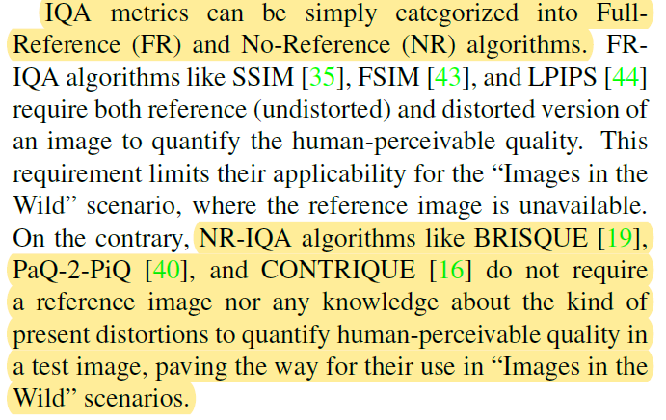
Introduction – 2/5
IQA分类：
方法分类： 主要分为全参考(FR)和无参考(NR)算法。
强调无参考方法的优势：不需要参考图像，也不需要任何关于当前失真的知识来量化测试图像中人类可感知的质量。可适用于真实失真场景。

Slide 23
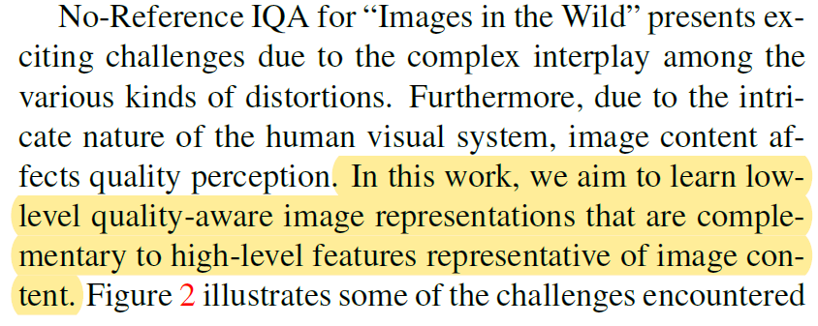
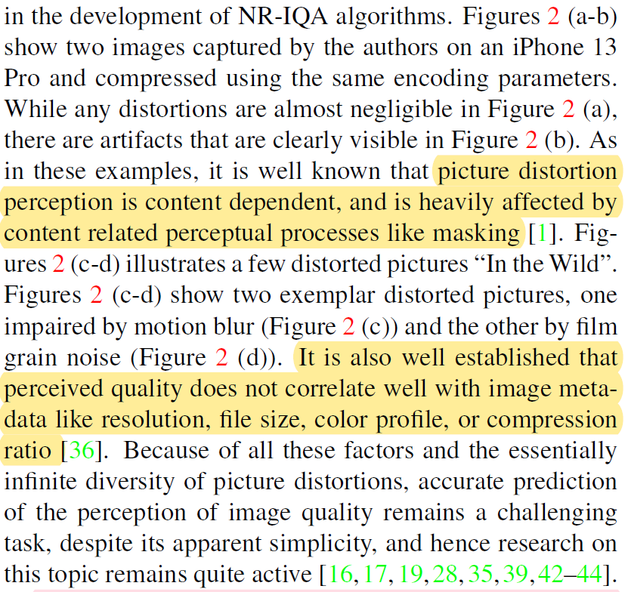
Introduction – 3/5
NR-IQA的挑战：
本文目标：学习低级别的质量感知图像表示，这些表示与代表图像内容的高级特征相补充。
挑战1：图像失真感知是内容依赖的，并且受到内容相关的感知过程的严重影响。
挑战2：感知质量与图像元数据(如分辨率、文件大小、颜色配置文件或压缩比)之间也没有很好的相关性。

Slide 24
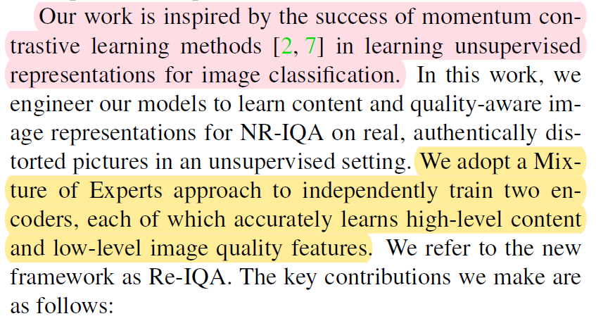
Introduction – 4/5
本文提出的方法
Idea来源：受到动量对比学习方法在学习用于图像分类的无监督表示方面的成功的启发。
方法思路：采用混合专家方法独立训练两个编码器，每个编码器都能准确地学习高级内容和低级图像质量特征。

Slide 25
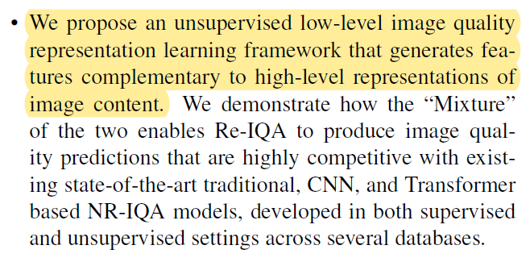
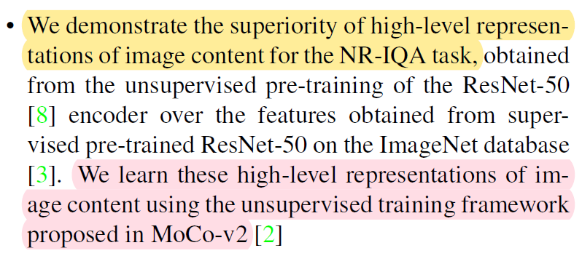
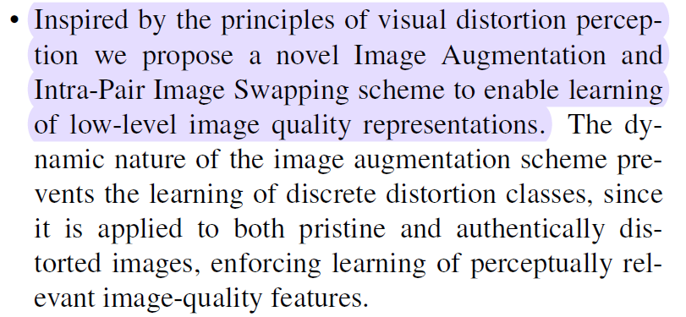
Introduction – 5/5
贡献总结
（1）提出了一个无监督的低级图像质量表示学习框架，该框架生成与图像内容的高级表示相补充的特征。
（2）证明了图像内容的高级表示在NR-IQA任务中的优越性。
（3）提出了一种新的图像增强和对内图像交换方案，以实现低级图像质量表示的学习。

Slide 26
THANKS

