Slide 1

Exploratory Data Analysis
G2M Cab Industry
27 Dec 2023

Slide 2
Agenda
Executive Summary
Problem Statement
Approach
EDA
EDA Summary
Recommendations

Slide 3
Executive Summary
XYZ, a private firm in the US, is considering an investment in the cab industry and seeks insights to aid their decision-making process. The analysis encompassed multiple datasets spanning the period from 31/01/2016 to 31/12/2018, including Cab_Data.csv, Customer_ID.csv, Transaction_ID.csv, City.csv and US_Holiday.csv.
Problem Statement
XYZ aims to grasp US cab market dynamics for informed investment. The challenge involves comprehensively analyzing diverse datasets to evaluate market dominance, pricing strategies, and seasonal demand patterns for investment decisions.
Approach
The analysis commences with reviewing, cleaning, transforming datasets, and conducting Exploratory Data Analysis (EDA). This encompasses hypothesis generation, outlier detection, and visualizations to comprehend the data. I have identified outliers in the 'Price_Charged' column, and these outliers are also affecting the 'Margin' profit column
EDA (Exploratory Data Analysis)
EDA dives into transactional behaviors, city-wise usage, pricing dynamics, and seasonal trends. Visualizations illuminate customer behaviors, market dominance, profit margins, and geographical preferences. Correlations reveal insights into population, infrastructure, and cab usage.

Slide 4
EDA (Exploratory Data Analysis)

Slide 5
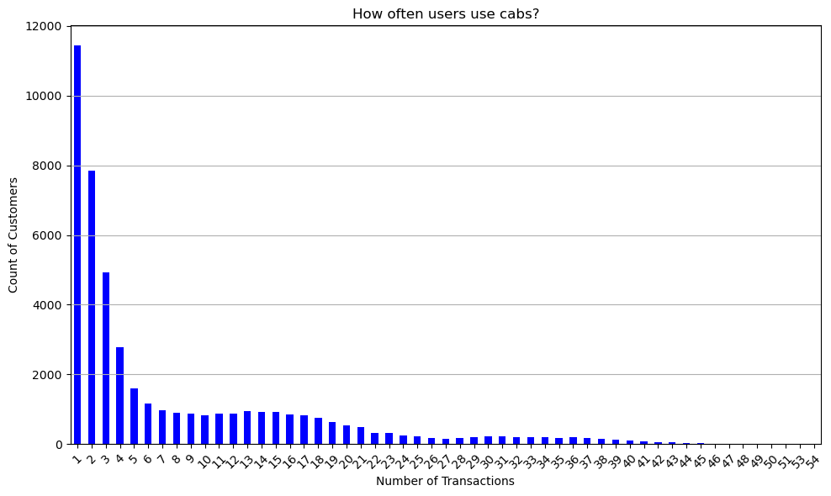
Most customers order the cab from 1 to 5 times

Slide 6
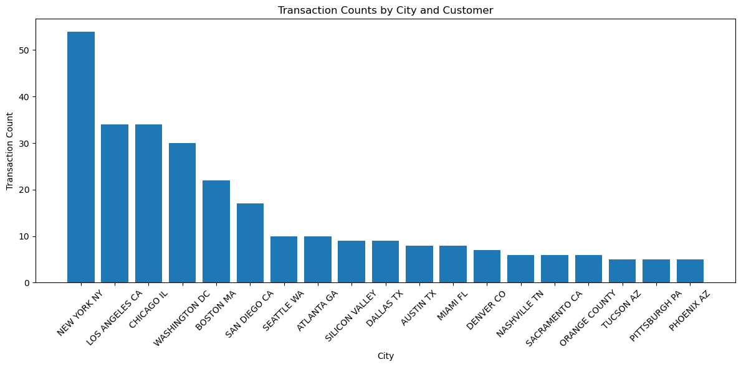
Many customers who live in New York use the cab service, which makes sense as New York is a big city.

Slide 7
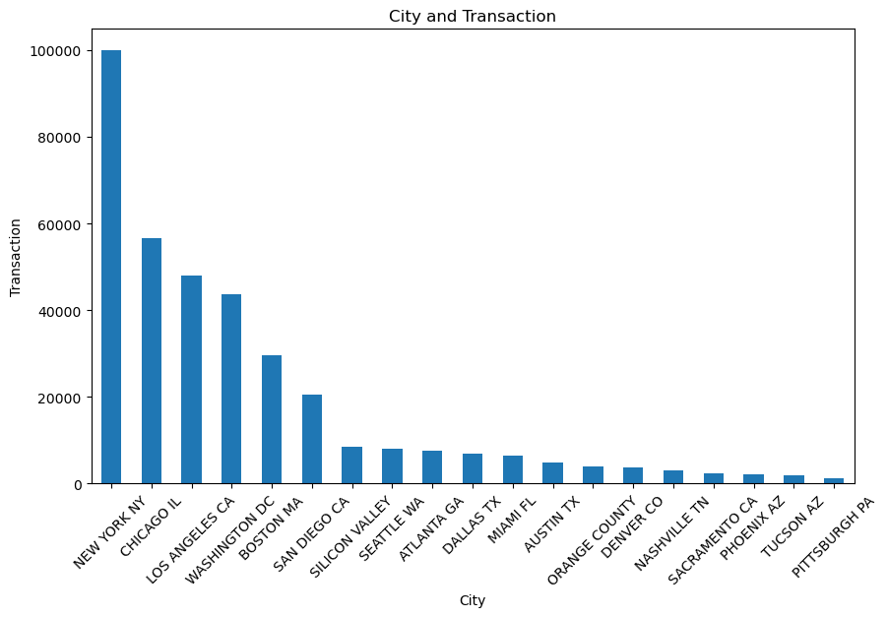
The highest number of transactions occurs in New York. This analysis closely aligns with the customer distribution, as most transactions take place in New York

Slide 8
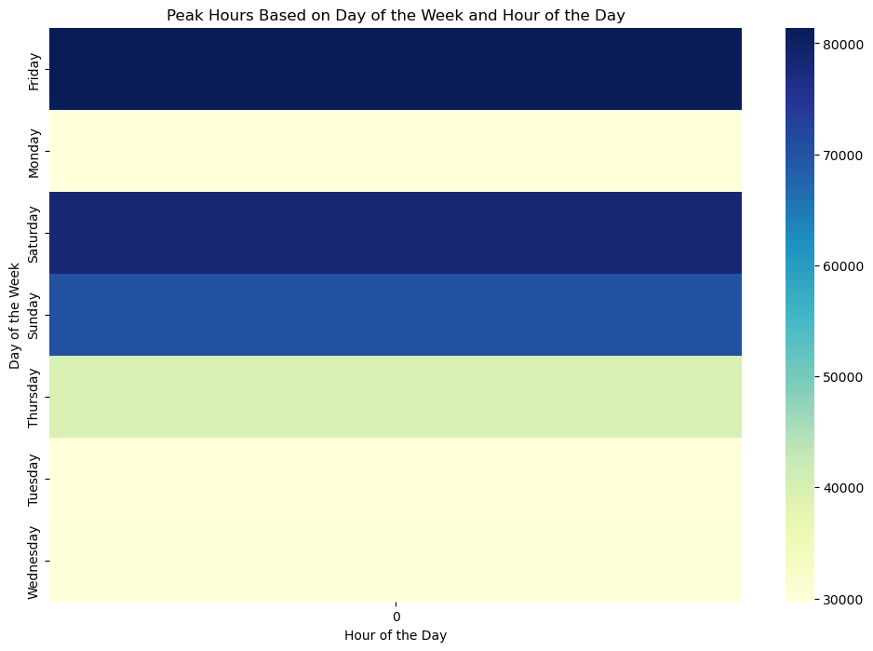
Friday is the busiest day, followed by Saturday and Sunday. During this period, people use cabs the most

Slide 9
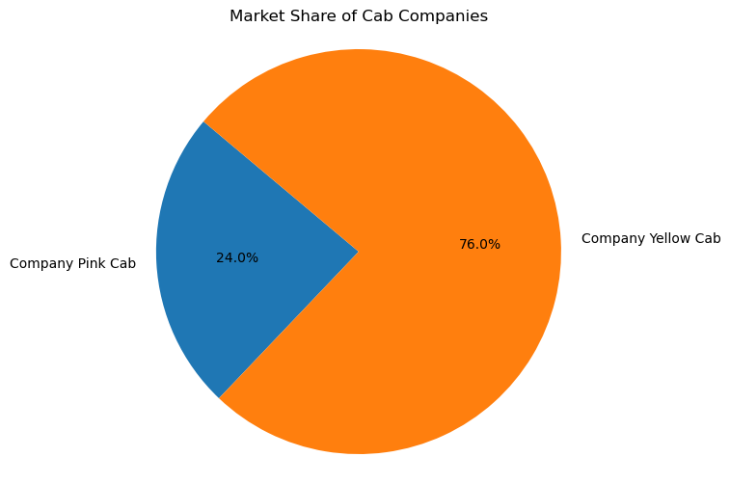
Based on the transactions and customer, the yellow cab has a market share of 76%, whereas the pink cab only holds 26%. This demonstrates the dominance of the yellow cab in the cab industry.

Slide 10
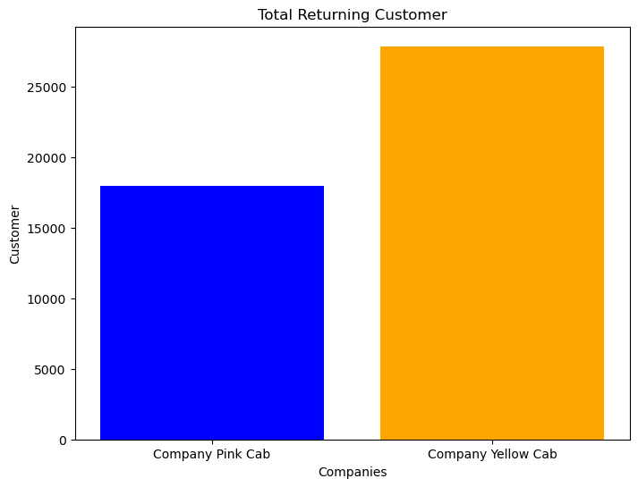
As depicted in the bar chart, it's evident that customers tend to return more frequently using the yellow cab rather than the pink cab

Slide 11
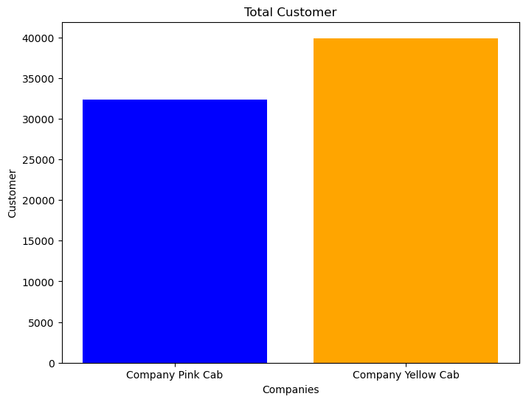
While there's not a significant difference, yellow cabs have more customers than pink cabs

Slide 12
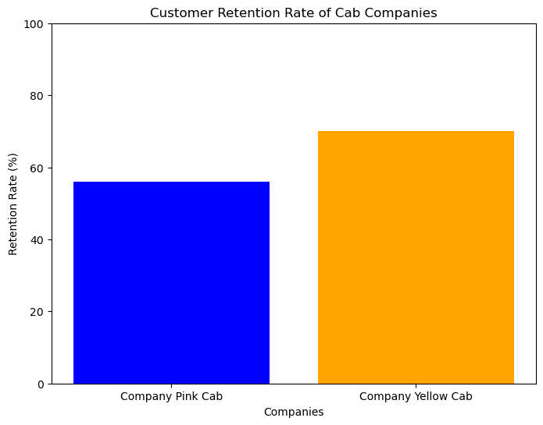
Yellow Cab has a higher rate of retaining customers compared to Pink Cab.

Slide 13
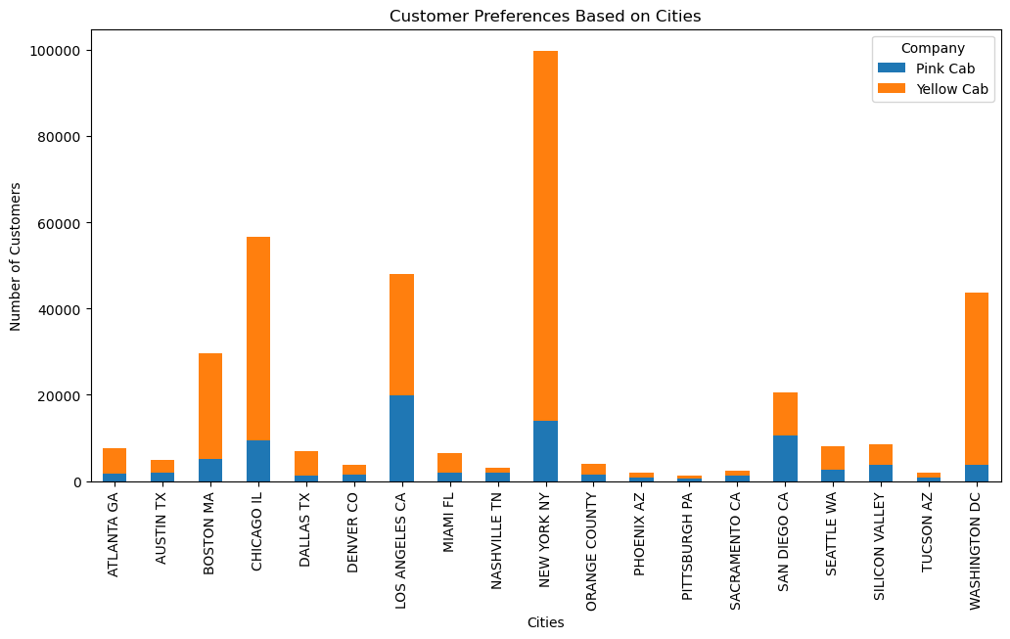
New York remains the city with the highest cab usage, followed by Chicago and Los Angeles. While more people use the pink cab in Nashville, in other cities, the majority tends to favor the yellow cab

Slide 14
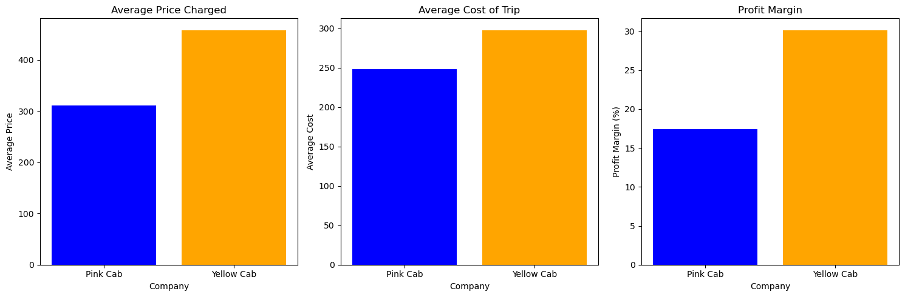
Yellow cabs have higher prices and trip costs compared to pink cabs. Despite the increased expenses, yellow cabs still maintain a higher profit margin than pink cabs

Slide 15
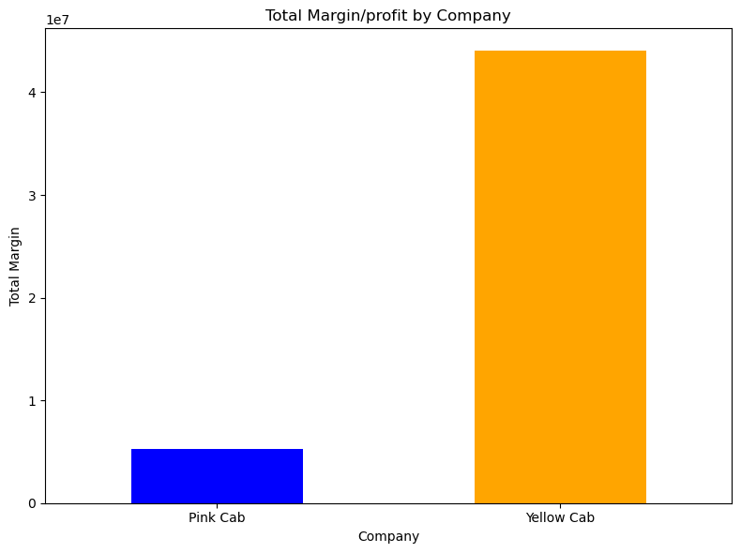
As we can see, the total profit margin for yellow cabs is four times higher than that of pink cabs.

Slide 16
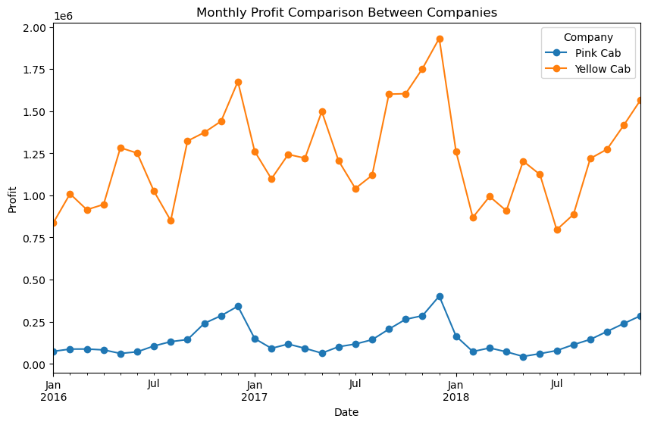
In terms of monthly profit, yellow cabs consistently earn a higher profit margin than pink cabs. Both companies experience a surge in profits in December, likely attributed to the Christmas season, marking the peak earnings for both

Slide 17
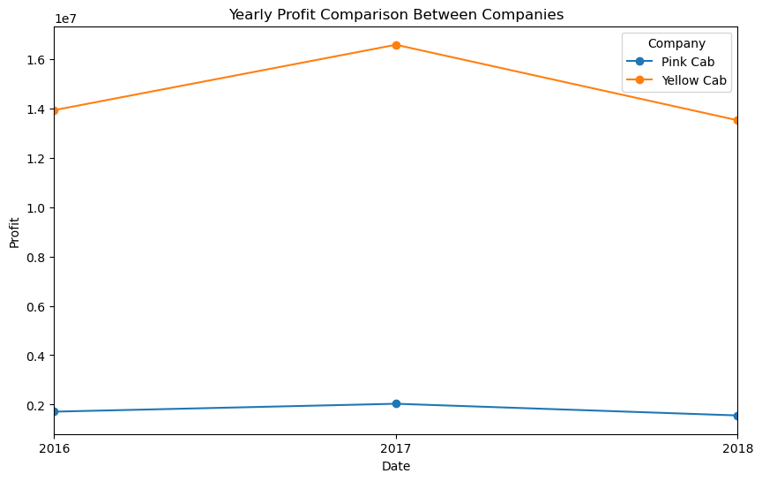
Yellow cabs make more money each year because they earn more every month. The difference in yearly profits shows that yellow cabs make a lot more money than pink cabs.

Slide 18
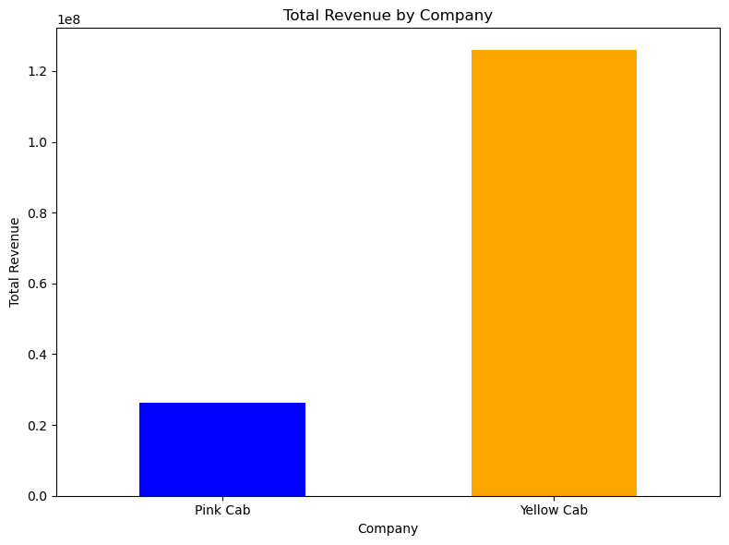
Yellow cabs charge higher prices, which is why they make a lot more money in revenue compared to pink cabs

Slide 19
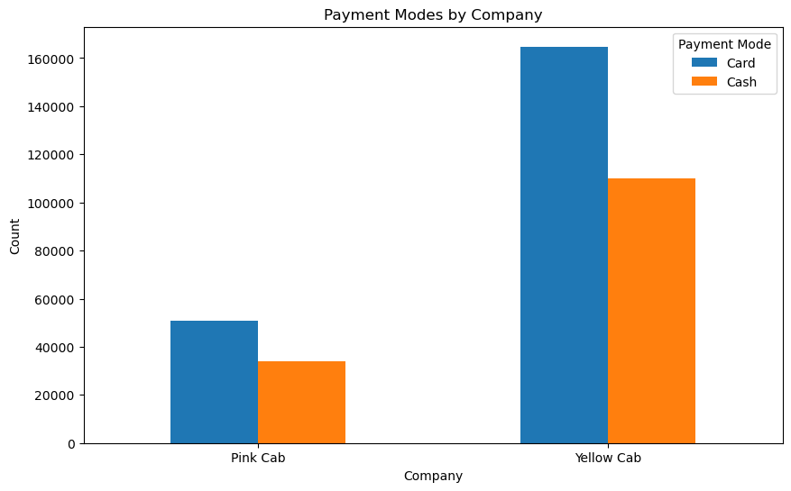
More customers prefer using cards, but there are still many who use cash, especially with pink cabs.

Slide 20
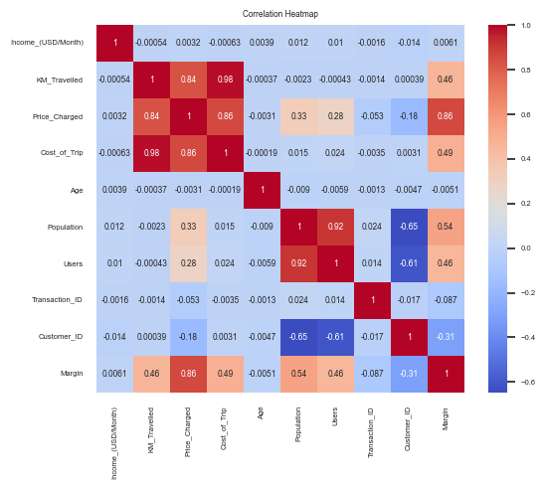
The chart indicates a correlation between pricing and factors like profit margin, trip cost, and distance traveled, suggesting pricing's influence on these elements. Population size impacts cab users, yet infrastructure, transport options, and lifestyle choices collectively shape usage patterns within a city.

Slide 21
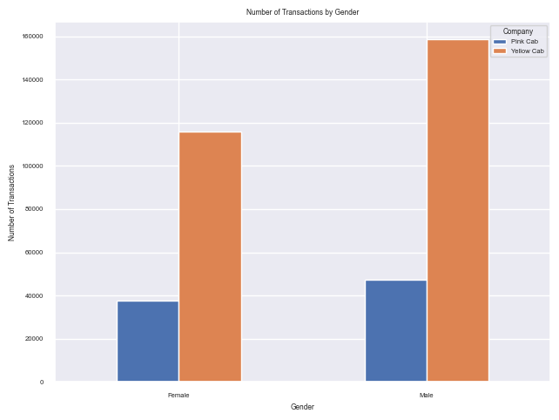
Males tend to use more cabs than females

Slide 22
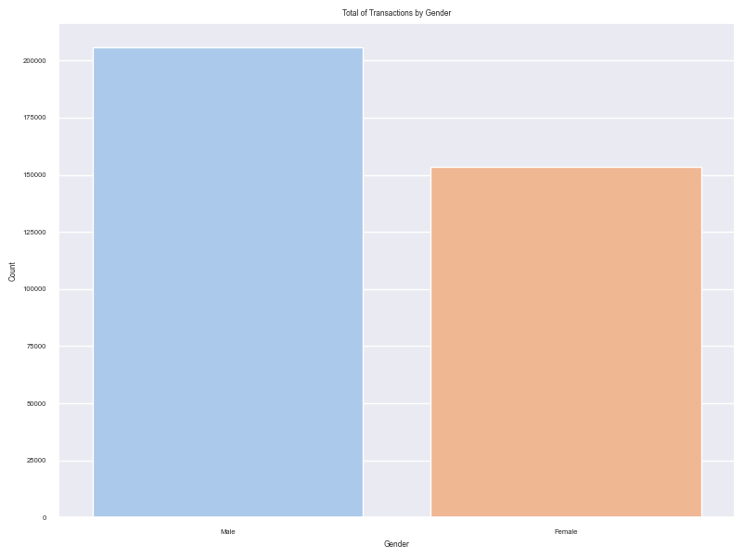
Total transaction by Gender

Slide 23
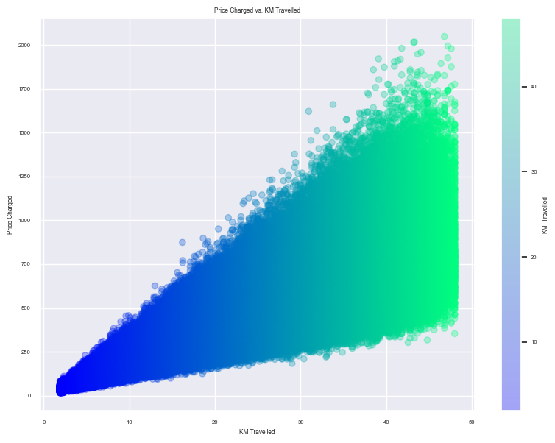
The farther you travel in kilometers, the higher the price charged will be

Slide 24
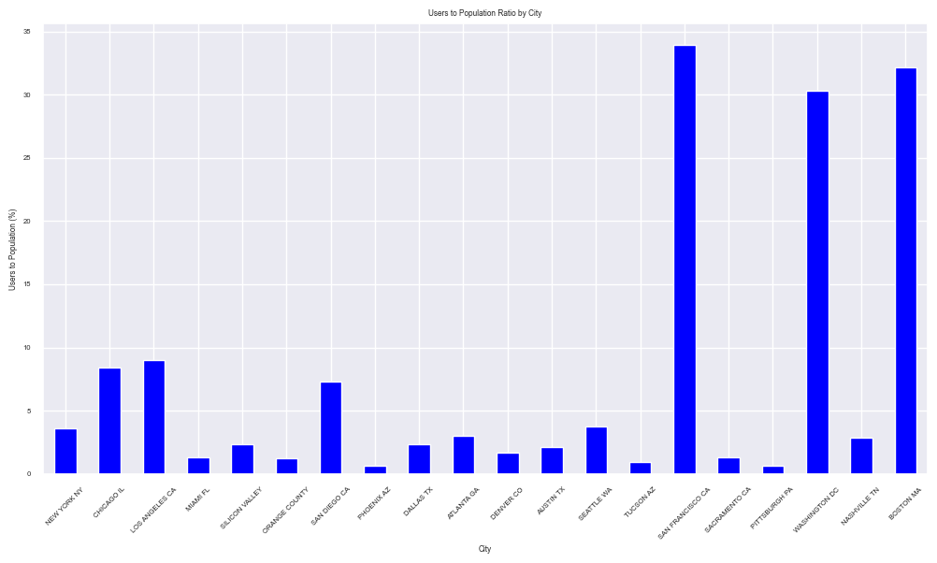
San Francisco, Boston, and Washington show higher cab user ratios relative to their population compared to New York, Chicago, and Los Angeles. Despite a lower user ratio, New York still holds the highest total customers due to its larger population, indicating higher absolute numbers compared to other cities

Slide 25
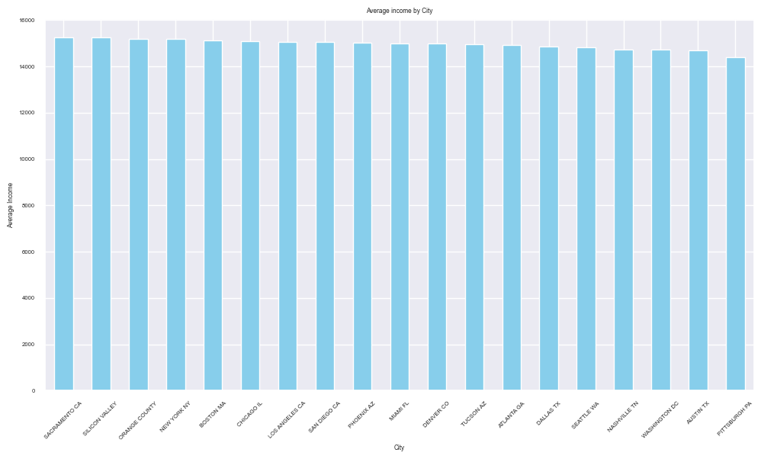
The average income is quite similar in every city

Slide 26
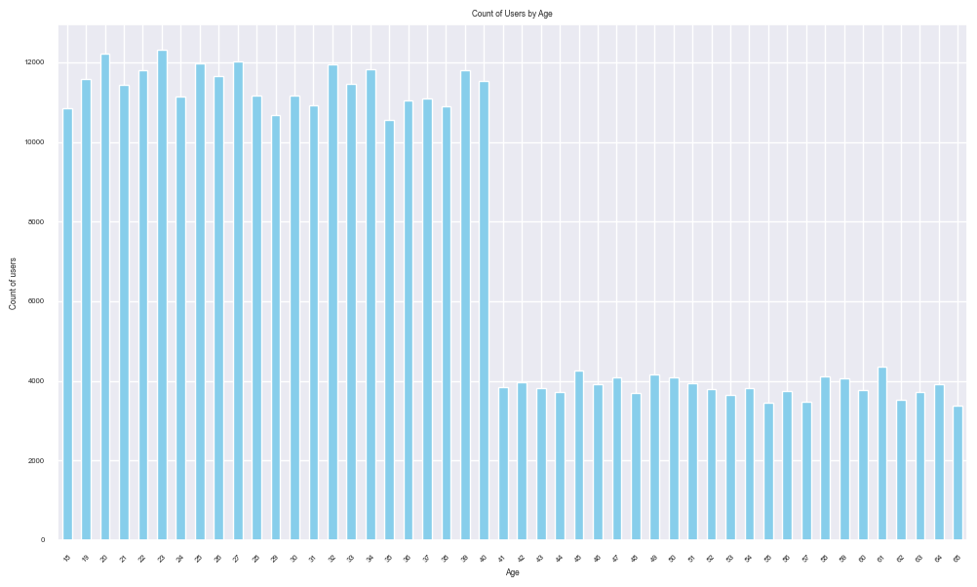
Younger individuals under 40 exhibit higher cab usage, possibly due to preferences for faster transport, unique work or lifestyle commutes, and convenience. Factors like tech-savviness and familiarity with app-based services also influence their higher usage

Slide 27
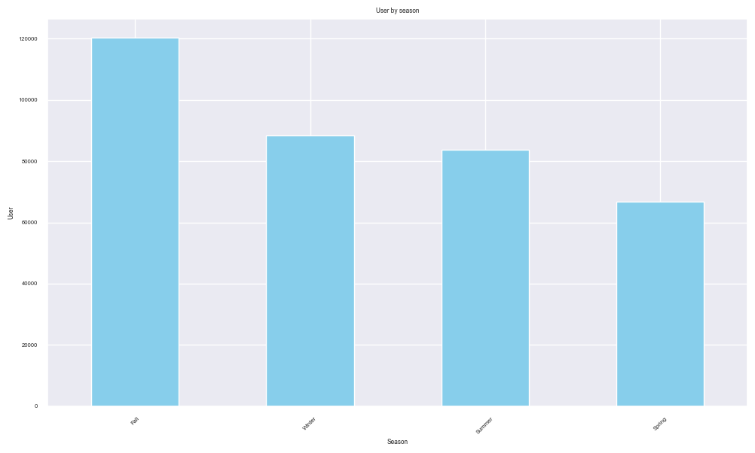
It appears that fall is a more popular season for people using cabs. Possibly during the fall, there might be more events, festivities, or cultural activities happening, prompting increased travel and hence, a higher demand for cab services.

Slide 28
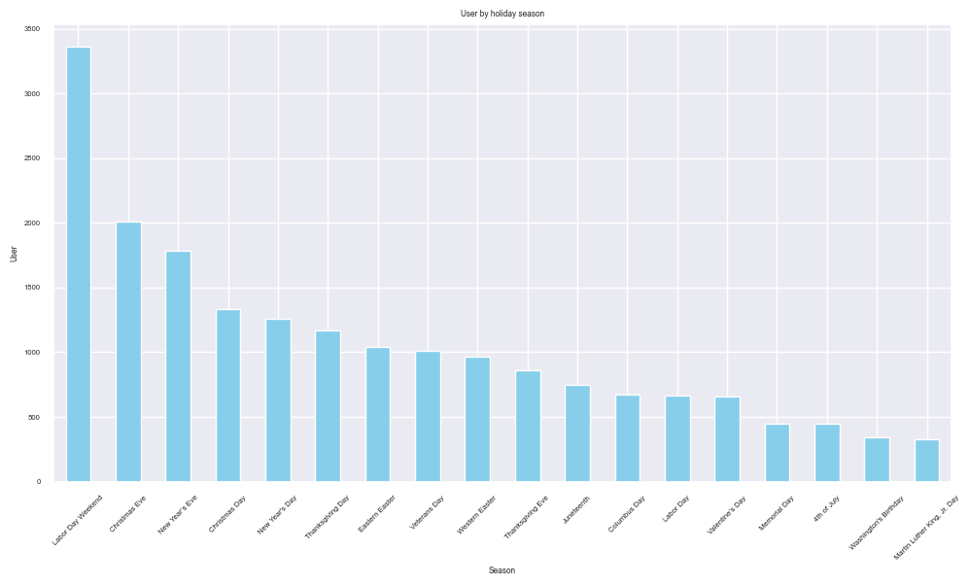
Labor Day marks the busiest holiday season for cab service users, followed by Christmas and New Year's. The monthly profit analysis also indicates a surge in profits starting from September, continuing to increase steadily until December

Slide 29
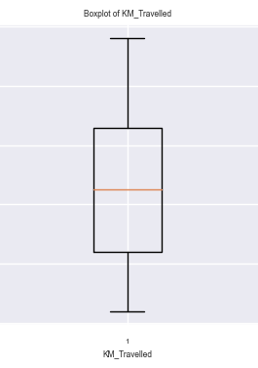
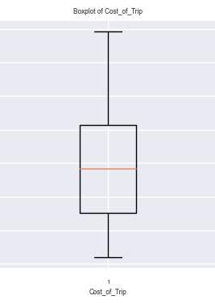
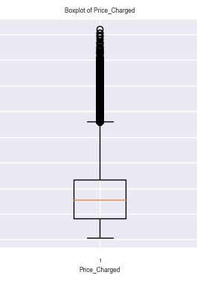

Slide 30
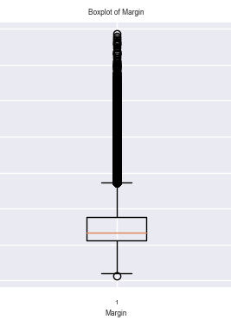
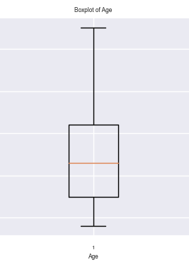
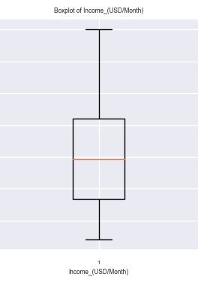

Slide 31
Recommendations
Investment Focus: Yellow Cab holds 76% market share, suggesting a more profitable investment over Pink Cab (26%). Directing investment toward Yellow Cab could yield higher returns.
Customer Retention: Prioritize loyalty programs, personalized offers, and service improvements based on Yellow Cab's better customer retention to reinforce loyalty industry-wide.
Geographical Strategy: Target markets like Chicago and Los Angeles, focusing on cities with potential Yellow Cab growth, despite New York's high usage.
Pricing Strategy: Despite higher costs, Yellow Cabs maintain better profit margins. Consider maintaining slightly higher prices while optimizing costs without service compromise.
Seasonal Demand: Optimize marketing during peak holidays like Labor Day, Christmas, and New Year's to capitalize on increased demand and maximize profits.
Demographic Targeting: Customize marketing for the under-40 demographic, recognizing their higher cab service usage, emphasizing app convenience.
Data Integration: Utilize weather and event datasets to uncover correlations and enhance insights into seasonal usage patterns.
Continuous Analysis: Regularly monitor trends, conduct customer surveys, and adapt strategies based on evolving customer preferences and market dynamics for ongoing success.

Slide 32
Thank You

