Slide 1

Wind Turbine Locations with Climate and Health Benefits
A wind turbine in West Virginia displaces twice as much carbon dioxide and seven times as much health damage as the same turbine in California.”” Kyle Siler-Evans, Ph.D. researcher from Carnegie Mellon University .

Slide 2
We Investigate the Coal Consumption in Each State in 2014
Dataset : United States Energy, Census, and GDP 2010-2014.csv
(the 2010-2014 US Energy, Census, and Economic data as described in the data set description, from U.S Energy Information Administration)
Here I only retrieve Coal total consumption for each state in 2014

Slide 3
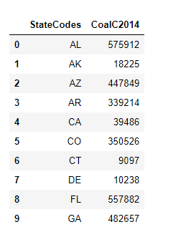
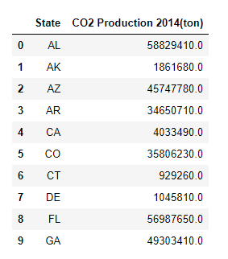
Coal total consumption
in billion BTU in 2014
Carbon Dioxide Production
Btu :British thermal units
Coal emits about 204.3 pounds of carbon dioxide per million Btu when completely burned.
2000 lb/ 1 tons
“CoalC2014” * 204300/2000 = “CO2 Production 2014(ton)”

Slide 4
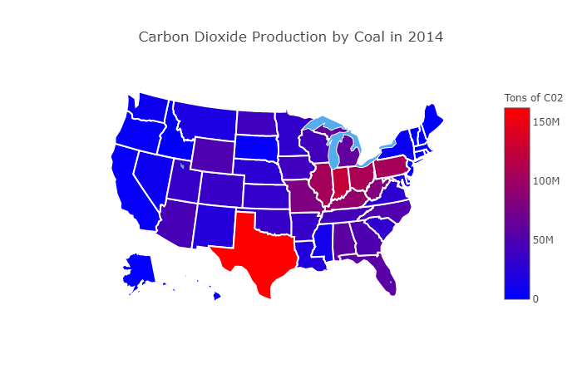

Slide 5
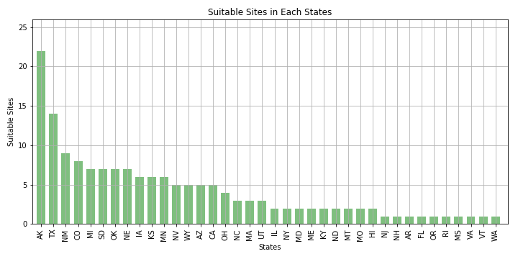
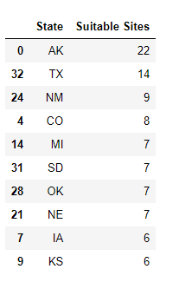
The Suitable Sites in Each States

Slide 6
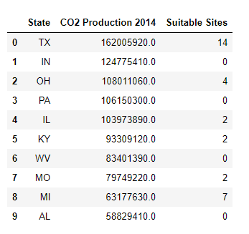
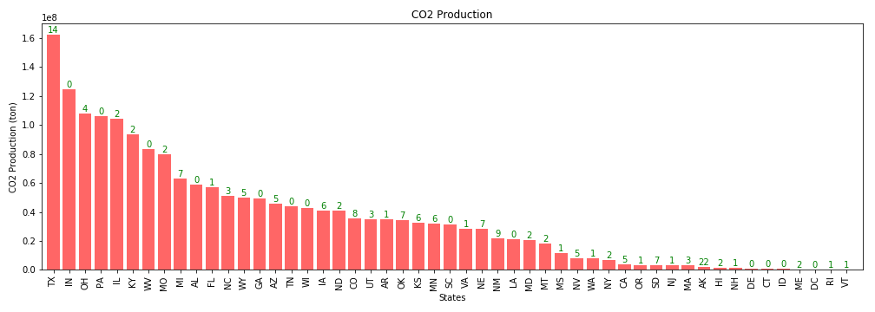
Combine Two Datasets
Wind turbines result in greater health and climate benefits in areas
of the country such as Texas, Ohio, Illinois, Kentucky.

